Slide 1



Compton polarimetry for SuperKEKB: laser system, photon detector
D. Charlet¹, T. Ishibashi², A. Martens¹, M. Masuzawa², F. Mawas^{1*}, Y. Peinaud¹, D. Zhou², F. Zomer¹
1: IJCLab; 2: KEK; *: PhD student

Slide 2
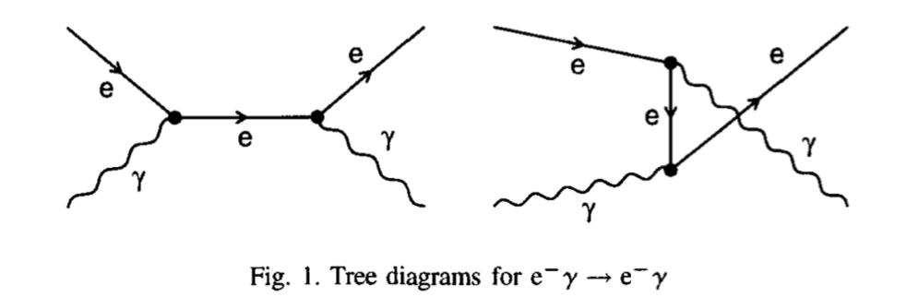
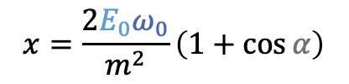
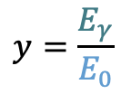

Compton scattering
$$x=\frac{2E_{0}ω_{0}}{m^{2}}\left(1+\cos{α}\right)$$
$$y=\frac{E_{γ}}{E_{0}}$$
The Compton cross-section averaged over scattered particles spins:
Differential cross-section
Transverse laser polarisation: nuisance parameter to minimize and keep under control
Transverse electron beam polarisation: intervenes as an asymmetry in the transverse plane
Berestskii & Lfshitz QED textbook
$$\frac{dσ}{dydφ_{obs}}\left(x,y\right)=\frac{dσ_{0}}{dy}\left(x,y\right)+\frac{dσ_{L}}{dy}\left(x,y\right)\cos\left(2\left(φ_{obs}−φ_{las}\right)\right)𝒫_{L}^{las}+\frac{dσ_{∥}}{dy}\left(x,y\right)𝒫_{C}^{las}(P_{T}f_{T}\left(x,y\right)\cos\left(φ_{obs}−φ_{elec}\right)+P_{z}f_{z}(x,y))$$
Electron beam polarization independent
Electron beam polarization dependent
$$\frac{dσ}{dy}(x,y)≅\frac{dσ_{0}}{dy}\left(1+{𝒫_{z}𝒫_{C}^{las}A}_{LR}\right)$$
⚠️ But small opening angle of scattered particles:
  Transverse polarimetry is more difficult to implement wrt longitudinal polarimetry

Slide 3
Integration
For spin rotators at current B2E location of SuperKEKB
→ a nice place before BLA2LE where polarization is longitudinal and enough free space
→ polarimeter data is representative of polarization at Belle II IP (up to magnet mislalignments)
2. For spin rotators at about 80m from Belle II IP
→ no solution found to measure longitudinal polarization
→ use same location but measure transverse polarization (no detailed study at this stage of this)
Photon detection
Electron detection ?
Laser/e-beam interaction point
BLA2LE

Slide 4
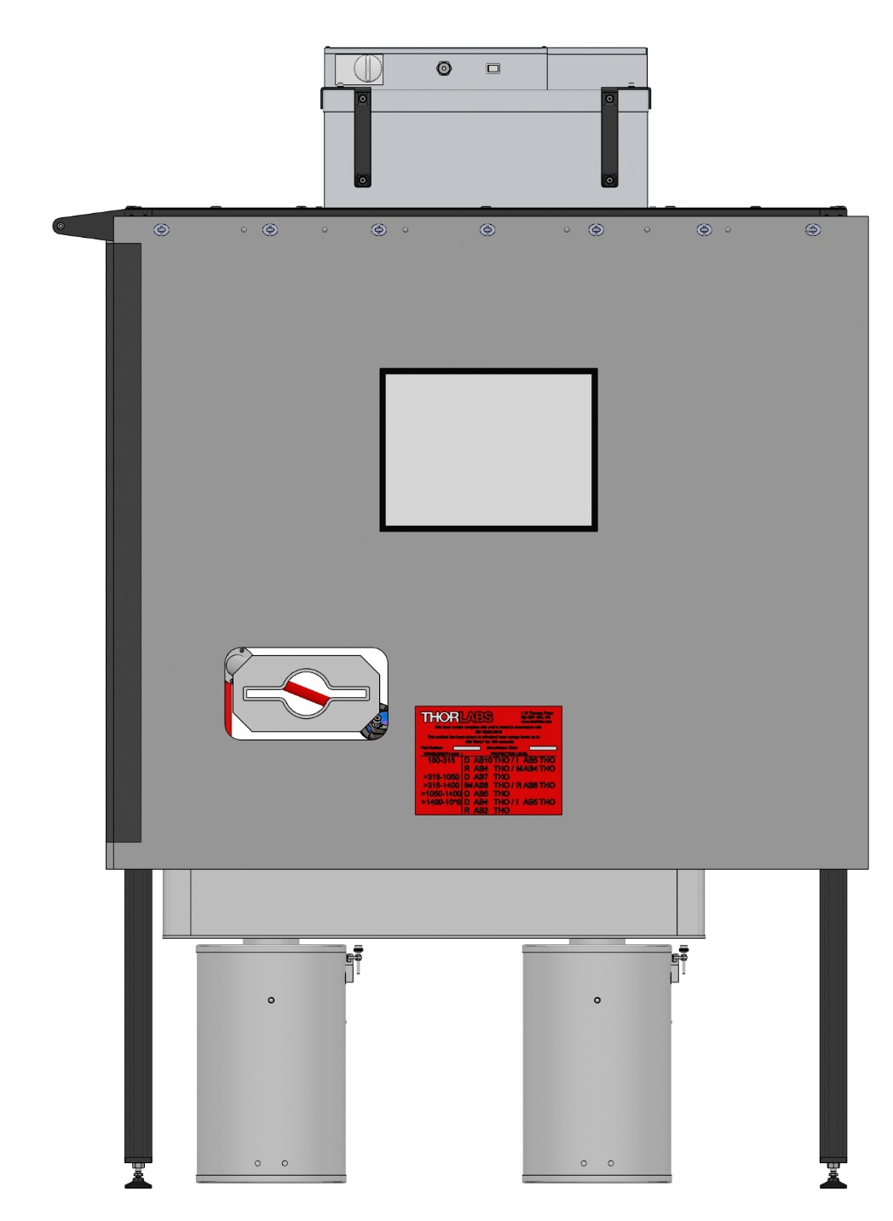
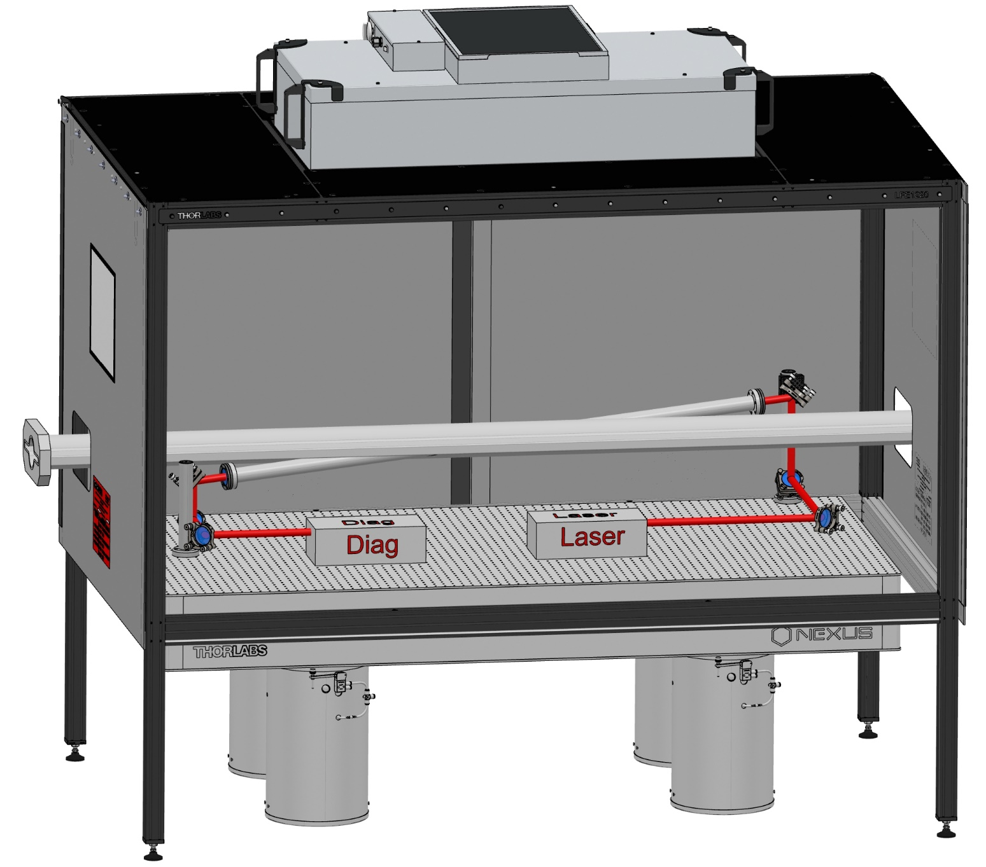
Mechanical system integration
910 mm
450 mm
Crossing Angle Horizontal : 8 deg
Crossing Angle Vertical : 4 deg
+ some neutron + lead shielding around electronics to be located below the table
+ some lead shielding around the table to protect the laser

Slide 5
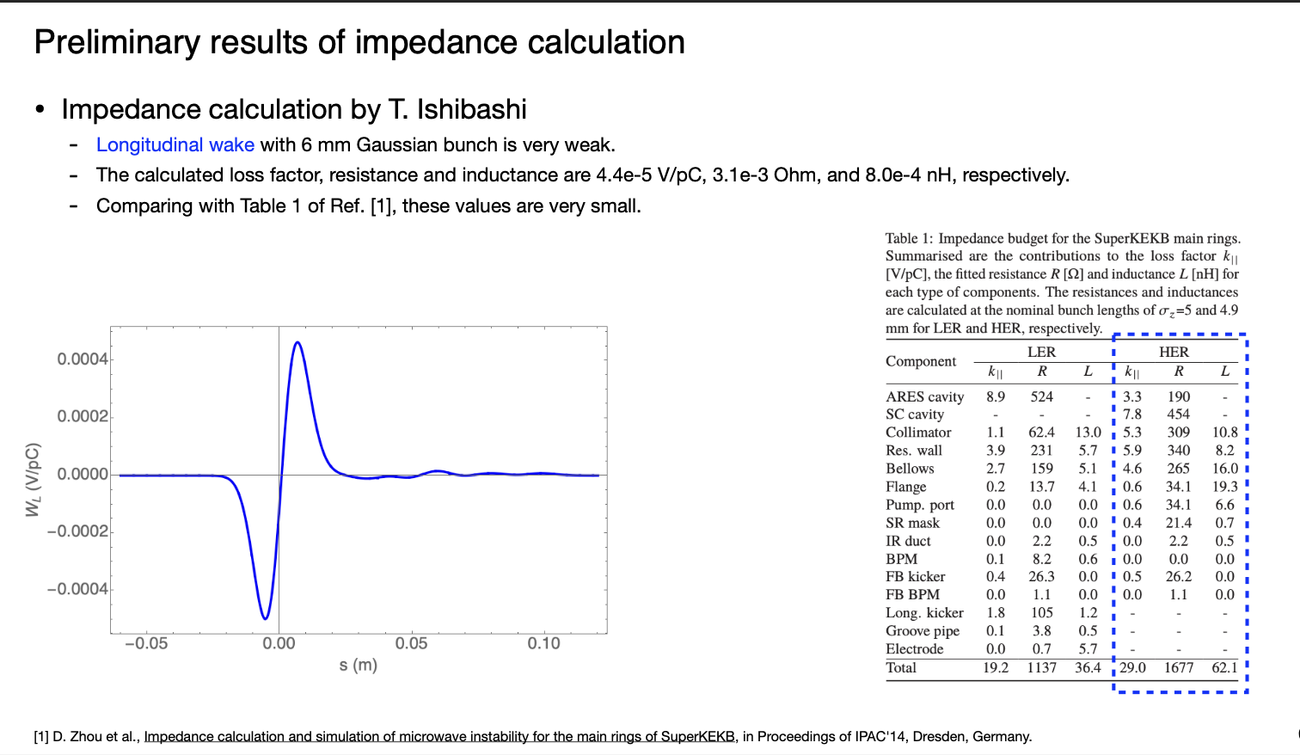
Beam impedance (longitudinal)
Zhou, Ishibashi

Slide 6
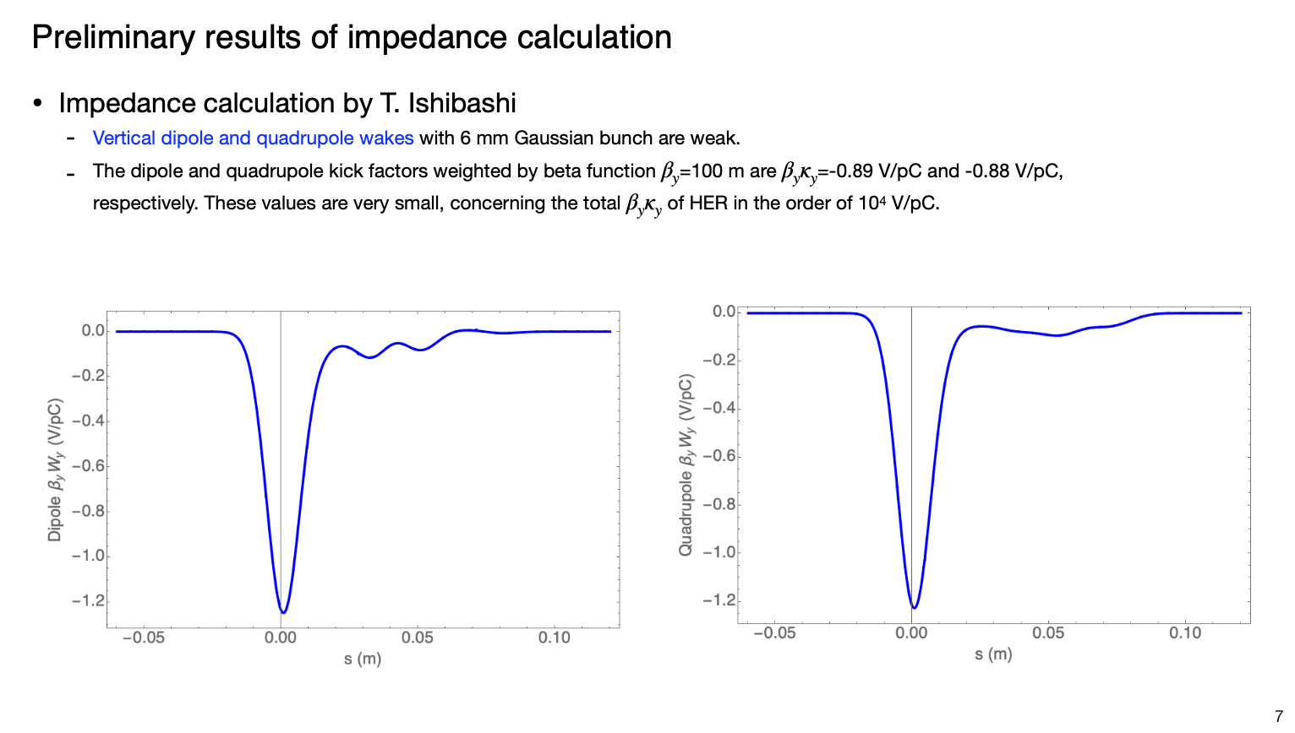
Beam impedance (vertical)
Zhou, Ishibashi

Slide 7
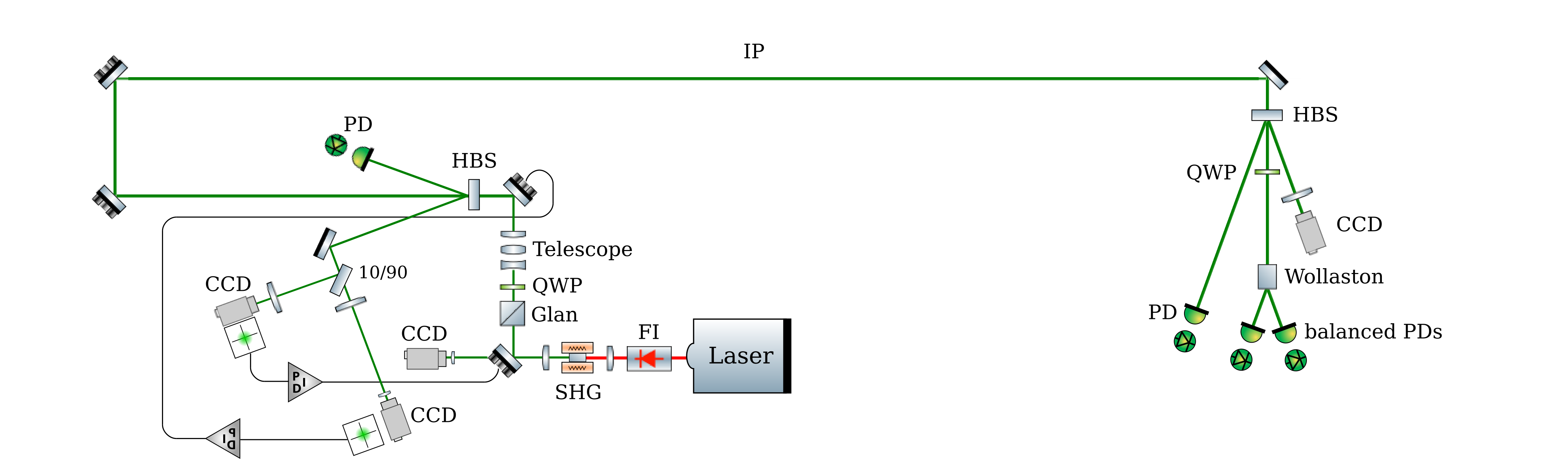
Laser system
Box with rough temperature control
Box with rough temperature control
Rough design based on past experience
300µm beam size shall not be a problem (Rayleigh range of 1m)
Elliptic beam can be delivered with cylindrical lenses/mirrors
Key aspect: remote operation of the system that will be located in the tunnel
Possibility to synchronize the laser on the RF clock of the accelerator using the WhiteRabbit+IDROGEN technology under experimental investigation at IJCLab

Slide 8
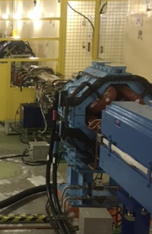
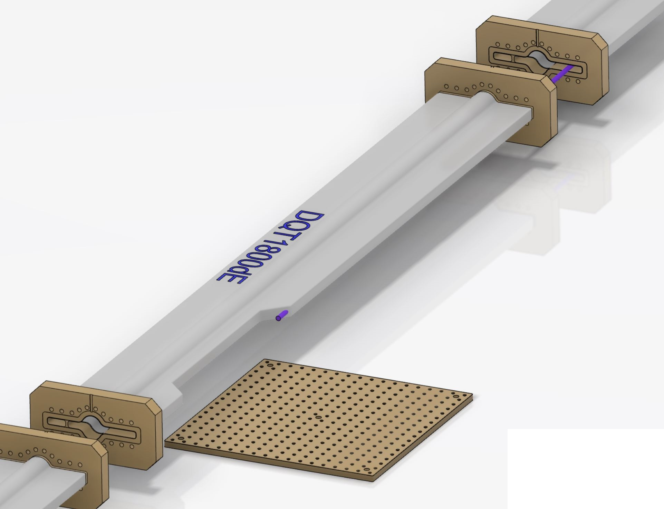
Photon detector integration
‘minor’ modifications of BLA2LE region
→ no modification of magnet required
→ NEG pumping on the ‘wrong’ side
Requires modification of a pipe to let photon beam out
→ proposed pipe modification (validated by T. Ishibashi and D. Zhou)
Pumping port side need to be changed.
Xray out : 210 µrad
≈ Ø6 mm at 14,5 meters
BreadBoard 450x450 mm²

Slide 9
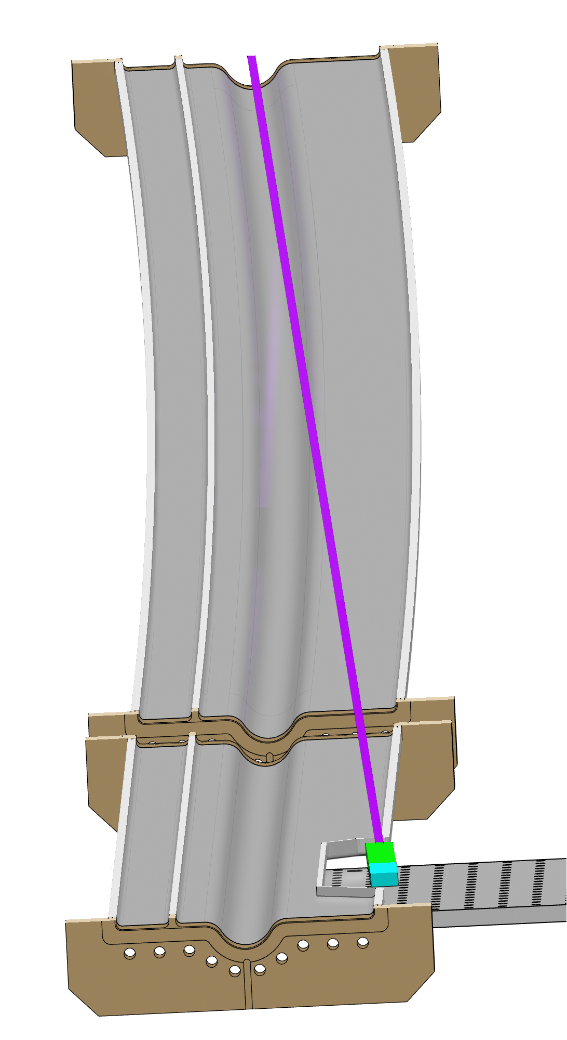
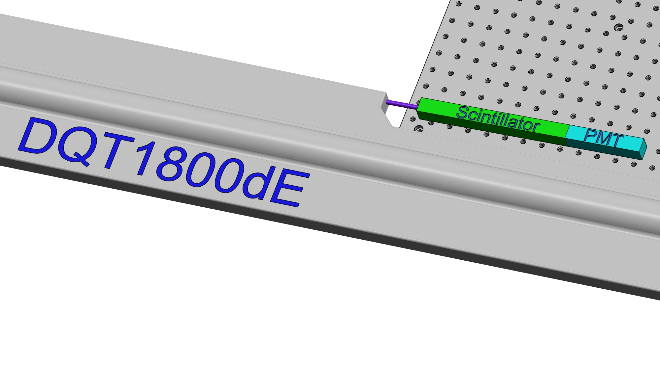
Integration in accelerator
Beam pipe at ~1m from ground
Electronics can be located and shielded on ground below scintillator +PMT

Slide 10
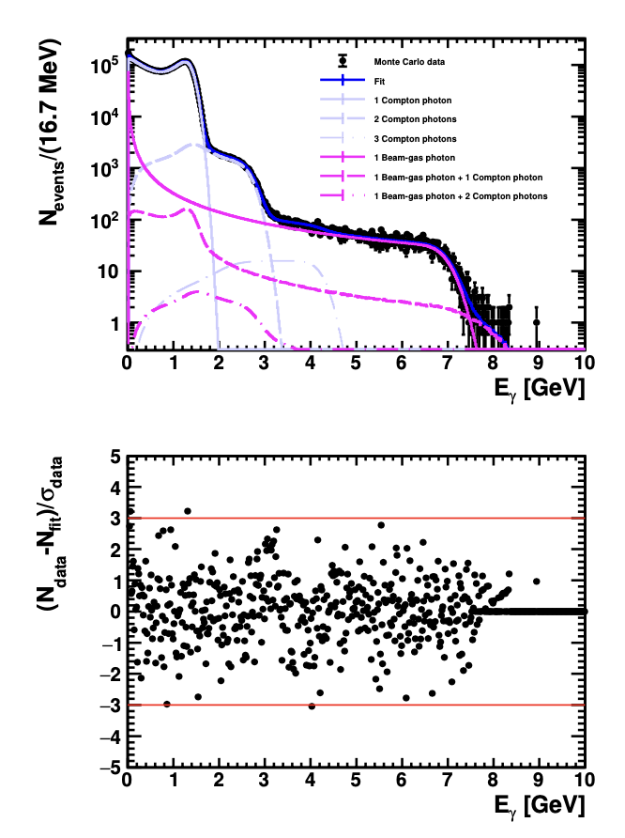
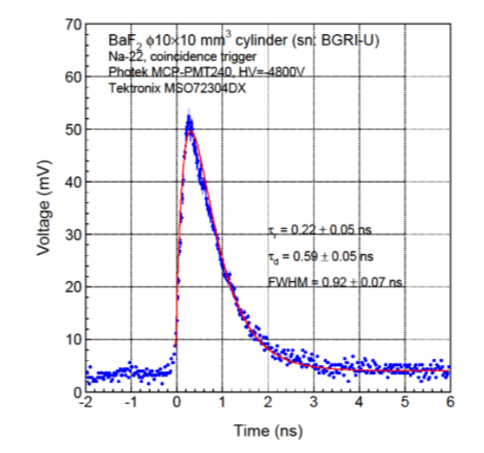
Single channel photon detector
Basic elements
  a VERY FAST radhard scintillating crystal → BaF2
    Need to filter out the slow component → UV optical filters
  a PMT with low transit time dispersion → commercially available (hamamatsu for instance)
  Bunch/bunch measurement
…
Energy measurement
2500 histrograms
Funding request to ANR submitted (answer feb-June ‘24)

Slide 11
Conceptual acquisition chain
Optical filter
BaF2
PMT
2500 histograms
Fast treatment: fit
Every 4ns
FPGA
Reduced data
To online monitoring
Analog Front-end
+ ADC (>=10bits)
clock
To remote storage (10MB/min)
Update program, constants
clock
reset
1rst Bunch identifier
Synchro card (WhiteRabbit ?)
Accelerator RF
Trigger to identify 1rst bunch

Slide 12
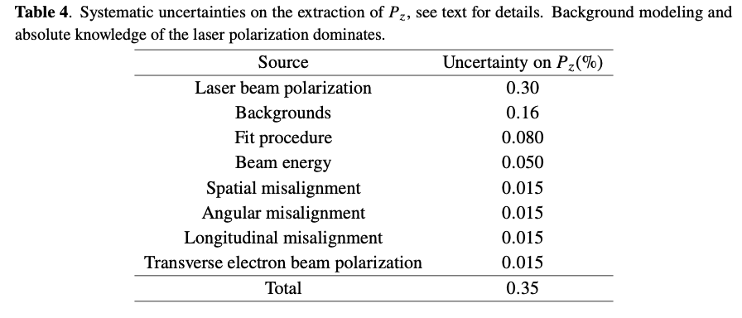
Expected performance
Statistical precision: 1%/bunch every 5min
NB: fit can be performed in 1min for the 2500 bunches assuming few nuisance parameters known and fixed (calibration can occur from time to time)
Systematic uncertainty related to beam transport from Compton IP to Belle 2 IP need to be evaluated → misalignements in beam transport

Slide 13
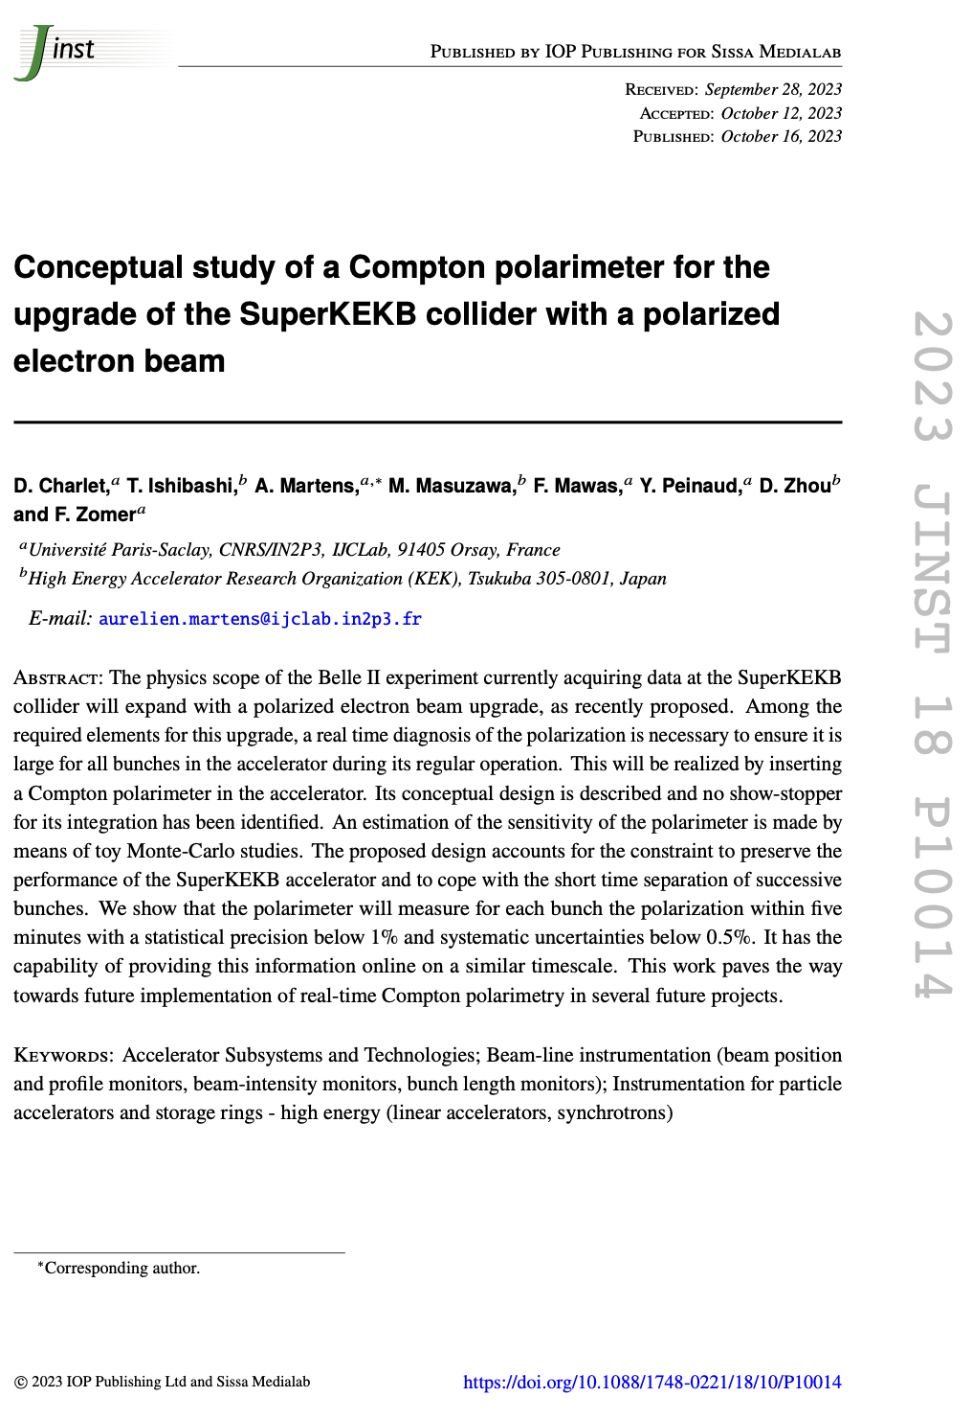
Conclusion & Prospects
A summary of the conceptual studies performed for the laser system and the scattered photon detector has been published recently in JINST
A summary of this paper is inserted in the current CDR draft
Further progress on detector relies on success of funding
Synchronisation scheme for laser to be validated in 2024
Currently investigating possibility of a concept of a transverse polarimeter using converter + pixels

Slide 14
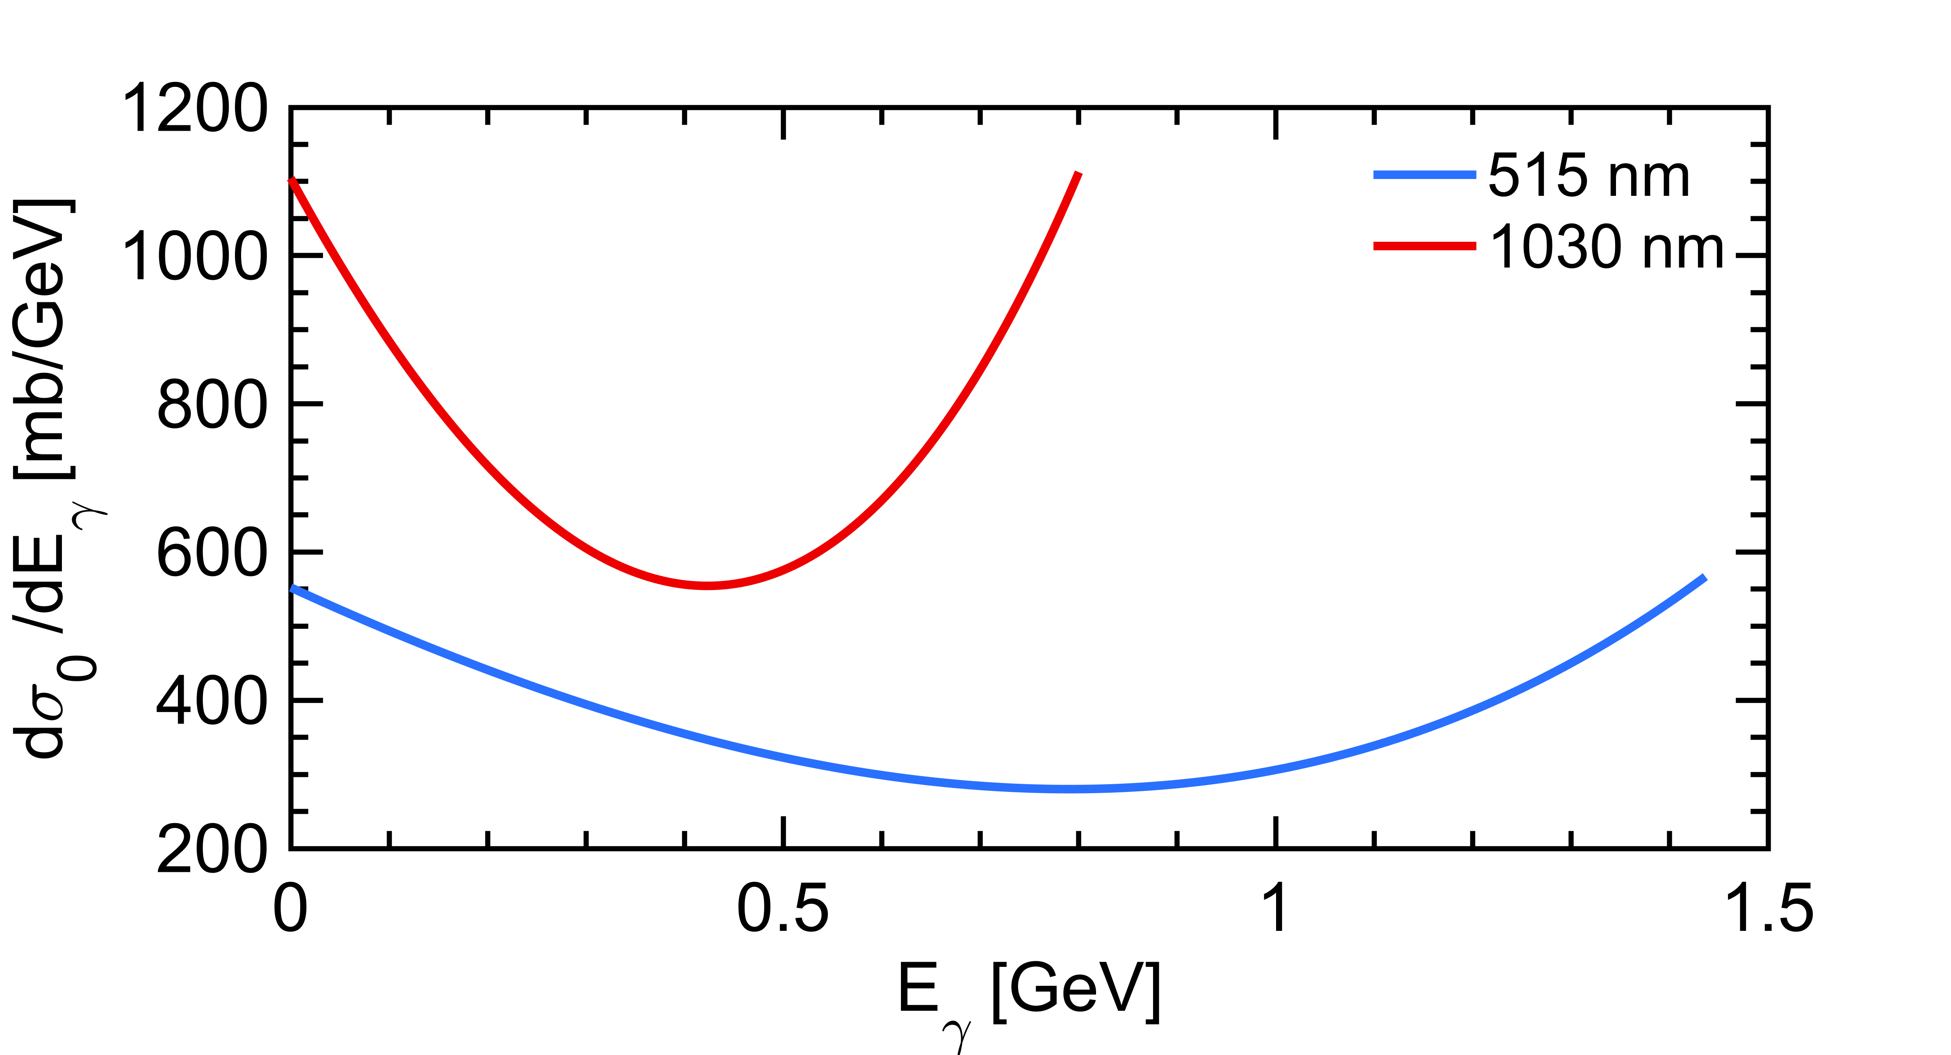
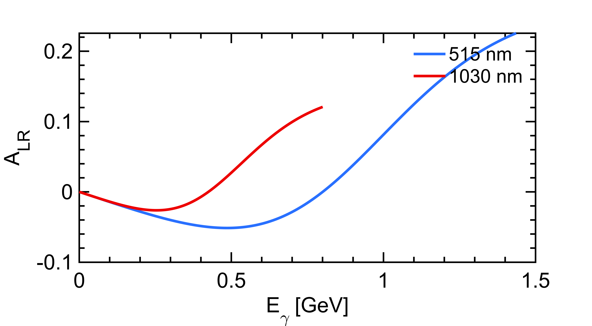
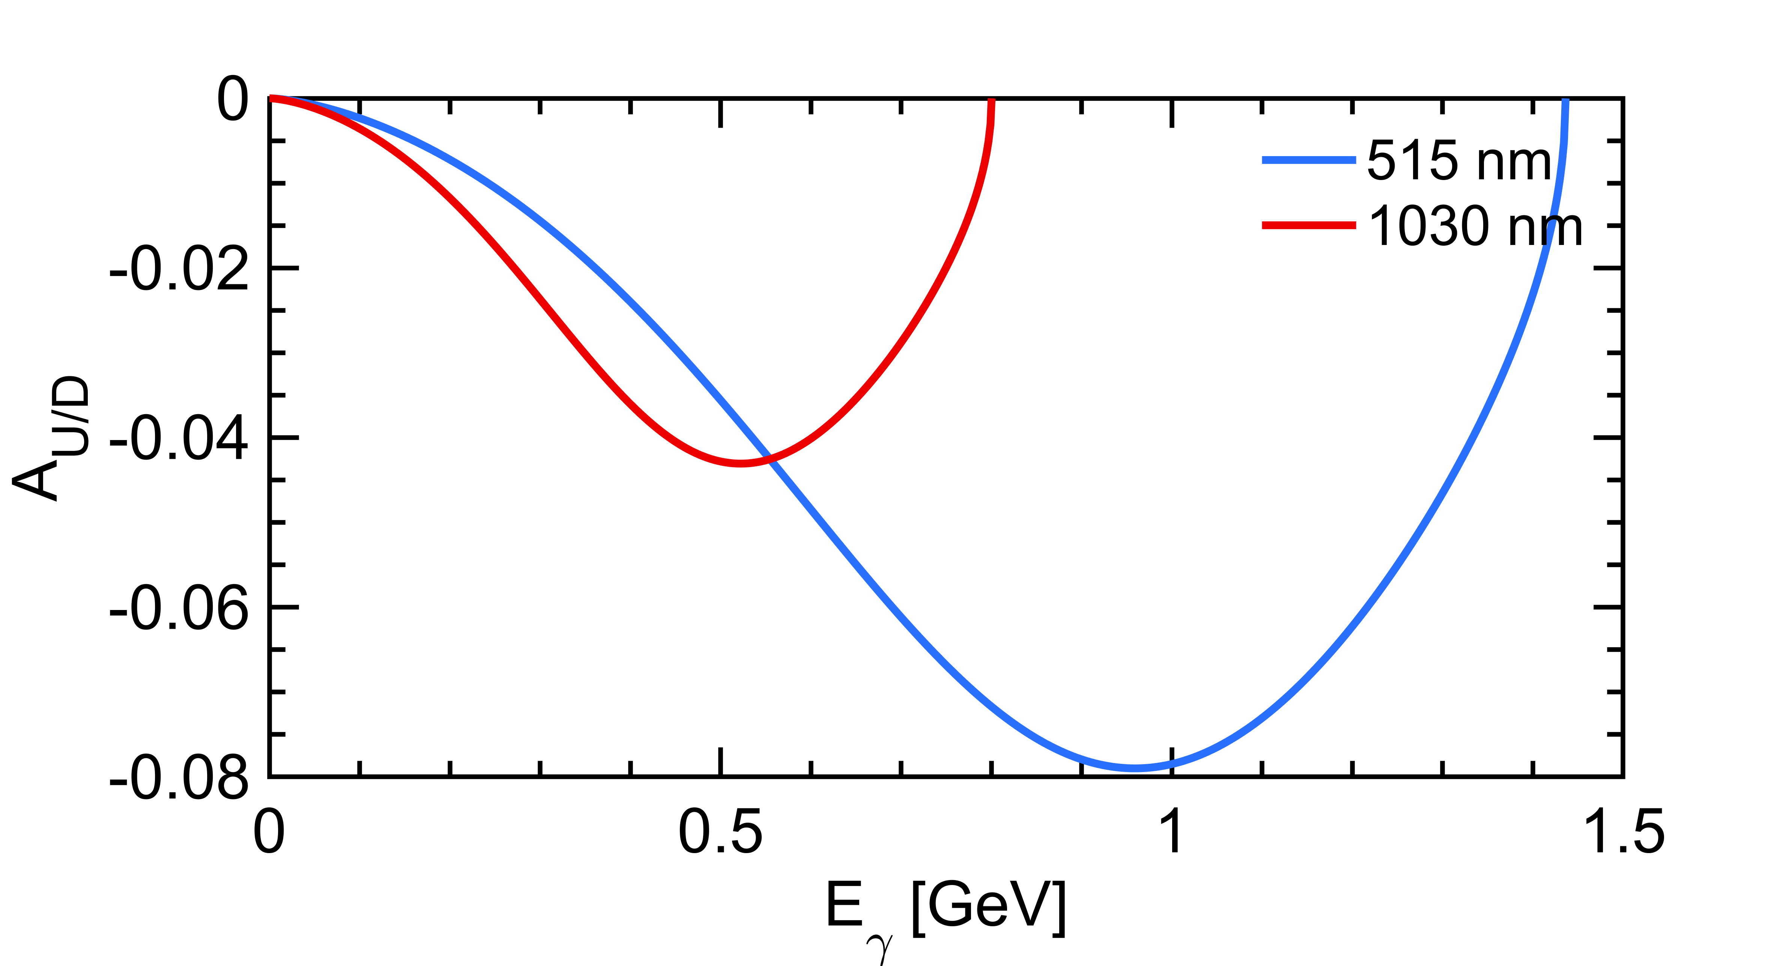


Compton polarimetry
$$\frac{dσ}{dy}(x,y)≅\frac{dσ_{0}}{dy}\left(1+{𝒫_{z}𝒫_{C}^{las}A}_{LR}\right)$$
$$\frac{dσ}{dy}(x,y)≅\frac{dσ_{0}}{dy}\left(1+{𝒫_{T}𝒫_{C}^{las}A}_{UD}\right)$$
Polarization dependent term generates a left-right asymmetry function of $E_{γ}$
Landau-Lifshitz QED book paragaphs 86 and 87
Use green (~515nm) laser
Postpone transverse polarimetry to a later stage

Slide 15
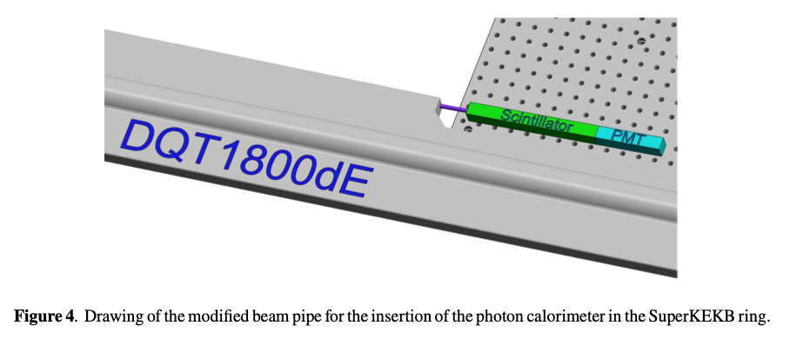
Conceptual design
A summary of the conceptual studies performed for the laser system and the scattered photon detector has been published recently
A summary of the results is inserted in the current CDR draft

Slide 16
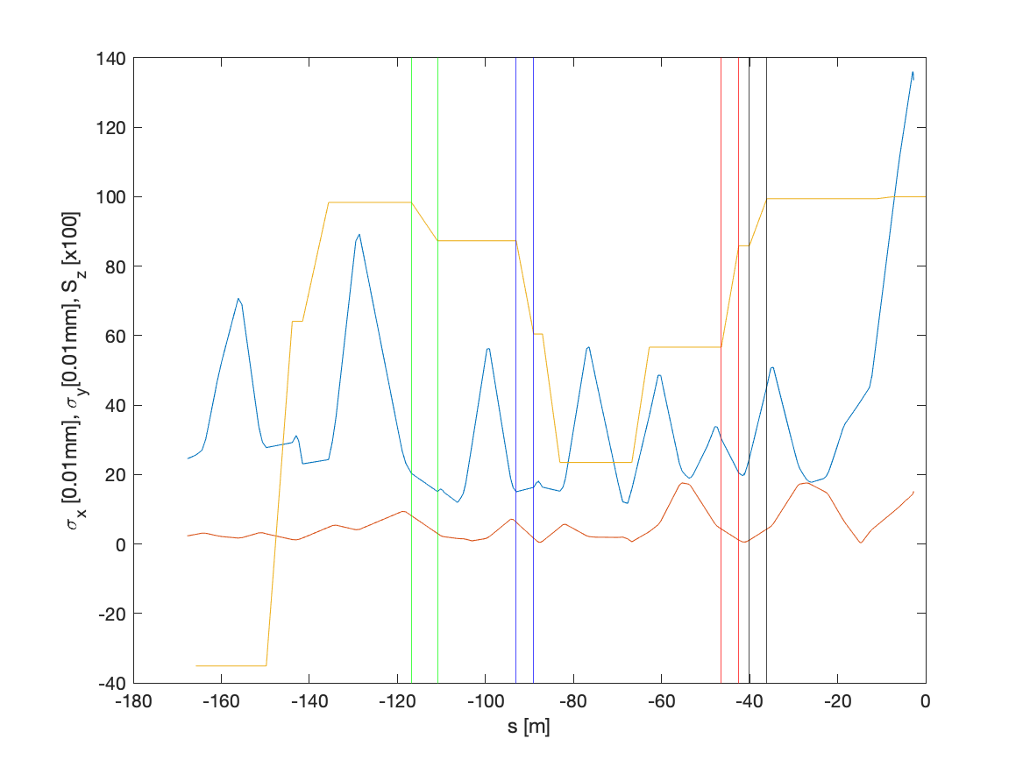
Beam sizes and spin projection in z
Using Y. Peng data, https://indico.belle2.org/event/5306/
BLA2LE
BLX2LE.2
BLY1LE.1/2
99% of the IP Sz
85% of the IP Sz
55% of the IP Sz

Slide 17
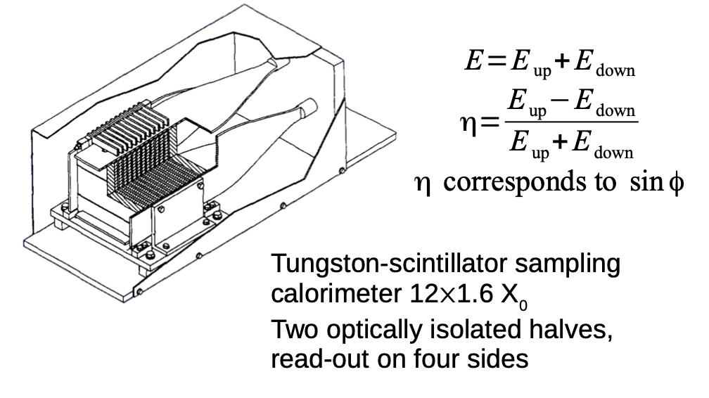
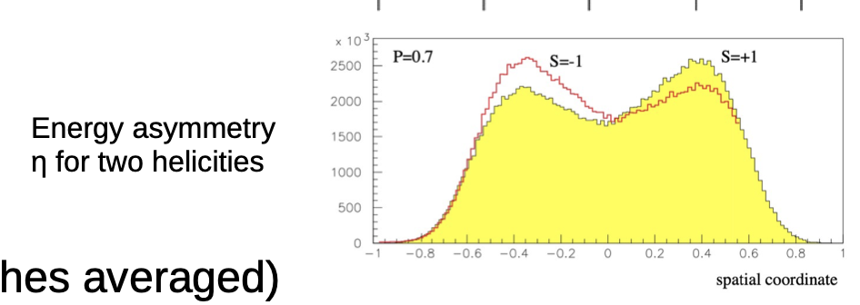
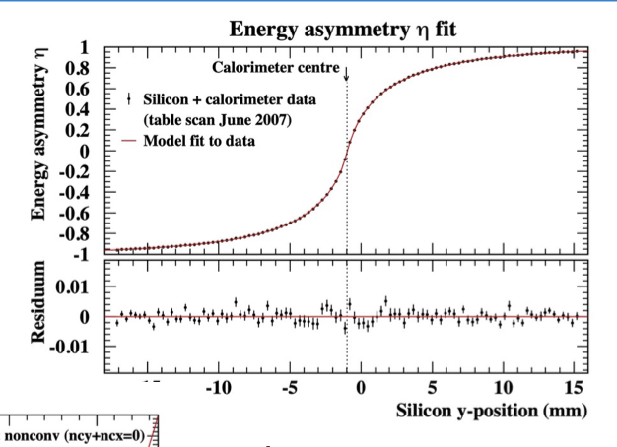
Transverse polarimetry at HERA
https://indico.cern.ch/event/1181966/contributions/5046178/attachments/2512013/4318517/220905_tpol.pdf
Exactly the operation that was done at HERA TPOL a long time ago.
Notoriously a difficult task but ‘do-able’
Requires detailed simulations
Requires some transverse sampling (not easy for photons)
Eased by implementing a nicely vertically segmented electron detector.

Slide 18
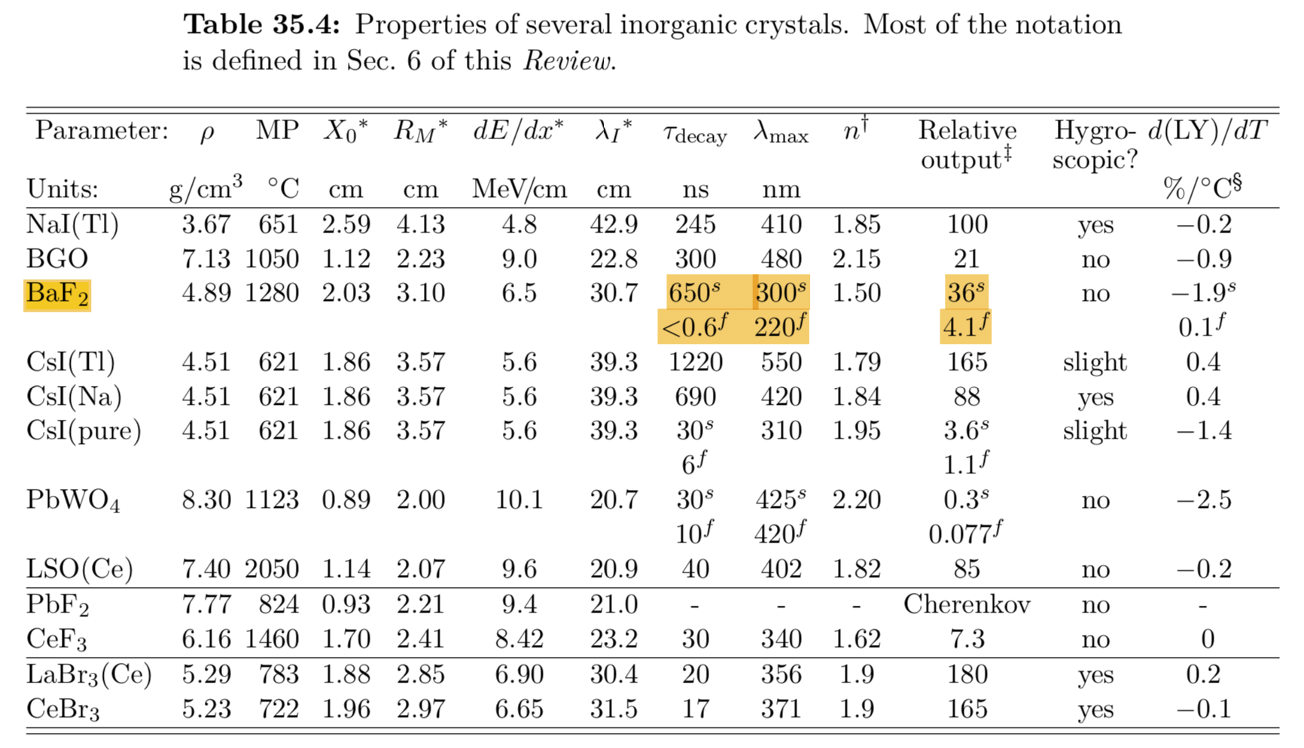
Choice of scintillating material
Basic elements
  a VERY FAST radhard scintillating crystal → BaF2, the only solution ?
  Filter for the slow component
  a PMT with low transit time dispersion (AND solar blind ?) → commercially available ?
  Associated electronics

Slide 19
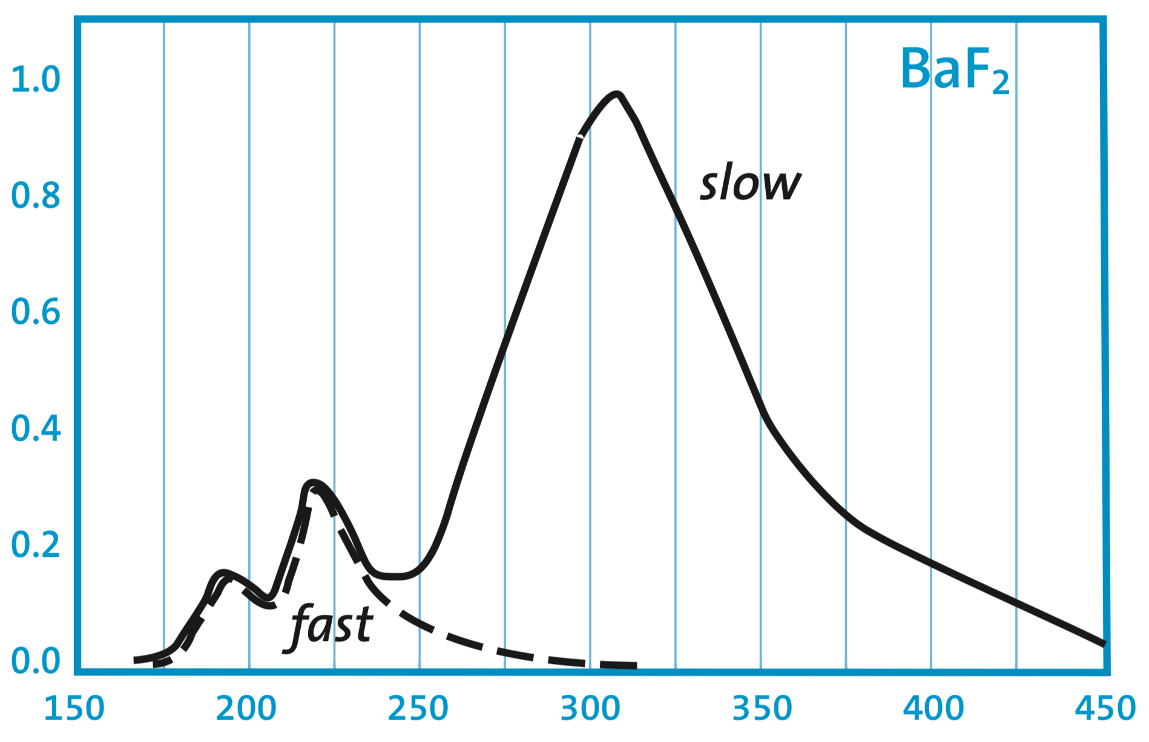
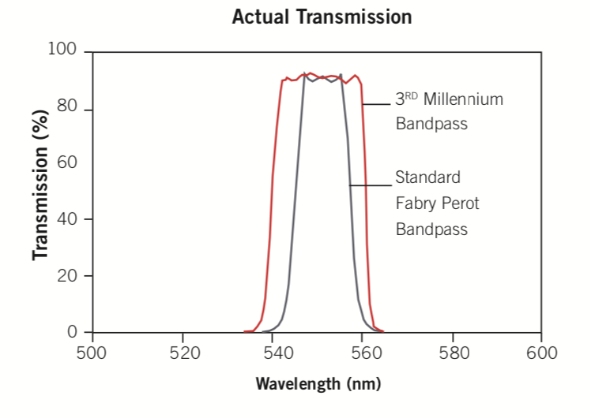
Slow component filtering
From Saint-Gobain datasheet.
Long tail → pile-up
Requires subtraction (in average), but fluctuations remain → spoil resolution
Solar blind photocathodes (CsTe) only reduce the. Slow component such that is amounts about 50% of the final light yield
Stefan Diehl et al 2015 J. Phys.: Conf. Ser. 587 012044
Use UV optical filters instead→commercial products exist for instace at 185nm +- 20nm (FWHM)
Y doped BaF2 being investigated

Slide 20
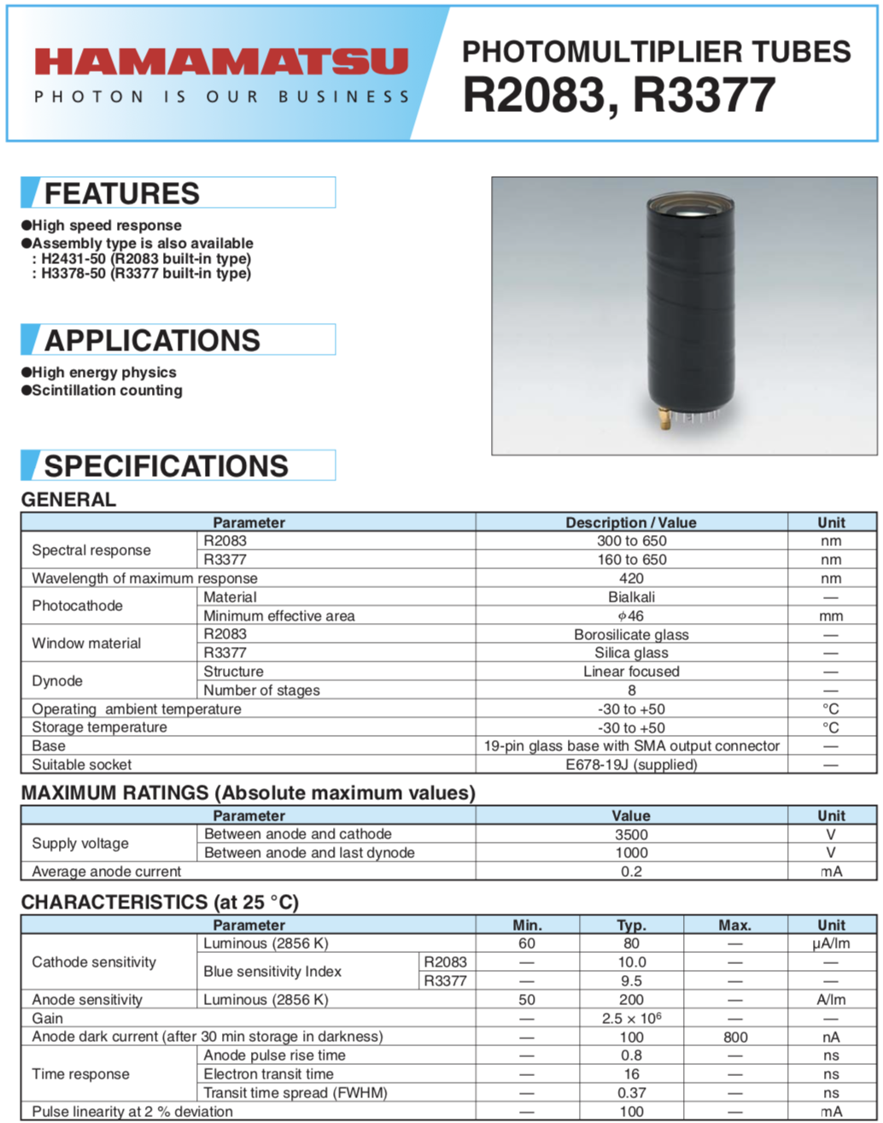
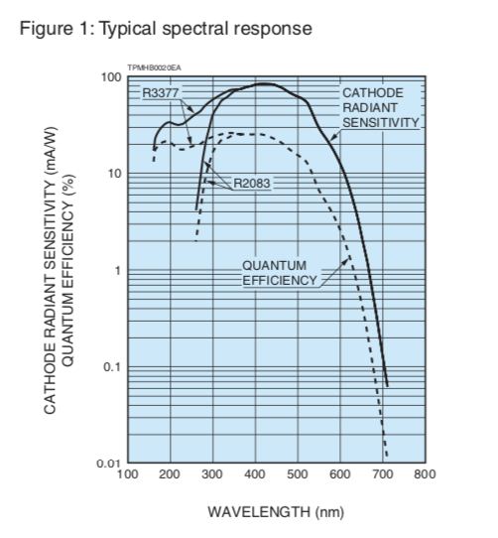
PMT
Main requirements: fast (low rise time, low transfer time spread) and not blind to UV.

