Slide 1
Touschek Polarization Lifetime Experiment
Z. J. Liptak
2024/01/09
Belle II Polarization Working Group Meeting

Slide 2
Overview and background
As a part of the larger beam polarization project, we have proposed a demonstration using only the polarized source.
Main ring rotators, Compton polarimeters, &c. will not be considered for this project.
Using data taken with polarized beams vs. without, we can extract the Touschek lifetime of the beam for polarized vs. unpolarized states to confirm the transport of polarized electrons to the IP.
Electrons can be polarized in both the + and – vectors based on the helicity of the driving laser’s circular polarization.

Slide 3
Motivation
1. Demonstrate a feasible polarized electron beam at SKB as a proof-of-concept.
This will provide a tangible result to build off of for the full polarization project.
It will also provide experience for the full polarization plan.
2. Validate simulations showing that spin is preserved in the Main Ring with a very long Touschek lifetime.
3. Provide information about polarization activity in collisions, which has not yet been simulated.

Slide 4
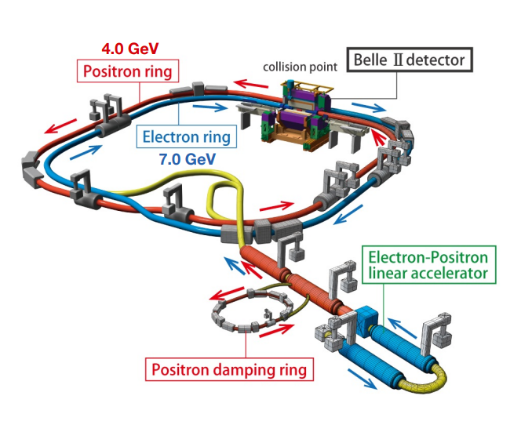
Experimental Needs
Polarized Electron Source
This project would only require changes to the SKB source area.
The planned introduction of spin rotators in the MR, Compton polarimeters, &c., would come later once those have been developed further.

Slide 5
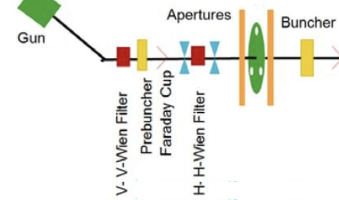
Experimental Needs
Polarized Electron Source
A source of polarized electrons will be necessary at the SKB injector.
The standard source of polarized electrons for several decades has been strained superlattice GaAs cathodes driven by a circularly polarized laser.
Cathodes generally have comparatively short lifetimes, but for a short study amounting to a few shifts this should not be an issue.
More robust sources, e.g. a DC gun similar to that developed by E. Wang’s group or new technology may be more mature by the time of the full project.
Adapted from R. Kazimi et al., “UPGRADING THE CEBAF INJECTOR WITH A NEW BOOSTER, HIGHER VOLTAGE GUN, AND HIGHER FINAL ENERGY”

Slide 6
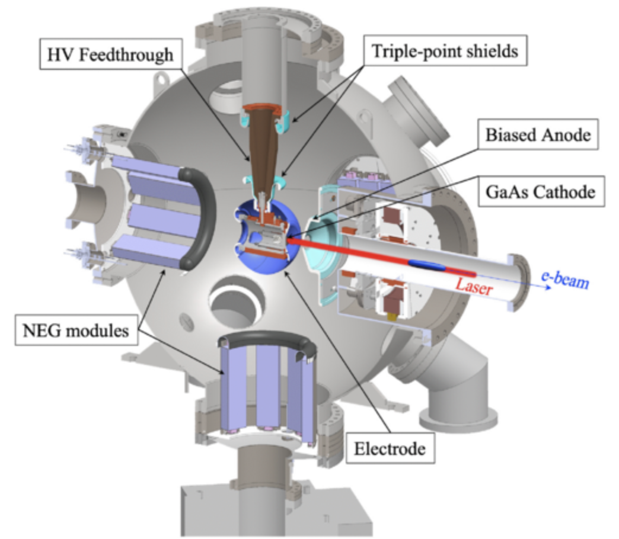
Experimental Needs
Example DC gun
E. Wang et al.
Phys. Rev. Accel. Beams 25, 033401
E. Wang et al.
Phys. Rev. Accel. Beams 25, 033401

Slide 7
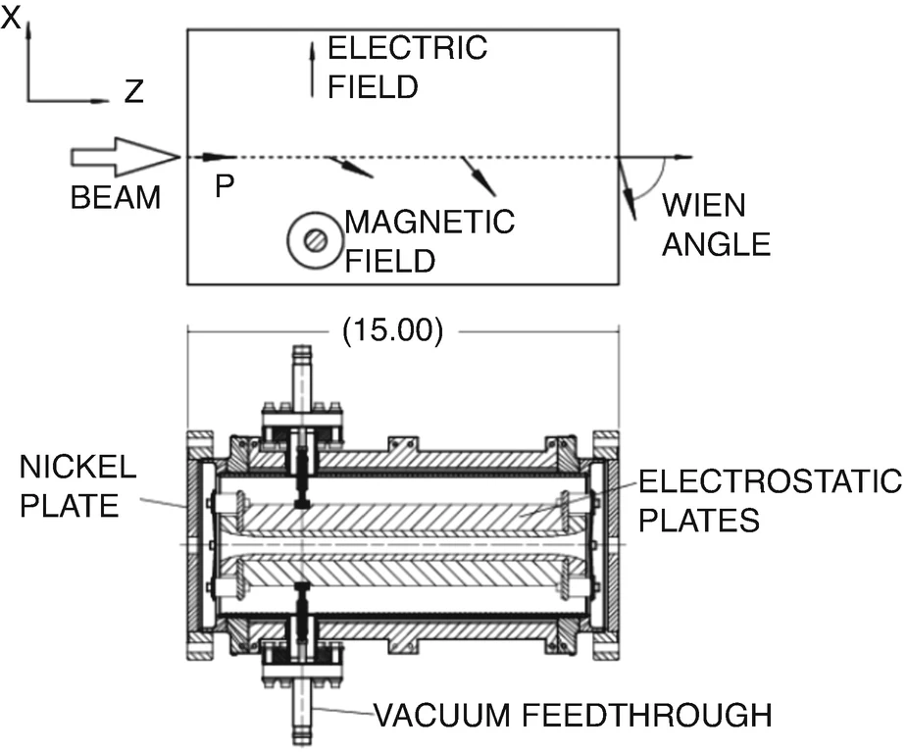
Experimental Needs
Wien Filter
Electrons produced at the cathode have spins (anti)parallel to the direction of travel.
In order to transport them through the J-arc in the linac, BT lines and Main Ring, their polarization vectors will need to be oriented to vertical.
Field is set s.t. E = β/c → electrons feel no Lorentz force, but spin rotates
CEBAF Wien Filter schematic (magnetic yoke not shown)

Slide 8
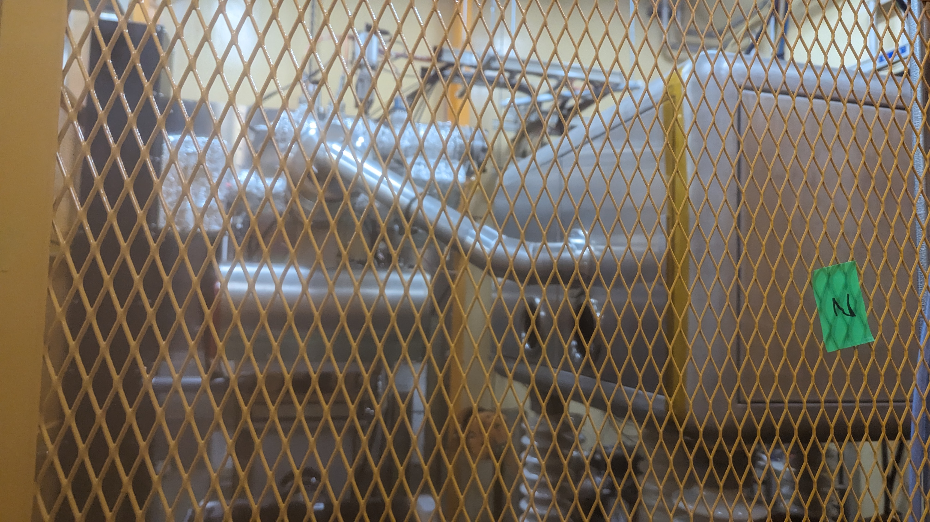
Challenges
SKB source area is very tight and installing a new DC gun will be difficult.
Thermionic gun is currently in use for the LER and cannot be removed.
Setup will require careful consideration of space, both in terms of physical layout as well as electric fields from the 200-250keV DC source.

Slide 9
US-Japan Application
We’ve applied for funding for this project via the US-Japan program.
Unlike in years past, this year’s application includes funding for the Touschek lifetime experiment along with rotator magnet design work.
We’ve also spent time working with the KEK accelerator team, and have tried to get more accelerator personnel involved and signed on as collaborators.
Zong-san (KEK) will be the Japan-side PI – see his talk in this session
Yoshida-san from the SKB source group has also agreed to join and has provided valuable knowledge and data already about the source needs.

Slide 10
Proposed Timeline
Winter-Spring ‘23/’24 (i.e., now): Submit proposal to US-J committee.
Hearing will be in early March this year.
Beamline work is scheduled already for the ‘24 summer shutdown – they won’t be able to spare time for this work this year.
FY’24: develop concrete plan for items to install in beamline.
Wien filter design, procurement of source (possibly existing DC gun), &c.
Laser/laser control system, &c.
FY’25 summer: perform necessary alterations to beamline
Perform runs at end of calendary ‘25
Final year of the US-J proposal is for analysis of data taken in this run (along with ongoing magnet work, &c.)

Slide 11
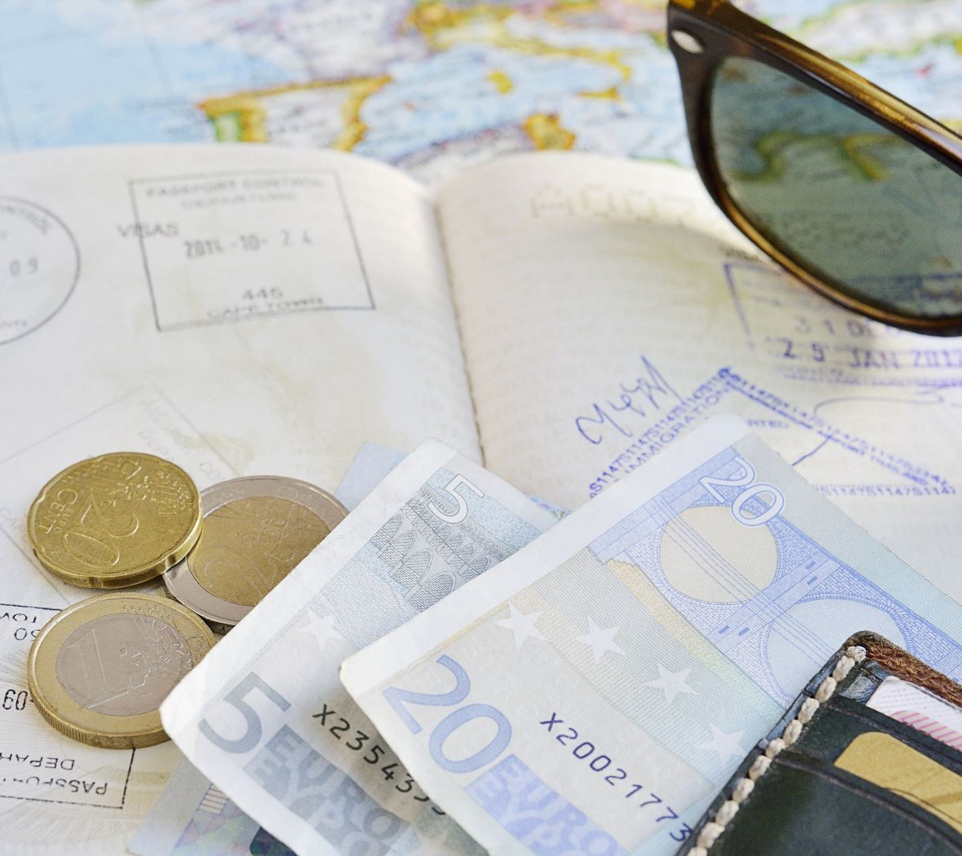
Project Costs
Major cost areas, as submitted to the US-Japan committee for the Touschek Lifetime Project only:
DC Gun, differential pumping equipment, &c.: ~30,000 kJPY
If we can use an existing DC gun, we may be able to reduce this cost
Laser system: ~27,000 kJPY
Beamline components, magnets, Wien Filter, setup: ~15,000 kJPY
Total 74,250 kJPY
(= 500k USD @ 148 JPY/USD)
Our request divides this over two years. The third year of our three-year proposal will be reserved for analysis of data taken in FY’25.

Slide 12
Summary
Touschek Polarization Lifetime Experiment included as part of our US-Japan funding proposal.
We hope to provide a viable proof of concept for the full polarization project, validate our predictions and get valuable information about how collisions affect polarization and lifetime.
Plan is to develop concrete plans and procure as much material as possible in FY’24, aiming at installing during the summer shutdown of ‘25 and doing a run over several shifts at the end of 2025 running.
There are challenges to overcome, but we are communicating and working with the accelerator team to overcome them.

