Slide 1
What is the P5 report and what are the implications for
Belle II@SuperKEKB ?
Tom Browder, (University of Hawai’i)
P5 = Particle Physics Project Prioritization Panel
After the decadal Snowmass community process with thousands of White Papers, the P5 decides on funding priorities in a couple of future funding scenarios.
They decide on a 10-year plan within a 20 year context. The P5 included panelists from Japan (new Director General Asai-san) and Europe. The chair was Hitoshi Murayama (UC Berkeley, U Tokyo).
Report at https://www.usparticlephysics.org/2023-p5-report/
Acknowledgements:
We thank the Belle II authors of the Snowmass White Papers
https://www.belle2.org/info/snowmass2021/
We also thank Jake Bennett, DG Yamauchi, Kodai Matsuoka (slides for the DG), Frank Zimmerman for talks at the P5, Yutaka Ushiroda for the translation of the MEXT review of the SuperKEKB/Belle II project. Many others helped in the P5 lobbying process.

Slide 2
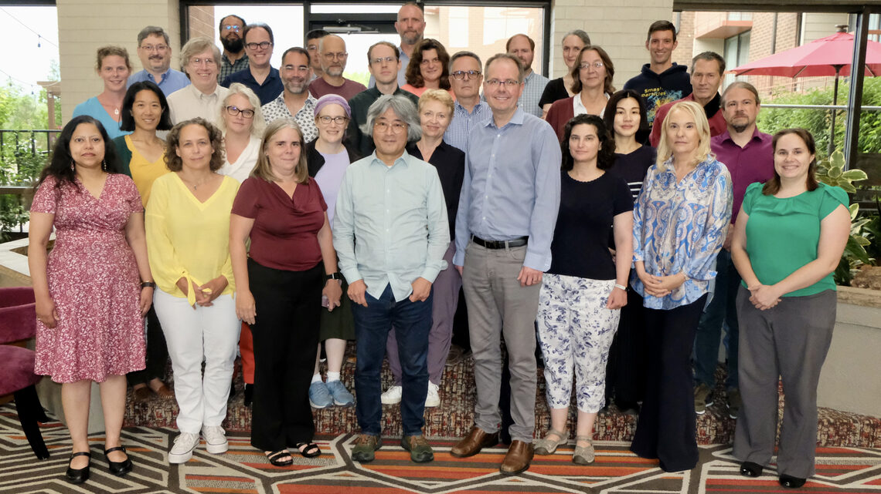
Much younger and more diverse than the 2013 panel
The P5 panel

Slide 3
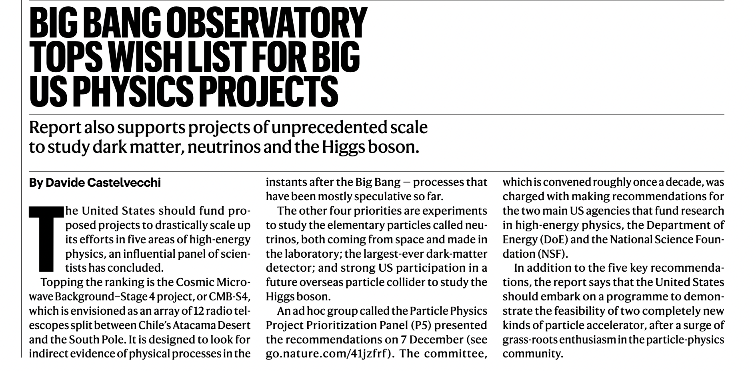
NATURE summary of P5
CMB-S4 (1 billion and South Pole infrastructure), DUNE (3.3 billion dollar neutrino project), DM G3
New York Times summary of the P5 report
Muon collider R&D endorsed with a long-term goal of a muon collider at FNAL

Slide 4
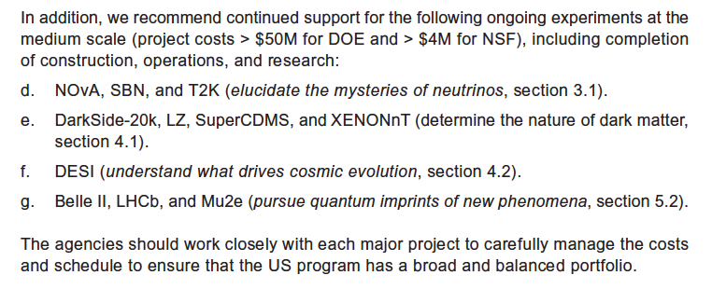
“Medium Size” and “Small” projects also discussed and endorsed.
Quite different from 2013
Part of Recommendation 1

Slide 6
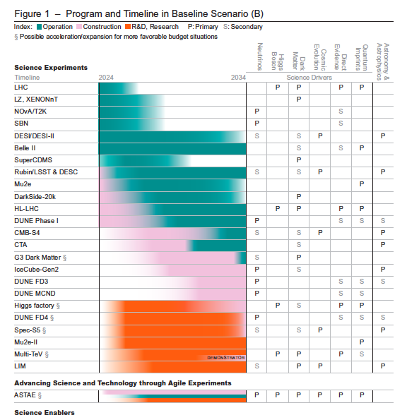
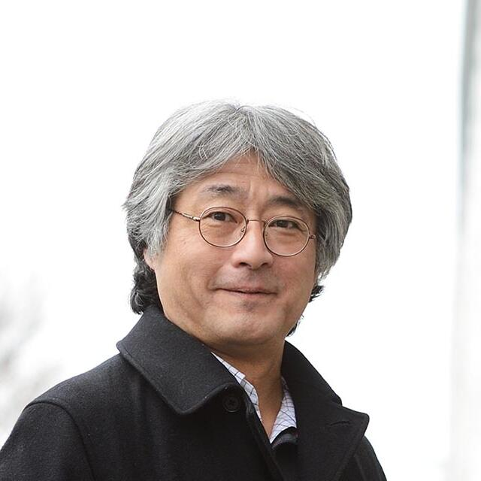
This is an important figure for Belle II@SuperKEKB
Extends to 2034,
following the MEXT review.
Belle II now pursues “Quantum Imprints of New Phenomena”, one of the five major science drivers.

Slide 7
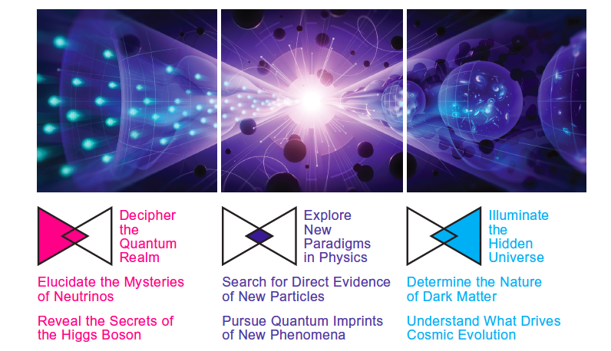
The New P5 Science Drivers (2023)
2013
→“Pursue Quantum Imprints of New Phenomena”

Slide 8
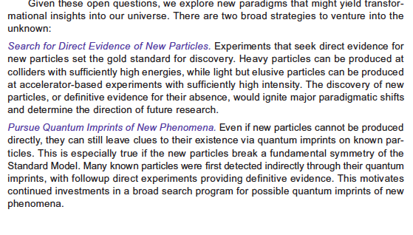
Now in the first tier of HEP.
Ole Miss Q: Can you give an example of a particle discovered first by its quantum imprints ?
GIM mechanism: see slides by Jim Libby.

Slide 9
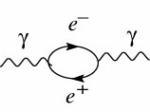
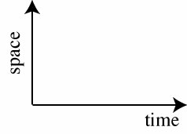
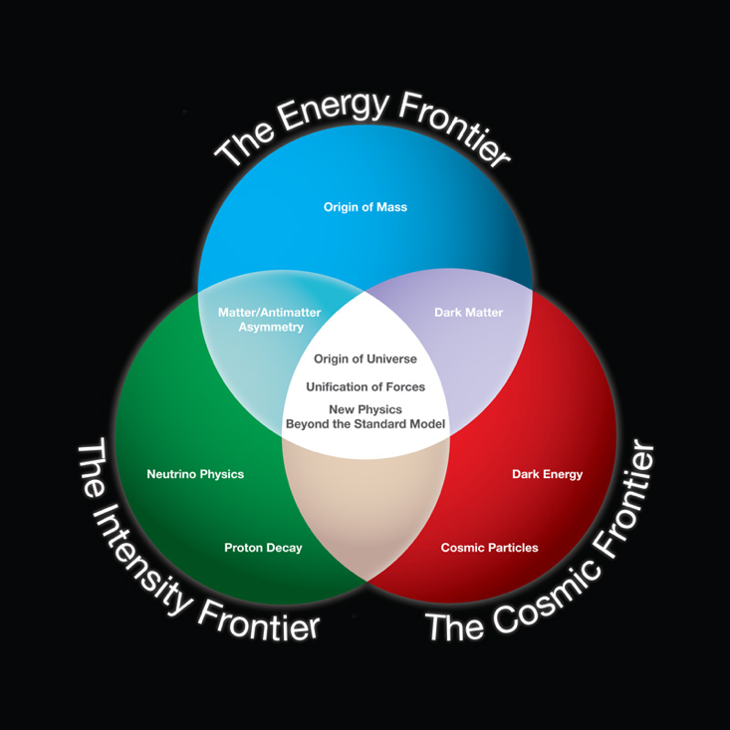
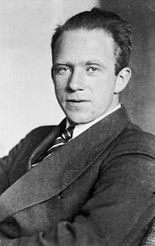
Quantum Mechanical (QM) Imprints versus Brute Force
Energy conservation ?
Banking Analogy (may be easier to understand):
At the Heisenberg Quantum Mechanical bank, customers with no collateral may take out billion Euro loans if they return the full loan within a billionth of a second.
If a beautiful but rare customer takes out such huge loans very frequently, the bank will take notice.
N.B. Sometimes it is much better to have a large collateral and pay back the loan directly after a longer time.
Werner Heisenberg,
Physicist and QM banker
Notes:
How to detect new particles ?
Now we compare the intensity frontier and the energy frontier approaches to finding new physics. The energy frontier is currently led by the LHC at CERN, while Belle II and LHCb are two of the leading experiments on the intensity frontier. Werner Heisenberg (1901-1976)

Slide 10
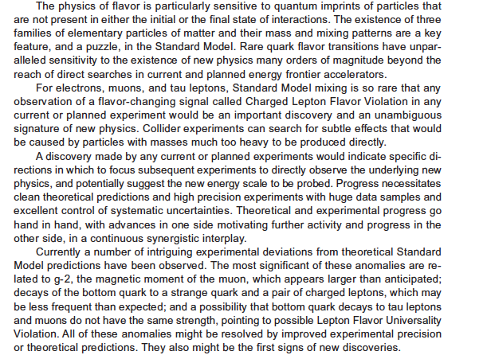
Now in the first tier of HEP.
Ole Miss Q:
What is meant by lepton flavor universality ?

Slide 11
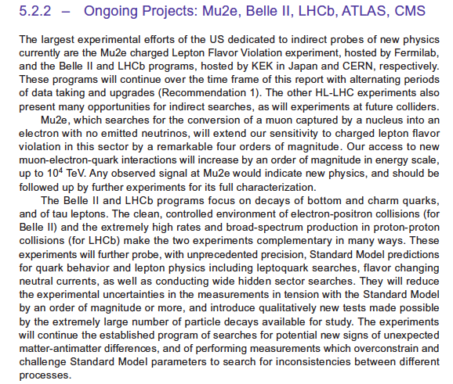
Dark Sector at Belle II,
Prof. Savino Longo

Slide 12
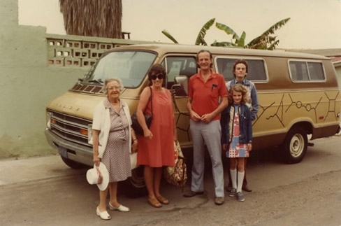
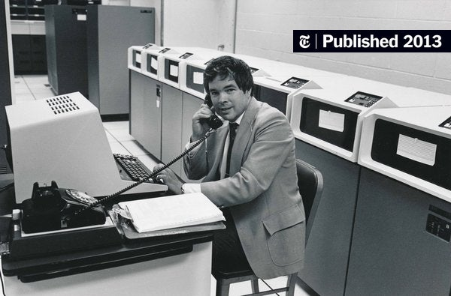
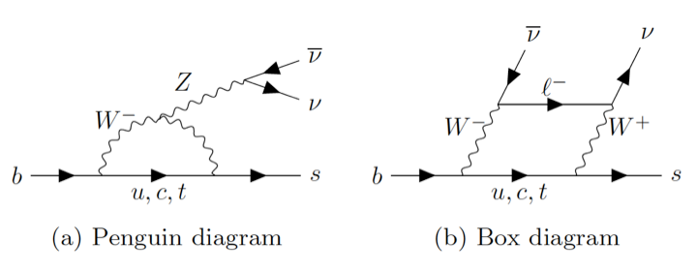
One new direction:
Feynman Diagrams and Model Building
Effective Field Theory
→Wilson Coefficients
Paradigm shift
Feynman family and diagrams
Ken Wilson (”Wilson coefficients”)
C₇, C₉, C₁₀
New Physics/BSM Couplings in b→s
Extract Wilson coefficients directly by fitting angular distributions in B→K* l+ l- or B→D* l $ν$
The primes are NP right-handed couplings.
Notes:
No more Feynman diagrams. Now move to effective field theory and parameterize the Lorentz structure of the New Physics effects.

Slide 13
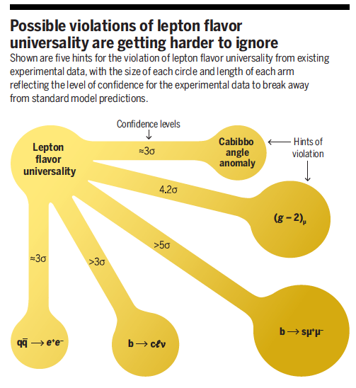
The landscape of BSM hints in High Energy Physics ?
“Tsukuba, we may have a problem” (apologies to Apollo 13 again)
Is this real ? R_{K} went away after LHCb re-analysis. Angular asymmetries persist. What about
B→K^{(*)} $ν νbar ?$ (BSM hint ?)
We must carry out the full program of measurements
at Belle II to find out.
From December 2021 SCIENCE magazine article by A. Crivellin and M. Hoferichter.
Notes:
I will show the figure on the left at least twice as the talk proceeds

Slide 14
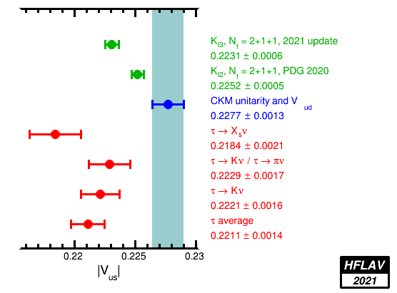
But wait there’s more…..
Belle II can contribute to the resolution of the Cabibbo Angle Anomaly (CAA)
There is a ~3$σ$ discrepancy between |V_{us} |measured from tau and kaon semileptonic decays. Belle II will measure |V_{us} |in inclusive tau decays to high precision
From December 2021 SCIENCE magazine article by A. Crivellin and M. Hoferichter.
A major supporting role of Belle II in the resolution of two more of the other HEP anomalies.
The CAA could be another hint of lepton flavor universality violation

Slide 15
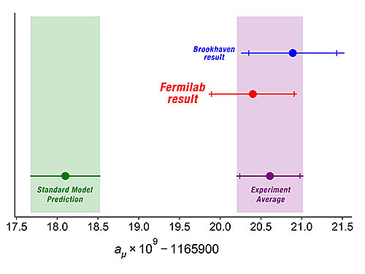
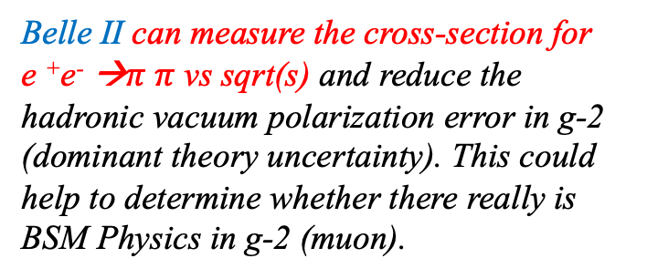
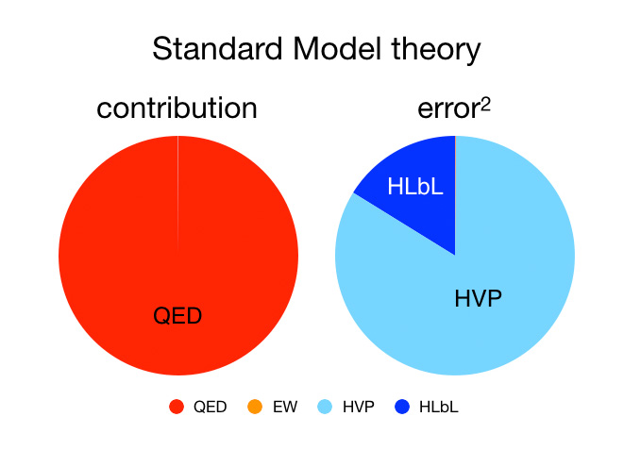
+But wait there’s still more…..
Belle II can contribute to g-2
KLOE, BaBar and CMD-2 data disagree
Belle II can measure the cross-section for
e ⁺e⁻ →$π π$ vs sqrt(s) and reduce the hadronic vacuum polarization error in g-2 (dominant theory uncertainty). This could help to determine whether there really is BSM Physics in g-2 (muon).
From December 2021 SCIENCE magazine article by A. Crivellin and M. Hoferichter.
A major supporting role of Belle II in the resolution of two more of the other major HEP anomalies.

Slide 16
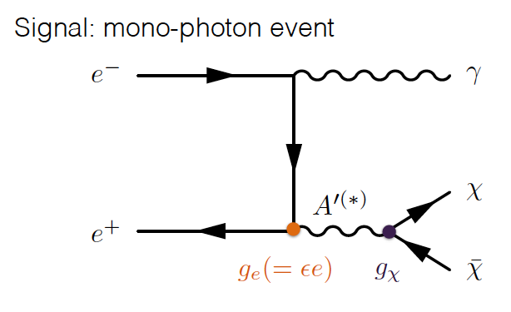
Only in e+ e-: “Light DM” (dark sector) sensitivity in e⁺e⁻→γ+nothing
BTW Belle II already has 6 published PRLs on the dark sector.
This is hard. Requires a special new trigger that is being used for Belle II. QED backgrounds are large.
Notes:
Belle and BaBar pushed many limits far beyond CLEO. Belle II will move below 10^-9

Slide 17
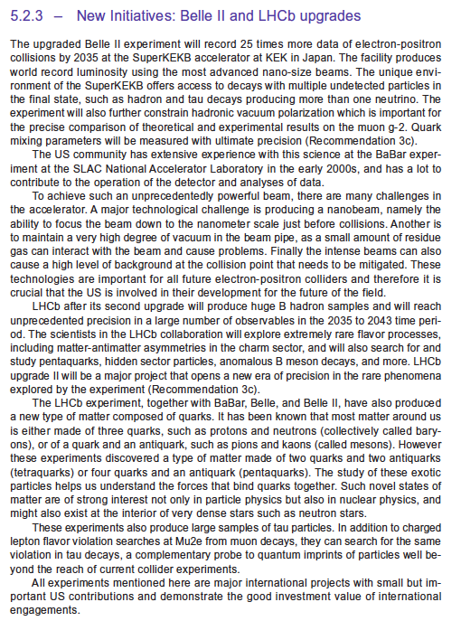
Excerpts from the P5 report
Ole Miss Q:
What is the major challenge for the accelerator ?
Ole Miss Q:
How can Belle II contribute to
charged lepton flavor violation ?

Slide 18
See talk by Dr Oskar Hartbrich

Slide 19
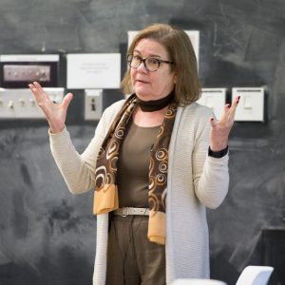
Presentation at the HEPAP meeting, May 9, 2024
Associate Director of OHEP, Gina Rameika

Slide 20
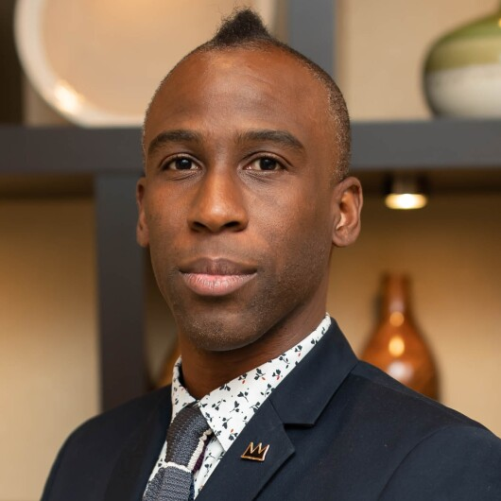
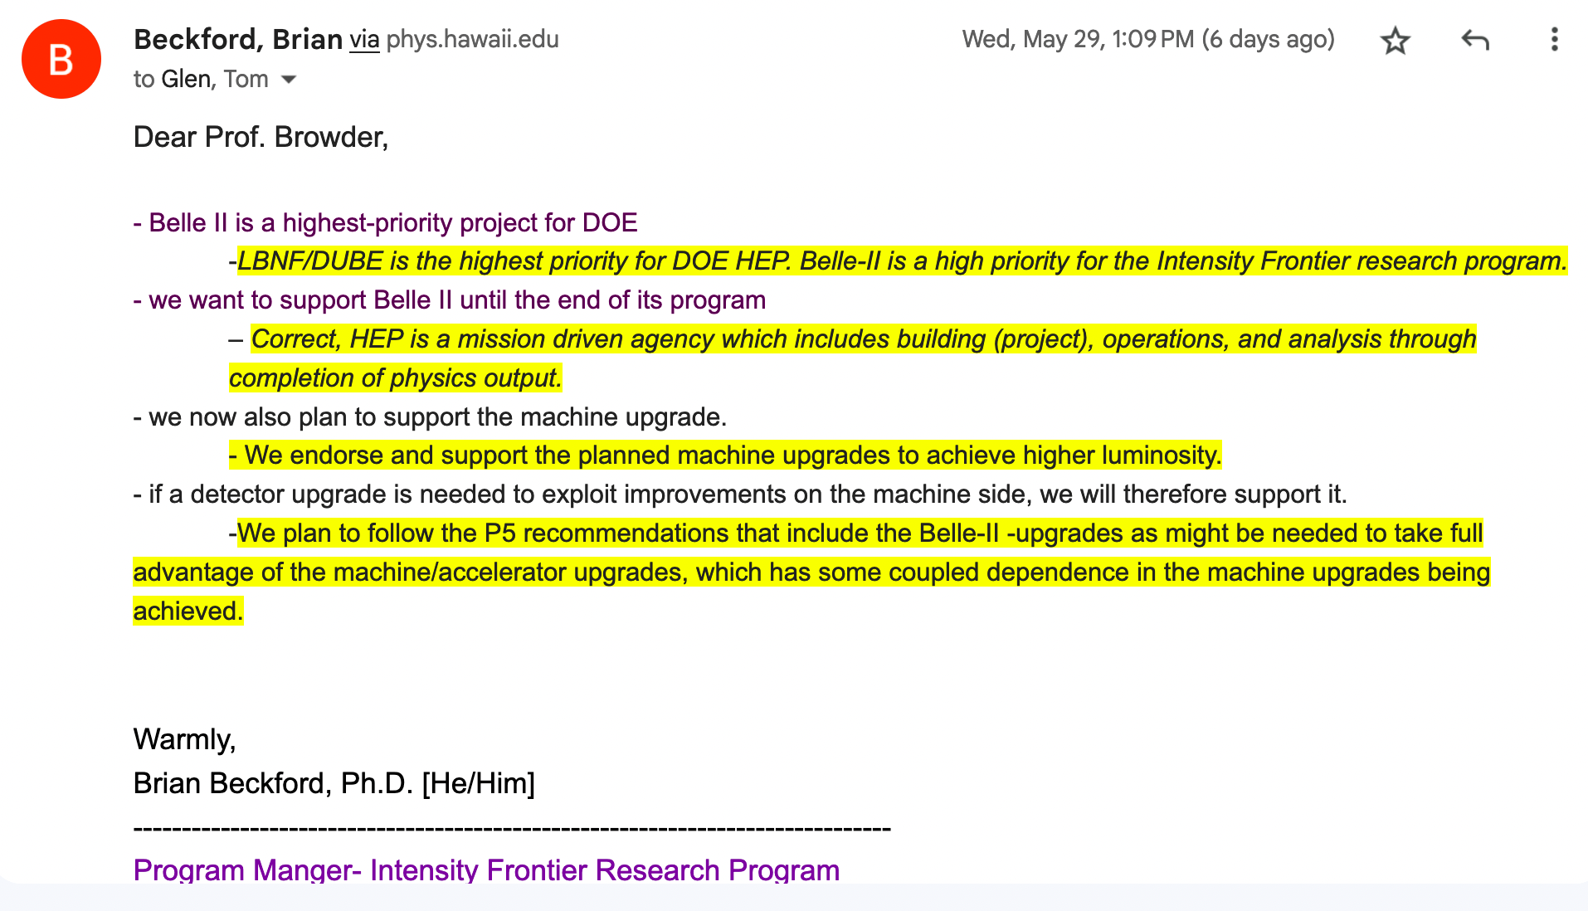
Further comments from Brian Beckford at the DPF/PHENO meeting in Pittsburgh and by e-mail
Dr Brian Beckford,
Program Manager for the Intensity Frontier.

Slide 21
What does the P5 report and the DOE response mean for Belle II@SuperKEKB ?
Seize the opportunity:
We are in the first tier of HEP priorities.
We can ask for a Belle II upgrade, do R&D on the upgrade,
hire junior faculty etc.
We can ask for targeted contributions to SuperKEKB.
Examples:
Fermilab is proposing ”start-up funding” for collaborative Nb₃Sn magnet R&D for SuperKEKB within the US-Japan fund.
Later, they will request more significant DOE funding (not in the intensity frontier) for this important type of magnet R&D.
BNL will request a “beam-beam” postdoc from lab LDRD in fall 2024 (delayed).

Slide 22
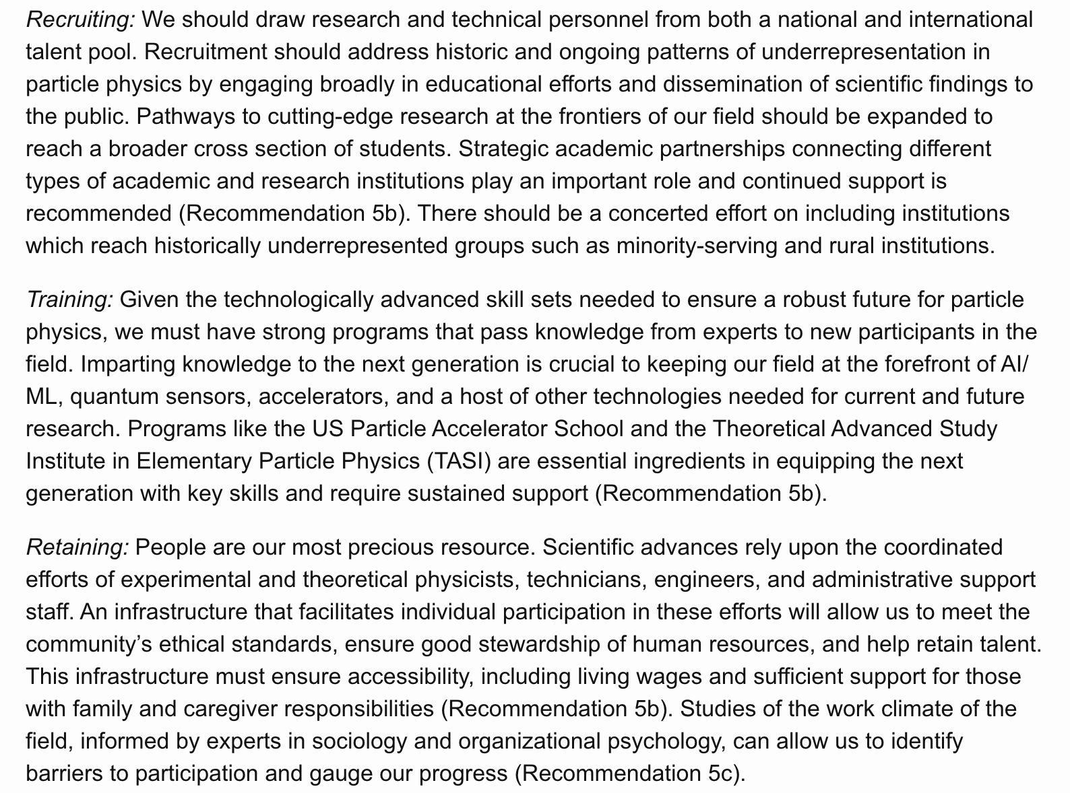
Technical Work-Force Development was highlighted in the P5 report
Professional Development
Professional Development and Hands-on Sessions.

Slide 23
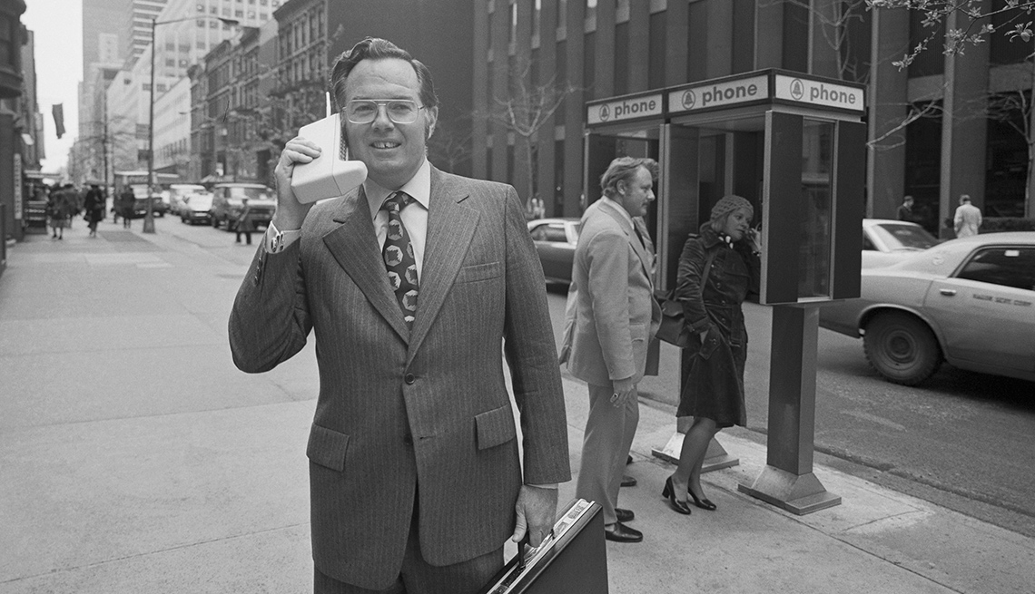
“Don’t stop thinking about tomorrow
Don’t stop it’ll soon be here”.
-Fleetwood Mac, 1977
In 2018, we fought hard and managed to integrate 0.428 fb⁻¹ for the whole spring run. Seemed pretty hopeless (KLM and trigger were not working). No vertex detector. DAQ was crashing all the time. Got a dark sector PRL paper from this tiny dataset.
By 2022, we integrated ~428 fb⁻¹ and reached 2.5 fb⁻¹/day. Found first hints of B->K nu nubar but started having SBLs.
Need to reach ~5 fb⁻¹/day every day and then integrate steadily during long 6-7 month runs. (see Karim Trabelsi’s talk) to reach 1 ab⁻¹/year level.
First cell phone call from NYC to Bell Labs, NJ 1973 (2.5 lbs, 30 minute battery life, 10 hours to recharge)
Took Motorola ten years to commercialize, 1983.
First small cell phone, 1989, Motorola
First cell phone with text messages, 1992, Nokia
Smart phone precursors, IBM 1994 Personal Communicator.
First IPhone 2007.

Slide 24
“Belle II needs more data !!!”
Last comment:
Apologies to Director Akira Kurosawa
Why ?To find out whether there are BSM couplings in the weak interaction
Imaginary but realistic future dialogue
“But Captain Ohnishi, I can’t squeeze $β$*_{y} any further”
“Well, increase the beam currents”
“Sorry Captain, I can’t push the linac any harder.”
The futuristic nano-beam e+e- collider, SuperKEKB, is the key. We are at ~200nm vertical beam height (and L x5 PEP-II). Need to go to 50 nm and build up beam currents.

Slide 25
P5 Appendix:
Technical Work-Force Development was highlighted

Slide 26
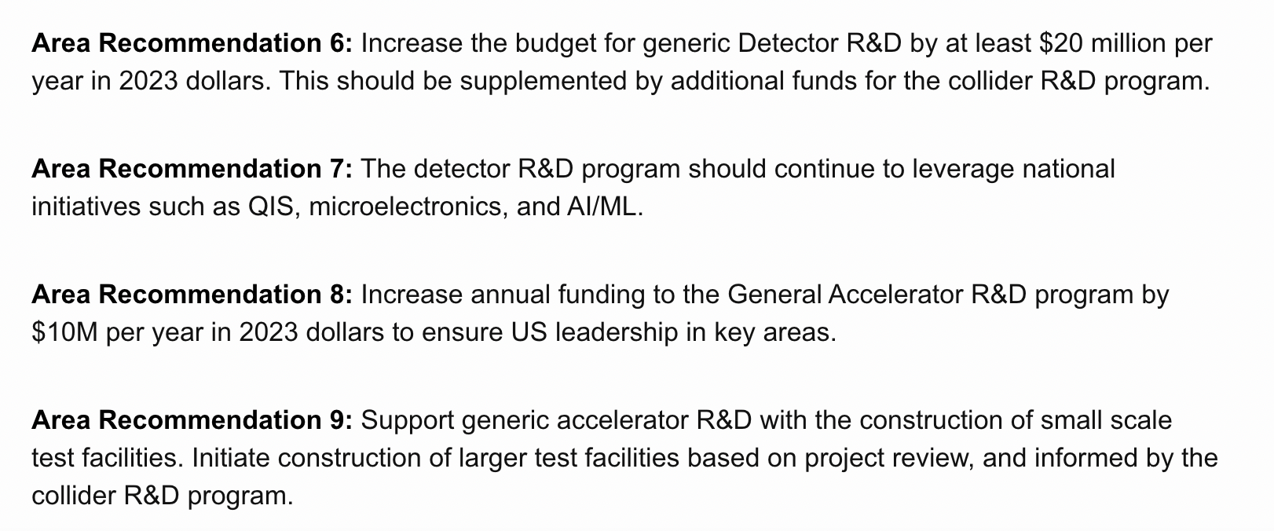
Need more detector and accelerator R&D

Slide 27
DEI
Prof. Kay Kinoshita et al.

Slide 28
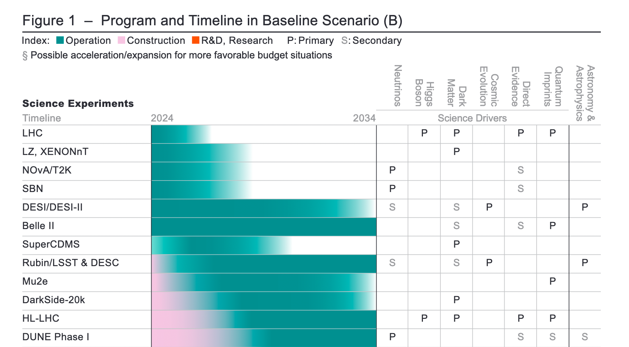
Appendix: Summary of Major Recommendations

Slide 29
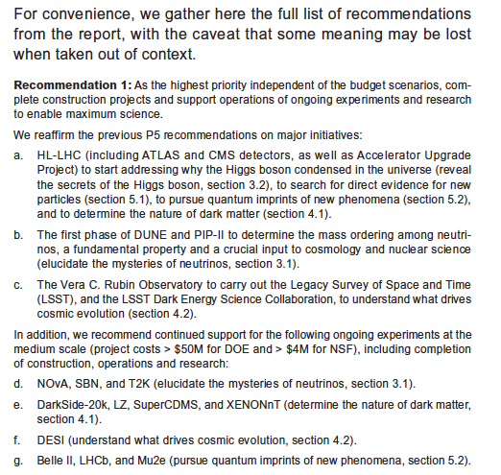

Slide 31
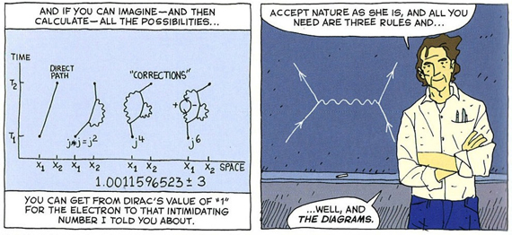
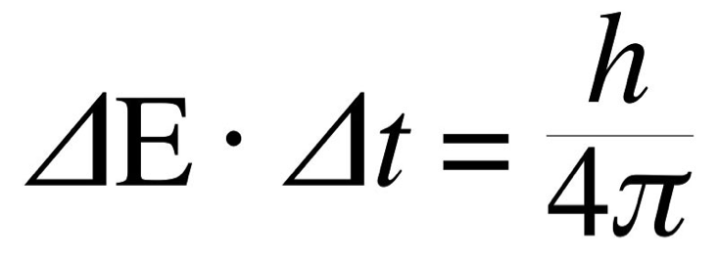
Feynman, Heisenberg and Virtual Particles
You can create and destroy a virtual massive heavy particle in the loop if you do it for a very short time

Slide 32
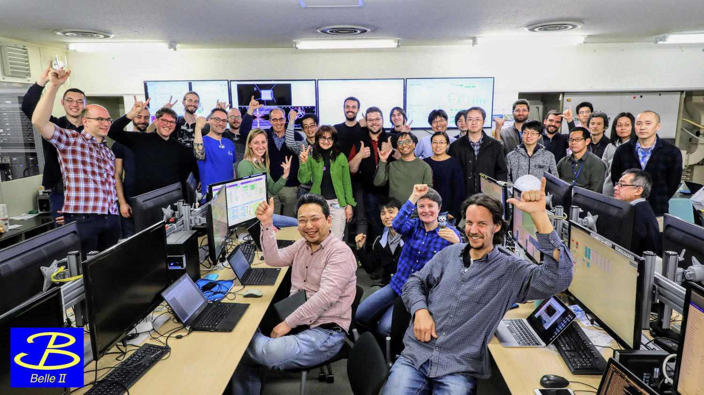
Not so long ago (before
the pandemic)
The experimental control room in Tsukuba Hall B3 (Spring 2019)
This was scientific history in the making: SuperKEKB/Belle II joined DORIS/ARGUS, CESR/CLEO, and PEP-II/BaBar and KEKB/Belle
Notes:
A celebration.

