Slide 1
Compton polarimetry for SuperKEKB: Synchronisation
Aurélien MARTENS

Slide 2
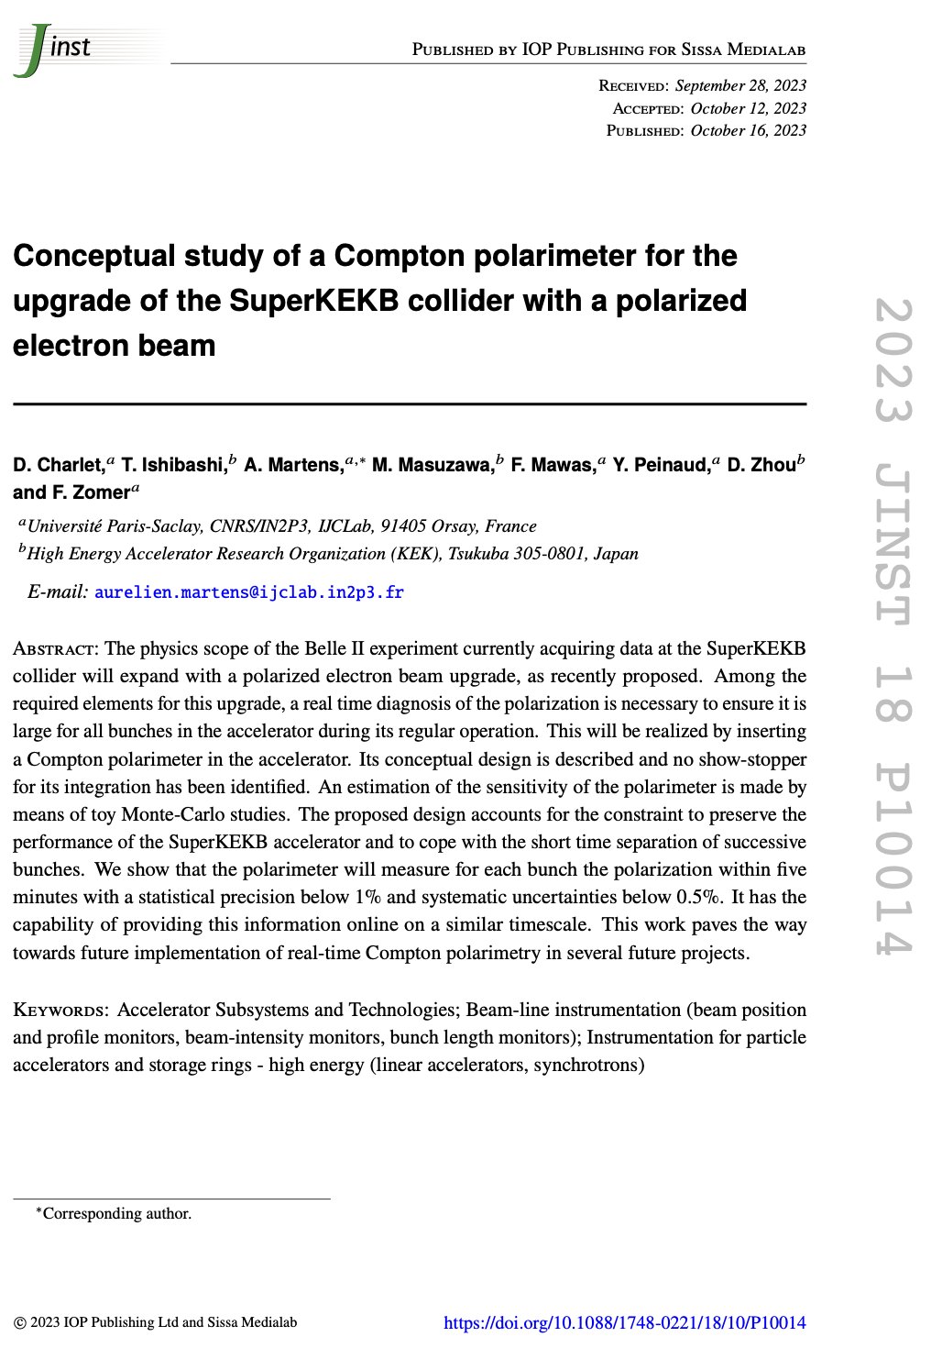
Introduction
Reminder:
We have draw a conceptual design with excellent expected performance
Design relies on:
Laser:
Integrated in accelerator: must be fully remote operated
Operated at frequency of 250MHz: must be well synchronized to accelerator RF
Typical acceptable time jitter of ~500fs (a small fraction of electron bunch/laser pulse durations
Detector:
photon calorimeter able to cope with photons incoming every 4ns.
The 2500 circulating bunches measured independently
Ability to provide fast on-line info to the control room
Embedded electronics, fast enough, with good ADC (10 bits min) and FPGA processing
With bunch identification

Slide 3
Conceptual acquisition chain
Optical filter
BaF2
PMT
2500 histograms
Fast treatment: fit
Every 4ns
FPGA
IDROGEN board
White Rabbit node
Reduced data
To online monitoring
Analog Front-end
+ ADC (>=10bits)
clock
To remote storage (10MB/min)
Update program, constants
1rst Bunch identifier
Accelerator RF
Funding request in preparation for submission to ‘Agence Nationale de la Recherche’ for building and testing this detector with the electronics

Slide 4
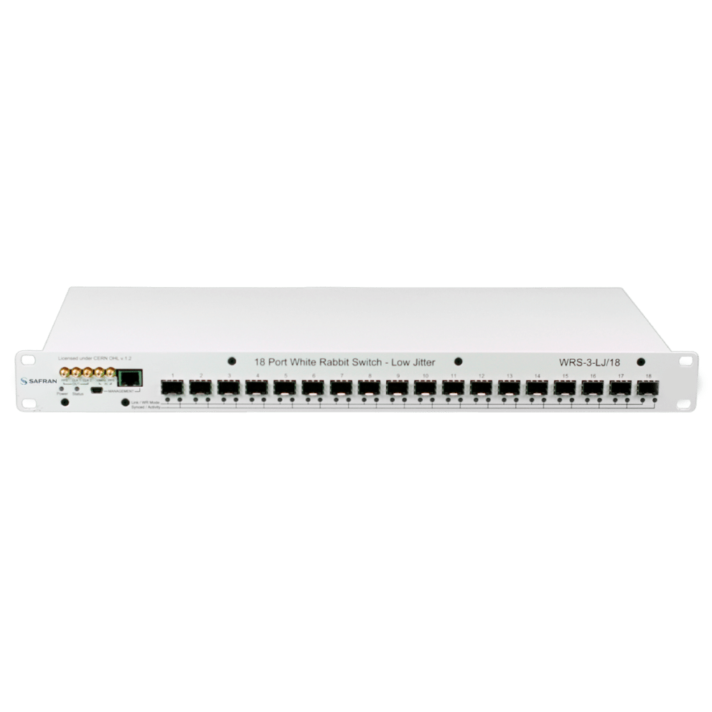
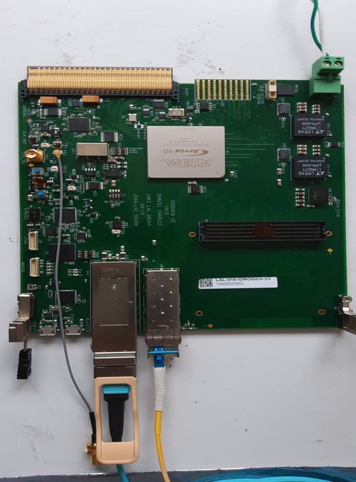
Laser synchronisation – concept
H. Kaji, D. Charlet
Master Oscillator (510MHz/51)
IDROGEN, high speed DAQ
Low noise WR node
FPGA mezzanine card
WhiteRabbit
WhiteRabbit allows to minimize implementation cost
A simple fibre to bring to the laser
No expensive/complicated fibre length compensation system to implement
D. Charlet et al., https://cds.cern.ch/record/2893372?ln=en
4km fibre link
Developments made in parallel at IJCLab and KEK:
IJClab:
Standalone tests with phase noise measurements
Test new developments on the IDROGEN board quickly
KEK:
Test within KEK environment
Possibility to test with 4km fibre loop easily
Possibility to test accelerator/laser synchronisation → these two weeks at ATF

Slide 5
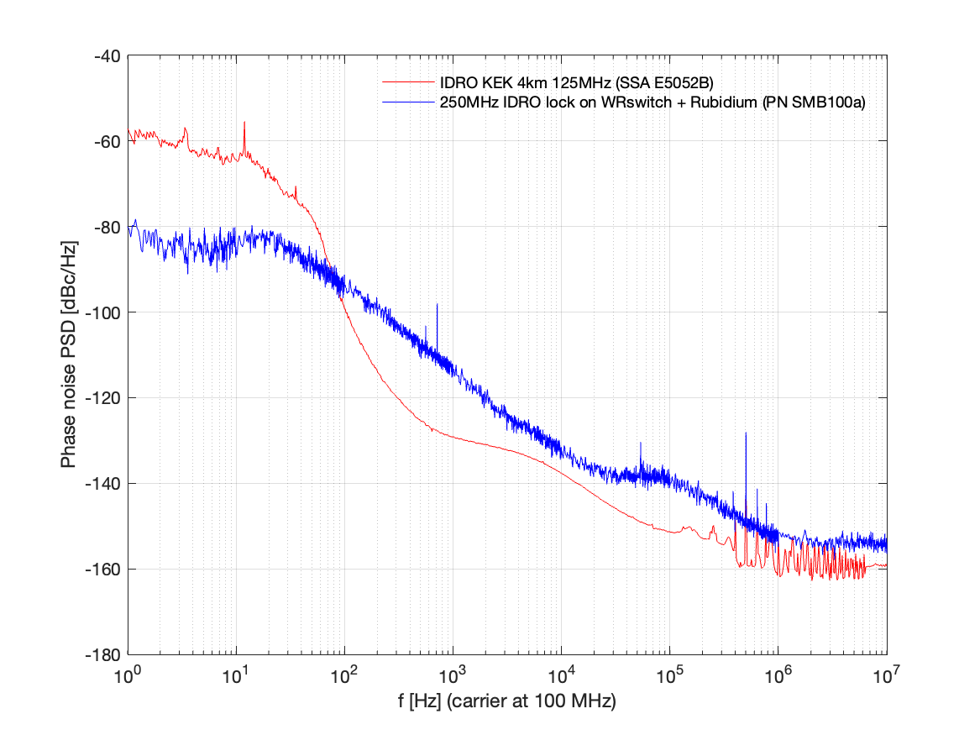
Results
Rubidium
8ps
Measured at KEK, 4km fibre, June 2024
NB: 2m fibre gives the same result !
530 fs
fibre link
1 ps
IJCLab, Sept. 2024
160 fs
Improvement in configuration of PLLs
Degradation may be due to the measurement chain at IJCLab, TBC

Slide 6
Next steps
Synchronisation of laser (and data acquisition) is part of essential elements for the implementation of Compton polarimeter
First tests made
Working principle confirmed
Performance is nearly met
Still some residual phase noise contributions to understand
Low frequency is more critical, planned laser technology is very stable at higher frequencies (>1kHz)
Further developments made in parallel at IJCLab and KEK:
IJClab:
Further improvements at low frequency may be possible → tests planned
Ability to generate arbitrary frequency by integrating SI536x component
KEK:
Test at ATF with laser
Import improvements obtained at IJCLab and validate new perf

