Slide 1
A quick review on the Touschek lifetime simulation
Aurélien MARTENS

Slide 2
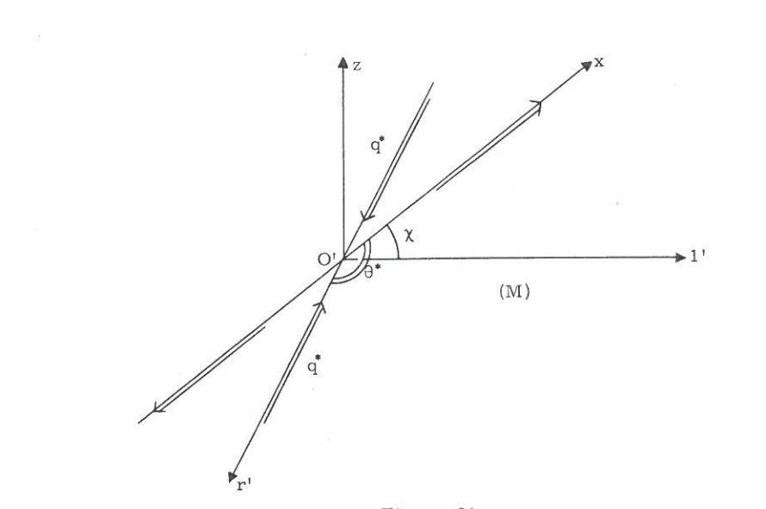
Introduction
Touschek is one of the main contributors to lifetime
There are some known MC/data discrepancies for HER/LER
Simulation is not ‘that’ simple (computer extensive if made from first principles)
Purpose of today’s presentation:
A quick review of what is currently implemented
Few suggestions for improvements
e$±$ beam
Some transverse momentum is transfered to longitudinal direction
→ To be compared with momentum acceptance
From Haissinski’s thesis

Slide 3
Current situation
Currently
Simulation is not ‘that’ simple (computer extensive if made from first principles); so approximation must be employed → Monte Carlo approach to compute a single integral
The beam is assumed to be flat (no vertical dimension)
The kinematics of the particles is assumed non-relativistic
Touschek/Haissinski/LeDuff/Bruck/…
Lower limit removed in MonteCarlo implementation
The lifetime reduces to an integral over the the center of mass difference momentum of initial particles weighted by a gaussian distribution and a kinematic factor proportionnal to the cross-section.
→ Assumes momentum acceptance is known
Currently implemented in SAD tracking simulations as a weighted Monte-Carlo (sampling over the cross-section and momentum difference of particles).
This computation must be ideally done at any s-coordinate in the ring. It is done for convenience at the location of quadrupoles

Slide 4
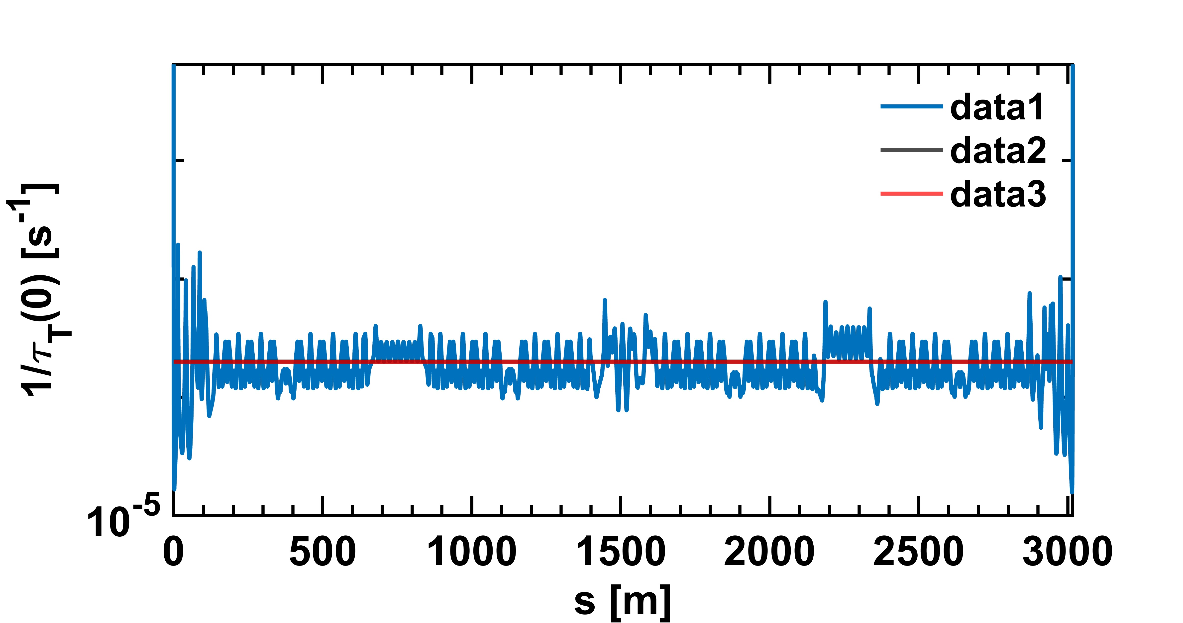
Losses may be locally underestimated
Estimation of Touschek losses (previous integral) assuming constant momentum aperture all over the ring with (quite) old SAD lattice file, just for illustration.
Lifetime contribution at each lattice element
Average lifetime
Average lifetime computed from contribution at quads only
In average, computation as quads only seems very appropriate but close to IP losses may be significanlty underestimated (1-2 orders of mag.)→ impact on Belle II background estimates ?

Slide 5
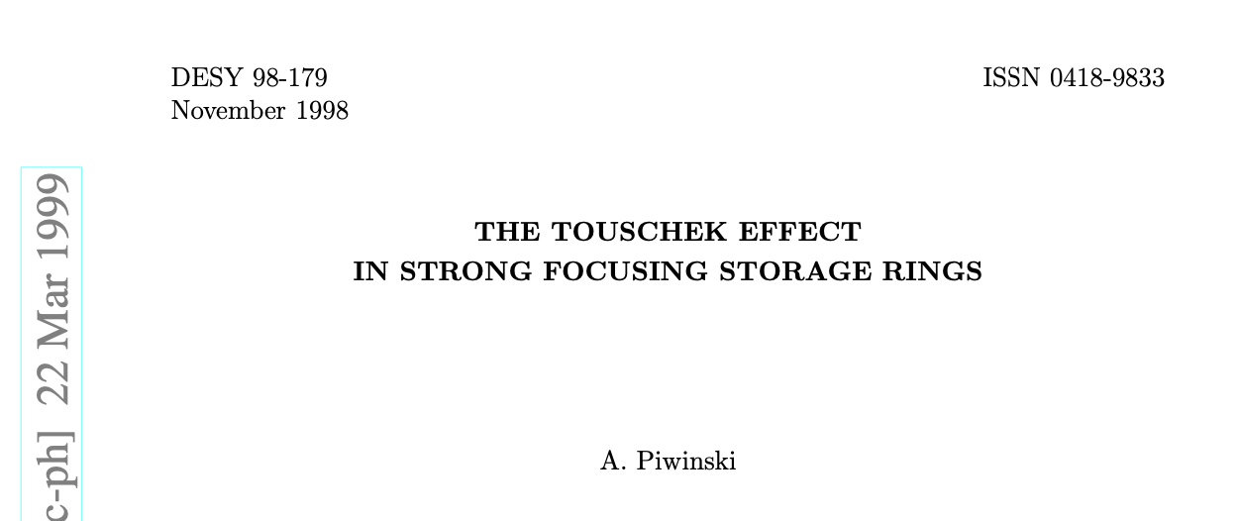
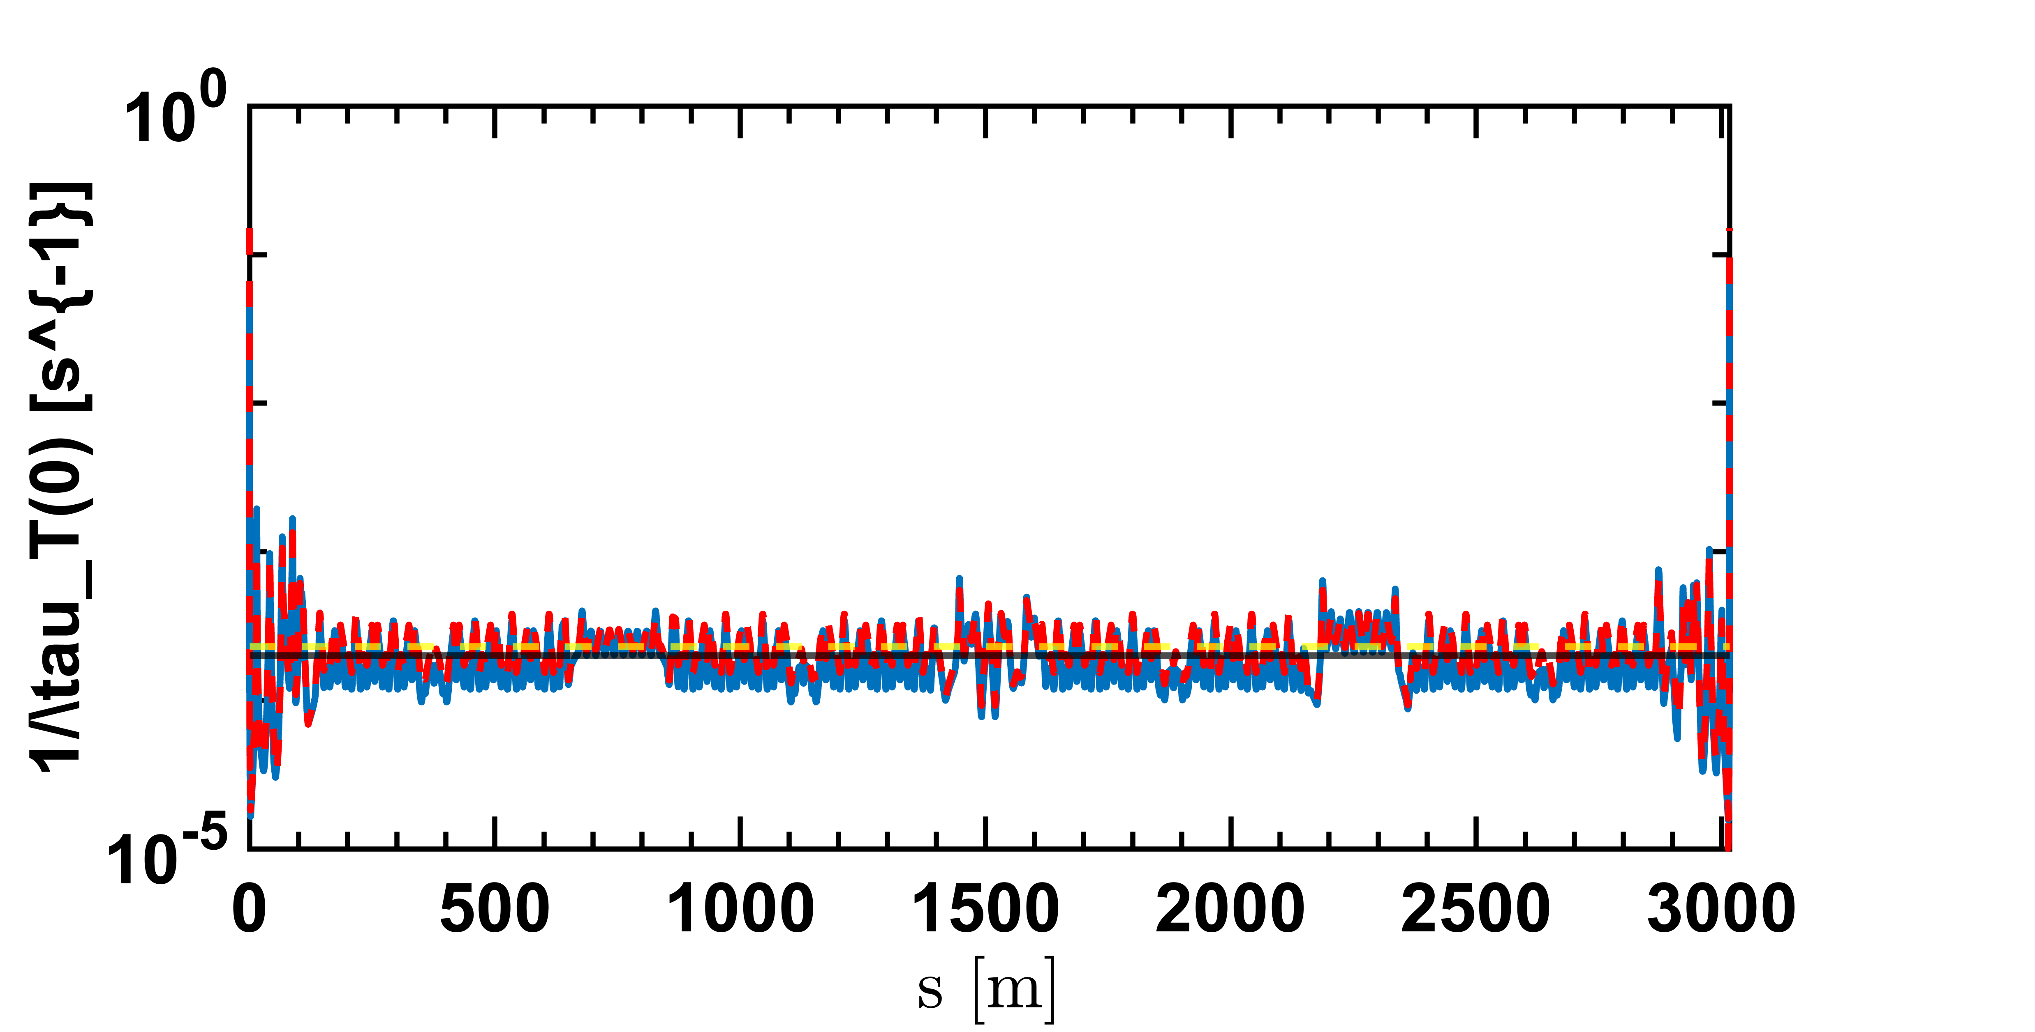
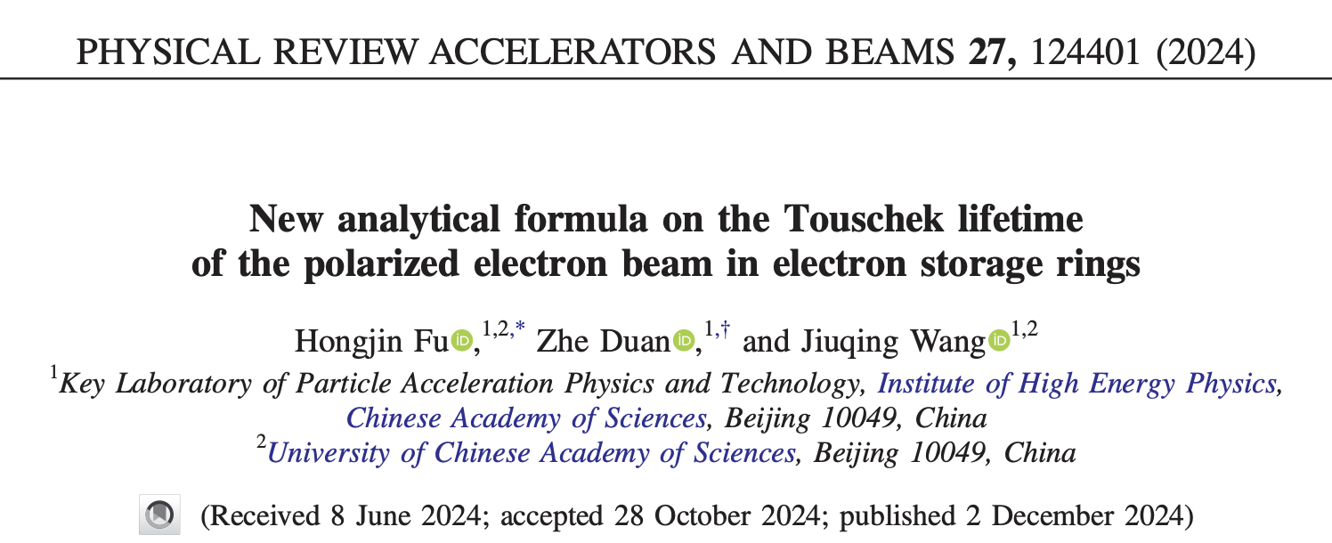
Kinematics is relativistic
The typical max momentum difference is ${3σ}_{x′,y′}p$ where $p$ is the beam momentum and $σ_{x′,y′}$ is related to the betatron function and emittance in horizontal and vertical planes
It can reach 5 MeV in horizontal plane maybe about 1MeV in the vertical plane.
Non relativistic approximation is likely incorrect
Vertical plane scattering may contribute too
Piwinski solved that problem already
Previous caculation and average
Piwinski formula and its average
Some recent work where similar effect is observed on another ring (BEPC2, HEPS):
15% reduction of lifetime in average

Slide 6
Proposal of new implementation
Implementation of the Piwinski formula seem feasible
Reduces also to an integral over a kinematic quantity
More complicated formula involving Bessel function (but can be numerically evaluated)
Sampling the phase space in (Psi,chi) might prove more efficient (than sampling momentum variables directly) ?
Similar approach to the one currently used (Monte Carlo) to sample the integral
To be carefully tested before implementation

Slide 7
Preliminary conclusion
More points for sampling the lattice around IP to better describe large losses around Belle II ?
Use the existing simulation simply increasing granularity close to IP
Relatively « easy » to test
More involved implementation of Touschek scattering using Piwinski formula
Some significant work
Possible increase in computing time
NB: Implementation timeline is vague (spare time work) at this stage, may be easier if this work could be considered as qualifying task for a student (may have one joining in October, TBC)

Slide 8
Compton scattering on thermal photons

Slide 9
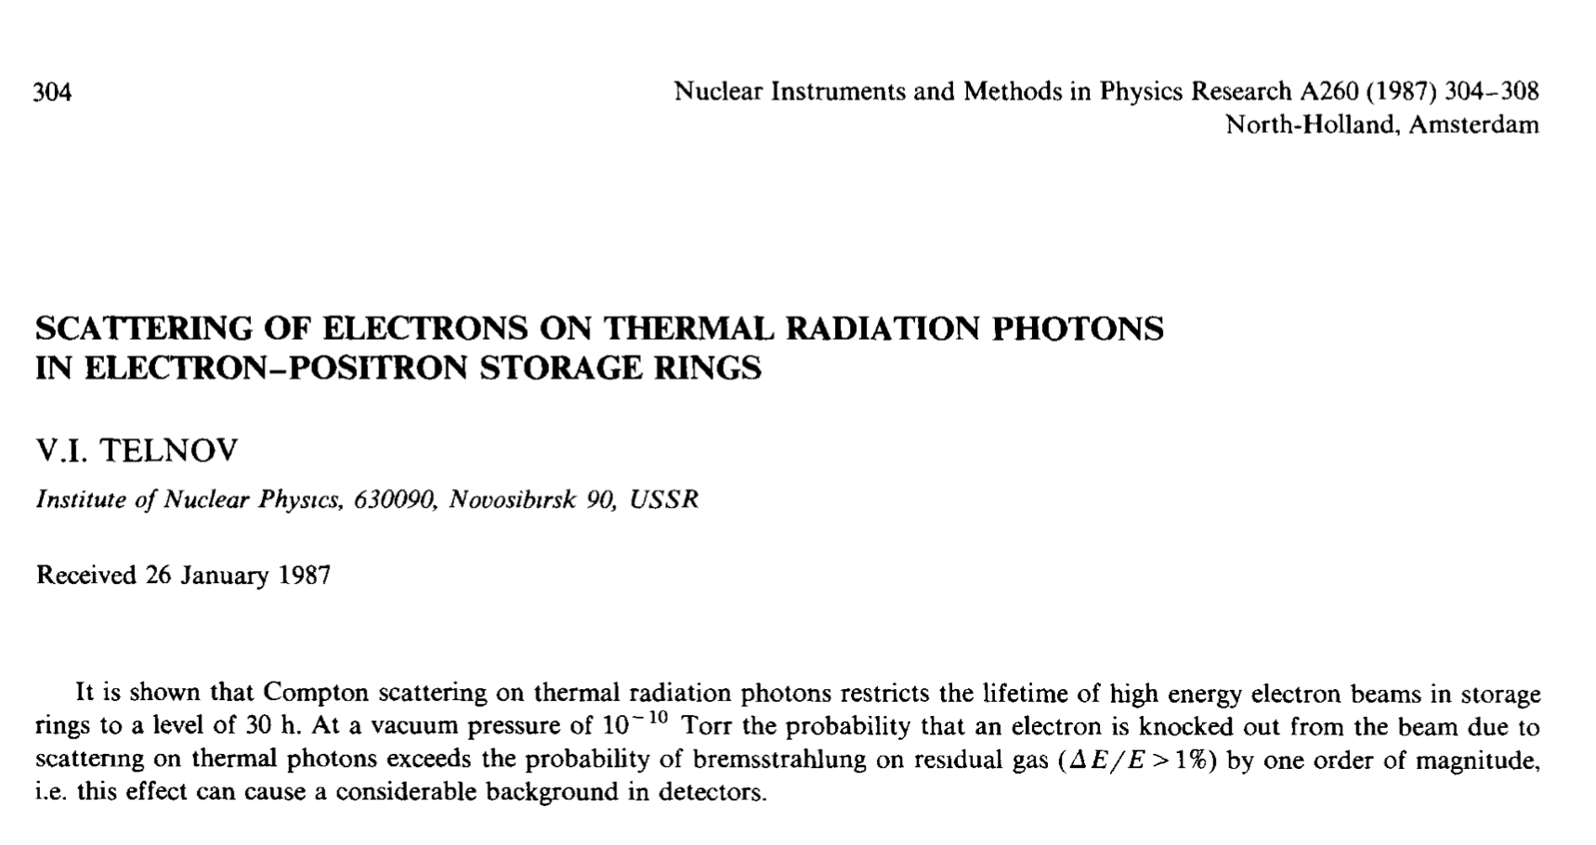
Introduction
Among the background sources, at least one, Compton scattering on thermal photons, has not been studied quantitatively, though
It is a known source of potential background, cf Compton polarimeter study
Already spotted a long time ago
Purpose of today’s presentation:
First, naïve, estimate of event rates (integrated over the ring)
Work plan for discussion

Slide 10
Thermal bath of photons
e$±$ beam

Slide 11
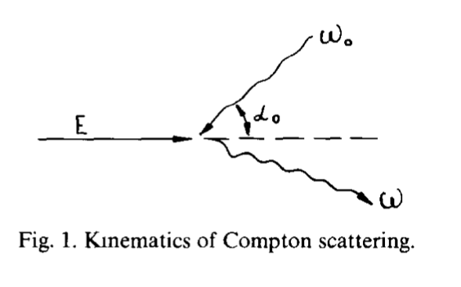
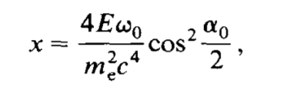
Compton scattering
Combining both aspects, randomly choosing the crossing angle, provides an estimate for the number of scattered photons and their spectrum

Slide 12
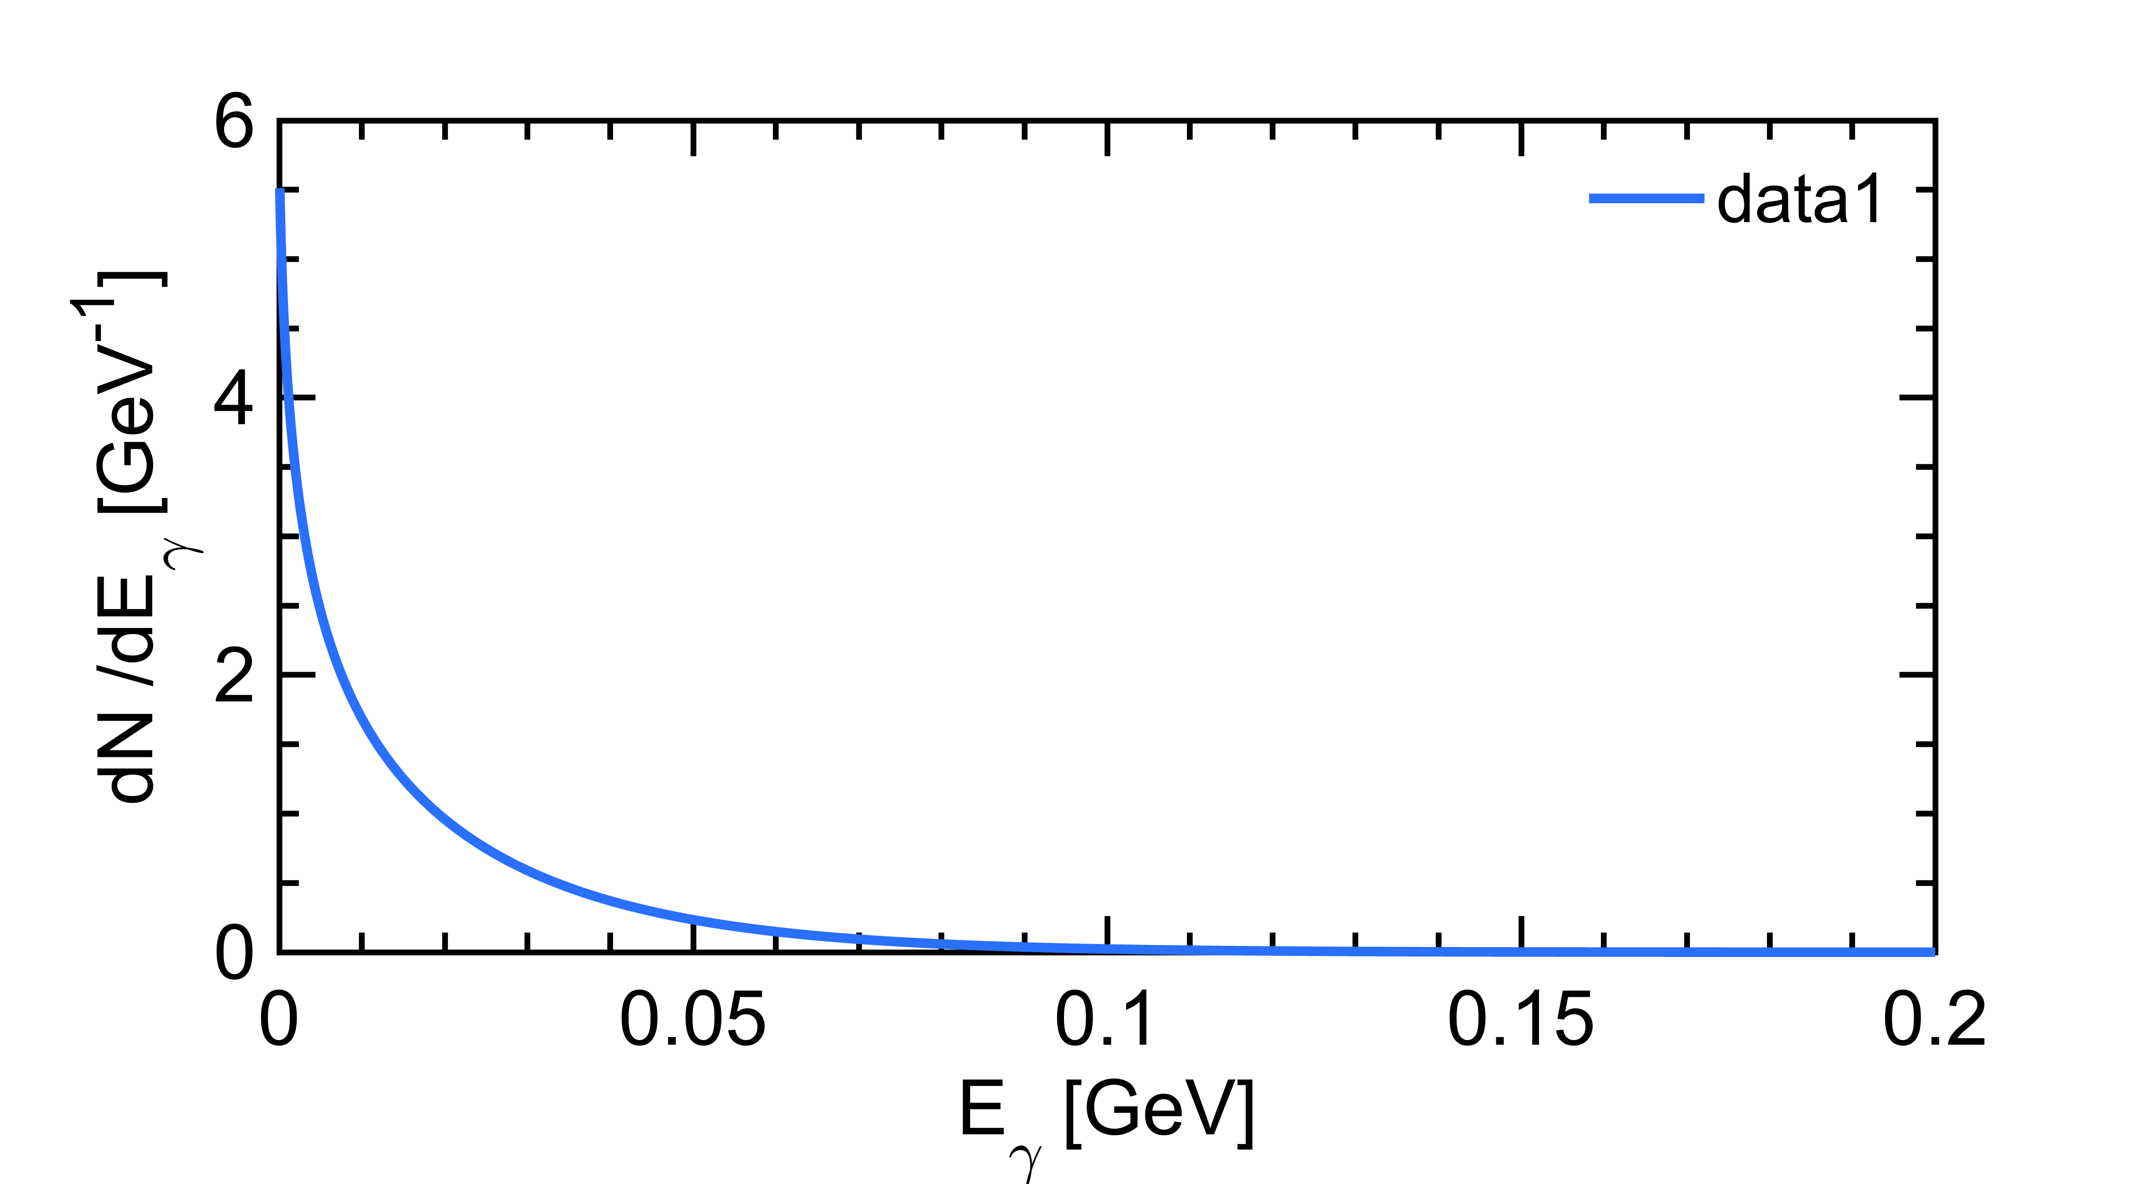
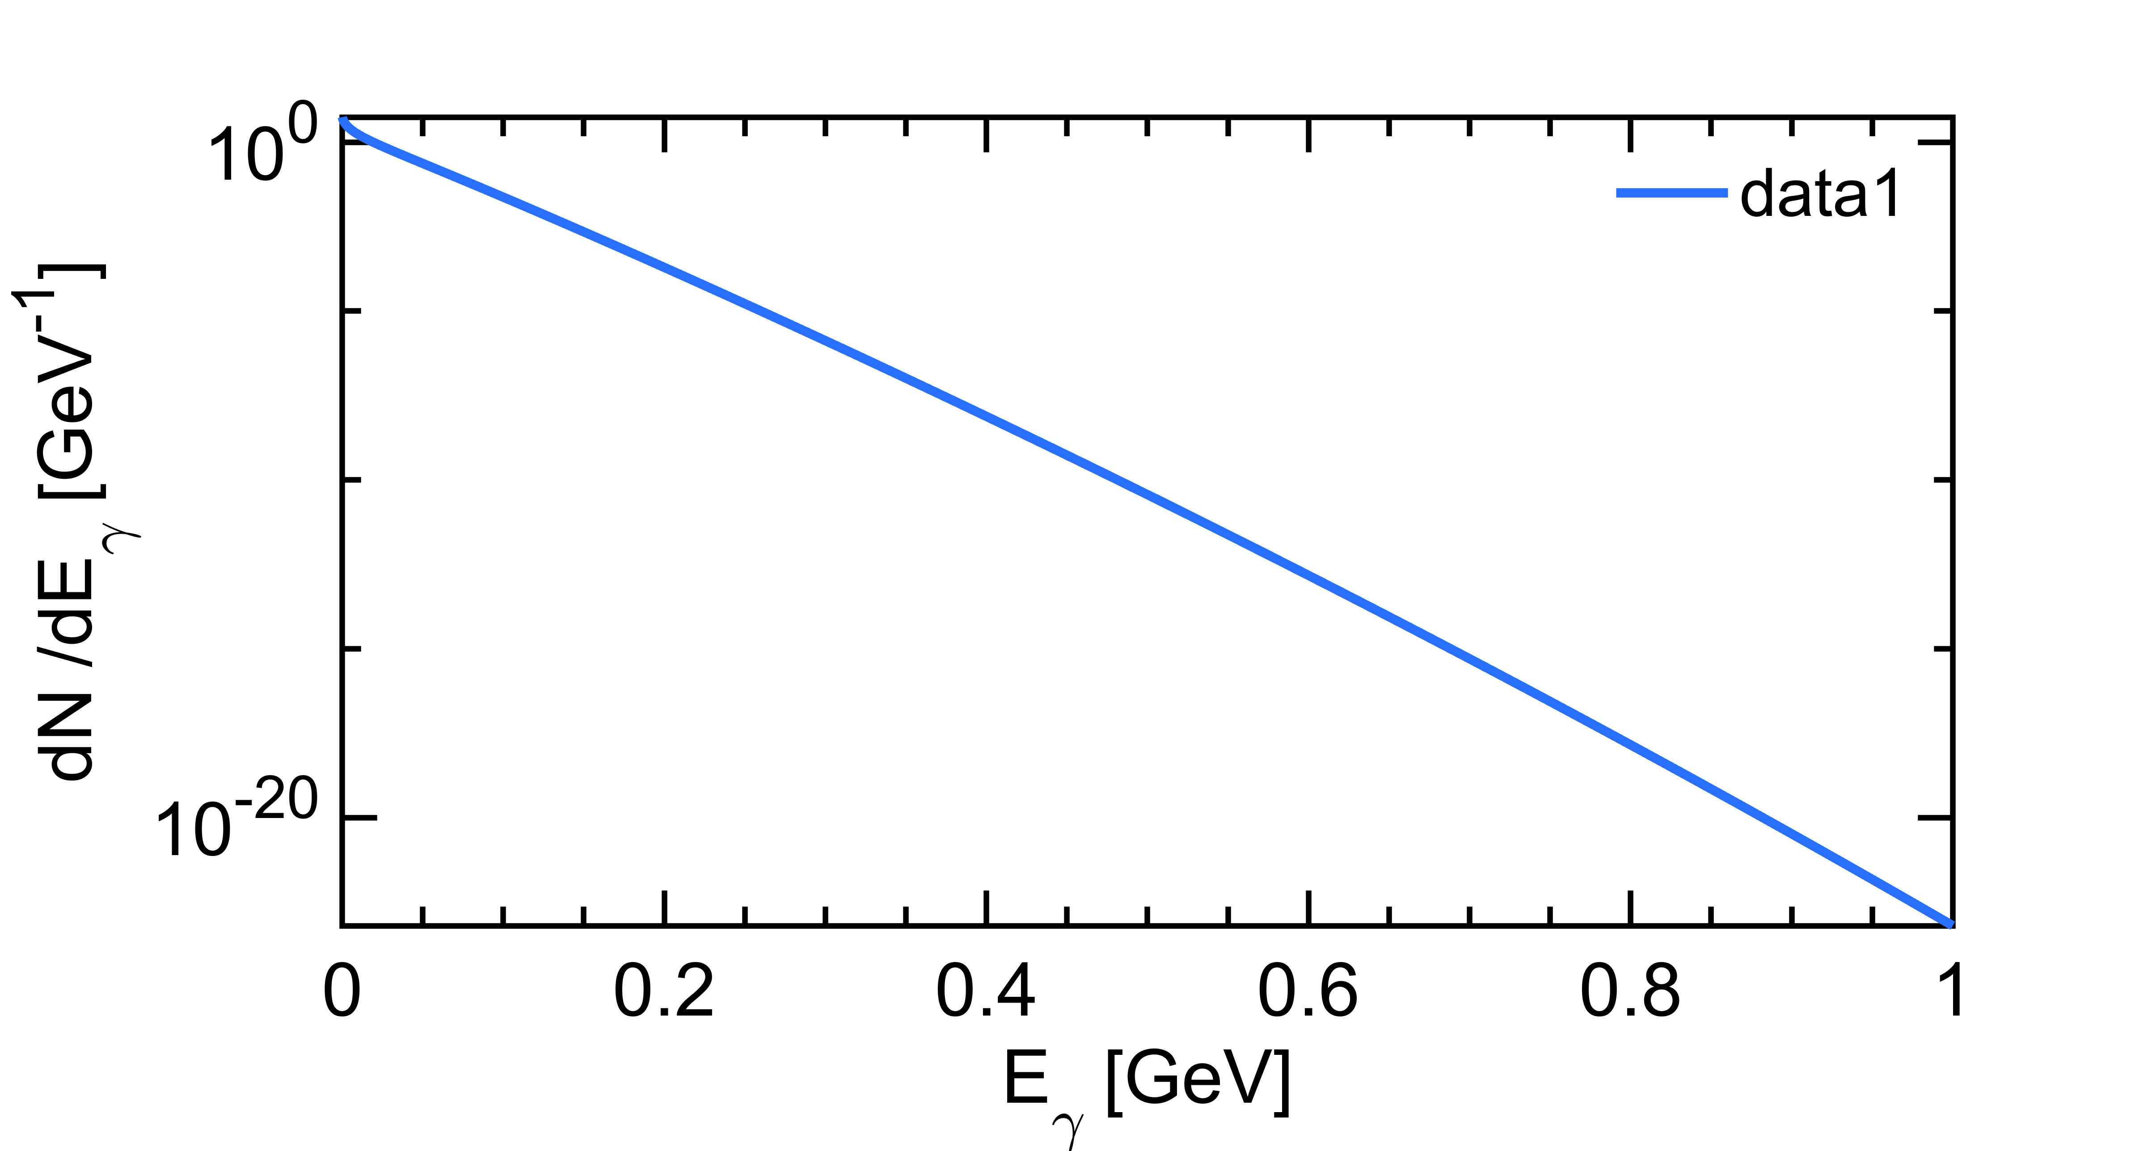
First crude estimate
Crude model:
assume pipe temperature is homogenous along the ring
Assume that scatter with photon energy > momentum acceptance ~10 energy spread of electron beam (6x10⁻⁴) are lost
T=330K, 20m pipe, 10nC
Increasing by 30K the temperature of the beam pipe → x1.6 in photons with energy above threshold !
→ Knowledge of pipe temperature ?
Estimated lifetime ~150h (after scaling to 3km)
An effect independent of pressure (so most important for HER) and proportional to Intensity (not squared)
→ Different scaling law wrt to other bkgs
Log scale

Slide 13
Model limitations
Temperature is not homogenous along the pipe, we know it can be realtively high in the IR
Momentum acceptance is a s-dependant quantity, the crude model may be an underestimation, but still the lifetime seems very long
Probably a small correction, maybe worth checking magnitude ?
Strategy, as suggested by Andrii:
Implement in SAD with some assumption on the temperature profile
Do we have some data on this aspect ?
If not, may use SR to estimate pipe temperature (more difficult, less reliable ?)

