Slide 1
Compton polarimetry for SuperKEKB: Synchronisation
Aurélien MARTENS
IJCLab

Slide 2
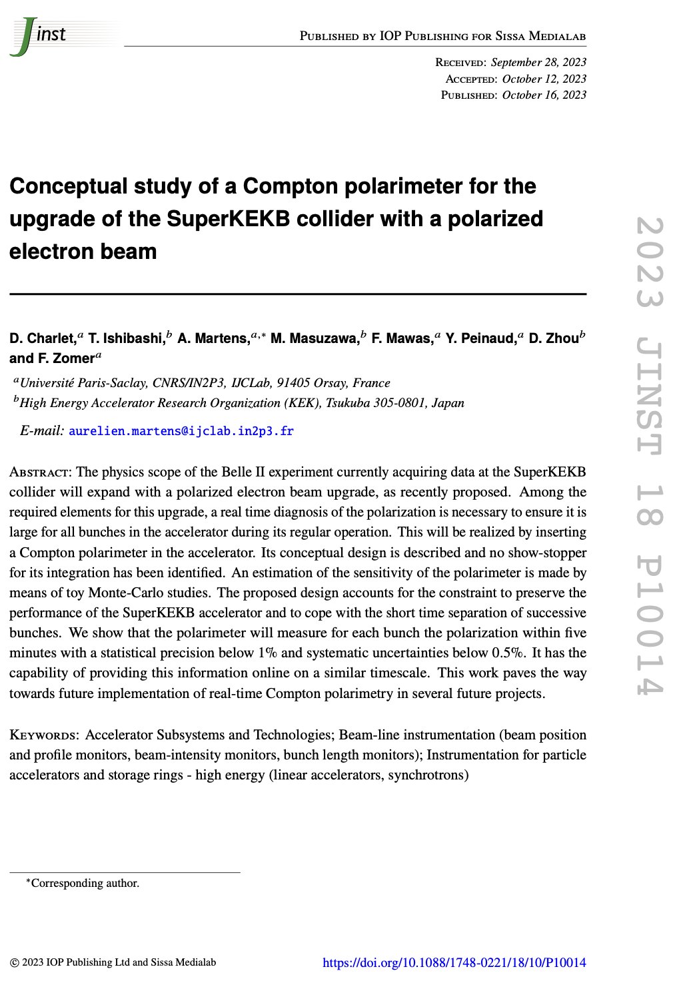
Introduction
Reminder:
We have draw a conceptual design with excellent expected performance
Design relies on:
Laser:
Integrated in accelerator: must be fully remote operated
Operated at frequency of 250MHz: must be well synchronized to accelerator RF
Typical acceptable (closed loop) time jitter of ~500fs (a small fraction of electron bunch/laser pulse durations
Detector:
photon calorimeter able to cope with photons incoming every 4ns.
The 2500 circulating bunches measured independently
Ability to provide fast on-line info to the control room
Embedded electronics, fast enough, with good ADC (10 bits min) and FPGA processing
With bunch identification

Slide 3
Conceptual acquisition chain
Optical filter
BaF2
PMT
2500 histograms
Fast treatment: fit
Every 4ns
FPGA
IDROGEN board
White Rabbit node
Reduced data
To online monitoring
Analog Front-end
+ ADC (>=10bits)
clock
To remote storage (10MB/min)
Update program, constants
1rst Bunch identifier
Accelerator RF
Funding request in preparation for submission to ‘Agence Nationale de la Recherche’ for building and testing this detector with the electronics
Proposal accepted for second stage of submission process → to be submitted on the 27th of March, result in June.

Slide 4
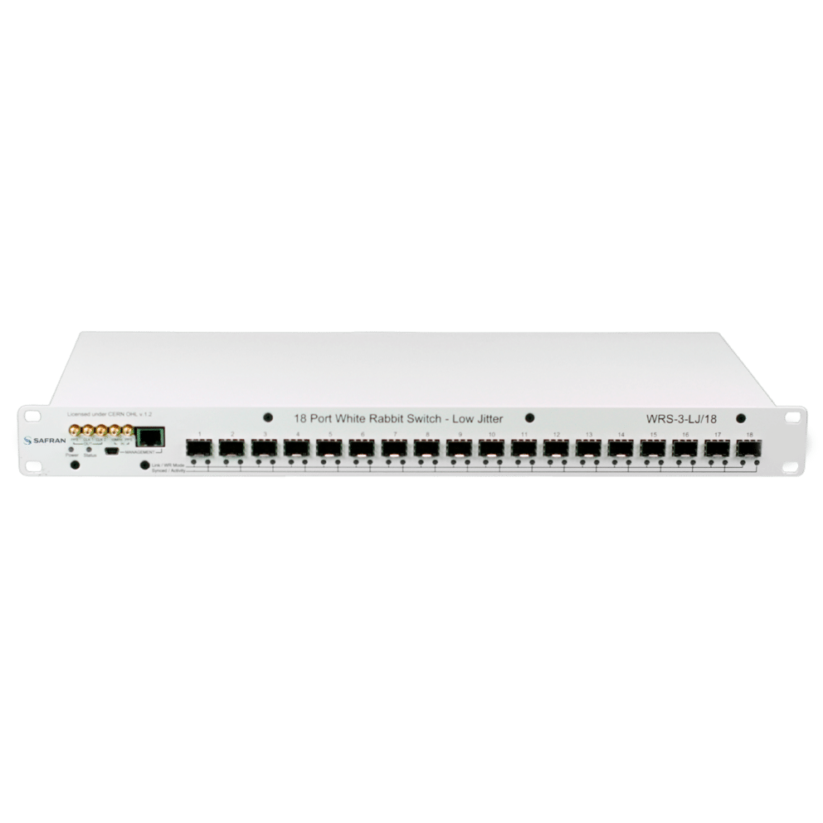
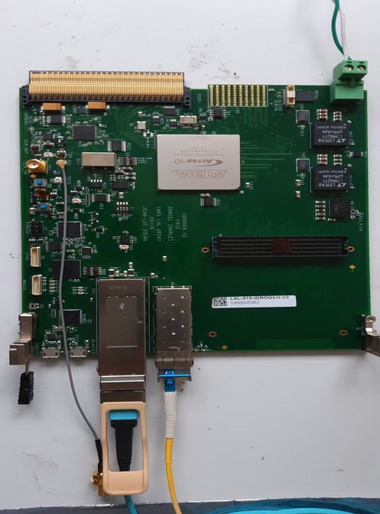
Laser synchronisation – concept
H. Kaji, D. Charlet
Master Oscillator (510MHz/51)
IDROGEN, high speed DAQ
Low noise WR node
FPGA mezzanine card
WhiteRabbit
WhiteRabbit allows to minimize implementation cost
A simple fibre to bring to the laser
No expensive/complicated fibre length compensation system to implement
D. Charlet et al., https://cds.cern.ch/record/2893372?ln=en
4km fibre link
Developments made in parallel at IJCLab and KEK:
IJClab:
Standalone tests with phase noise measurements
Test new developments on the IDROGEN board quickly
KEK:
Test within KEK environment for instance at ATF
Possibility to test with 4km fibre loop easily (shown in Oct’24)
Possibility to test accelerator/laser synchronisation → rescheduled for June at ATF

Slide 5
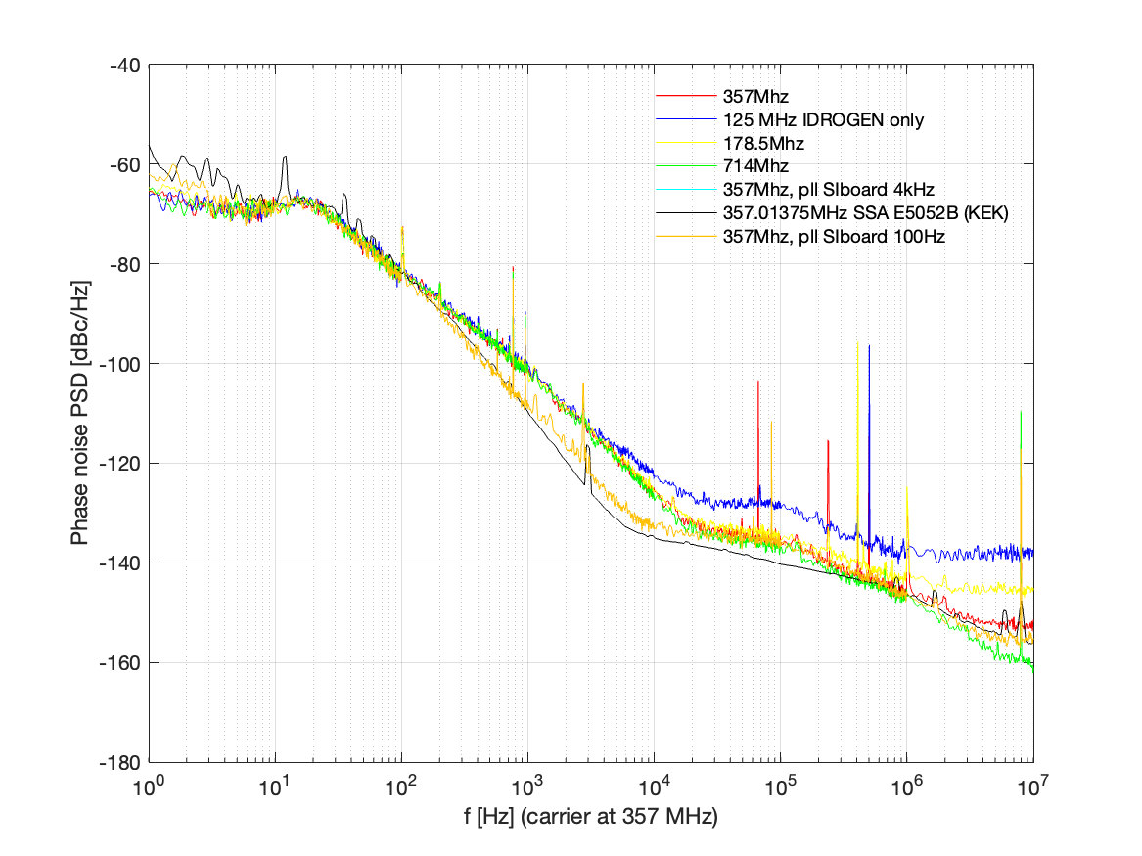
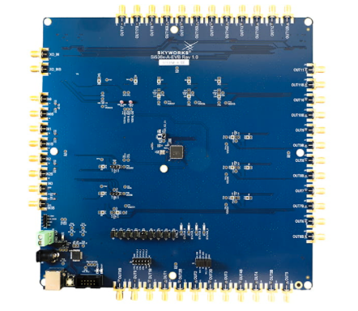
Arbitrary frequency generation
D. Charlet (IJCLab) et al., H. Kaji (KEK SKB),
K. Popov, A. Aryshev (KEK ATF)
Rubidium
RF
Same configuration but two totally different qualification schemes
fibre link
Identical phase noise for various different output frequencies
1.7ps RMS jitter [1Hz, 10MHz]
Arbitrary frequency
Precision of 1 Hz, accuracy excellent (no drift over several hours)
Consistency of KEK and IJCLab measurements.

Slide 6
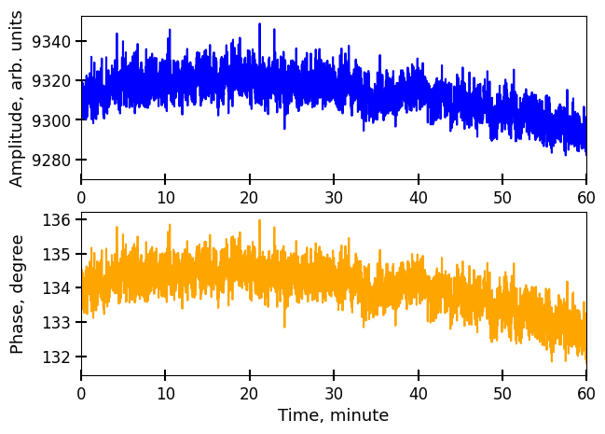
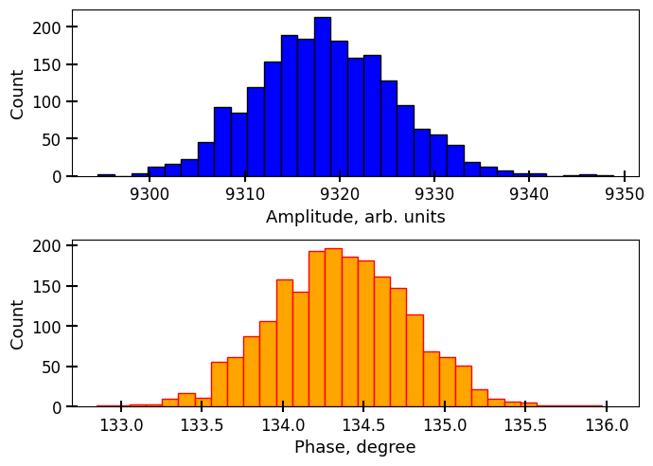
Long term drift
D. Charlet (IJCLab) et al., K. Popov, A. Aryshev (KEK ATF)
Generated freq.
X
Low Pass
$$KA\sin{φ}$$
split 50:50
$$A\cos{(ωt+φ)}$$
$$\cos{(ωt)}$$
Reference freq.
split 50:50
$$φ$$
X
Low Pass
$$KA\cos{φ}$$
~0.3degree RMS phase jitter (at 357MHz) i.e. 2.3ps RMS (below 1Hz)
NB: measurements made in a regular office, no thermal stabilization

Slide 7
Next steps
Synchronisation of laser (and data acquisition) is part of essential elements for the implementation of Compton polarimeter
Very encouraging results 2.4 ps RMS (<1Hz); 1.7ps RMS (>1Hz)
Work ongoing to understand
drift component of phase noise (temperature ?)
Noise in intermediate region [1Hz, 100Hz] → White Rabbit protocol related ?
Laser +accel synchro test not yet done (not possible in October) → June ‘25 at KEK ATF
Integrate SI5362 chip on the IDROGEN board (avoid some spurs)
Replace commercial switches by home made, well configured IDROGEN board (first results being analyzed)
ADC mezzanine card at 1GHz prepared first tests being performed at IJCLab and KEK
Possibility to measure absolute frequency with colleagues from metrology lab (SYRTE, Paris)
NB:
These results are only concerning the added jitter induced by the RF transport.
Electron beam jittering itself against absolute RF reference may be of similar scale already

