Slide 1
The Belle II VTX Readout presented at the
Belle II Trigger/DAQ Workshop 2025
=former “HEPHY Vienna”

Slide 2
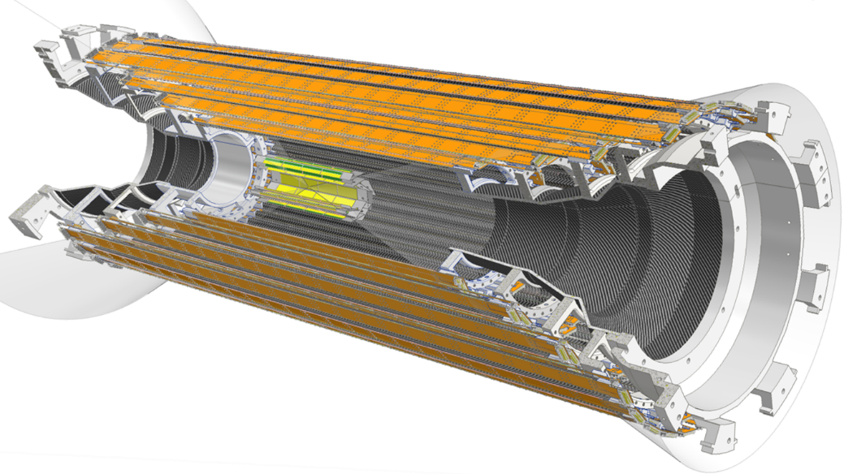
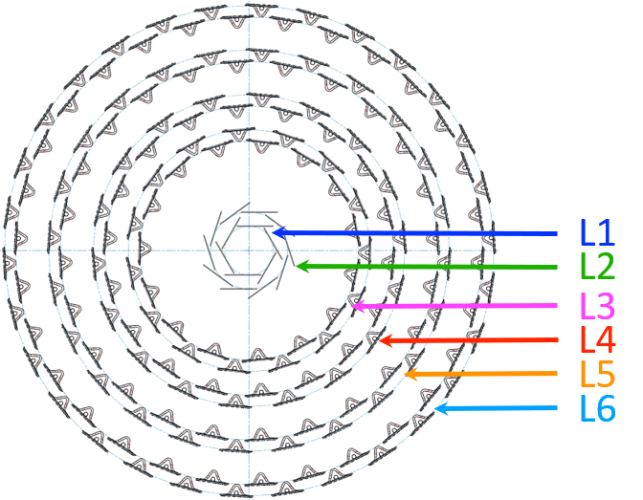
The VTX upgrade proposal
Planned for LS2 ~2032
Baseline: 6 straight layers using the same DMAPS sensor
Optimized BELle II pIXel sensor (OBELIX)
iVTX: L1, L2 → 0.3% X0
  All silicon ladders, self-supported
  Exploring different cooling options: air and passive cooling utilizing heat-drain material as well as liquid cooling with thin pipes
oVTX: L3, L4, L5, L6 → 0.8% X0
  Carbon fiber support frame
  Cold plate with liquid cooling

Slide 3
VTX Organisation
Institutional Board
Project Coordination
J. Baudot
Publications and Speakers
J. Serrano + WG Leaders
WG1:
Performance
V. Vobbilisetti
WG2:
Sensor design
H. Pham
WG3: Characterization and system tests
G. Rizzo
WG4:
Layer development
S. Bettarini
WG5:
System integration
C. Irmler
WG6:
Demonstrator
C. Marinas
Software
Tracking
Benchmarking
Analog
Digital
Verification
Irradiations
Test beam
Lab Testing
iVTX Electrical
oVTX Electrical
iVTX Thermomech
oVTX Thermomech
Readout
Track trigger
Powering, GND
Cooling services
Monitoring
Run / slow control
MBI (Vienna)
IHEP (Beijing)
University of Jilin
CPPM (Marseille)
IJCLab (Orsay)
IPHC (Strasbourg)
University of Bergamo
INFN Pavia
INFN & University of Pisa
University of Bonn
University of Dortmund
University of Goettingen
KEK (Tsukuba)
University of Tokyo
IPMU (Kashiwa)
IFCA (CSIC-UC, Santander)
IGFAE (Santiago de Compostella)
IFIC (CSIC-UV) (Valencia)
ITAINNOVA (Zaragoza)
Queen Mary University (London)
RAL (UK)

Slide 4
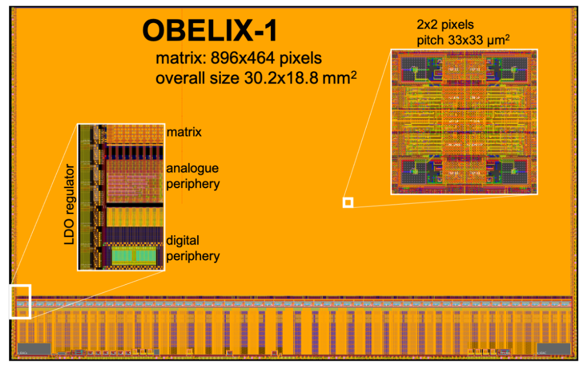
The OBELIX Chip
Matrix inherited from TJ-Monopix2
developed for ATLAS
  Tower 180 nm modified imaging technology
Dimensions adjusted to VTX geometry
  464 rows and 896 columns,
  29.60×15.33 mm² active area
Low dropout regulators (LDOs)
  to allow input supply voltage range of 2 to 3V
Completely revised digital periphery
  Trigger unit with up to 10µs latency
  Precision timing measurement
  Low latency output for trigger contribution
Submission planned by December 2025
Clock frequencies:
  Derived from SuperKEKB RF: 508.9 MHz
  Main clock frequency 169.6 MHz
  2 LVDS data links operated at 339.2 MHz (169.6 MHz DDR) for hit and trigger data

Slide 5
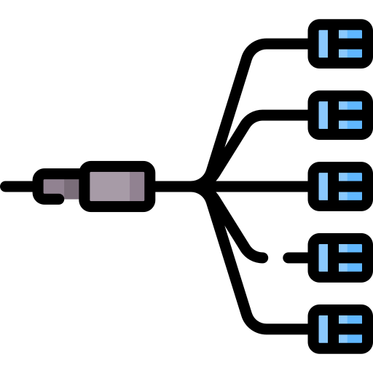
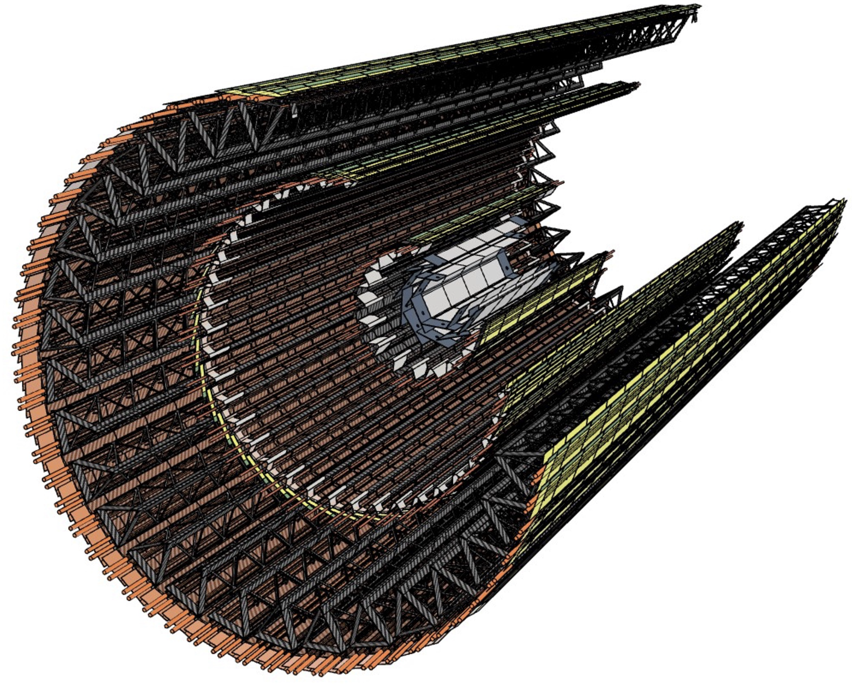
VTX Readout Concept
Dock Box
Belle II DAQ
optical
transceiver
Belle II trigger &
clock
(TTD)
DC/DC converters
optical transceiver
Back-end electronics
L1
trigger
Dock Box
optical
transceiver
Run control
DC/DC converters
power
Slow control &
config
e-link: data, cfg, clock, trigger
Power supplies
Optical transceivers placed
as close to the modules as possible
radiation hard components
commercial components

Slide 6
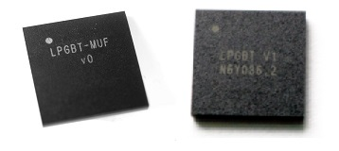
Transceiver and optical transmitter
Need fast and radiation hard transceiver and optical driver
CERN developed a common solution for LHC upgrades
  lpGBT (low power Gigabit Transceiver)
    Collects/distributes data/clock from/to several electrical links and aggregates them on a single pair of serial high-speed data stream
    https://cern.ch/lpgbt
  VTRx+
    Bi-directional optical link module
    1 Rx channel, 2.56 Gb/s
    Up to 4 Tx channels, 10.24 Gb/s
    VTRx+ Application Note
Promising device, but we need to operate it out of specs
  Specified system frequency range: 39 MHz – 41 MHz
  For VTX we need RF/12 = 42.4 MHz

Slide 7
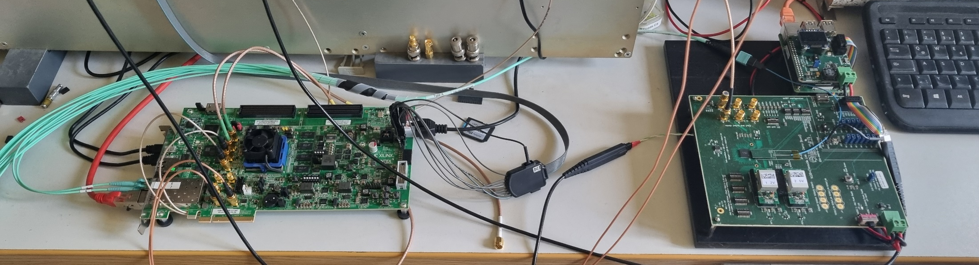
Tests at MBI Vienna
Verification if chip can be operated with a clock frequency of 42.4 MHz
So far ~60 chips from 8 different wafers tested in Vienna with lpGBT test kit
Performed full loopback test with simulated OBELIX data frames
“Back-end”
Optical Fiber
“Front-end”

Slide 8
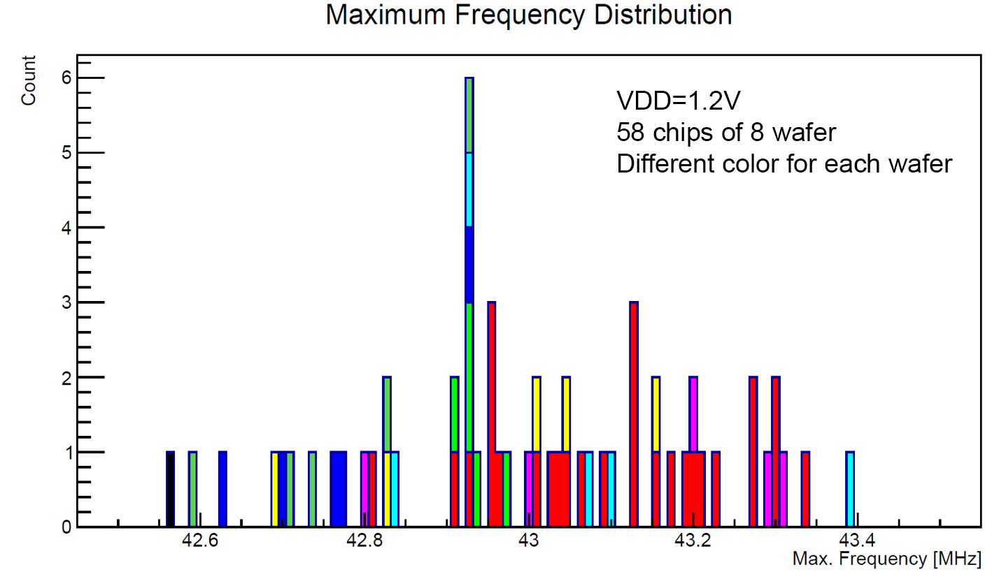
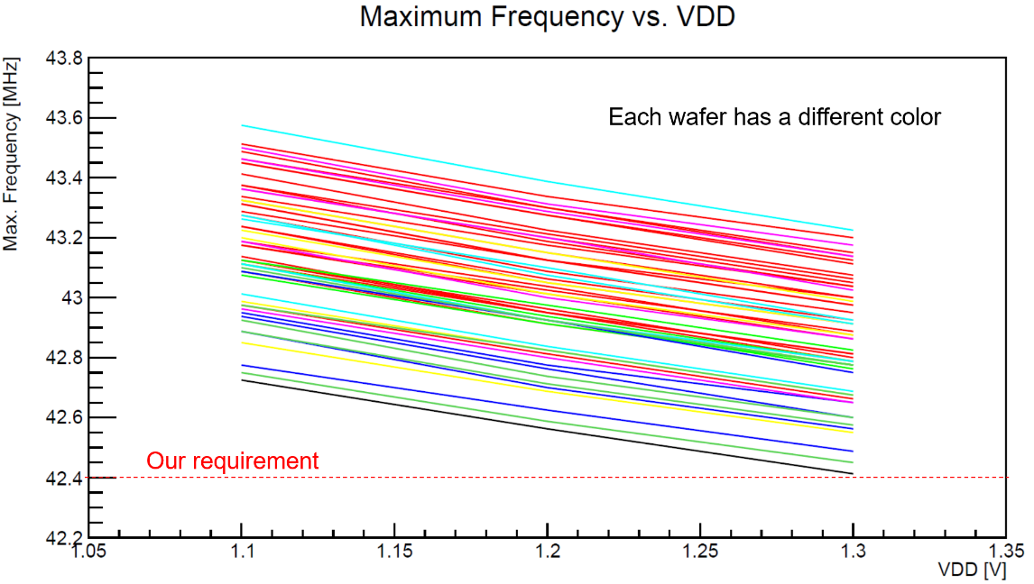
lpGBT Test results
Tested 61 lpGBT chips from 8 different wafers.
lpGBT operation frequency: 338MHz−350MHz
Corresponds to a lpGBT base frequency range of 42.25MHz − 43.75MHz.
VDD: 1.1 V, 1.2 V and 1.3 V
Test results:
  All chips achieved a maximum frequency of >42.55 MHz at nominal VDD, which is above the required value.
  Three chips did not work properly at 1.1 V and/or 1.3 V, resulting in bit errors.
  Maximum frequency improves with decreasing VDD
So far only non-irradiated samples tested

Slide 9
Temperature Tests at CPPM (Marseille)
Patrick Breugnon
(CPPM)
20 August 2025

Slide 10
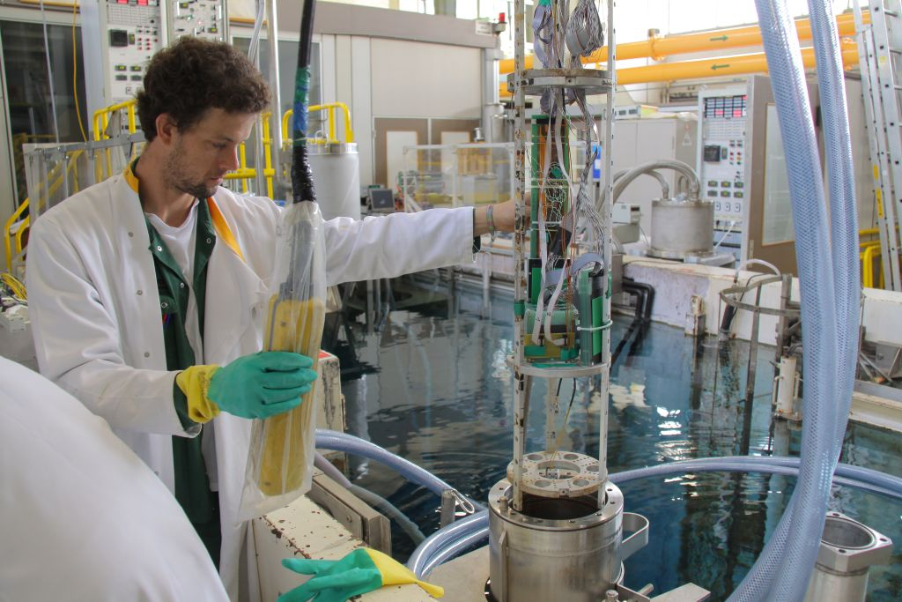
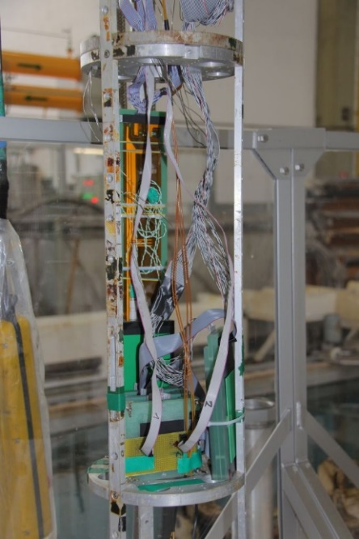
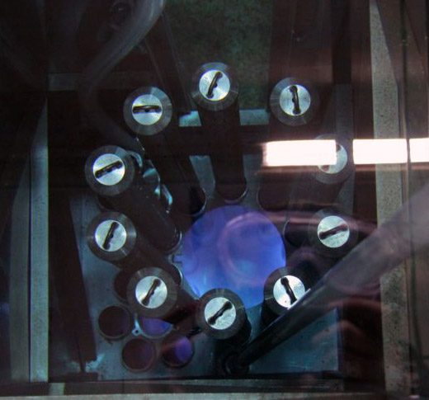
Irradiation @ SCK-CEN (Mol, Belgium)
Irradiation under bias; we aim for (up to) 100 Mrad
Underwater Cobalt-60 source:
  BRIGITTE with ~600 krad/h (1 week to 100 Mrad) – still under commissioning, more info soon
  Irradiation planned for early 2026
2010

Slide 11
Back-End Electronics - lpGBT data uplink
lpGBT data frame contains 4 types of data:
  Hit data: particle hits = physics data
  Trigger data from TTT: input for L1 trigger, need low latency readout
  OBELIX register values: read on demand and sent via hit data path
  Monitoring data from lpGBT ADCs, e.g. temperature probes, voltages, etc.
Back-end data handling
  Unpack, decode and split lpGBT data into individual data streams
  Discard OBELIX IDLE patterns
  Forward data streams to
    DAQ: hit data
    Trigger system: TTT data with low latency
    Slow control SW: monitoring data

Slide 12
Back-End Electronics - lpGBT data downlink
Data from several sources to be sent to lpGBT via optical downlink
  From Belle II TTD
    Clock
    Trigger
  From VTX run and slow control
    OBELIX slow control commands:
      Configuration
      Reset and local run commands
      Register read-back
    lpGBT and VTRx+ configuration
  Belle trigger need to be converted into OBELIX trigger commands (RD53 style)

Slide 13
Back-End Electronics HW
Will be placed in e-hut → does not need to be radiation hard
FPGA based system with sufficient amount of optical links
  Current 6 layer VTX design requires up to 334 bi-directional optical links
  Uplink: 10.2 Gb/s, downlink: 2.5 gb/s
In the process of identifying appropriate boards and systems
  Future-proof choice of FPGA: mid- and long-term availability, adequate performance, sufficient contingency, reasonable price
  PCIe40: currently used in Belle Il, uses Intel Aria 10, released 2013, need to verify if it fulfils our requirement regarding performance, moreover the FPGA might be outdated when VTX is installed
  PCIe400 under development: Intel Agilex 7, first boards expected 2026/2027, to be checked if we can use them for VTX
  CEPC TDAQ board currently under development by IHEP China: based on ATCA, but ATCA might fade out soon…

Slide 14
TDAQ Board for CEPC: Details
(proposed by Jingzhou Zhao, IHEP China)
Common Trigger board function list
  ATCA standard
  Virtex Ultrascale Plus FPGA (VU9P,VU13P pin compatible)
  44 channels for optical, 11 QSFP+
    Optical channel: 10-25 Gbps/ch
    40 channels for links to FEE and Trigger
    4 channels for DAQ readout
    Optical Ethernet or RDMA : 40-100GbE
    RDMA IP core is under developing
  DDR4 for mass data buffering:16GB
  Front 1 GbE and Z2 GbE fabric port for parameter configuration and control
  SoC module for board management
  IPMC module for Power management
Progress
  Preliminary finished schematics, PCB layout is next step
  First version is expected mid-2026

Slide 15
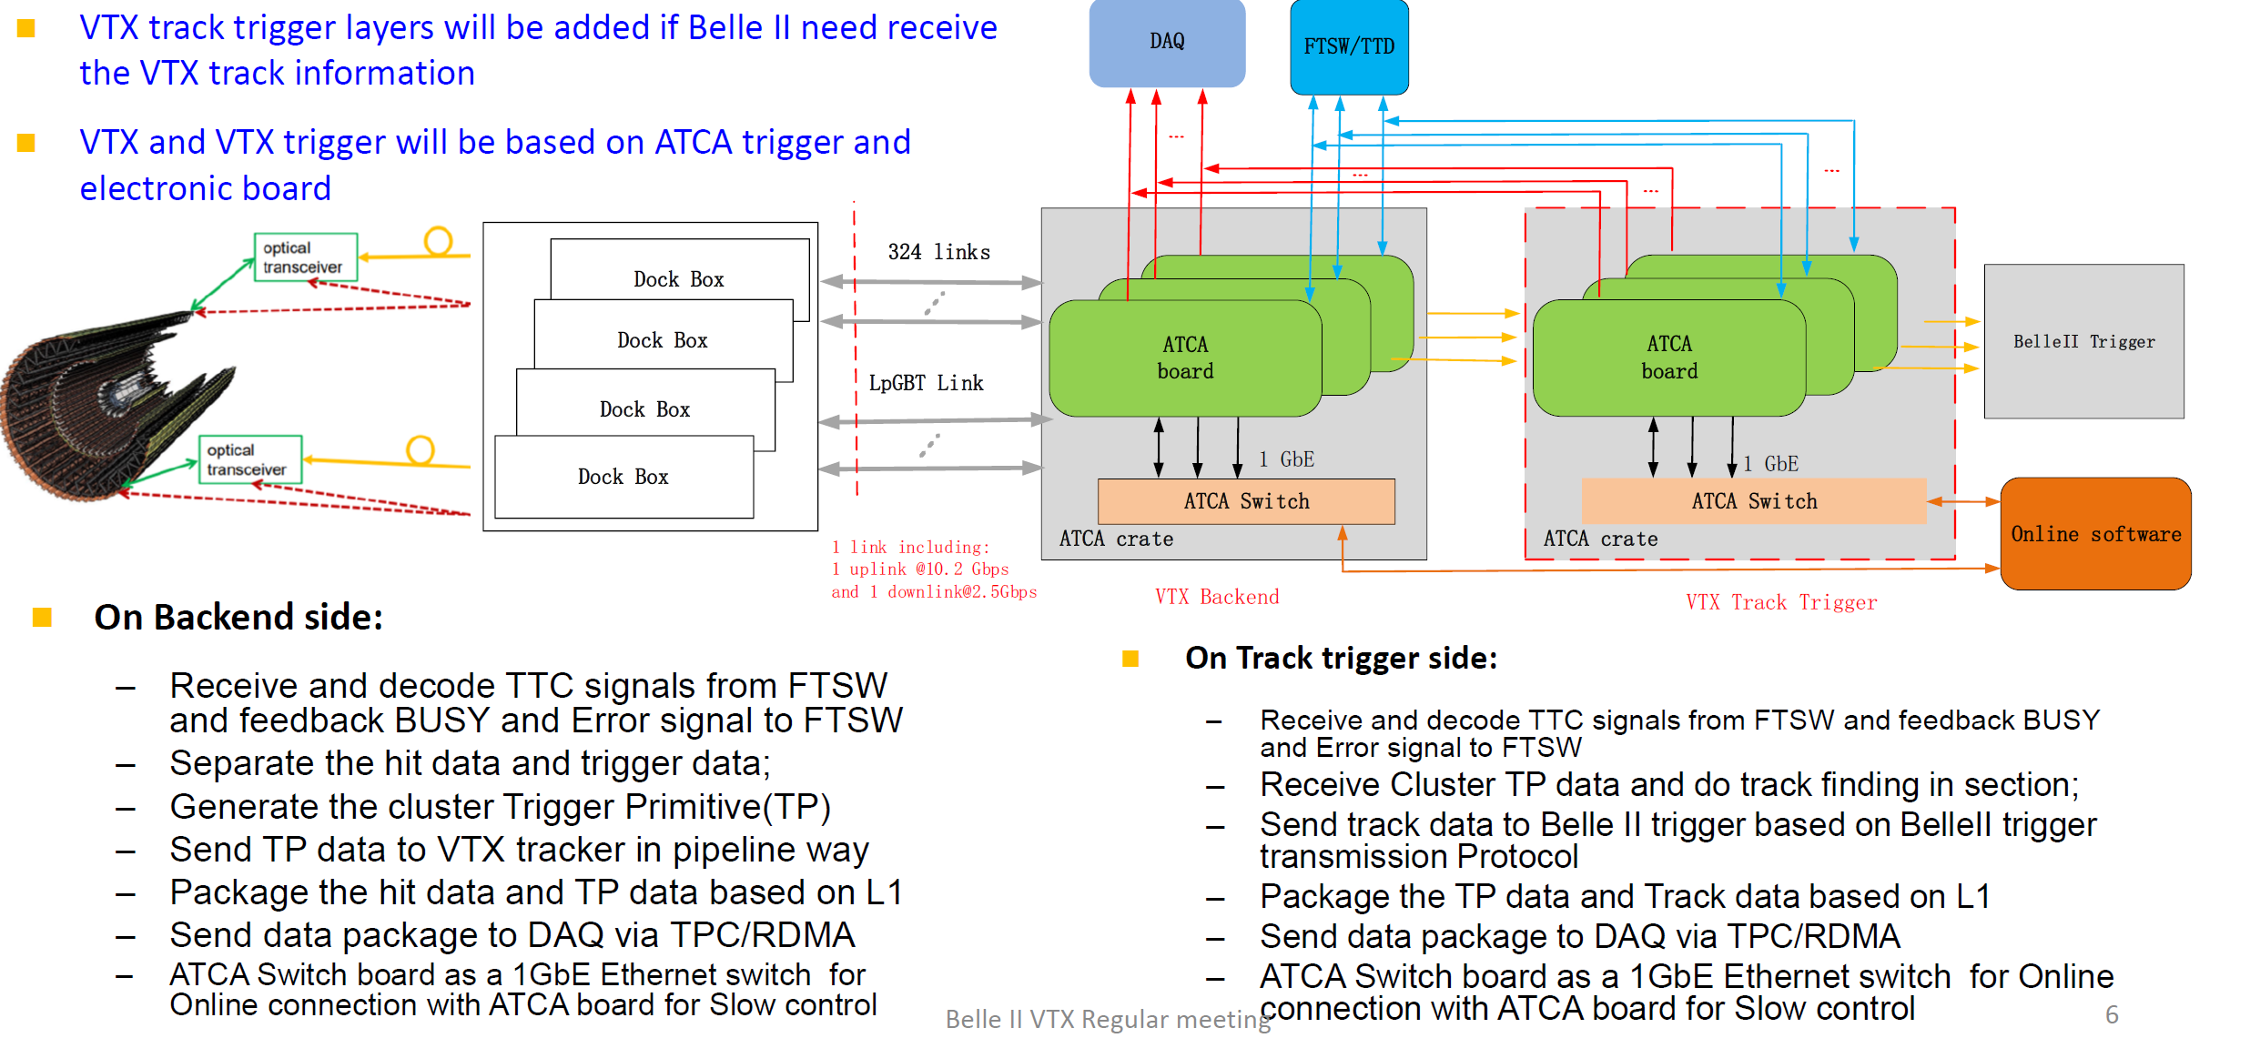
IHEP Proposal for VTX Backend (1)
(proposed by Jingzhou Zhao,
IHEP China)

Slide 16
IHEP Proposal for VTX Backend (2)
Scale estimation:
  Back-end: One ATCA board deals with 36 lpGBT links → 9 boards needed
  VTX Track Finding: one ATCA board deals with 60 degrees or 120 degrees → 6 or 12 boards needed
More information needed for further discussion
  What does Belle-II trigger need from VTX?
  What is the maximum latency allowed for VTX backend?
  Data transmission protocol with Belle-II trigger?
Need to verify and ensure long-term availability of ATCA platform

Slide 17
Roadmap Towards L2 (2032)
Milestones
  Technology decision 2026
  TDR mid-2027
  Prototype system for demonstrator and module testing ~2029
  Production of final system 2030+

Slide 18

Outlook
Will continue evaluation of lpGBT
Continue the search for possible HW solutions for the back-end electronics.
  The proposal from IHEP is promising, but we are open for suggestions, especially from Belle II (T)DAQ groups, and new collaborators.
Have to intensify discussion on
  Powering (power supplies, DC/DC converters, etc.)
    Currently preparing requirements
  Monitoring (temperatures, humidity, etc.)
  Run and slow control software: so far not started, which framework, etc.
Have monthly WG5 meetings
  Next meeting Nov. 30th partially combined with WG4
New collaborators are always welcome

Slide 19
Summary
The Belle II Upgrade proposal includes the replacement of the innermost detector by a fully pixelated vertex detector (VTX) made of DMAPS
Evaluation lpGBT and VTRx+ for optical link ongoing
  So far very promising results
  Will conduct an irradiation campaign in early 2026
Currently identifying appropriate platform for back-end electronics

Slide 20
Backup

Slide 21
Overview lpGBT
Low power Giga Bit Transeiver chip
Uplink:
  5.12 Gbps: 128b@40MHz
  10.24 Gbps: 256b@40MHz
Downlink: 2.56 Gbps: 64b@40MHz
Up to 28 e-links
Further features
  4 programmable clocks with
  50 ps resolution
  3 x I2C masters
  16-bit GPIO, 10-bit ADC, 8-bit DACs
  Programmable current sources for PT100/1000
Design specifications
  65 nm CMOS technology
  ~200 Mrad TID / SEU robust
  0.75W @ 10.24Gbps / 0.5W @ 5.12Gbps
Link qualitymonitoring
  Eye Opening Monitor
  Bit Error Monitoring
Small Footprint:
  9 mm x 9 mm with 0.5 mm pitch

Slide 22
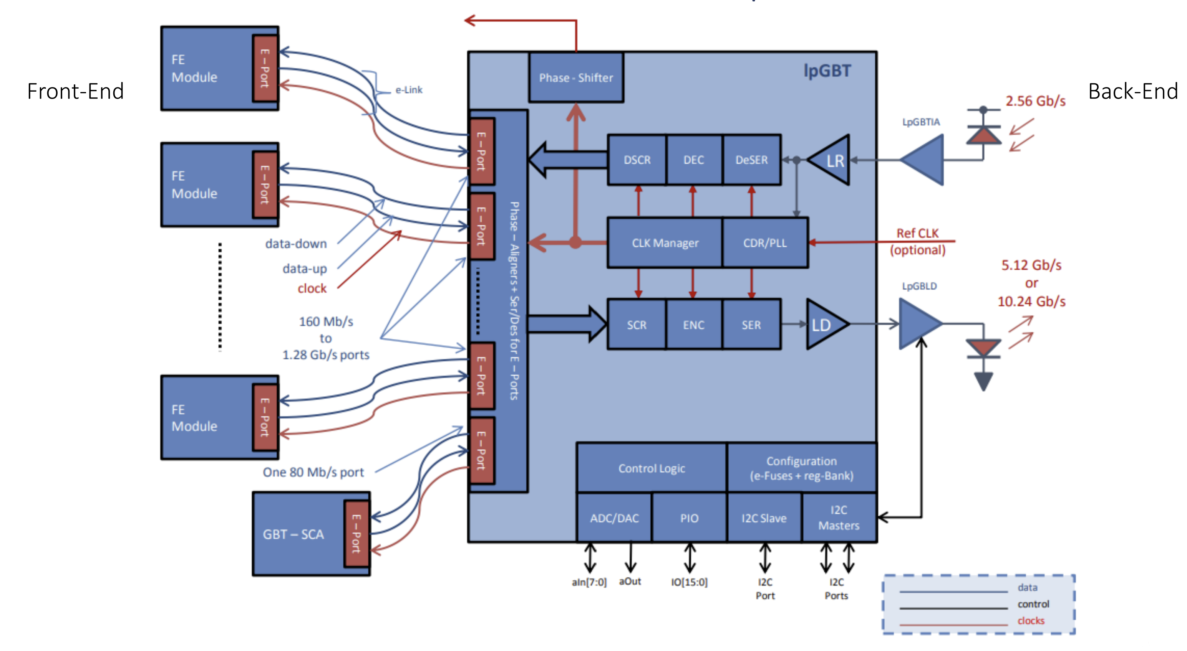
General architecture of the lpGBT ASIC

Slide 23
LpGBTdata transmission
Uplink |  | e-link
Speed | Encoding | Bandwitdh [Mbps] | #
5.12 Gbps | FEC5 | 160 | 28
 |  | 320 | 14
 |  | 640 | 7
 | FEC12 | 160 | 24
 |  | 320 | 12
 |  | 640 | 6
10.24 Gbps | FEC5 | 320 | 28
 |  | 640 | 14
 |  | 1280 | 7
 | FEC12 | 320 | 24
 |  | 640 | 12
 |  | 1280 | 6
Different configuration possible
Number of available e-links depends on BW of e-link as well as speed and mode of uplink.
Downplink |  | e-link
Speed | Encoding | Bandwitdh [Mbps] | #
2.56 Gbps | FEC12 | 80 | 16
 |  | 160 | 8
 |  | 320 | 4

