Slide 1
Compton polarimetry for SuperKEKB:
Synchronisation
Aurélien MARTENS
IJCLab

Slide 2
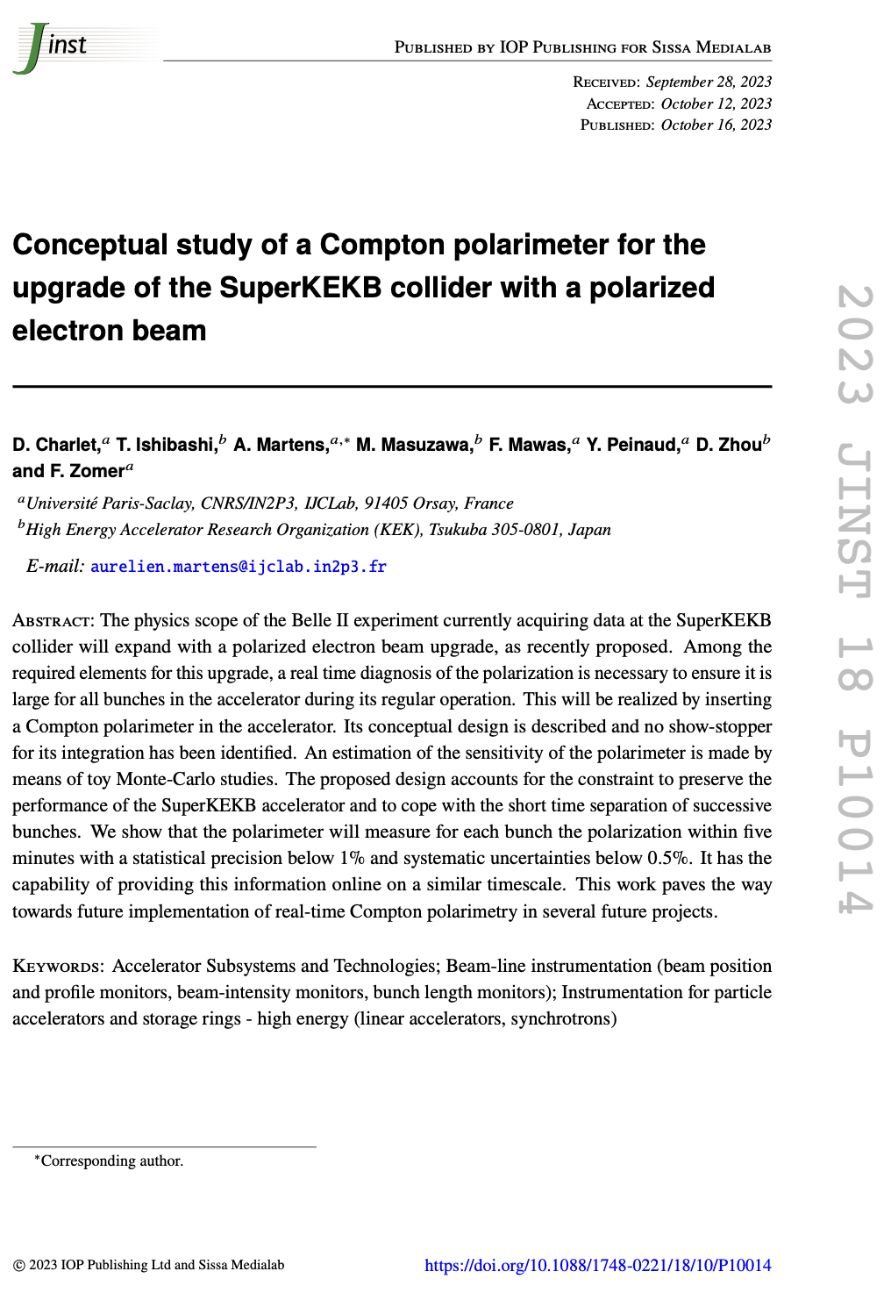
Introduction
Reminder:
  We have draw a conceptual design with excellent expected performance
  Design relies on:
Laser:
  Integrated in accelerator: must be fully remote operated
  Operated at frequency of 250MHz: must be well synchronized to accelerator RF
  Typical acceptable (closed loop) time jitter of ~500fs (a small fraction of electron bunch/laser pulse durations
Detector:
  photon calorimeter able to cope with photons incoming every 4ns.
  The 2500 circulating bunches measured independently
  Ability to provide fast on-line info to the control room
  Embedded electronics, fast enough, with good ADC (10 bits min) and FPGA processing
  With bunch identification

Slide 3
Conceptual acquisition chain
Optical filter
BaF2
PMT
2500 histograms
Fast treatment: fit
Every 4ns
FPGA
IDROGEN board
White Rabbit node
Reduced data
To online monitoring
Analog Front-end
+ ADC (>=10bits)
clock
To remote storage (10MB/min)
Update program, constants
1rst Bunch identifier
Accelerator RF
Funding request in preparation for submission to ‘Agence Nationale de la Recherche’ for building and testing this detector with the electronics
Proposal accepted for second stage of submission process → to be submitted on the 27th of March, result in June.

Slide 4
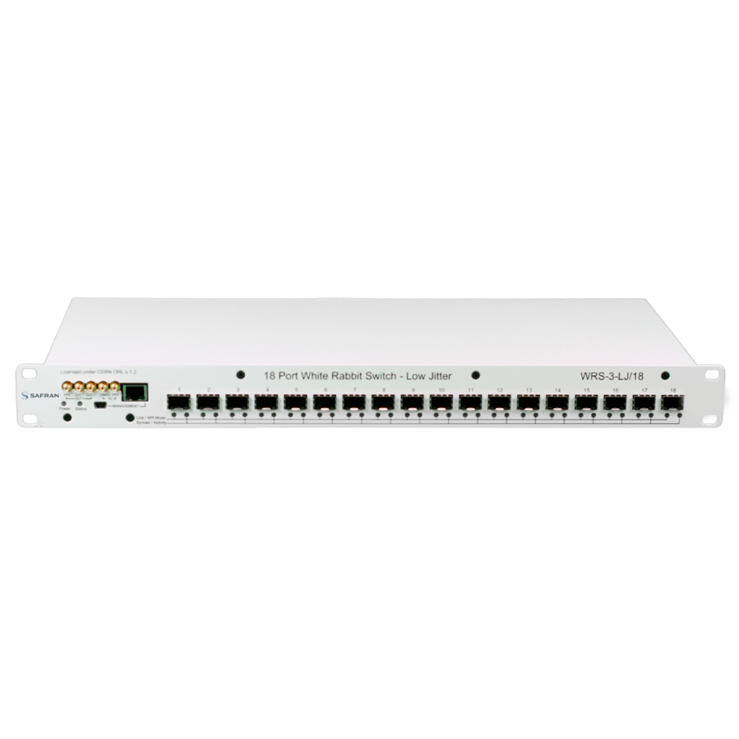
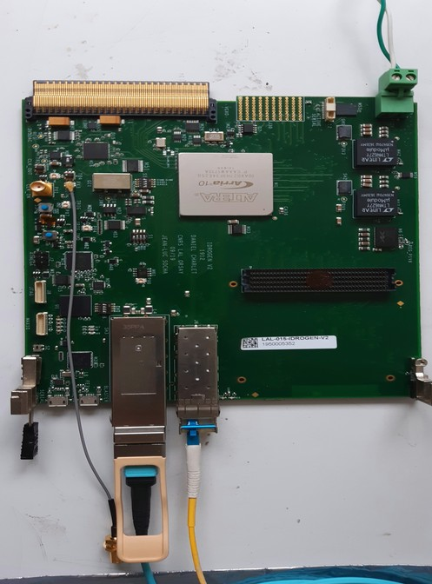
Laser synchronisation – concept
H. Kaji, D. Charlet
Master Oscillator (510MHz/51)
IDROGEN, high speed DAQ
Low noise WR node
FPGA mezzanine card
WhiteRabbit
WhiteRabbit allows to minimize implementation cost
A simple fibre to bring to the laser
No expensive/complicated fibre length compensation system to implement
D. Charlet et al., https://cds.cern.ch/record/2893372?ln=en
4km fibre link
Developments made in parallel at IJCLab and KEK:
IJClab:
  Standalone tests with phase noise measurements
  Test new developments on the IDROGEN board quickly
KEK:
  Test within KEK environment for instance at ATF
  Possibility to test with 4km fibre loop easily (shown in Oct’24)
  Possibility to test accelerator/laser synchronisation → rescheduled for June at ATF

Slide 5
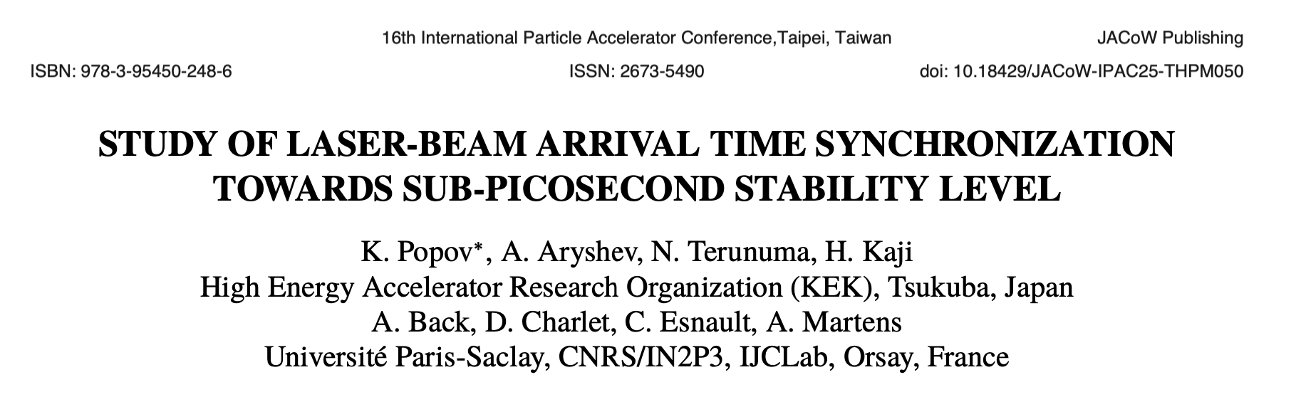
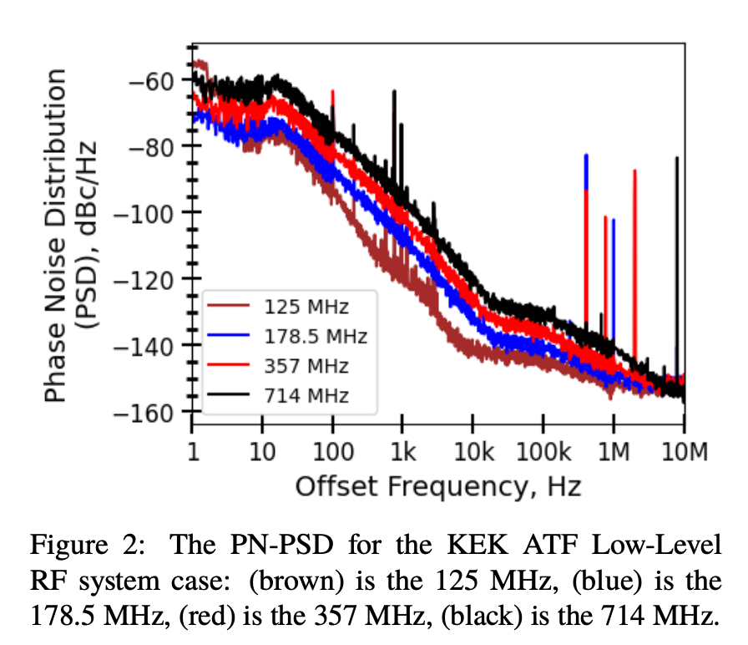
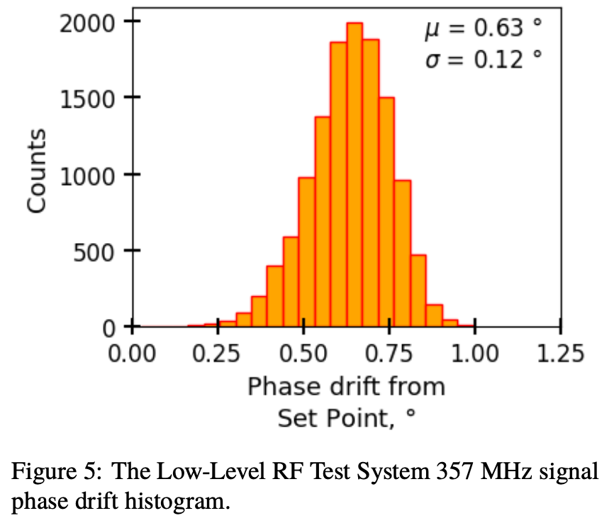
Current status w/ commercial switch
Arbitrary frequency generation.
3.5h
i.e. 0.9ps RMS jitter over 3.5h

Slide 6
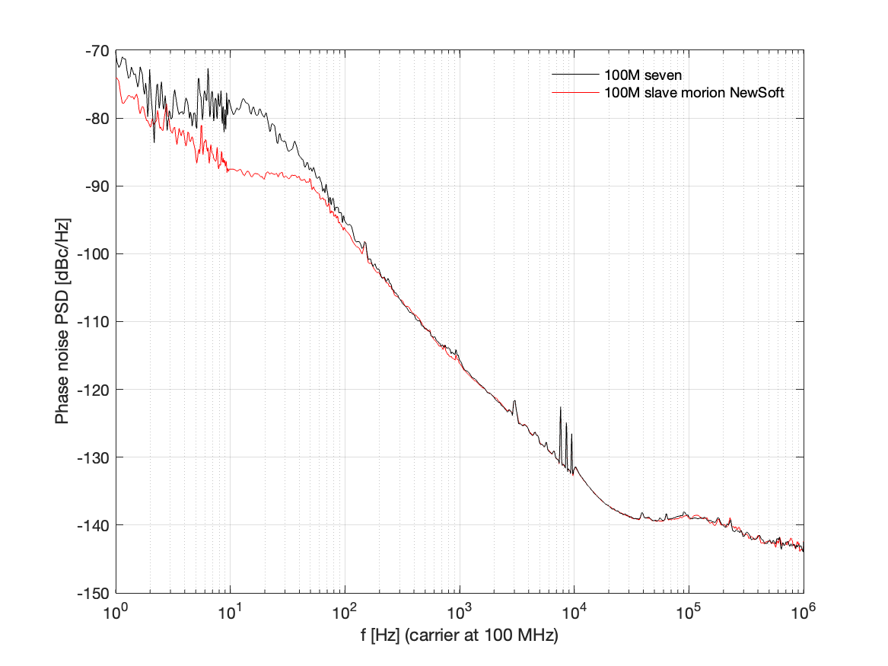
Last results at Orsay (March’25)
Rubidium
RF
fibre link
Rubidium
IDROGEN master
Substantial phase noise improvement
Obtained down to <0.9ps RMS [1Hz, 1MHz]
Good enough for laser/electron
slave
RF
fibre link

Slide 7
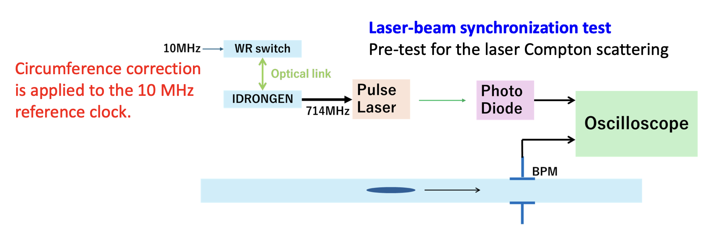
Planned activities at KEK this year
Performance demonstration
Long term phase stability in representative accelerator conditions
Check jitter in real conditions
Check jitter of laser with respect to beam itself
Use the ADC capability of the board (if time left) to accurately quantify relative beam to laser jitter

Slide 8
Next steps
Synchronisation of laser (and data acquisition) is part of essential elements for the implementation of Compton polarimeter
  Very encouraging results 0.9 ps RMS (<1Hz); 0.9ps RMS (>1Hz)
  Work ongoing to understand
    drift component of phase noise (temperature ?)
    Noise in intermediate region [1Hz, 100Hz] → White Rabbit protocol related ?
  Laser +accel synchro test planned this week
  Integrate SI5362 chip on the IDROGEN board (avoid some spurs)
  ADC mezzanine card at 1GHz validated
  Possibility to measure absolute frequency with colleagues from metrology lab (SYRTE, Paris)
NB:
These results are only concerning the added jitter induced by the RF transport.
Electron beam jittering itself against absolute RF reference may be of similar scale already

