Slide 1
Merge Line studies
Zachary Liptak
2026/02/02
B2GM Chiral Belle Upgrade Session

Slide 2
recent merge line layout idea
(my understanding, anyway)
V. dipole
New beam pipe (elevated)
(Do we use a similar dipole pair to get the beam up here?)
New beam pipe
Quad
(Pre)Buncher + accel. Structures?
Existing Beamline
V. dipole

Slide 3
Study goals
Add a beam merging section to approximate the new layout and match the expected linac emittance
Because the beam size and emittance are likely to change based on the final electron gun/solenoid/Wien filter design, we investigate the change in those parameters introduced by the dipole magnets.
Specific values used in this study can then be adjusted/optimized based on the finalized gun/magnet designs.
It’s unclear to me if it will be necessary to accelerate the beam before merging, and if so how to include the necessary accelerating structures.

Slide 4
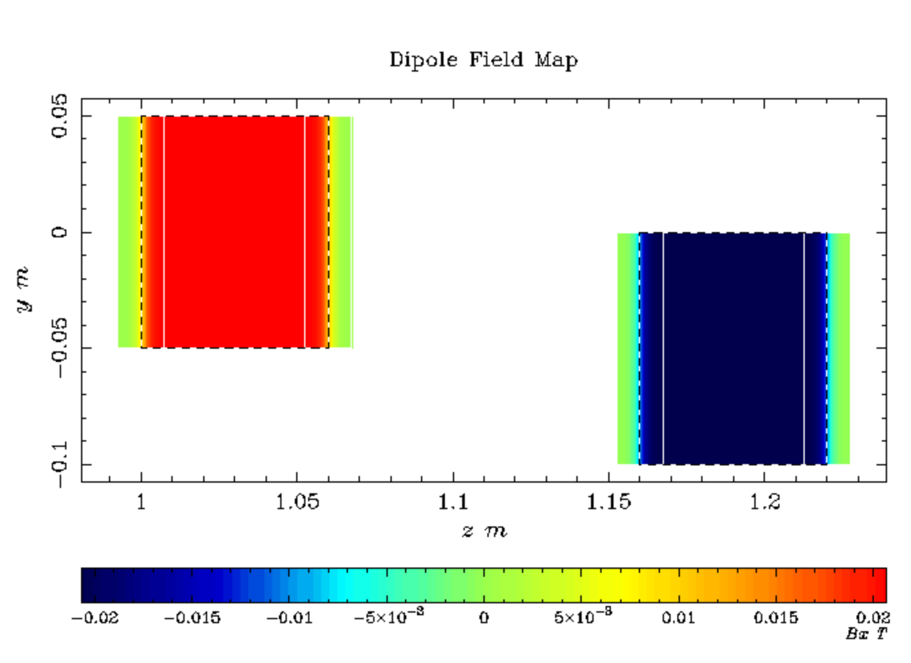
Vertical dogleg section
Vertical change is accomplished with two bending dipoles placed in sequence with equal and opposite strength (i.e. half a chicane)
At 200 keV, the field required should only be of order ~1000s of G for a thin dipole.
If acceleration happens prior to bending, magnets will need to be adjusted accordingly (longer/stronger)

Slide 5
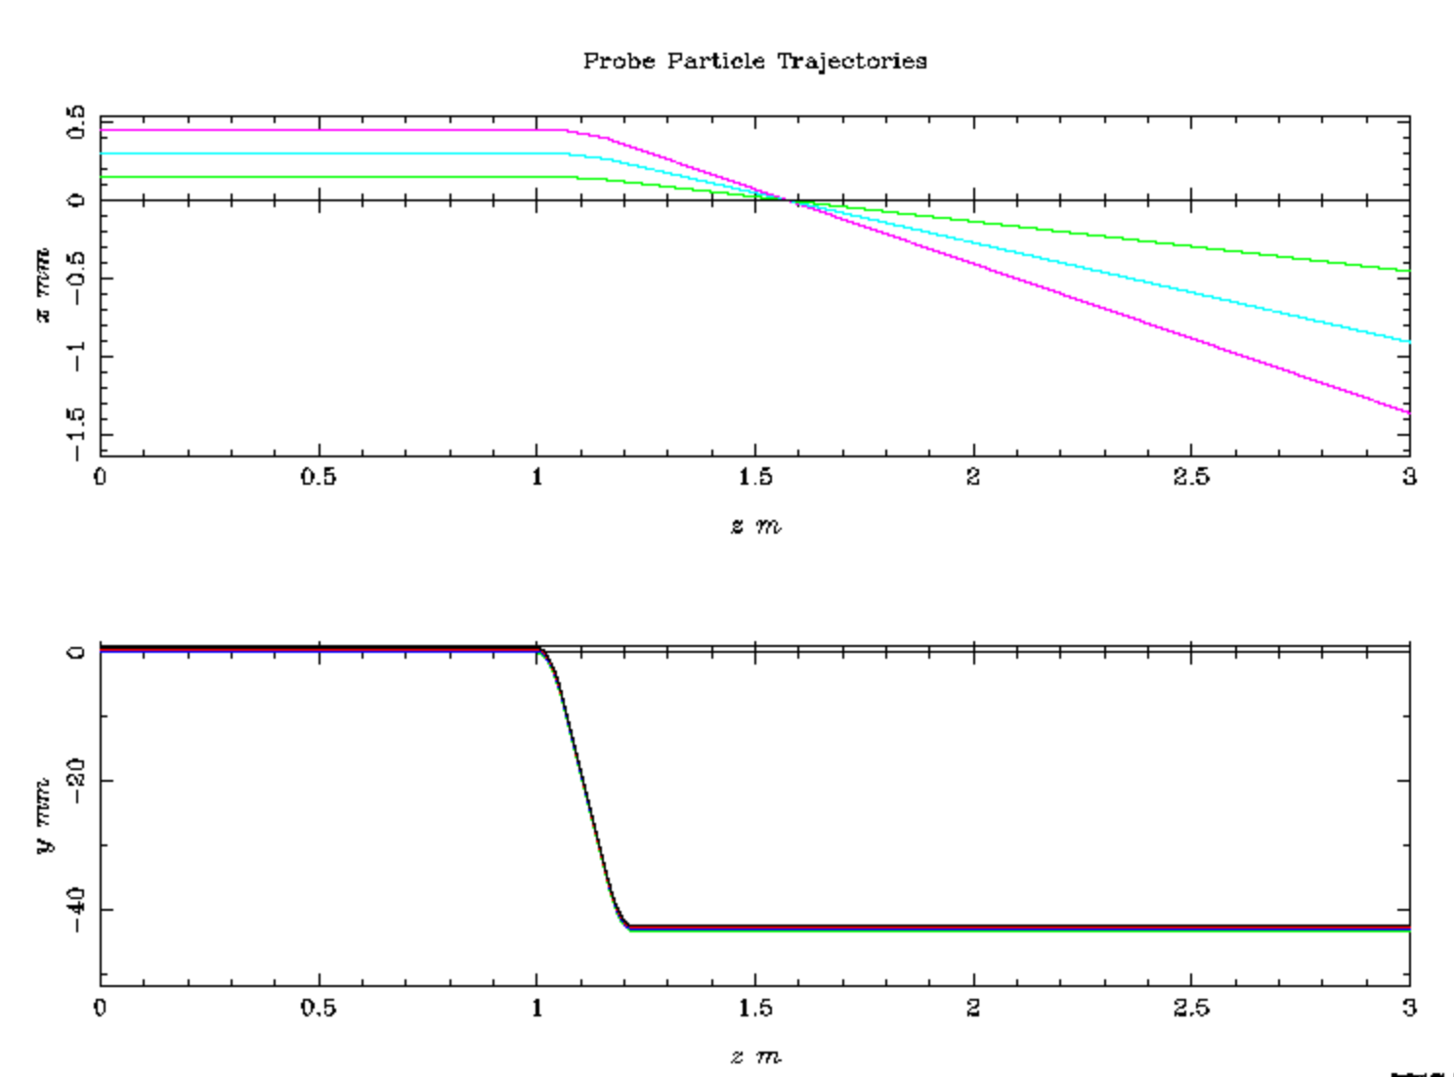
Linac emittance matching parameters
The dipole magnets bend the electron beam in Y as expected, but also produce some deflection in X.
As a result, correction may need to be applied after the dogleg section, depending on how strict the matching requirements are.

Slide 6
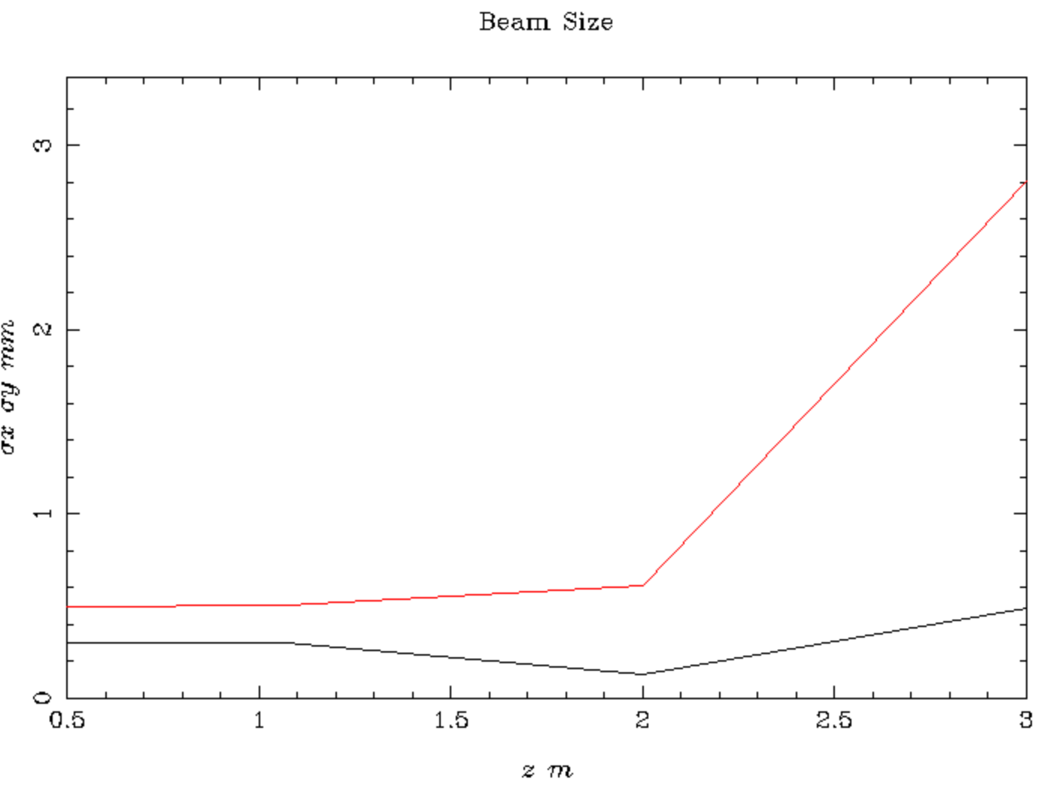
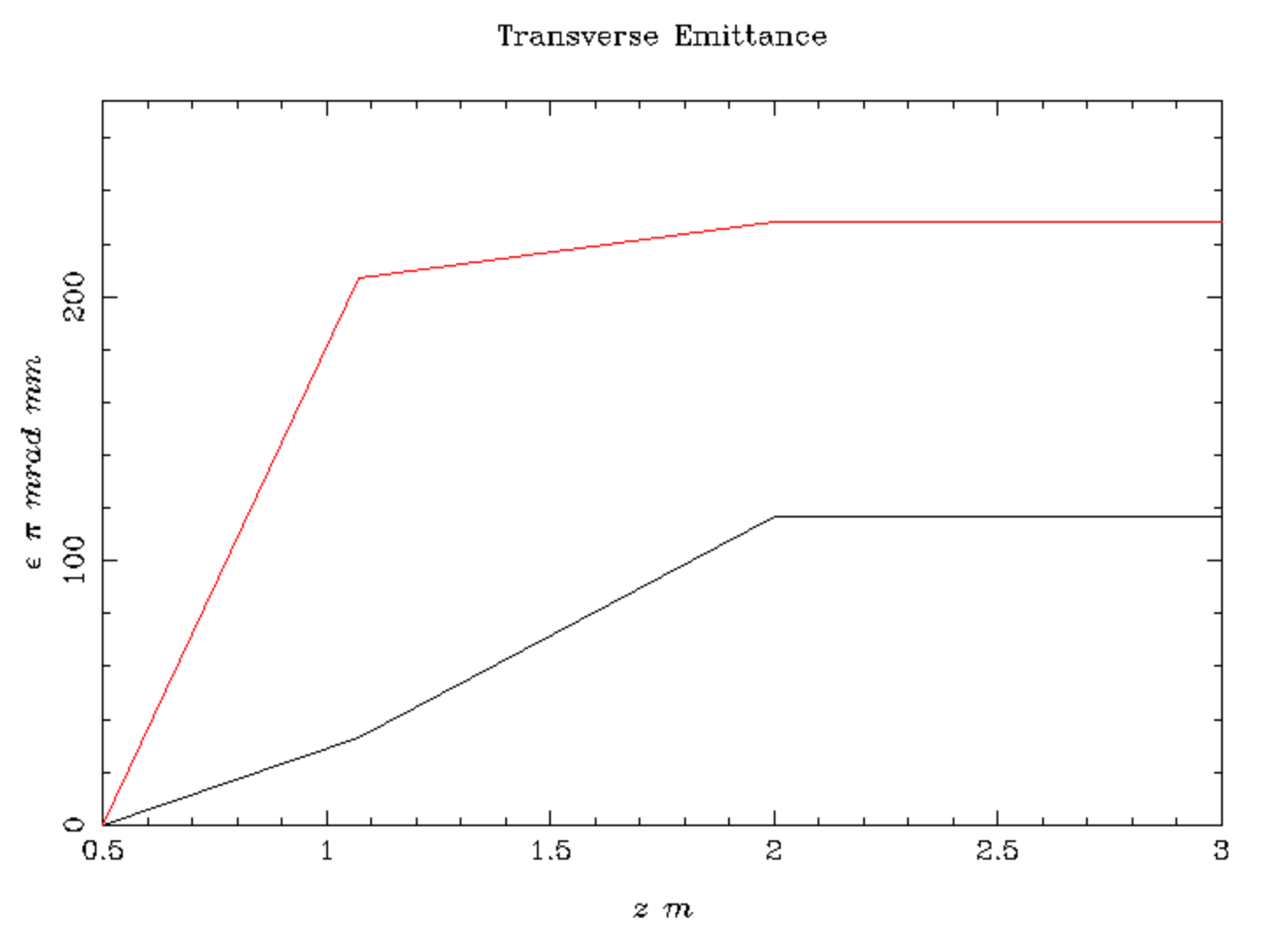
Linac emittance matching parameters
The dipole magnets bend the electron beam in Y as expected, but also produce some deflection in X.
As a result, correction may need to be applied after the dogleg section, depending on how strict the matching requirements are.

Slide 7
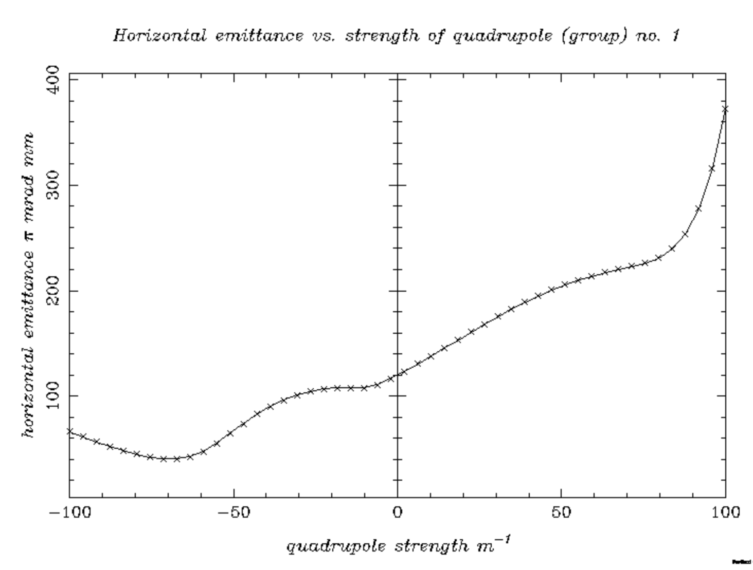
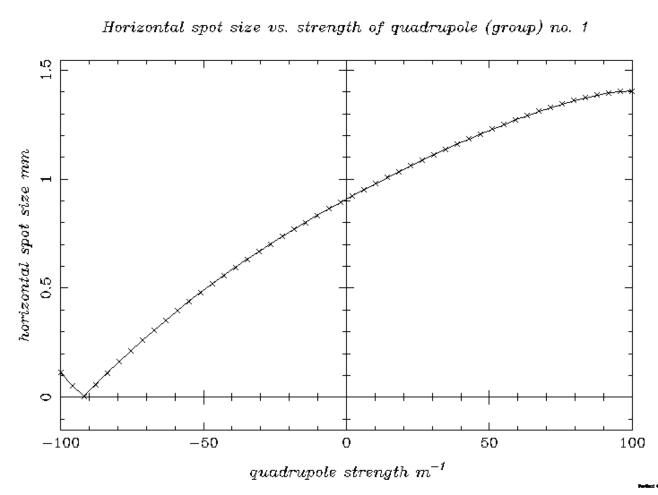
Quadrupole optimization
Horizontal emittance (left) and beam size (right) can be optimized with a single Quadrupole magnet downstream of the dipoles.
(If the required field strength is unreasonable, it might require re-optimizing upstream or using multiple quads.)

Slide 8
Conclusion and further work
On the surface, making the merger line can be accomplished with two bending magnets + quadrupole
  Specifics can be optimized based on final electron gun/solenoid/magnet design and their outgoing beam parameters
Dipoles introduce some spread to the beam in X direction, hence the need for a quadrupole
Next issue – this beam was simulated as monoenergetic, but introducing energy spread will also introduce dispersion in Y. Might be necessary to also include a quad to deal with this in Y?

