Slide 1
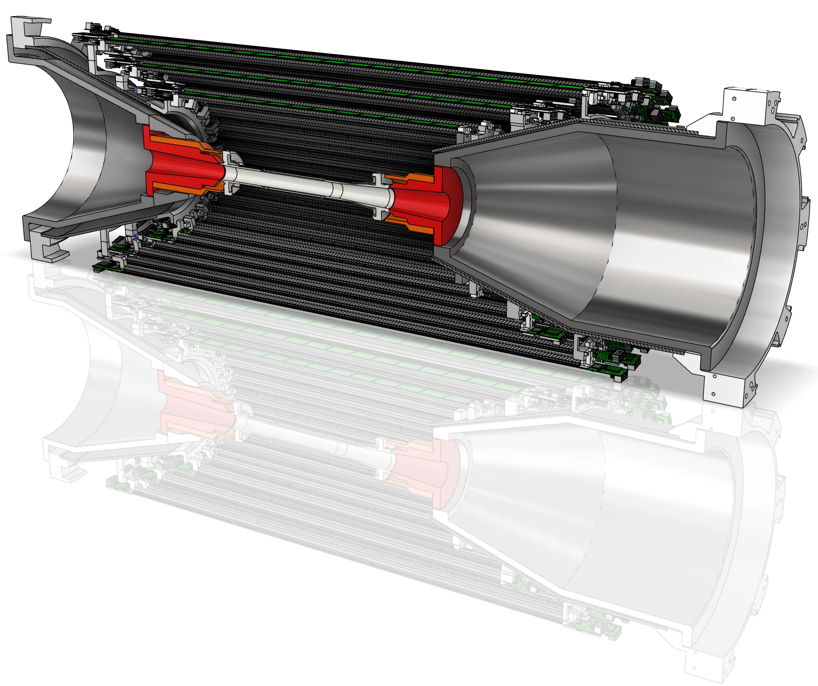


oVTX Mechanical design Status
2nd VTX Workshop
M. Rovini - A. Moggi – M. Massa – F. Buchsteiner

Slide 2

Outline
Update on cad model
  Sliding mechanism
  Ladder mounting
  End rings
Flex types
Cooling system considerations
Mechanical prototypes
Thermal tests
All mechanical components shown are for visual purposes only and require further engineering development

Slide 3
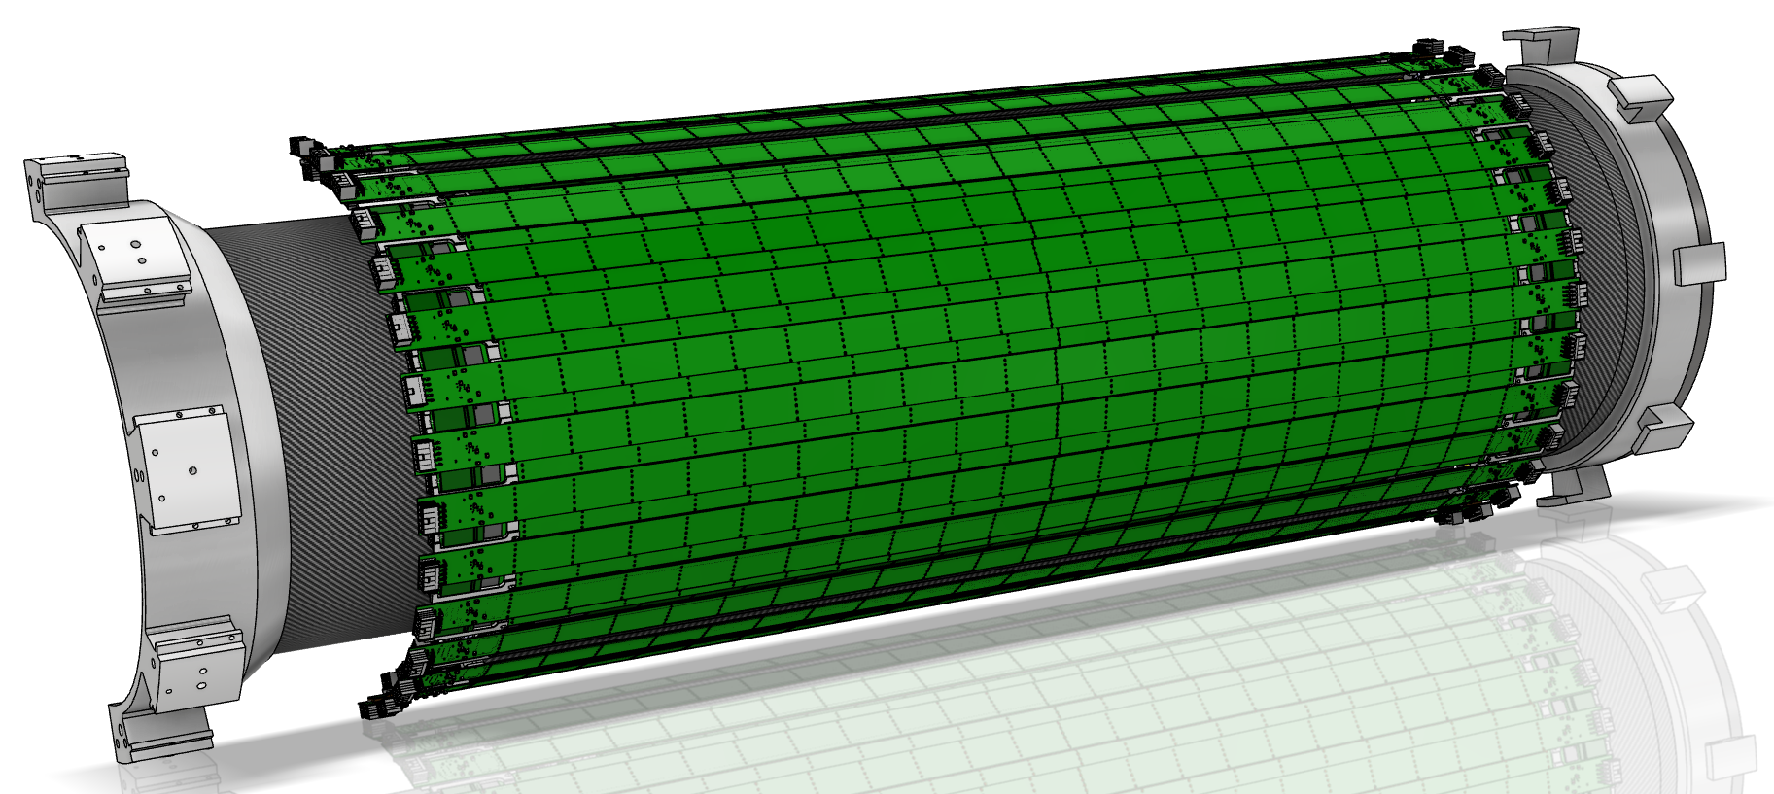
Cad model
BWD
The CAD model, even if slowly, is moving forward
FWD
Missing items:
  Manifolds
  Engineering of mechanical components to simplify the machining process → cheaper components

Slide 4
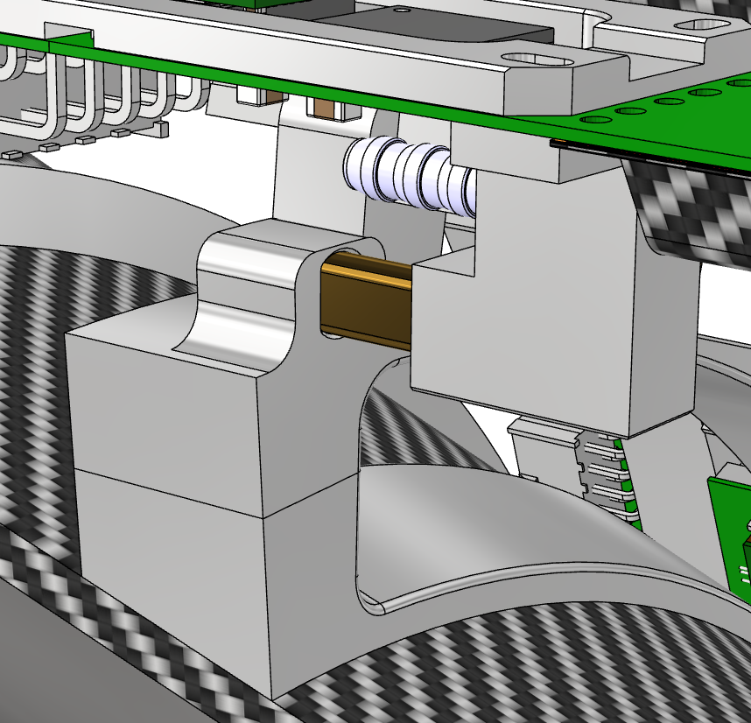
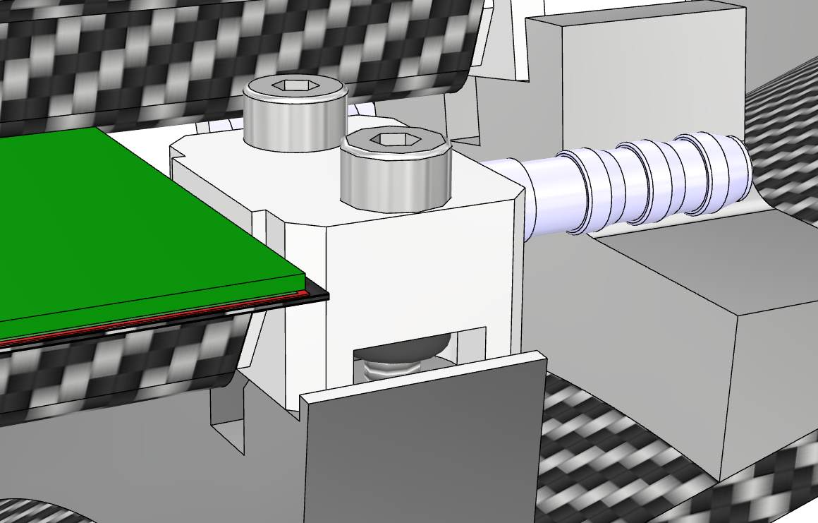
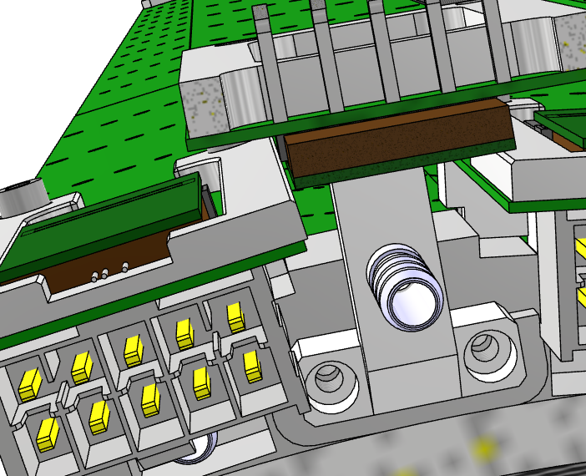
BWD Sliding mechanism and FWD fixation
New sliding mechanism concept, all the suggestions implemented:
  Anti-rotational shape
  Pin glued on the end-piece body
A very precise gluing jig must be designed. It’s important to control the relative position of both end-pieces and ladder mechanics.
BWD SIDE
L5/L6 → no access to the threaded holes if screws installed from the top
FWD SIDE
Traditional FWD fixation with screws
  L4A and L4B: screws installed from the top; no FWD flex head present
  Other layers: threaded holes on the end ring access issues due to the FWD flex head → fixation from the end‑ring side
End-ring side
fixation from the end‑ring side

Slide 5
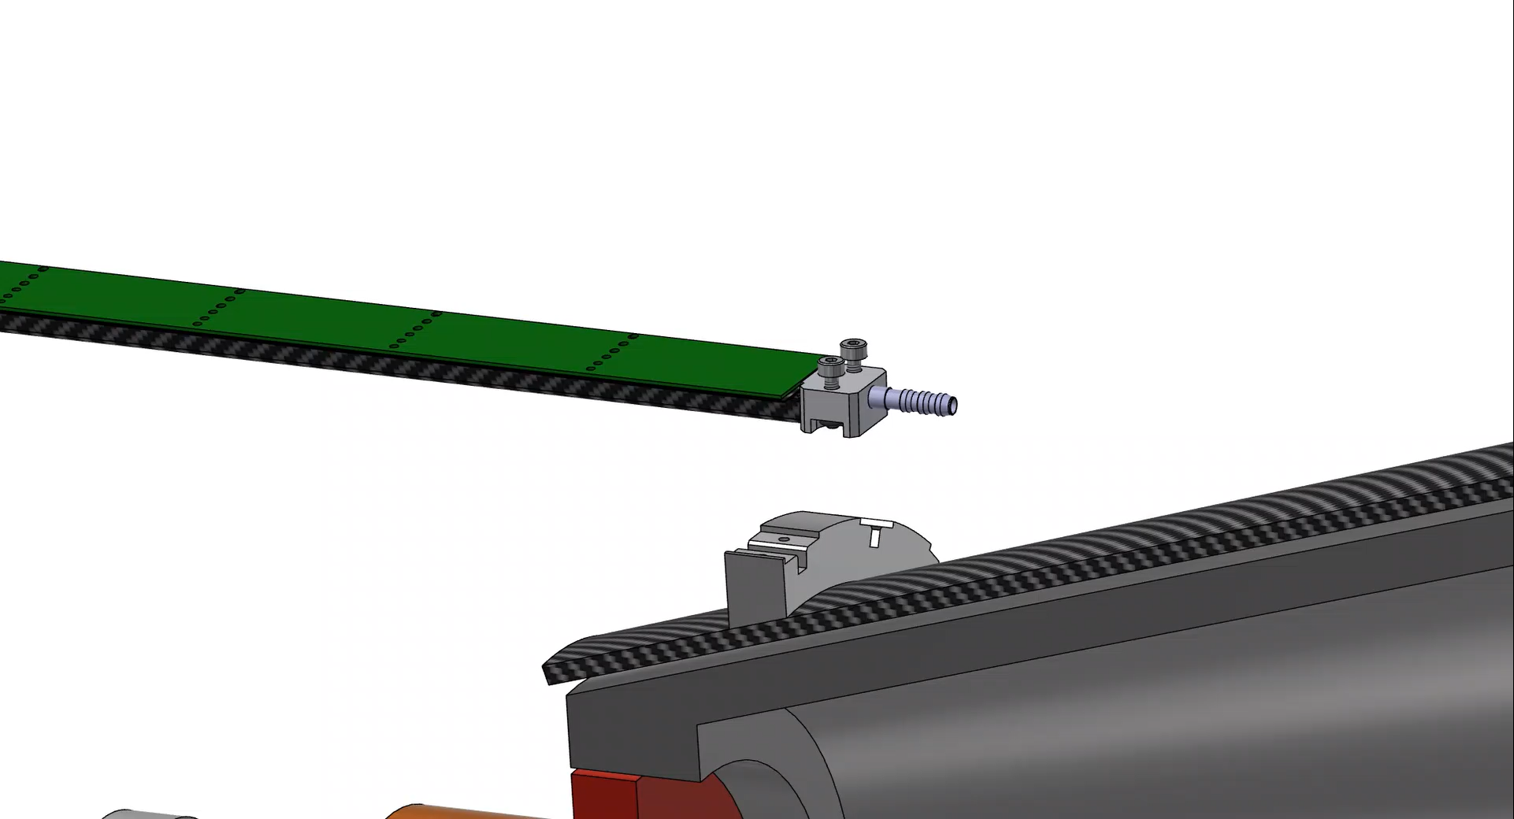
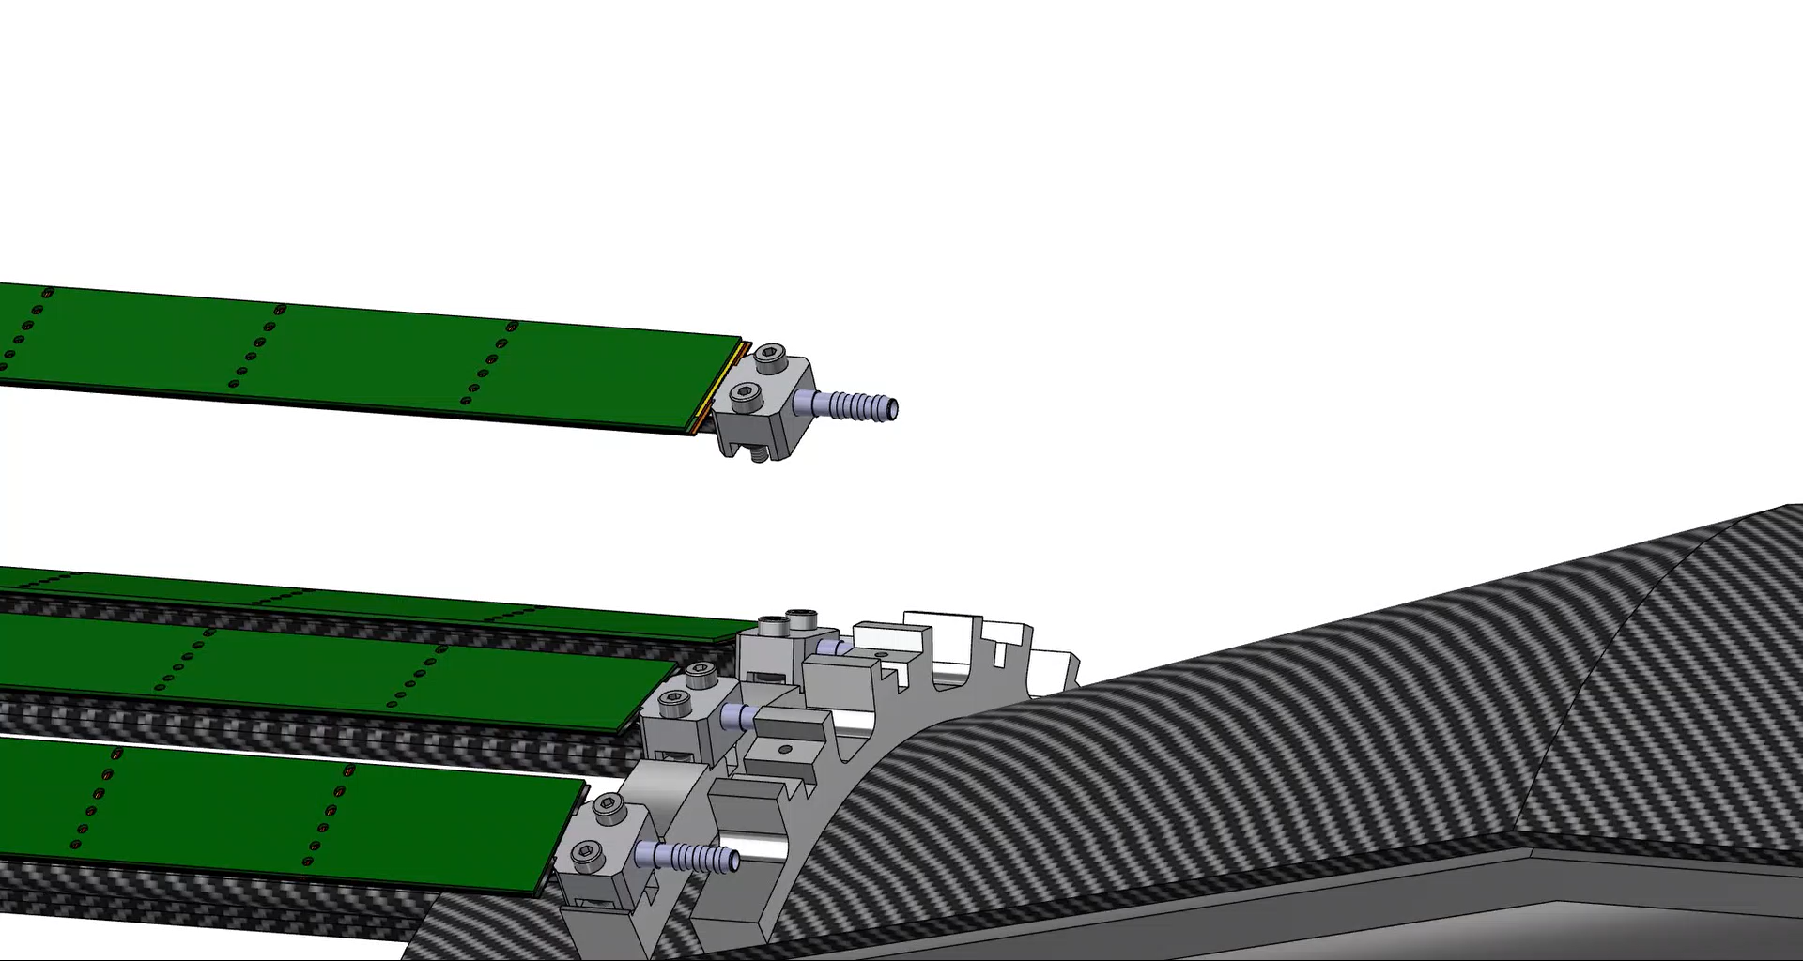
Ladder mounting procedure
The new ladder mounting procedure appears to be compatible with the current ladder mounting table.
  Modifications are required to allow proper ladder clamping.
  The interface between the ladder and the mounting tool still needs to be defined.
  Need to evaluate strokes and the capability to move in X (R) and Z
Procedure for Layer 4A ladders:
  Approach in the radial (R) direction.
  Once the correct R position is reached, slide in the axial (Z) direction, toward the BWD side.
  Tighten the screws to secure the ladder.
Procedure for other layers:
  The installation procedure for Layer 4B, 5A, 5B, 6A, and 6B ladders is identical to that of Layer 4A

Slide 6
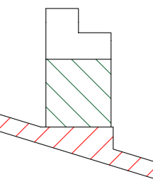
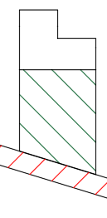
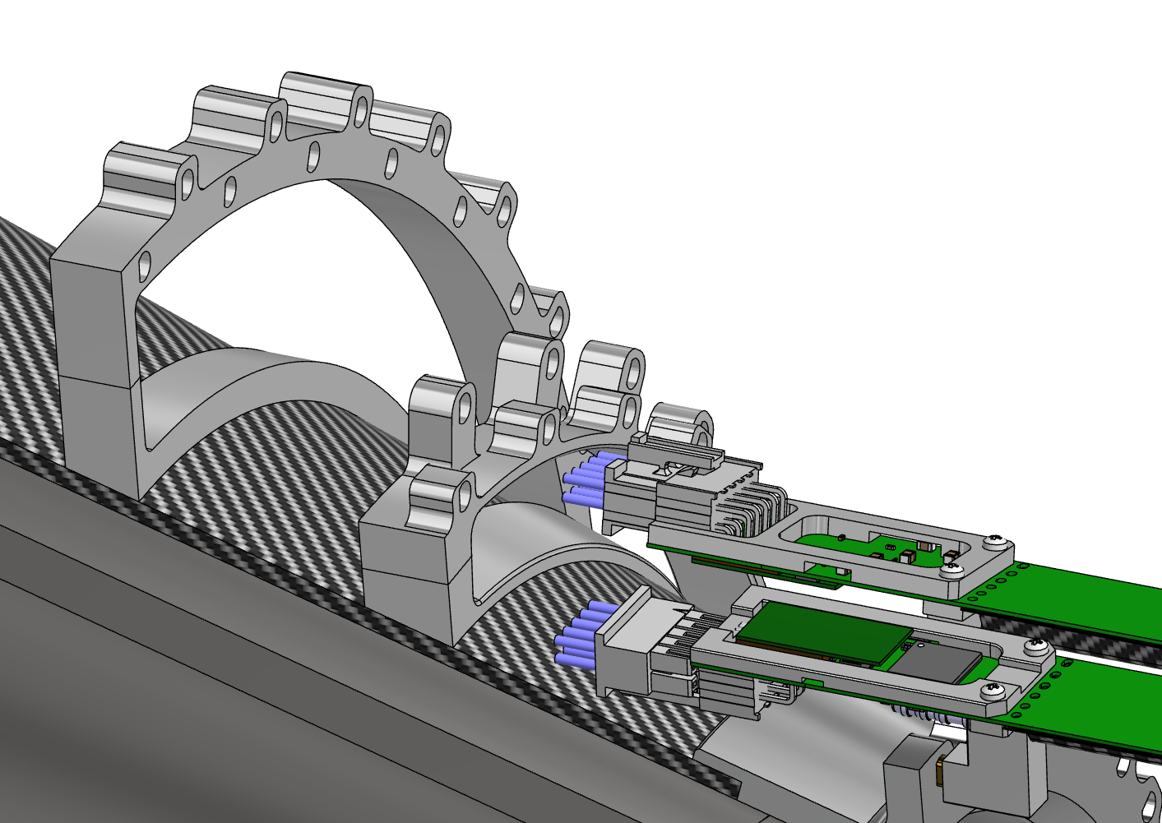
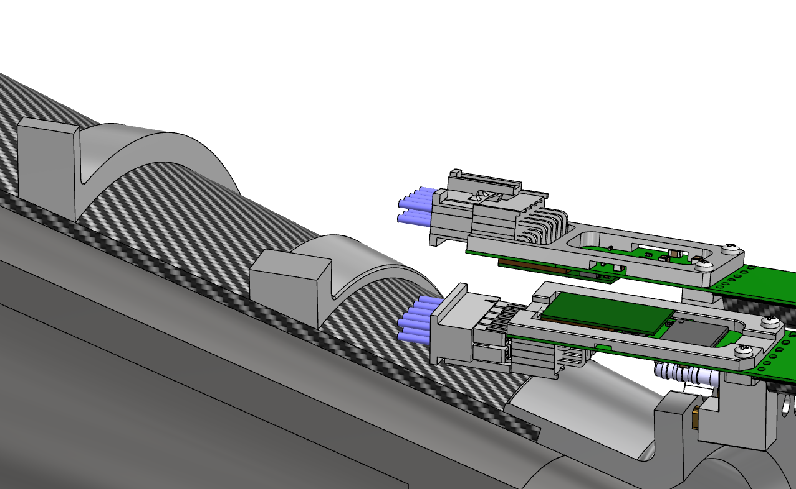
End Rings development
The design of the end rings supporting the ladders is currently under definition.
Two options are under evaluation: a flat interface on the cones (Solution A), or an inner ring surface machined to match the slope of the CF cones (Solution B).
End-ring
Solution A:
Solution B:
CF cone
To mitigate ladder mounting issues, a two‑part end‑ring design is currently under study.
This configuration is expected to simplify both ladder installation and cable routing.
No obstacles are present for cable routing and piping
Possible issue with connector mounting: the end ring is too narrow at the ladder end
For example, after completing the installation of all Layer 4 ladders, the upper part of the Layer 5 end-ring can be mounted and aligned using screws and reference pins.

Slide 7
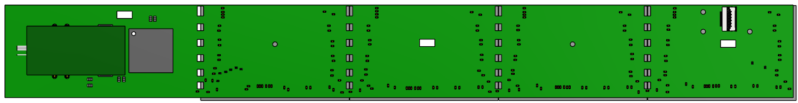
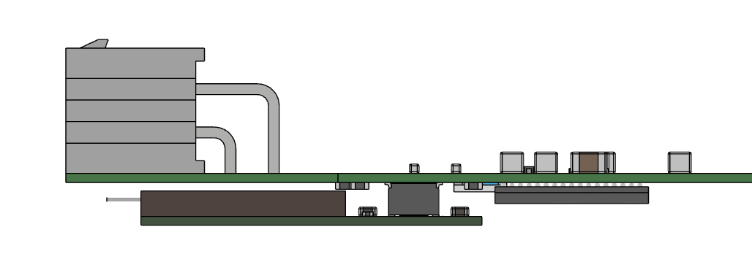
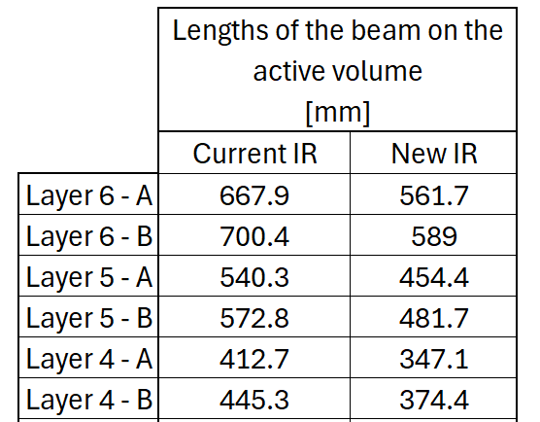
Flex types
Some considerations about Flex geometry:
  Flex FWD and Flex BWD are mirrored with respect to the XY plane, due to the asymmetry of Obelix.
  Ladder A and Ladder B head flexes differ because the connector, VTRx+, and lpGBT are mirrored with respect to the XZ plane.
XY plane
BWD
FWD
XZ plane
Connector
Ladder “A”
Ladder “B”
Sensors
Considering:
  The active lengths with the new I.R.
  The Obelix dimensions from the latest GDS file: 30.214 mm x 19.409 mm
VTRx +
lpGBT
Sensor length with 0.1 mm inter‑sensor gap
L6A: 561.7/30.314=18.5 → 19(*) sensors
L6B: 589.0/30.314=19.4 → 20 sensors
L5A: 454.4/30.314=15.0 → 16 sensors
L5B: 481.7/30.314=15.9 → 17 sensors
L4A: 347.1/30.314=11.5 → 12 sensors
L4B: 374.4/30.314=12.4 → 13 sensors
(*): For mechanical reasons we considered for L6A 20 sensors. This couldn’t be done for L5A because of narrow space between L4 and L5 (see next slide)

Slide 8
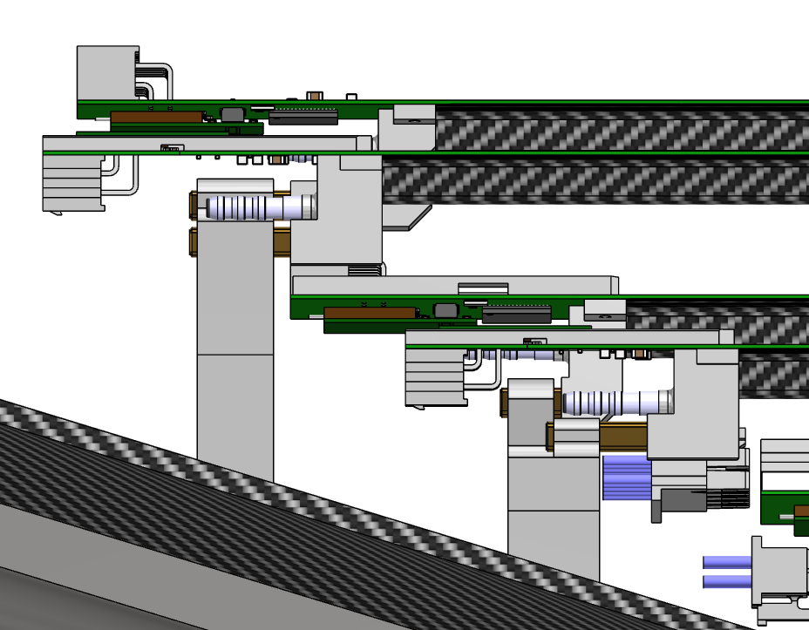
Flex: Additional considerations
For layer 6A, a nominal number of 19 sensors is sufficient to cover the active area.
This would require shifting the L6A end piece (and the L6 end ring) toward the forward (FWD) side.
Such a shift may lead to cabling issues due to the reduced spacing between the end rings.
Therefore, the adopted mechanical solution is to implement L6A with 20 sensors.
L5 BWD end ring
L6 BWD end ring
L6A BWD end piece
Flex naming convention:
  BWD/FWD → Side from which the flex is read
  UP/DOWN → Side where the connector is located

Slide 9
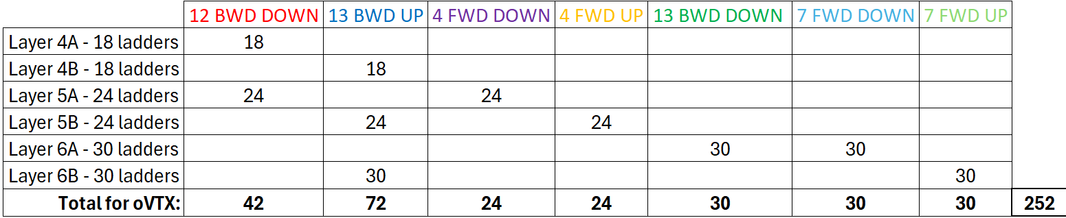
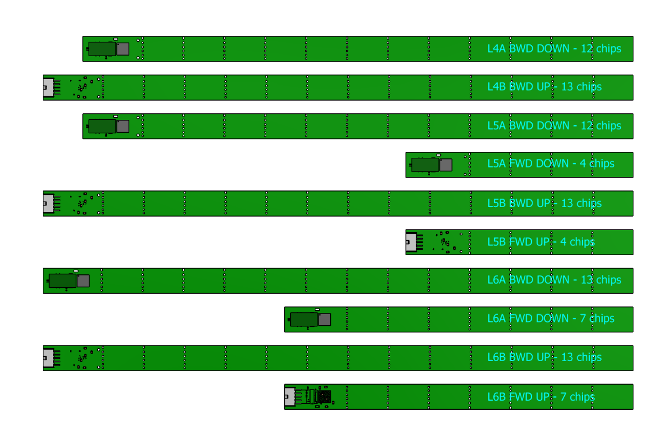
Flex size summary
Table for all oVTX, 7 types of Flex
L4A: 12 sensors → #1 Flex 12 BWD DOWN
L4B: 13 sensors → #1 Flex 13 BWD UP
L5A: 16 sensors → #1 Flex 12 BWD DOWN + #1 Flex 4 FWD DOWN
L5B: 17 sensors → #1 Flex 13 BWD UP + #1 Flex 4 FWD UP
L6A: 20 sensors → #1 Flex 13 BWD DOWN + #1 Flex 7 FWD DOWN
L6B: 20 sensors → #1 Flex 13 BWD UP + #1 Flex 7 FWD UP
L4A
L4B
L5A
L5B
L6A
L6B

Slide 10
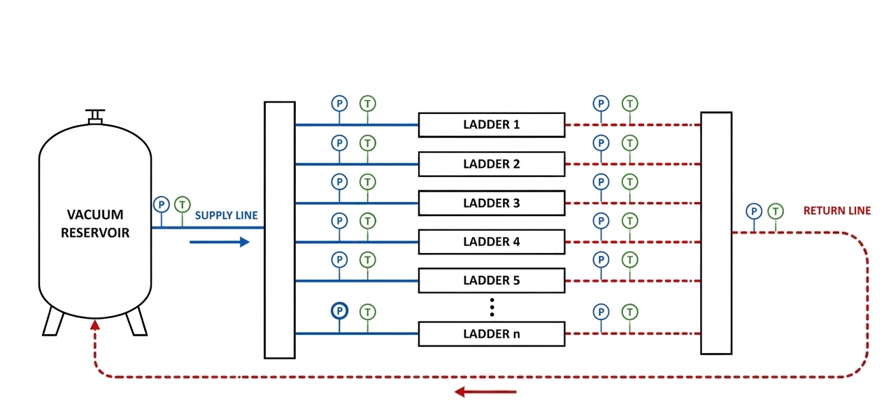
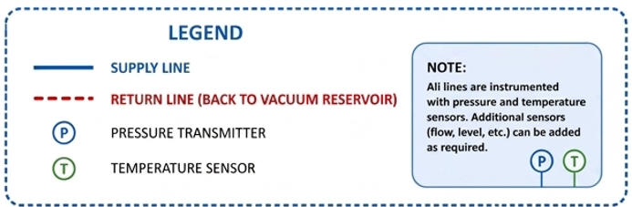
Cooling system design
These considerations about the cooling system design are based on the experience of ALICE on the design and realization of the cooling plant for ITS2.
Are the water leak sensors inside the detector mandatory?
  When the sensors will alert probably is too late and the space to exit with sensor cables is too small.
A new cooling plant design will be required. Responsibility for this activity still needs to be defined.
oVTX mechanical designers can provide all the technical specifications for the oVTX cooling.
In any case, a comprehensive analysis of the operational modes and potential failure scenarios must be carried out
  Operational modes includes:
    Loop control within the system architecture (and loop definition)
    Parameters monitoring and control
The sensors shown in the scheme represent only a subset and are not exhaustive.

Slide 11
Cooling system design
  Failure scenarios. What will happen in case of:
      Small air inflow in a loop?
      Major air inflow in case of truncation of one line? (e.g.: Use of pressure sensors for each loop to find the line affected by the failure. The affected loop is automatically moved to the OFF state…sensors at system level and not inside the oVTX volume)
      Pump or vacuum pump failure? (e.g.: use of redundant pump/vacuum pump)
      Power cut? (e.g.: UPS mandatory)
      Trapped water in one line? (e.g., use of safety valves)
      Inlet pressure exceeding 1 bar during operation? (e.g.: monitoring of the pressure of each single loop and use of pressure regulator valves through PID loop)
      Detector on without cooling? (e.g.: Electronics can be turned on only after the cooling loop is on)

Slide 12
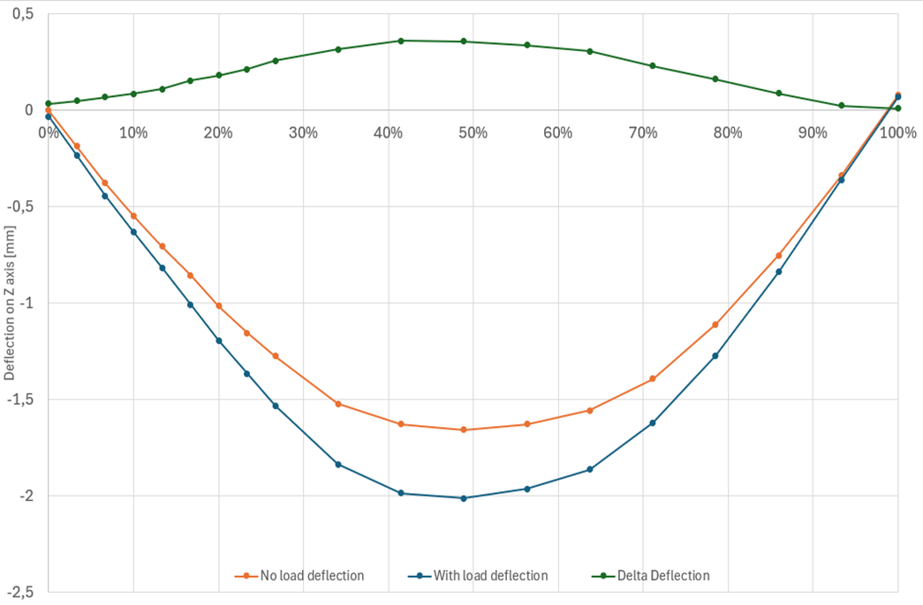
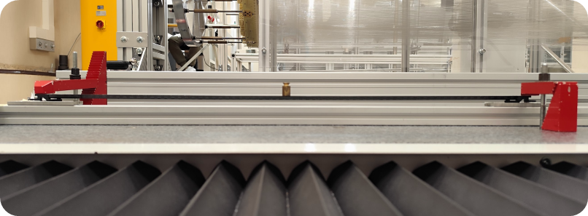
First Prototype mechanical characterization
Previous test with no reinforce, flexural test performed with optical CMM
Sagitta due to the load
Max sagitta: 360 μm
Setup:
  Both end pieces clamped
  20 grams of concentrated load @ midspan
Unloaded beam deflection
Max initial deflection: -1.6 mm
Loaded beam deflection
Beam rotated by 180° to evaluate gravity-induced sagitta
Same initial deflection measured in both orientations
Negligible contribution from self-weight
Structural shape confirmed to be independent of gravity effects

Slide 13
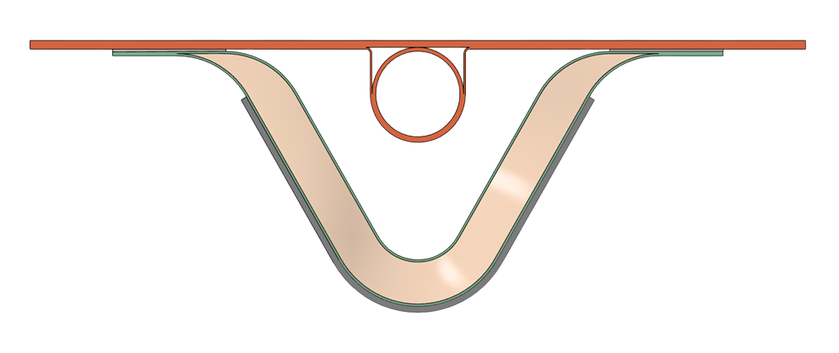
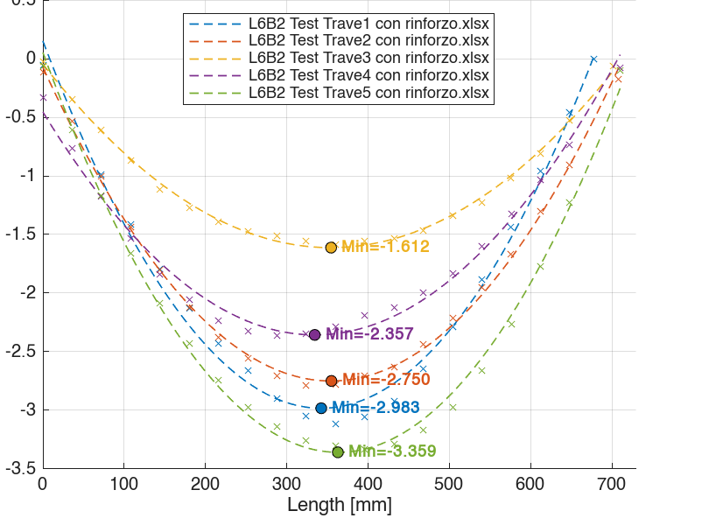
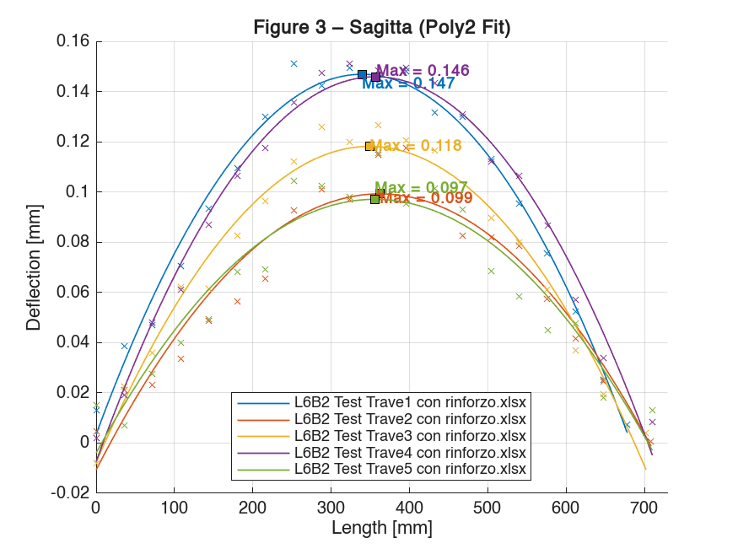
Prototypes with reinforcement mechanical characterization
Tests of the new prototypes with reinforcement
Same setup of the previous one
  UD carbon fiber layer of M46J
  Initial deflection [mm]
  Difference between unloaded and loaded cases
Unloaded beam deflection
Max initial deflection range:
1.6 mm < y < 3.36 mm
Beam deflection with concentrated load:
Sagitta range:
100 μm < y < 147 μm
The results are consistent with the simulation outcomes, confirming a good material characterization in Ansys.
For the distributed load case, the sagitta will be reduced to half of the value.(δ_{distributed} ≈ 0.5 * δ_{concentrated})

Slide 14
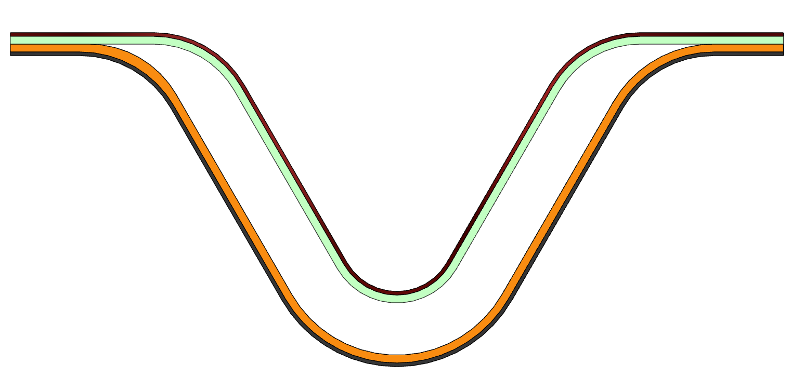
Initial deflection mitigation - Loson
Loson’s engineers think the beam is deformed due to an unbalanced layup, they decide to manufacture some new balanced ladders
The new layout is composed of:
  70 μm of GG52 woven / 150 μm of M46J UD / 150 μm of M46J UD /70 μm of GG52 woven
Lamination of the single skins @ 125 °C and 3 bar
Cold gluing of the two skins
Cold gluing of the cold plate
70 μm GG52
150 μm M46J
150 μm M46J
70 μm GG52
Initial deformation of 0.9 mm observed for all ladders, together with an increase in stiffness.
The initial deformation can be further improved by optimizing the T, p and t during the manufacturing process.
The current prototypes are 730 mm long (corresponding to the “old” L6). The new L6 design foresees a reduced length of 610 mm, which is expected to simplify the manufacturing process.

Slide 15
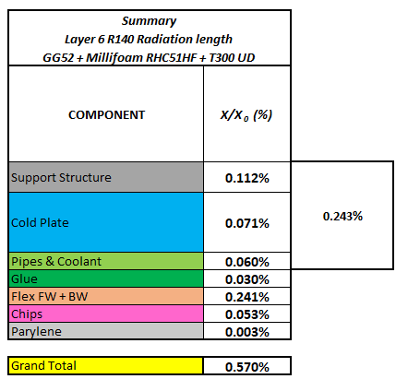
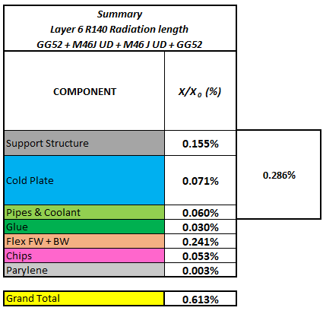
Material budget - Loson
With this new layout, there is a slight penalty in terms of material budget, increasing from 0.57% to 0.61%
Material budget for perpendicular tracks
We are waiting to receive the new ladders from the company in order to evaluate the stiffness and perform a metrological survey.

Slide 16
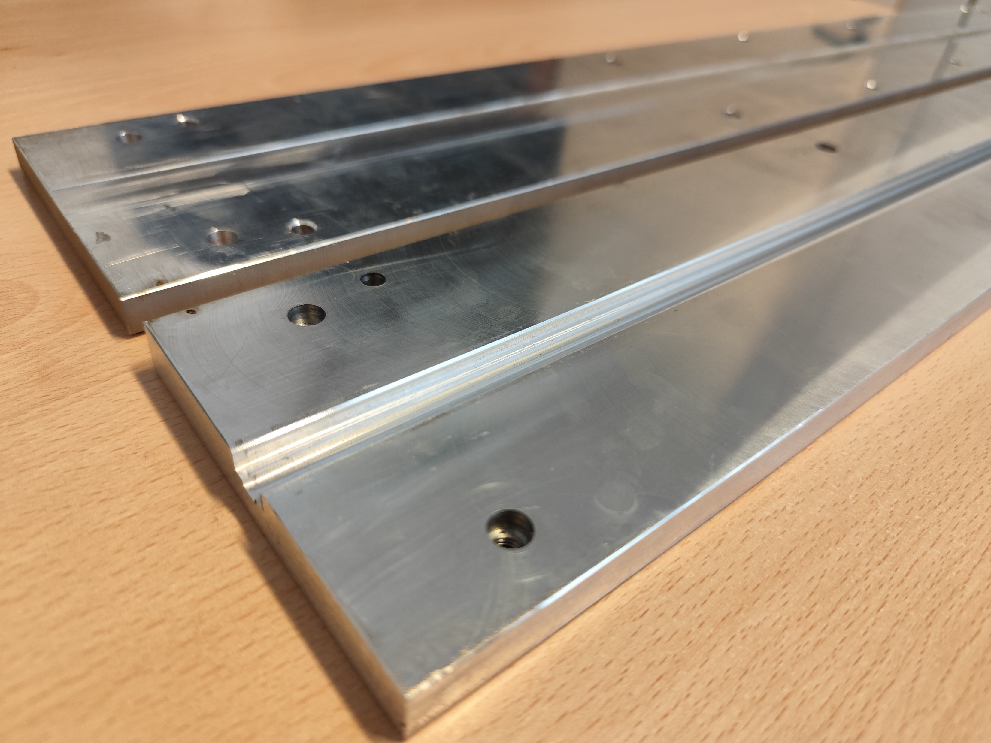
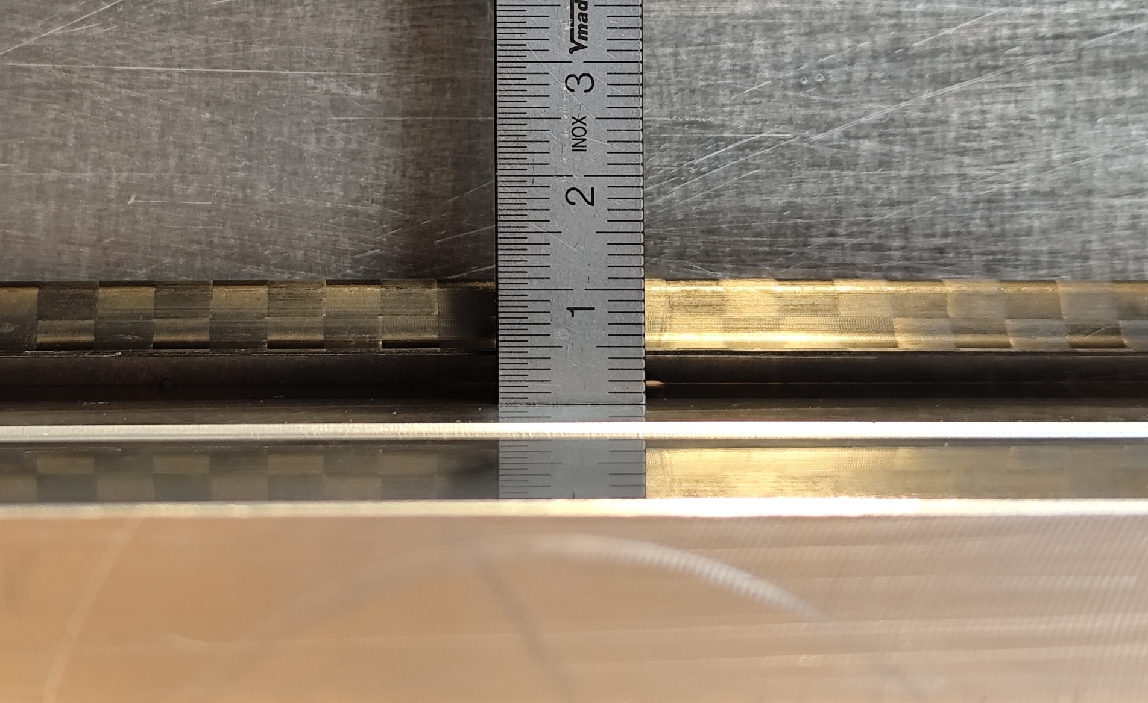
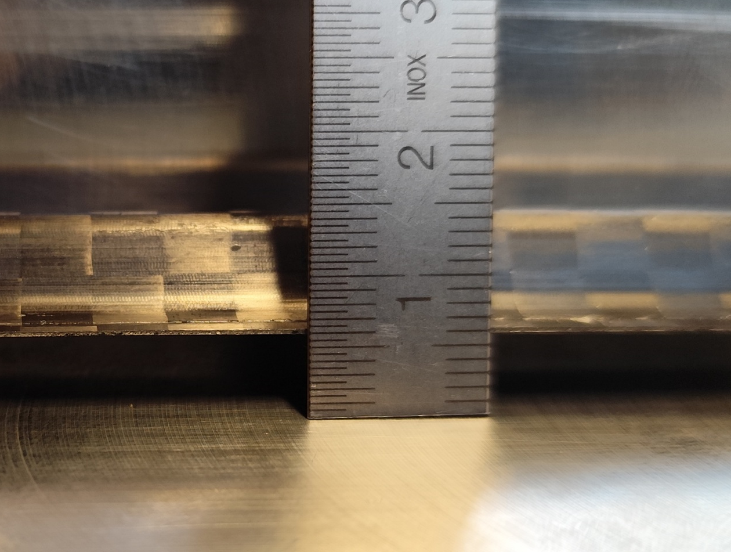

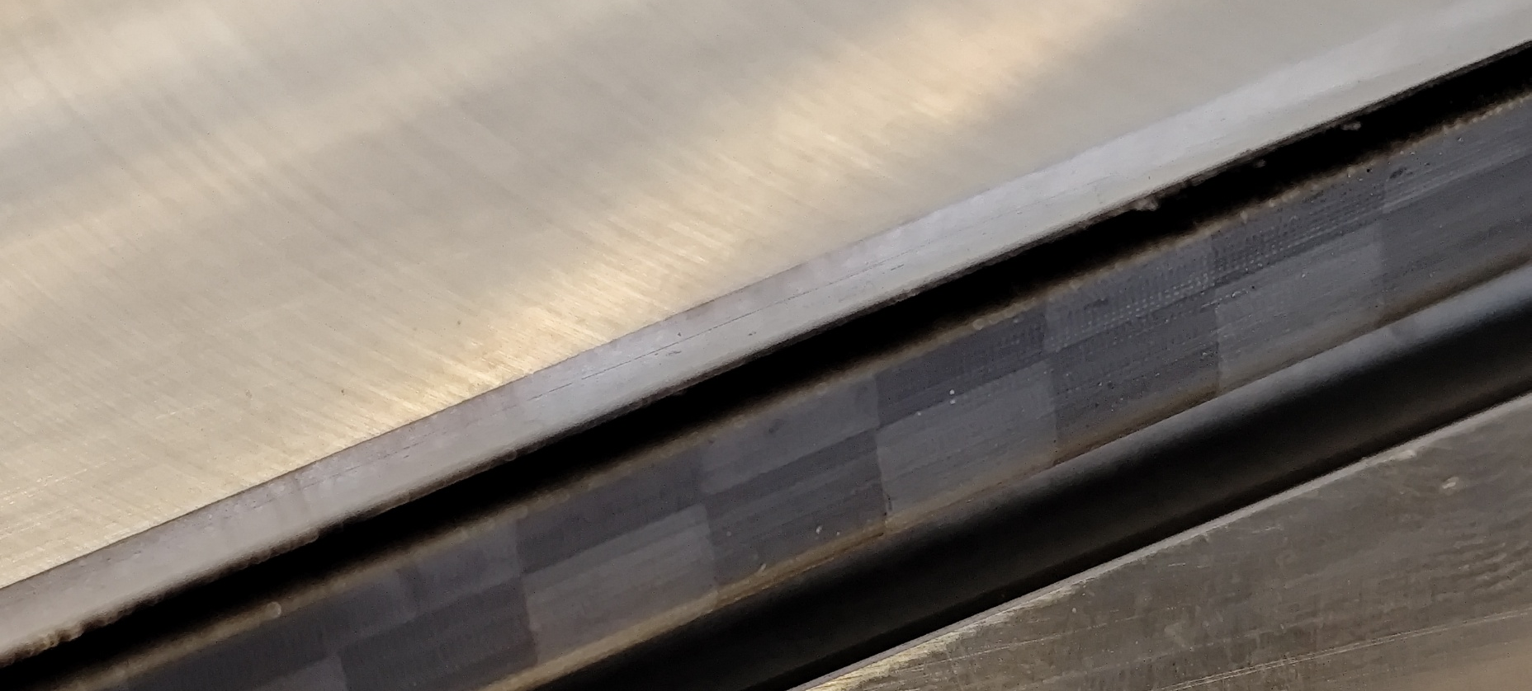
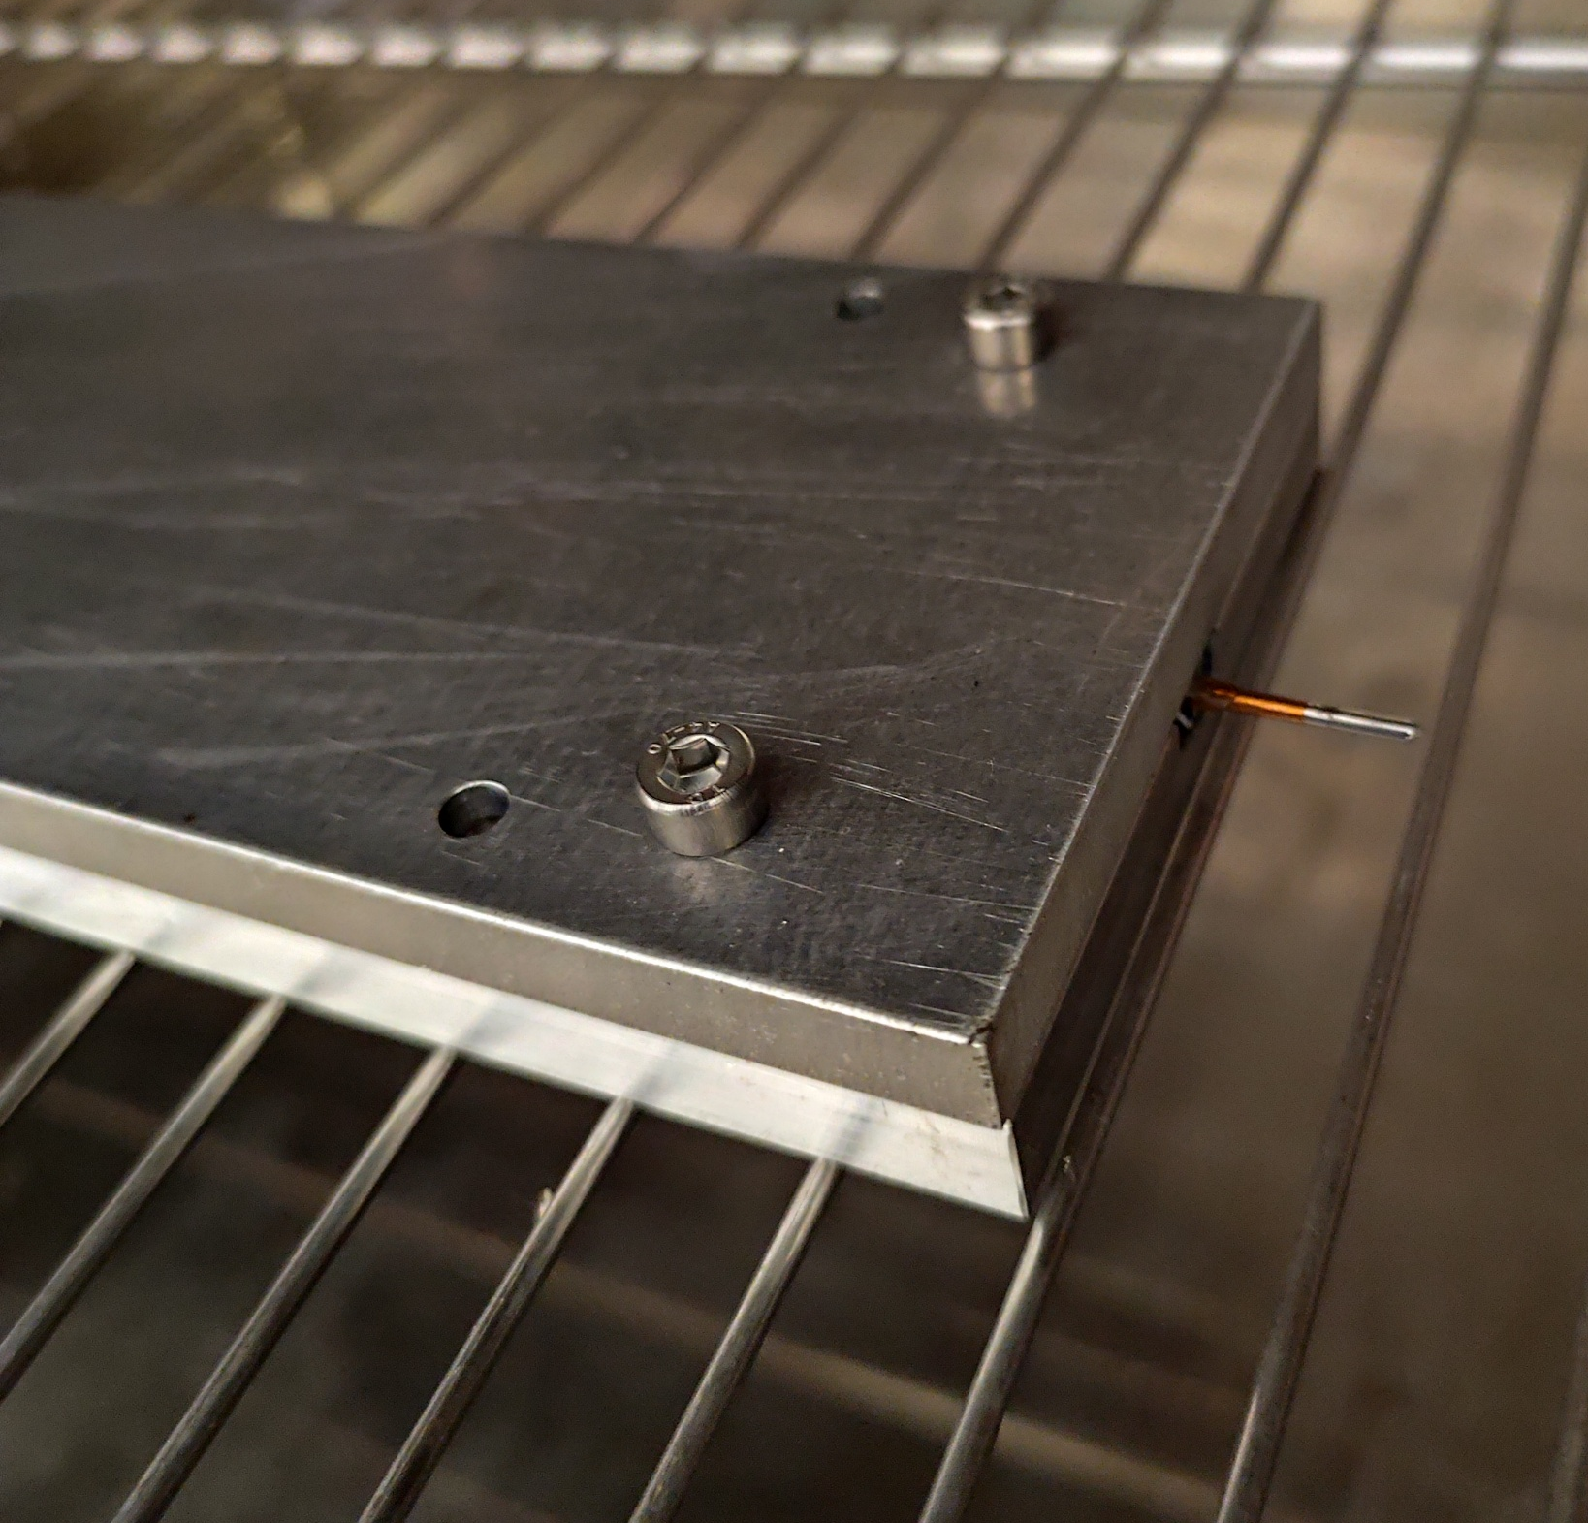
Re-curing attempt - INFN
Goal: reduce ladder deformation via stress‑relief using climatic chamber
Mold and counter‑mold redesigned (PTFE insert not suitable for thermal cycling)
We decided to follow this cycle:
  Ramp up of 1 °C/min
  Stress relief for 4 hr @ 130 °C
  Slow cool down
We started with the worst ladder with 4 mm of initial deflection
Summary of results (negative outcome)
Cold plate
Gap
Omega
Ladder into the climatic chamber
Delamination of the cold plate from the omega beam!
Deformation increases!
After this test, we received information from Loson that the cold plate is bonded with Araldite and the T_{g} is approximately 60 °C
The curing of the glue was done in a vacuum bag at ambient temperature for 24 hr
This technique is not viable for an omega beam and cold plate bonded together, but it remains valid for the single skins

Slide 17
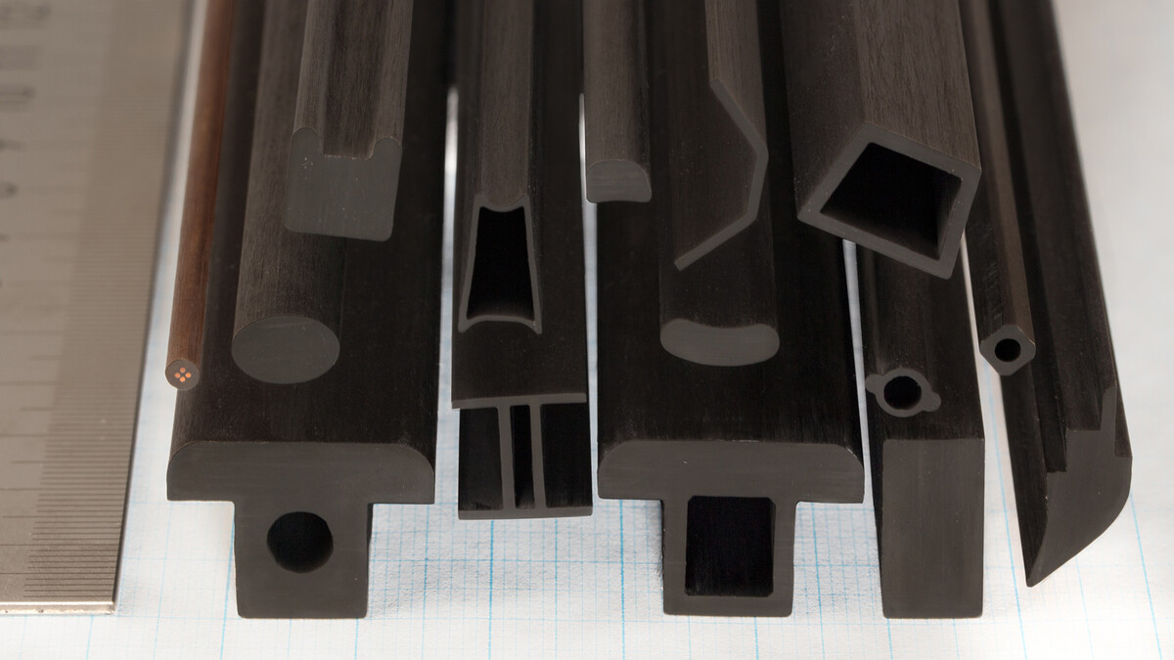
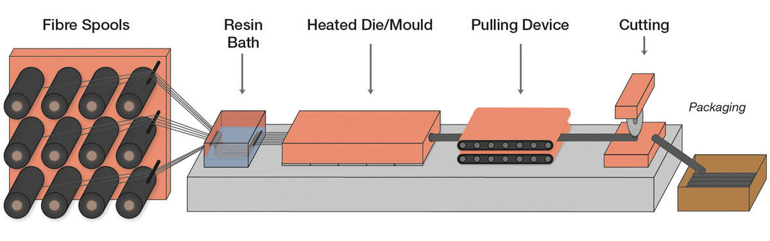
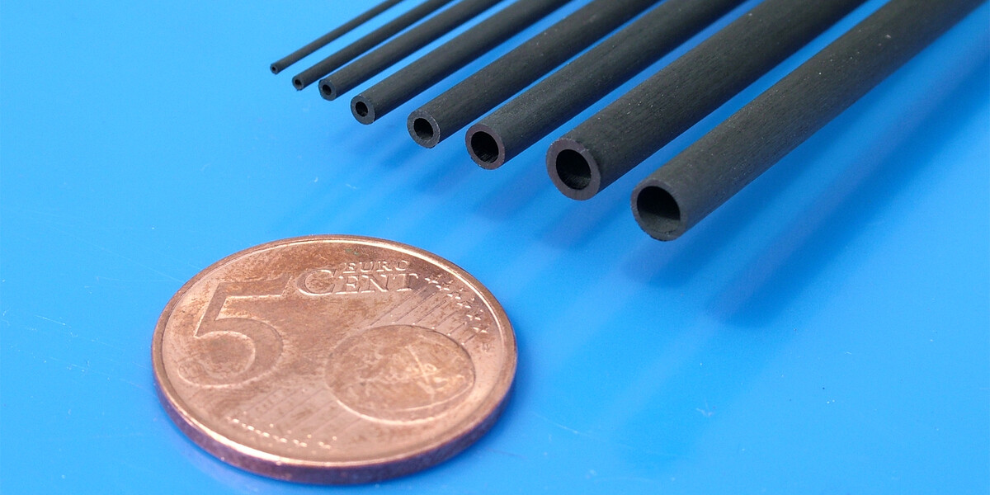
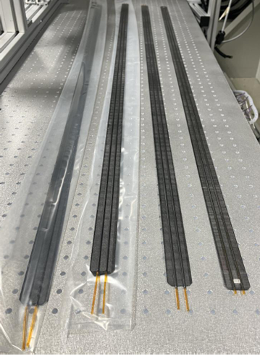
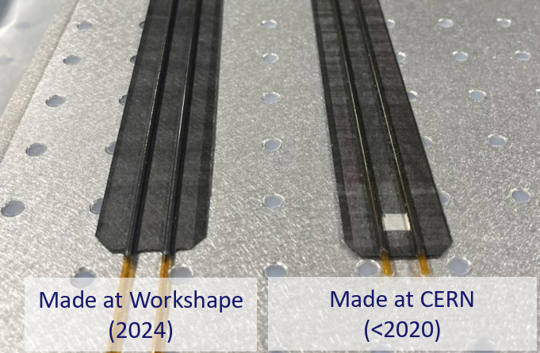
Alternative manufacturing solutions
If the target beam straightness is not met, we can investigate an alternative solution!
Omega Beam:
  Pultruded omega beam made of UD carbon fibers and epoxy resin
    Technology available from DPP Pultrusion (NL): : https://www.dpp-pultrusion.com/en-NL
    Same company already used ~20 years ago for a microchannel-based project
    Open points / missing information:
      Fiber grade (impact on beam stiffness):
        Standard Modulus (HS): Most common.
        Intermediate Modulus (IM).
        High Modulus (HM).
        Ultra High Modulus (UHM): Highest stiffness.
      Fiber / resin ratio
      Young’s modulus of materials
Cold Plate:
  An achievement of AIDAInnova project was to transfer know-how to a French company, Workshape: https://workshape.fr/en/
  They realized 1.5 m long cold plates addressing issues met during production
  The technology is now part of the CERN Venture connect program: https://ventureconnect.cern/ultra-light-cold-plate

Slide 18
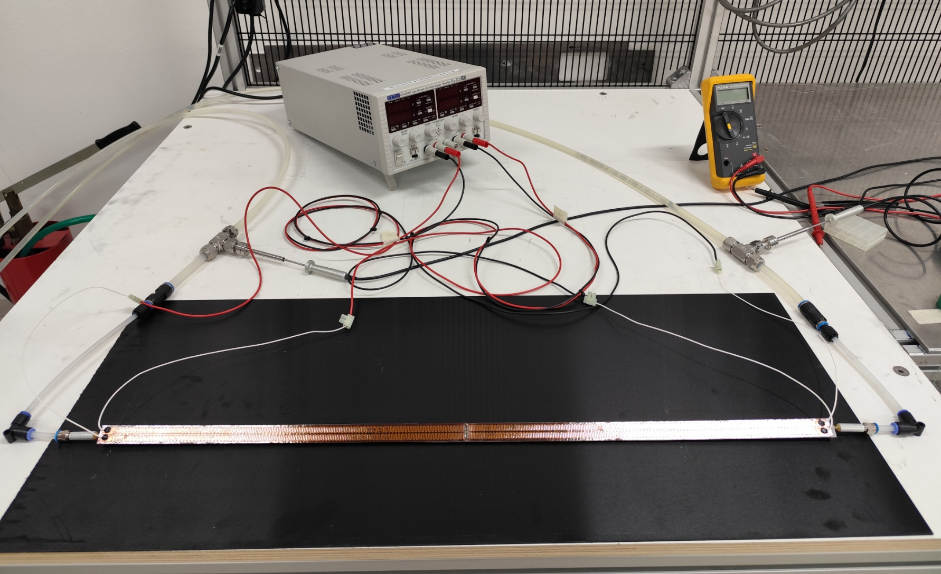
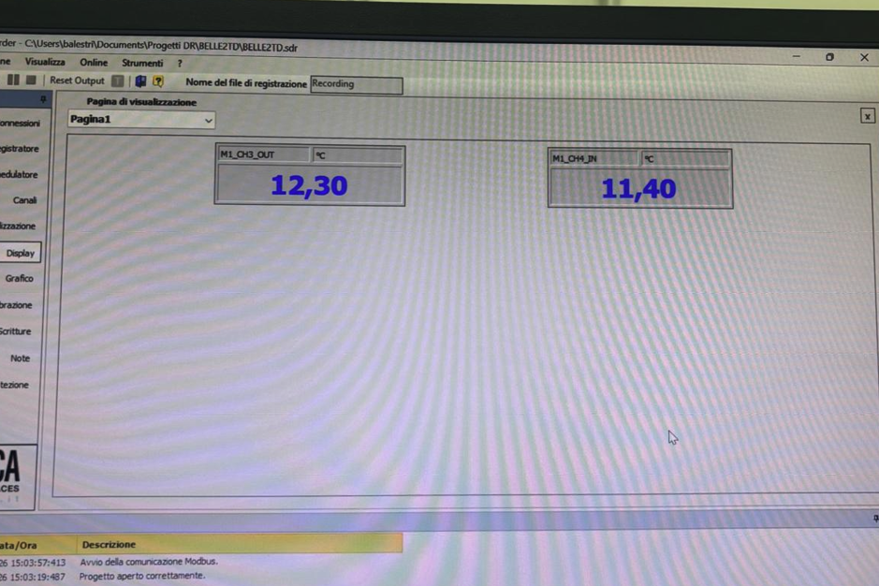
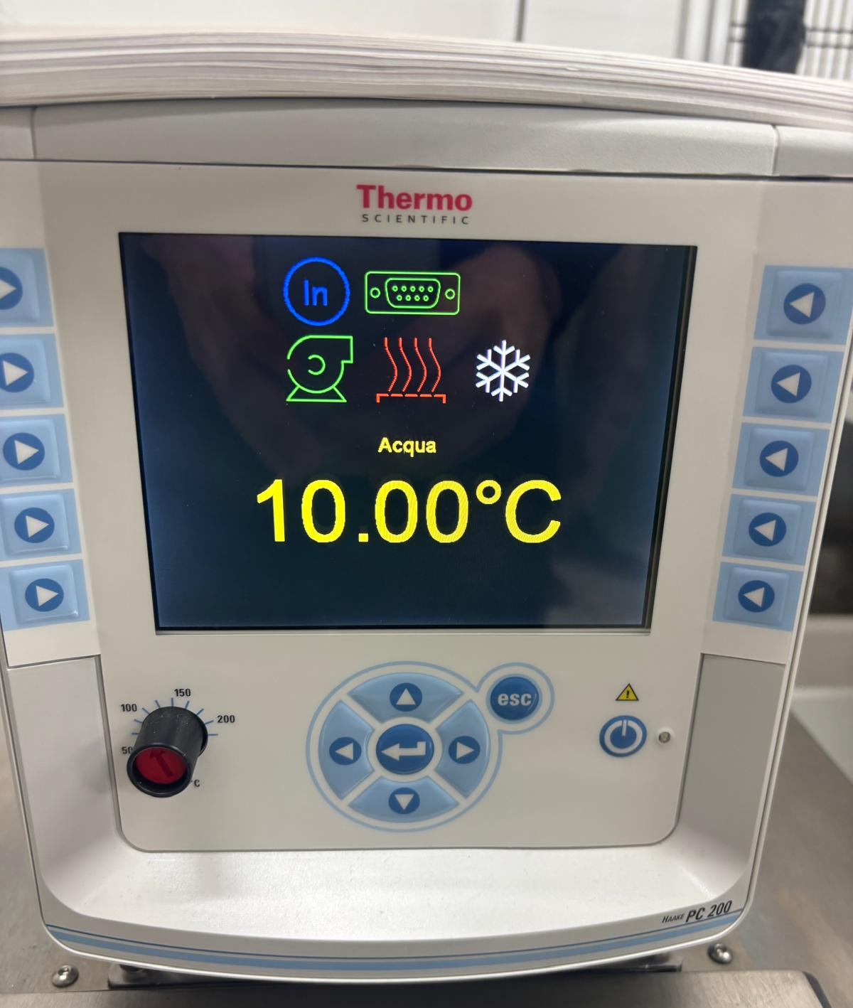
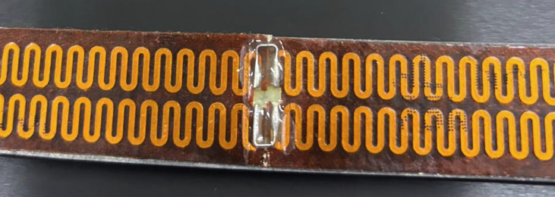
Thermal test setup
While preparing the setup, we identified issues with the flow meter and the pressure gauges.
We proceeded anyway with the tests by controlling the chiller pump speed (from 40% to 100%).
The test provides a preliminary check that the output temperatures are in the right ballpark.
Outlet Temperature
DAQ
T_{in} and T_{out}
Kapton Heaters
Inlet Temperature
Water Flow
Chiller Display
Matrix line
Periphery line

Slide 19
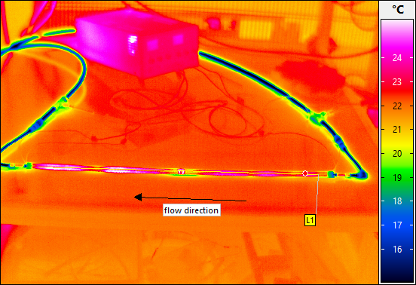
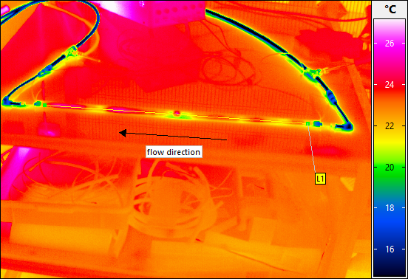
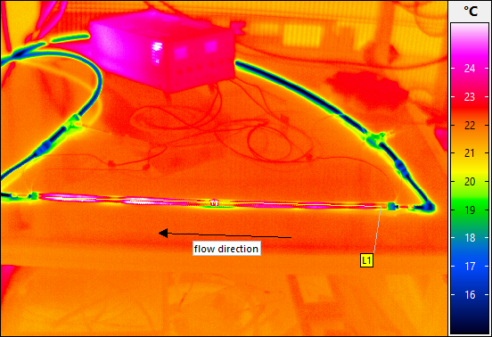
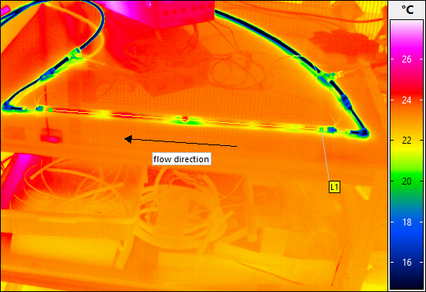
Thermal test preliminary results
Common inputs: Matrix total power: 12.6 W; Periphery total power: 14.3 W; T_{chiller}: 10 °C
Pump @ 40%
T_{in} = 11.4 °C
T_{out} = 12.4 °C
T_{amb} = 23.4 °C
Pump @ 70%
T_{in} = 11.4 °C
T_{out} = 12.4 °C
T_{amb} = 23.4 °C
Pump @ 50%
T_{in} = 11.4 °C
T_{out} = 12.4 °C
T_{amb} = 23.4 °C
Pump @ 80%
T_{in} = 11.1 °C
T_{out} = 11.7 °C
T_{amb} = 23.4 °C
White spots observed on cold plate, likely due to Kapton gluing → improved gluing foreseen.
Preliminary results are encouraging; setup and measurements still to be optimized.

Slide 20
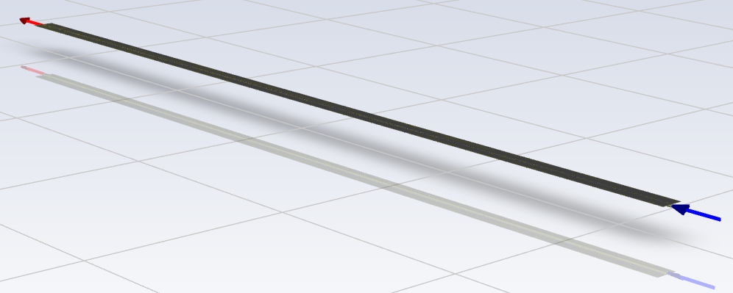
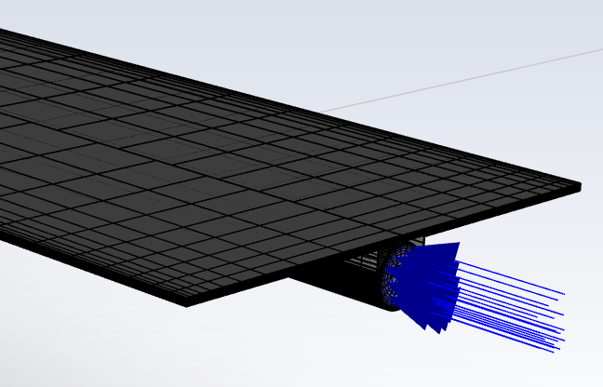
Thermal simulation - setup
Thermal simulation performed with ANSYS Fluent, including fluid flow in the cooling pipe (The coolant warms up along the Kapton pipe)
To reproduce the test conditions, matrix and periphery have the same width, which is set by the two tracks of the Kapton
The simulation is adiabatic; we didn’t consider air convection. Next step is to implement in Fluent the convective effect
Boundaries conditions:
  Matrix power density: 180 mW/cm² → 12.6 W → The entire power of the matrix is spread over one half of the cold plate
  Periphery power density: 210 mW/cm² → 14.3 W → The entire power of the periphery is spread over one half of the cold plate.
  Inlet temperature: 10 °C
  Inlet velocity (*): 1.1 m/s → around 13 lit/hour. (*): Same as ALICE ITS2
Thermal conductivities [W/mK ]:
  Carbon fleece: 0.22 / Glue: 0.22 / Graphite: 1500 in-plane – 150 out-of-plane / Kapton: 0.12 / Silicon: 150
  K13D2U(*): 376 fiber direction / 7.5 in-plane / 1.44 out-of-plane. (*) Thanks to our CMS colleagues at Purdue University

Slide 21
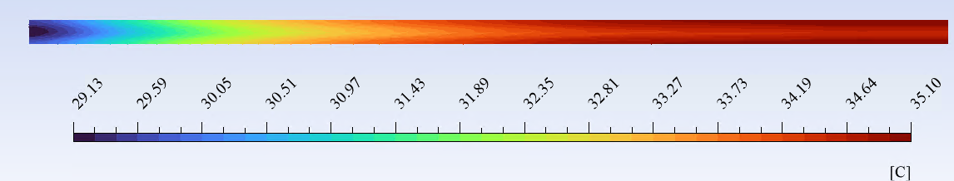
Thermal simulation - results
730 mm – 24 chips
The results appear promising and consistent with the thermal test outcomes, in terms of order of magnitude:
  Maximum temperature: around 32 °C
  Longitudinal total gradient: around 3 °C
After full calibration of the thermal model with test data (including convection), simulations with realistic matrix and periphery widths can be performed.

