Slide 1
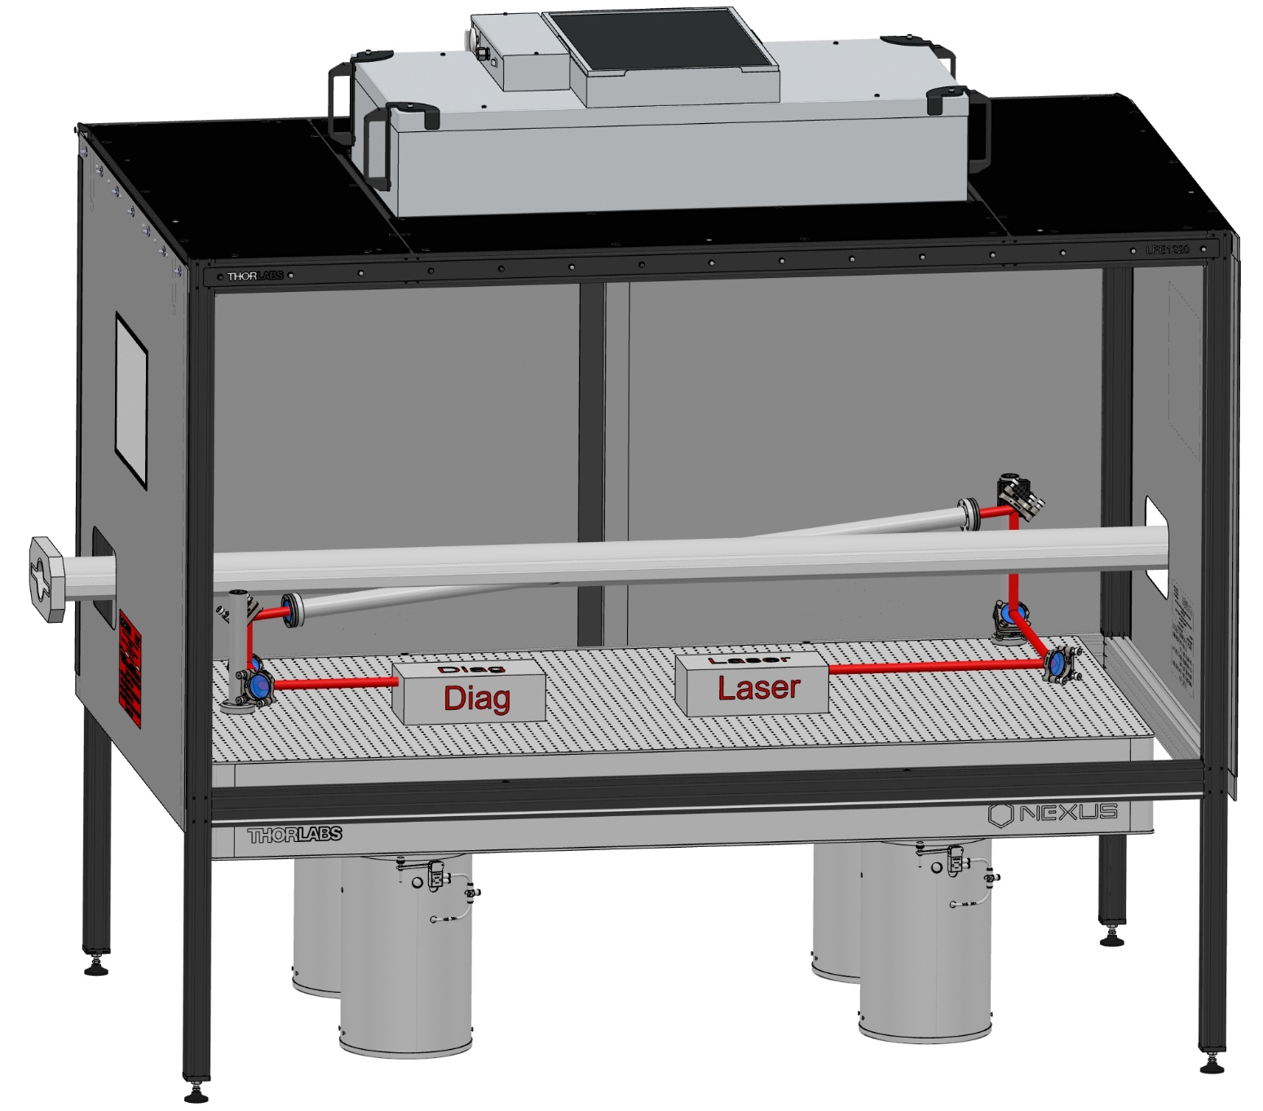
Photon Detector for Compton Polarimeter at SuperKEKB
D. Charlet et al., 2023 JINST 18 P10014

Slide 2
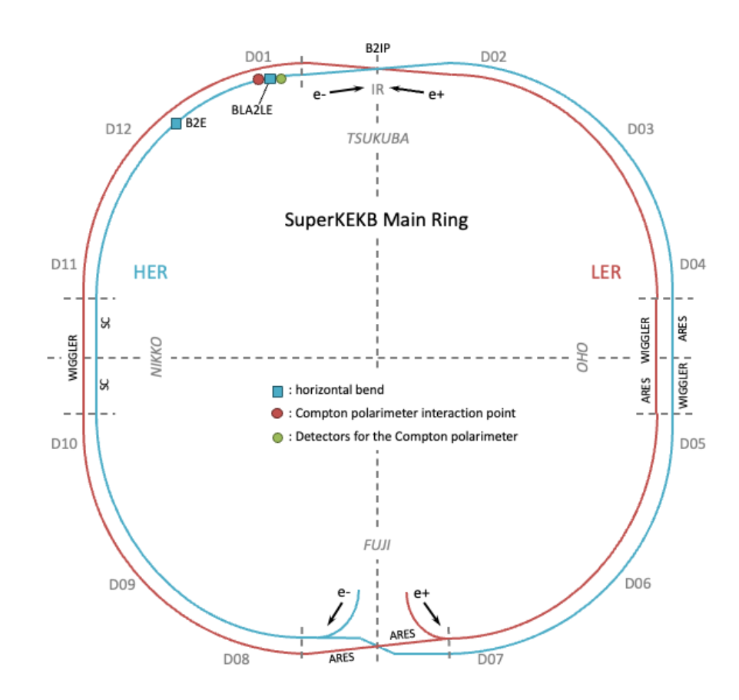
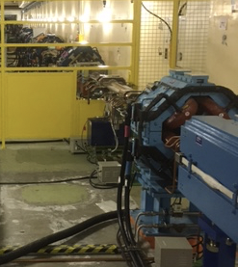
Introduction
  Photon Detector
  Requirements :
    Rate : 250 MHz
    Independent Bunch-by-Bunch Measurement
    Dynamic Range : from 100 MeV to 10 GeV
    Radiation Hard : 0,6 MGy for 6 months of operation
    Precise : 1 % of statistical uncertainty every 5 minutes
Detector Location

Slide 3
Acquisition Chain
UV filter
Scintillator
PMT
2500 histograms
Fast treatment: fit
Every 4ns
FPGA
IDROGEN board
White Rabbit node
Reduced data
To online monitoring
Analog Front-end
+ ADC (>=10bits)
clock
To remote storage (10MB/min)
Update program, constants
1rst Bunch identifier
Accelerator RF
Clock to Laser Synchronization

Slide 4
Scintillator Choice : Requirements
  Requirements :
    Radiation Hard : 0,6 MGy for 6 months of operation
    Very fast Scintillation : 4ns between bunches
  BaF2:
    Sub-ns scintillation
    Density higher than organic scintillators
    Not hygroscopic
    Fast / Slow components
    Filter for the slow component

Slide 5
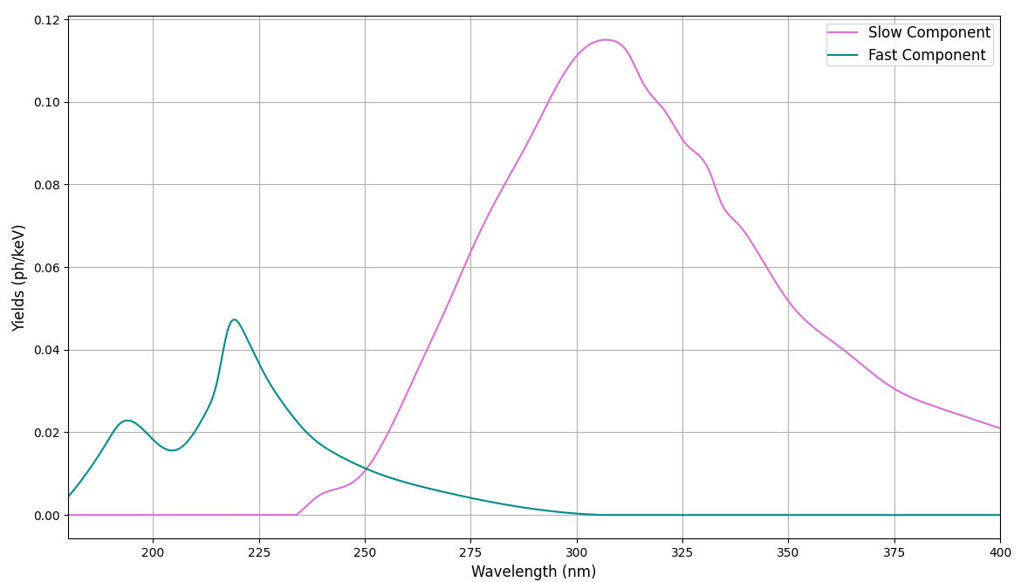
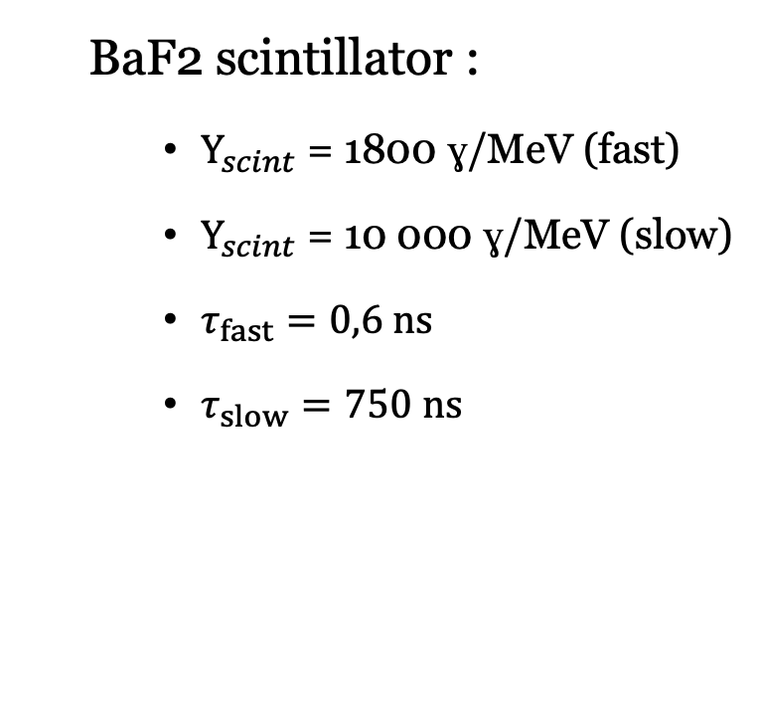
Scintillator Choice : Undoped BaF2
  BaF2 scintillator :
    $Y_{scint}$ = 1800 ɣ/MeV (fast)
    $Y_{scint}$ = 10 000 ɣ/MeV (slow)
    $τ_{fast}=0,6 ns$
    $τ_{slow}=750 ns$
  Datasheet Saint-Gobain BaF2

Slide 6
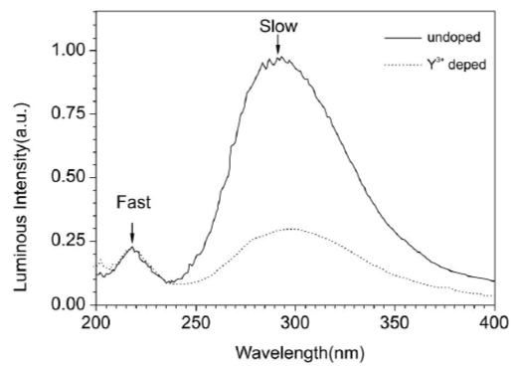
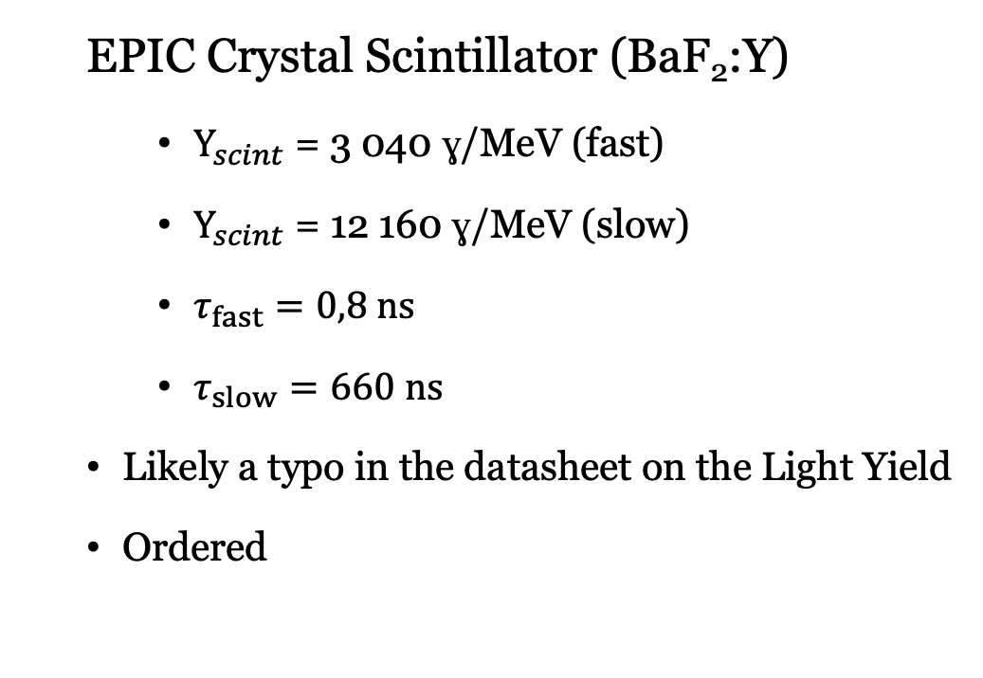
Scintillator Choice : BaF2:Y
  EPIC Crystal Scintillator (BaF₂:Y)
    $Y_{scint}$ = 3 040 ɣ/MeV (fast)
    $Y_{scint}$ = 12 160 ɣ/MeV (slow)
    $τ_{fast}=0,8 ns$
    $τ_{slow}=660 ns$
  Likely a typo in the datasheet on the Light Yield
  Ordered
  Datasheet Epic Crystal BaF2:Y

Slide 7
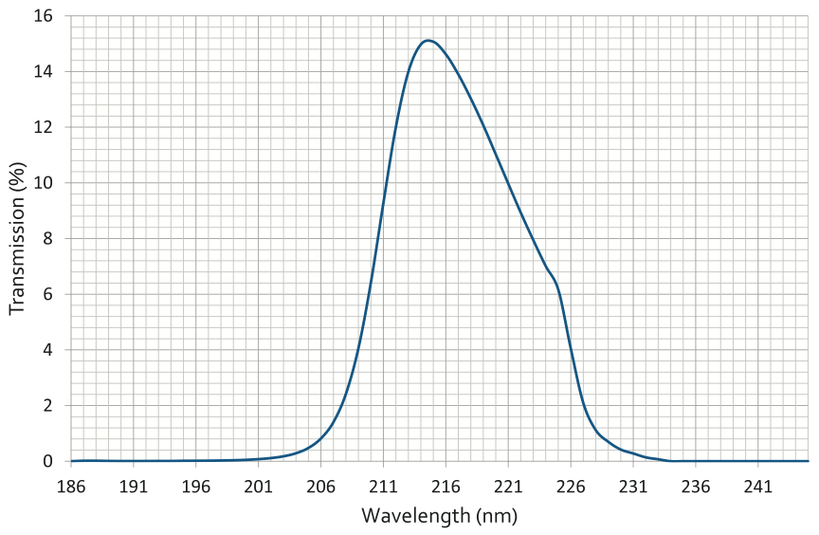
UV Filter Transmission
BaF₂:Y
BaF₂
Datasheet Knight Optical Filter

Slide 8

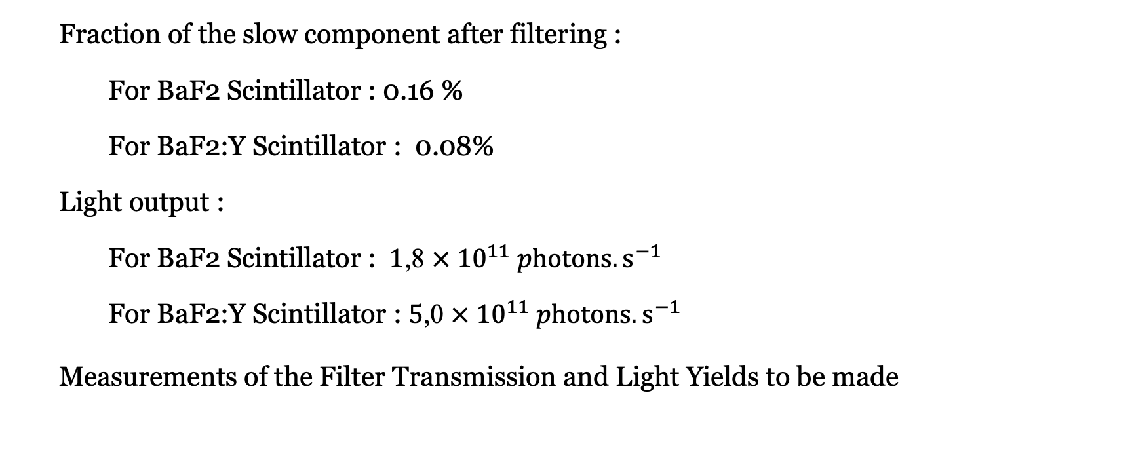
Slow Component Filtering
  Fraction of the slow component after filtering :
    For BaF2 Scintillator : 0.16 %
    For BaF2:Y Scintillator : 0.08%
  Light output :
    For BaF2 Scintillator : $\text{1}\text{,}\text{8} × {10}^{11} photons. s^{−1}$
    For BaF2:Y Scintillator : $\text{5}\text{,}\text{0} × {10}^{11} photons. s^{−1}$
  Measurements of the Filter Transmission and Light Yields to be made
$$× 3$$

Slide 9
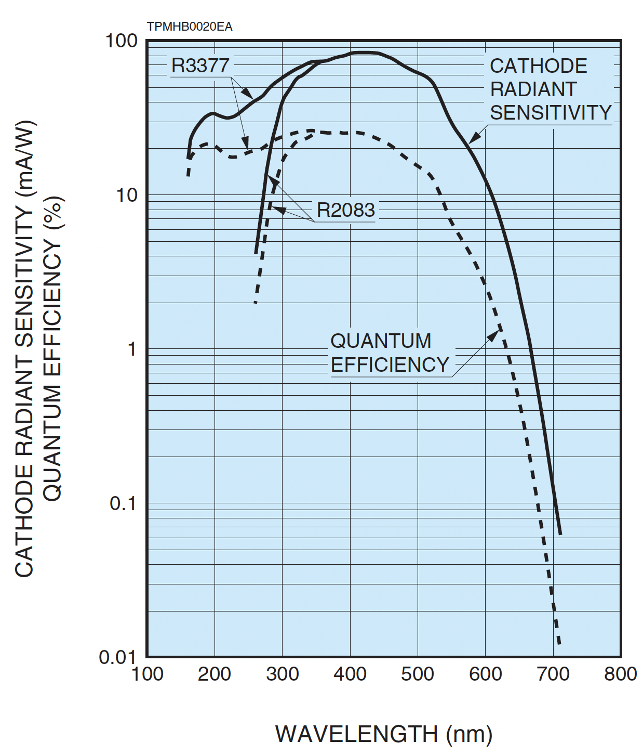

Photomultiplier Tube
Requirements : Fast Response (Low Rise Time and Low Transit time Spread) and not blind to UV.
Hamamatsu Photomultiplier R3377 ( Datasheet Hamamatsu R3377 )
  Nominal Gain : $2,5×{10}^{6}$
  Silica Glass Window : Respond to UV.
  Linear Focusing Dynodes : fast response
 | Nominal Gain | G = 10⁴
Rise Time (ns) | 0.80 | 1.39
Transit Time Spread (ns) | 0.37 | 0.64
Typical Spectral Response

Slide 10
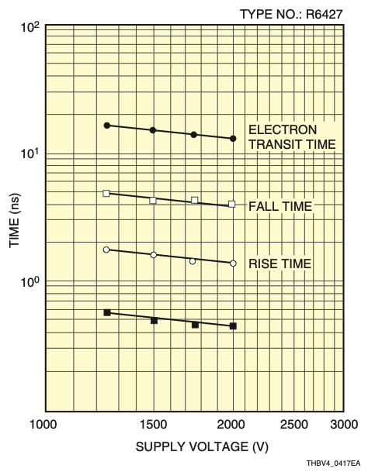

Photomultiplier Tube
Requirements : Fast Response (Low Rise Time and Low Transit time Spread) and not blind to UV.
Hamamatsu Photomultiplier R3377 ( Datasheet Hamamatsu R3377 )
  Nominal Gain : $2,5×{10}^{6}$
  Silica Glass Window : Respond to UV.
  Linear Focusing Dynodes : fast response
  Hamamatsu Handbook
 | Nominal Gain | G = 10⁴
Rise Time (ns) | 0.80 | 1.39
Transit Time Spread (ns) | 0.37 | 0.64
$$t∝ V^{-1/2}$$
Time Characteristics vs. Supply Voltage

Slide 11
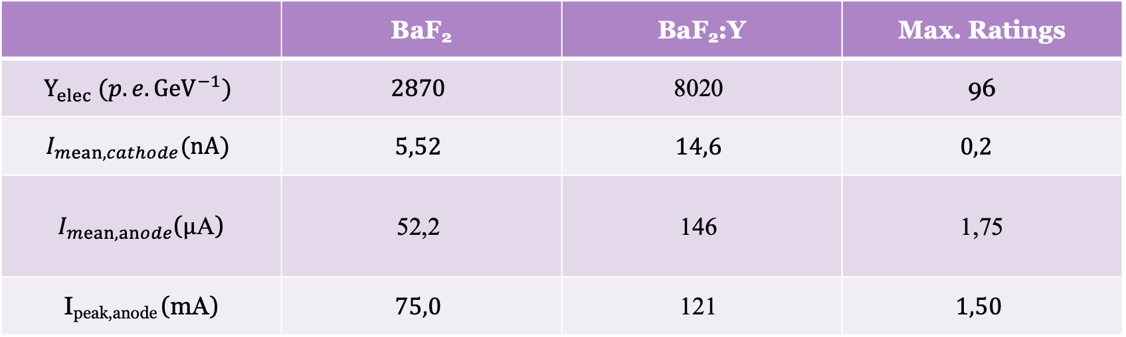
Expected Sensitivity
Hypothesis : Light Collection = 10 %, no light attenuation yet, G_{pmt} = 10⁴
 | BaF₂ | BaF₂:Y | Max. Ratings
$$Y_{elec} (p.e. {GeV}^{−1})$$ | $$\text{2870}$$ | $$\text{8}\text{020}$$ | 96
$$I_{mean,cathode}(nA)$$ | $$5,52$$ | $$14,6$$ | $$0,2$$
$I_{mean, anode}$($μ\text{A}$) | $$\text{52,2}$$ | $$\text{1}\text{46}$$ | $$\text{1,75}$$
I_{peak,anode} (mA) | $$\text{75,0}$$ | $$\text{1}\text{21}$$ | $$\text{1}\text{,50}$$
We need to lower the current at the anode maybe by lowering the light flux

Slide 12
Solutions
Concessions to be made on time and/or energy resolution
  Reduce the sampling rate
  Lower the light intensity at the photocathode with a diaphragm or another filter

Slide 13
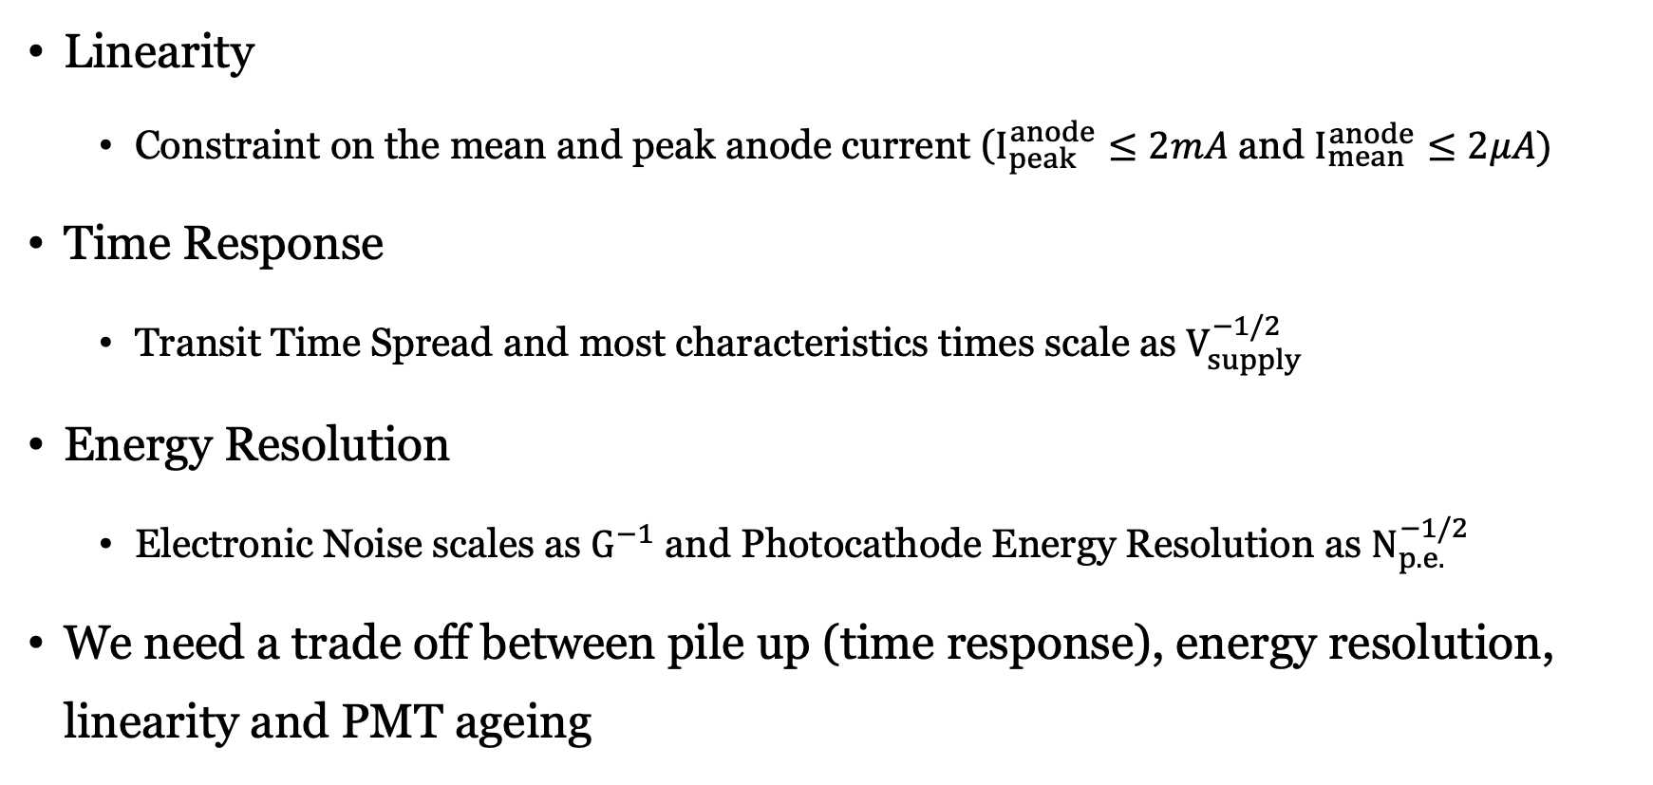
Limitations
Linearity
  Constraint on the mean and peak anode current ($I_{peak}^{anode}≤2mA$ and $I_{mean}^{anode}≤2μA)$
Time Response
  Transit Time Spread and most characteristics times scale as $V_{supply}^{−1/2}$
Energy Resolution
  Electronic Noise scales as $G^{−1}$ and Photocathode Energy Resolution as $N_{p.e.}^{−1/2}$
We need a trade off between pile up (time response), energy resolution, linearity and PMT ageing

Slide 14
Simulations
Goal : Find the maximum energy resolution that is acceptable
Monte Carlo Simulation
  Energy spectrum of the scattered photons
  Fitting of energy spectrum
Acquisition Chain Simulation
  Scintillator and PMT response
  Electronic noise and Time response
  Filter
  ADC

Slide 15
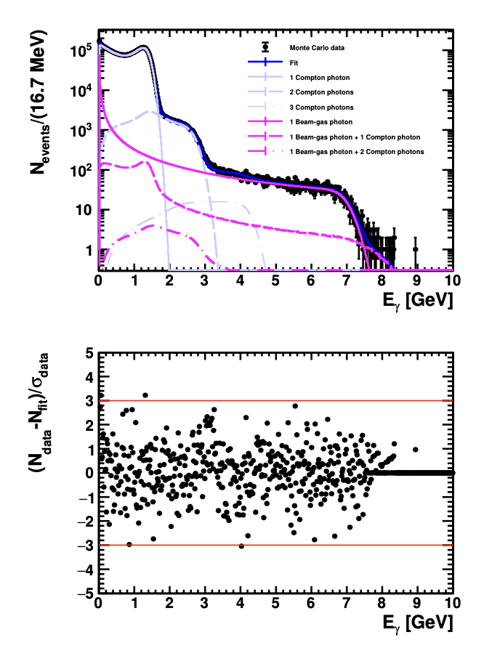
Pulses Simulation
First Approach :
Generate 10⁶ pulses ( 5 minutes ) with the Compton energy distribution.
Simulate the acquisition chain.
Export the reconstructed energy to fit the data.
But the acquisition chain cannot simulate 10⁶ pulses (Memory Limits)
D. Charlet et al., 2023 JINST 18 P10014

Slide 16
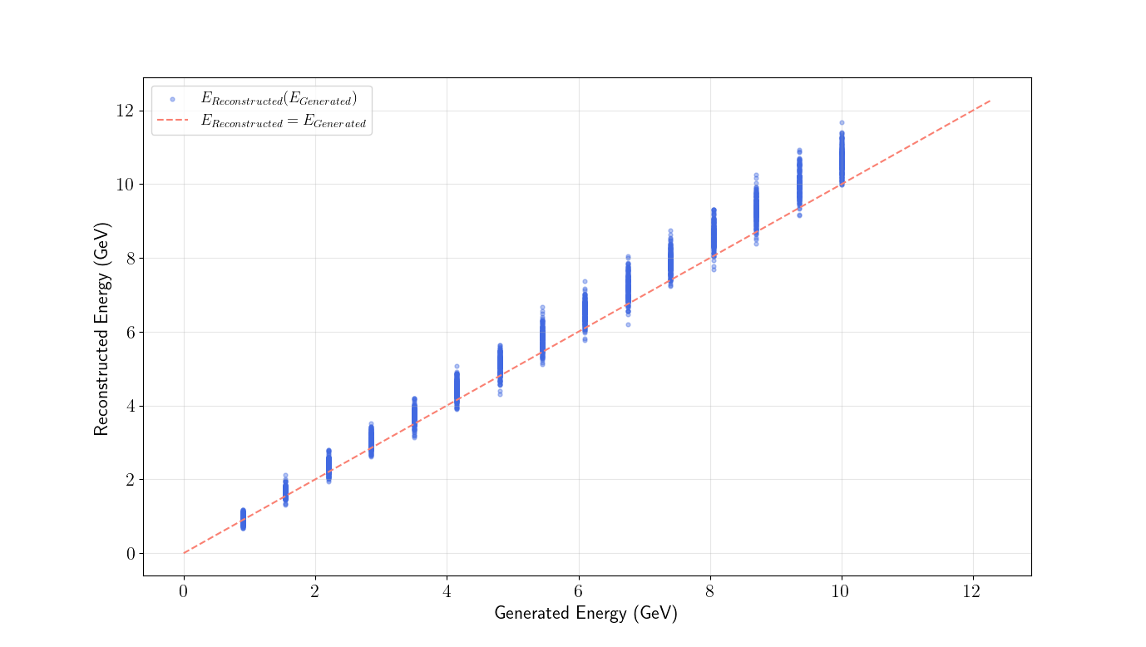
Acquisition Chain - Energy Resolution
Other Approach
  Energy sampling on the range 0.9 to 10 GeV
  Simulation of 200 pulses with a fixed energy
  Determination of the energy resolution
  Monte Carlo simulation with this energy resolution
  Fit of the simulated data
What is in the Simulation
  Poisson Distribution
  Excess Noise factor
  ADC

Slide 17
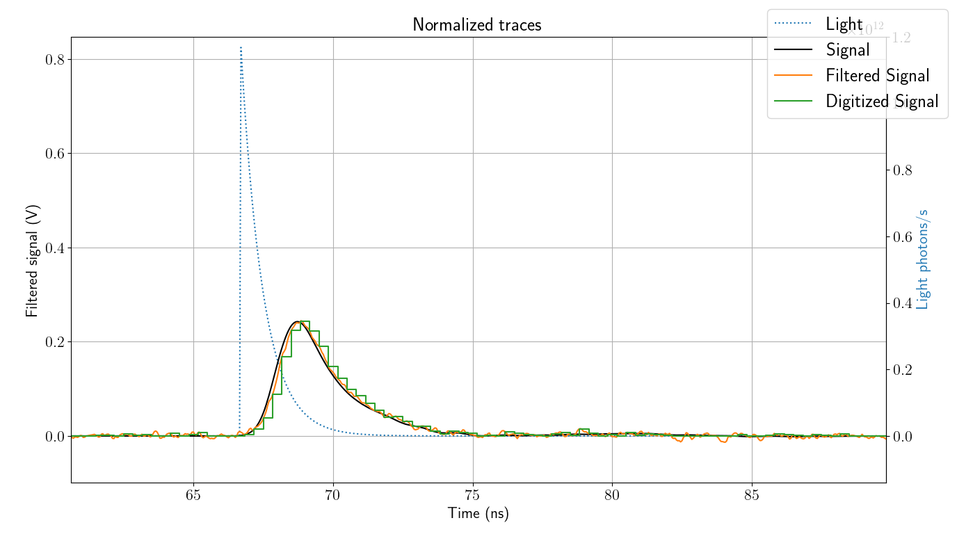
Simulation Parameters
Rate = 15 MHz
Sampling Rate = 3 GHz
N_{bits} = 10 bits
ADC Range = 1,5 V
𝜏_{fast} = 0,8 ns
Excess Noise Factor : 1.2

Slide 18
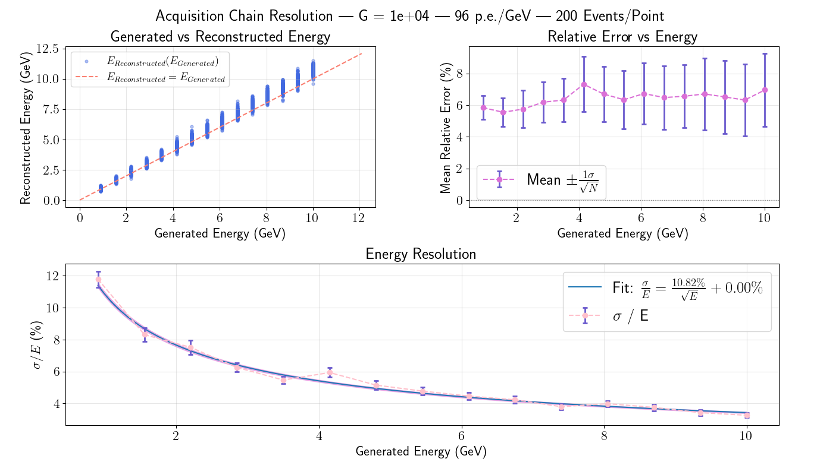
Results on Energy Resolution
Notes:
A = 10.815 ± 0.137 %·\sqrt{GeV} | B = 5.000e-19 ± 0.000e+00 %

Slide 19
What’s Next ?
Measurements on the Scintillators and Filter → Conclude on the expected Light Yield
Light Collection Measurement
Choose a PMT Gain and how much we want to reduce the light flux

Slide 20
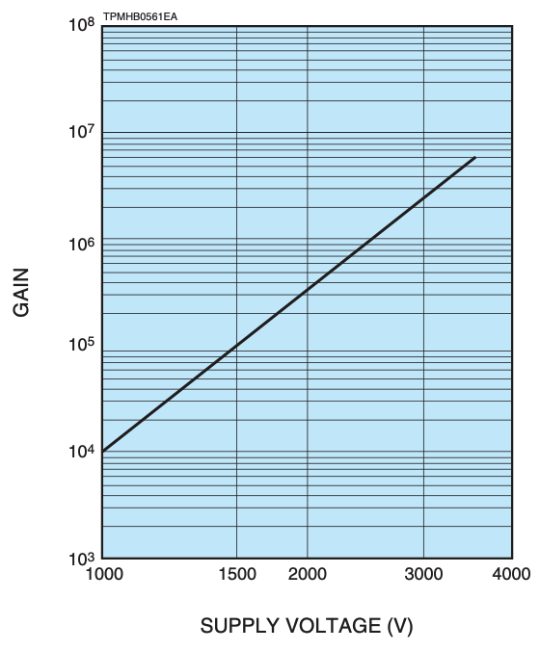
Back up – Gain vs. Supply Voltage

Slide 21
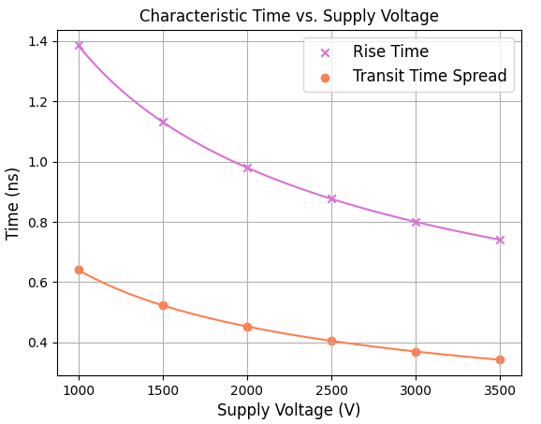
Back up – Time Response vs. V_{supply} (R3377)

Slide 22
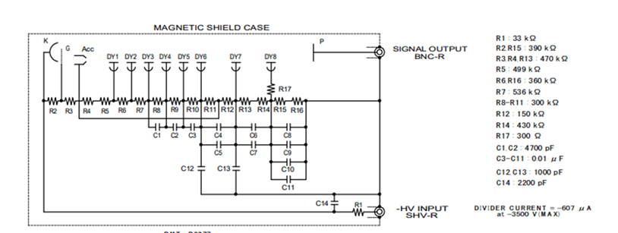
Back up – Voltage Divider Constraint

Slide 23
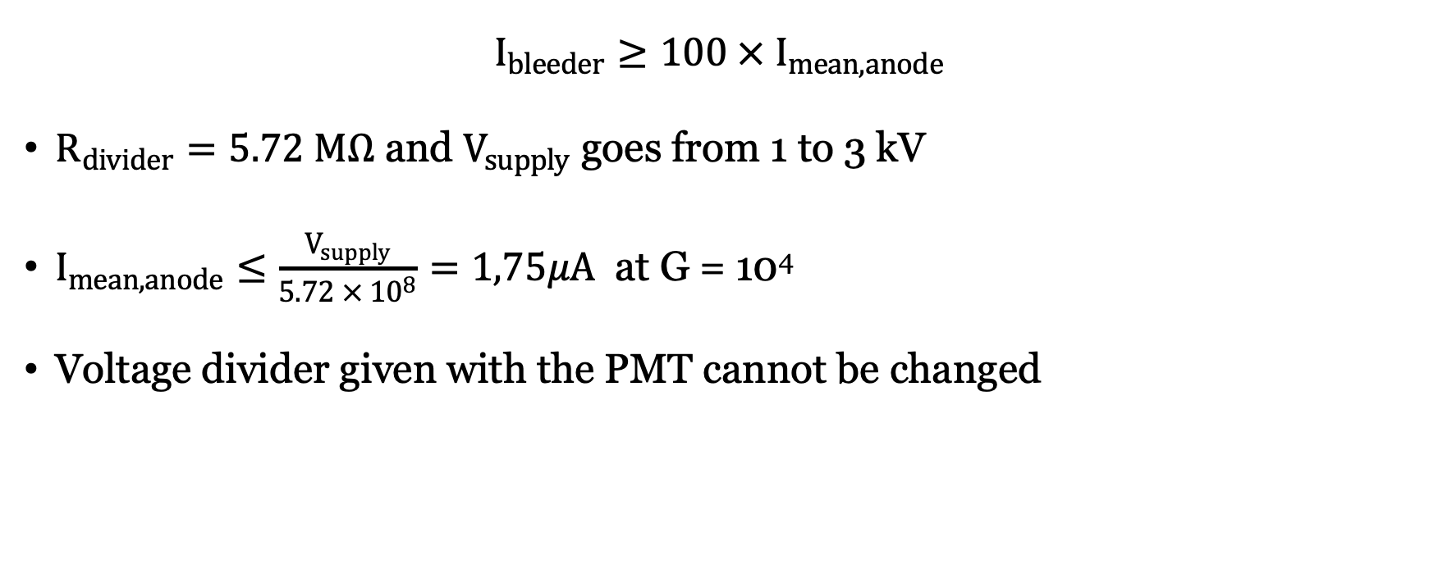
Back up – Voltage Divider Constraint
$$I_{bleeder}≥100 × I_{mean,anode}$$
$R_{divider}=5.72 MΩ$ and $V_{supply}$ goes from 1 to 3 kV
$I_{mean,anode}≤\frac{V_{supply}}{5.72 × {10}^{8}}=1,75μA$ at G = 10⁴
Voltage divider given with the PMT cannot be changed

