Slide 1
Compton polarimetry for SuperKEKB upgrade
Aurélien MARTENS

Slide 2
Introduction
White report drafting:
  A draft document for the polarimeter is ready, attached to the indico page, please comment.
  An overleaf version is available upon request
  Baseline location of polarimeter needs to be decided to progress further
  Assumes so far that longitudinal polarization will be measured
Content of today’s presentation:
  Investigations related to the detection system for photons
  Short summary about the physics process
  Summary of what needs to be done (assuming at this stage a longitudinal e-beam polarization)
  Detection system for photons ?
  Progress on a dedicated MC and fitter (for offline extraction)

Slide 3

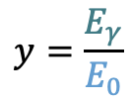
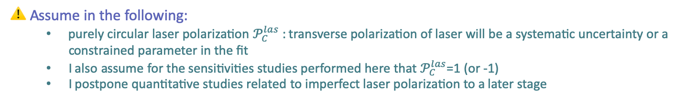
Compton cross-section
$$x=\frac{2E_{0}ω_{0}}{m^{2}}\left(1+\cos{θ_{0}}\right)$$
$$y=\frac{E_{γ}}{E_{0}}$$
The Compton cross-section averaged over scattered particles spins:
Differential cross-section
Transverse laser polarisation: nuisance parameter to minimize and keep under control
Transverse electron beam polarisation: intervenes as an asymmetry in the transverse plane
$$\frac{dσ}{dydφ_{obs}}\left(x,y\right)=\frac{dσ_{0}}{dy}\left(x,y\right)+\frac{dσ_{⊥}}{dy}\left(x,y\right)\cos\left(2\left(φ_{obs}−φ_{las}\right)\right)𝒫_{⊥}^{las}+\frac{dσ_{∥}}{dy}\left(x,y\right)𝒫_{C}^{las}(P_{T}f_{T}\left(x,y\right)\cos\left(φ_{obs}−φ_{elec}\right)+P_{L}f_{L}(x,y))$$
Electron beam polarization independent
Electron beam polarization dependent
⚠️ Assume in the following:
  purely circular laser polarization $𝒫_{C}^{las}$ : transverse polarization of laser will be a systematic uncertainty or a constrained parameter in the fit
  I also assume for the sensitivities studies performed here that $𝒫_{C}^{las}$=1 (or -1)
  I postpone quantitative studies related to imperfect laser polarization to a later stage

Slide 4
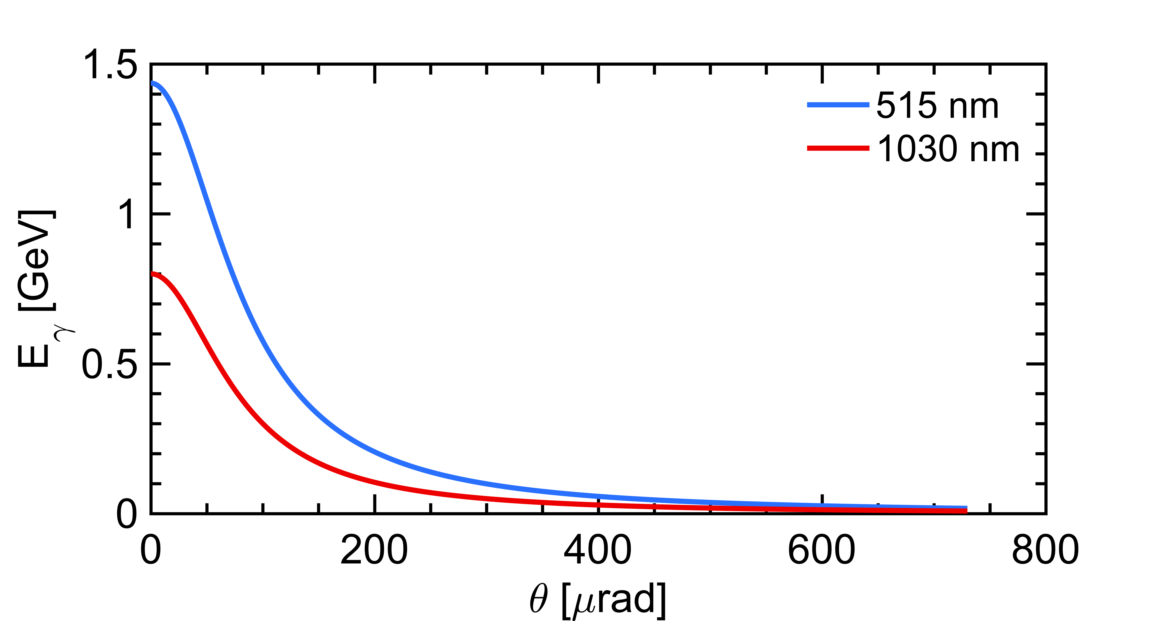


A first look at the unpolarized term
laser (E_{λ})
Initial electron energy (7 GeV)
Initial photon energy (1.2eV at 1030nm)
Crossing angle of beams
Emitted photon energy
$$θ_{0}$$
θ
e⁻ beam $Ee$
energy vs emission angle correlation
Landau-Lifshitz QED book paragaphs 86 and 87
Conical emission:
98% of photons within 730𝜇rad
⚠️ Remember:
  Photons (electrons too) are scatterred in the forward direction, in a narrow cone around the electron beam axis
  I further implicitely assume that detection of photons require to clear a line of sight of about L=30m

Slide 5
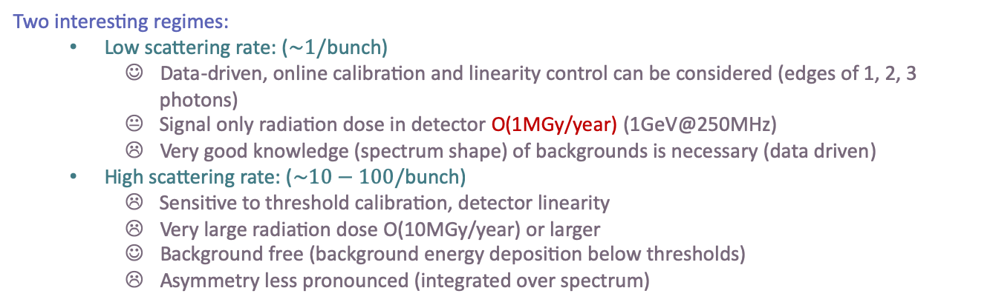
Detection of photons: requirements
Energy of photons (~1GeV) in a narrow cone
Distinguish each bunch at 250MHz (4ns)
Two interesting regimes:
  Low scattering rate: ($\sim 1/$bunch)
    Data-driven, online calibration and linearity control can be considered (edges of 1, 2, 3 photons)
    Signal only radiation dose in detector O(1MGy/year) (1GeV@250MHz)
    Very good knowledge (spectrum shape) of backgrounds is necessary (data driven)
  High scattering rate: ($\sim 10−100/$bunch)
    Sensitive to threshold calibration, detector linearity
    Very large radiation dose O(10MGy/year) or larger
    Background free (background energy deposition below thresholds)
    Asymmetry less pronounced (integrated over spectrum)
Concentrate on this strategy

Slide 6
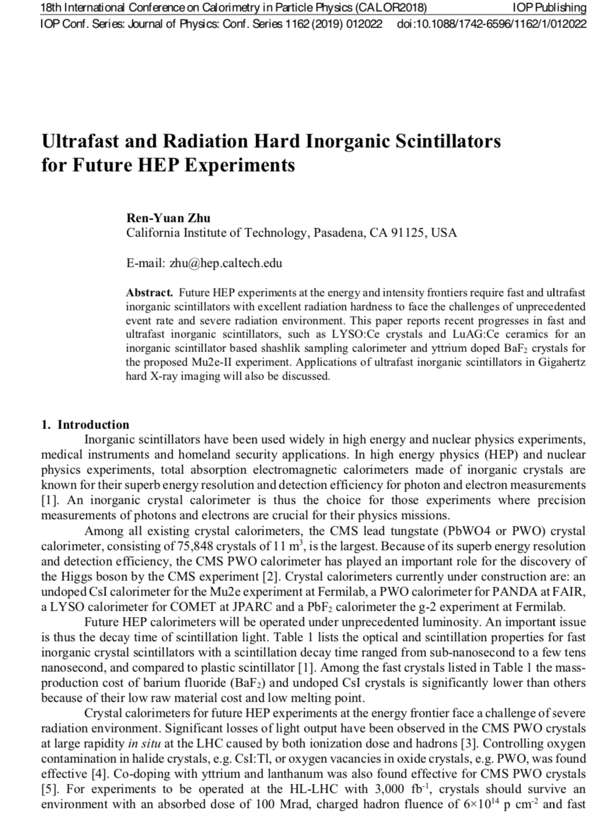
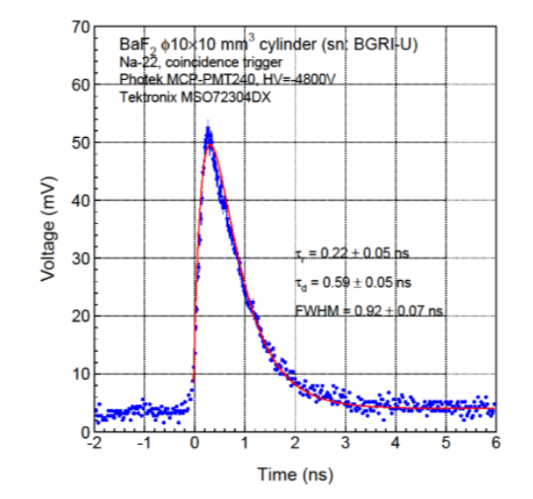
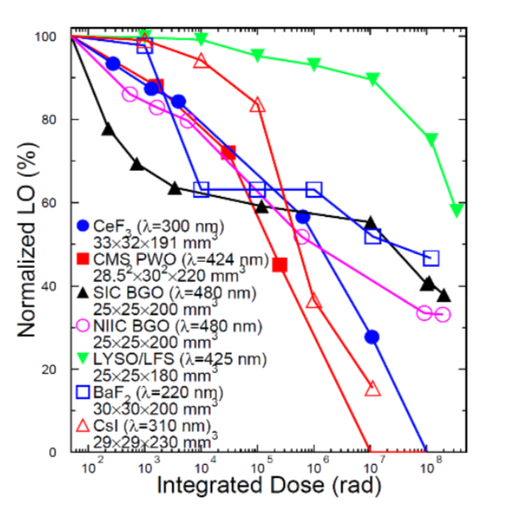
Basic idea of detector
Basic elements
  a VERY FAST radhard scintillating crystal → BaF2
    Need to filter out the slow component → UV optical filters
    Interesting: Y doping reduces the slow component, but R&D stage
  a PMT with low transit time dispersion → commercially available (hamamatsu for instance)
  Associated electronics
  Next step: validate detection scheme

Slide 7
Basic idea of detector
Basic elements
  a VERY FAST radhard scintillating crystal → BaF2, the only solution ?
    Need to filter out the slow component → UV optical filters
    ☺ Interesting: Y doping reduces the slow component, but R&D stage
  a PMT with low transit time dispersion → commercially available (hamamatsu for instance)
  Associated electronics
  Next step: validate detection scheme
…
2500 bunches → 2500 histograms
About 1000 bins each (or less ?)
12 bits dynamics ?
30Mb (3.75MB) to transfer every minute
Two options
  Embarked ADC and data processing in the accelerator bay w/transfer link to storage, requires clock (laser also needs it) and bunch identification
  Deported electronics ‘à la’ lumi with diamonds sensors ? (expensive high BW cables)

Slide 8
Polarization extraction
Offline: fitter
  Not immediate but can be very precise
  Account for every detail of the experiment → I start by implementing this step by step
Online: fast approximate/biased extraction
  To be investigated based on HERA work by C. Pascaud et al. (Orsay group)
HERA

Slide 9
Offline fitter: ingredients
Ideally (time consuming, can be part of a PhD project):
  One should probably use a dedicated generator (CAIN most probably)
  Account for every detail of the detection system with a Geant4 reconstruction
However the most important aspects of the simulation are relatively simple to implement in a quick Monte Carlo :
  Compton cross-section (polarization effects included)
  Detector energy resolution
  Finite detector size
  Smearing from the finite electron beam emittance and dispersion (depends on baseline location)
  Data filled in histograms
All these effects can also be fit in a simple binned chi2 (or ML) with ROOT6 and MINUIT2 library
  To start with: I only fit a scale factor and Pz.
  I numerically integrate the Compton cross-section over the detector size and bin width accounting for
    detector energy resolution
    horizontal point spread due to finite e-beam sizes
    Miscalibration (if any)
  I assume that the detector has nominally a square cross-section (despite it may be simpler to implement a cylindrical detector in the end)
I first go through a sanity check that everything goes fine when I assume one and only photon is scaterred per bunch crossing.
This is obviously work in progress !

Slide 10
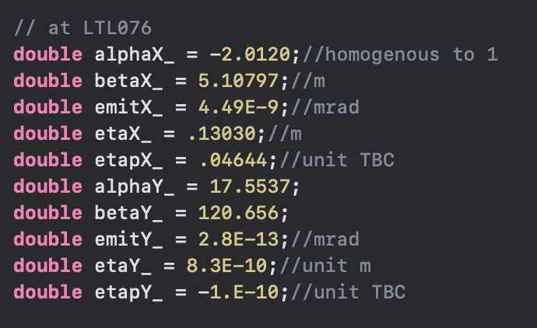
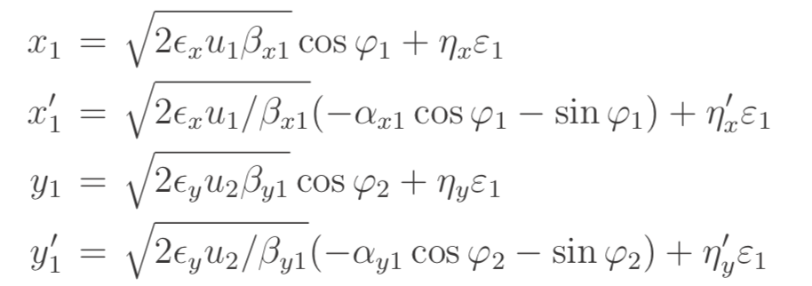
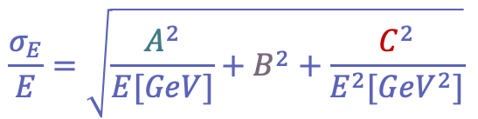
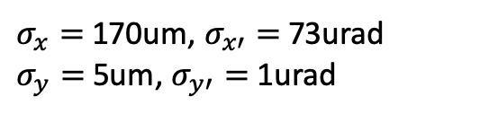

Detector/e-beam parameters
$$\frac{σ_{E}}{E}=\sqrt{\frac{A^{2}}{E[GeV]}+B^{2}+\frac{C^{2}}{E^{2}[{GeV}^{2}]}}$$
Detector energy resolution
Finite detector size
  Detector assumed to be placed at L=30m from Compton IP
  Square section of 25x25 mm²
Electron beam parameters
  Taken at LTL076 (numbers to consolidate)
  Relative energy spread 6.3e-4
Induces a (gaussian) point spread function at the detector plane:
  Similarly in y
A=10% (conservative ?); B=1% (optimistic ?); C=pile-up, electronics, 0 for now on
See for instance CAIN user manual, for the generation of e-beam parameters
$σ_{x}=$170um, $σ_{x′}=$73urad
$σ_{y}=$5um, $σ_{y′}=$1urad
$$σ_{D}^{2}=σ_{x}^{2}+{L^{2}σ}_{x′}^{2}$$

Slide 11
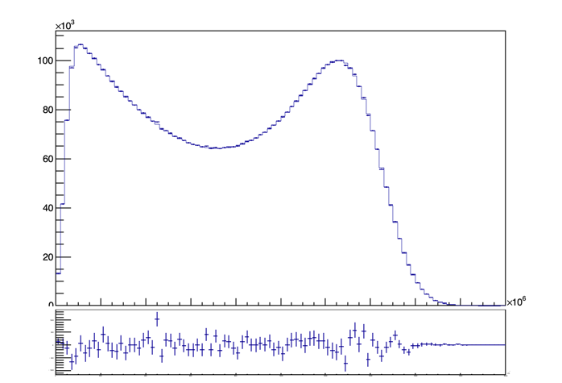
Result
Perfectly aligned, calibrated, known average beam energy, known e-beam phase-space parameters
Chi2=101
Ndf = 98
6M entries (1minute data taking)
3.5h fit !!! (four numerical integrations)

Slide 12
But…
The fit is time consuming but actually too accurate for the situation we may face in data:
I will now try to look at ‘degraded’ fitters to investigate several effects, keeping in mind that we are able to revert to an accurate fit of MC data (and that maybe a cylindrical geometry is maybe more appropriate)
Beam gas + synchrotron radiation peak may be the dominant contributions at low energies
HERA
Maybe not so important to accurately fit the low energy part

Slide 13
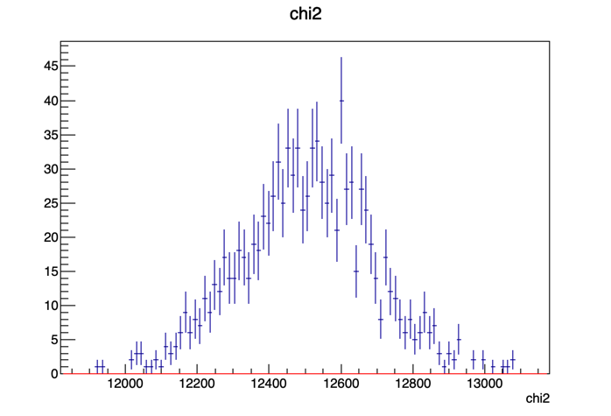
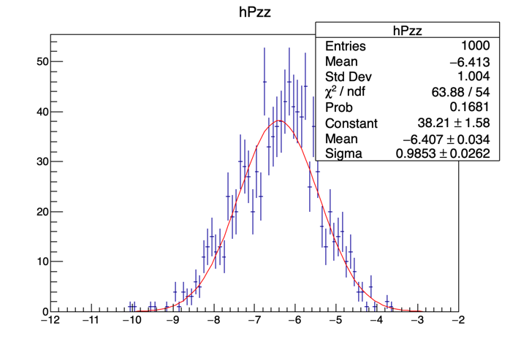
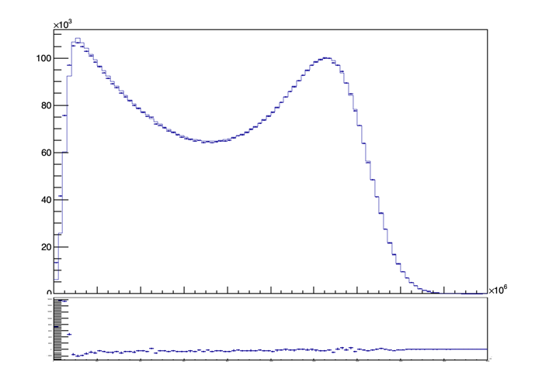
Lower energy part of spectrum
Chi2 around 12450
Pull for Pz
10% resolution
w/ e-beam smearing
Cylindrical det.
The (deliberately) wrong assumption about detector geometry mainly biases low energy contibution that is likely to be dominated by backgrounds and will not provide sensitivity.
→ Need a full model with realistic backgrounds

Slide 14
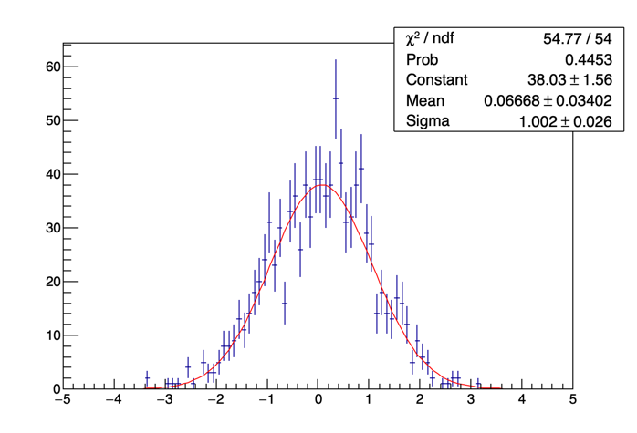
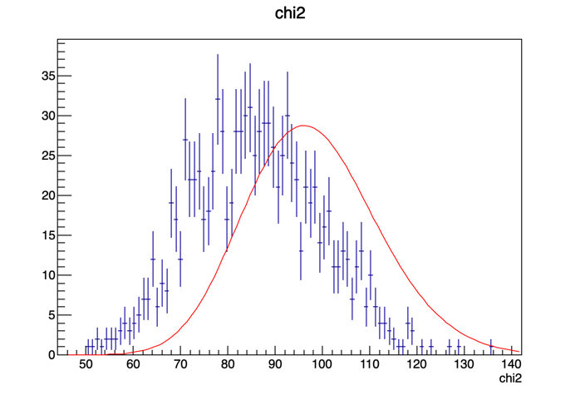
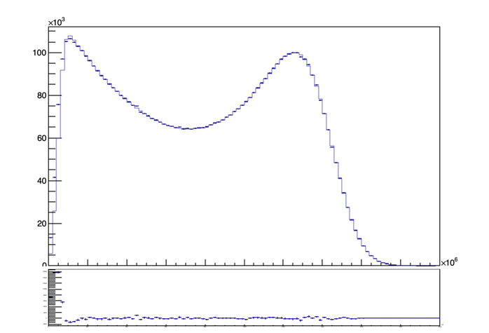
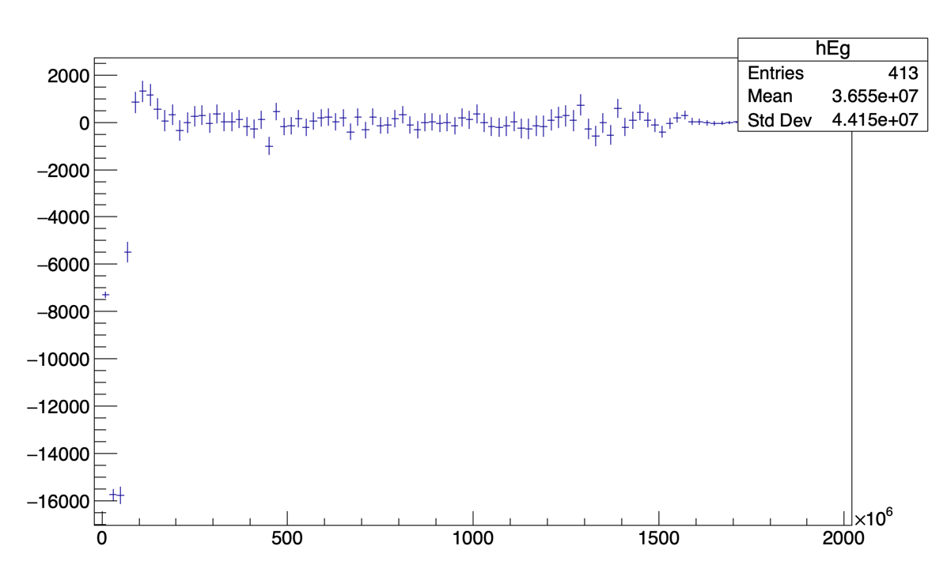
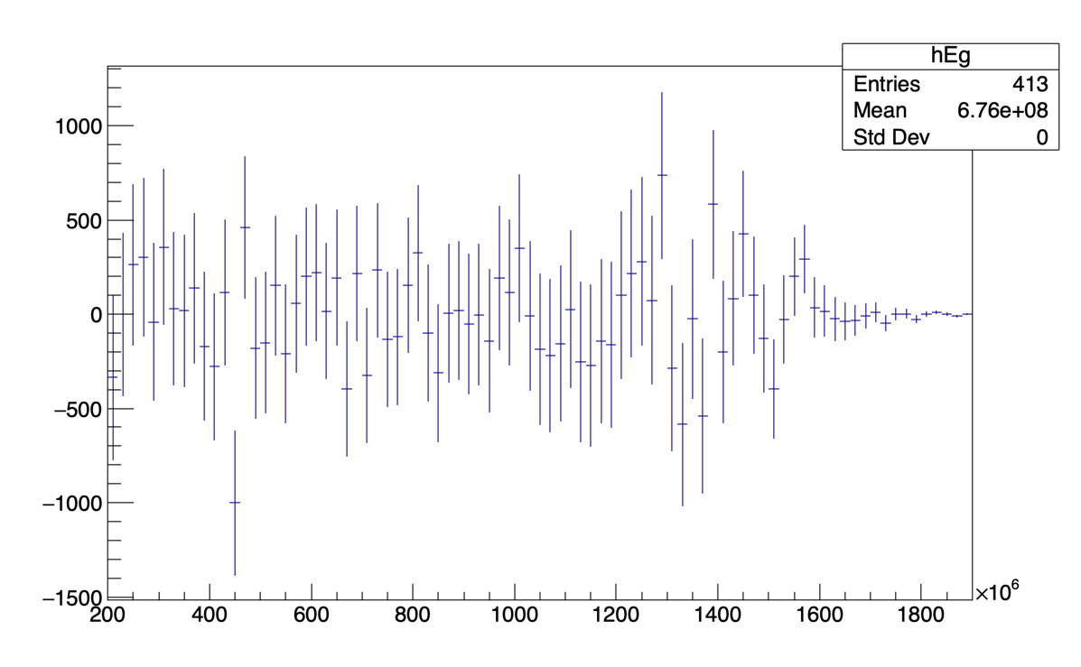
Removing the first 10 bins from fit
Chi2 good (10 removed bins)
Fit-MC
Confirms that the detector geometry and beam spreads do not impact longitudinal polarization extraction on the largest (and most senstive part) of the spectrum

Slide 15
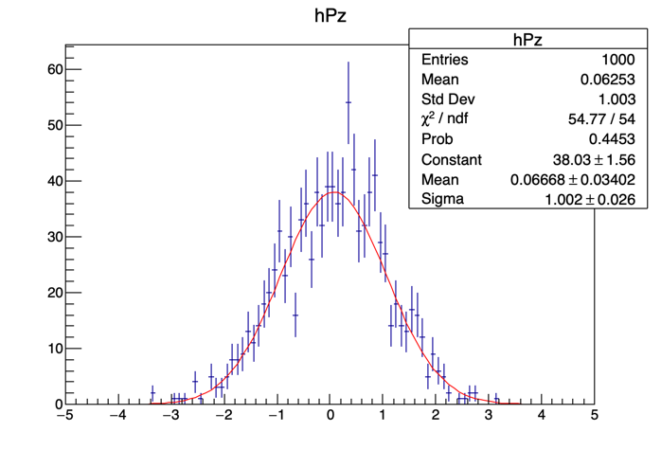
Effect of detector energy resolution
Pull for Pz
10% resolution
Pull for Pz
3% resolution

Slide 16
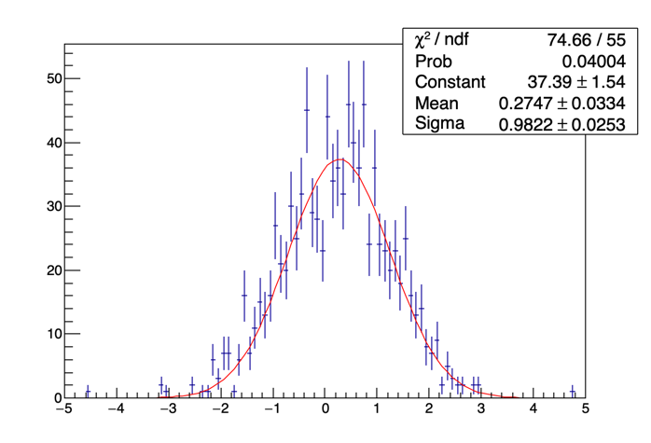
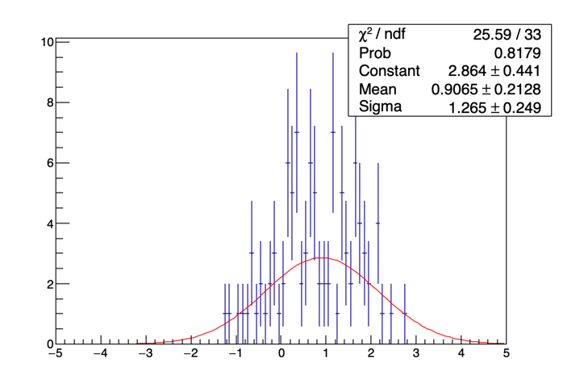
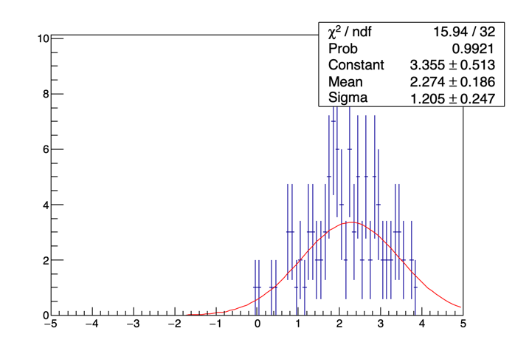
Misalignements
Repeat the previous fit but with various misalignments, or angular pointing biases
Pull for Pz
1mm misalignment
Or 30urad pointing bias
Pull for Pz
2mm misalignment
Or 70urad pointing bias
Pull for Pz
3mm misalignment
Or 100urad pointing bias
misaligned e-beam axis
misalignment
Pointing bias
Detection plane
Perfectly aligned e-beam. Axis
L=30m
Need to ensure the beam points towards the center of the detector within 1mm to avoid biasing the polarization more than 0.001

Slide 17
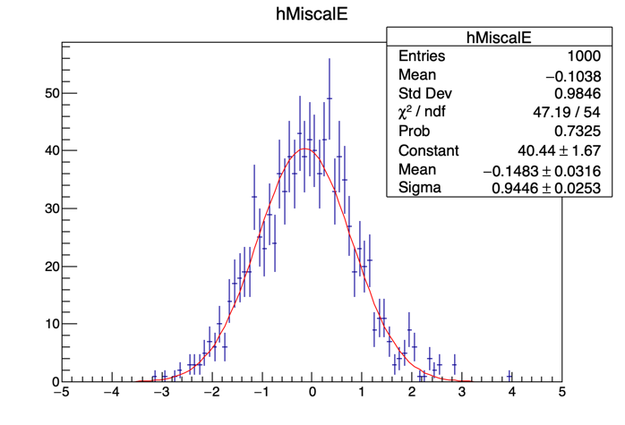
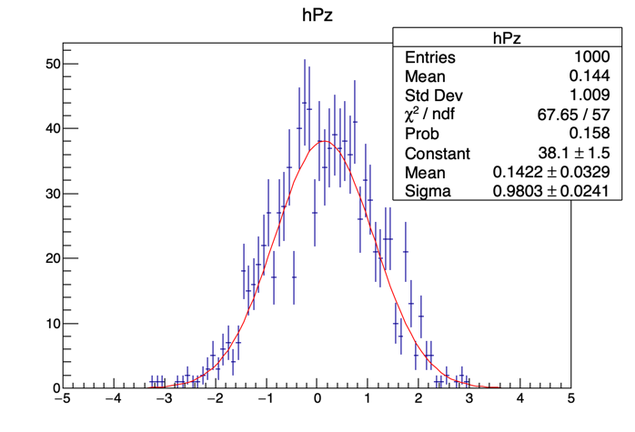
Miscalibration (10% on scale)
Pull for energy scale
Pull for Pz

Slide 18
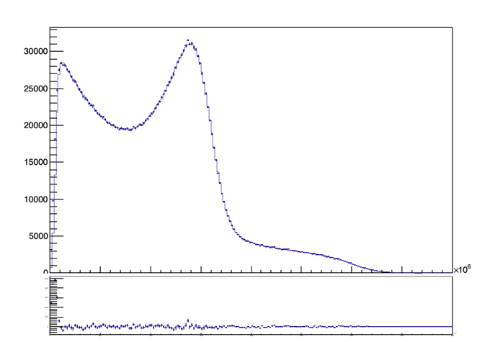
Ongoing improvements
Extraction of polarization:
  Upgraded the fit to perform with LUT filled on demand 6s → 0.15s/fit
    Performs well
    O(2500) estimates in a minute may be done that way on a relatively powerful PC
  Multi-photon contributions included (so far only 2 photon)
  Statistical precision in a minute with a 5W 515nm laser → 0.9% for every bunch.
  Next steps
    Re-estimate systematic uncertainties
    alignment procedure
    Backgrounds
    E-beam jitters ?

Slide 19
Next steps
Waiting for comments on White Report
Continue progressing on extraction of polarization:
R&D:
  Test the concept of a BaF2 detector
  Costing exercice for the laser system

Slide 20
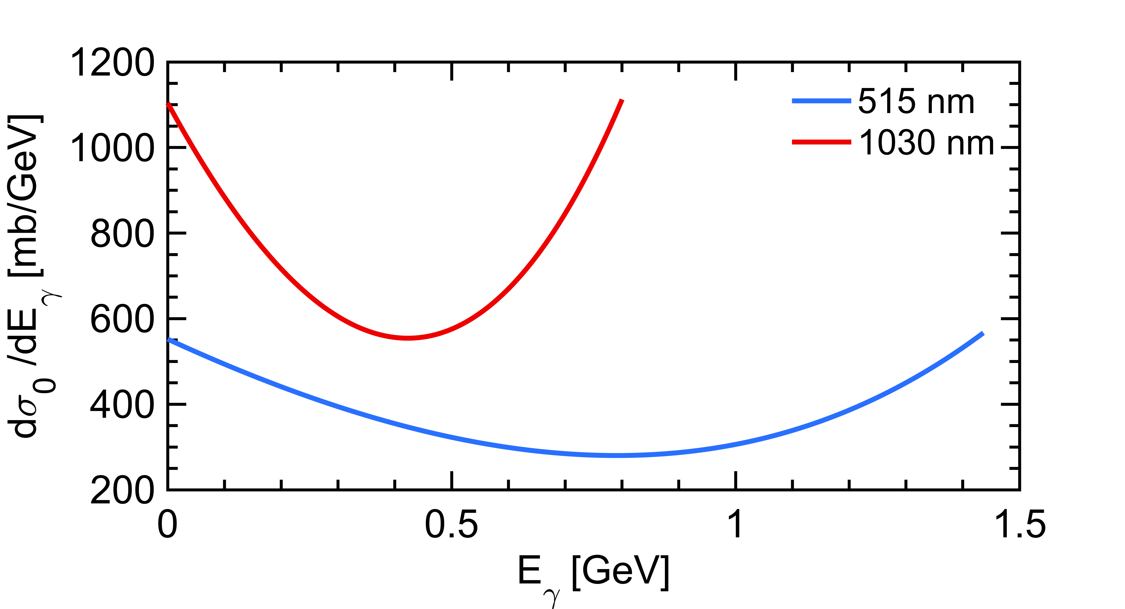
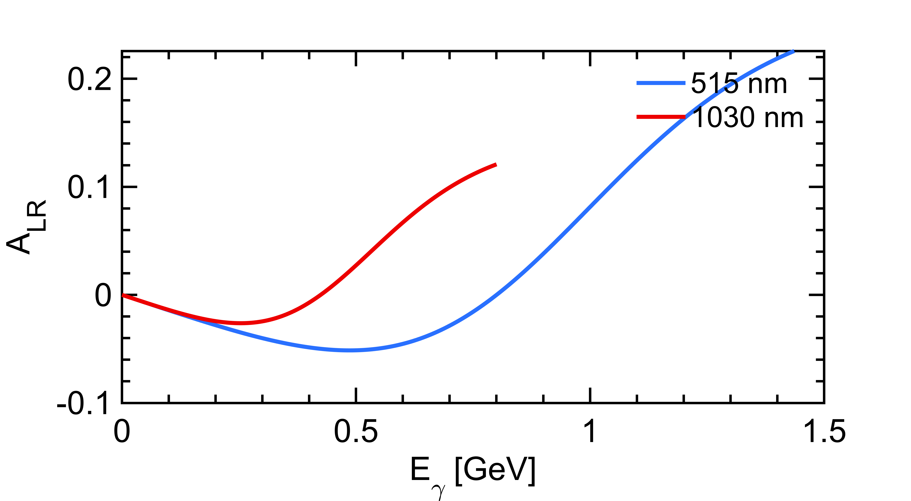
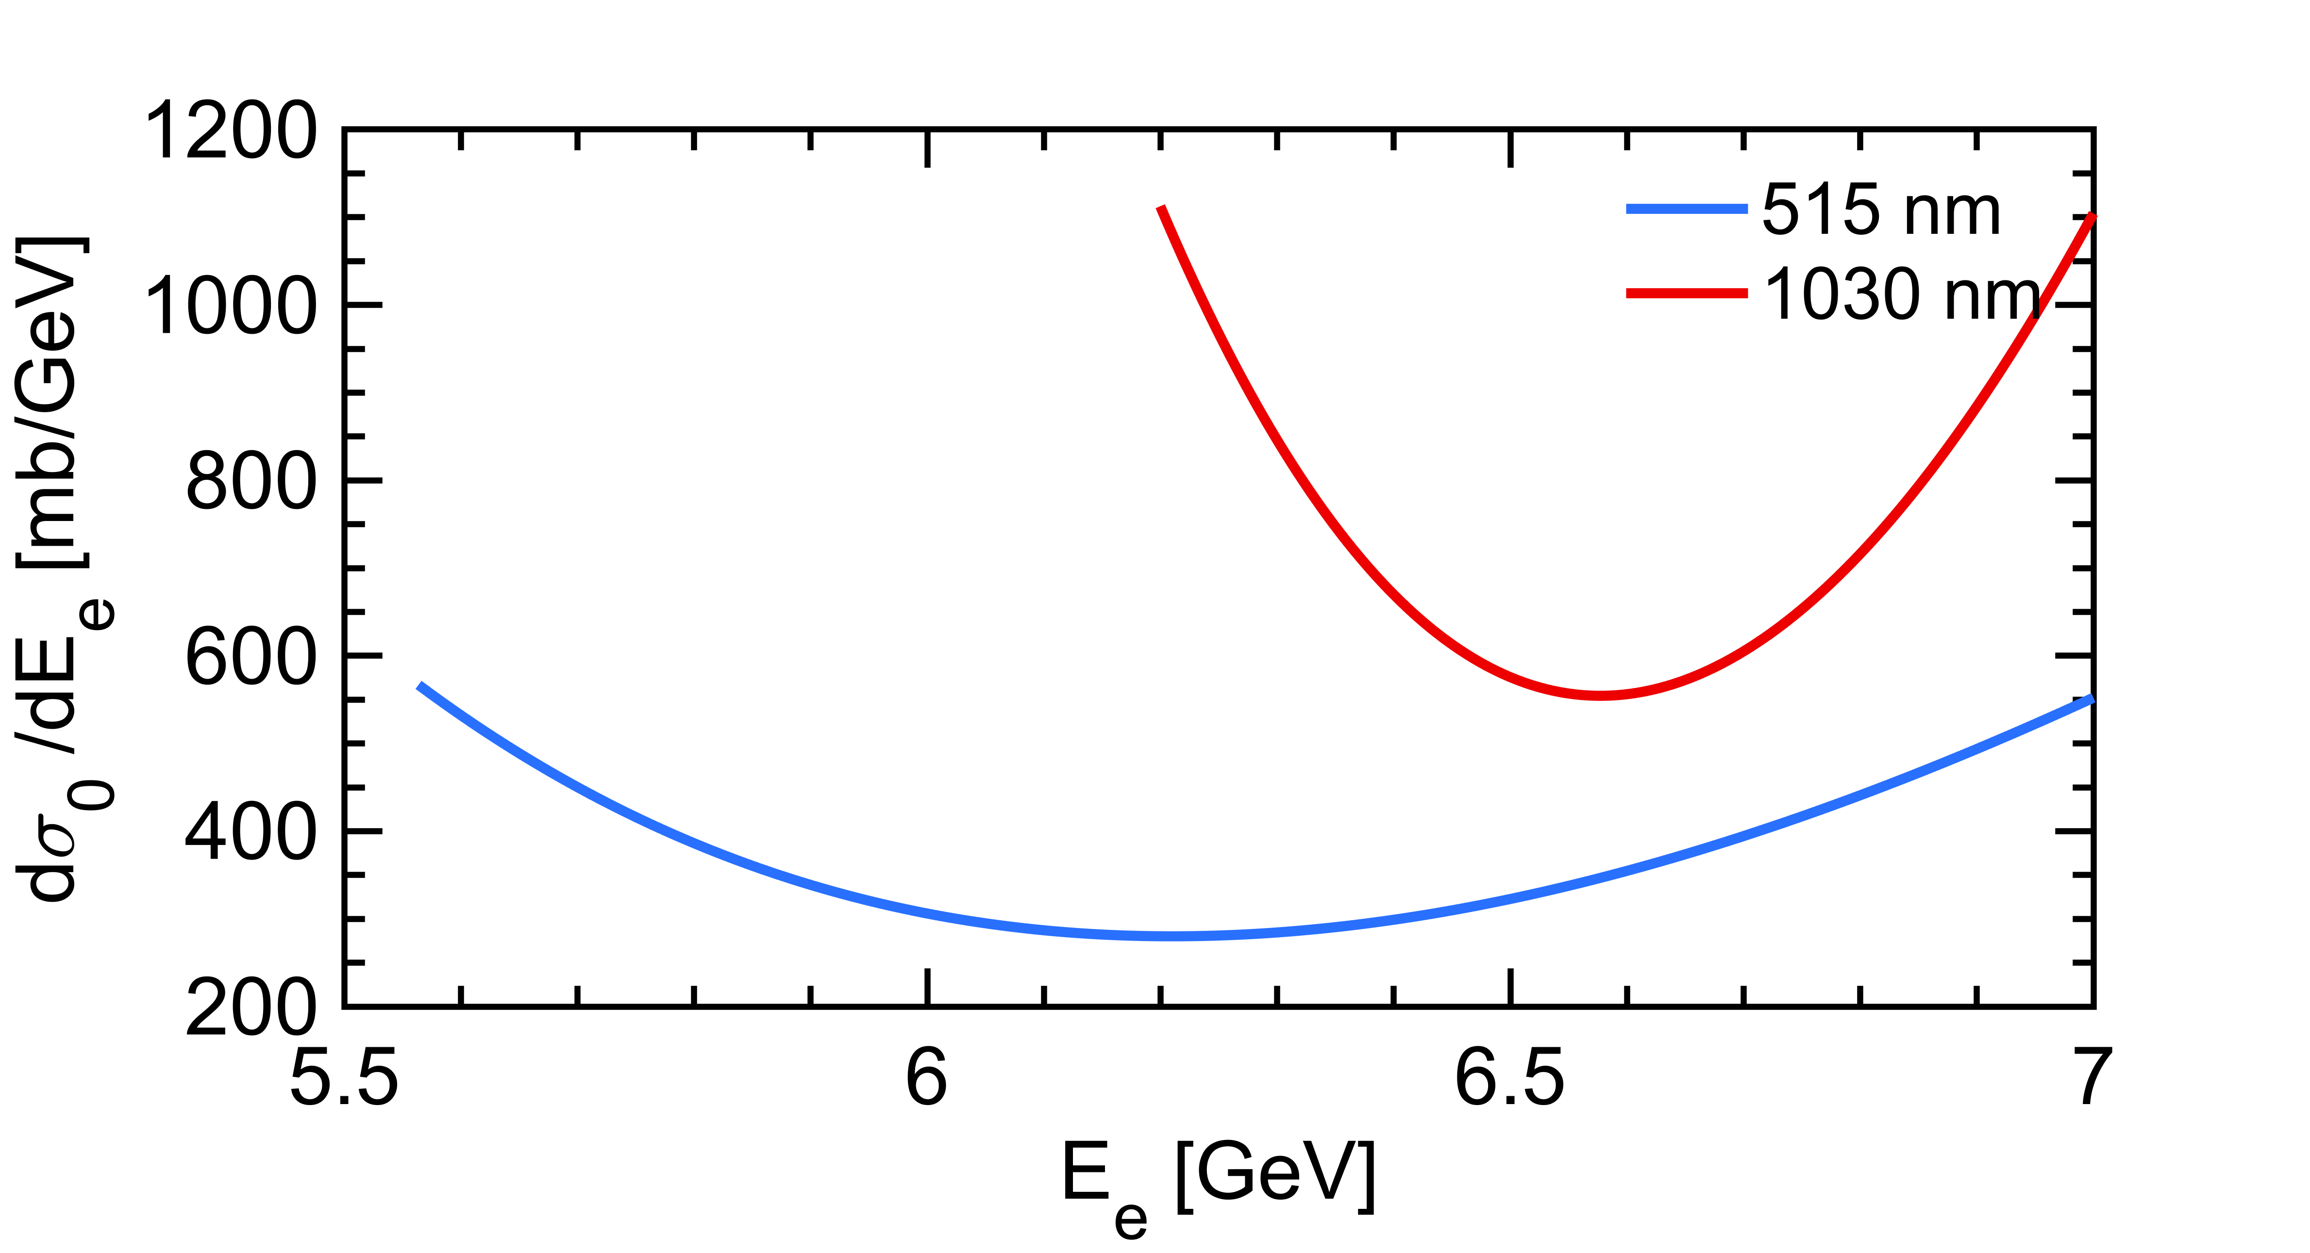
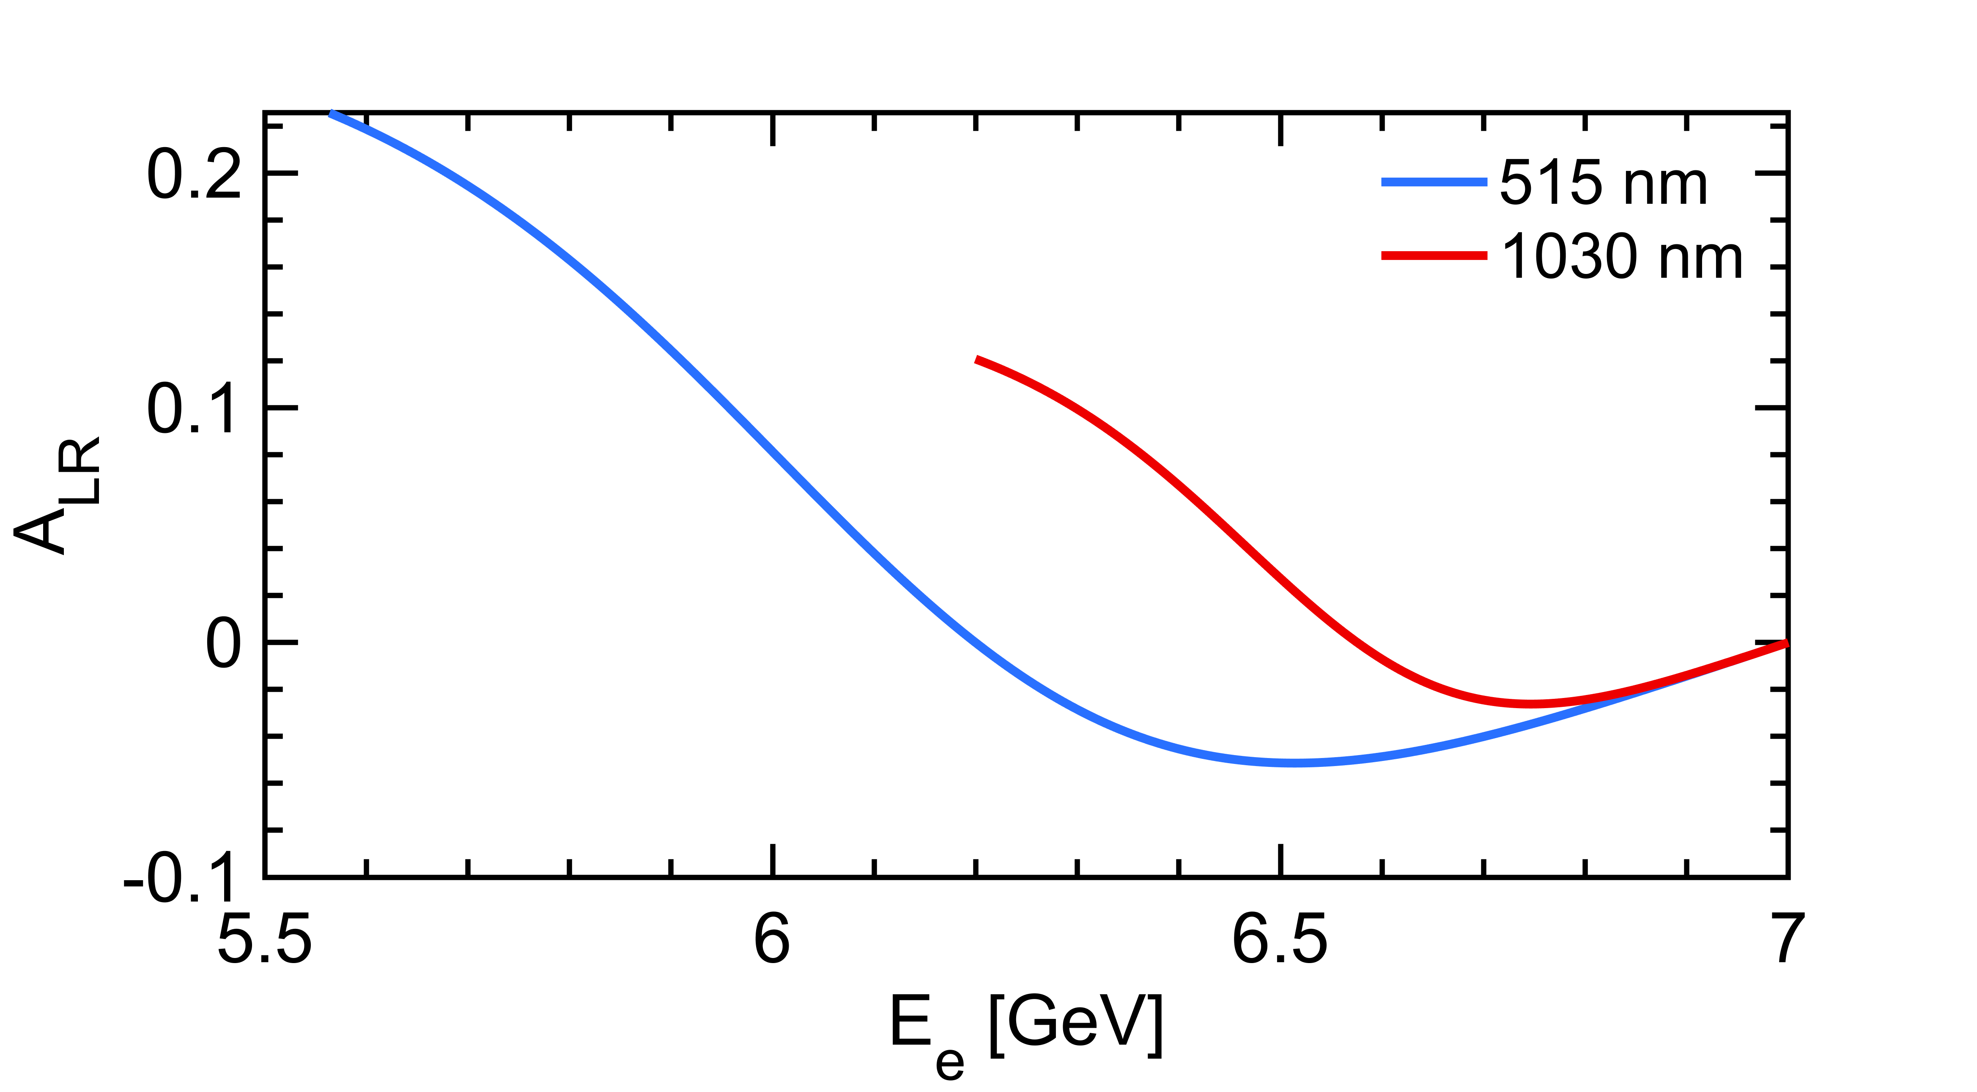
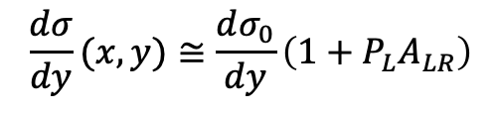
A slightly more detailed look
$$\frac{dσ}{dy}(x,y)≅\frac{dσ_{0}}{dy}\left(1+{P_{L}A}_{LR}\right)$$
Polarization dependent term generates a left-right asymmetry function of $E_{γ}$
Landau-Lifshitz QED book paragaphs 86 and 87
that reflects also as a function of the energy of the emitted electron
Green light provides higher sensitivity

