Slide 1
Compton polarimetry for SuperKEKB upgrade
Aurélien MARTENS for IJCLab group

Slide 2
Introduction
Nothing new since June.
Today:
Some thoughts about proposed content for the White Report
Proposed R&D towards design report
Proposed (TBD) task sharing

Slide 3
White report (WR) sections
How many pages ?
Subsections:
Introduction
Strategy
Ring polarimeter
Additional polarimeters (if we have some content ?)
Summary of required R&D before Technical design report

Slide 4
White report (WR) content (1)
Introduction:
  Some (quick) historical introduction → Orsay + Manitoba ?
  The specific challenges related to SuperKEKB polarized beam (top-up, high lumi). Comparison with EIC ? Synergies ? → Orsay + Manitoba ?
Strategy
  Bunch/bunch polarization measurement (cf HERA) in ring → Orsay + KEK ?
    Discuss Transverse vs (nearly) longitudinal polarimetry. Pros vs cons.
    Will decide depending on integration possibilities (KEK input required) + risk related to difficulty of transverse polarimetry (vertical alignment).
  Complement with measurements prior injection in ring ? → Orsay + Manitoba (+ KEK) ?
    Need to check polarization at photocathode ?
    Need a further check beam polarization before injection in ring ?
    Very preliminary thoughts on these questions.
Ring polarimeter
Additional polarimeters (if we have some content ?)
Summary of required R&D before Technical design report

Slide 5
White report (WR) content (2)
Introduction:
Strategy
Ring polarimeter
  Integration → Orsay + KEK + Manitoba ?
    Some suggestions on the table
    Decide based on integration constraints and background levels (measurements ?). (after WR ?)
    Require KEK feedback.
  Laser system → Orsay ?
    Rough design proposed. Mention industrial system exist. Mention typical technology choice. Robust. Past experience with similar systems.
    Green or red ? Pros vs con. Green → constrain laser design and price. Need to be assessed. Keep red as backup solution if green is baseline.
    Laser location + ‘hut’ ? Postpone when location is decided. Mention constraints (radiation levels, constant temperature, reasonable humidity, remote control). Assume difficult to suggest to excavate a dedicated room.
    Laser transport to Compton interaction point. Need to design once final location chosen. Mention the needs. Vacuum (what level) beam transport. Alignment feedbacks.
  Detection system → Manitoba + Orsay ?
    Electron spectrometer: pros vs cons available technologies. Integration ? R&D ?
    Photon calorimeter. Pros vs cons. R&D needed.
    I suggest to assume we could use both as a baseline
  Quick assessment of achievable performance → Orsay + Novosibirsk + KEK ?
    Caveats: background, systematics: beam transport to IP, beam-beam effects at IP ?
Additional polarimeters (if we have some content ?)
Summary of required R&D before Technical design report

Slide 6
White report (WR) content (3)
Introduction:
Strategy
Ring polarimeter
Additional polarimeters (if we have some content ?)
  At photogun → Manitoba + KEK ?
    As for EIC ? Mott polarimeter ?
    Achievable accuracy ?
    Decide based on integration constraints and background levels (measurements ?). (after WR ?)
    Require KEK feedback.
  Further away ? → ?
    Is it actually needed ?
    Where ? In the damping ring ? (may be easier for laser system)
Summary of required R&D before Technical design report → All ?
  Provide an indicative timescale for the R&D needed and decisions to be made.

Slide 7
Practical aspects
I propose to prepare a draft with overleaf and share it with all of you.
By when do we need a first full draft ?
How many pages allocated ?
Need to meet regularly ?

Slide 8
Indicative task list + tentative sharing
Decide on the need of polarimeter in injection linac.
  How ? Who ?
Integration and choice of technologies for ring Compton polarimeter
  Decide on location → will constrain transverse or longitudinal polarimetry KEK ?
  Estimate detectors position and estimate backgrounds → measurements or simulations needed ? (representative ?) KEK + Manitoba + Orsay ?
  Decide on detectors technologies Manitoba (+ Orsay) ?
  Decide on laser wavelength and technology → additional R&D may be needed ? Orsay + Manitoba ?
Laser
  Design of laser ellipsometry (polarimetry) need R&D → Money ? Orsay ?
  Design of laser and Compton IP integration depending on possibilities → needed modifications ? KEK mainly + Orsay ?
  Design of laser diagnostics Orsay ?
Detectors
  Design of detectors and electronics → needed prototyping ? Money ? Manitoba (+ Orsay) ?
Assessment of performances
  Simulation of the polarimeter as a whole Who ? (Orsay ?)
  Sensitivity to misalignments, other systematics Who ? (Orsay ?)
  Polarization transport to IP ? Who ?
  Beam beam effects at IP ? Who ?
Costing exercice All ?

Slide 9
Backup slides

Slide 10
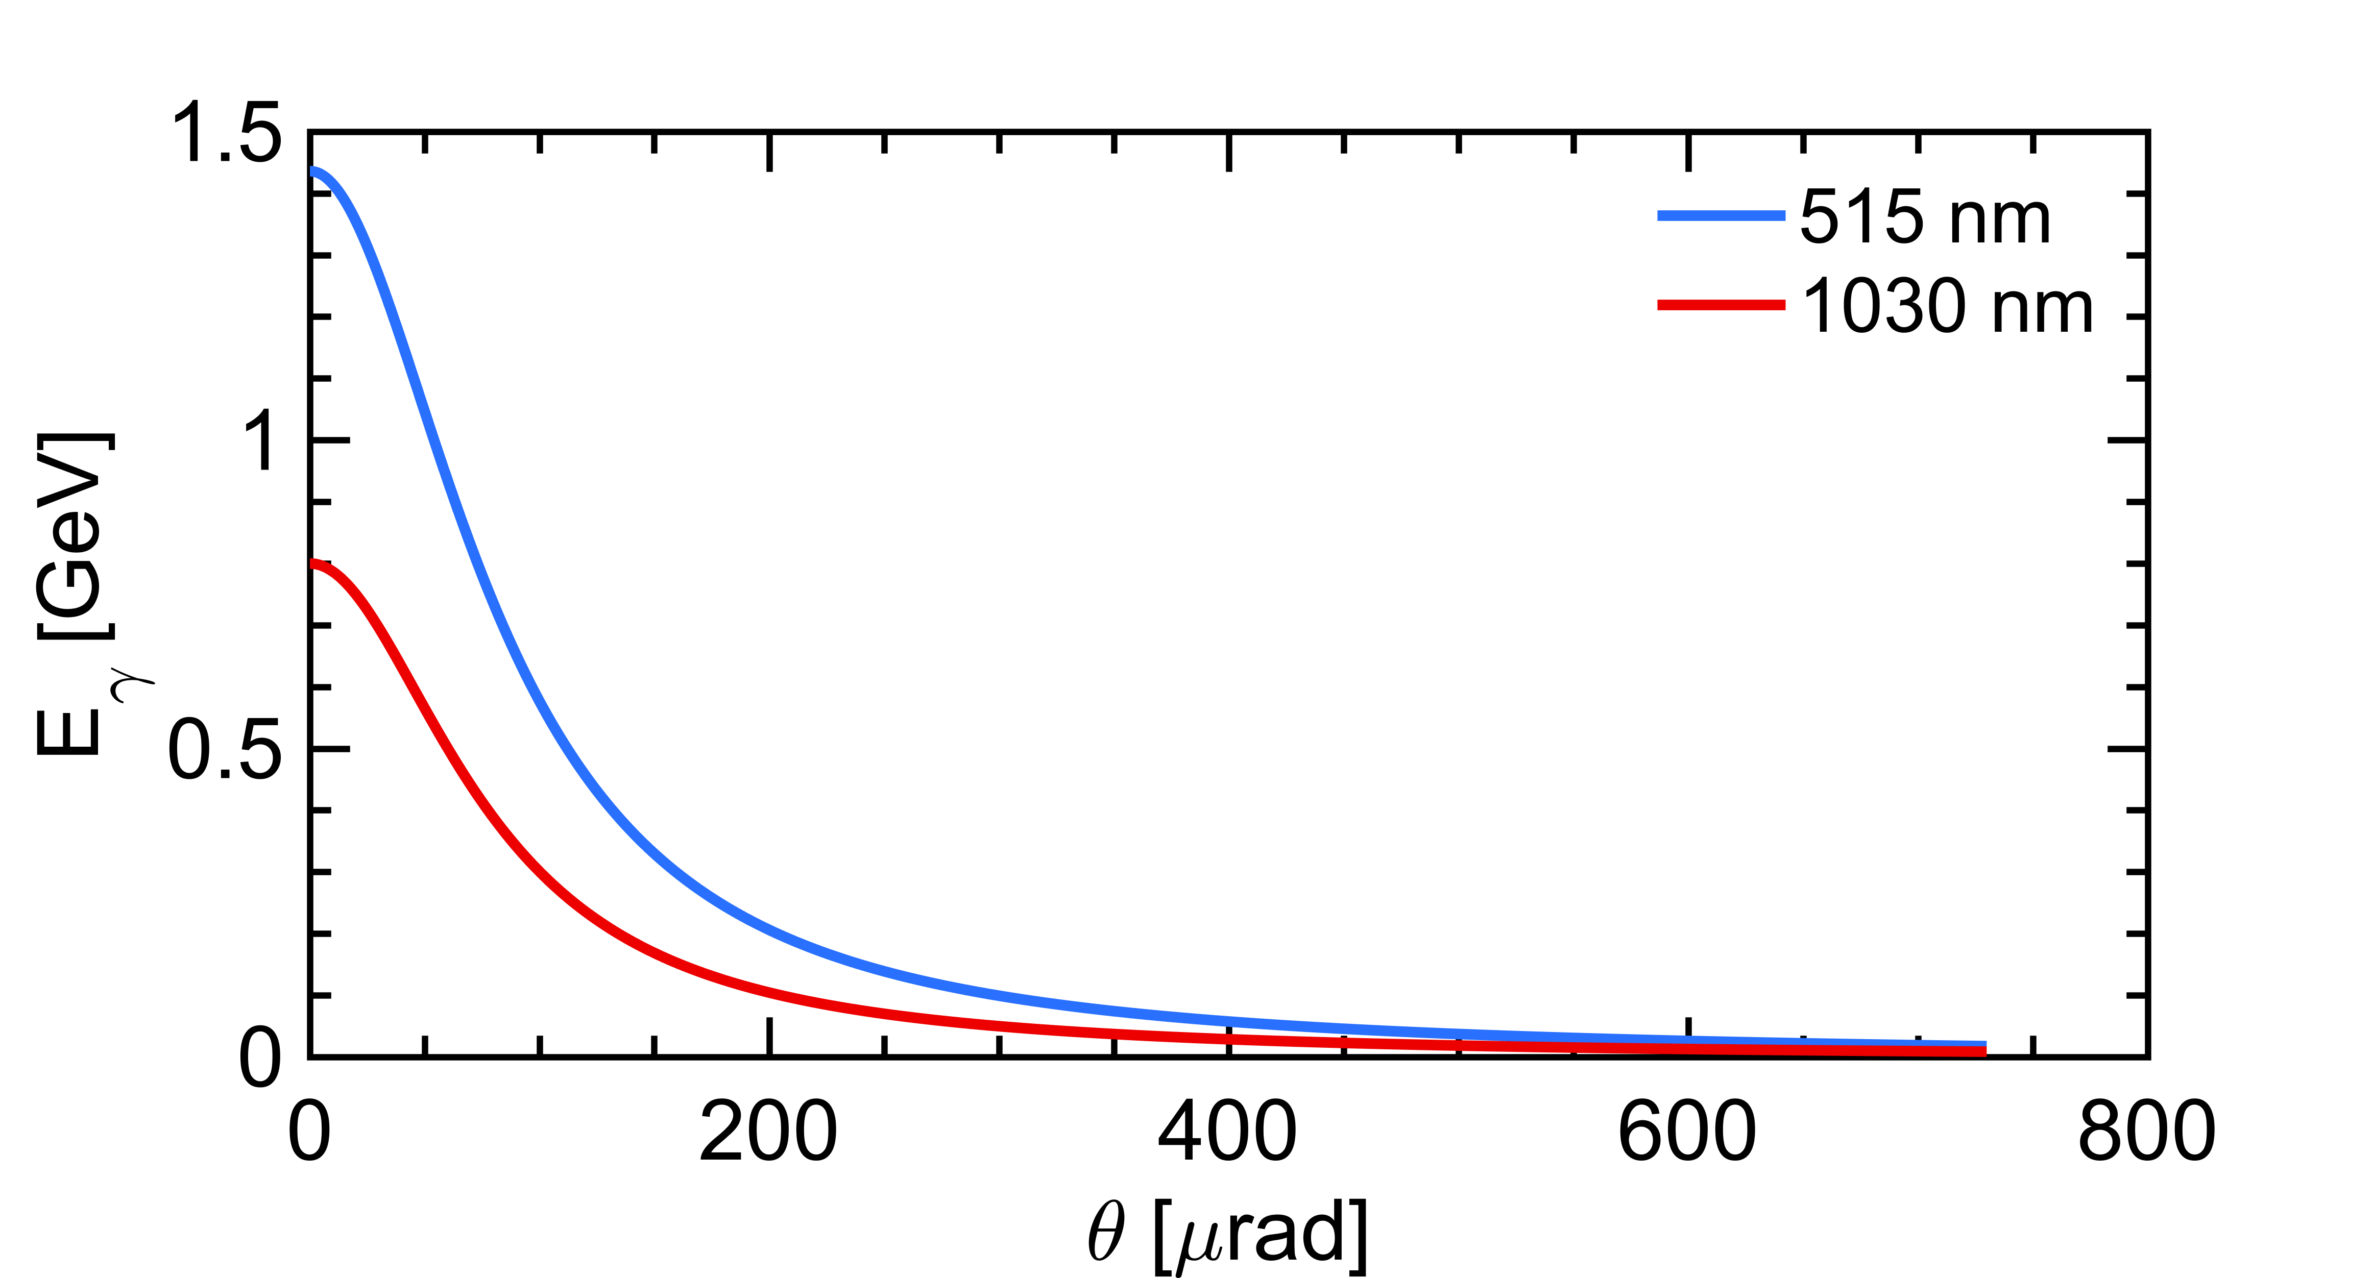



A first look to Compton backscattering
laser ($ω_{0}$)
Initial electron energy (7 GeV)
Initial photon energy (1.2eV at 1030nm)
Crossing angle of beams
Emitted photon energy
$$θ_{0}$$
θ
e⁻ beam $E0$
The energy vs emission angle correlation is specific and must be kept in mind
Landau-Lifshitz QED book paragaphs 86 and 87
Conical emission:
98% of photons within 730𝜇rad
⚠️ Remember:
  Photons (electrons too) are scatterred in the forward direction, in a narrow cone around the electron beam axis
  I further implicitely assume that detection of photons require to clear a line of sight of about 30 to 100m

Slide 11

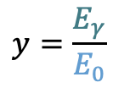
Compton cross-section
$$x=\frac{2E_{0}ω_{0}}{m^{2}}\left(1+\cos{θ_{0}}\right)$$
$$y=\frac{E_{γ}}{E_{0}}$$
The Compton cross-section averaged over scattered particles spins:
Differential cross-section
Transverse laser polarisation: nuisance parameter to minimize and keep under control
Transverse electron beam polarisation: intervenes as an asymmetry in the transverse plane
$$\frac{dσ}{dydφ_{obs}}\left(x,y\right)=\frac{dσ_{0}}{dy}\left(x,y\right)+\frac{dσ_{⊥}}{dy}\left(x,y\right)\cos\left(2\left(φ_{obs}−φ_{las}\right)\right)𝒫_{⊥}^{las}+\frac{dσ_{∥}}{dy}\left(x,y\right)𝒫_{C}^{las}(P_{T}f_{T}\left(x,y\right)\cos\left(φ_{obs}−φ_{elec}\right)+P_{L}f_{L}(x,y))$$
Electron beam polarization independent
Electron beam polarization dependent
Azimuthal observation angle
Orientation of transverse laser polar.
Orientation of transverse electron beam polar.
⚠️ Assume in the following:
  purely circular laser polarization $𝒫_{C}^{las}$ : transverse polarization of laser will be a systematic uncertainty or a constrained parameter in the fit
⚠️ Remember:
  It is much easier to measure the longitudinal electron beam polarization

Slide 12
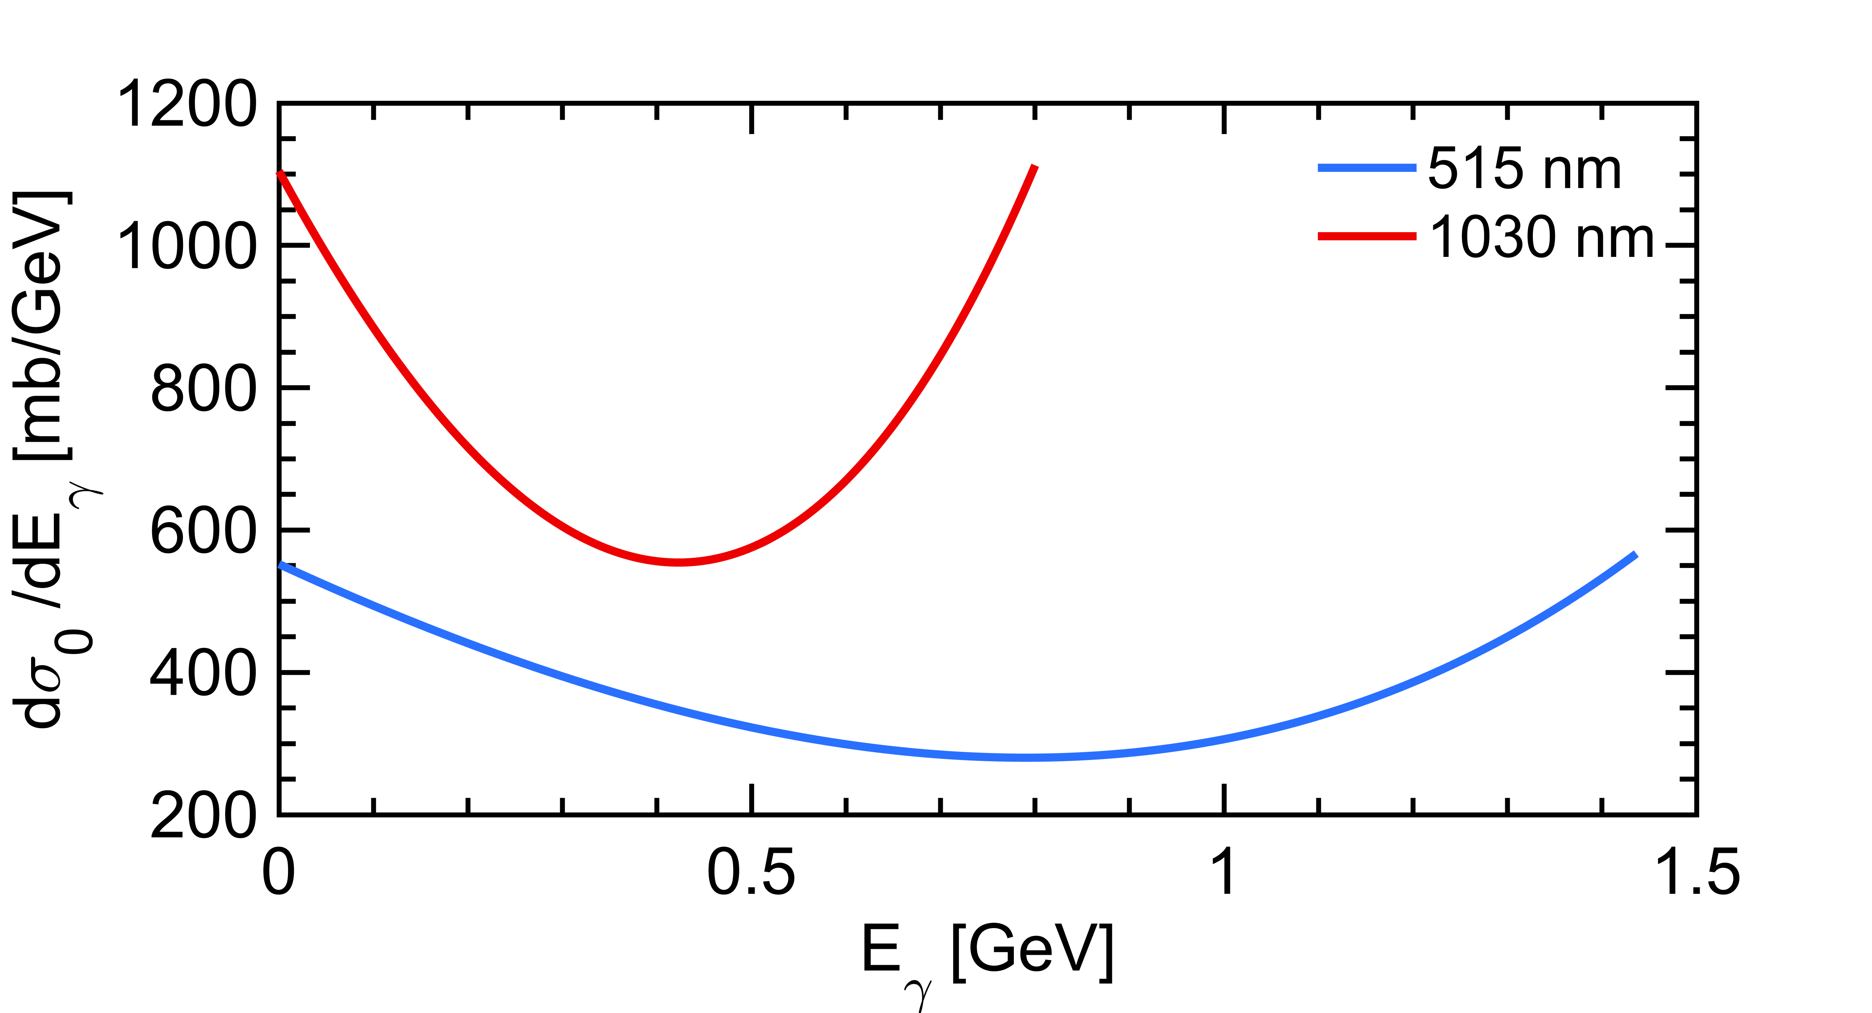
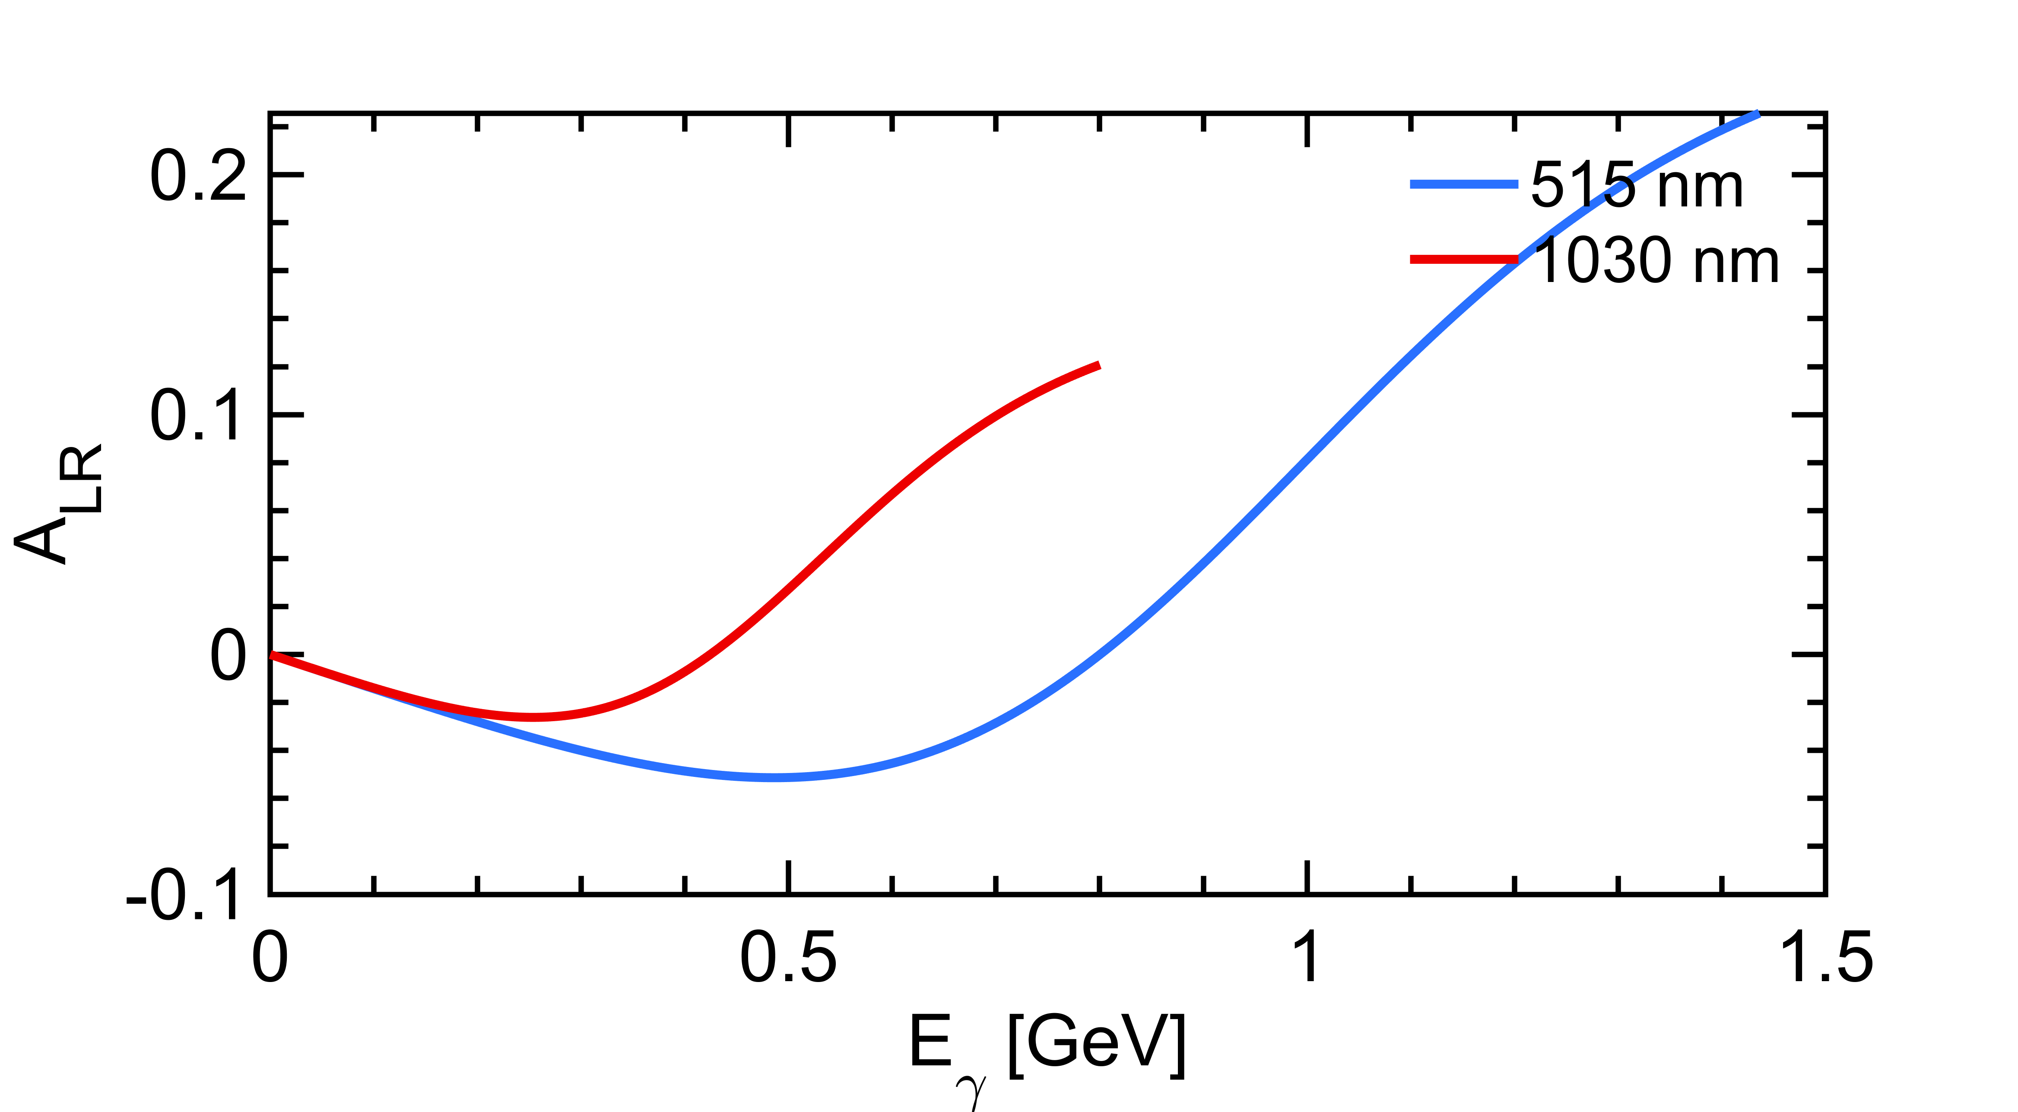
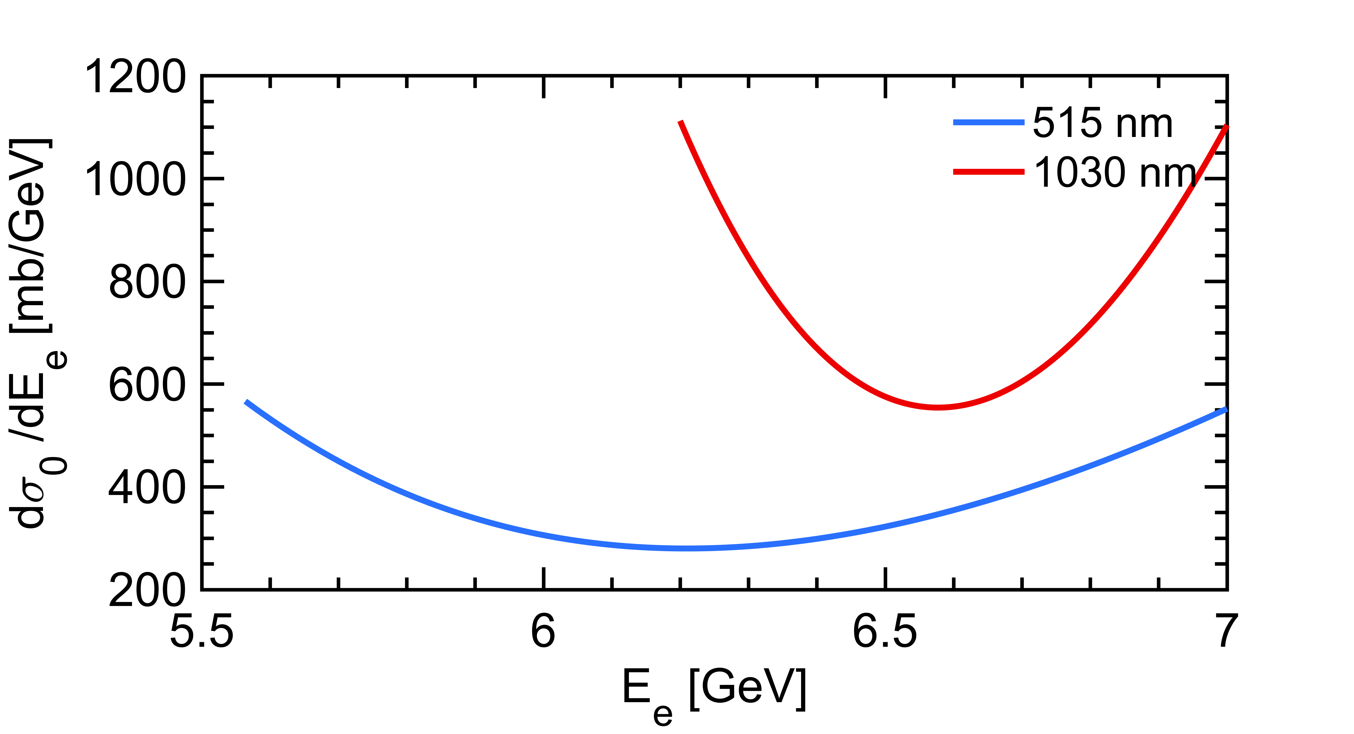
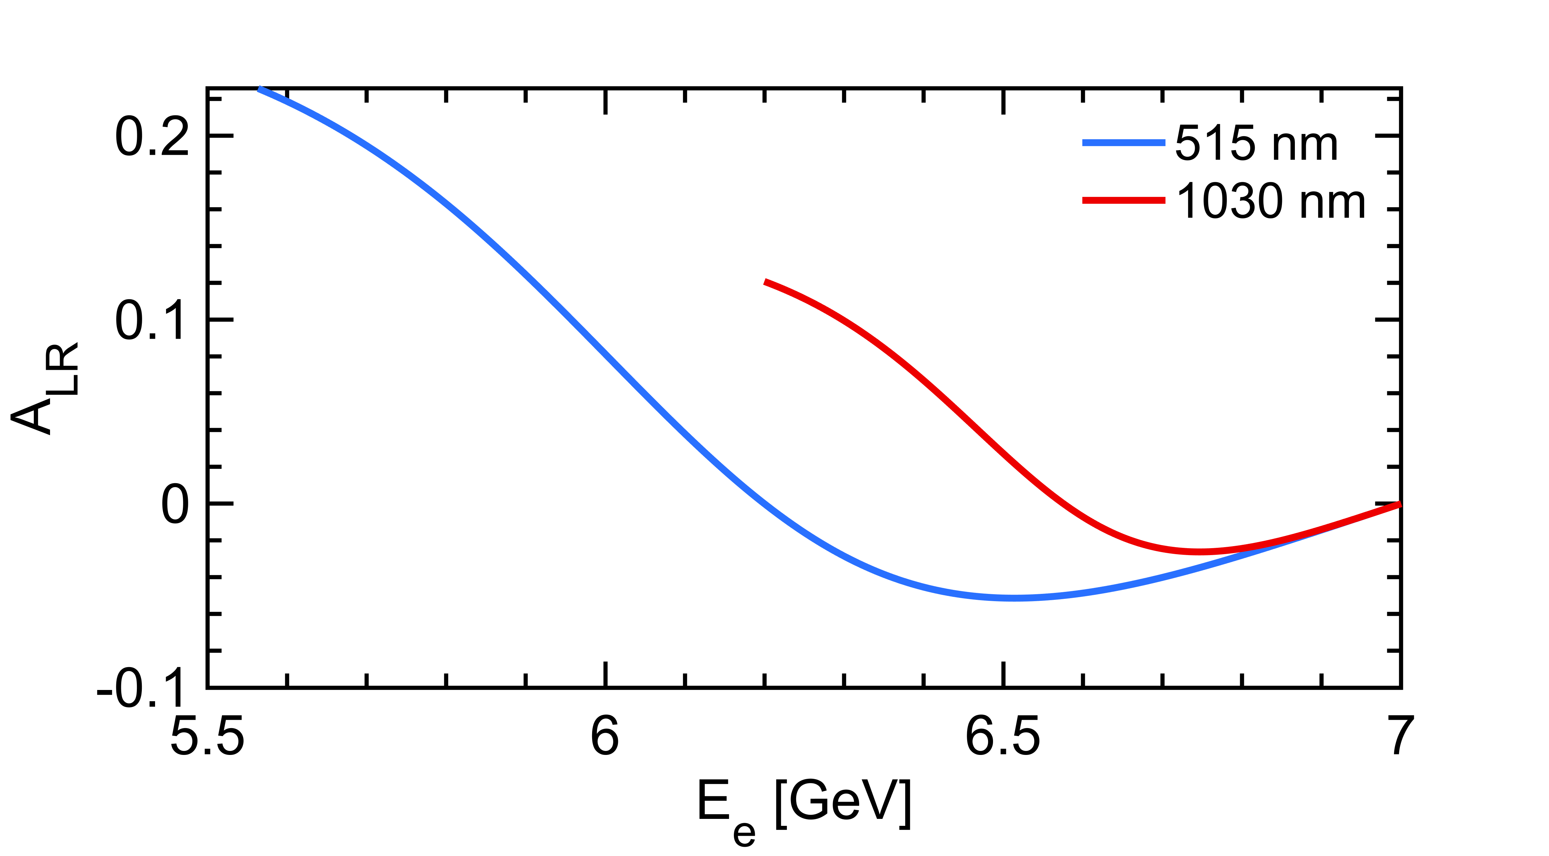

Longitudinal Compton polarimetry
$$\frac{dσ}{dy}(x,y)≅\frac{dσ_{0}}{dy}\left(1+{𝒫_{z}λA}_{LR}\right)$$
Polarization dependent term generates a left-right asymmetry function of $E_{γ}$
Landau-Lifshitz QED book paragaphs 86 and 87
that reflects also as a function of the energy of the emitted electron
Using a 515nm laser provides higher sensitivity

Slide 13
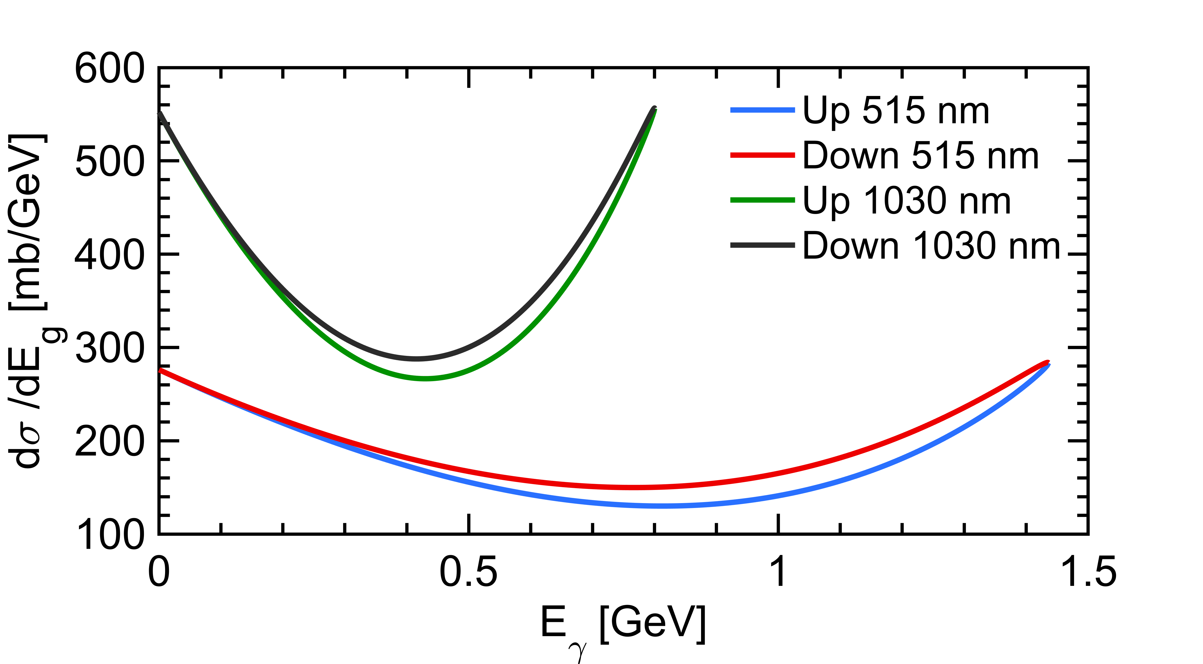
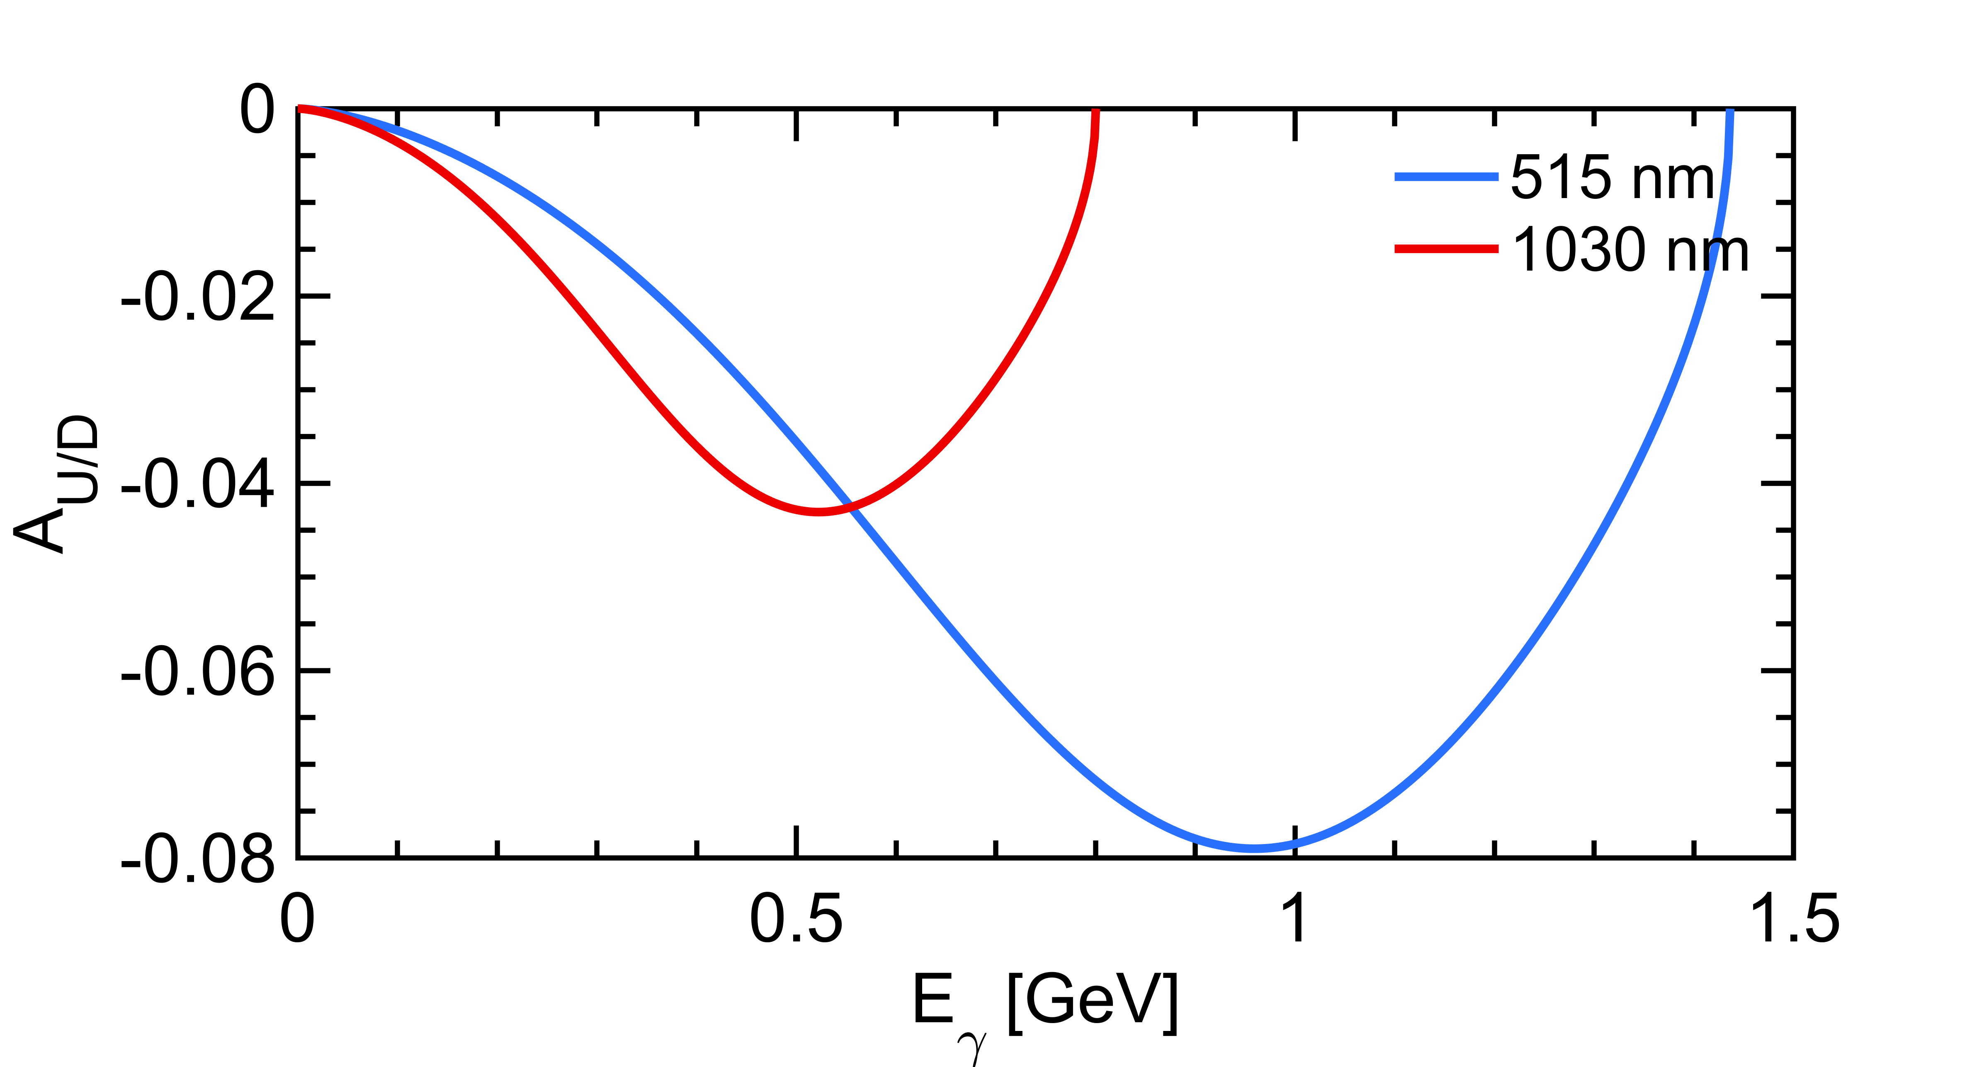
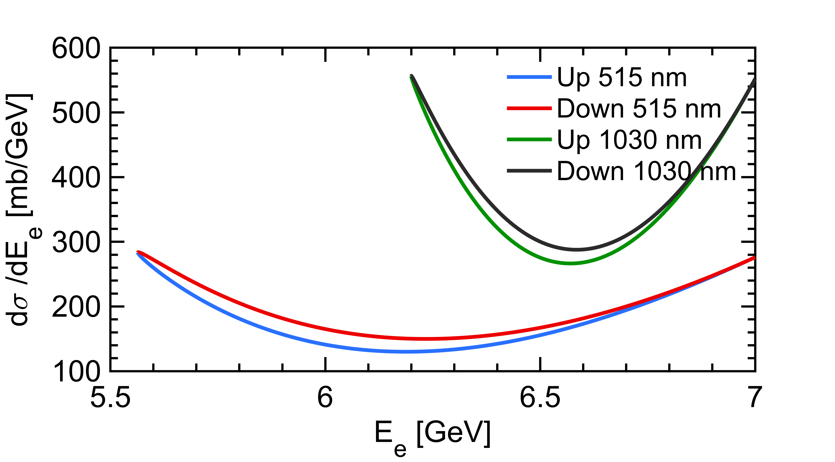
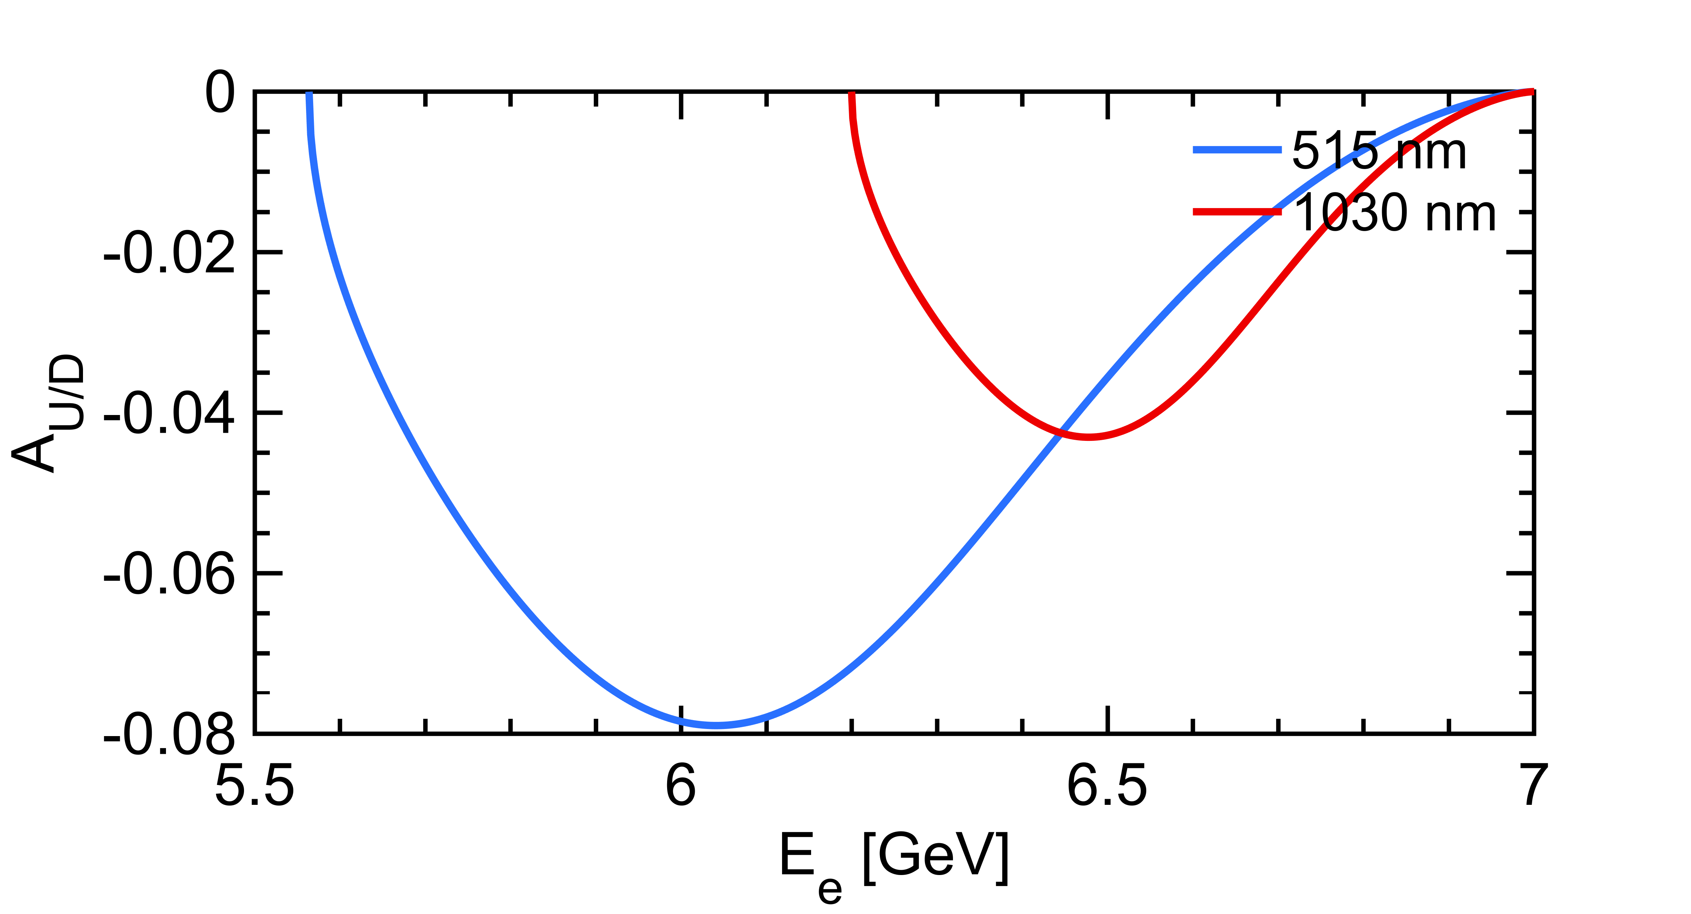

Transverse Compton polarimetry
$$\frac{dσ}{dy}(x,y)≅\frac{dσ_{0}}{dy}\left(1+{𝒫_{T}λA}_{UD}\right)$$
Polarization dependent term generates an up-down asymmetry function of $E_{γ}$
Landau-Lifshitz QED book paragaphs 86 and 87
that reflects also as a function of the energy of the emitted electron
The asymmetry is smaller, requires excellent transverse alignement (and or resolution for electron detection)

Slide 14
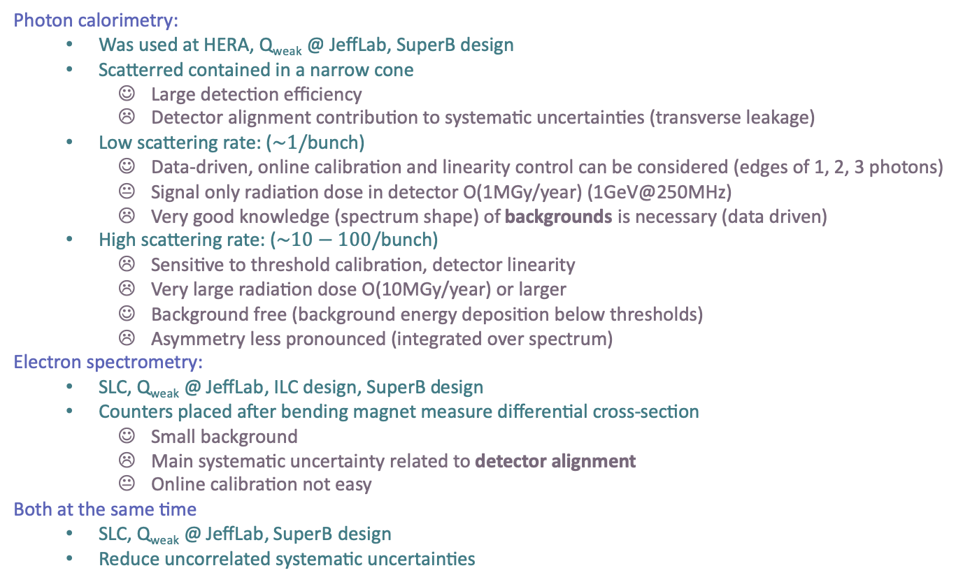
Detection strategies
Photon calorimetry:
  Was used at HERA, Q_{weak} @ JeffLab, SuperB design
  Scatterred contained in a narrow cone
    Large detection efficiency
    Detector alignment contribution to systematic uncertainties (transverse leakage)
  Low scattering rate: ($\sim 1/$bunch)
    Data-driven, online calibration and linearity control can be considered (edges of 1, 2, 3 photons)
    Signal only radiation dose in detector O(1MGy/year) (1GeV@250MHz)
    Very good knowledge (spectrum shape) of backgrounds is necessary (data driven)
  High scattering rate: ($\sim 10−100/$bunch)
    Sensitive to threshold calibration, detector linearity
    Very large radiation dose O(10MGy/year) or larger
    Background free (background energy deposition below thresholds)
    Asymmetry less pronounced (integrated over spectrum)
Electron spectrometry:
  SLC, Q_{weak} @ JeffLab, ILC design, SuperB design
  Counters placed after bending magnet measure differential cross-section
    Small background
    Main systematic uncertainty related to detector alignment
    Online calibration not easy
Both at the same time
  SLC, Q_{weak} @ JeffLab, SuperB design
  Reduce uncorrelated systematic uncertainties

Slide 15
Polarimeter location
1. Ideally: want to measure the beam polarization at (close to) IP, but:
  Extremely busy place already ← difficult to inject laser
  Very large backgrounds for a Compton detector placed nearby IP
  Very large backgrounds in the line of sight of the IP (radiative Bhabha, bremstrahlung on poor residual vacuum at IP integrated over several tens of meters). NB: there is already LumiBelle2 installed. This can provide some estimated levels.
  In my opinion it is not an option to consider. Extensive background studies must be performed to validate such a location.
2. A bit further away (approx. mid-point in between Belle2 and spin rotators)
  Backgrounds from the opposite beam ?
  Only a fraction of the IP polarization is measured. This sensitivity loss is probably not a major problem for a tool that is mainly devoted to real time monitoring for machine optimization. NB: avoid horizontal orientation of polarization.
  Difficult to relate it precisely to IP polarization (difficult task to track the spin to IP with precision including misalignments). Systematics to be evaluated.
  I quickly investigated this possibility
3. Somewhere else: Measure transverse polarization
  Requires to measure vertical asymmetry of scattered particles with few tens µrad resolution
  Vertical alignment must be maintained within few 10µm,µrad ! (see HERA’s experience)
  Unlikely to relate it precisely to IP polarization
  I will also try to investigate where it could be placed.

Slide 16
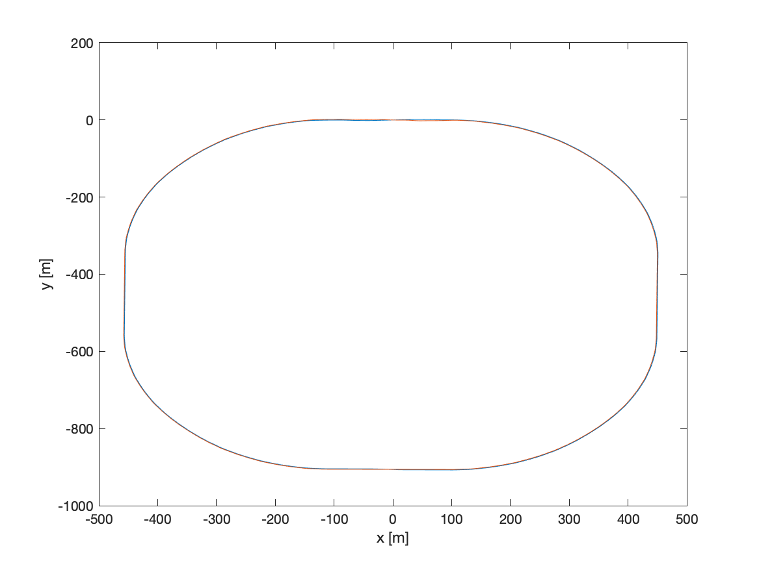
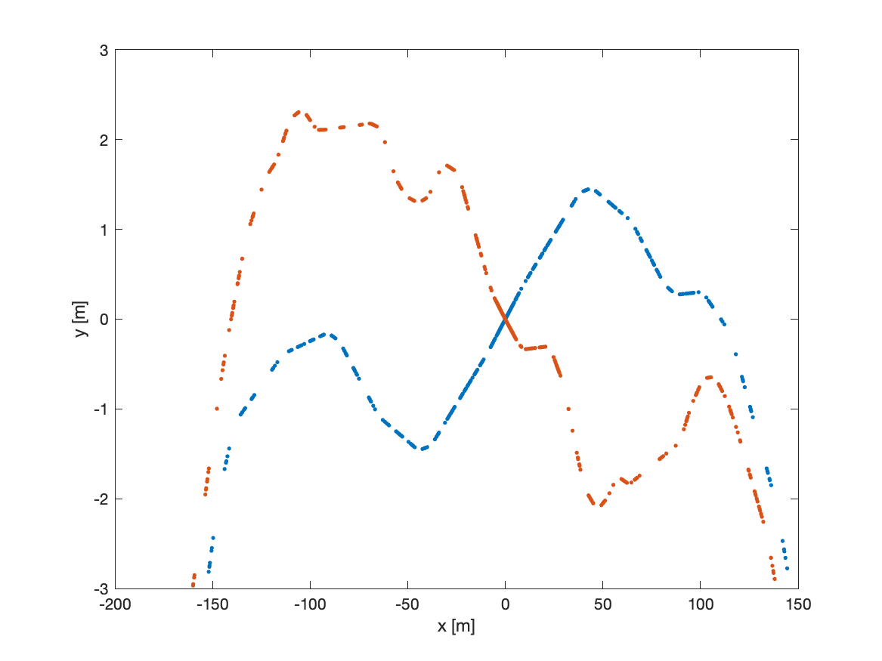
SuperKEKB lattice
⚠️ Inputs related to the SuperKEKB lattice:
  sher_5781_80_2.sad, sler_1705_80_2.sad thanks to MDI group through Karim
  I’ve applied the following commands to the lattice to extract the beam parameters at any point
    CELL;CALC;EMIOUT;CODPLOT;EMIT;BEAM; DISP OG ALL; DISP B ALL;
    Please report any mistake in the sequence of these commands (I’m not an usual SAD user)
  I also had to
    flip the sign of the transverse beam position at each element in the accelerator plane (x and y)
    Rotate each geometry by +-41.5mraad (83mrad crossing angle, arxiv:1809.01958v2)
LER (positron)
HER (electron)
Belle2 is here
⚠️ Mind the scales

Slide 17
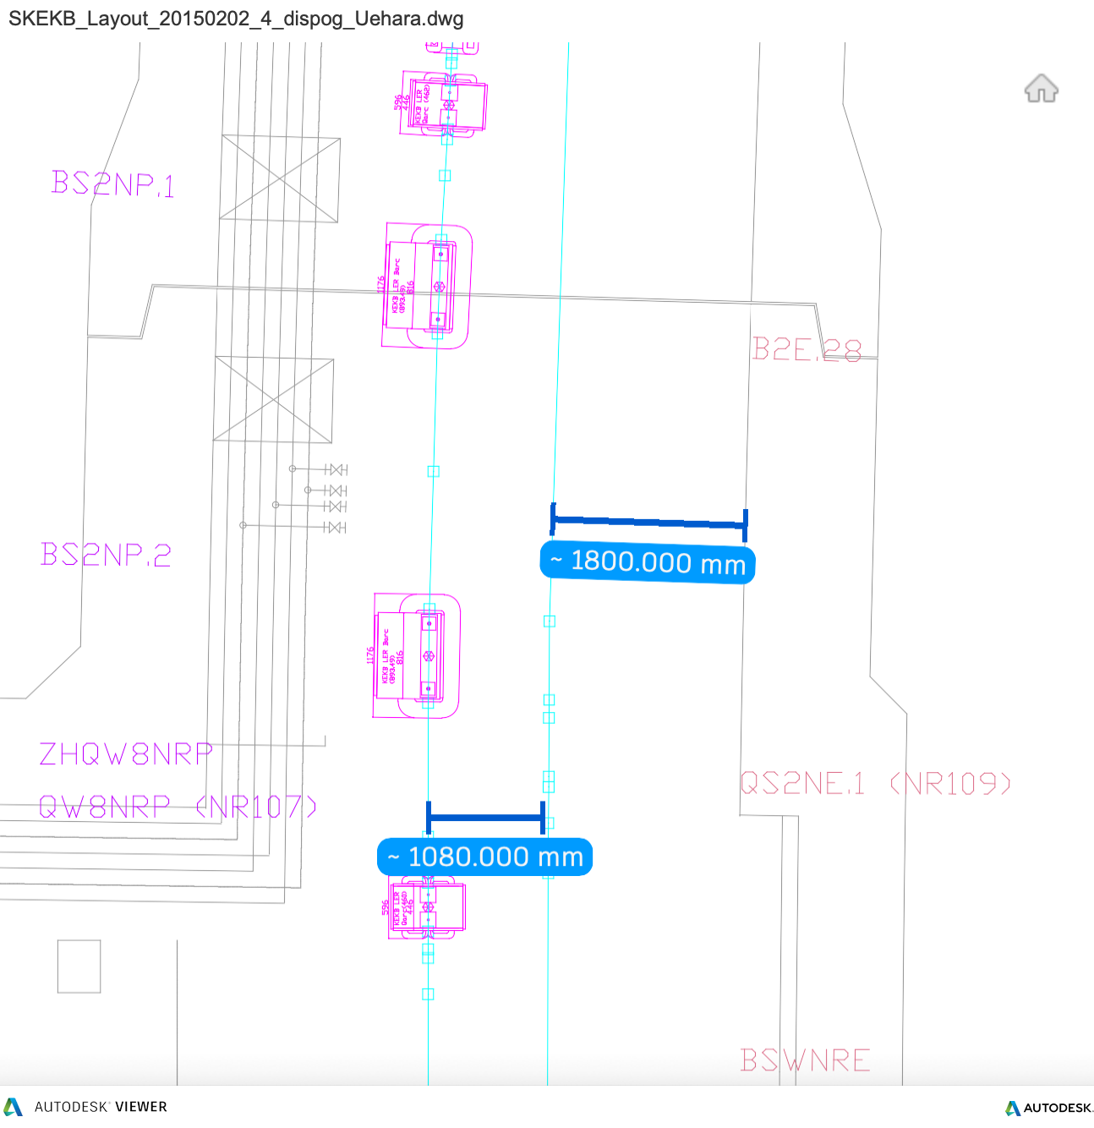
Ring transverse polarimeter (option #3)
Not much space here
Belle2 IP
Left part of the HER ring:
1m in between LER and HER
  → No space for a calorimeter in the. Line of sight of the beam
<2m in between HER and wall
  Most of it may be used for maintenance works ? (guess)
  Small space to place a spectrometer ? But energy of electrons is only few hundreds MeV apart from nominal. With a 0.22T 6m length magnet → 0.22degree deflection for 500MeV energy loss.
  Spectrometer precision will depend on precision of knowledge of magnet strengths

Slide 18
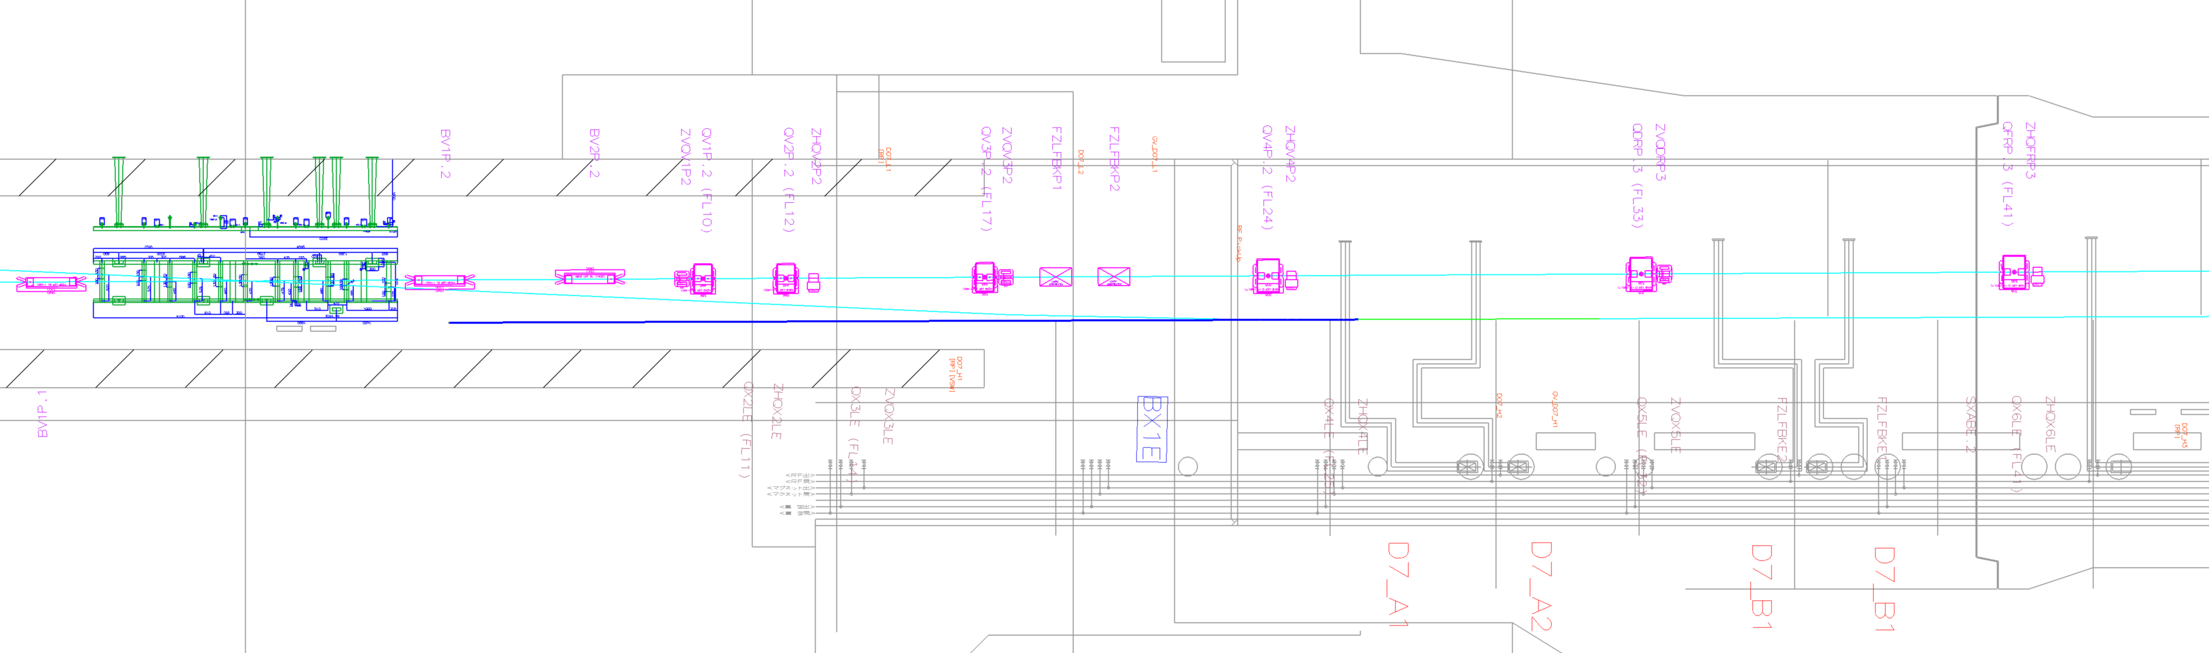
Ring transverse polarimeter (option #3)
Not much space here
Right part of the HER ring:
Similar statements hold
FUJI hall:
There may be a possibility
Is it reasonable ?
May allow both electron spectrometry with tracking after a single magnet and calorimetric measurement of photons
Belle2 IP
Yann Peinaud, Uhehara-san
Blue line is line of sight for photons scattered from IP located right before BX1E

Slide 19
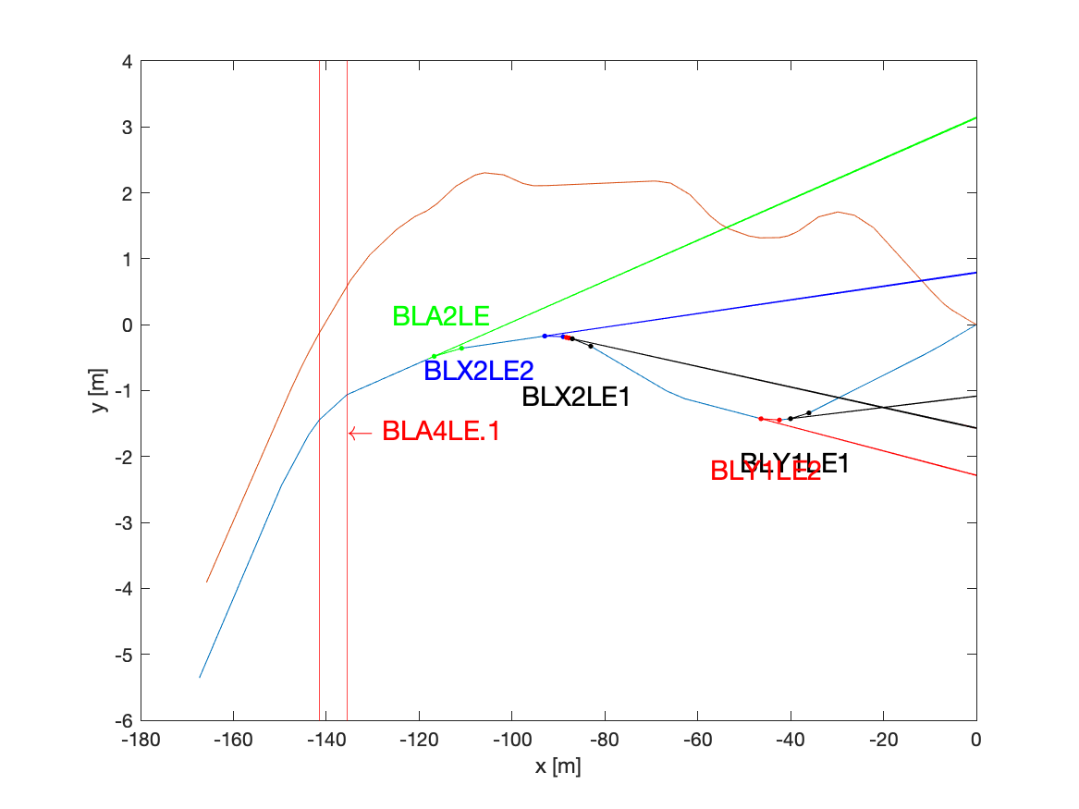
Nearly longitudinal pol. (option#2)
⚠️ accelerator tunnel walls and utilities are not drawn
Line of sight of photons produced at interaction points located right before BLA2LE, BLX2LE(1,2), BLY1LE(1,2)
About 2.5 meters
LER (positron)
HER (electron)
⚠️ what is the expected longitudinal polarization magnitude at these locations ?

Slide 20
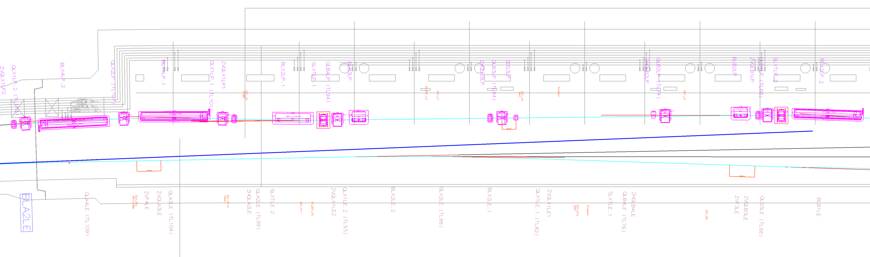
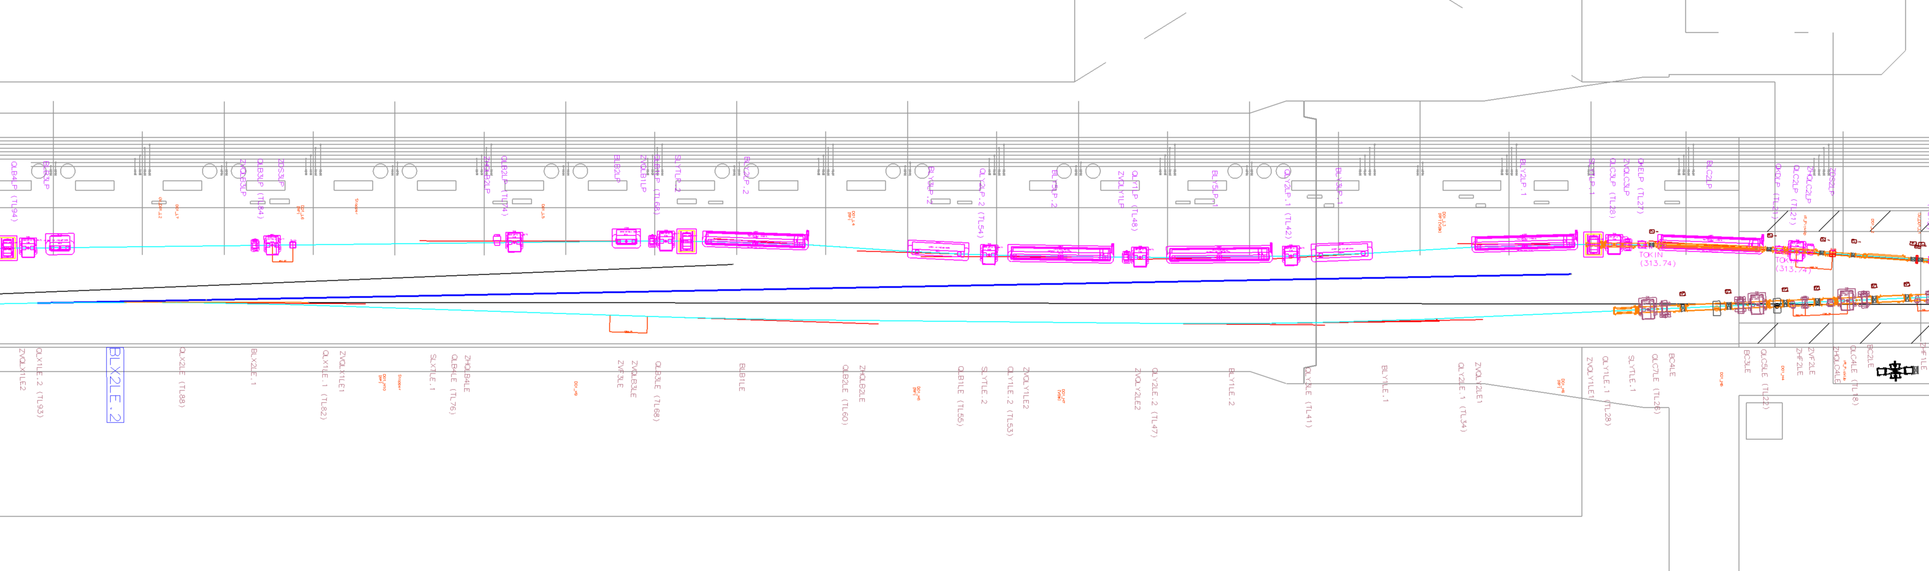
BLA2LE and BLX2LE.2
Yann Peinaud + Uhehara-san for the 2D drawing
There seem to be enough space for a photon detector after BLA2LE or BLX2LE.2
Blue lines are line of sights for photons scattered from IPs located right before these dipoles

Slide 21
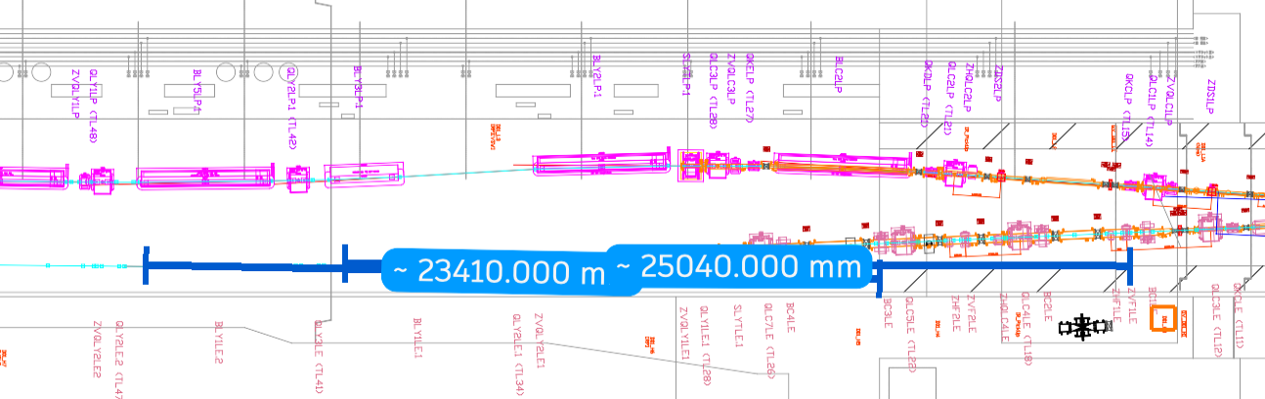
BLY1LE.1 and BLY1LE.2
Yann Peinaud + Uhehara-san for the 2D drawing
There seem to be enough space for a photon detector after BLY1LE.1 or BLY1LE.2
Blue lines are line of sights for photons scattered from IPs located right before these dipoles
calorimetric measurement of photons seem OK (backgrounds do not seem too large at first glance)
electron spectrometry location to be evaluated, electrons about 2cm apart from main beam about 10m away from magnet center. May be ok if Compton IP before BLY1LE.2 and detector after BLY1LE.1 ? (vertical bend is ok because we are not interested in transverse polarisation)

Slide 22
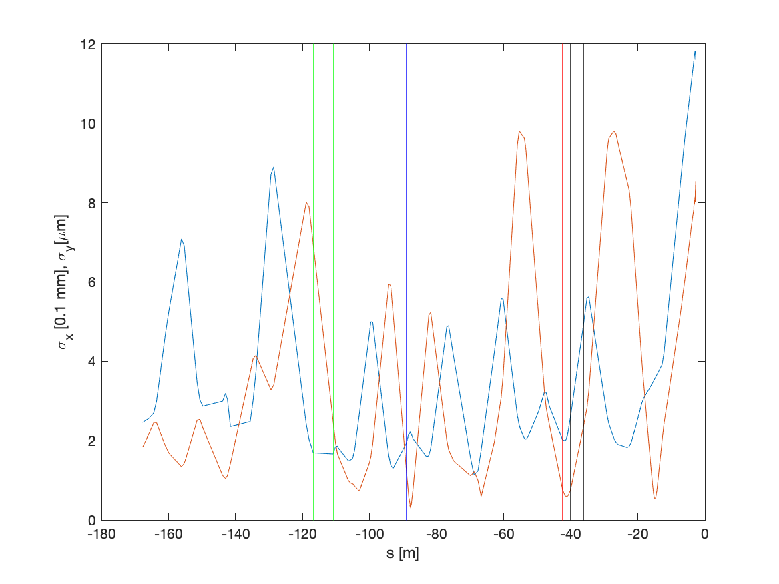
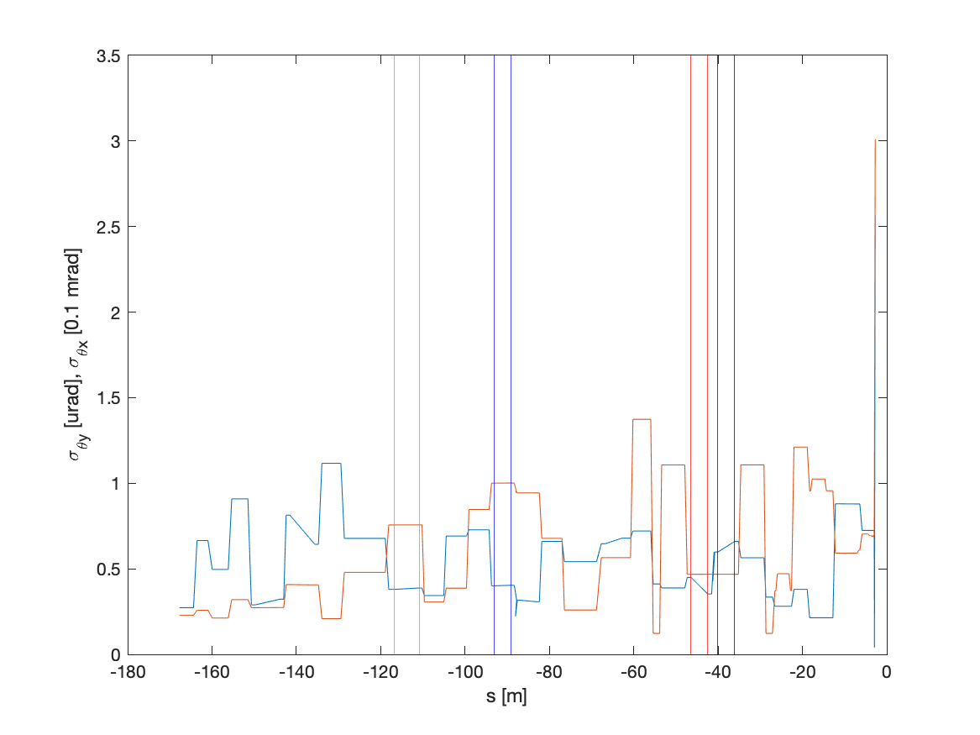

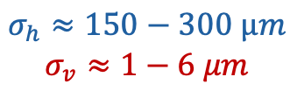
Beam parameters
BLA2LE
BLX2LE.2
$$σ_{h}≈150−300 µm$$
$$σ_{v}≈1−6 μm$$
$$σ_{θh}≈40−60μrad$$
$$σ_{θv}≈0.4−1μrad$$
Dispersion in vertical direction is negligible, contributes in horizontal
⚠️ Not looked at yet:
  Magnitude of beam jittering at these locations?

Slide 23
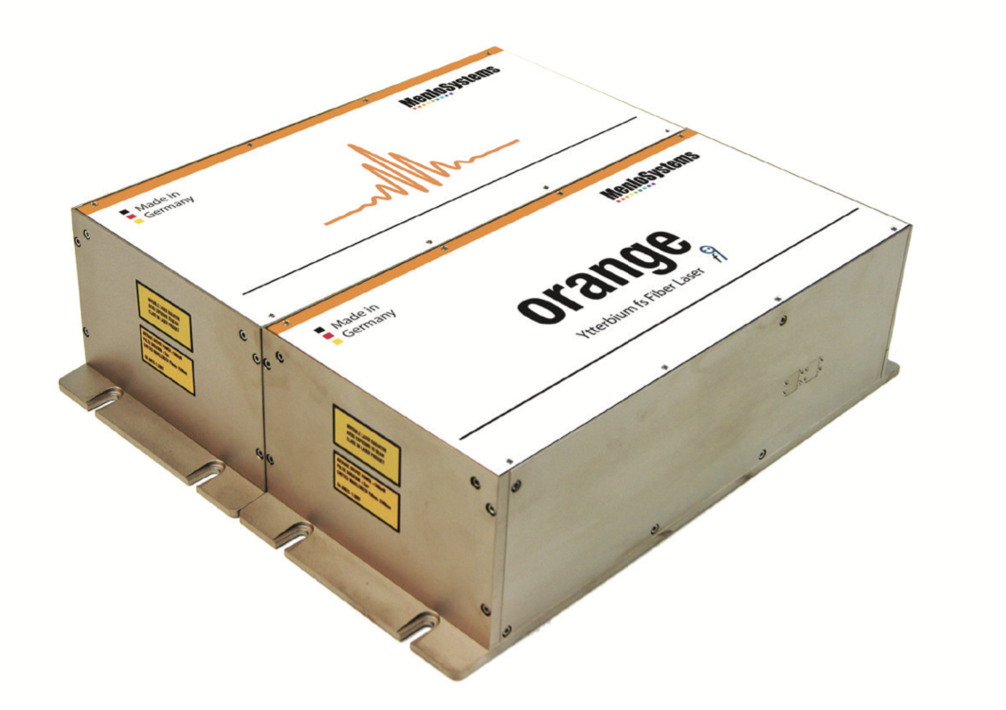
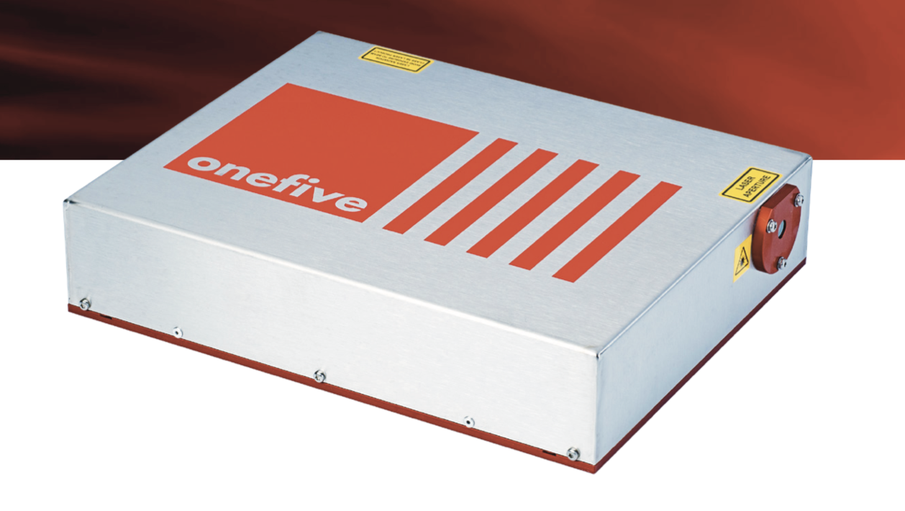
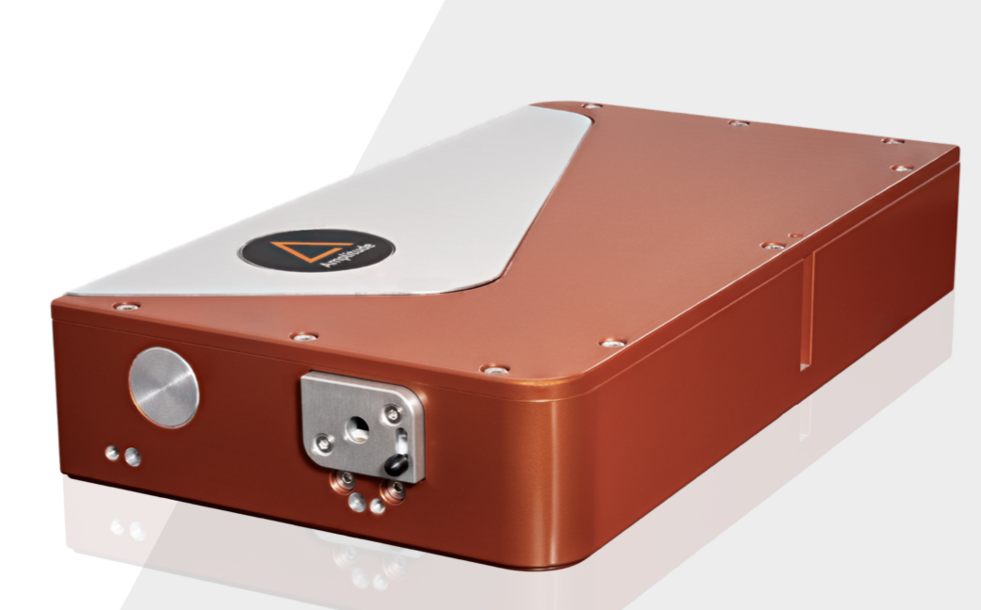

Laser system (very preliminary)
Input parameters assumed:
  E-beam: Q=10nC, 𝜎_{ℎ}=150µm, 𝜎_{v}=8µm, 𝜎_{𝜃v}=1µrad, 𝜎_{𝜃h}=40µrad
  Laser :𝜆=515nm, 20W, 250MHz pulsed (frequency comb), 𝜎_{ℎ}=𝜎_{v}=200µm, 1 degree crossing angle
A 20W green laser @ 250MHz provides about 2.2 photons in average per bunch crossing
Many commercial products:
laser oscillator + amplifier
This needs consolidation once location of polarimeter is confirmed

Slide 24
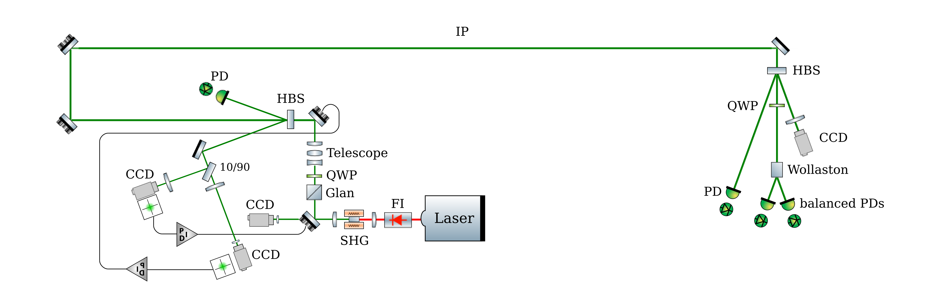
Laser beam injection line (preliminary)
Vacuum vessel
Box with rough temperature control
Box with rough temperature control
Telescope needs to be designed once laser beam parameters are confirmed
Additional positioning and pointing feedbacks can be added if needed
Components need to be validated for the required average power
Laser beam size and length of transport line as to be consolidates once location is decided

Slide 25
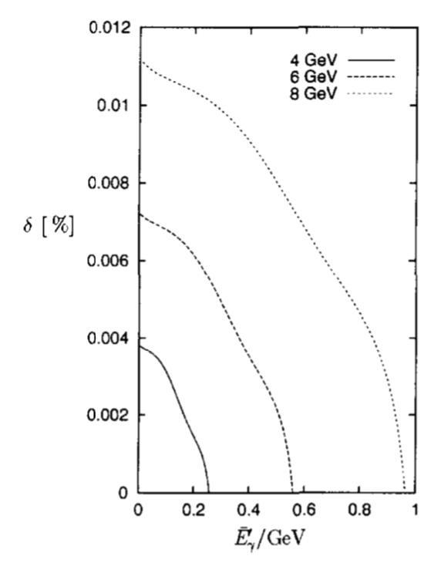
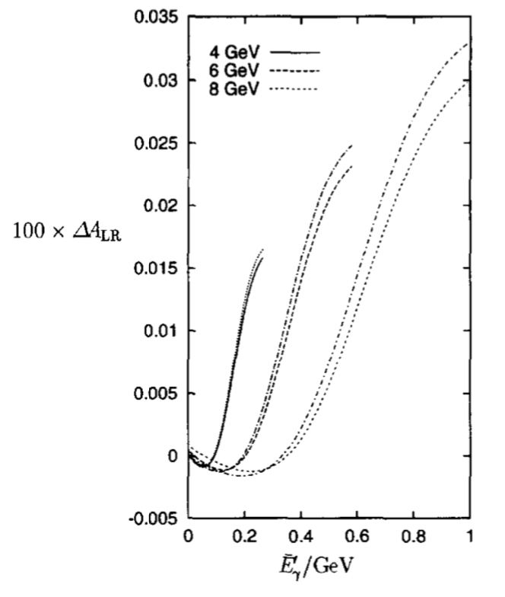


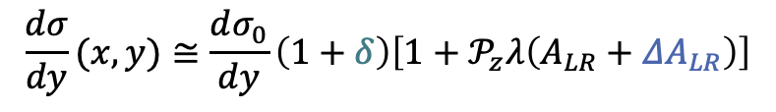
QED corrections
$$\frac{dσ}{dy}(x,y)≅\frac{dσ_{0}}{dy}\left(1+δ\right)\left[1+𝒫_{z}λ\left(A_{LR}+{ΔA}_{LR}\right)\right]$$
$$δ<{10}^{−4}$$
Denner & Dittmaier Nucl. Phys. B 540 (1999) 58 and references therein
$${ΔA}_{LR}<{3 10}^{−4}$$
Tree-level cross-sections are robust against QED corrections

Slide 26
A bit of history: HERA L-POL1
Beckmann et al., NIMA479 (2002) 334, Zhu @ Mu2e-II Workshop at ANL
Transverse sampling scintillating crystal
  Alignment uncertainty mitigated by transverse sampling
Choice of scintillating material ?
  Fast (250MHz rate) → BaF2
    recent developments for Mu2e
  Radiation hard
photon energy integrated asymmetry of 5-10%
  Precise measurement can be very fast
Calibration
  Lead absorber calibration : Variable thickness ?
  Detection linearity ?
  Online calibration with gamma source ?
Large deposited energy:
  Energy resolution degradation (pile-up)
  Lifetime of detector (huge radiation dose)

Slide 27
A bit of history: HERA L-POL2
Helicity opposite sign
Helicity same sign
Online !!!
Baudrand et al., JINST 5 P06005 (2010), Brisson et al., JINST 5 P06006 (2010), Escoffier et al., Nucl. Instrum. Meth. A 551 (2005) 563
Electron beam polarization can be estimated without helicity flip
  if modeling under control
  Signal spectrum shape sensitive
Precise modeling is required
  Beam-gas (bremsstrahlung) reduces with straight section length and residual pressure
  Compton on black-body photons negligible a priori but to be checked at lower energy
  Synchrotron radiation contribution large
  Pile-up correction is necessary
Calibration
  May be performed online if few photons contributions are measured
  tunable laser power ?
  May alternatively use 2-color laser

Slide 28
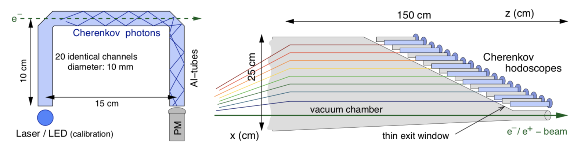
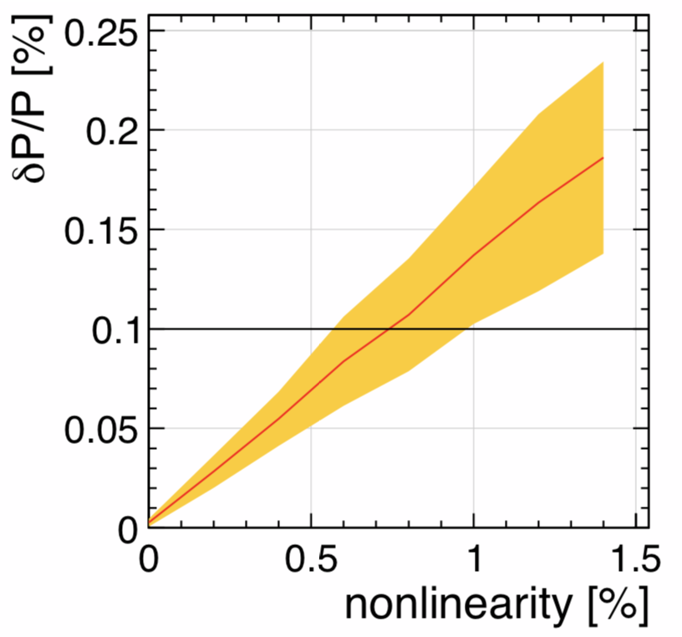
Electron Cherenkov counters…
Rather use quartz bars à la ILC instead
  More compact
  More granularity, low occupancy
  More simple to implement
  Online LED calibration ? (empty bunches ?)
    Non-linear LED intensity under control
Lath SLAC PhD thesis (1994), Woods SLAC-PUB-7319, Vormvald et al., arxiv:1509.03178, List et al., JINST 10 P05014 (2015)

Slide 29
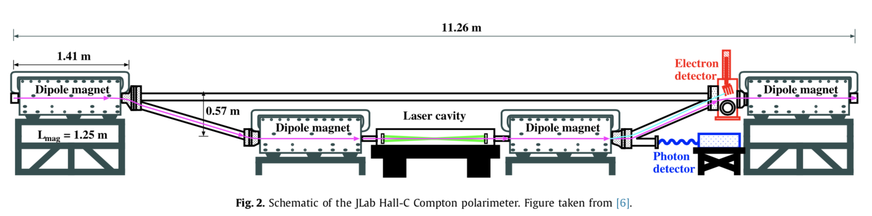
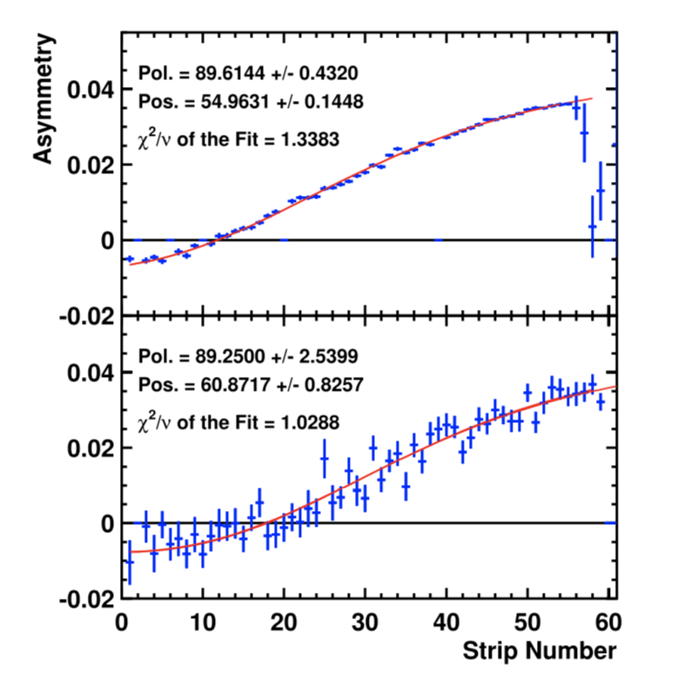
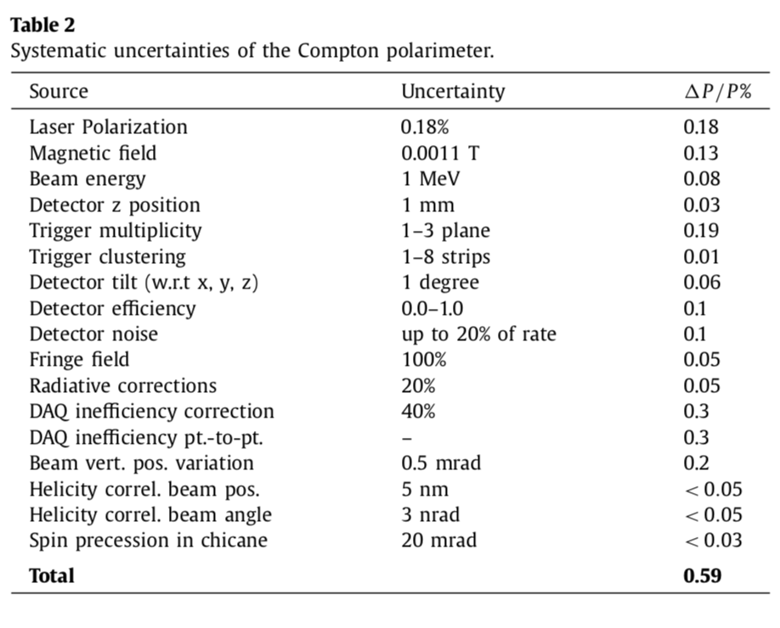
…or diamond counters
Magee et al., Physics Letters B 766 (2017) 339–344

Slide 30
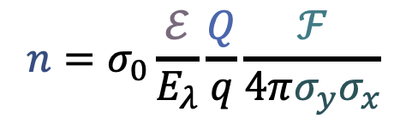
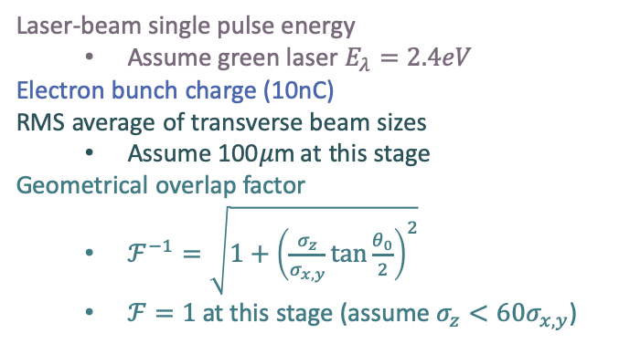
Laser system design
Laser-beam single pulse energy
  Assume green laser $E_{λ}=2.4eV$
Electron bunch charge (10nC)
RMS average of transverse beam sizes
  Assume 100𝜇m at this stage
Geometrical overlap factor
  $ℱ^{−1}=\sqrt{1+{\left(\frac{σ_{z}}{σ_{x,y}}\tan{\frac{θ_{0}}{2}}\right)}^{2}}$
  $ℱ=1$ at this stage (assume $σ_{z}<60σ_{x,y}$)
$$n=σ_{0}\frac{ℰ}{E_{λ}}\frac{Q}{q}\frac{ℱ}{4π{σ_{y}σ}_{x}}$$
Photon rate
A 10W green laser @ 250MHz provides about 2.5 photons in average per bunch crossing
www.menlosystems.com, www.amplitude-laser.com, www.nktphotonics.com, www.afs-jena.de
Many commercial products:
laser oscillator + small amplifier
This needs consolidation with actual consideration of location of polarimeter

Slide 31
Laser polarization control
PDe
IP
QWP2
PD2
LASER
GLAN
Beam transport
Beam transport
HBS
Wollaston
PD1
QWP
PDi
Minimize number of optical component to generate (pure) circular laser beam polarization
Brisson JINST 5 P06006 (2010), Zomer HDR (2003), Jacquet HDR (2009), Baudrand PhD thesis (2007)
Residual wrong polarization vs QWP tilt angle
About 1 per mil contribution from wrong polarization
Fine modeling of beam transport is required

Slide 32
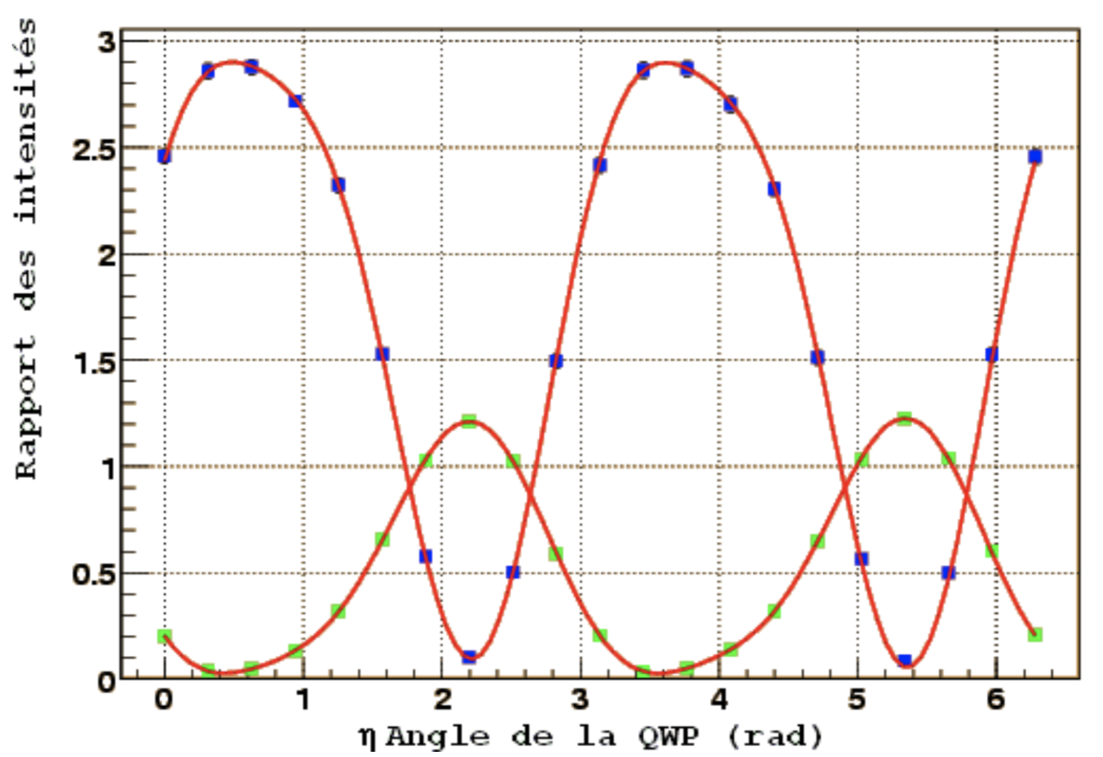
Laser beam polarization control
PDe
IP
QWP2
PD2
LASER
GLAN
Beam transport
Beam transport
HBS
Wollaston
PD1
QWP
PDi
use of reflective optics
reducing optical path length
calibrate effects from laser-beam transport
Brisson JINST 5 P06006 (2010), Zomer HDR (2003), Jacquet HDR (2009), Baudrand PhD thesis (2007)
Example of fit of PD intensities versus QWP angle
  Large number of parameters (misalignments, thickness defaults,…)
  Fraction of per-mil precision

Slide 33
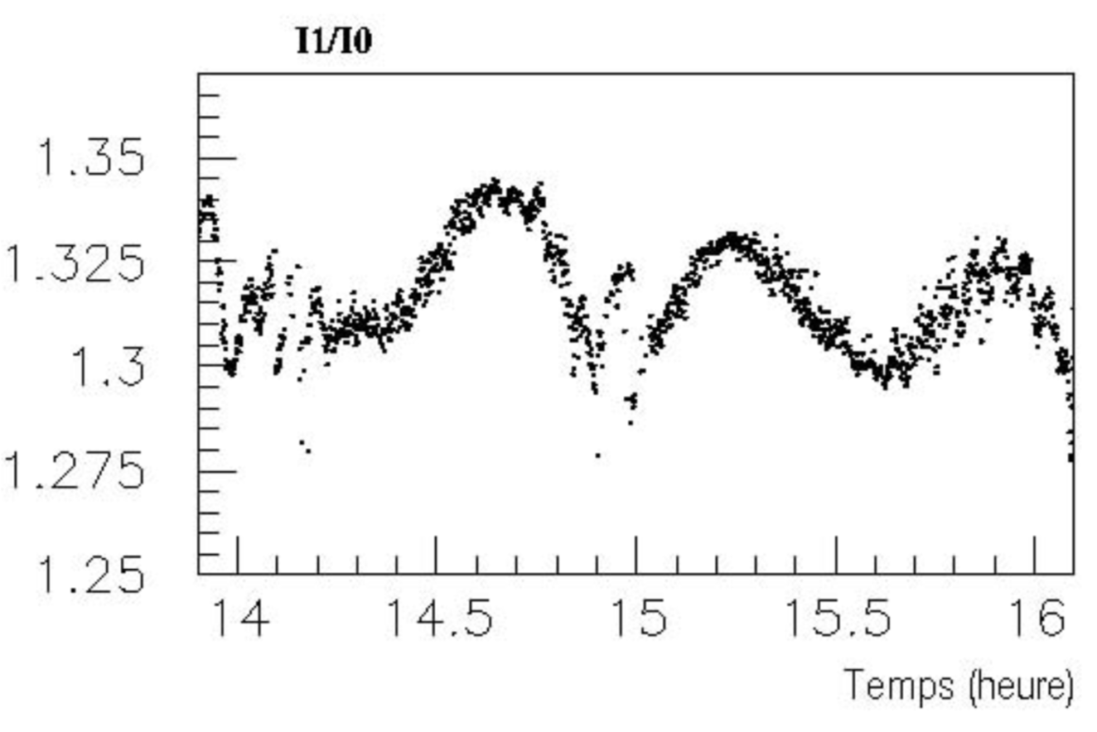
Laser beam polarization control
PDe
IP
QWP2
PD2
LASER
GLAN
Beam transport
Beam transport
HBS
Wollaston
PD1
QWP
PDi
Polarization independent Holographic Beam Sampler
Careful suppression of laser intensity fluctuations
Use of balanced photodiodes and differential electronics
Brisson JINST 5 P06006 (2010), Zomer HDR (2003), Jacquet HDR (2009), Baudrand PhD thesis (2007)
Example of time dependent measurement at HERA
  Remaining 0.3% fluctuations
More frequent measurements ?
Modulation of circular polarization to avoid DC fluctuations ?

Slide 34
HERA LPOL 1
Low sensitivity to threshold & backgrounds
Beckmann et al., NIMA479 (2002) 334
Extrapolation of calibration ?
Data driven control channel ?
Thousand of scatters per crossing

Slide 35
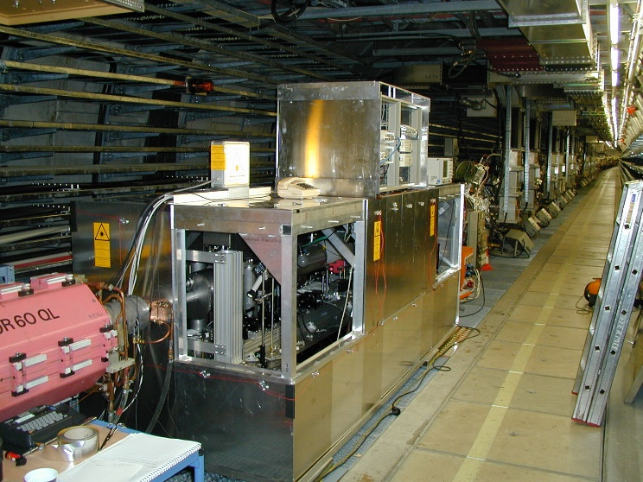
HERA LPOL 2
Baudrand et al., JINST 5 P06005 (2010), Brisson et al., JINST 5 P06006 (2010), Escoffier et al., Nucl. Instrum. Meth. A 551 (2005) 563
Careful design of ellipsometer <0.3% systematics

Slide 36
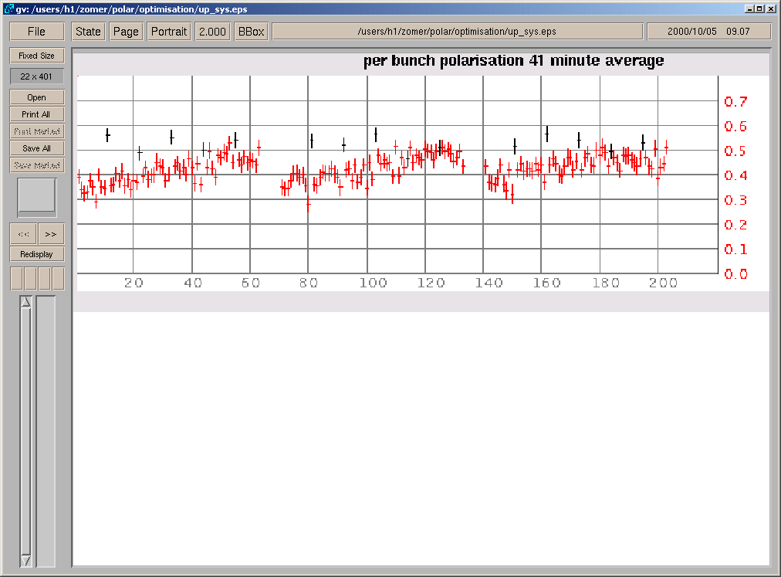
HERA: bunch/bunch measurements
Bunch per bunch measurement required
Baudrand et al., JINST 5 P06005 (2010)
Detector knowledge and performance
Position sensitivity of the detector (too small?)
Synchrotron radiation treatment

Slide 37
Current design of detectors
Permille control of non-linear LED intensity thanks to differential LED pulses
Quartz crystals: data driven gain calibration of PMs
Vormvald et al., arxiv:1509.03178, List et al., JINST 10 P05014 (2015)

Slide 38
Ellipsometer @ HERA
Brisson JINST 5 P06006 (2010), Zomer HDR (2003), Jacquet HDR (2009), Baudrand PhD thesis (2007)

Slide 39
Why challenging per-mille precision?
Optical birefringence of all optical elements must be under control at per-mille level
NB: influenced by mechanical stress, temperature, roughness defects, thickness defects,…
Example : QWP
Poirson et al. Applied Optics 34 6806 (1995)
Per-mille box
AR coating reduces angular dependence
but azimuthal coating inhomogeneities experienced !

Slide 40
Why challenging per-mille precision?
Optical birefringence of all optical elements must be under control at per-mille level
NB: influenced by mechanical stress, temperature, roughness defects, thickness defects,…
Example : QWP
Poirson et al. Applied Optics 34 6806 (1995), Hale & Day Applied Optics 27 5147 (1988)
Temperature sensitivity: fraction of permille per Kelvin
Certainly an issue for 50W laser and 10⁻²/cm absorption
0.5W absorbed power in compound 0-rder QWP
Look for thin (1rst order ?) QWP to reduce heat
Intense R&D to validate polarisation shaping, control, characterisation also at 50W or so…
One of the very first point to deal with

Slide 41
Strategy
Per-mille suppression of parasitic polarisation certainly an extremely difficult task
Minimize amount of material traversed, use reflective optics where possible
Accept residual parasitic polarisation (unavaoidable)
Model fine effects, calibrate and control at best
Redundant synchronized and frequent measurements (time variations)
Reduce the optical path between IP and
laser-beam source (optical room close to IP)
diags (embedded in accelerator bay)
Carefully review the baseline option of surface optical rooms
R&D: proper balanced photodetectors w/ dedicated differential electronics
R&D: modulate polarisation w/ Electro-Optic techniques to suppress DC noise
Option: Exploit duty cycle for ellipsometry ?

Slide 42
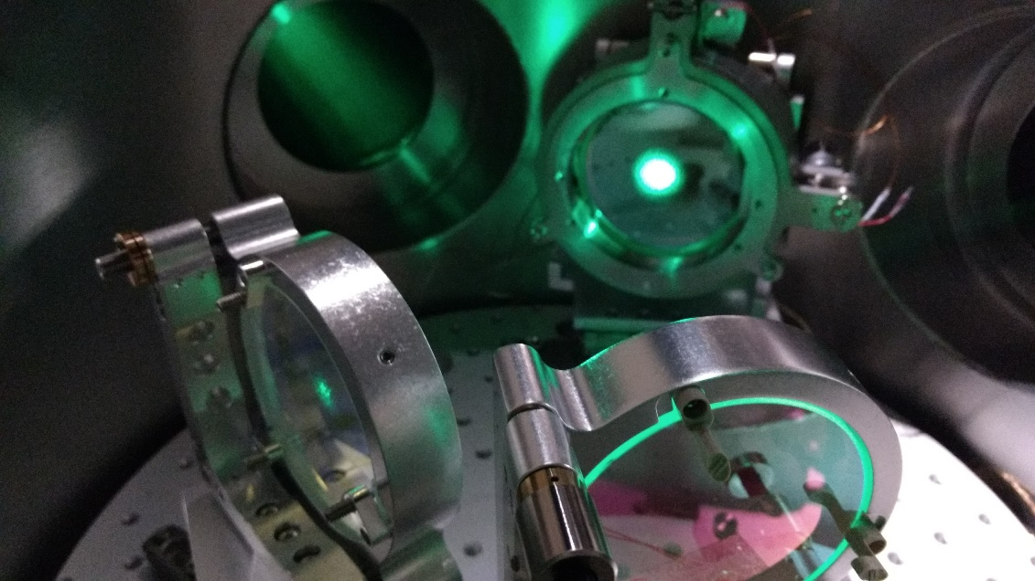
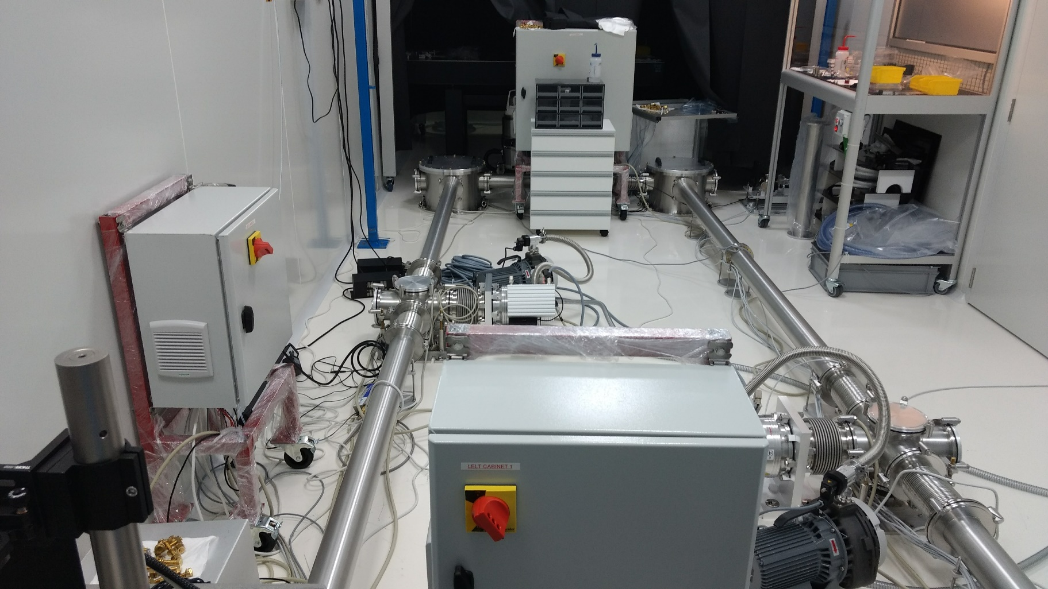

Slide 43
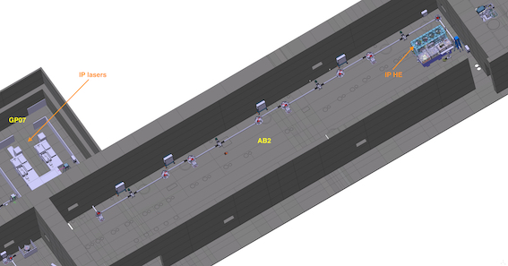
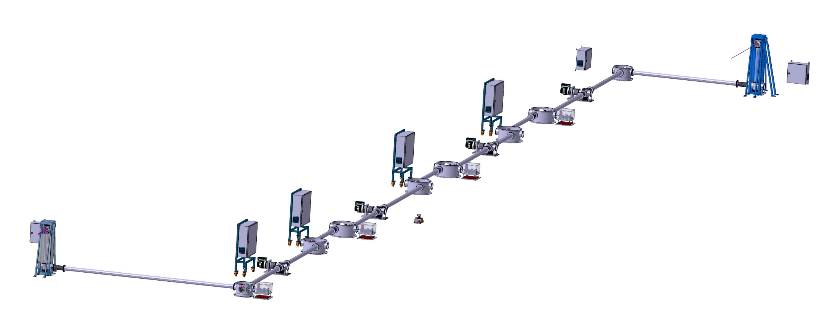

Slide 44
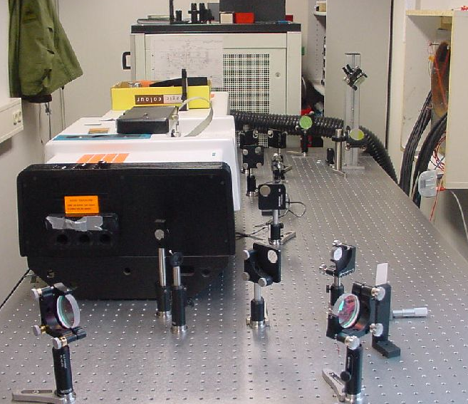
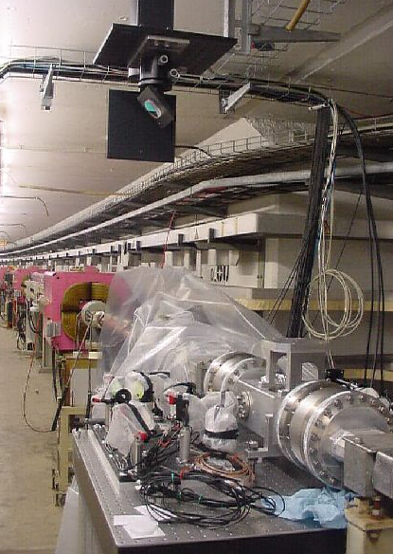
PETRA
Small room behind hall was implemented

Slide 46
HERA L-POL 2: tiny effects
Background fluctuations in between changes of laser helicity
Baudrand et al., JINST 5 P06005 (2010)
Pile-up effects are included

Slide 47
HERA L-POL 2/T-POL comparison
Baudrand et al., JINST 5 P06005 (2010)
Compatible results with more precision with L-POL
One measurement every 10s
Detector knowledge and performance
Position sensitivity of the detector
Synchrotron radiation treatment

Slide 48
Introduction
Spin (longitudinal) polarization of e- beams at LHeC is an involved subject
Ring-ring option:
Spin tends to (anti-)align with B field due to synchrotron radiation (ST, BK)
Spin precess (T-BMT equation) quickly (large 'spin tune')
Depolarization arise due to vertical betatron motion, skew quads, spin rotators, solenoids
Depolarization increases with energy
LINAC-ring option:
Depolarization can be small
→chromatic effects in spin rotators
LHeC Design report, CERN-OPEN-2012-015
Precise Compton polarimetry is required to reach physics goals

