Slide 1

Systematic effects simulation studies for an electron beam polarimeter for SuperKEKB
Farah MAWAS
Aurélien MARTENS

Slide 2
Introduction
Current status:
Several sensitivity studies shown in the past
Look-up tables (LUTs) introduced to fasten the fit procedure
Purpose of today’s presentation:
Reminder of Compton scattering and cross section
MC sensitivity studies reviewed with LUTs
Detector misalignment
Beam jittering related to top-up injection
Backgrounds

Slide 3

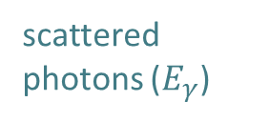

Compton backscattering
laser (E_{λ})
scattered photons ($E_{γ}$)
Initial electron energy (7 GeV)
Initial photon energy (2.4eV at 515nm)
Crossing angle of beams
Emitted photon energy
$$θ_{0}$$
θ
e⁻ beam $Ee$

Slide 4


Compton backscattering
$$x=\frac{2E_{e}\text{E}\text{λ}}{m^{2}}\left(1+\cos{θ_{0}}\right)$$
$$y=\frac{E_{γ}}{E_{e}}$$
The Compton cross-section averaged over scattered particles spins:
Differential cross-section
Transverse laser polarisation: nuisance parameter to minimize and keep under control
Transverse electron beam polarisation: intervenes as an asymmetry in the transverse plane
$$\frac{dσ}{dydφ_{obs}}\left(x,y\right)=\frac{dσ_{0}}{dy}\left(x,y\right)+\frac{dσ_{⊥}}{dy}\left(x,y\right)\cos\left(2\left(φ_{obs}−φ_{las}\right)\right)𝒫_{⊥}^{las}+\frac{dσ_{∥}}{dy}\left(x,y\right)𝒫_{las}^{circ}(P_{T}f_{T}\left(x,y\right)\cos\left(φ_{obs}−φ_{elec}\right)+P_{Z}f_{L}(x,y))$$
Electron beam polarization independent
Electron beam polarization dependent

Slide 5
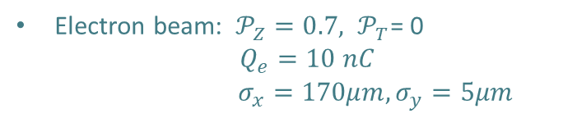
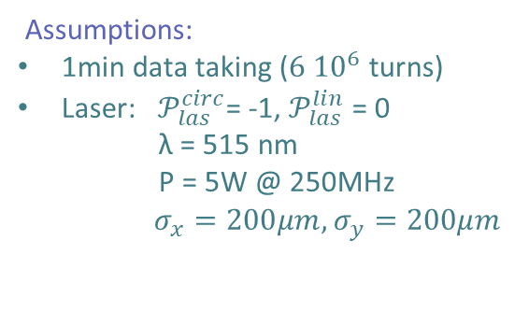

Toy-MC sensitivity studies
We simulate the e-/laser interaction and we try to extract the polarization of the electrons
Assumptions:
1min data taking (${6 10}^{6}$ turns)
Laser: $𝒫_{las}^{circ}$= -1, $𝒫_{las}^{lin}$ = 0
λ = 515 nm
P = 5W @ 250MHz
$σ_{x}=200μm, σ_{y}=200μm$
Electron beam: $𝒫_{Z}=0.7, 𝒫_{T}$= 0
$Q_{e}=10 nC$ $σ_{x}=170μm, σ_{y}=5μm$
Detector’s geometry:
$BaF_{2}$ Crystal size: 2.5cm
L = 30 m
Resolution: $σ_{E} \sim A\sqrt{E}$
$miscalibration scale\sim 1.1$
We concentrate on photon detection only
Fixed parameters: e- beam energy and spread, detector energy resolution, $𝒫_{T}=0$, $𝒫_{las}^{circ}$ , $𝒫_{las}^{lin}$=0
Fitted parameters: $𝒫_{Z}$, miscalibration scale, relative scale of each contribution (1 or 2 Compton photons)

Slide 6
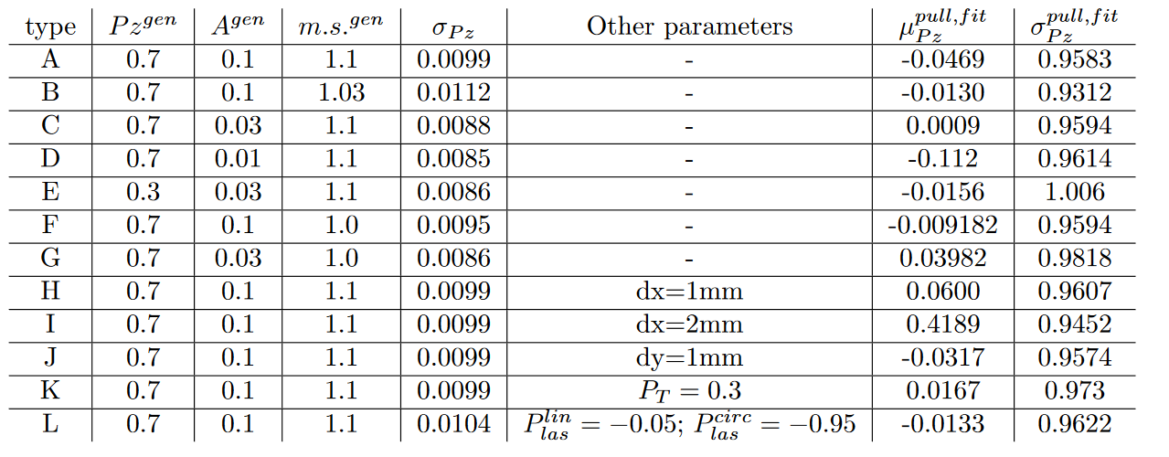
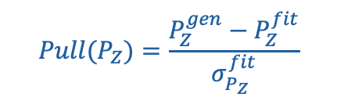
Toy-MC sensitivity studies
dx and dy: misalignments on the detector
$$Pull(P_{Z})=\frac{P_{Z}^{gen}−P_{Z}^{fit}}{σ_{P_{Z}}^{fit}}$$
Misalignment
dx
Top view
Miscalibration scale

Slide 7
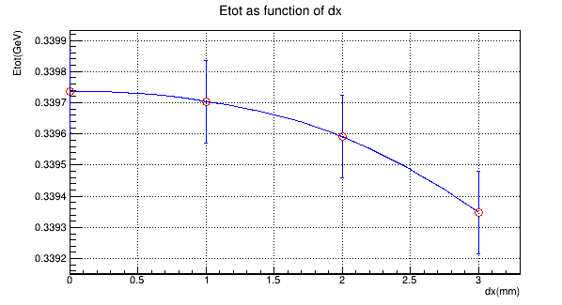

Basic Alignment of detector
Mean energy deposited in the detector per bunch-crossing as function of the misalignment of the detector:
E tot (GeV)
${10}^{−4}$!
dx (mm)

Slide 8


Beam jitters at injection
Following e-mail exchange with Oide-san.
Any mistake reflects our misunderstanding.
Injection of fresh electrons affects the beam dynamics in two ways:
laser beam
electron beam
Shift of the center of gravity of e bunch:
Damped by the feedback in ~100turns
Emittance growth:
Damped by radiation in ~10000turns
$${dy}_{E}$$
$${dx}_{E}$$
Goal: study the jitters and their impact on the sensitivity of the polarimetry

Slide 9
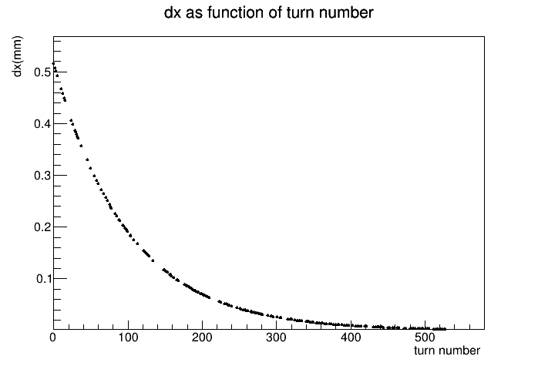
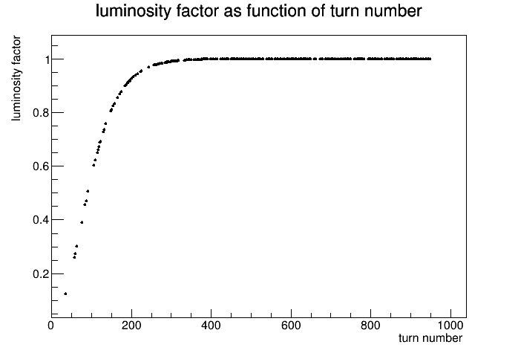
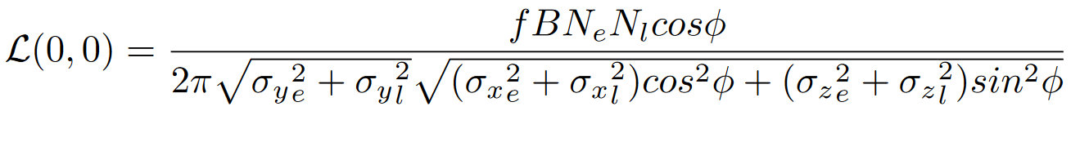


Center of gravity
$$dx_{E}(mm)$$
Displacement of electron beam:
Proposed model of $dx_{E}$, $dy_{E}$ the center of gravity shift:
$di_{E}\left(t\right)=3 σ_{i }e^{\frac{−turn}{N_{1}}}$ (i=x,y) $N_{1}$=100
Luminosity formula with the center of gravity shift:
turn number

Slide 10
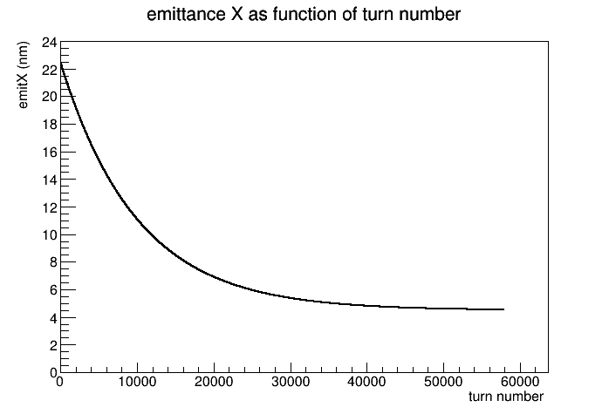
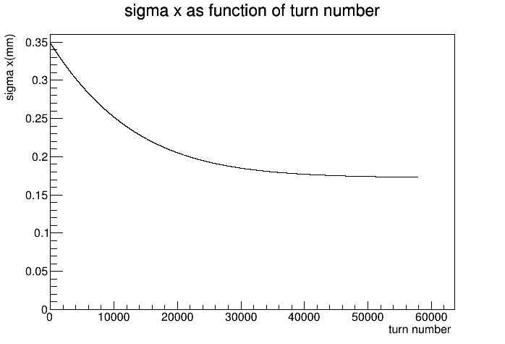
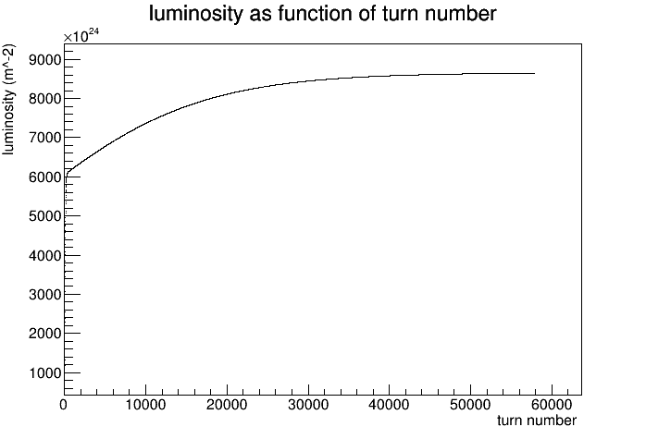

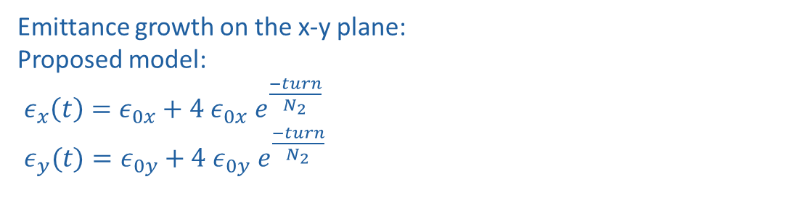
Emittance growth
Emittance growth on the x-y plane:
Proposed model:
$ε_{x}\left(t\right)=ε_{0x}+4 ε_{0x} e^{\frac{−turn}{N_{2}}}$
$ε_{y}(t)=ε_{0y}+4 ε_{0y} e^{\frac{−turn}{N_{2}}}$
$N_{2}$=10000
This leads to a change in the e- beam size and the luminosity !

Slide 11
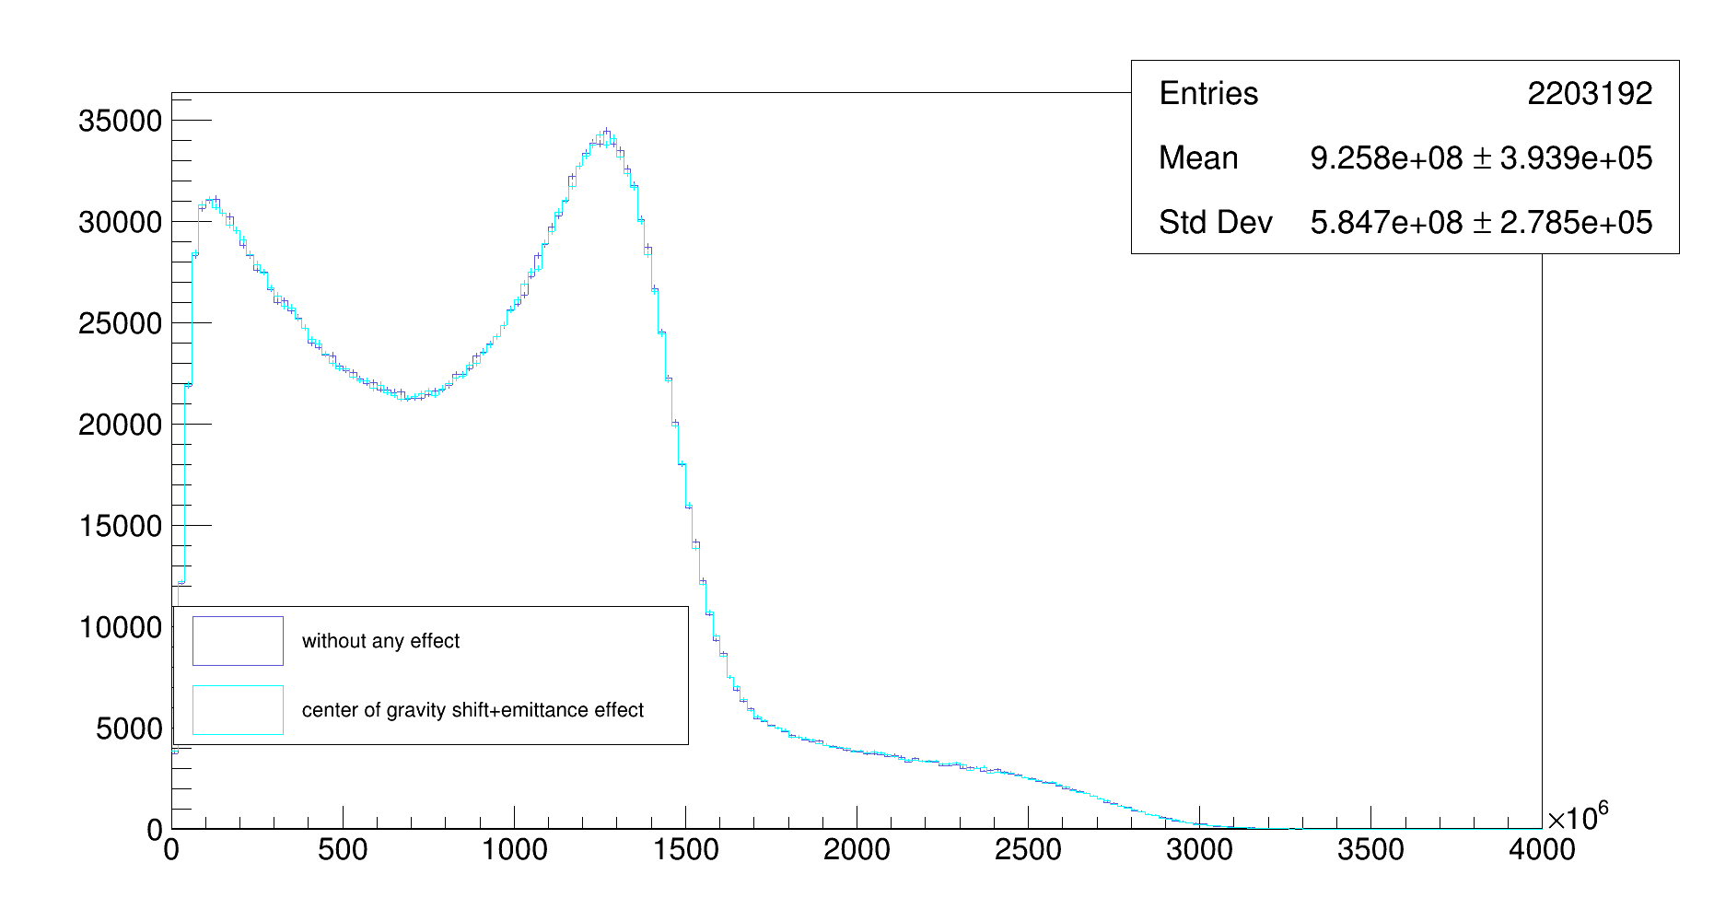
Effect on energy spectrum

Slide 12
Backgrounds
List of background contributions:
Bremsstrahlung radiation
Synchrotron radiation
Compton on blackbody radiation
HERA
Main Contribution ?
Just as at HERA, we suppose bremsstrahlung radiation is one of the dominant contributions
We try to make a first rough estimate here

Slide 13
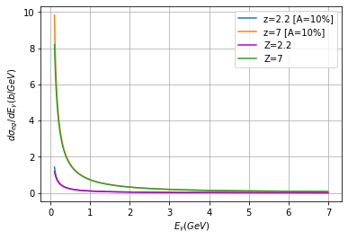
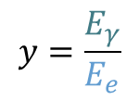
Bremstrahlung
Bremsstrahlung radiation :
Z: mean atomic number of the residual gas nucleus , taken as 2.2 or 7
e + g e + g + γ
The cross section averaged over scattered particles spins :
$$y=\frac{E_{γ}}{E_{e}}$$
$\frac{dσ}{dy}=\frac{4αr_{e}^{2}}{y}\{\left(y^{2}−\frac{4}{3}y+\frac{4}{3}\right)(Z^{2}ln\left(184.15Z^{−1/3}\right)+Zln\left(1194Z^{−2/3}\right))+\frac{1}{9}(Z^{2}+Z)(1−y)$}
Yung-Su Tsai: Pair production and bremsstrahlung of charged leptons. Rev Mod. Phys. 46 (1974) 815
P.M Lewis et al. First measurements of beam backgrounds at SuperKEKB. NiMA 914 (2019) 69
Detector energy resolution has
no effect except for small energies

Slide 14
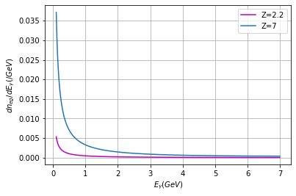
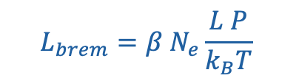

Bremstrahlung luminosity
Following e-mail exchange with Andrii Natochi.
Any mistake reflects our misunderstanding.
Luminosity of the collision between the electron bunch and the gas particles in the beam pipe of length L:
L=30m
P<${10}^{−7}Pa$
T=300K
$N_{e}$=10nC
P
Number of photons for P=10⁻⁷Pa:
e- bunch
L
gas particles uniformly distributed in the beam pipe, having pressure P
$$L_{brem}=β N_{e}\frac{L P}{k_{B}T}$$

Slide 15
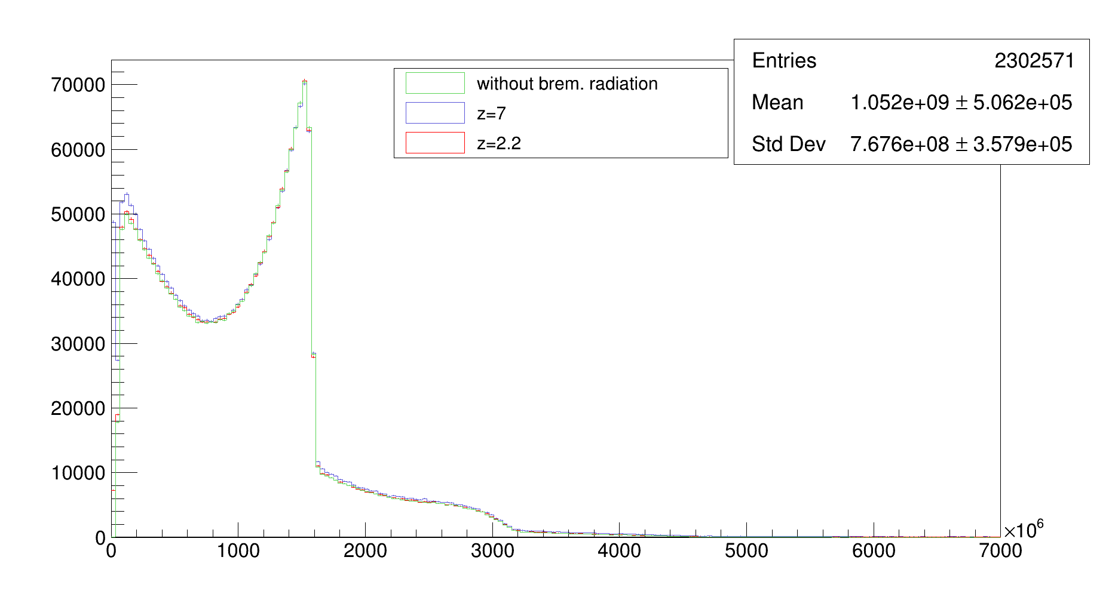
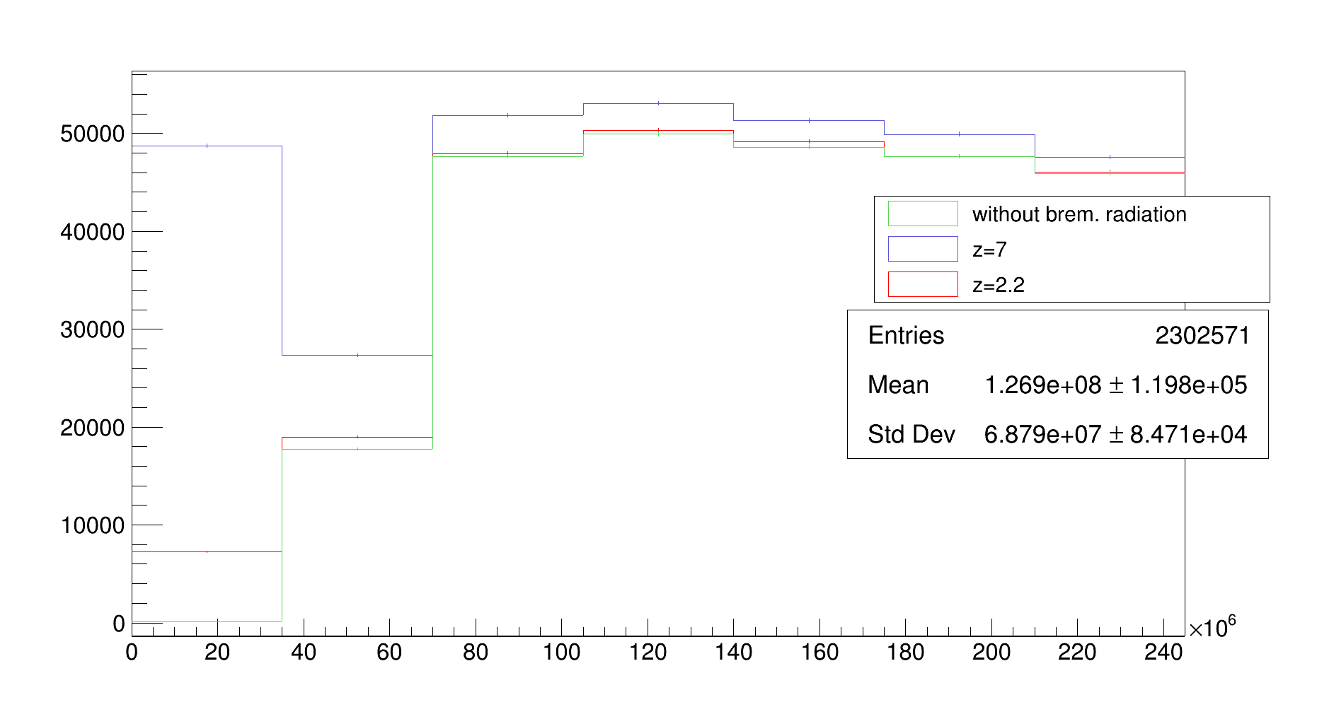
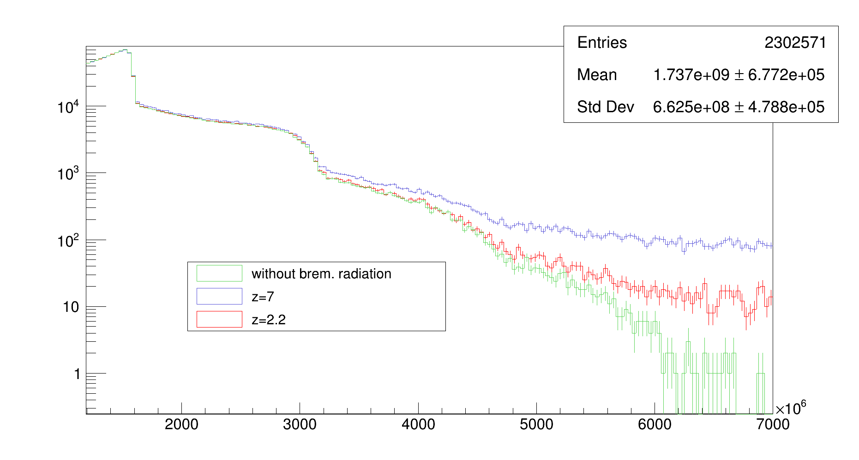
Energy spectrum
At low energy: we see an increase of the number of photons emitted with bremsstrahlung radiation for a beam gas of effective z=7
At high energy, we see photons emitted with bremsstrahlung radiation for a beam gas of effective z=7

Slide 16
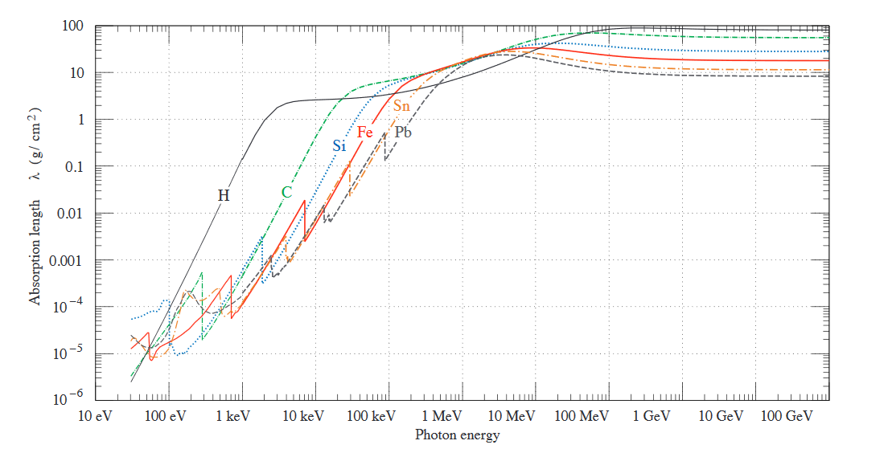




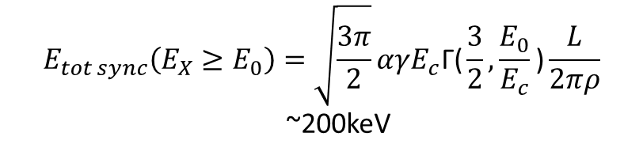
Synchrotron radiation
$$E_{c}=\frac{3}{2}γ^{3}\frac{c}{ρ} \sim 5keV$$
“Critical energy” of synchrotron radiation:
$ρ$: radius of curvature ~ 146 m
Total radiated energy by synchrotron radiation:
$$E_{tot sync}\left(E_{X}≥E_{0}\right)=\sqrt{\frac{3π}{2}}αγE_{c}\text{Γ}\text{(}\frac{3}{2},\frac{E_{0}}{E_{c}}\text{)}\frac{L}{2πρ}$$
~200keV
Jackson Book, Classical Electrodynamics
1${g cm}^{−2}$
Density of lead: 11.34${g cm}^{−3}$
Solution: put a ~1 mm lead plate in front of the detector to get rid of synchrotron radiation

Slide 17
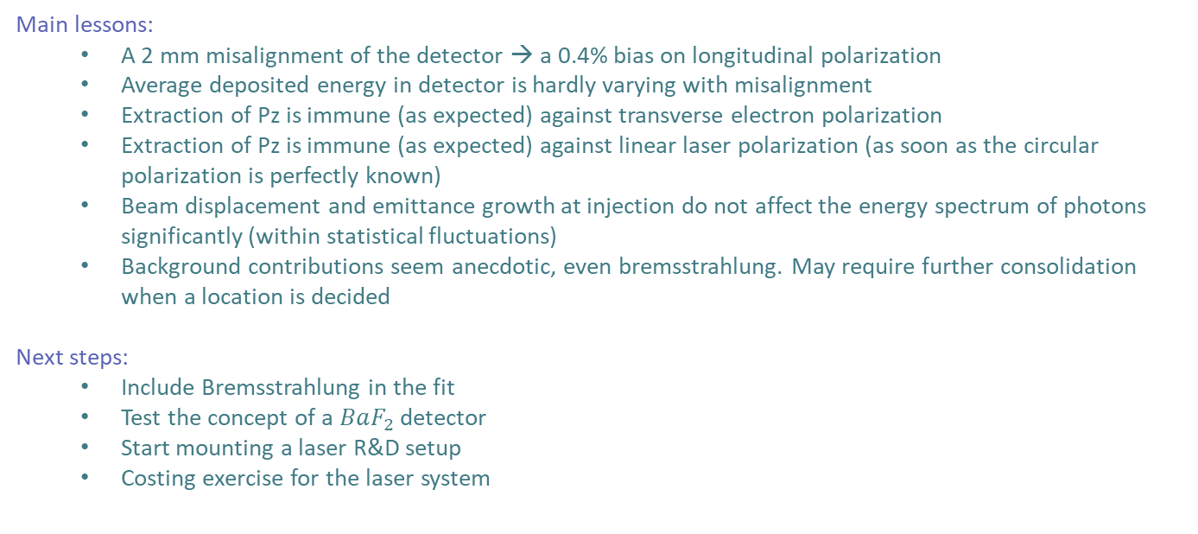
Summary and next steps
Main lessons:
  A 2 mm misalignment of the detector → a 0.4% bias on longitudinal polarization
  Average deposited energy in detector is hardly varying with misalignment
  Extraction of Pz is immune (as expected) against transverse electron polarization
  Extraction of Pz is immune (as expected) against linear laser polarization (as soon as the circular polarization is perfectly known)
  Beam displacement and emittance growth at injection do not affect the energy spectrum of photons significantly (within statistical fluctuations)
  Background contributions seem anecdotic, even bremsstrahlung. May require further consolidation when a location is decided
Next steps:
  Include Bremsstrahlung in the fit
  Test the concept of a $BaF_{2}$ detector
  Start mounting a laser R&D setup
  Costing exercise for the laser system

Slide 18
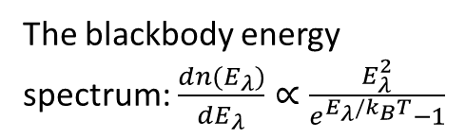
Compton on blackbody
The beam pipe emits photons through blackbody radiation, these photons scatter on the electron beam and the scattered photons contribute in the background effects and have an impact on the energy spectrum.
The blackbody energy spectrum: $\frac{dn(E_{λ})}{dE_{λ}}∝\frac{E_{λ}^{2}}{e^{E_{λ}/k_{B}T}−1}$

Slide 19
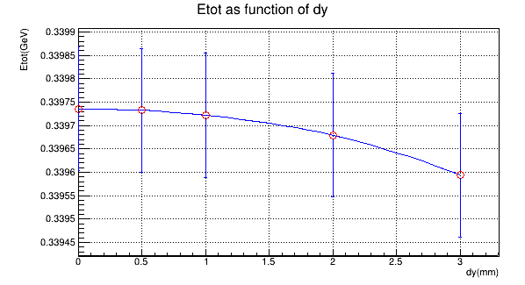
Basic Alignment of detector
Deposited energy in the detector with misalignment :

Slide 20
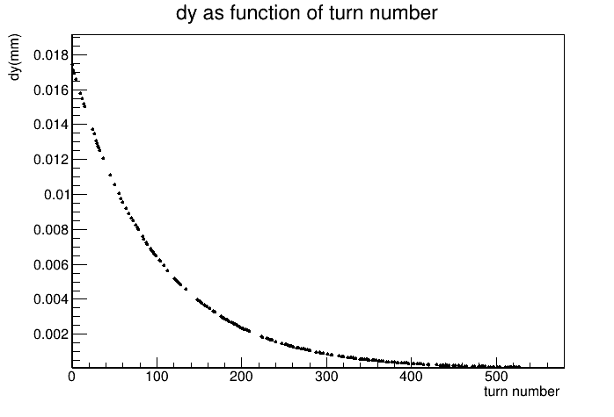
Jitter issues
Misalignment of the e beam: (w/o emittance growth)

Slide 21
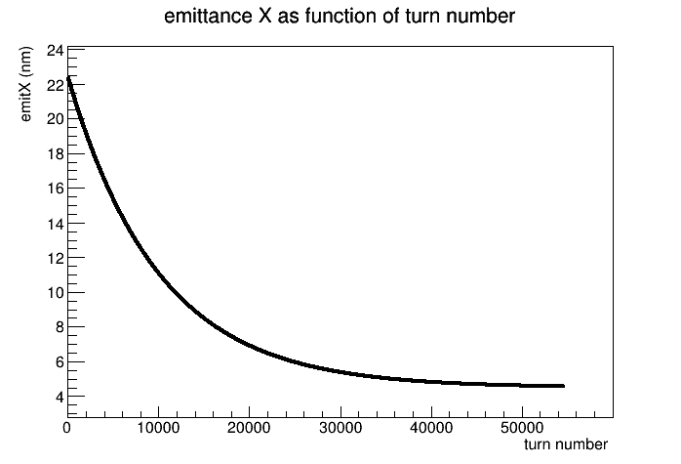
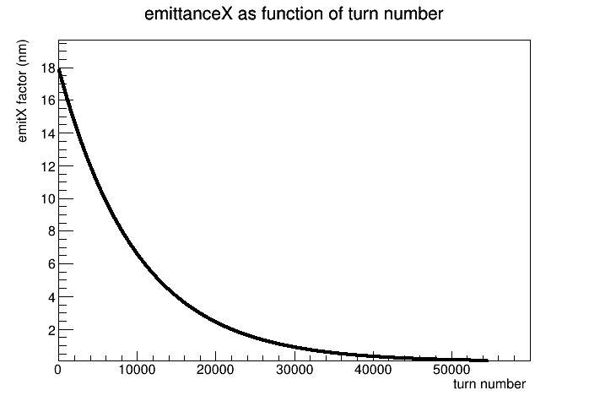
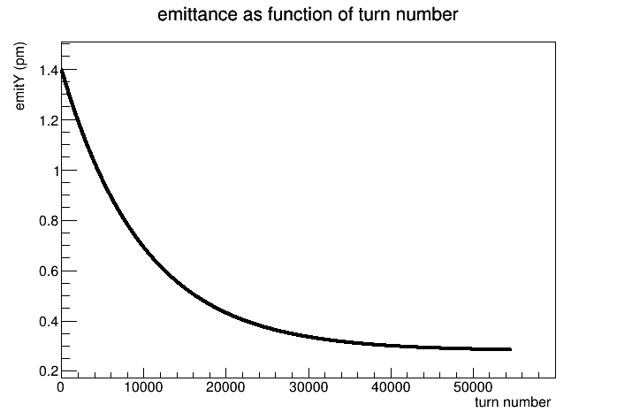
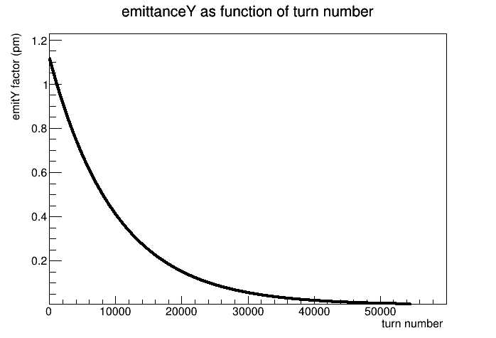
Jitter issues
Taking into consideration misalignment on e- beam + Emittance growth :

Slide 22
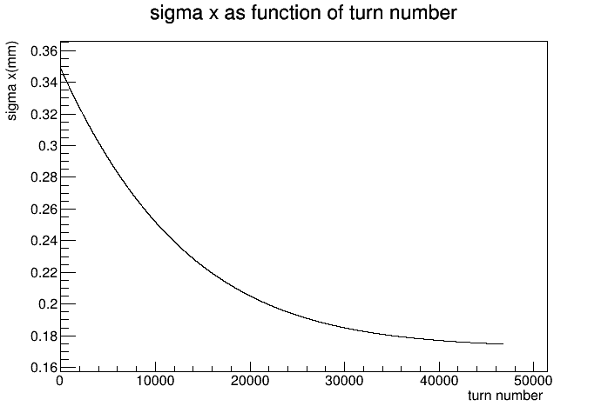
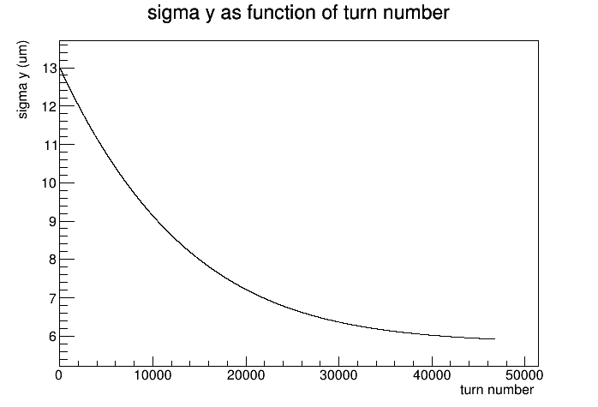
Jitter issues
Taking into consideration misalignment on e- beam + Emittance growth :

Slide 23
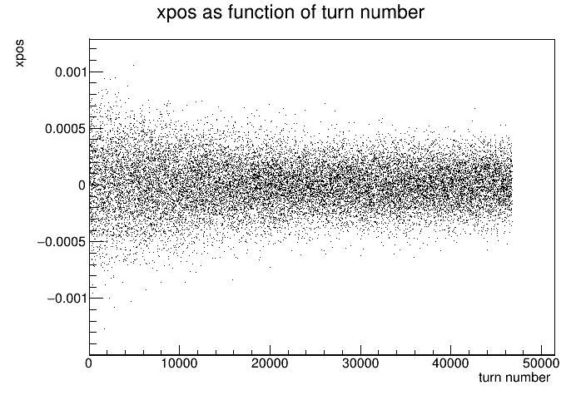
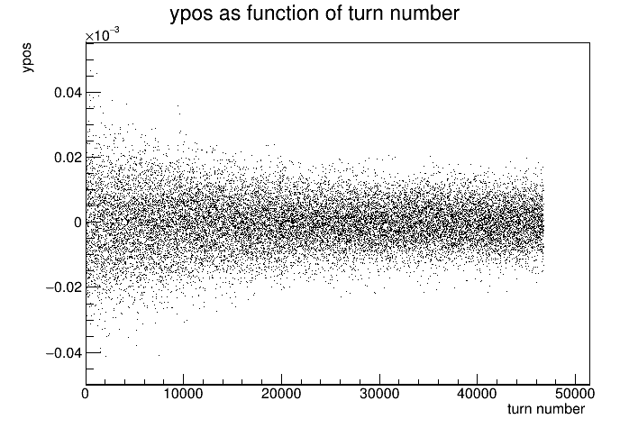
Jitter issues
Taking into consideration misalignment on e- beam + Emittance growth :
xpos and ypos are the positions of electrons inside the bunch on the x and y axis

Slide 24
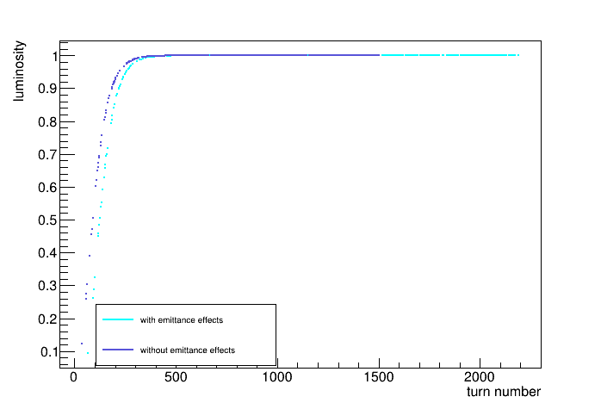
Jitter issues
Comparison:

Slide 25
Jitter issues
Taking into consideration misalignment on e- beam + Emittance growth :
xpos: the positions of electrons inside the bunch on the x axis

Slide 26
Misalignments on the detector
Perfectly aligned beam
Misalignment
dx

