Slide 1
Time-dependent
CP Violation analysis
of B meson
Experiment (I: Belle)
29 October 2019
Y.Sakai (KEK Emeritus)

Slide 2
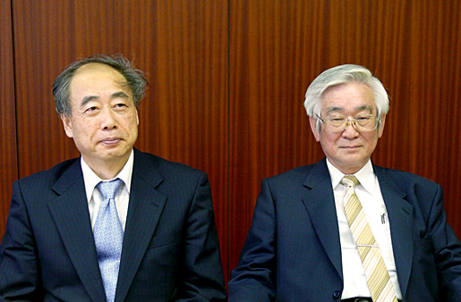
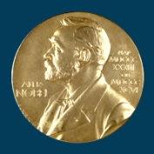
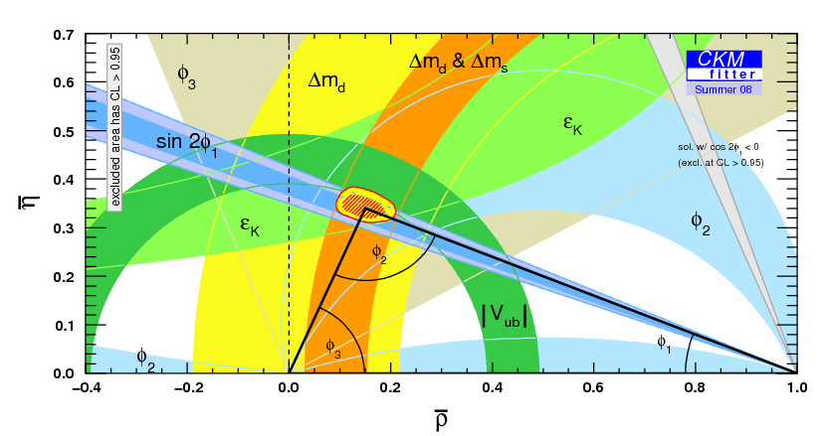
CPV in B: Kobayashi-Maskawa
2008 Physics Nobel Prize
ＣＰ Violation：
One of Mystery
of the SM
caused by Single
Complex Phase
in CＫＭ matrix
Validation by
B-Factory
Experiments

Slide 3
KEKB/Belle→ SuperKEKB/Belle II
KEK B-factory accelerator
Luminosity Frontier
World highest Lum.
（ｅ＋ｅ－asymmetric energy collider）
Main goal
Study of CPV in B decays
Many other physics
（Rare B decays,
Charm/tau physics
New resonances！）
Now Upgraded to
SuperKEKB/Belle II
x40 Peak Luminosity
x50 accumulated data

Slide 4
Scope
Introduction:
Discovery of CPV in B decays at B-Factories
Time-dependent CPV, φ₁
Further CPV in B decays
φ₂ and φ₃ of Unitarity Triangle
CP Violation beyond SM:
Search for New Physics
［Ref：“CP Violation”, I.I.Bigi and A.I.Sanda (2000), Cambridge U. press]

Slide 5
Introduction:

Slide 6
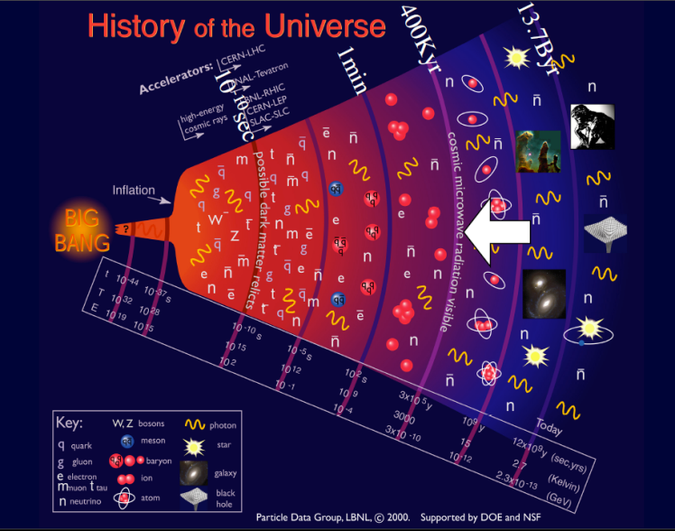
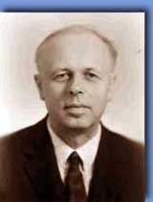
Why CPV is important ?
Difference between particle & anti-particle
(matter & anti-matter)
Universe: almost “matter” only (no anti-matter)
Big-Bang → N(particles) = N(anti-particles)
Sakhalov’s 3 conditions (1967):
1. baryon number violation
2. CP violation
3. existence of non-equiblium
CPV is a key for Existence of Universe & us !
Andrei Sakharov (1921-1989)

Slide 7

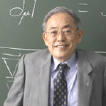

CPV: Why B ?
Size of CPV in K: O(10⁻³) ~ small
not enough information to confirm
Kobayashi-Maskawa scheme (1973)
t
b
Specialty of B
long lifetime (~1.5 ps)
Large B⁰-B⁰ mixing
Various decay modes
Surprise
Lucky !
top
bottom
c
s
(ARGUS,1987)
charm
strange
Sanda-Bigi-Carter (1980)
Large CPV
in B-system
u
d
up
down

Slide 8
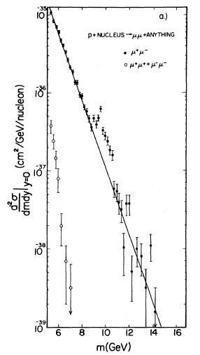
Discovery of b-quark & B meson
p+N → μ⁺μ⁻ X
e⁺e⁻ → hadrons
Υ(1S)
_
Y(nS): (bb)
−
ΒΒ
1978~ e⁺e⁻ collider
DORIS (ARGUS),
CESR (CLEO)
1977 Fermilab, fixed-target
L.Lederman
1983: first B meson reconstruction
[PRL 39, 252 (1977)]
Asym. B-Factory is needed for CPV
Notes:
1st Observation of Y(4S): PRL 45, 219 (1980) CLEO D.Andrews et al.
1st Observation (reconstruction) of B-meson: PRL 50, 881 (1983) CLEO S.Behrends et al.

Slide 9

Origin of CPV ?
Kobayashi-Maskawa Ansatz
(1973)
Complex phase in the quark mixing matrix
→ source of CPV in Weak Interactions
KM-phase
Requires 3 (or more) generation of quarks
only 3 quaks (u, d, s) were known at that time !
All 6 quarks are now discovered
( c: 1974, b: 1977, t: 1994 )
Essential ingredient of
the Standard Model (SM)

Slide 10
CP Violation in SM
CP Violation：look for
（Behavior of Particle） ≠ （Behavior of Anti-particle）
Particle experiment: investigate Decays of particle
3 types of CP Violation
−
−
1. Direct CPV： |A(P→f)| ≠ |A(P→f)|
2. Indirect CPV (CPV in mixing) : |q/p| ≠ 1
3. Mixing induced CPV (interference of mixing & decay):
Imλ =
All are caused by the Complex Phase of CKM matrix
[CP is conserved in Strong and EM interactions]

Slide 11
Mixing induced CPV (1)
Final sate: CP eigenstate
can decay from both B⁰, B⁰
B⁰
f_{CP}
−
=
B⁰
f_{CP}
B⁰
B⁰
Direct decay and decay via Mixing
2 decay amplitudes → CPV via Interference
[Sanda,Carter,Bigi 1980]
Decay rates: using Mixing formula
Γ(B⁰→ f_{CP}) = |〈 f_{CP} |B⁰(t)〉|² = e^{-t/τ} |A|²[1+Imλ sin(Δm･t)]
−
−
Γ(B⁰→ f_{CP}) = |〈 f_{CP} |B⁰(t)〉|² = e^{-t/τ} |A|²[1−Imλ sin(Δm･t)]
−
−
−
〈 f_{CP} |B⁰〉=A, 〈 f_{CP} |B⁰〉=A, λ =(q/p)(A/A)
−
(|A|=|A| and |q/p|=1 assumed: no CPV in A/mixing)
Γ
(
B
0
→
f
)
−
Γ
(
B
0
→
f
)
A
≡
d
CP
d
CP
= −Imλ sin(Δm･t)
CP
Γ
(
B
0
→
f
)
+
Γ
(
B
0
→
f
)
≠ 0：CP Violation
d
CP
d
CP

Slide 12
Discovery of CP Violation in B decays at B-Factories
Time-dependent CPV
(Mixing-induced CPV)

Slide 13
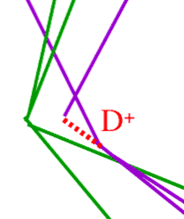
B-mesons at B-Factory
Best condition（2.1X１０^{３４}／cm^{２}／s）
Produce 20 pairs/s
e⁻（８ＧｅＶ）
e⁺ （３.５ＧｅＶ）
B
B
ϒ(4S )
10.58GeV/c²
B and B-bar meson pairs are produced
Flight a short length, then decay into light stable particles

Slide 14
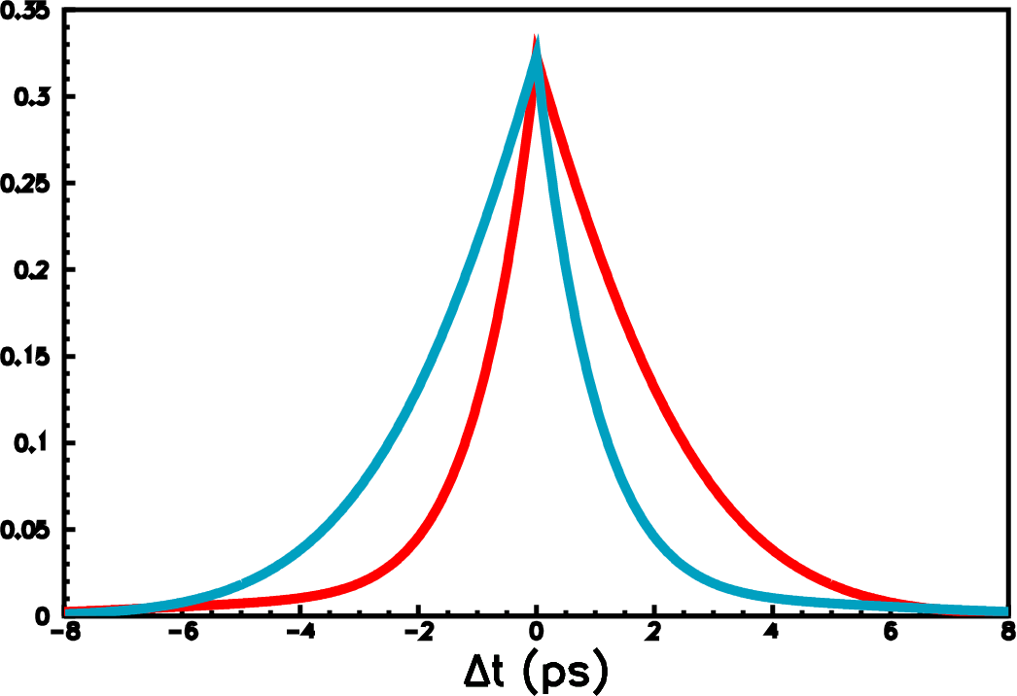
Time-dep CPV Measurement
Flavor-tag
(B⁰ or B⁰ ?)
Reconstruction
ε_{eff} ~30%
J/ψ(φ,η’)
e⁺
f_{CP}
e⁻
t=0
Vertexing
Δz
K_{S}
σ_{Δt}~140ps
B⁰
fit
B⁰
Extract
CPV
B⁰-tag
B⁰-tag
Δt ≈ Δz/cβγ
βγ=0.425 (KEKB)
0.56 (PEP-II)
same analysis method applied for all modes

Slide 15
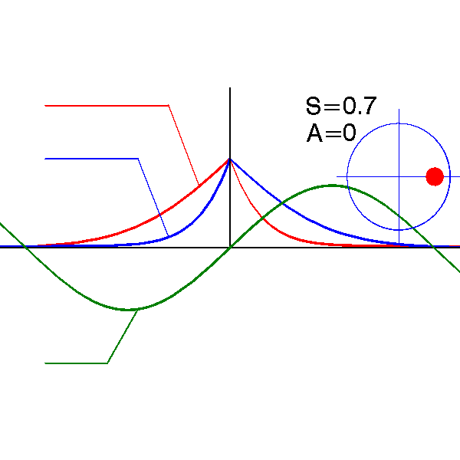
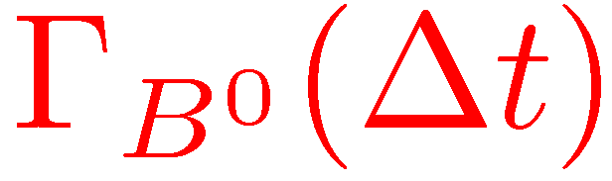

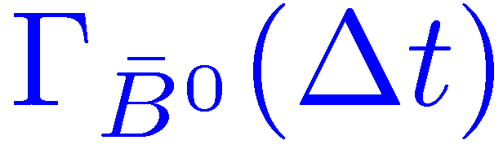
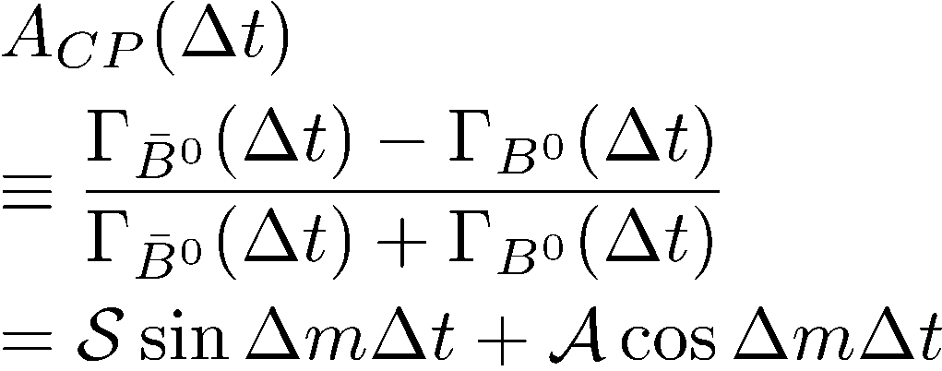
CPV in B
CPV in B: Time-dependent CPV
Sanda
Bigi
Carter
made by H. Miyake
Δt
q
p
A
A
2Imλ_{CP}
1+ |λ_{CP} |²
λ_{CP} =
S =
mixing
decay
|λ_{CP} |² −1
|λ_{CP} |² +1
A =
A=A: No DCPV
sin-term only
Mixing-induced CPV
Direct CPV
(A = −C )
_

Slide 16
φ₁ Measurement
_
_
_
_
V*_{cb}
c
_
V*_{td}
J/ψ
d
_
b
b
t
B⁰
B⁰
w
c
B⁰
w
w
_
b
t
d
d
s
K⁰
V*_{td}
d
*
V_{ud} V_{ub}
φ₂(α)
*
V_{td} V_{tb}
A
= − ξ_{cp}sin2φ₁ sin(ΔmΔt) +A cos (ΔmΔt)
φ₃(γ)
CP
φ₁(β)
Mixing induced CPV
Direct CPV
V_{cd} V_{cb}
A ≅ 0
*
ξ_{CP} : CP eigenvalue
First observed CPV in B (2001)

Slide 17

φ₁ Measurement
At the Υ(4S): t Δt = t - t
CP
tag
Decay time evolution
B⁰
Asym. in two ways
B⁰
B⁰-tag
B⁰
B⁰
B⁰-tag
Δt
-Δt
Systematics cancel
Δt

Slide 18
Analysis Procedure: sin2φ₁
_
1.Reconstruct B→CP decays
B or B ?
Decay to CP eigenstate
Signal fraction:f_{sig}
ϒ(4S)
_
J/ψ
2.Determine B or B
e⁻
e⁺
t=0
Δz
Wrong tag fraction:ω
K_{S}
Vertex diff.
3.Measure decay time diff.
Time resolution: R_{res}
B⁰
B⁰
B⁰-tag
B⁰-tag
4.Measure CP asym.:ML fit
sin2φ₁ (and A)
Δt

Slide 19
B→CP Eigenstate Decays
Can use ~all low-background ccK⁰ modes
B_{CP} → J/ψ K_{S}(→π⁺π⁻ & π⁰π⁰)
ψ(2S)(→l⁺l⁻ & J/ψπ⁺π⁻) K_{S}
χ_{c1}(→J/ψγ) K_{S}
η_{c}(→K_{S}K⁺π⁻, K⁺K⁻π⁰,pp)K_{S}
J/ψ K_{L}
ξ _{f} =-1
CP odd
-
CP even
ξ _{f}=+1
J/ψ K*⁰ (→K_{S}π⁰) (81% ξ_{f} =+1)
［ full angular analysis ]

Slide 20
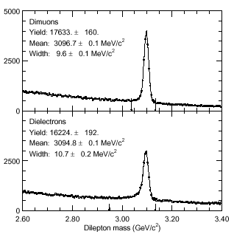
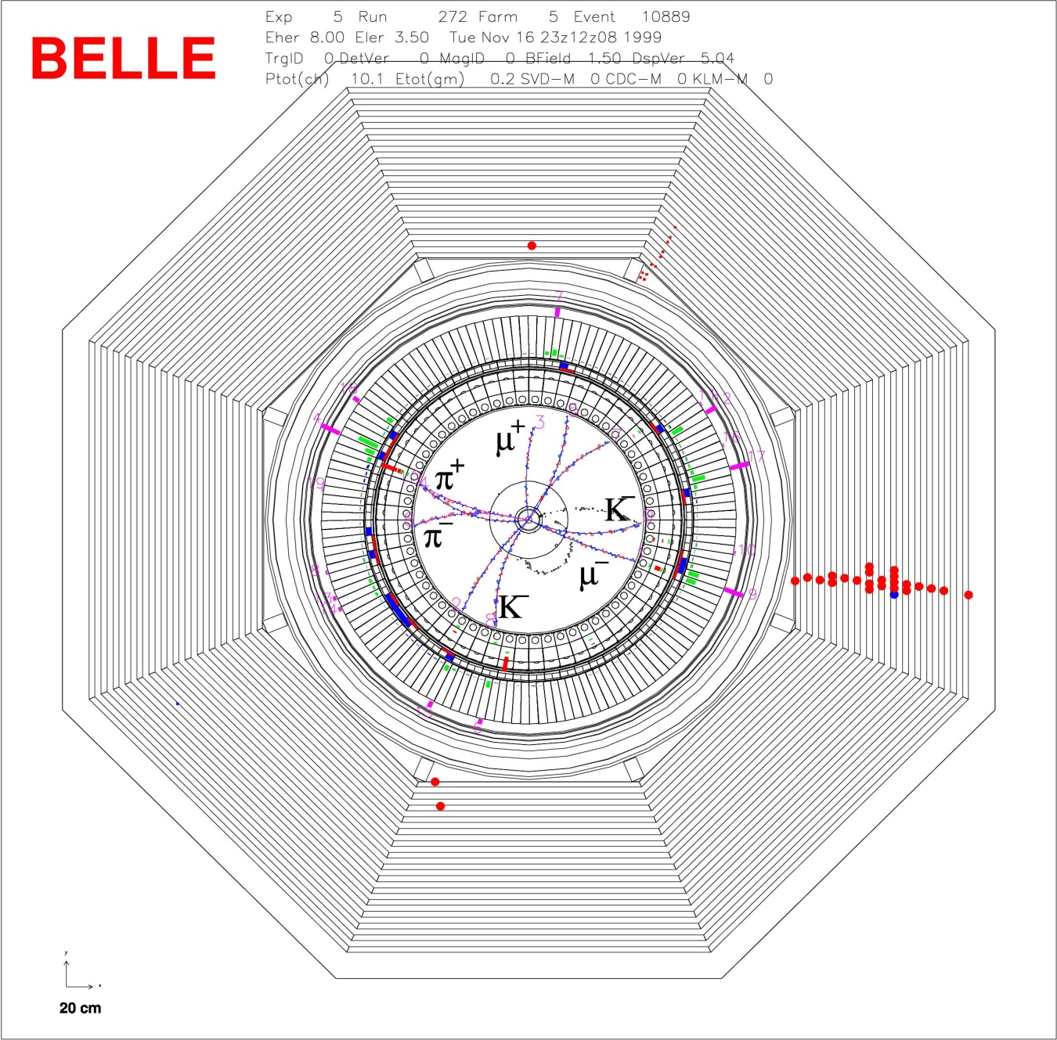
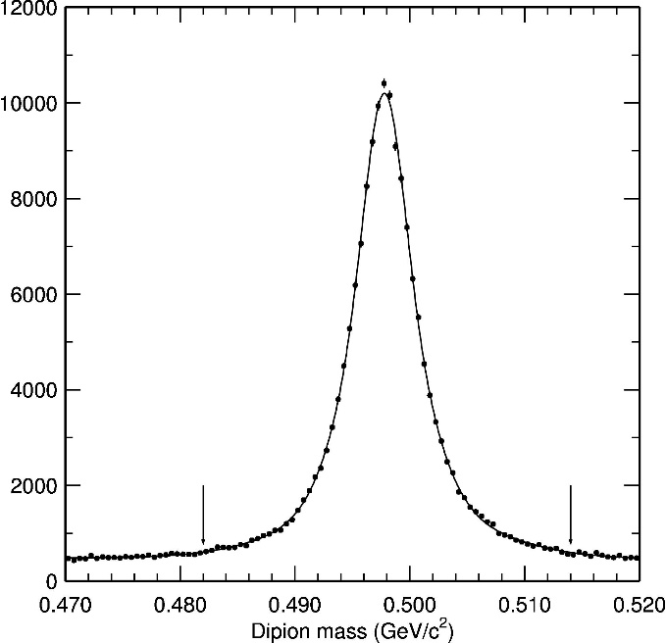
B⁰ → J/ψ K_{S} : Signals
J/ψ→μ⁺μ⁻
σ~10 MeV/c²
B⁰ → J/ψ K_{s}(→π⁺π⁻ )
J/ψ→e⁺e⁻
σ~11 MeV/c²
K_{s}→π⁺π⁻
σ~4MeV/c²
Golden mode

Slide 21
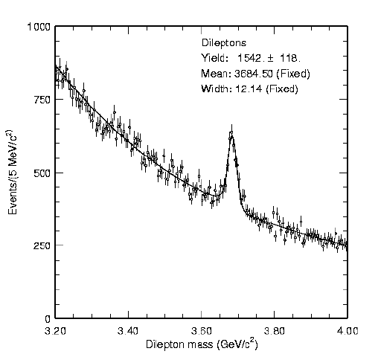
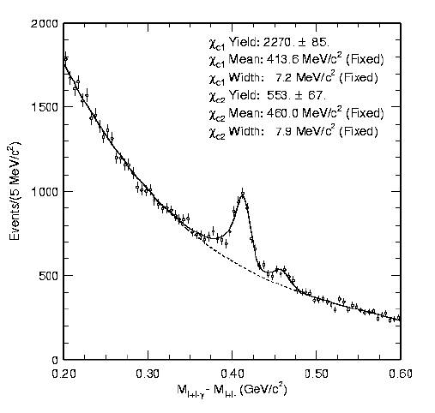
ψ’ and χ_{c1}
ψ’→μ⁺μ⁻,e⁺e⁻
σ=12.1 MeV/c²
χ_{c1},χ_{c2}→J/ψ+γ
σ=7.0 MeV/c²

Slide 22
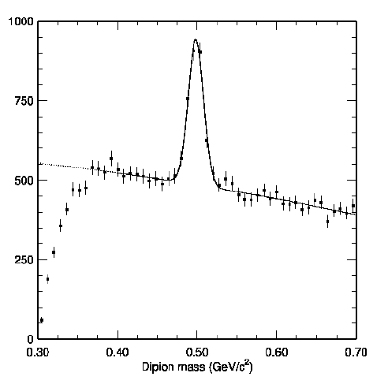
π⁰ and Ks(→ π⁰ π⁰)
π⁰
σ_{M}=9.3 MeV/c²
in inclusive J/ψ events
M(K_{S}→π⁰π⁰) (GeV/c²)

Slide 23
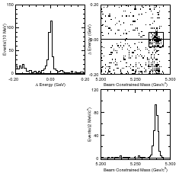

B-meson Reconstruction
Utilize
special Kinematics
at Y(4S)
Energy difference:
B⁰→ J/ψ K_{S}
Beam-constrained mass:
M_{bc}

Slide 24
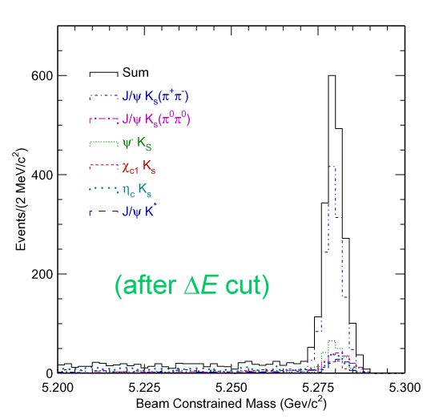
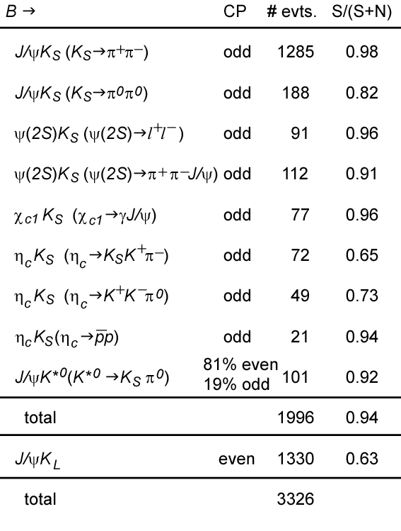
All Charmonium Ks/K* modes
Belle 2002
78 fb⁻¹ , 85 x 10⁶ BB pairs
1895(CP−) +101 events

Slide 25
All Charmonium Ks/K* modes
Belle 2012
771 fb⁻¹ , 772 x 10⁶ BB pairs
15,560(CP-) events
Full Data sample
[PRL 108, 171802 (2012)]

Slide 26
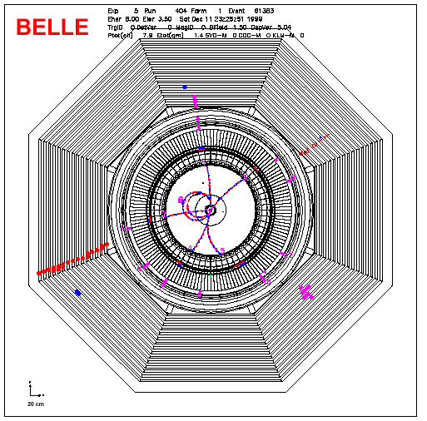
B⁰ → J/ψ K_{L} : Signals
772M BB
μ⁻
μ⁺
Nsig = 10,040
Purity 63 %
CP even
K_{L}
K_{L} direction + 2-body
decay kinematics
p_{KL} information is poor
→ lower purity

Slide 27

Flavor Tagging
l⁺
u
l⁻
ー
π⁺
ν
d
ー
ν
_
_
W⁺
ｃ
W⁻
_
ｂ
ｓ
ー
K⁺
Λ
B⁰
ｄ
D^{*−}
π⁻
slow
High-p (primary), low-p (secondary) leptons
Strangeness (b → c → s)
Fast π, slow π
2-stage Multi-dim. Likelihood based
method (incl. correlations)
Neural Network
utilize all
available info.

Slide 28
2-stage Multi-variable Flavor tagging
Q, p*, p_{miss}, e-id,..
π_{s}
Λ
K
Lepton
Lookup Table
(MC)
Track-level LH
N_{B}- N_{B}
q.r =
N_{B}+ N_{B}
Event-level LH
q = +1 ⇒ B_{tag}
q = −1 ⇒ B_{tag}
r=(1-2ω)
Lookup Table
q.r
⇒ 6 r-regions (6 tag categories)

Slide 29
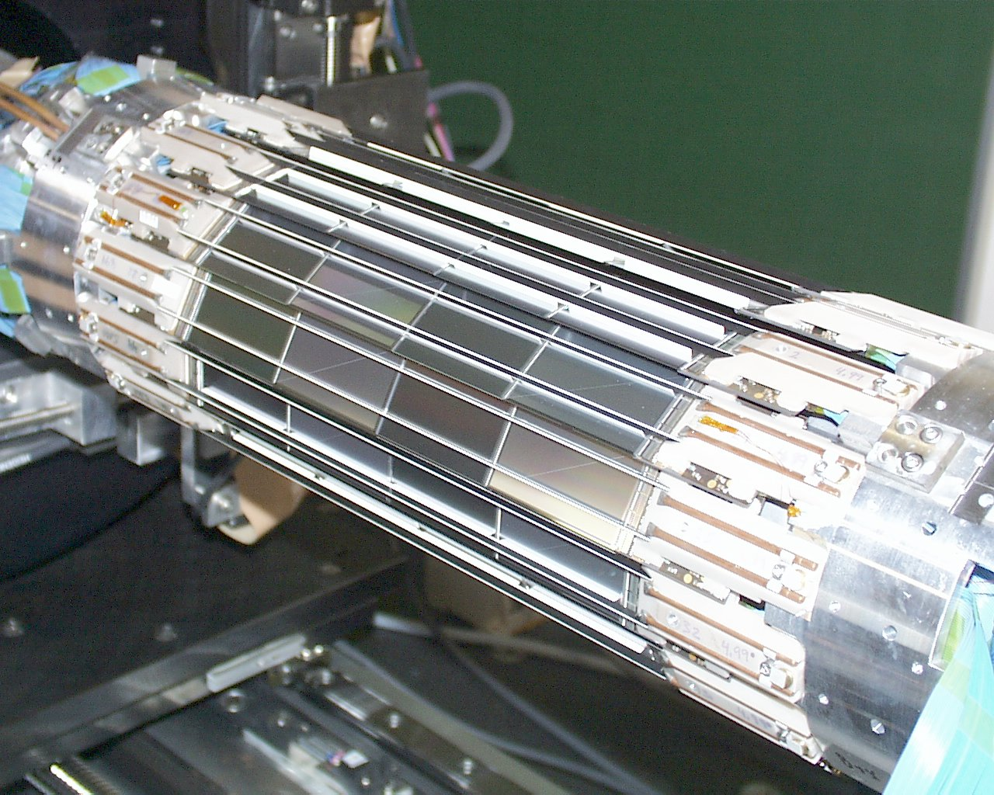
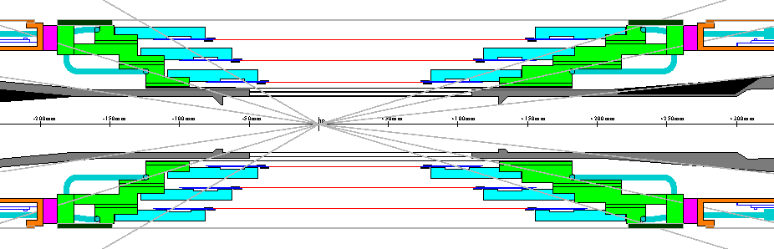
Vertex Reconstruction
Silicon Vertex detector
Δ
z
Δ
t
=
c
βγ
( )
ϒ
σ(z_{CP}) ~ 75μm
σ(z_{tag}) ~ 140μm
IP constrained fit

Slide 30
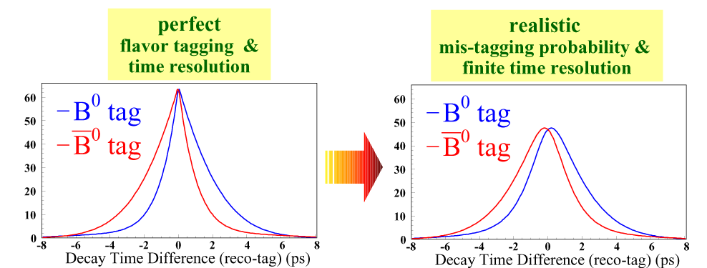
Theoretical & Observed ΔT

Slide 31
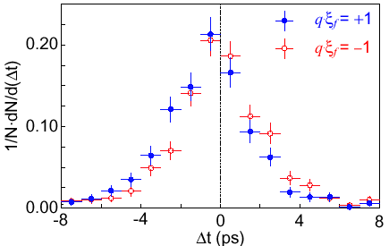
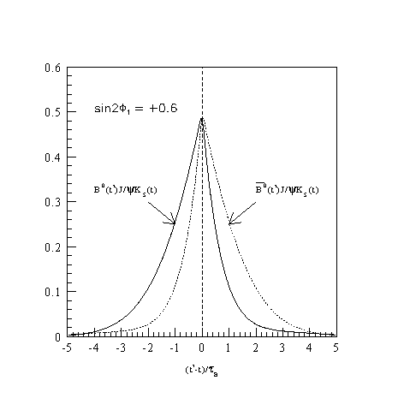
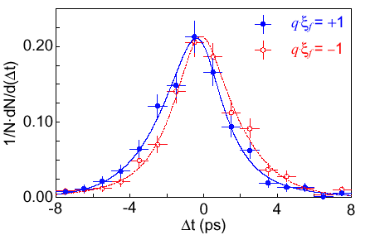
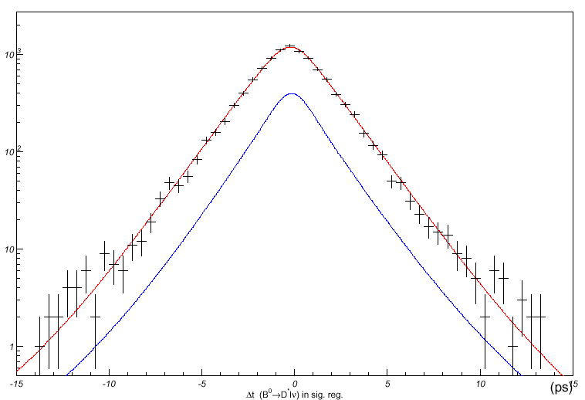
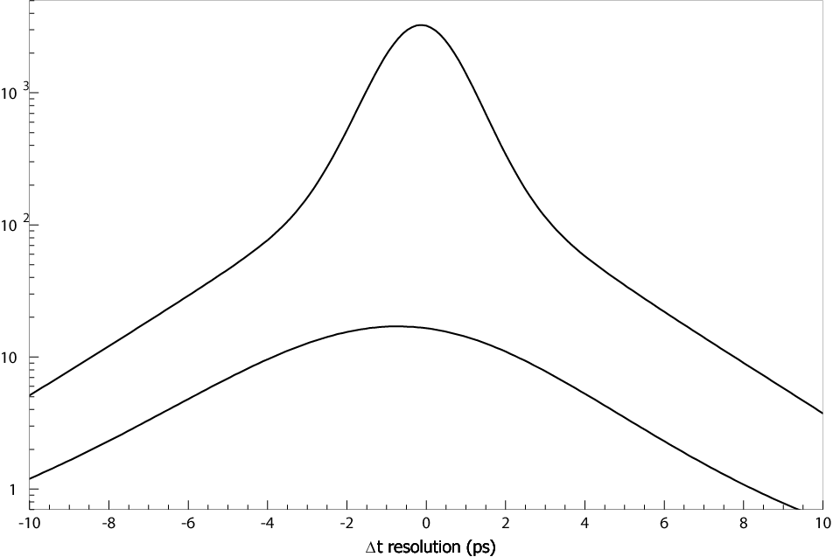
CP fit : Max. Likelihood Fit
raw data
Wrong tag
Δt Resolution
B⁰
B⁰
Signal True distr.
sin2φ₁
Max. Likelihood fit
background
t
sin2φ₁

Slide 32
PDF for CP fit : signal
L
=
∫
f
P
R
(
Δ
t
−
Δ
t
'
)
d
Δ
t
'
+
(
1
−
f
)
P
i
sig
sig
sig
BG
signal fraction
R : resolution function
e
−
Δ
t
τ
B
[
]
P
=
1
−
ξ
q
(
1
−
2
ω
)
sin
2
φ
sin
Δ
m
Δ
t
sig
2
τ
f
1
B
(+Acos term)
_{f} : ±1 for CP= ±1
q : B or B
ω : wrong tag fraction
Δm_{B}, τ_{B} : from PDG
_
PDF: Probability Density Function
R and ω :
⬄ (1-2w) quality of flavor tagging
They are well determined by
Lifetime/Mixing fit using control
sample D*lν, D^{(*)}π etc…
Unbinned Max. Likelihood Fit
Free param: sin2φ₁, (A)

Slide 33
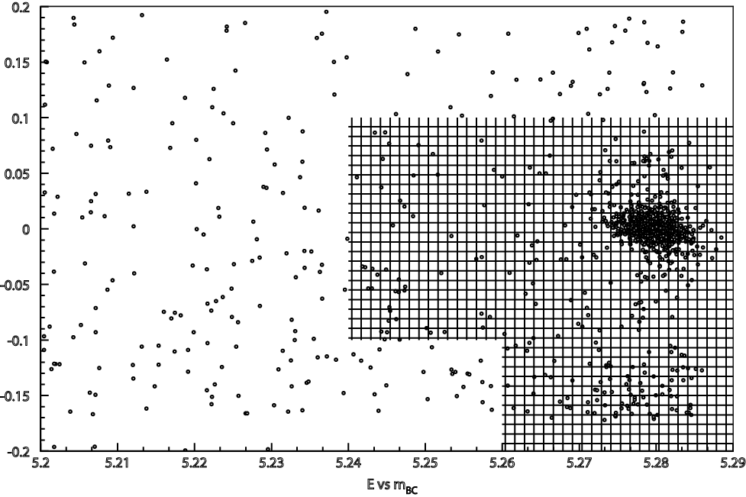
PDF for CP fit: background
L
=
∫
f
P
R
(
Δ
t
−
Δ
t
'
)
d
Δ
t
'
+
(
1
−
f
)
P
i
sig
sig
sig
BG
R : resolution function
(M_{bc},ΔE)
2D fit
e
−
Δ
t
τ
B
[
]
P
=
1
−
ξ
q
(
1
−
2
ω
)
sin
2
φ
sin
Δ
m
Δ
t
sig
2
τ
f
1
B
J/ψKs/K±
e
−
Δ
t
τ
B
G
P
=
∫
[
f
+
(
1
−
f
)
δ
(
Δ
t
) ] R_{BG}
BG
τ
2
τ
τ
BG
ΔE
Obtain by fit to sideband
Unbinned Max. Likelihood Fit
M_{bc}

Slide 34
Resolution Function
Pdf(Δt) = P_{sig} R_{sig} + P_{BG} + P_{OL}
(P_{OL} : outlier, Gaussian)
R_{sig} = R_{det} R_{NP} R_{Kin}
CP-fit
Mixing
lifetime
same
R_{det}
: detector resolution
Multipul track: single Gaussian
σ_{Δz} = (s₀ + s₁ξ) ε_{Zvtx}
(rec. and asoc. vtx)
ξ= (1/n)Σ(z_{vtx}-z_{trk})²/ε_{Ztrk}²
(goodness of fit)
Single track: two Gaussians (s_{main}, s_{tail}, f_{tail},)
R_{NP}
: non-primary particle effect
Asymmetric exponential (τ_{BG} depends on σ_{Δz})
R_{Kin}
: effect of B motion in CMS
Analytic formula as a function of cosθ_{Brec}

Slide 35
Resolution Function
Pdf(Δt) = P_{sig} R_{sig} + P_{BG} + P_{OL}
(P_{OL} : outlier, Gaussian)
R_{sig} = R_{det} R_{NP} R_{Kin}
CP-fit
Mixing
lifetime
same
R_{det}
: detector resolution
Multipul track: single Gaussian
σ_{Δz} = F(h)
(rec. and asoc. vtx)
2011~
h = (χ²_{total}-χ²_{IP})/N_{dof}
(goodness of fit)
Single track: two Gaussians (s_{main}, s_{tail}, f_{tail},)
R_{NP}
: non-primary particle effect
Asymmetric exponential (τ_{BG} depends on σ_{Δz})
R_{Kin}
: effect of B motion in CMS
Analytic formula as a function of cosθ_{Brec}

Slide 36
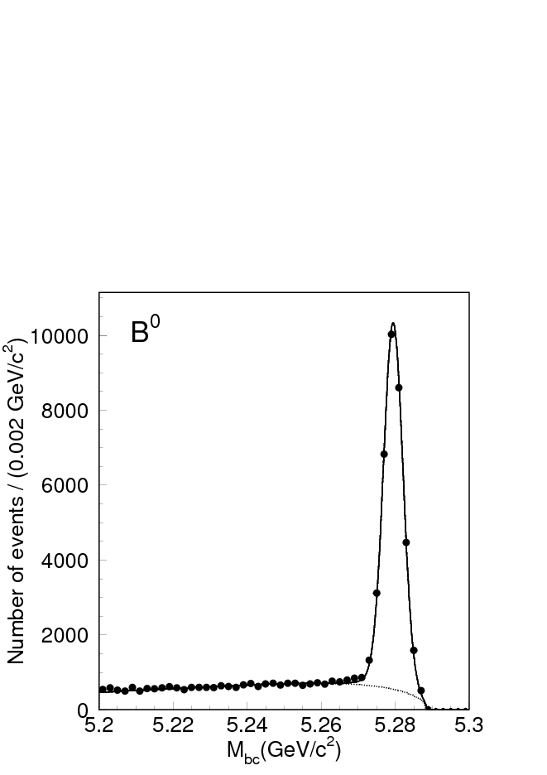
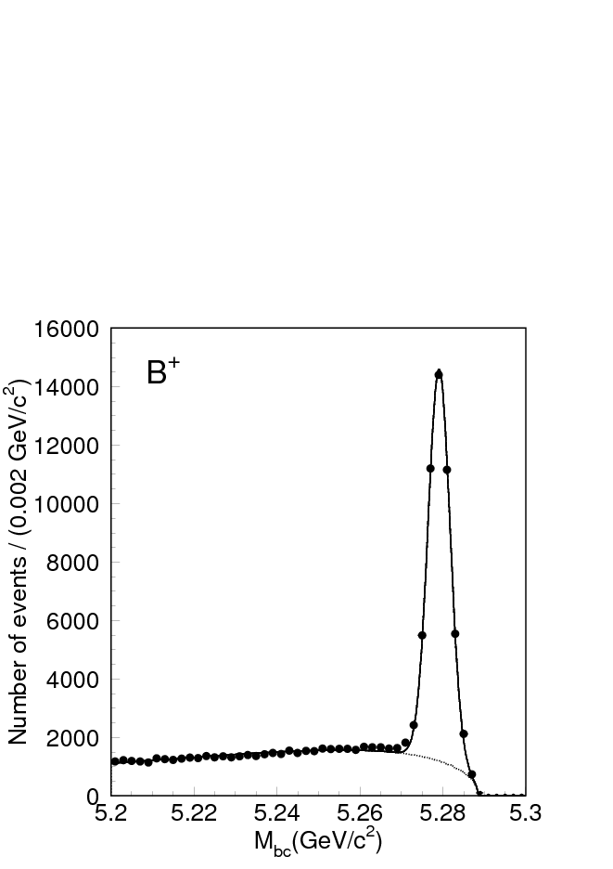
Control Sample: Hadronic
Cabbibo Favored Hadronic Decays
b → cud, ccs
∫L dt = 140 fb⁻¹
-
-
D^{(*)+}π⁻/ρ⁻
D^{*+} → D ⁰π⁺ (68%)
J/ψKs/K^{*0}
D⁰ → K⁻π⁺ (3.8%)
K⁻π⁺π⁰ (13.1%)
K⁻π⁺π⁺π⁻ (7.5%)
37K ev
D⁰π⁻
D⁺ → K⁻π⁺π⁺ (9.1%)
J/ψK⁻
55K ev
Vertex:
primary
+
pseud-D
l/π/ρ
Mbc (GeV)
B⁰(except J/ψKs): used for
Flavor-tag/Mixing, Null-Asym.
D

Slide 37
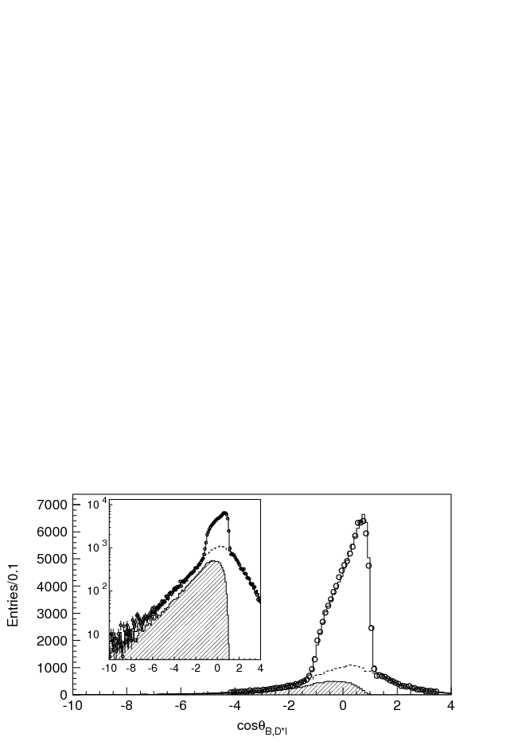
Control Sample: B⁰→D^{*+}l⁻ ν
Flavor-tag(w)/Mixing, Null-Asym. Control
∫L dt = 140 fb⁻¹
D^{*+} → D ⁰π⁺ (68%)
D⁰ → K⁻π⁺ (3.8%)
K⁻π⁺π⁰ (13.1%)
K⁻π⁺π⁺π⁻ (7.5%)
Signal
85K ev
purity 78%
Other
backgrounds
1.4 < p_{l}* < 2.5,
p_{D}* < 2.6 GeV/c
(E_{B}-E_{D*l})²-|p_{B}|²-|p_{D*l} |²
2 |p_{B}||p_{D*l} |
D**background
cosθ_{B,D*l} =
|cosθ_{B,D*l} |< 1.1 ( m_{ν}=0)

Slide 38
Resolution Func: Lifetime fit
∫L dt = 140 fb⁻¹
B⁰: 124K ev: D*lν, J/ψK*,D^{(*)+}π/ρ⁻
B± : 57K ev: J/ψK ⁻,D⁰π⁻
B⁰
τ = 1.533 ±0.008(stat) ps
B⁰
PDG2003: 1.537 ±0.015 ps
τ = 1.634 ±0.011(stat) ps
B±
PDG2003: 1.671 ±0.018 ps
Obtain (simulteneously)
Lifetime &
Resolution function
Time resolution (rms)
1.43 ps

Slide 39
Mixing/w fit
L
=
∫
f
P
R
(
Δ
t
−
Δ
t
'
)
d
Δ
t
'
+
(
1
−
f
)
P
i
sig
sig
sig
BG
R : resolution function
+: opposite flavor
(unmix)
−: same flavor (mix)
e
−
Δ
t
τ
B
P
=
1
±
(
)
cos(ΔmΔt)
1− 2w
sig
2
τ
B
Signal PDF for Mixing
Unbinned Max. Likelihood Fit
w (and Δm ) are Free parameters in fit
（Otherwise same as CP-fit）

Slide 40
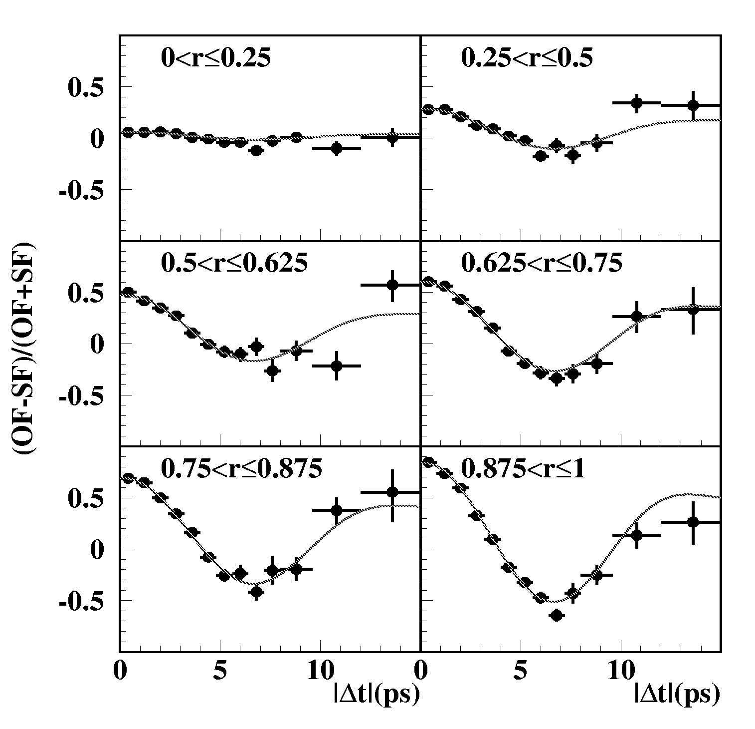
Flavor Tagging Performance
_
B⁰ → D*lν, D^{(*)}π/ρ
Determine wrong-tag fraction w
B⁰ –B⁰ mixing
(OF-SF)/(OF+SF)
~(1-2 w)cos(Δm t)
12 r-bins, 6 divisions in r. B⁰ and B⁰ tags treated separately.
_
  Efficiency > 99.5%
  _{effective} = Σ_{i} (1-2w_{i})²ε_{i}
  = 29 ± 0.5%
determined by data
∫L dt = 140 fb⁻¹

Slide 41
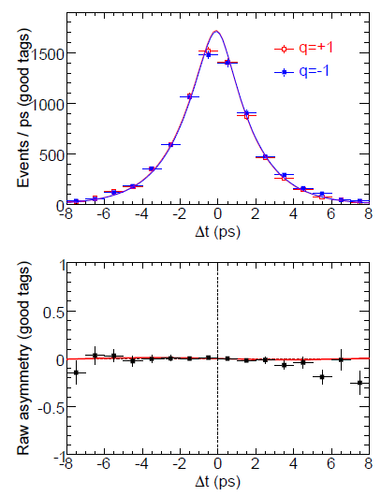
Control sample: B⁰→non-CP states
B→J/ψK⁺
S = −0.018 ± 0.020
A= +0.003 ± 0.014
Consistent with 0

Slide 42
First Observation !
Lepton-Photon 2001

Slide 43
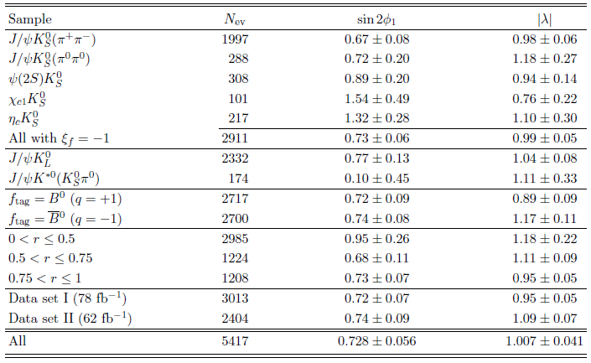
sin2φ₁ from various subsamples
Example: ∫L dt = 140 fb⁻¹

Slide 44
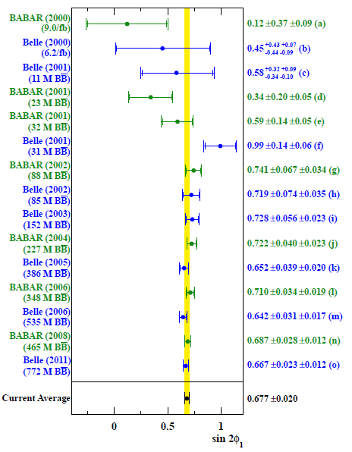
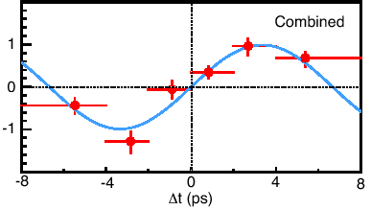
sin2φ₁ : History
_
1137
events
B⁰ tag
B⁰ tag
2001
Asymmetry
31M BB
CPV Observed !

Slide 45
sin2φ₁ : History
_
15560
signals
B⁰ tag
B⁰ tag
CP-odd
2012
772M BB
0.677 ± 0.020
Precision measurement
Reference for NP

Slide 46

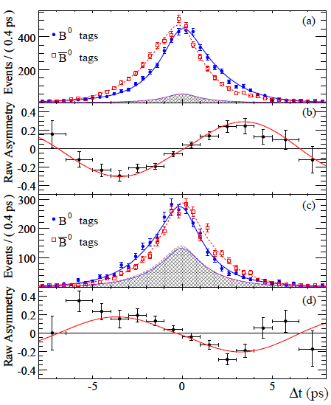
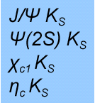

Comparison with BaBar
_
465M BB
_
(cc)K^{(*)0}
772M BB
25600
signals
_
12000
signals
B⁰ tag
B⁰ tag
CP-even
CP-odd
Av. 0.677 ± 0.020: 3.0% error !
sin2φ₁= 0.667 ± 0.023 ± 0.012
0.687 ± 0.028 ± 0.012
[PRL 108,171802(2012)]
[PRD 79,072009(2009)]

Slide 47
sin2φ₁ Systematic Uncertainty
(Δm_{B}, τ_{B})
CPV 2Rsin(2φ₁+φ₃) term
Tag-side B⁰ → D^{(*)+}π⁻ etc.
Still smaller than
statistical error
Stat. 0.031 0.021

Slide 48
Further CP Violation in B decays at B-Factories
φ₂ and φ₃ of UT
(Verification of KM)

Slide 49


φ₂ measurement
*
V_{ud} V_{ub}
φ₂(α)
*
mixing
V_{td} V_{tb}
φ₃(γ)
φ₁(β)
V_{cd} V_{cb}
*
Penguin
V_{ud}
∗
_ _
d
W
Tree
V_{tb}
V_{td}
W
π/ρ⁺
∗
d
u
b
b
t
g
π/ρ⁺
V_{ub}
0
d
u
0
d
u
B
B
π/ρ⁻
u
π/ρ⁻
d
d
d
d
S ≠ ξ sinφ₂
Isospin Analysis

Slide 50
Penguin Polution
B→π ⁺π ⁻ : contribution of 2 diagrams different weak phases
V_{ud}
∗
W
d
π⁺
V_{tb}
V_{td}
W
∗
u
b
d
π⁺
b
t
g
V_{ub}
0
d
u
0
d
u
B
B
π⁻
u
π⁻
d
d
d
d
Tree
~ φ₃
Penguin
~ φ₁
A
= S sin(ΔmΔt) + A cos (ΔmΔt)
CP
φ₂ is not measured
correctly
2Imλ
|λ|² + 1
S =
= (1-A²)^{1/2} sin(φ₂+θ)
q
p
A
A
|λ|² −1
|λ|² +1
λ = ξ_{f}
A =
(possible Direct CP !)

Slide 51
Solution: Isospin Analysis
[Gronau,London, PRL65, 3381(1990)]
B⁰→π π system: Bose statistics → only I=0, 2 allowed
Tree: I=0, 2 Penguin: I=0 only
(analgy to K→π π )
−
Define: A^{ij}=A(B→π^{i}π^{j}) [i,j=+,−,0], and A^{ij} for C.C.
A₂ , A₀ : I=2, I=0 amplitudes
using Clebsh-Gordan coeff.
A⁺⁻/ 2 = A₂ − A₀
A⁺⁻/ 2 +A⁰⁰ = A⁺⁰
A⁰⁰ = 2A₂ + A₀
−
|A⁰⁰|
A⁺⁰ = 3A₂
−
|A⁺⁻|/ 2
−
−
−
A⁺⁻/ 2 = A₂ − A₀
|A⁰⁰|
−
−
−
2θ
|A⁺⁻|/ 2
A⁰⁰ = 2A₂ + A₀
−
−
A⁺⁰ = 3A₂
−
|A⁺⁰| = |A⁺⁰|

Slide 52
B→π⁺π⁻ Analysis Procedure
1.Reconstruct B→CP decays
Basically same as sin2φ₁
_
B or B ?
Decay to CP eigenstate
Signal fraction:f_{sig}
_
ϒ(4S)
2.Determine B or B
J/ψ
e⁻
e⁺
t=0
Δz
Wrong tag fraction:ω
K_{S}
Vertex diff.
3.Measure decay time diff.
use same ones as sin2φ₁
Time resolution: R_{res}
4.Measure CP asym.:ML fit
Difference：much more
Background !
> signal
S_{ππ}, A_{ππ}

Slide 53
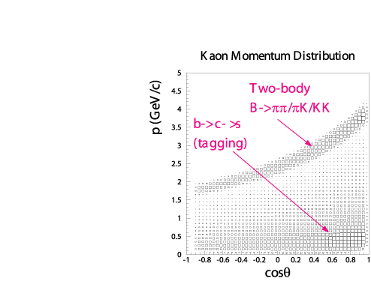
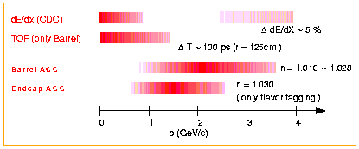
Background：I. B→ Κ⁺π⁻
B→ π⁺π⁻
Br = 0.44x10⁻⁵
B→ Κ⁺π⁻
Br = 1.74x 10⁻⁵ ~ 4xBr(B→π⁺π⁻)
2-3.5GeV/c
π/K separation is crusial
Aerogel Cherenkov + ToF + dE/dx
~0 for π
~1 for K
for π⁺π–,
π eff. = 0.91
K fake rate = 0.10

Slide 54
Background：II. Continuum
Background is dominated by random combinations in e⁺e⁻ → qq continuum events.
B→ π⁺π⁻
p*=2.6 GeV
Kinematic limit
e⁺e⁻ → qq
only 1/2 of
kinematic limit
Jetty (q q)
Isotropic(b b)
Follow technique developed for B → h⁺h⁻ analysis
Evolving in time !

Slide 55
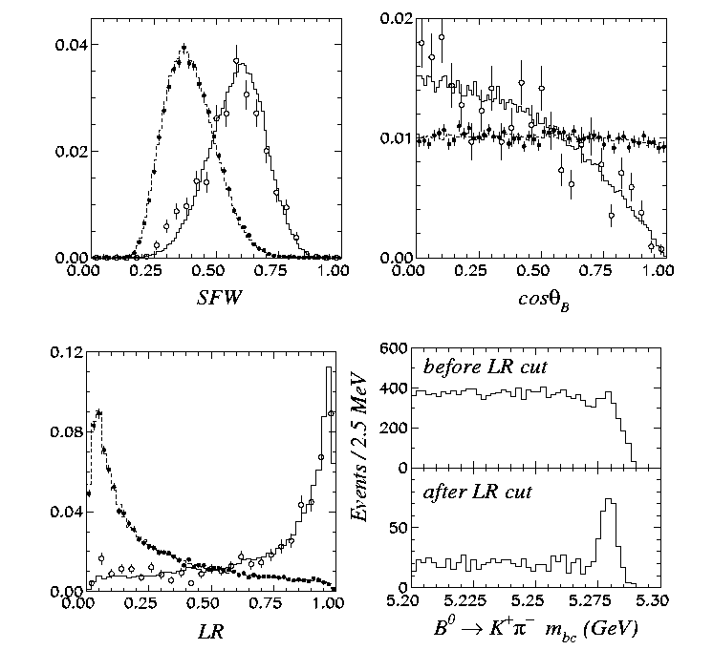
Continuum Suppression
SFW = Fisher
modified
Fox-Wolflam
moments (6)
signal
continuum
cosθ_{B}: direction
of B flight
signal
Likelihood Ratio
continuum
L_{S}/(L_{s} + L_{B} )
(optimized in each r-bin)

Slide 56
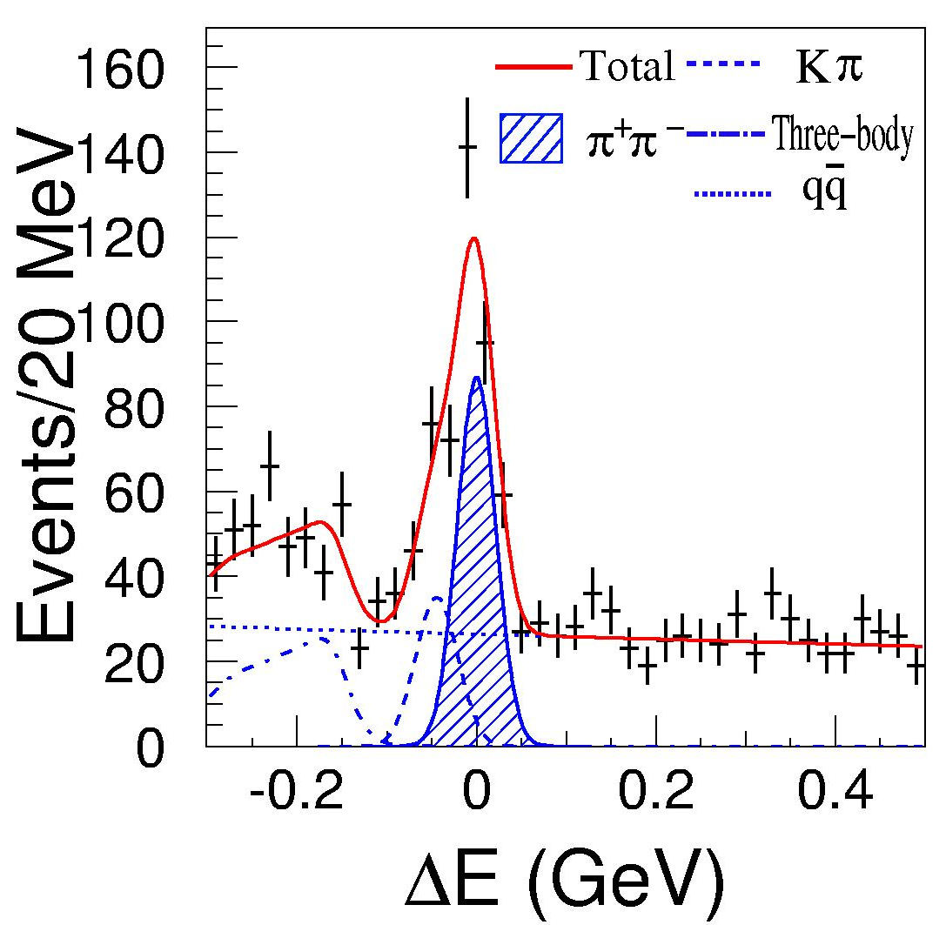
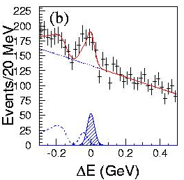
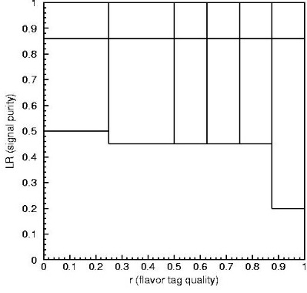
B⁰ g π⁺π⁻ candidates
140fb⁻¹
0.86 < LR
High quality
LR ≤ 0.86
Low quality
π⁺π⁻ : 141
π⁺π⁻ : 231.4
Kπ : 83.3
qq : 168.3
total : 483
1529 candidates (801 B⁰- and 728 B⁰-tags) containing (372 ± 32) π⁺π⁻ signal events
LR
tag r

Slide 57
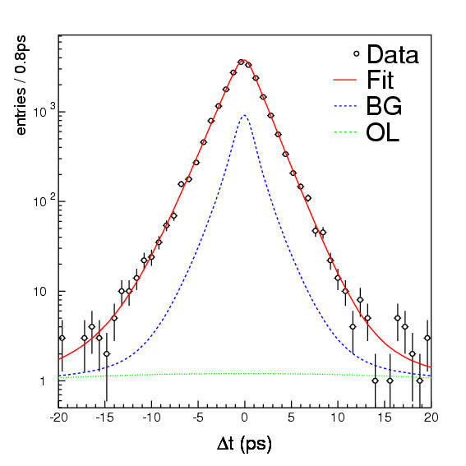
Time-dependent analyses
Unbinned maximum-likelihood fit
2 free parameters (Aππ , Sππ)
in the final fit
ΔE-M_{bc} dist.
B⁰gD⁺π⁻, D*⁺π⁻, D*⁺ρ⁻, J/ψK_{S} and J/ψK*⁰
(single Gaussian
outlier)
Include A_{CP}(Κπ)
Lifetime fit

Slide 58
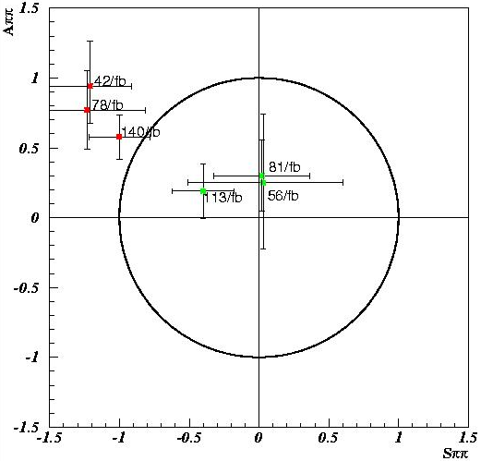
Early Results of A_{ππ} and S_{ππ}
Made intensive
studies on
Validity checks
Statistical analysis !
Belle
1st Evidence
DCPV ! (3.2σ)
Belle 140fb⁻¹
BaBar
Difference
still at ~2.2σ level

Slide 59

History of A_{ππ} and S_{ππ}
(C = −A)
All consistent
Av. of Belle/BaBar/LHCb
A_{ππ} = +0.32 ± 0.04
S_{ππ} = −0.63 ± 0.04
~8σ DCＰＶ !

Slide 60
Fit Result (latest result)
772M BB
2964±88 signal events
π⁺π⁻ yields
first error: stat., second: syst.
Sizable Direct CP violation (5σ)
Large mixing-induced CPV (7σ)
π⁺π⁻ asymmetry
background subtracted
[PRD 88, 092003 (2013) ]

Slide 61

BaBar tCPV in B⁰ g π⁺π⁻
_
467M BB
1394±54signal events
B⁰ tag
_
B⁰ tag
Observation of CP violation (6.5σ)
Direct CPV (~ 3σ)
S_{ππ}
A_{ππ}
confidence level contour
[PRD 87, 052009 (3013)]
Δt(ps)

Slide 62

φ₂ constraints from B→ππ
Inputs (HFLAG ICHEP16)
B(π⁺π⁰) = (5.48 ±0.35)
B(π⁺π⁻) = (5.10 ±0.19) × 10⁻⁶
B(π⁰π⁰) = (1.17 ±0.13)
A(π⁰π⁰) = +0.43 ±0.24
S(π⁺π⁻) = −0.68 ± 0.04
A(π⁺π⁻) = +0.27 ± 0.04
8(4) fold ambiguity
→ No stringent
constraint obtained
with ππ system alone
→ need ρρ and ρπ
using Isospin analysis (GL)

Slide 63

φ₂: B⁰→ ρρ CPV
Similar to π⁺π⁻, but more complicated …
B → VV: not CP eigenstate in general
ρ⁺ → π⁺π⁰: wide resonance
CP
+
+
_
Two lucky cards !
f_{L} ~ 100% → CP ≈ +1
B(ρ⁰ρ⁰) << B(ρ⁺ρ⁻), B(ρ⁺ρ⁰)
0.7 ± 0.3 24 ± 3 24 ± 2 x10⁻⁶ (HFAG)
2θ
A⁺⁻/ 2
small Penguin effect (θ )
A⁰⁰
A⁺⁰

Slide 64





Fit Results
B⁰ tags
background
signal
_
383M BB
_
772M BB
B⁰ tags
Good tag
Δt (ps)
Δt (ps)
-5
0
5
S = -0.17 ±0.20±
A = -0.01 ±0.15±0.06
S = +0.13 ±0.15±0.05
A = 0.00 ±0.10 ±0.06
0.05
0.06
[PRD76,052007(07)]
[PRD93, 032010(16)]

Slide 65

ρ⁺ρ⁻ Isospin analysis
All measured now !
Inputs (HFLAV ICHEP18)
B(ρ⁺ρ⁰) = (24.0 ±2.0)
B(ρ⁺ρ⁻) = (24.2 ±3.2) × 10⁻⁶
B(ρ⁰ρ⁰) = (0.95 ±0.16)
S(ρ⁰ρ⁰) = +0.3 ±0.7
A(ρ⁰ρ⁰) = −0.2 ±0.8
S(ρ⁺ρ⁻) = −0.14 ± 0.13
A(ρ⁺ρ⁻) = +0.00 ± 0.09
φ₂
2 fold ambiguity

Slide 66
B⁰→ ρ⁺π⁻ tCPV
B⁰→ ρ⁺π⁻ : not CP eigenstate, same diagram as π⁺π⁻
Mixing CPV with 4 amplitudes (complicated)
[BaBar PRL 91,201802(’03); Belle PRL94,121801(’05)]
ρ⁺
π ⁻
B⁰
ρ⁻
π ⁺
π ⁺π ⁻π ⁰
–
ρ ⁰
π ⁰
B⁰
Mixing (Δt)
Dalitz
_
Interference in (B⁰, B⁰) & (ρ⁺, ρ⁻, ρ⁰)

Slide 67

B⁰→ ρ⁺π⁻ t-Dalitz CPV
B⁰→ π⁺π⁻π⁰ : Dalitz
A_{3π}= f₊ A⁺ ⁻ + f₋ A⁻ ⁺ + f₀ A⁰⁰
ρ⁺π⁻
A(ρ ^{i}π ^{j}) = A^{ij} =e^{iφ2} T ^{ij} + P ^{ij}
P⁰⁰ = −(P⁺⁻+P⁻⁺)/2
s₋= m(π⁻π⁰)²
f_{i} (s₊, s₋) : form factors
(Breit-Wigner)
Fit to Δt, Dalitz dist.
→ φ₂ w/o discrete ambiguity !
ρ⁺π⁻
[Synyder, Quin, PRD48,2139(‘93)]
ρ⁻π⁺
s₊=m(π⁺π⁰)²
26 parameters fit (ρ⁺π⁻, ρ⁻π⁺, ρ⁰π⁰)

Slide 68

B⁰→ ρ⁺π⁻ t-Dalitz CPV
Square Dalitz Plot
B⁰→ π⁺π⁻π⁰ : Dalitz
A_{3π}= f₊ A⁺ ⁻ + f₋ A⁻ ⁺ + f₀ A⁰⁰
A(ρ ^{i}π ^{j}) = A^{ij} =e^{iφ2} T ^{ij} + P ^{ij}
P⁰⁰ = −(P⁺⁻+P⁻⁺)/2
f_{i} (s₊, s₋) : form factors
(Breit-Wigner)
Fit to Δt, Square Dalitz dist.
→ φ₂ w/o discrete ambiguity !
[Synyder, Quin, PRD48,2139(‘93)]
26 parameters fit (ρ⁺π⁻, ρ⁻π⁺, ρ⁰π⁰)
used in B → 3 body tCPV analysis

Slide 69
B g (ρπ)⁰ t-Dalitz analysis
mass
helicity
asymmetry
ρ⁺π⁻
ρ⁻π⁺
ρ⁰π⁰
449M BB
[PRL 98, 221602(07)]

Slide 70

B g (ρπ)⁰ t-Dalitz analysis
26 parameters fit (ρ⁺π⁻, ρ⁻π⁺, ρ⁰π⁰) → φ₂
_
471M BB
449M BB
[PRL 98, 221602(2007)]
[PRD 88, 012003(2013)]
1−CL

Slide 71

φ₂ Summary
φ₂
φ₂
α/φ₂ = [84.9 ]°
+5.1
−4.5

Slide 72

φ₃ measurement
*
V_{ud} V_{ub}
φ₂(α)
Simple mixing CPV
→ φ₃ (with B_{d} )
*
V_{td} V_{tb}
+
φ₃(γ)
φ₁(β)
V_{cd} V_{cb}
*
Tree
V_{us}
∗
Tree
s
V_{ub}
Κ⁺
u
D⁰
W
u
b
c
b
f_{COM}
W
f_{COM}
V_{cb}
_
+
d
+
d
c
B
V_{cs}
B
∗
s
D⁰
Κ⁺
u
u
u
u
λ³
λ³
interference

Slide 73
φ₃ Measurements
1) B gDK
a) f_{COM} = D_{CP} Gronau-Wyler-London
[PLB 253,483; 265,172(’91)]
_
D⁰/D⁰→ π⁺π⁻/ Κ⁺Κ⁻ (CP=+1) , Κ_{S}π⁰/η/φ/ω..(CP= −1)
b) f_{COM} = D_{DCSD} Atwood-Dunietz-Soni
[PRL 91,171801(’03)]
_
ex) B⁺→ D⁰[Κ⁻π⁺] Κ⁺ & D⁰[Κ⁻π⁺] Κ⁺
c) f_{COM} = D⁰ → K_{S}π⁺π⁻
Bondar, GGSZ
[PRD 68,054018(’03)]
Currently gives most precise results
2) B gD^{(*)+}π/ρ⁻
t-CPV
Dunietz
[PLB 427, 179(’98)]
R_{D} sin(2φ₁+φ₃ ± δ)

Slide 74

φ₃ measurements: Summary
γ/φ₃ = [71.1 ]°
φ₃
+4.6
−5.3

Slide 75

φ_{1,2,3} → Unitarity Triangle
φ₂ = [84.9 ]°
one of KM validation
+5.1
−4.5
φ₃ = [71.1 ]°
φ₁ = [22.2 ]°
+4.6
−5.3
+0.7
−0.7
φ₁ + φ₂ +φ₃ = [178.2 ]°
+6.9
−7.0

Slide 76
CP Violation beyond SM in B decays
Search for New Physics

Slide 77
Next Challenge
In spite of Great Success of SM, there must be
New Physics beyond SM at High Energy scale
(SM is valid effective theory at current E-scale)
Observed CPV in SM is not enough
to explain matter dominance of Universe
[>O(10¹⁰)] !
New Source of CPV should exists
(beyond SM)
One of Next important goals of Flavor Physics
Energy Frontier
Note) NP effects appear in Flavor Physics in various way !

Slide 78

New physics Search :
-
b → sqq CPV
b
t
s
φ,η’..
b
X
s
φ,η’..
_
B⁰
s
s
+
s
s
K_{S}
K_{S}
d
d
d
d
*
?
V_{ts} V_{tb}
SM: b→s Penguin
phase = (cc) K⁰
+ New Physics
with New Phase
-
S_{bs} ≠ S_{bc} , A can ≠ 0
-
“b → ccs: sin2φ₁” (SM reference)
deviation

Slide 79





Experimental Challenge
We need
1) large number of BB pairs
2) additional background rejection
B⁰ g J/ψK_{S}
Tree
Event Shape
much smaller
BF
B⁰ g φK_{S}
(Spherical)
(Jet-like)
Penguin
Continuum Suppression
using Event Shape likelihood
Similar to B → h⁺h⁻ tCPV analysis

Slide 80


“Golden” mode: φK⁰
φK⁰
unbinned fit
SM
535M BB
“sin2φ₁” = +0.50 ± 0.21 ± 0.05
A = +0.07 ± 0.15 ± 0.06
Time-dep. K⁺K⁻K_{S} Dalitz
New method
[PRL 98,031802(2007)]

Slide 81
“Golden” mode: η’K⁰
η’K_{S}⁰
1st observation
b → s mode tCPV
535MBB
5.6σ
(2007)
η’Ks
η’K_{L}
772M BB
“sin2φ₁” = +0.68 ± 0.07 ± 0.03
A = +0.03 ± 0.05 ± 0.04
[JHEP 1410, 165 (2014)]

Slide 82


Summary of b g s Penguins
13 penguin modes
No significant dev. in each
Simple av. agrees with SM
Important to measure modes
w/ small theory uncertainty
Need much more Data !
→ Belle II

Slide 83

b g s Penguins: A vs S
13 penguin modes
No significant dev. in each
Simple av. agrees with SM
Important to measure modes
w/ small theory uncertainty
Need much more Data !
→ Belle II

Slide 84
Summary
Time Dependent CPV analysis has been established in early Asym. B-Factory analysis
Belle adopted sophisticated Δt resolution func. composed from each source: ξ → h, still not perfect → ?
Belle took 2-step (signal fraction, CPV) fit → single multi-dimensional fit (more free params) in recent analysis
Belle used Multi-dim. LH method for Flavor Tag → NN or more advanced DL ?

Slide 85
Supplements

Slide 86

Summary: CPV Diagram
B⁰
B⁰
1,3: established
2: still too small
to be observed
Next:
CPV in NP !
[Y.Nir, ICHEP02]

Slide 87
B⁰-B⁰ Mixing （Suppl.）
_
Rewriting with B⁰ and B⁰ basis
|B⁰〉 = (| B_{L} 〉 + | B_{H} 〉)/2p
Time Evolution :
|B_{L/H}(t)〉~ exp(-im_{L/H}t -t/2τ_{L/H})
m=(m_{H}+m_{L})/2, Δm= m_{H}−m_{L}
= e^{-imt} e^{-t/2τ}(e^{+iΔmt/2} | B_{L} 〉 + e^{−iΔmt/2} | B_{H} 〉)/2p
−
−
= e^{-imt} e^{-t/2τ}[e^{+iΔmt/2} (p|B⁰〉+q|B⁰〉) + e^{−iΔmt/2} (p|B⁰〉−q|B⁰〉) ]/2p
−
= e^{-imt} e^{-t/2τ}[p(e^{+iΔmt/2}+e^{−iΔmt/2})|B⁰〉+q(e^{+iΔmt/2}−e^{−iΔmt/2})|B⁰〉 ]/2p
−
= e^{-imt} e^{-t/2τ}[cos(Δmt/2)|B⁰〉 + iq/p sin (Δmt/2) |B⁰〉 ]
Unmixed: |〈B⁰|B⁰〉|² = e^{-t/τ} [1+cos(Δmt)]/2
−
Mixed: |〈B⁰|B⁰〉|² = e^{-t/τ} [1−cos(Δmt)]/2
(|q/p|=1)

Slide 88
Mixing induced CPV (3)
Interference of 2 amplitudes: Direct and via Mixing
Analogy with Direct CPV：
（Mixing t-dep. fomula）
A(B→f) = |A₁|exp(iφ_{D})exp(iδ_{D}) + |A₂|exp(−iφ_{D} +i2φ_{M})exp(iδ_{D}+iπ/2)
−
A(B→f) = |A₁|exp(−iφ_{D})exp(iδ_{D}) + |A₂|exp(iφ_{D} −i2φ_{M})exp(iδ_{D}+iπ/2)
unmixed
mixed
(i)
[mixing]
|A₁| = |A_{D}| cos(Δm･t/2),
|A_{２}| = |A_{D}| sin(Δm･t/2)
A_{D} = |A_{D}| exp(iφ_{D})exp(iδ_{D}) , q/p = exp(i2φ_{M})
Φ₁= φ_{D}, Φ₂= −φ_{D} +2φ_{M}, Φ₁−Φ₂= 2(φ_{D}− φ_{M} ) = 2φ_{i}
δ₁= δ_{D}, δ₂= δ_{D}−π/2, δ₁−δ₂= −π/2 ← mixing
A_{CP} = −sin 2φ_{i} sin(Δm･t)
[hadronic phases do not enter]

Slide 89
Time Evolution of B⁰ at Υ(4S)
−
Υ(4S)→B⁰B⁰
C=1 Coherent state (till one B decays)
−
−
Two-Boson system → asymmetric (B⁰B⁰, B⁰B⁰ not allowed)
−
−
|Ψ(t=0)〉=[|B⁰(k)〉|B⁰(-k)〉 − |B⁰(k)〉|B⁰(-k)〉]/ 2
−
Time evol.： C=1 conserved → always only B⁰B⁰
−
put Time evol.
formula
|B⁰(t)〉 = e^{-imt} e^{-t/2τ}[cos(Δmt/2)|B⁰〉 + iq/p sin (Δmt/2) |B⁰〉 ]
−
−
|B⁰(t)〉 = e^{-imt} e^{-t/2τ}[cos(Δmt/2)|B⁰〉 + ip/q sin (Δmt/2) |B⁰〉 ]
−
−
|Ψ(t)〉= e^{-2imt}e^{-t/τ}[|B⁰(k)〉|B⁰(-k)〉 - |B⁰(k)〉|B⁰(-k)〉]/ 2
−
−
At t₁, one decays as B⁰ → the other B⁰at t₁ : |B⁰(Δt)〉 time evol.
−
B⁰
B⁰ ： |B⁰(Δt)〉
Flavor Tag
Δt= t₂-t₁のみに依存

Slide 90
CP Violation at Υ(4S)
Γ(B⁰→ f_{CP}) = |〈 f_{CP} |B⁰(Δt)〉|² = e^{-|Δt|/τ} |A|²[1+Imλ sin(Δm･Δt)]
−
−
Γ(B⁰→ f_{CP}) = |〈 f_{CP} |B⁰(Δt)〉|² = e^{-|Δt|/τ} |A|²[1−Imλ sin(Δm･Δt)]
Γ
(
B
0
→
f
)
−
Γ
(
B
0
→
f
)
A
≡
d
CP
d
CP
= -Imλ sin(Δm･Δt)
CP
Γ
(
B
0
→
f
)
+
Γ
(
B
0
→
f
)
d
CP
d
CP
Δt integrated：Asymmetry cancels
B⁰
Δt distribution needs to be
measured
B⁰
τ_{B}~1.5ps → too small to measure
time directly
(ps=10⁻¹²sec)
Measure flight distance
Δt

Slide 91
CP Violation at Υ(4S)
Proper Decay time t = L/cβγ
cτ_{B} ~ 460μm → βγ > ~0.3
(L: flight length before decay)
M(Υ(4S)) ≈ 2M(B⁰)
［almost at rest in Υ(4S) rest frame］
Both B’s are boosted with ~same βγ →
Δt ≈ Δz/cβγ
Flavor-tag
(B⁰ or B⁰ ?)
Reconstruction
of
B₁
J/ψ
e⁺
f_{CP}
e⁻
t=0
Δz
B₂
Vertexing
K_{S}

Slide 92
Penguin for J/ψ Ks
ー
ｃ
ｃ
J/ψ
ー
V_{cb}
J/ψ
ー
ｂ
ｃ
B⁰
ｃ
V_{tb}
ー
ｔ
B⁰
ー
ー
ｓ
V_{cs}
ー
ｂ
V_{ts}
ｄ
ｓ
Ks
ー
Ks
ｄ
ｄ
ｄ
Tree
φ_{w} ~0
Penguin
φ_{w} ~0
Only single weak phase !
Tree and Penguin
week phases are same
C = 0 (|λ|=1)
A_{CP}(Δt) = -ξ_{f} sin2φ₁ sin(ΔmΔt)
Theoretically & Experimentally clean
Golden mode

Slide 93

Fit and Stat. errors
Fit result:outside the physical region (Aππ² + Sππ² <1)
We quote the rms values of the A_{ππ} and S_{ππ} distributions in the MC pseudo-experiments as the statistical errors of A_{ππ} and S_{ππ} .
140fb⁻¹
Aππ error: ±0.15 (± 0.27@78fb-1)
Sππ error: ±0.21 (± 0.41@78fb-1)
Similar to errors defined by
log-likelihood curves now

Slide 94


MC pseudo-experiments
Belle
140fb⁻¹
Input: (A_{ππ}, S_{ππ}) = (0,0)
Belle result almost impossible
probability ~ 0.1 ppm
Input: (A_{ππ}, S_{ππ}) = maximum likelihood point in the physical region
Belle result no problem
probability ~ 27%
10⁷ experiments (140fb⁻¹ each)
10⁷ experiments (140fb⁻¹ each)

Slide 95

Significance
140fb⁻¹
Feldman-Cousins Analysis
Observation of CP violation
(5.2σ)
Evidence for direct CP violation
A_{ππ}
≥3.2σ
for A_{ππ}=0 and any S_{ππ}
3.3σ
for “superweak” case
S_{ππ}

Slide 96
Cross Checks
Several crosschecks were gone through
before opening the box.
  Lifetime measurement
    B⁰ → π⁺π⁻, B⁰ → K⁺π⁻
  Δt asymmetry
    Sideband (qq), Non-CP sample, B⁰ → K⁺π⁻
  MC pseduo-experiments

Slide 97


Lifetime & Δm Check
535M BB
SVD1
SVD2a
Lifetime
PDG : 1.530 ± 0.009 ps
SVD1 : 1.505 ± 0.050
SVD2a: 1.503 ± 0.053
SVD2b: 1.430 ± 0.042
SVD2c: 1.434 ± 0.067
SVD2b
SVD2c
Δm
PDG : 0.507 ± 0.005/ps

Slide 98



Null asymmetry tests: OK !
535M BB
SVD1
SVD2a
Sideband
SVD2b
SVD2c

Slide 99

Toy MC: Linearity check

Slide 100
DCPV check
time-integrated fit
535M BB
ΔE projection onto P(K)<0.4
280±20 π⁺π⁻
169±16 π⁺π⁻
P(K)<0.4 & good tag

Slide 101
Validity Check
535M BB
r=6
r=5
r=4
r=3
r=2
r=1
LR<0.85
LR>0.85
ΔE<2σ
ΔE<1σ
ΔE<0
ΔE>0
multi
single
A_{ππ}
S_{ππ}

Slide 102


K⁺K⁻K_{S} Time Dep. Dalitz CPV
Fit with |A| and phase (CPV) free for each component
φK_{S}
f₀(980)K_{S}
f_{X}K_{S}
χ_{c0}K_{S}
NR
657M BB
4 solutions w/ Δ(-2lnL) <10
φK⁰ region

Slide 103
φ₃ measurement (general)
B :
0
d
Mixing q/p phase = φ_{１}
Decay amplitude phase = 0, φ_{１}, φ₃,
Can not measure φ₃ by Mixing Induced CPV in simple way
0
ｓ
B
:
V_{ts}
t
V_{tb}
*
Mixing q/p phase = 0
s
b
0
ｓ
B
Decay amplitude phase = φ₃
W
W
b
s
t
V_{tb}
V_{ts}
Mixing Induced CPV = φ₃
*
ー
Problem at B-Factory： run at Y(5S)
Too rapid oscillation to measure
V_{ub}
u
ー
ρ⁰
ｂ
u
0
ｓ
B
V_{ud}
ー
s
d
|V_{ts}V_{tb}|²~λ⁴
≫
|V_{td}V_{tb}|²~λ⁶
Ks
Tree
s
possible at LHCb

Slide 104
φ₃ measurement: GLW
(1a) GLW method: f_{com} = D_{CP} [Gronau,London,Weiler]
−
[PLB 253,483; 265,172(’91)]
B⁺→D⁰K⁺
C.C.
−
−
−
−
V_{us}
A_{D} = |A_{D}|e^{iδ}
A_{D} = |A_{D}|e^{iδ}
∗
−
−
−
−
s
Κ⁺
B⁺→D⁰K⁺
W
u
−
−
b
c
A_{D} = |A_{D}|e^{iδ} e^{iφ3}
A_{D} = |A_{D}|e^{iδ} e^{-iφ3}
+
V_{cb}
−
B
D⁰
B⁺→D_{CP}K⁺
u
u
−
−
−
A_{DCP}=(A_{D} ±A_{D})/ 2
−
−
A_{DCP}=(A_{D} ±A_{D})/ 2
−
−
V_{ub}
u
|A_{DCP}|
−
−
c
D⁰
2
|A_{D}|
2
|A_{DCP}|
b
+
W
|A_{D}|
B
V_{cs}
∗
s
−
Κ⁺
|A_{D}|
|A_{D}|
−
−
u
u
|Δ+φ₃|
|Δ−φ₃|
−
(Δ=δ−δ)

Slide 105

φ₃ measurement: GLW
How to obtain φ₃ from measurements
_
±
r_{B} = |A_{D}|/| A_{D} |
−
(δ’ = Δ =δ−δ)
D_{1,2} : D_{CP} decay to ＣＰ=+1, −1
Constraint: A₁R₁ = − A₂R₂
3 measurements ↔ ３ unknowns
can determine unknowns （but, 4 fold ambiguity)

Slide 106



φ₃ measurement: ADS
(1b) ADS method: f_{com} = D_{DCS} [Atowood, Dunietz, Soni]
_
[PRL 91,171801(’03)]
ex) B⁺→ D⁰[Κ⁻π⁺] Κ⁺ & D⁰[Κ⁻π⁺] Κ⁺
CF
DCS
2 amplitudes are
Similar in size
CS
CF
Large
Interference
φ₃
φ₃

Slide 107
φ₃ measurement: ADS
_
B⁺→ D⁰[Κ⁻π⁺] Κ⁺ & D⁰[Κ⁻π⁺] Κ⁺
772M BB
[PRL 106,231803 (2011)]

Slide 108
ADS method: LHCb
1 fb⁻¹
[PLB 712, 203 (2012)]
First Observation of ADS signal(~10σ) !
A_{ADS} = −0.40 ± 0.06 ± 0.01
Large CPV (>5σ Observation !)
[PLB 760, 117 (2016)]
3 fb⁻¹

Slide 109


ADS Results: Summary

Slide 110
Measurement of CKM
Determination
of UT
Complete test of KM & SM
B→ ππ, ρπ, ρρ
*
b→ u l⁻ν
*
V_{td} V_{tb}
V_{ud} V_{ub}
φ₂
B→ π/ρ l ν
(α)
B⁰-mixing (Δm_{d})
B→ ργ
φ₃
(γ)
(β)
φ₁
B⁻ → D_{com}K⁻
*
V_{cd} V_{cb}
B⁰ → (cc)K^{(*)0}
B⁰→ D^{(*)+}π⁻
b → c l⁻ν
B⁰ → D^{*+}D^{(*)-}(K)
B → D^{(*)}l ν
Over constraint !
B experiments can provide all measurements !

Slide 111

SM CPV: too small
WMAP
Too Small in SM
Why? Jarlskog Invariant in SM (need 3 generation in KM)
Normalize by T ~ 100 GeV
masses too small !
in SM
is common (unique) area of triangle
CPV Phase
[W.S.Hou]

