Slide 1
Status of PCIe40 project
Daniel Charlet/Patrick Robbe, Seoul, 28 aout 2019

Slide 2
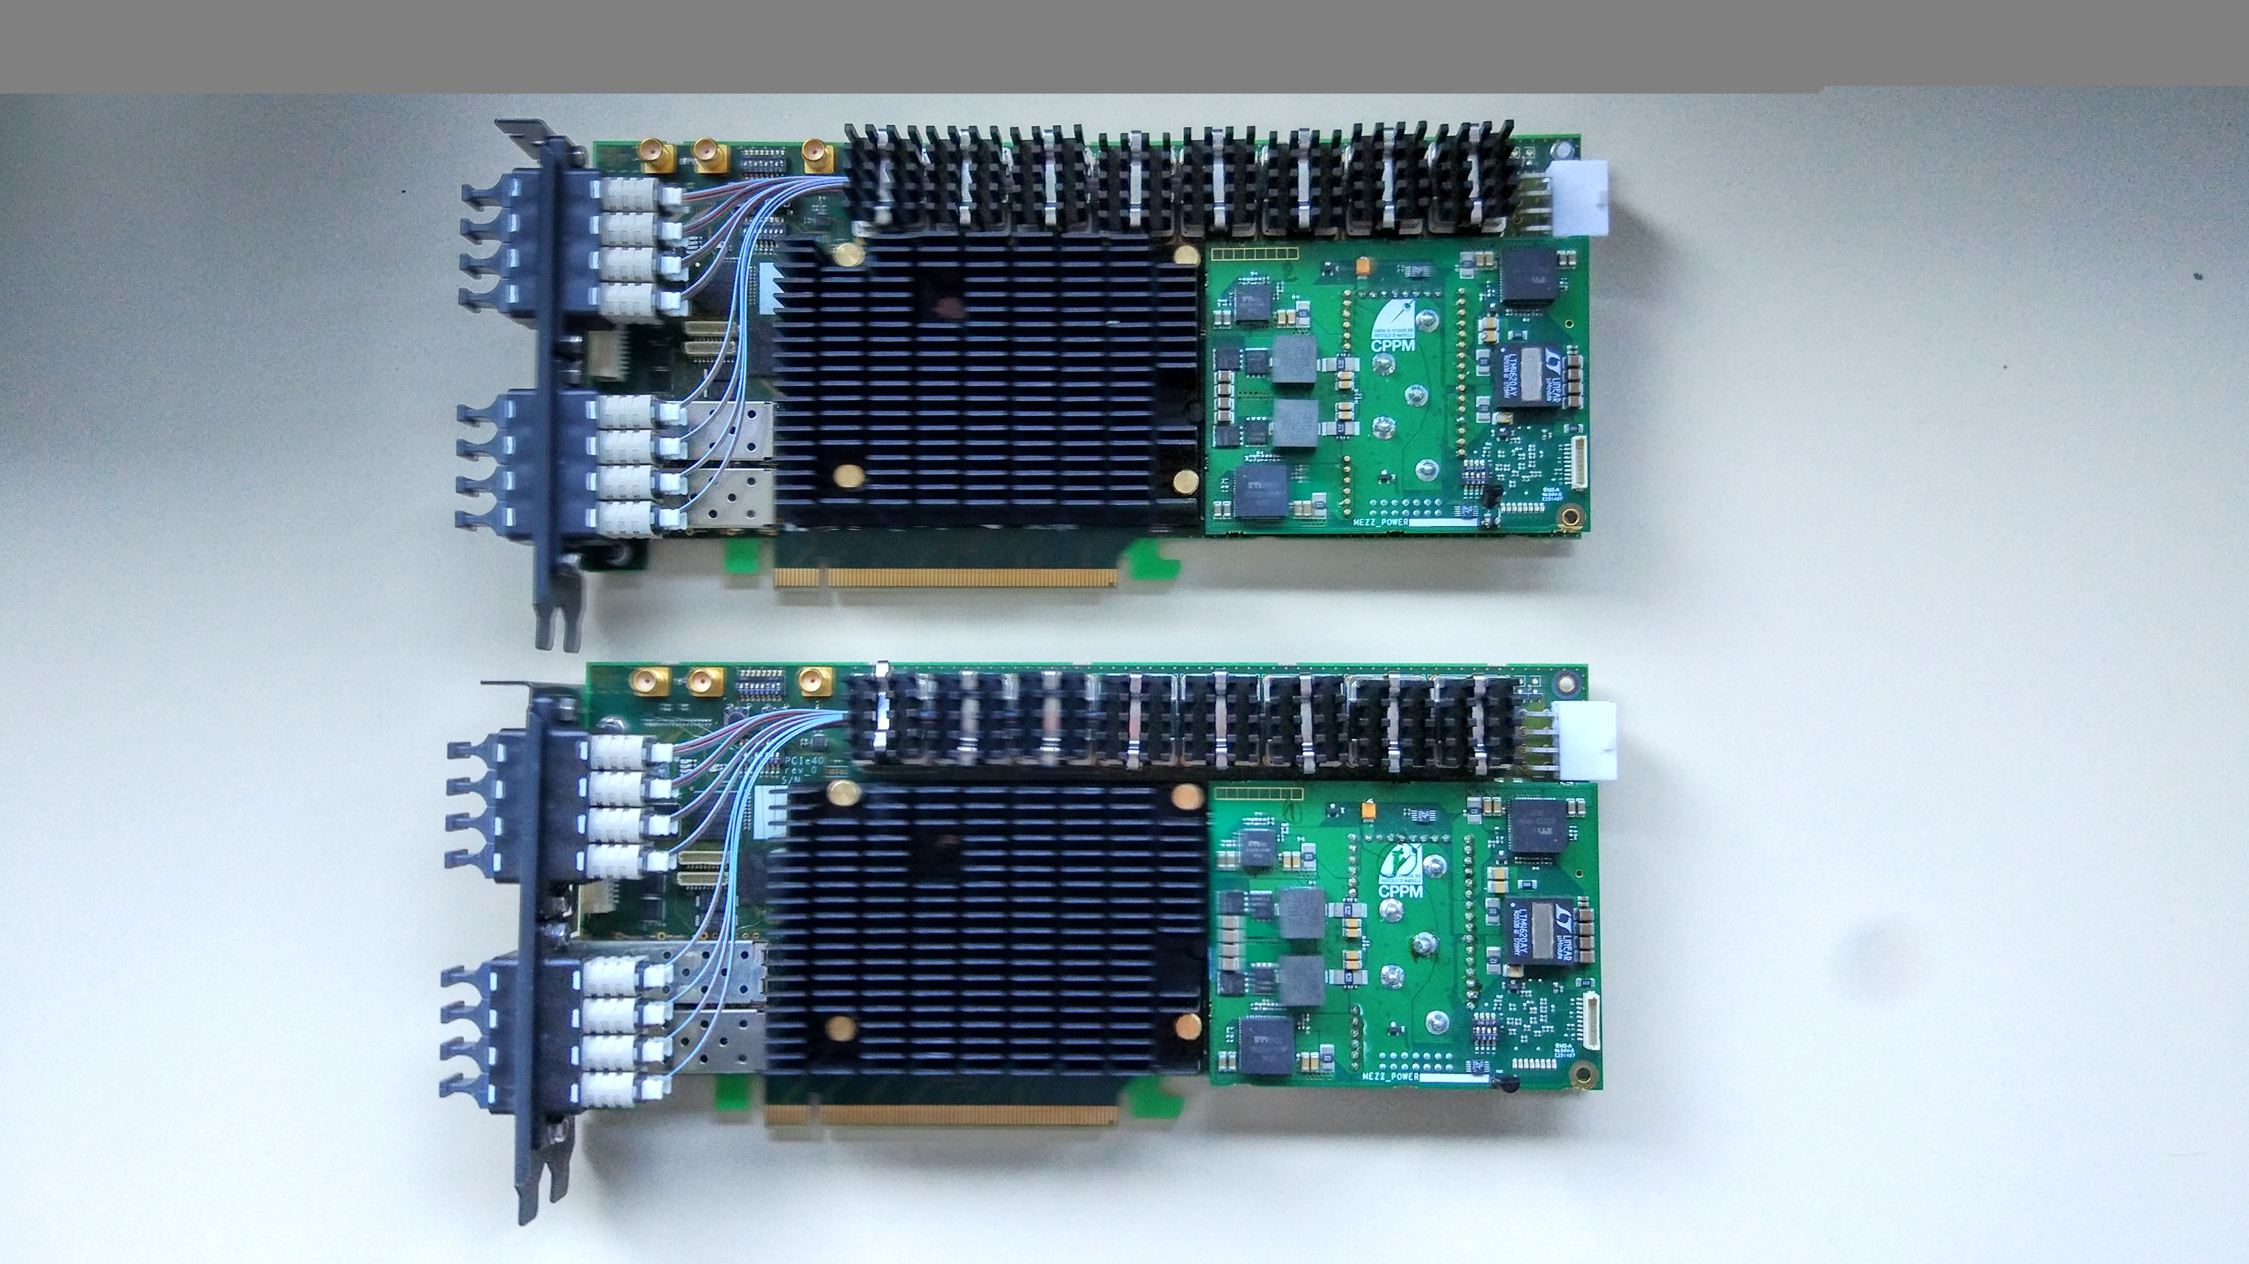
PCIe40 module
  Based on ARRIA 10 GX115 FPGA
  48 transceivers.
  PCIe 16x Gen3 (2 8x lanes)
  DMA Transfer up to 100 Gbps.
  External clock synchronisation capability.
  Up to 66 Mbit internal memory in FPGA
  External memory by the server (Giga Byte)

Slide 3
PCIe40 board production status
  Boards produced in large quantities for LHCb and ALICE experiments
  Main batch(~700 boards) currently in production (finished at the end of September)
  Last batch produced at the beginning of November 2019: if PCIe40 project accepted, Belle II production must be done there
  ~ 7 KEuro by board (to be adjusted depending of the volume production and price of components at the time of production)
  Belle II production should be ready and fully tested by Summer 2020 (exact planning known when production is launched, depends on component availability)

Slide 4
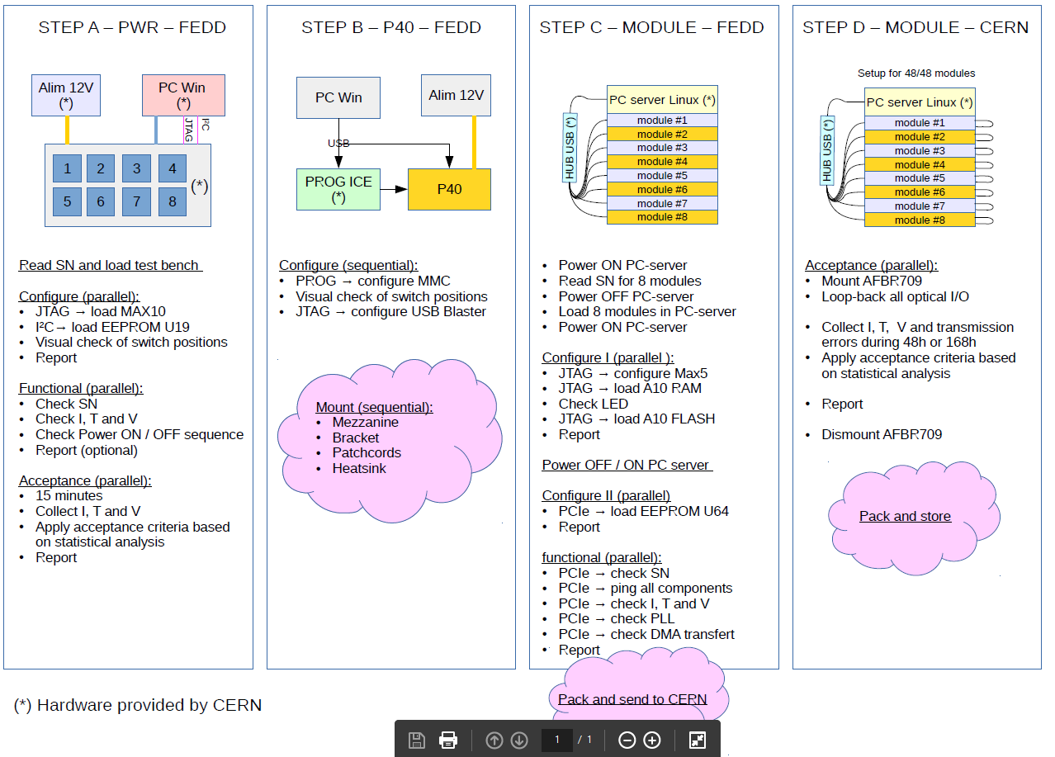
Testing methodology
  Complete test procedure in place, will be used also for the Belle II production
  4 steps: directly at the company and at LAL

Slide 5
PCIe40 for Belle II DAQ upgrade
  Hardware is ready for Belle II DAQ upgrade, but needs to develop firmware
  Main functionalities needed to prove PCIe40 solution is possible, requested by DAQ upgrade committee:
    Belle2link (done)
    TTD interface (done)
    Slow control (done)
    Data readout and transfer to PC server (done)
    User logic implementation (on-going)
  Corresponding sofware developped (driver and libraries)
  Stability test with TOP testbench at KEK (still to do)

Slide 6
Current Firmware structure
  Based on Low Level Interface (LLI) firmware developped at CPPM Marseille, plus Belle II specific additions:
        B2TT interface.
        Slow Control.
        Event bulding (user logic, in development at KEK)

Slide 7
Firmware Status
Current version includes (available in git repository):
  1 belle2link (already tested OK), DMA (new), slow control (new), B2TT (already tested OK).
  Optimized timing constraints (false path declaration) → firmware compilation ~30mn
  NEW: Slow control : based on Q.Zhou firmware
    Emission: slow control frame prepared directly in software.
    Reception: output of slow control decoding state machine readout by software via PCIexpress
    Tested with CDC Front-End board: read/write of random values, no error seen in 1 Million transactions
  Corresponding driver and software libraries developped in parallel at LAL, source code available on git.

Slide 8
PCIexpress transfer
Data transferred to PC via PCIexpress.
Two types of transfer:
  read/write to registers (BAR), for « slow » data : slow control and PCIe40 internal configuration (PLLs for example)
  Read by DMA for fast data acquisition: is used for data coming from Front-End, after event building is done in PCIe40
PCIe40 uses 2x8 lanes busses, not 1x16: if one wants to use the 2x8 configuration, the server must implement the « PCIe bifurcation » feature, not available on all of them
For the moment, current firmware development based on 1x8 PCIe interface: bandwith limited to 50 Gb/s (but large enough since ultimately the data transfered out of the PC server is limited to 10 Gb/s by the ethernet connection)
Upgrade to 100 Gb/s will also be possible in the future
NEW: DMA transfer developped at LAL: now implemented in firmware and software, and fully tested
8

Slide 9
Firmware Test Status
Current firmware includes all requested features from DAQ Upgrade committee, except the user logic part which is well advanced
It can be used on the KEK TOP test bench for stability tests for example: preparation ongoing, remotely in Septembre, on-site in October
3 test benches:
  LAL, with CDC and ARICH Front-End
  KEK, with CDC, HSLB emulation, TOP modules, SVD
  Hawaii, under preparation

Slide 10
Upcoming firmware version
  4 links, slow control, B2TT.
  User logic (event building), developped by Yamada-san, already well advanced

Slide 11
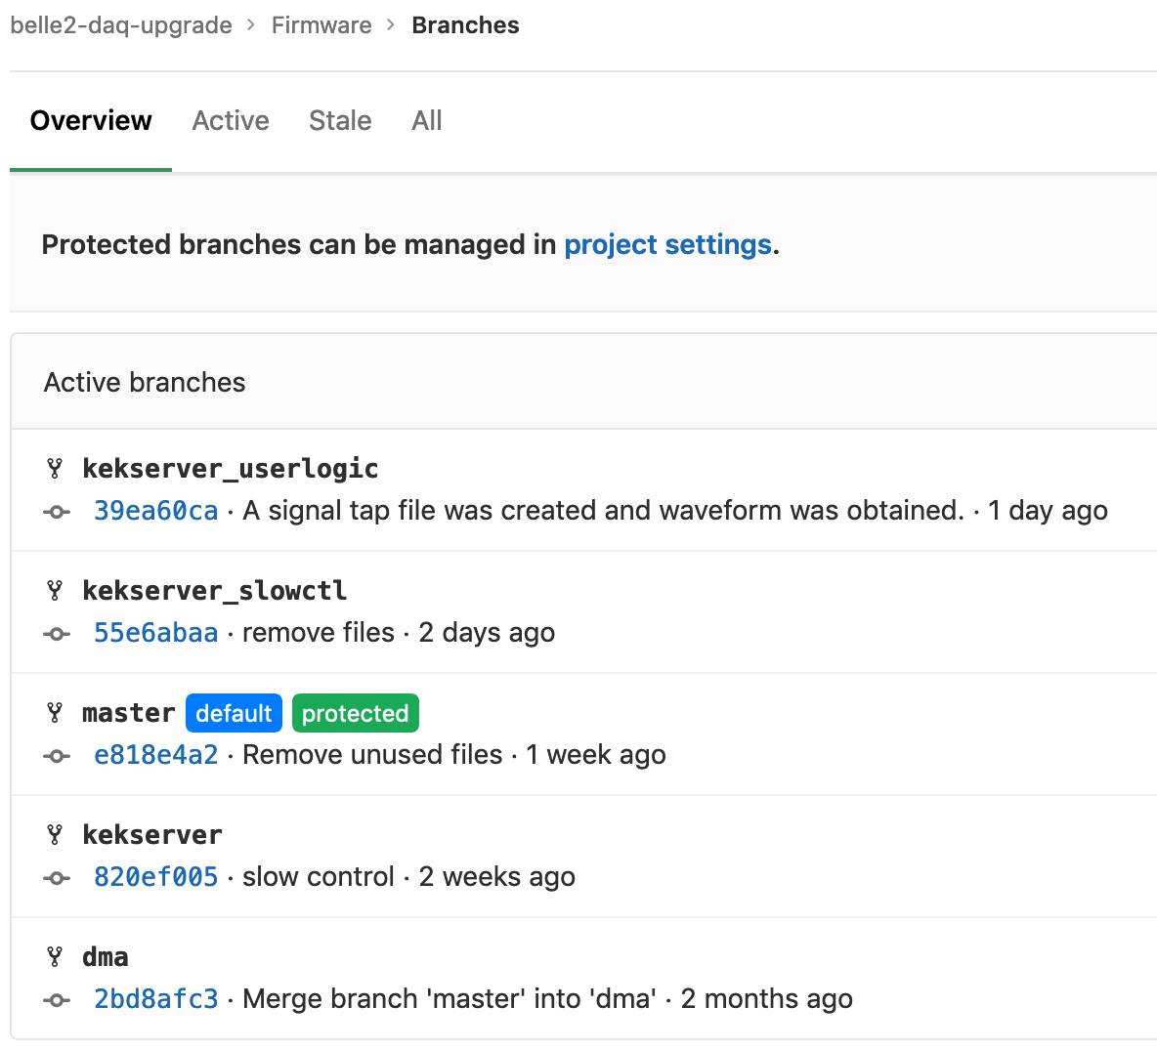
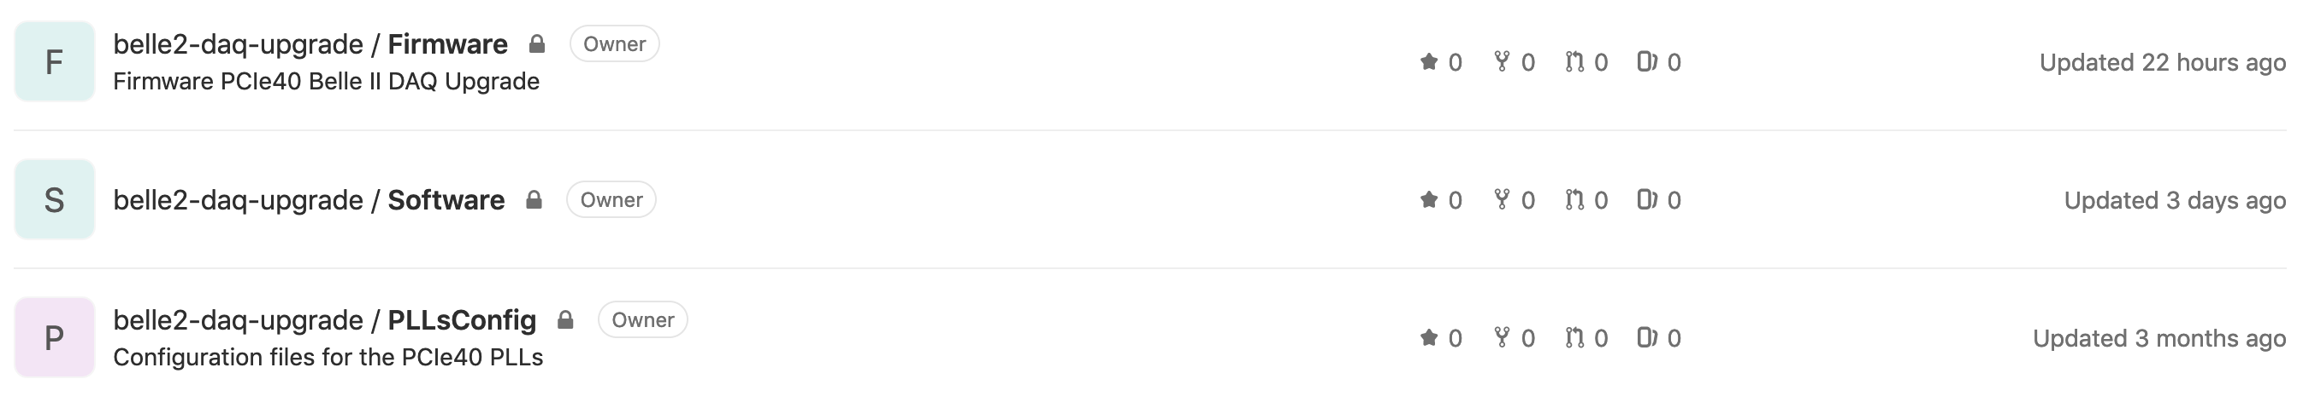
Git repository
Firmware and software on git repository (github at In2p3 for the moment, can move to another service if needed): [https://gitlab.in2p3.fr/belle2-daq-upgrade]
Actively used by KEK and LAL (screenshot)
We will store also documentation (wiki pages for example) in the git repository
Everyone can ask an account (and then send me an email to be added to the list of developpers) [robbe@lal.in2p3.fr]
11

Slide 12
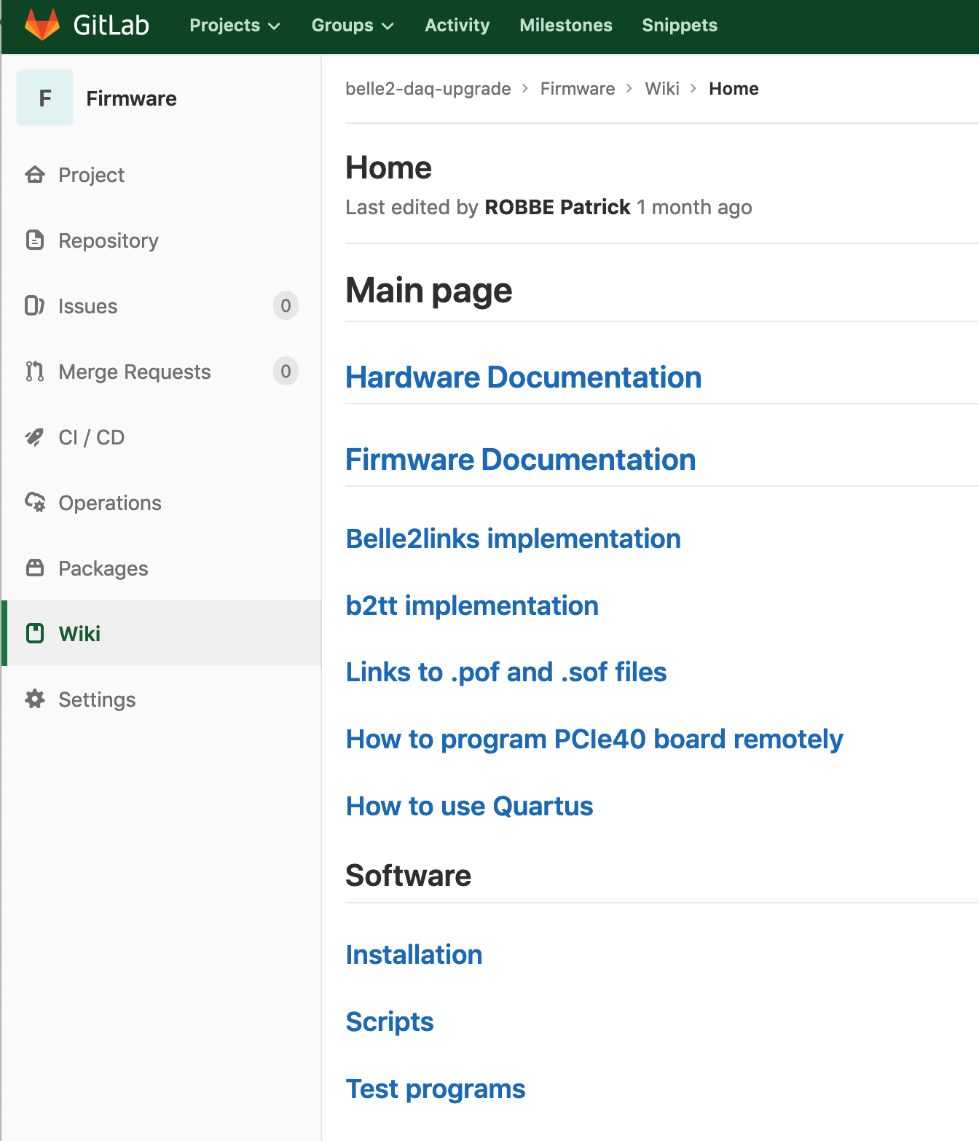
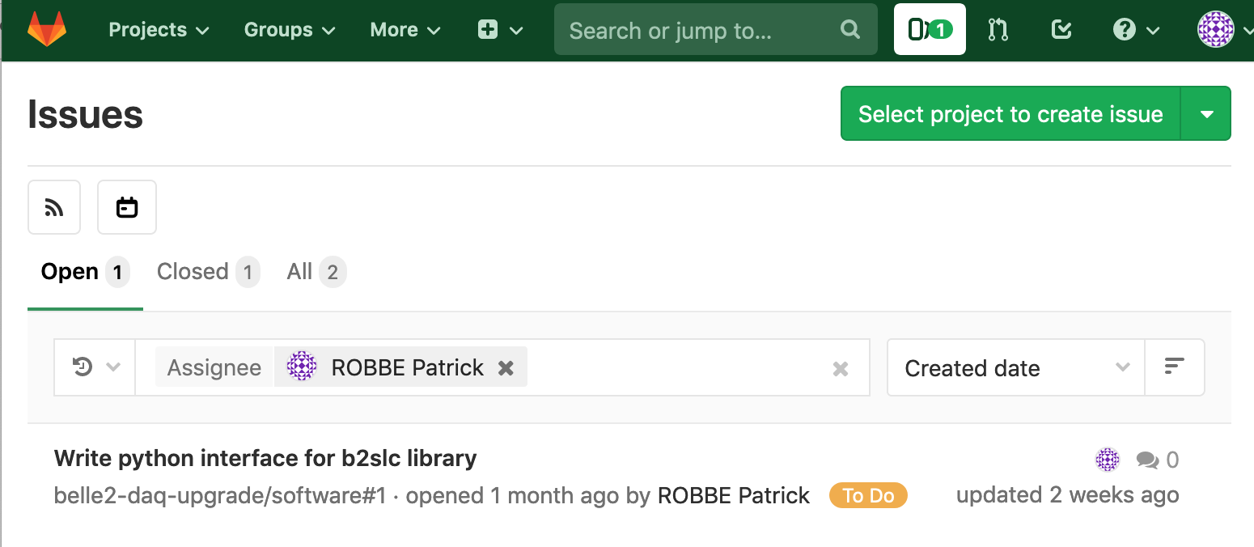
Git repository
It is also used for documentation repository and bug tracking system
12

Slide 13
MoU preparation
Template for MoU provided by DAQ Upgrade Committee
PCIe40 version now circulating with French funding agency for feedback and be ready to launch the production at end of October in case the PCIe40 project is selected
Hardware side:
  KEK will provide infrastructure (servers, optical fibers, ...)
  LAL – CNRS/IN2P3 will provide 26 PCIe40 boards : 18 production, 2 spare and 6 development boards, for Summer 2020
Person-power, LAL – CNRS/IN2P3 will provide:
  Firmware and software development (1.5 FTE) and then for the corresponding support for the entire duration when the boards will be used
  Presence on-site for installation and commissioning (summer 2020 and following shutdown if necessary)
13

Slide 14
Conclusion
  Most of the required functionality have been implemented and tested:
        Belle2Link implementation in ALTERA FPGA
        B2TT implementation (thanks to Nakao-san)
        DMA transfer
        Slow control (thanks to Qidong Zhou)
  Last one (user logic and event building) well advanced (thanks to Yamada-san)
  Ready for the test with KEK TOP test bench
  Last oportunity to launch board production for Belle II is beginning of November 2019

Slide 15
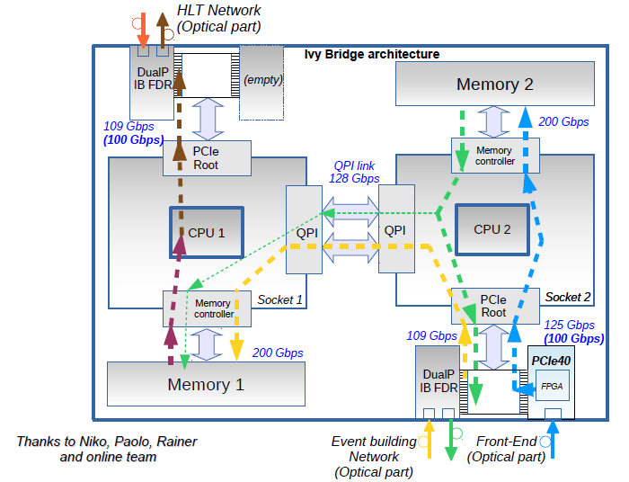
Data path in the computer

Slide 16
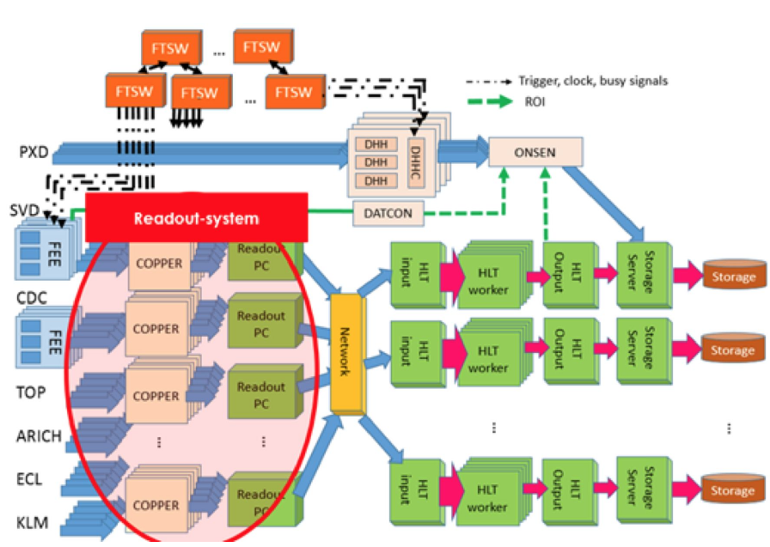
Bell2 Daq upgrade
Curent readout system
    Copper base on obsolete technology
    Could not follow the future luminosity.
    ~300 copper with 40 readout PC

