Slide 1
Compton polarimetry for SuperKEKB upgrade
Aurélien MARTENS

Slide 2
Introduction
Description of the current best candidate for the location of the polarimeter
Open questions related to integration of the polarimeter that is made of 3 elements
  A laser-e beams interaction chamber
  A scattered electron detector
  A scattered photon detector

Slide 3
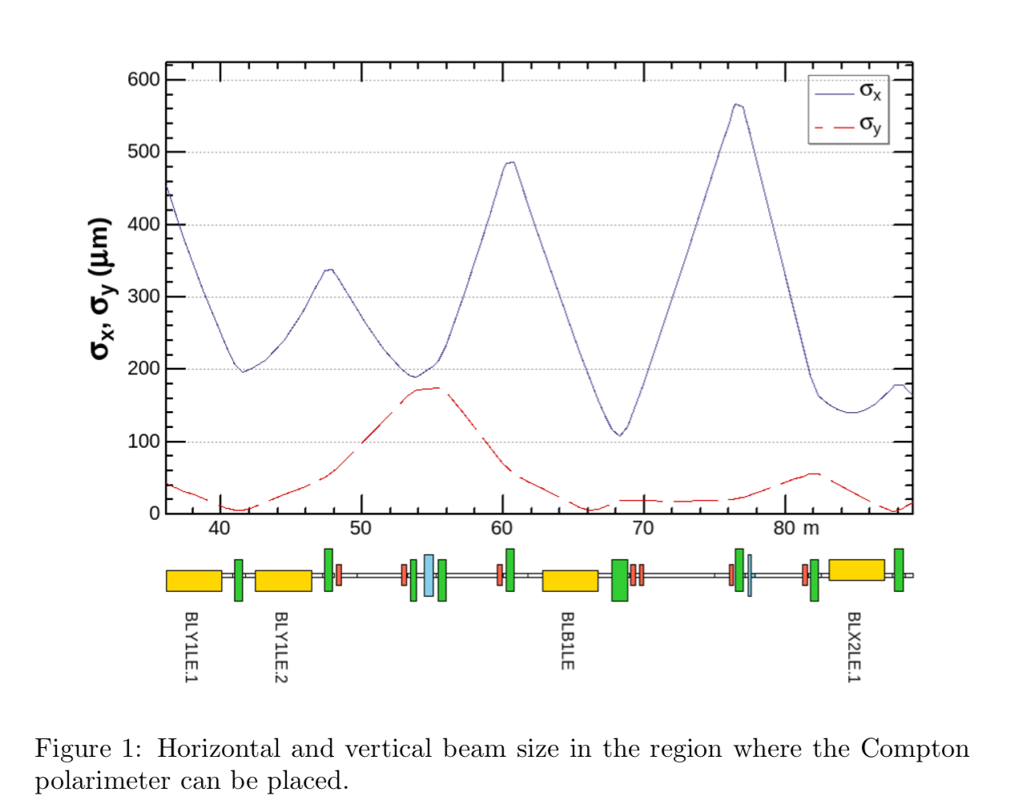
Lattice around BLY magnets
Region of interest for laser-e interaction
Furtherest from the IP is better (less background)
e- beam ellipticity is not of major concern

Slide 4
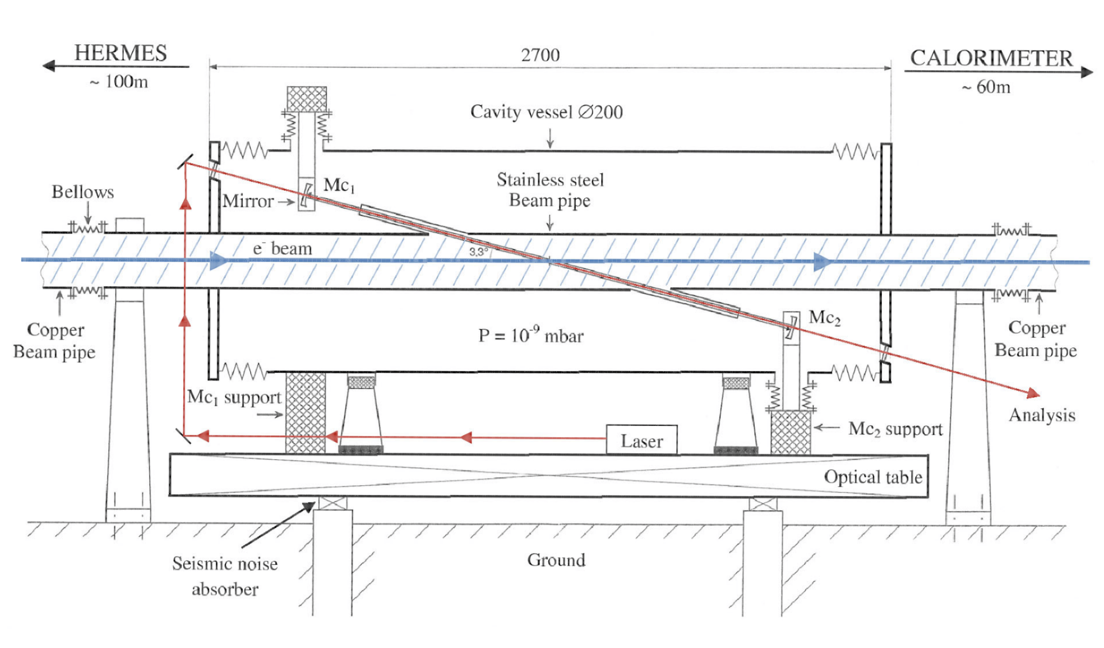
Beam pipe for interaction chamber
We do not need these
Belle2
Hera design
Similar design could be implemented:
What contraints on the tube ?
Probably need some shielding around the laser box (that needs to be thermalized)

Slide 5
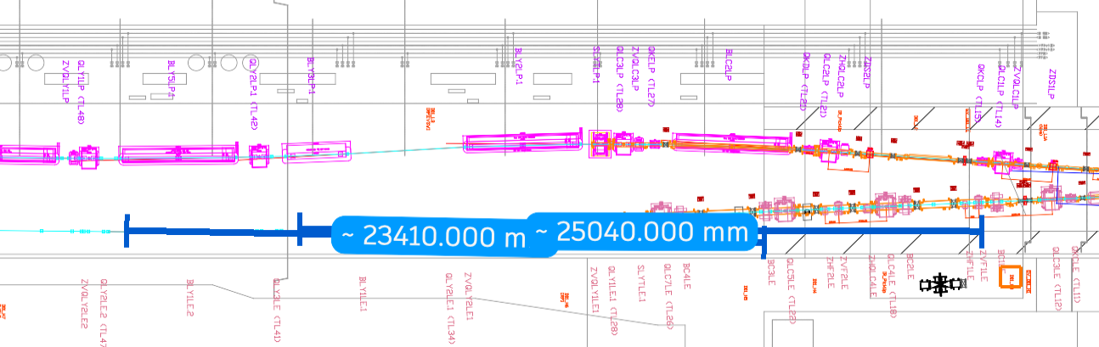
Photon detector location and needs
1m
There seem to be enough space for a photon detector after BLY1LE.1 or BLY1LE.2
Blue lines are line of sights for photons scattered from IPs located right before these dipoles
A window in the e-beam pipe must be placed and a secondary tube installed to the photon detector (in air, thus a second window needed)
--> vacuum level requirement to be determined but probably 10-6mbar is already too good.

Slide 6
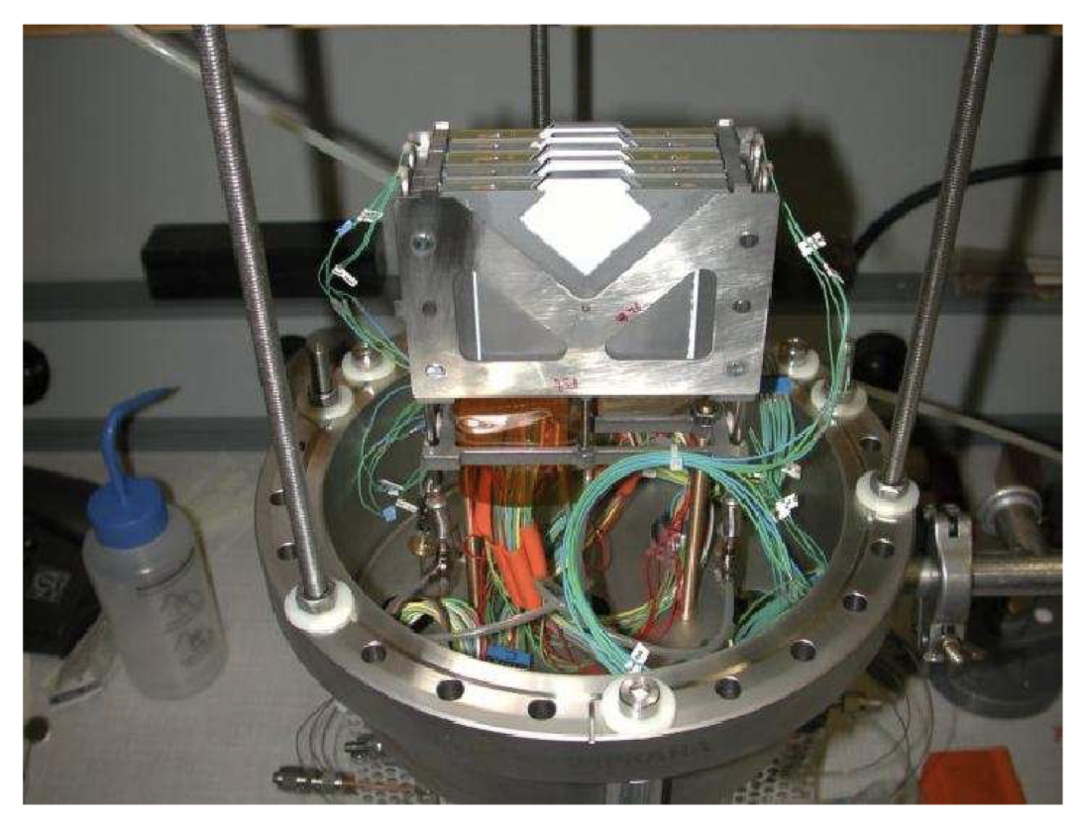
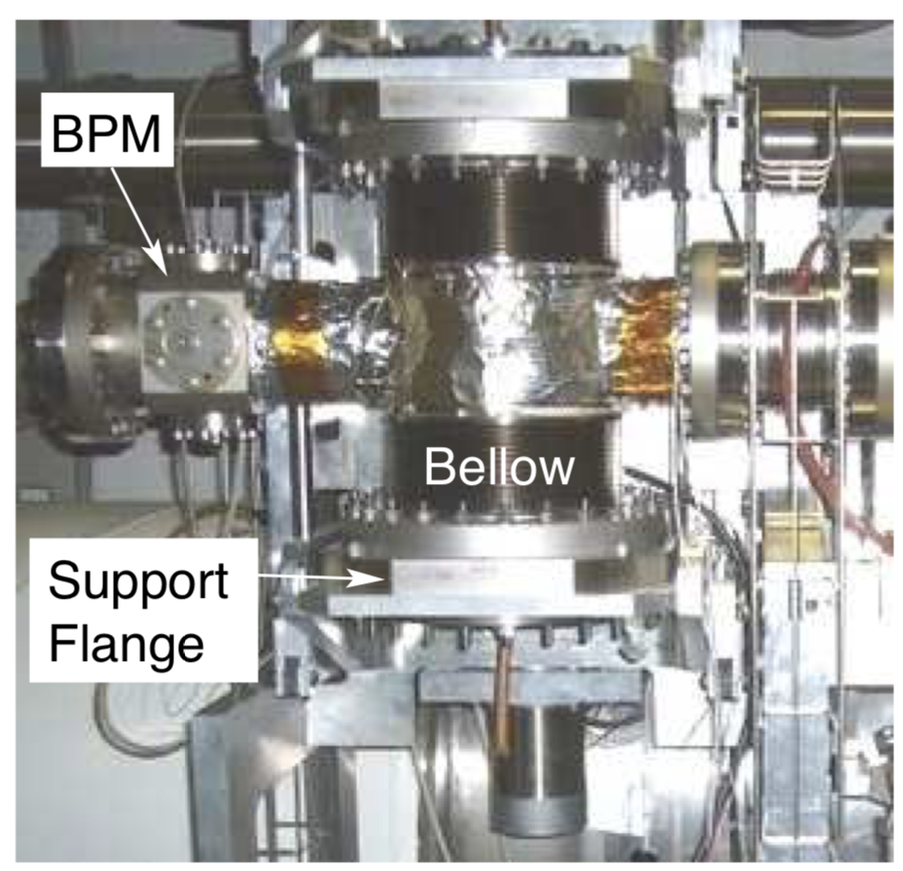
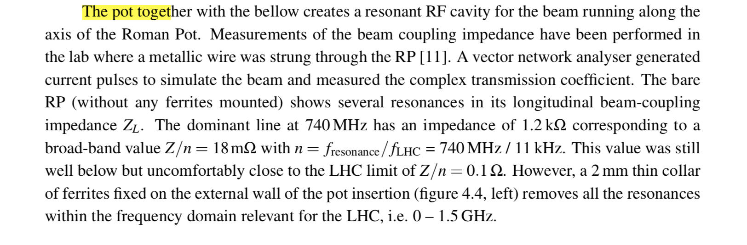
Electron detector location
https://jinst.sissa.it/LHC/TOTEM/ch04.pdf

Slide 7
Questions
Do you a major issue to implement the polarimeter at this location ?
Any comment on these ideas of implementation ? In particular impedance-wise

