Slide 1
Compton polarimetry for SuperKEKB upgrade
Aurélien MARTENS, Yann PEINAUD, Fabian ZOMER
+ some inputs from Philip BAMBADE, François LE DIBERDER, Karim TRABELSI

Slide 2
Introduction
The goal here is to summarize what we did to find possible locations for the polarimeter to trigger some discussions
Outline:
Generalities about Compton backscattering (slides #3-6)
Ideas and questions about the strategy to adopt for SuperKEKB (slide #7-9)
SuperKEKB lattice (slide #10)
Discussing localization of transverse polarimeter (slides #11-12)
Discussing localization of longitudinal polarimeter (slides #13-16)
Quick Laser system design (slides #17-18)
Conclusion and Next steps (slides #19)

Slide 3
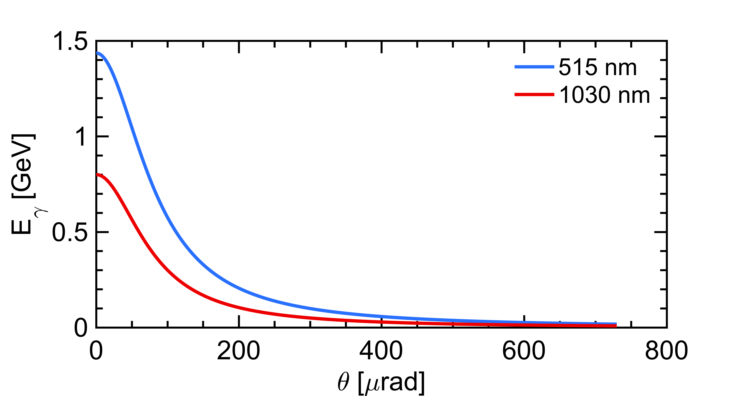



A first look to Compton backscattering
laser ($ω_{0}$)
Initial electron energy (7 GeV)
Initial photon energy (1.2eV at 1030nm)
Crossing angle of beams
Emitted photon energy
$$θ_{0}$$
θ
e⁻ beam $E0$
The energy vs emission angle correlation is specific and must be kept in mind
Landau-Lifshitz QED book paragaphs 86 and 87
Conical emission:
98% of photons within 730𝜇rad
⚠️ Remember:
  Photons (electrons too) are scatterred in the forward direction, in a narrow cone around the electron beam axis
  I further implicitely assume that detection of photons require to clear a line of sight of about 30 to 100m

Slide 4

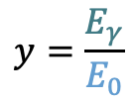
Compton cross-section
$$x=\frac{2E_{0}ω_{0}}{m^{2}}\left(1+\cos{θ_{0}}\right)$$
$$y=\frac{E_{γ}}{E_{0}}$$
The Compton cross-section averaged over scattered particles spins:
Differential cross-section
Transverse laser polarisation: nuisance parameter to minimize and keep under control
Transverse electron beam polarisation: intervenes as an asymmetry in the transverse plane
$$\frac{dσ}{dydφ_{obs}}\left(x,y\right)=\frac{dσ_{0}}{dy}\left(x,y\right)+\frac{dσ_{⊥}}{dy}\left(x,y\right)\cos\left(2\left(φ_{obs}−φ_{las}\right)\right)𝒫_{⊥}^{las}+\frac{dσ_{∥}}{dy}\left(x,y\right)𝒫_{C}^{las}(P_{T}f_{T}\left(x,y\right)\cos\left(φ_{obs}−φ_{elec}\right)+P_{L}f_{L}(x,y))$$
Electron beam polarization independent
Electron beam polarization dependent
Azimuthal observation angle
Orientation of transverse laser polar.
Orientation of transverse electron beam polar.
⚠️ Assume in the following:
  purely circular laser polarization $𝒫_{C}^{las}$ : transverse polarization of laser will be a systematic uncertainty or a constrained parameter in the fit
⚠️ Remember:
  It is much easier to measure the longitudinal electron beam polarization

Slide 5
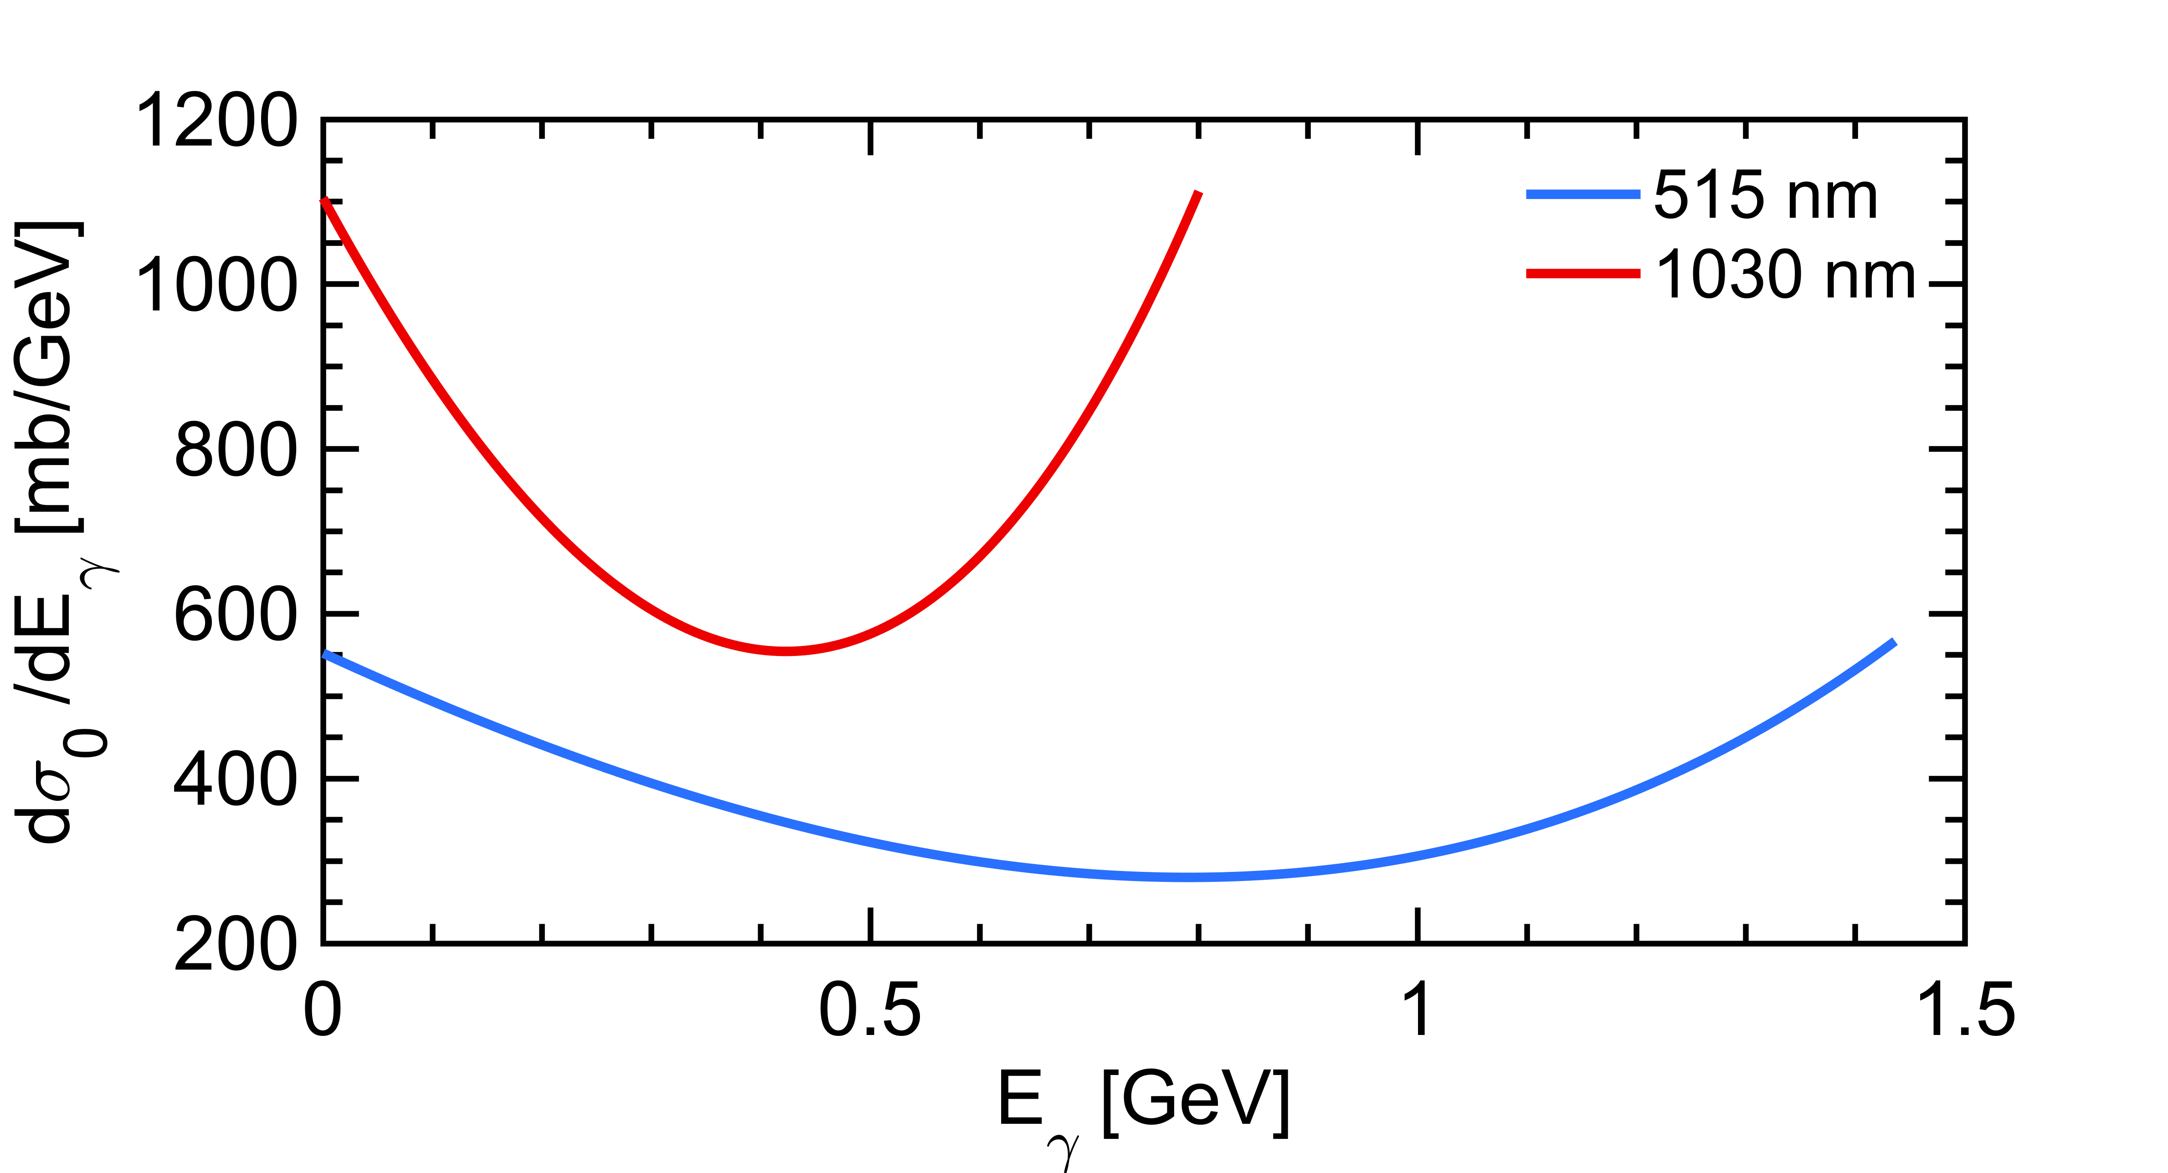
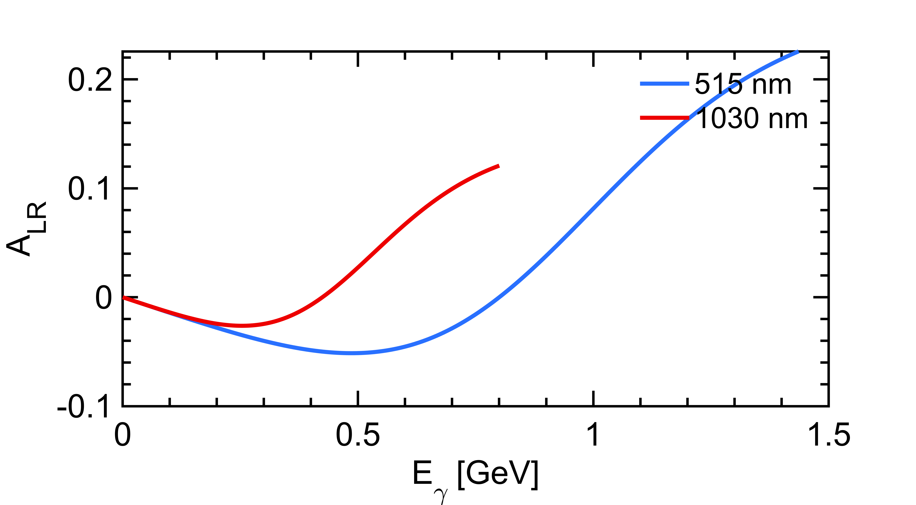
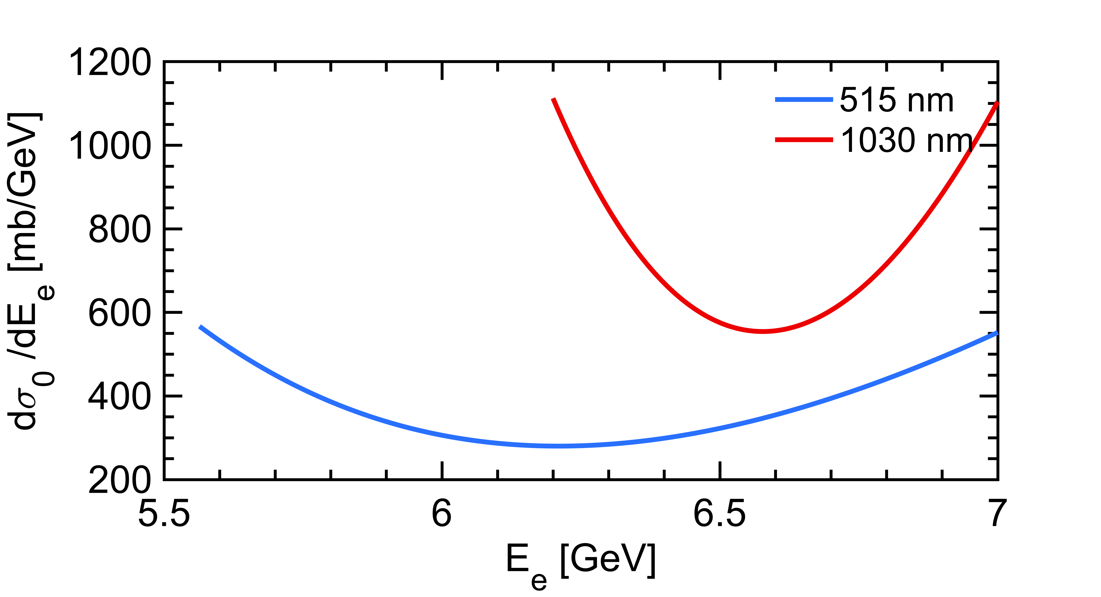
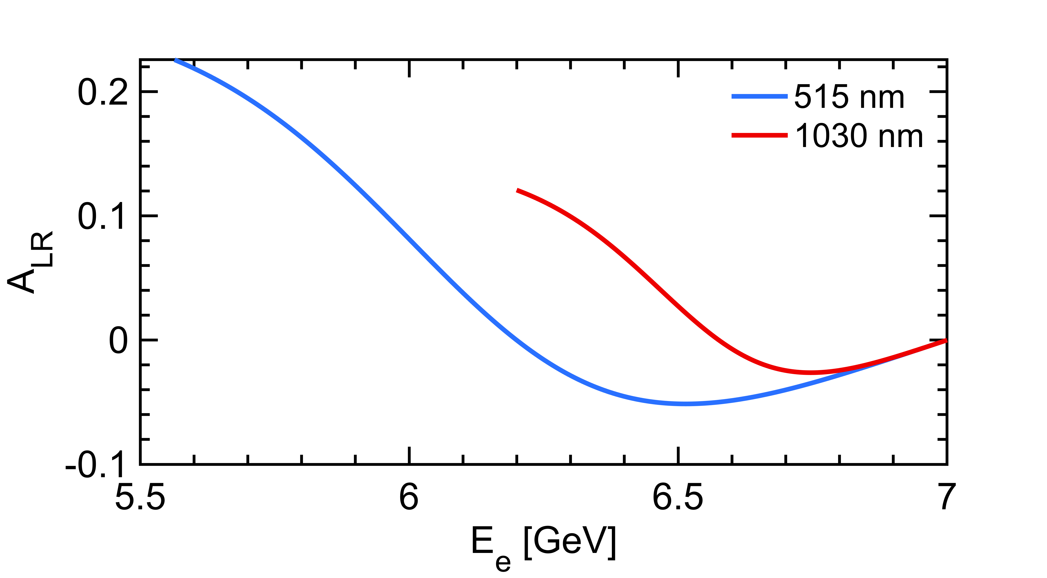

Longitudinal Compton polarimetry
$$\frac{dσ}{dy}(x,y)≅\frac{dσ_{0}}{dy}\left(1+{𝒫_{z}λA}_{LR}\right)$$
Polarization dependent term generates a left-right asymmetry function of $E_{γ}$
Landau-Lifshitz QED book paragaphs 86 and 87
that reflects also as a function of the energy of the emitted electron
Using a 515nm laser provides higher sensitivity

Slide 6
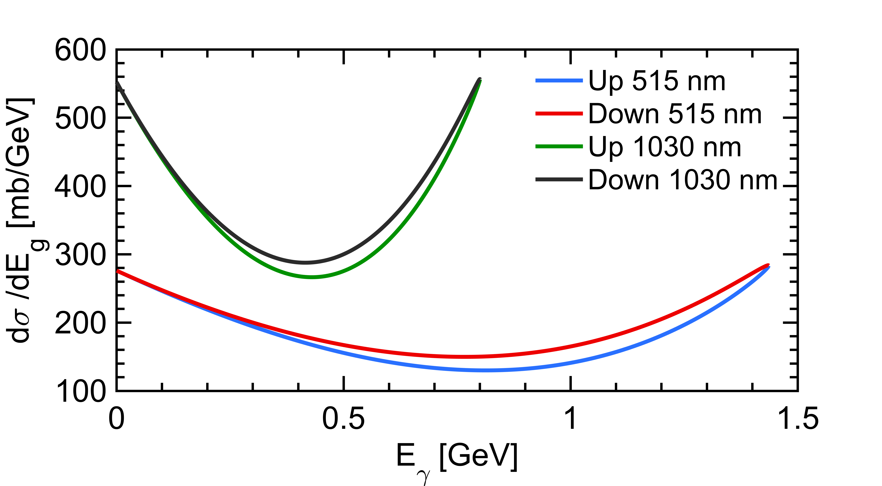
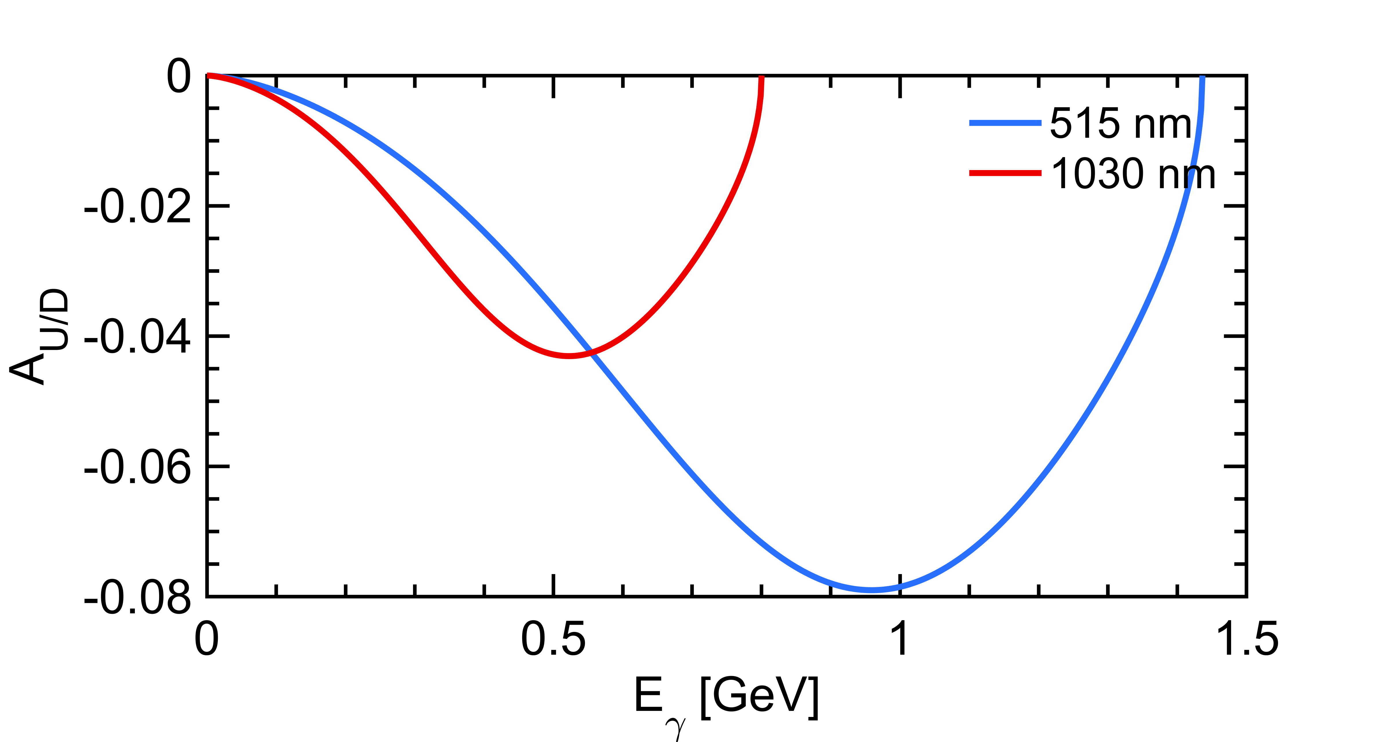
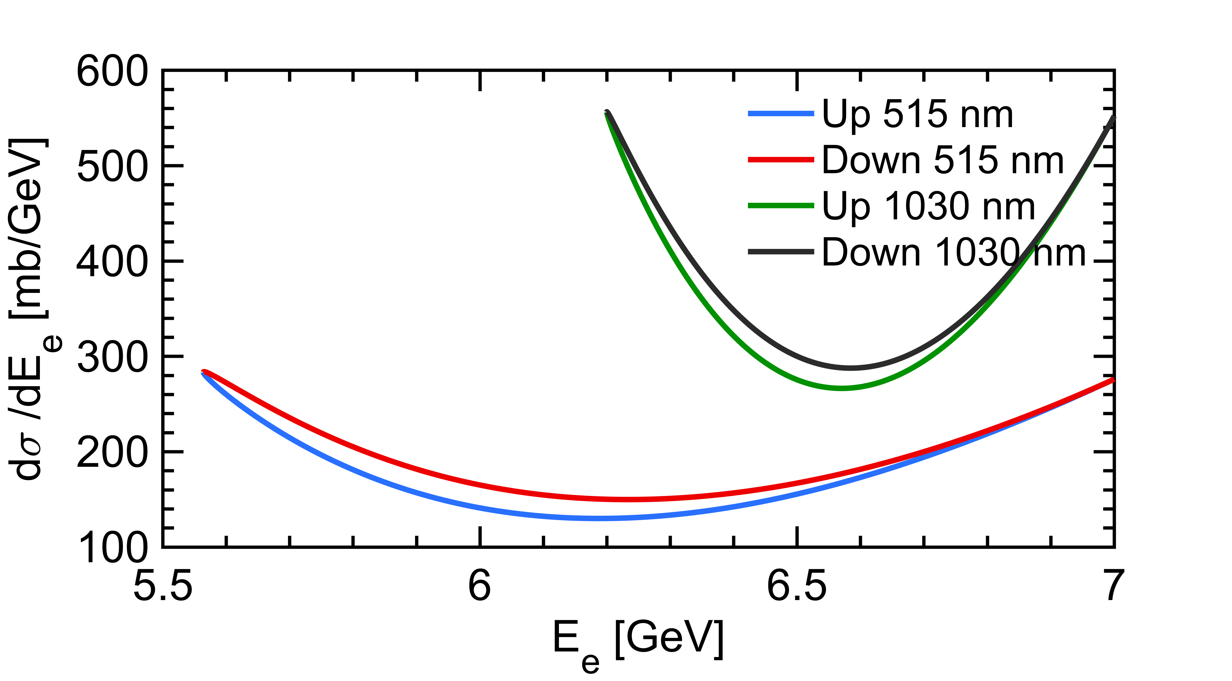
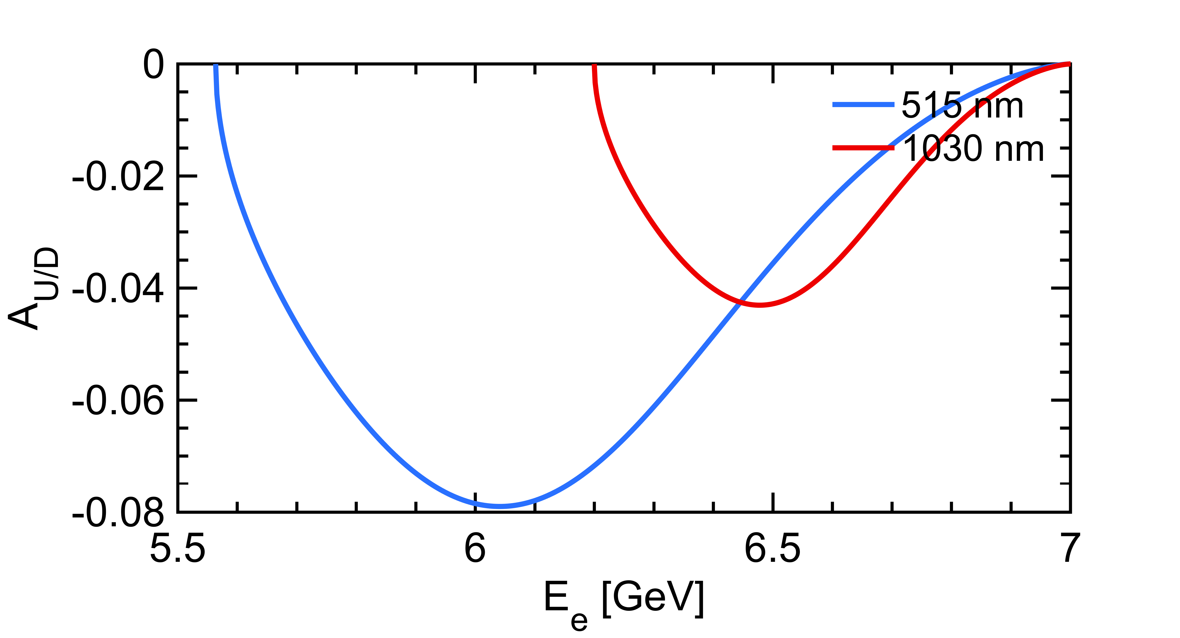

Transverse Compton polarimetry
$$\frac{dσ}{dy}(x,y)≅\frac{dσ_{0}}{dy}\left(1+{𝒫_{T}λA}_{UD}\right)$$
Polarization dependent term generates an up-down asymmetry function of $E_{γ}$
Landau-Lifshitz QED book paragaphs 86 and 87
that reflects also as a function of the energy of the emitted electron
The asymmetry is smaller, requires excellent transverse alignement (and or resolution for electron detection)

Slide 7
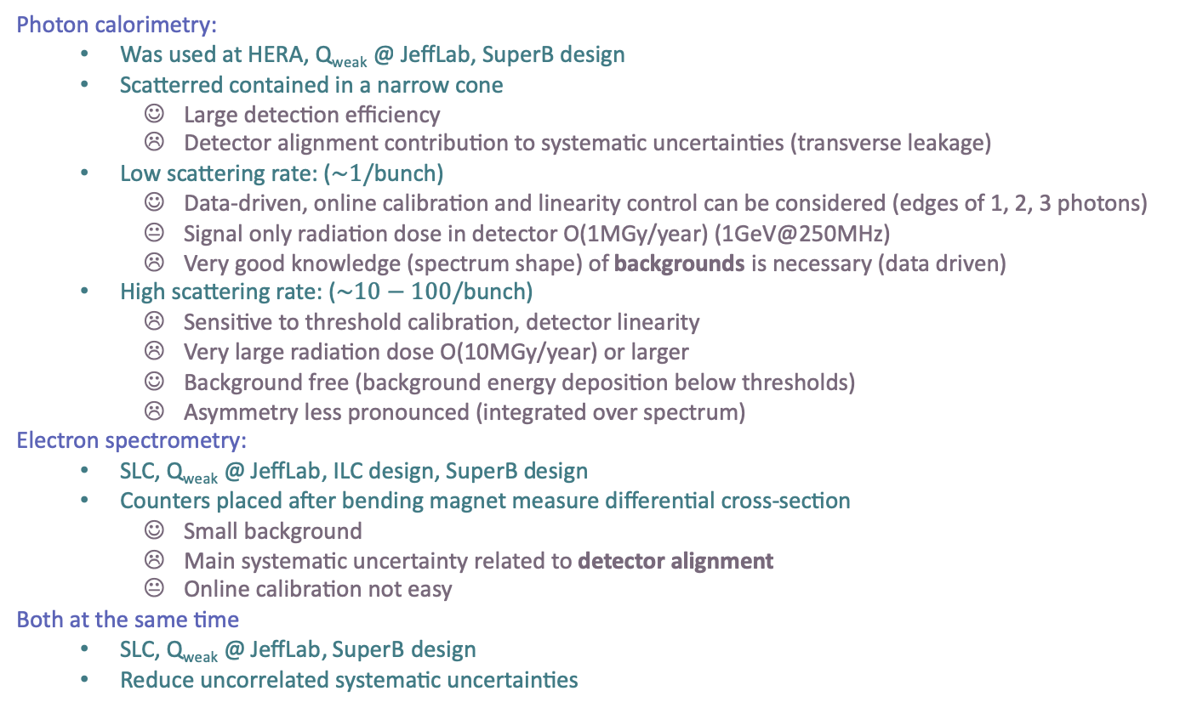
Detection strategies
Photon calorimetry:
  Was used at HERA, Q_{weak} @ JeffLab, SuperB design
  Scatterred contained in a narrow cone
    Large detection efficiency
    Detector alignment contribution to systematic uncertainties (transverse leakage)
  Low scattering rate: ($\sim 1/$bunch)
    Data-driven, online calibration and linearity control can be considered (edges of 1, 2, 3 photons)
    Signal only radiation dose in detector O(1MGy/year) (1GeV@250MHz)
    Very good knowledge (spectrum shape) of backgrounds is necessary (data driven)
  High scattering rate: ($\sim 10−100/$bunch)
    Sensitive to threshold calibration, detector linearity
    Very large radiation dose O(10MGy/year) or larger
    Background free (background energy deposition below thresholds)
    Asymmetry less pronounced (integrated over spectrum)
Electron spectrometry:
  SLC, Q_{weak} @ JeffLab, ILC design, SuperB design
  Counters placed after bending magnet measure differential cross-section
    Small background
    Main systematic uncertainty related to detector alignment
    Online calibration not easy
Both at the same time
  SLC, Q_{weak} @ JeffLab, SuperB design
  Reduce uncorrelated systematic uncertainties

Slide 8
General strategy, questions to address
Some constraints:
  Bunch/bunch effects observed at HERA
    → Measure polarization for every bunch independently continuously (top-up operation)
    → Require fast detectors, able to measure polarization every 4ns.
  Flip polarization very often or use bunches w/ opposite polarizations
  Avoid correlations polarization and luminosity
Check that vertical polarization is actually properly toped to the circulating bunch :
  Real time measurement of polarization in the injector line needed ? Is it possible ?
  Transverse polarimeter in the ring ? Or infer the info from a longitudinal polarimeter ?
Measure the longitudinal polarization close to the IP precisely:
  Is there room for that ?
  What is the expected level of longitudinal polarization at that place ?
Since no permanent regime will be reached (contrary to HERA):
  At what frequency must the polarization be measured ? (every minute is enough ?)

Slide 9
Polarimeter location
1. Ideally: want to measure the beam polarization at (close to) IP, but:
  Extremely busy place already ← difficult to inject laser
  Very large backgrounds for a Compton detector placed nearby IP
  Very large backgrounds in the line of sight of the IP (radiative Bhabha, bremstrahlung on poor residual vacuum at IP integrated over several tens of meters). NB: there is already LumiBelle2 installed. This can provide some estimated levels.
  In my opinion it is not an option to consider. Extensive background studies must be performed to validate such a location.
2. A bit further away (approx. mid-point in between Belle2 and spin rotators)
  Backgrounds from the opposite beam ?
  Only a fraction of the IP polarization is measured. This sensitivity loss is probably not a major problem for a tool that is mainly devoted to real time monitoring for machine optimization. NB: avoid horizontal orientation of polarization.
  Difficult to relate it precisely to IP polarization (difficult task to track the spin to IP with precision including misalignments). Systematics to be evaluated.
  I quickly investigated this possibility
3. Somewhere else: Measure transverse polarization
  Requires to measure vertical asymmetry of scattered particles with few tens µrad resolution
  Vertical alignment must be maintained within few 10µm,µrad ! (see HERA’s experience)
  Unlikely to relate it precisely to IP polarization
  I will also try to investigate where it could be placed.

Slide 10
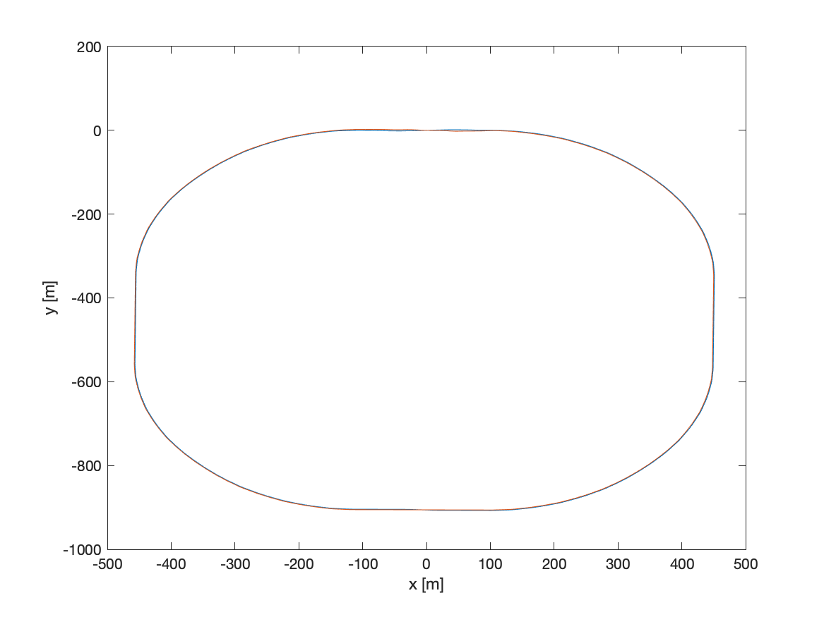
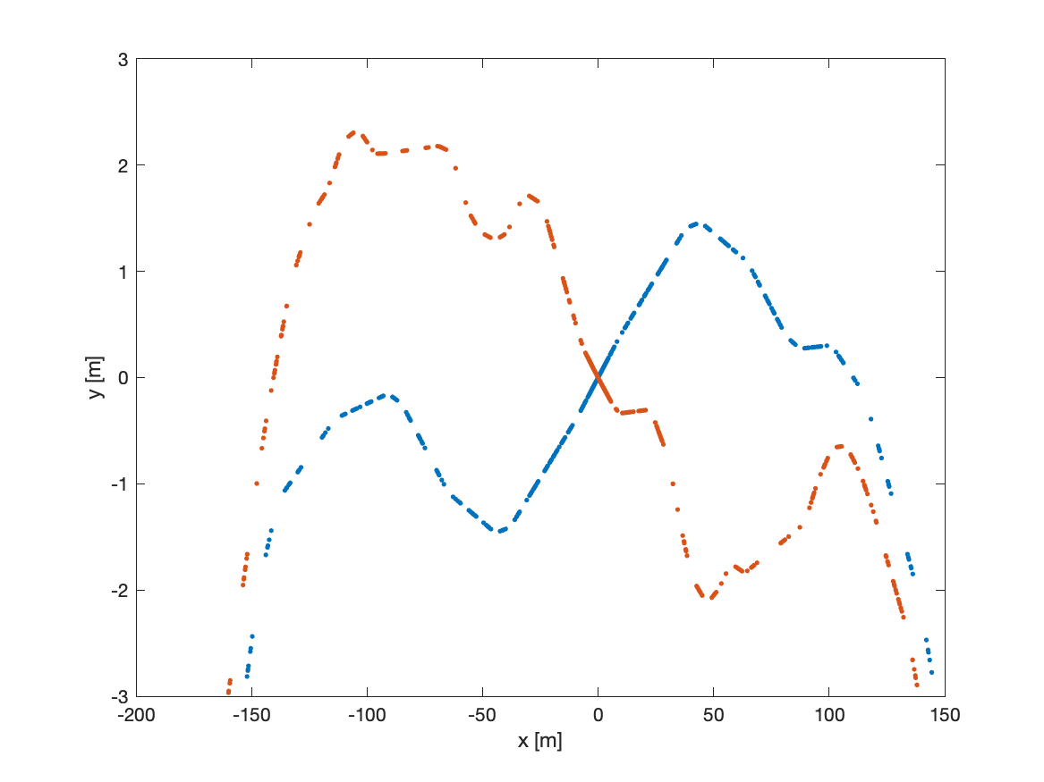
SuperKEKB lattice
⚠️ Inputs related to the SuperKEKB lattice:
  sher_5781_80_2.sad, sler_1705_80_2.sad thanks to MDI group through Karim
  I’ve applied the following commands to the lattice to extract the beam parameters at any point
    CELL;CALC;EMIOUT;CODPLOT;EMIT;BEAM; DISP OG ALL; DISP B ALL;
    Please report any mistake in the sequence of these commands (I’m not an usual SAD user)
  I also had to
    flip the sign of the transverse beam position at each element in the accelerator plane (x and y)
    Rotate each geometry by +-41.5mraad (83mrad crossing angle, arxiv:1809.01958v2)
LER (positron)
HER (electron)
Belle2 is here
⚠️ Mind the scales

Slide 11
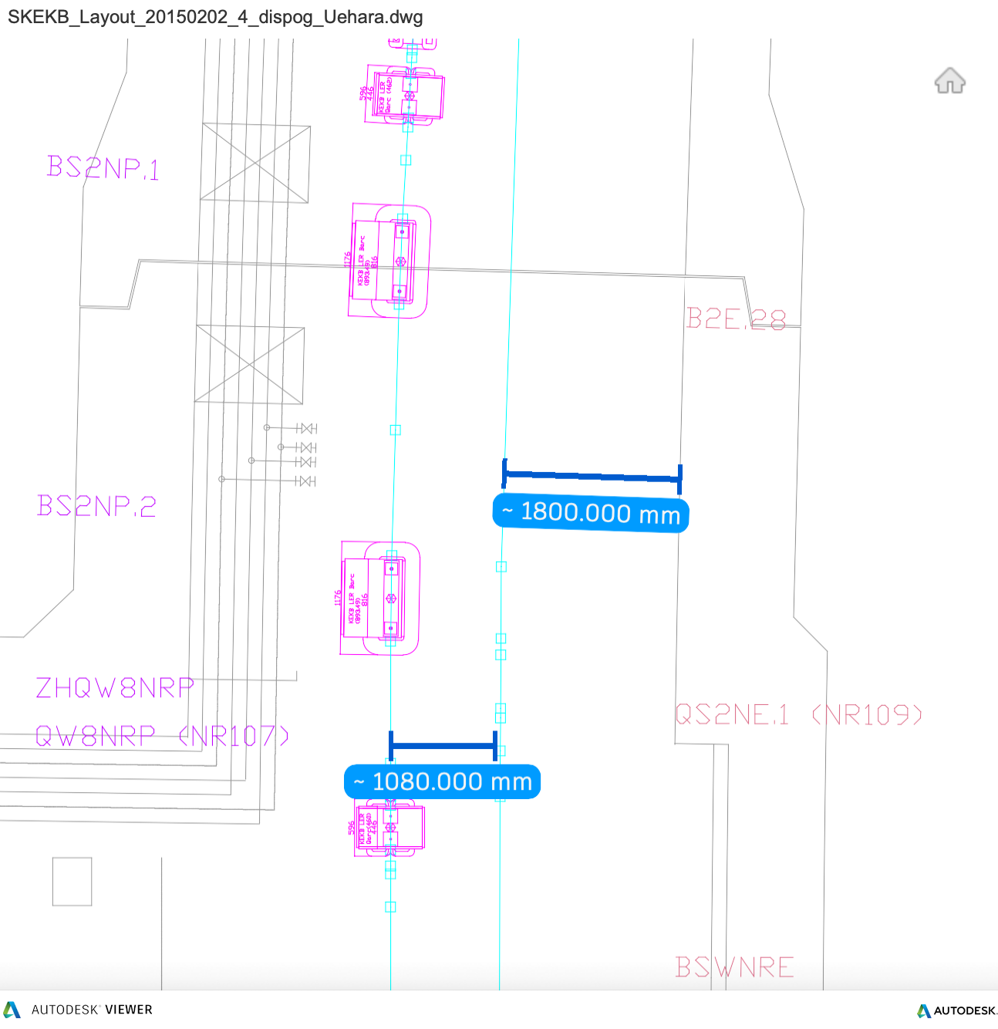
Ring transverse polarimeter (option #3)
Not much space here
Belle2 IP
Left part of the HER ring:
1m in between LER and HER
  → No space for a calorimeter in the. Line of sight of the beam
<2m in between HER and wall
  Most of it may be used for maintenance works ? (guess)
  Small space to place a spectrometer ? But energy of electrons is only few hundreds MeV apart from nominal. With a 0.22T 6m length magnet → 0.22degree deflection for 500MeV energy loss.
  Spectrometer precision will depend on precision of knowledge of magnet strengths

Slide 12
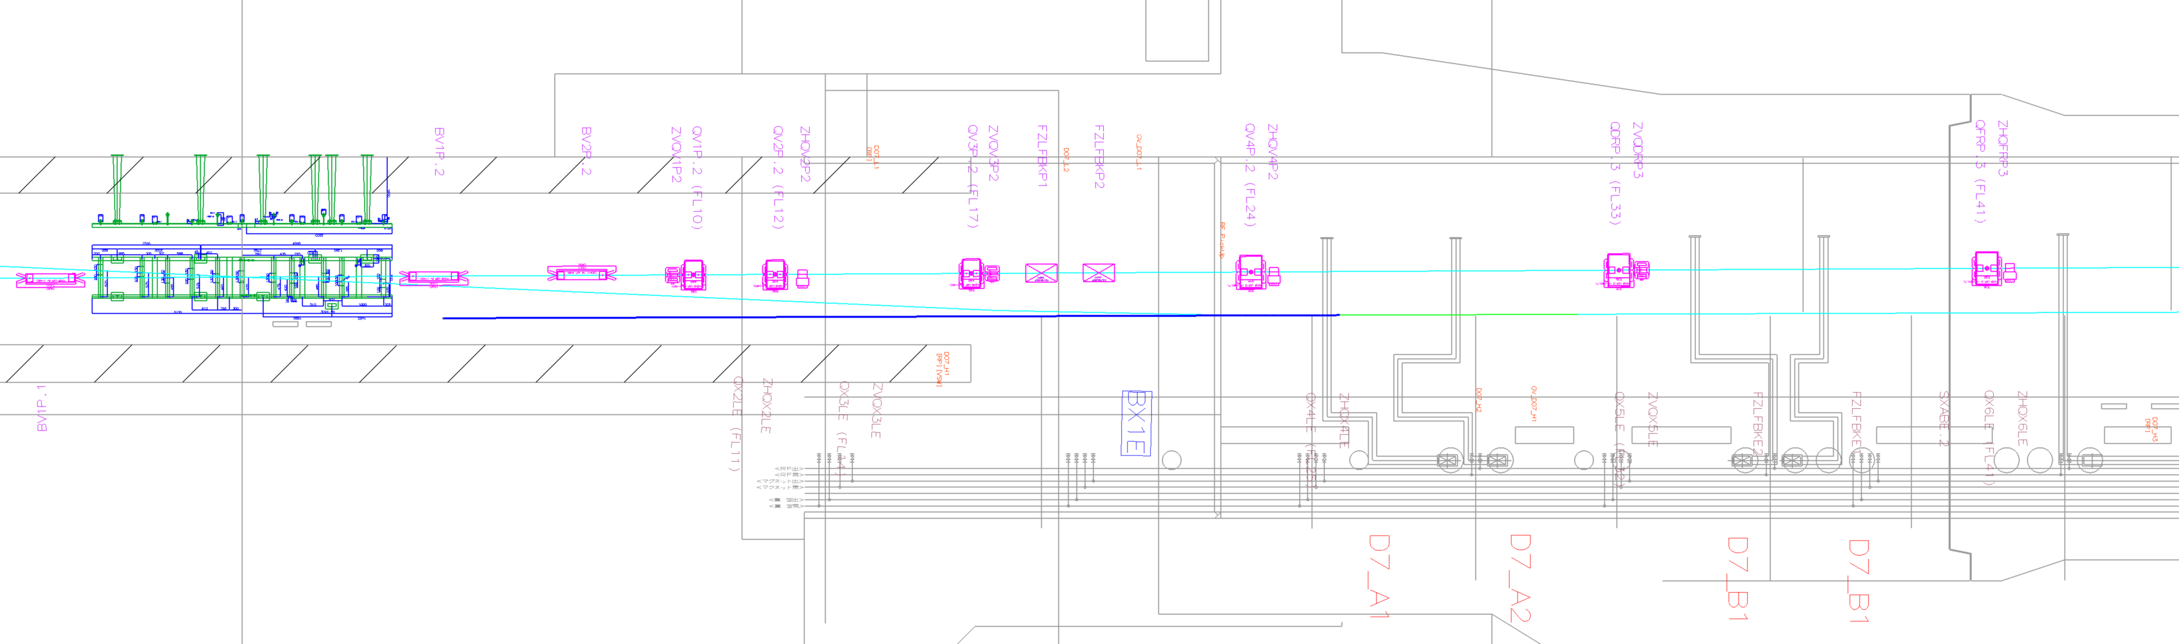
Ring transverse polarimeter (option #3)
Not much space here
Right part of the HER ring:
Similar statements hold
FUJI hall:
There may be a possibility
Is it reasonable ?
May allow both electron spectrometry with tracking after a single magnet and calorimetric measurement of photons
Belle2 IP
Yann Peinaud, Uhehara-san
Blue line is line of sight for photons scattered from IP located right before BX1E

Slide 13
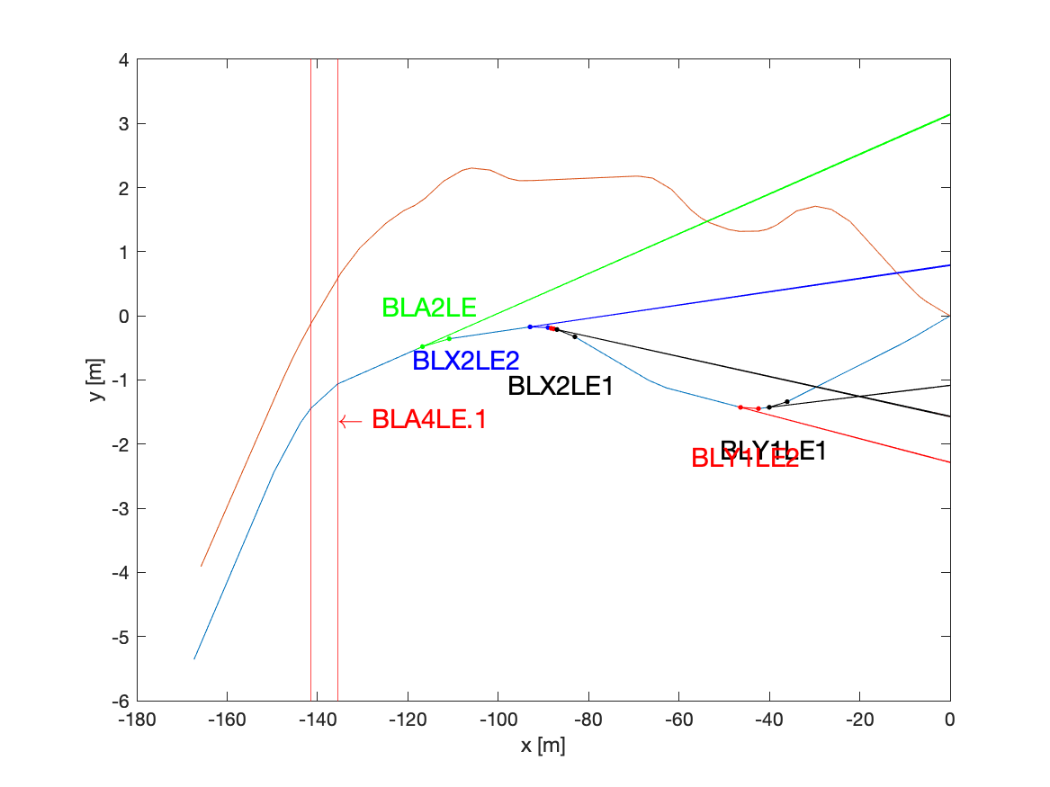
Nearly longitudinal pol. (option#2)
⚠️ accelerator tunnel walls and utilities are not drawn
Line of sight of photons produced at interaction points located right before BLA2LE, BLX2LE(1,2), BLY1LE(1,2)
About 2.5 meters
LER (positron)
HER (electron)
⚠️ what is the expected longitudinal polarization magnitude at these locations ?

Slide 14
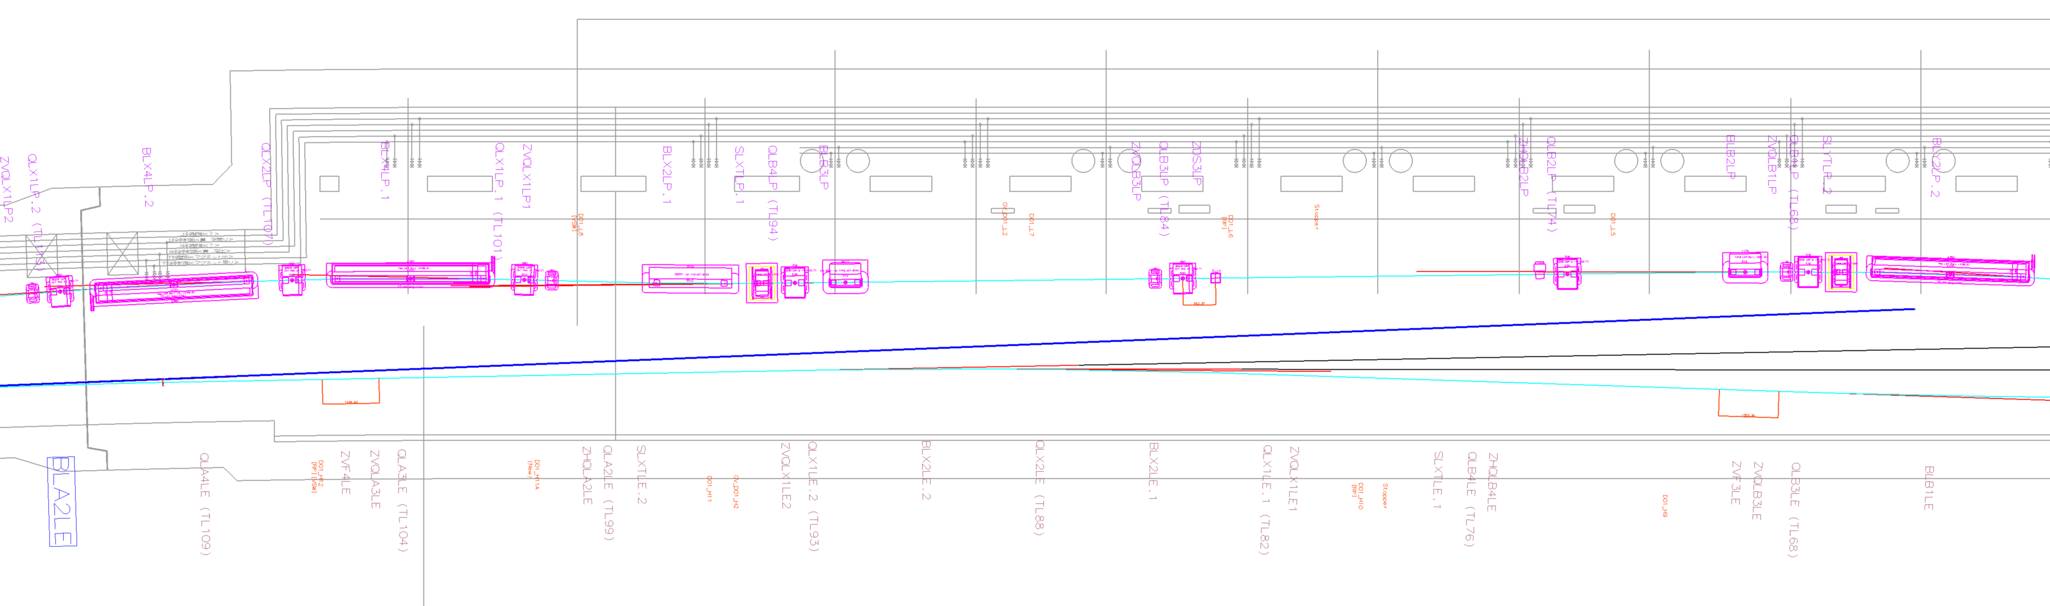
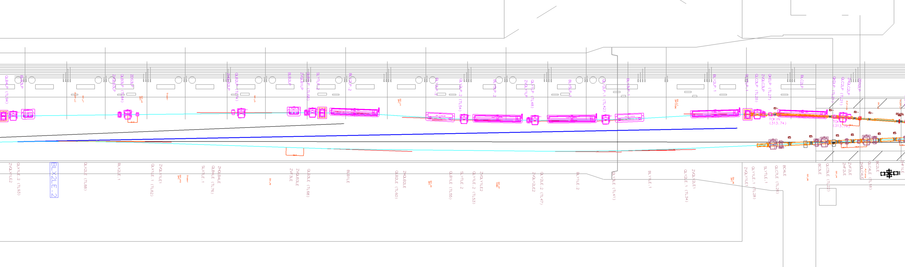
BLA2LE and BLX2LE.2
Yann Peinaud + Uhehara-san for the 2D drawing
There seem to be enough space for a photon detector after BLA2LE or BLX2LE.2
Blue lines are line of sights for photons scattered from IPs located right before these dipoles

Slide 15
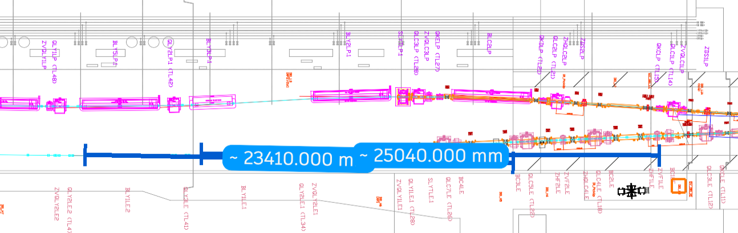
BLY1LE.1 and BLY1LE.2
Yann Peinaud + Uhehara-san for the 2D drawing
There seem to be enough space for a photon detector after BLY1LE.1 or BLY1LE.2
Blue lines are line of sights for photons scattered from IPs located right before these dipoles
calorimetric measurement of photons seem OK (backgrounds do not seem too large at first glance)
electron spectrometry location to be evaluated, electrons about 2cm apart from main beam about 10m away from magnet center. May be ok if Compton IP before BLY1LE.2 and detector after BLY1LE.1 ? (vertical bend is ok because we are not interested in transverse polarisation)

Slide 16
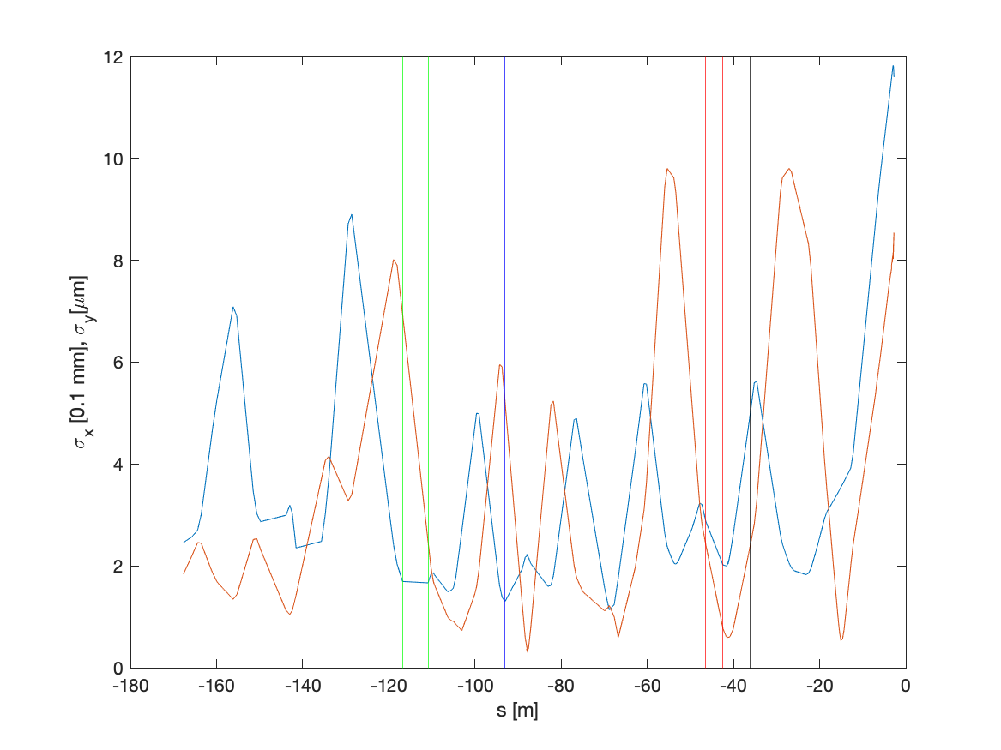
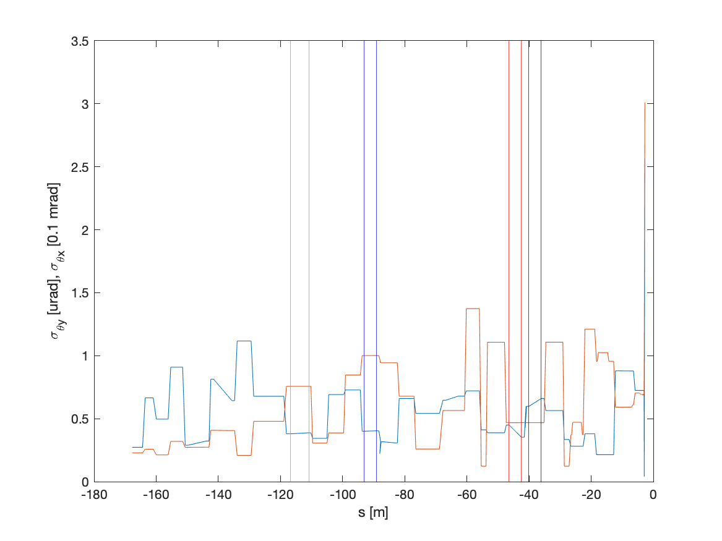

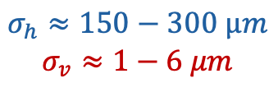
Beam parameters
BLA2LE
BLX2LE.2
$$σ_{h}≈150−300 µm$$
$$σ_{v}≈1−6 μm$$
$$σ_{θh}≈40−60μrad$$
$$σ_{θv}≈0.4−1μrad$$
Dispersion in vertical direction is negligible, contributes in horizontal
⚠️ Not looked at yet:
  Magnitude of beam jittering at these locations?

Slide 17
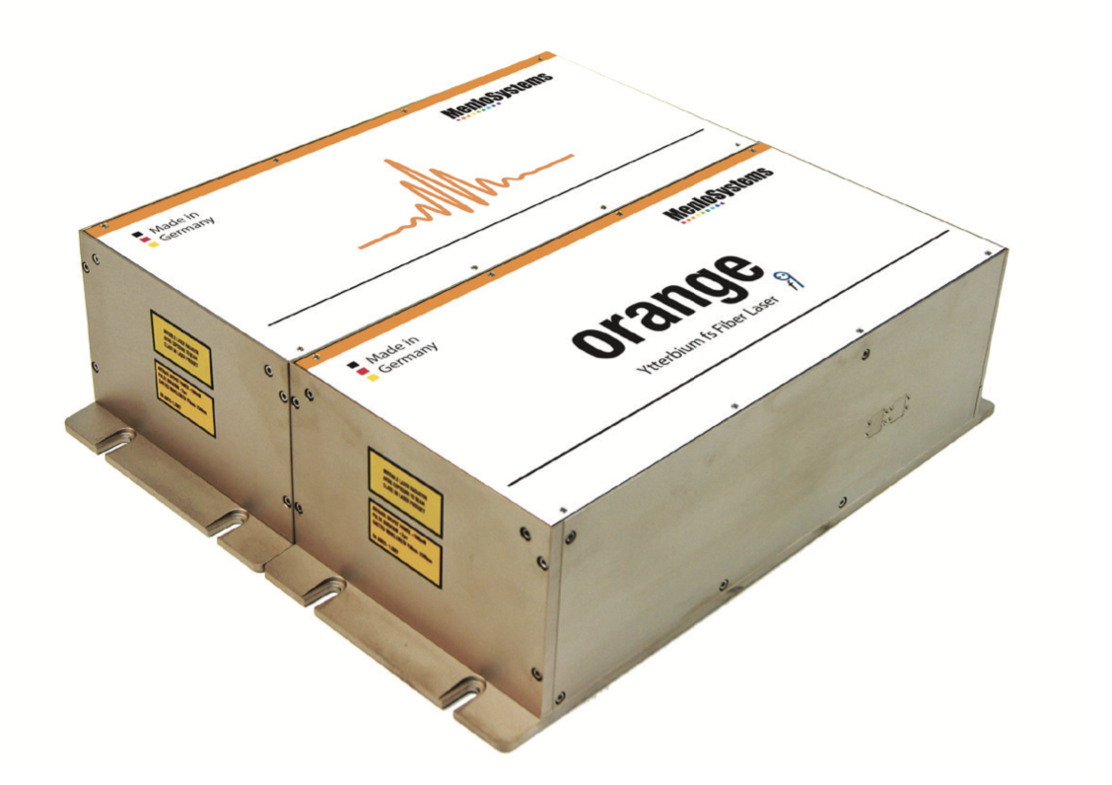
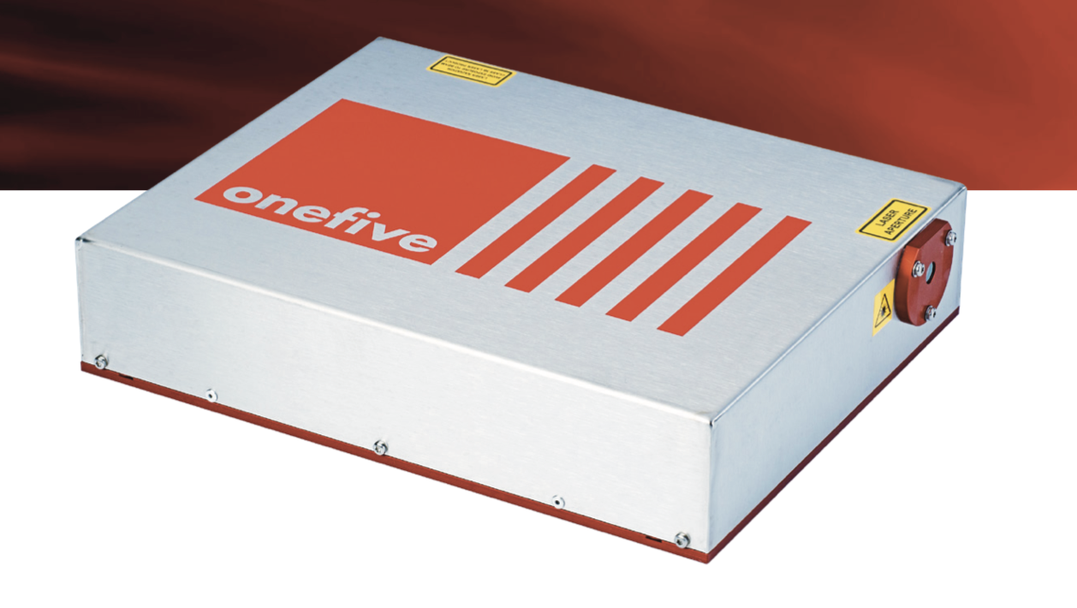
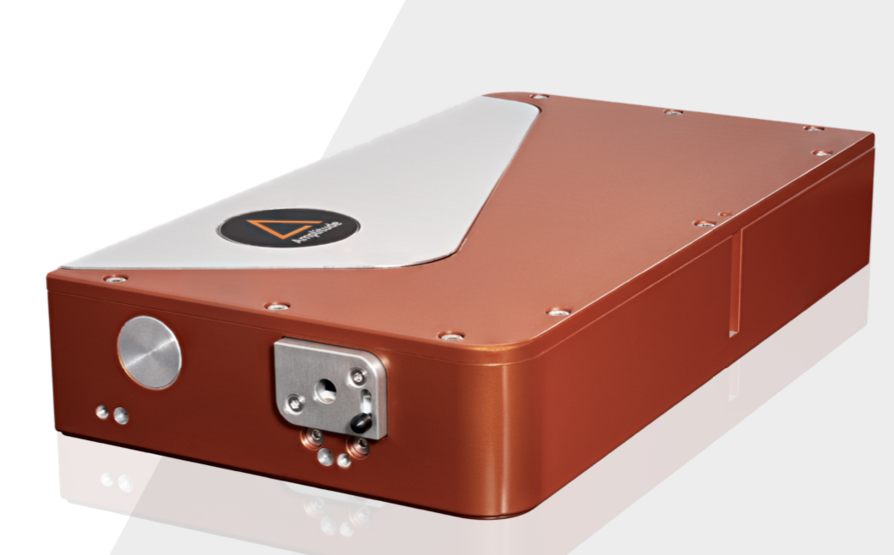

Laser system (very preliminary)
Input parameters assumed:
  E-beam: Q=10nC, 𝜎_{ℎ}=150µm, 𝜎_{v}=8µm, 𝜎_{𝜃v}=1µrad, 𝜎_{𝜃h}=40µrad
  Laser :𝜆=515nm, 20W, 250MHz pulsed (frequency comb), 𝜎_{ℎ}=𝜎_{v}=200µm, 1 degree crossing angle
A 5W green laser @ 250MHz provides about 0.6 photons in average per bunch crossing
Many commercial products:
laser oscillator + amplifier
This needs consolidation once location of polarimeter is confirmed

Slide 18
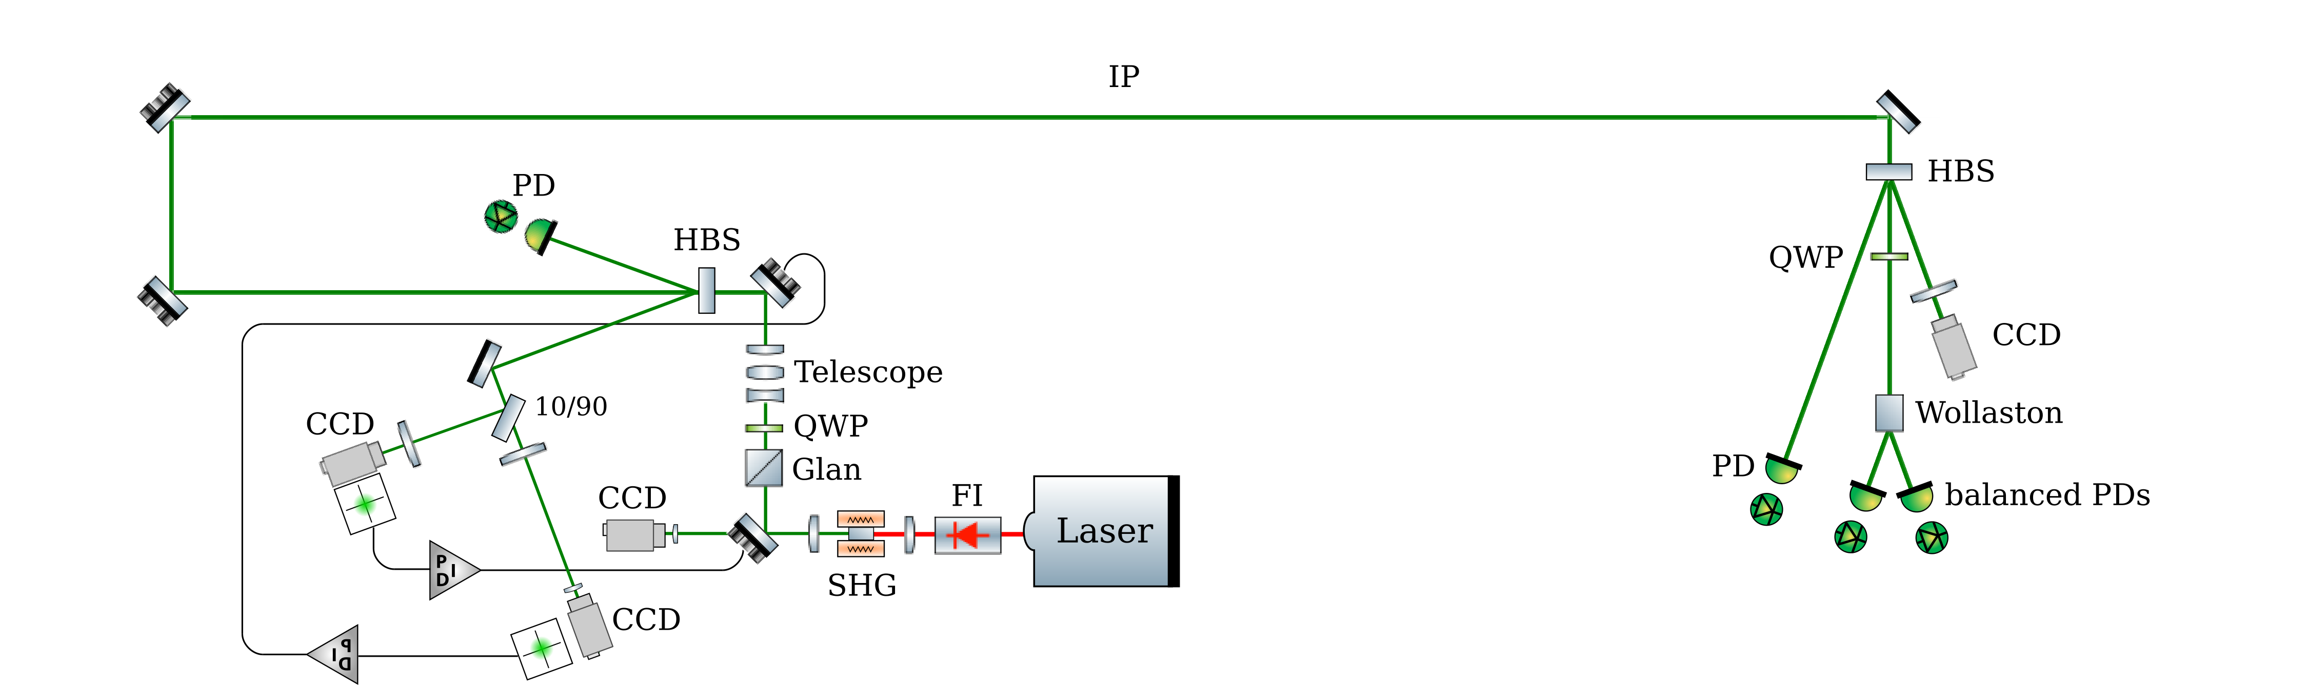
Laser beam injection line (preliminary)
Vacuum vessel
Box with rough temperature control
Box with rough temperature control
Telescope needs to be designed once laser beam parameters are confirmed
Additional positioning and pointing feedbacks can be added if needed
Components need to be validated for the required average power
Laser beam size and length of transport line as to be consolidates once location is decided

Slide 19
Conclusion
Longitudinal polarimeter seems possible to implement before BLY1LE(1,2) or BLX2LE2
  what is the level of longitudinal polarization at this place ?
  What would be the required modifications to vacuum pipes to extract photons and or electrons ?
  Is it in conflict with the magnet apertures and existing elements ?
  Would it be in conflict with the updated lattice with spin rotators included ?
  Viewpoint of SuperKEKB lattice expert ?
Transverse (vertical) polarimeter location seem at first glance much more difficult to find
  FUJI hall maybe ?
  Viewpoint of SuperKEKB lattice expert ?
  If ok and needed, I would suggest to contact B. List (DESY, former member of the TPOL team at HERA) since this is a difficult task, and we must profit from past experience
Preliminary drawing of typical laser system has been provided
Next steps:
  some sensitivity studies for a most likely location along with specification of performance
  Task sharing ?

