Slide 1
Compton polarimetry
Aurélien MARTENS

Slide 2
Introduction
Several meetings held and many email e-mail exchanges with the SuperKEKB team:
  Many thanks to Demin, Mika, Renjun
  Most of material presented here from them
I try to summarize the lessons from these meeting:
  Also includes input from Yuhao regarding the spin projection (longitudinal polarimeter is easier)

Slide 3
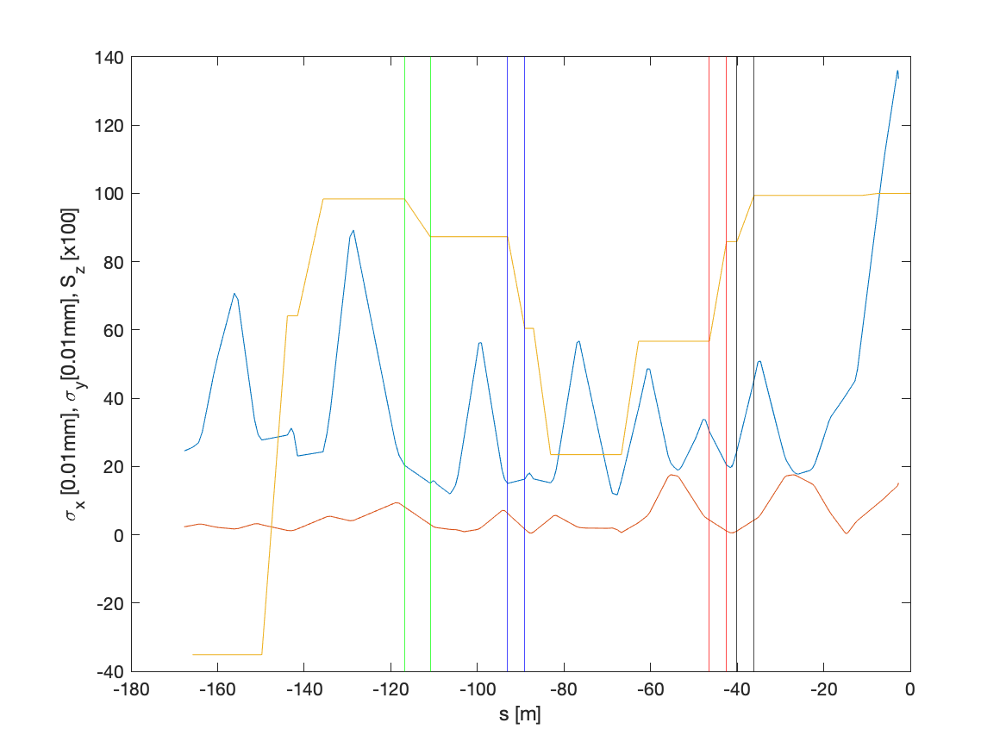
Beam sizes and spin projection in z
Using Yuhao data, https://indico.belle2.org/event/5306/
Rotator assumed to be around B2E
BLY1LE.1/2
IP
BLA2LE
BLX2LE.2
99% of the IP Sz
85% of the IP Sz
55% of the IP Sz

Slide 4
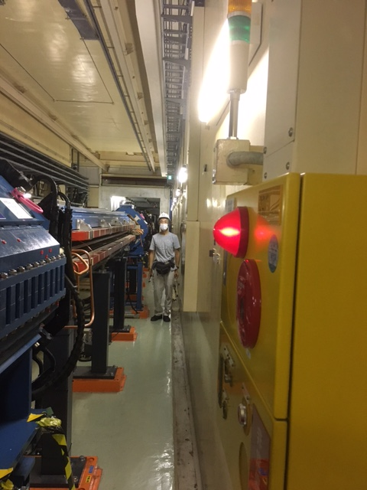
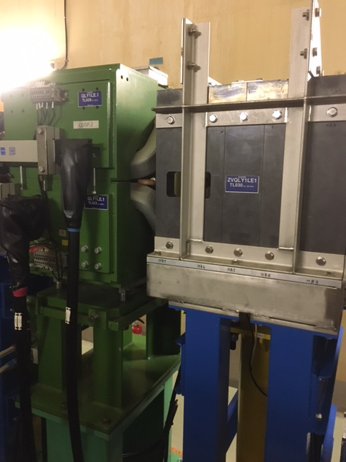
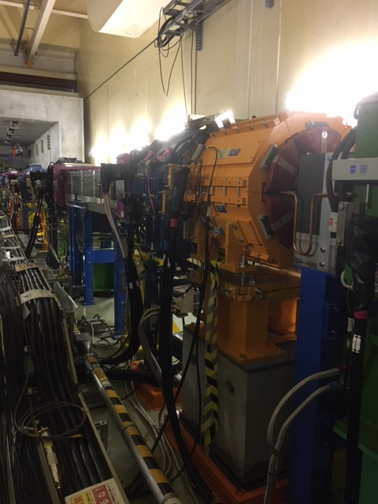
BLY1LE.1/2
Not ideal in terms of spin projection on the longitudinal axis:
  55% of the value at IP
  Extremely busy area
  Collimators nearby → background
  Difficult to implement the electron detector (backgrounds, beam halo with large beam size, integration)
SLYTLE.1
BLY1LE.2
QLY1LE.1
QLY1LE.1

Slide 5
BLA2LE/BLX2LE.2
Ideal in terms of spin projection on the longitudinal axis:
  99%/85% of the value at IP if interaction before BLA2LE or BLX2LE.2
  Not so busy area
BLA2LE

Slide 6
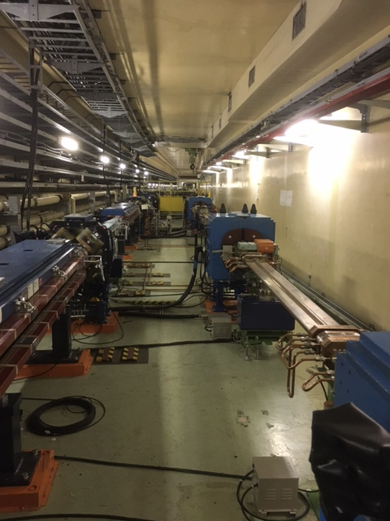
Pictures
Interaction region ?
Or immediately downstream (after quad) ?

Slide 7
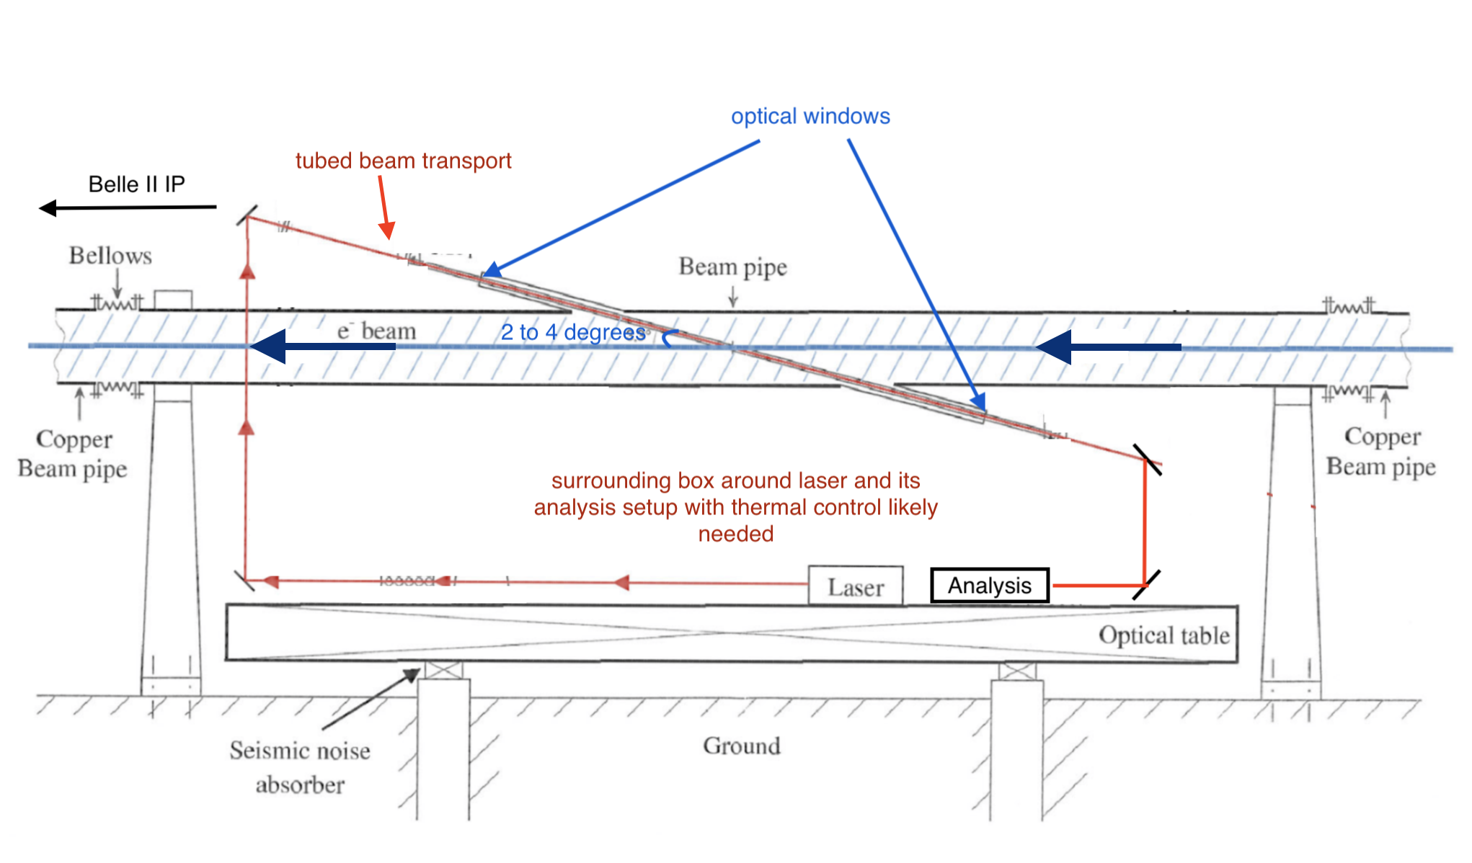
Beam pipe for interaction chamber
Assumed vertical crossing,
could be horizontal ?
2m

Slide 8
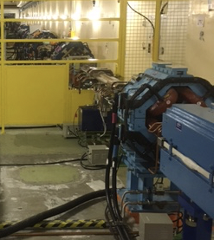
Gamma-beam detector
According to
her_2021-06-09_231636.388_MeasOpt
BLA2LE is 5.9m long and bends the electrons by 20.6mrad
Photon beam at the exit of magnet will be 122mm away from beam centre
Outside of beam pipe acceptance.
Pumping port on opposite side of SR 1m length every 4mm
The open side of the C-shape magnet is on the opposite !
→situation is the same for the next bend
→ Previous bend is opened on the SR side but Sz~60% and very short straight section…
Reverse the open side ? Split magnet in two separate elements ?

Slide 9
Electron detector
Electron detector is on opposite side of SR, so pumping port side
Deflection wrt electron beam of 30mm (for threshold energy electrons) after BLA2LE
Pumping port on opposite side of SR 1m length every 4mm
Here ?
Roman-pot like system ? (Wouter)
Need to remove one pumping screen ?

Slide 10
Conclusion
Nice place for integration of laser system is found about 126m upstream IP:
  99% of IP polarization
  Enough space
  Any cons ?
  Next step: design of a chamber ? → who ?
Photon-beam detector:
  Cannot be integrated without modification of BLA2LE ? → major modification that we would initially like to avoid
  What can reasonably be done ?
Electron detector:
  Seems to be some space between BLA2LE and BLX2LE.2
  Requires to remove a pumping screen ?
  Need to progress on design of its housing
Other topic:
  E-JADE 2 (EU program) on collaboration on accelerators for particle physics. Main topic of collaboration is SuperKEKB, including polarimetry. KEK is involved in the discussions, North America could also be involved in the project.

