Slide 1
Compton polarimetry for SuperKEKB upgrade
Aurélien MARTENS

Slide 2
Introduction
Description of the current best candidate for the location of the polarimeter
Open questions related to integration of the polarimeter that is made of 3 elements
  A laser-e beams interaction chamber
  A scattered electron detector
  A scattered photon detector

Slide 3
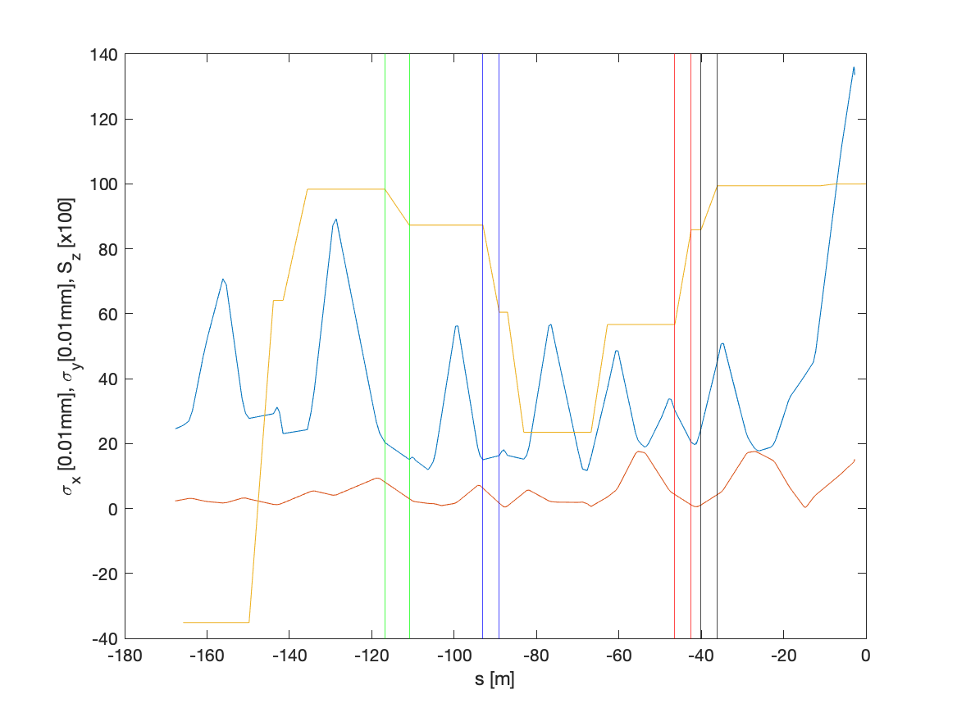
Beam sizes and spin projection in z
Using Yuhao data, https://indico.belle2.org/event/5306/
BLA2LE
BLX2LE.2
BLY1LE.1/2
99% of the IP Sz
85% of the IP Sz
55% of the IP Sz

Slide 4
BLA2LE/BLX2LE.2
Ideal in terms of spin projection on the longitudinal axis:
  99%/85% of the value at IP if interaction before BLA2LE or BLX2LE.2
  Not so busy area
Photon detection
Electron detection
Laser/e-beam interaction point
BLA2LE

Slide 5
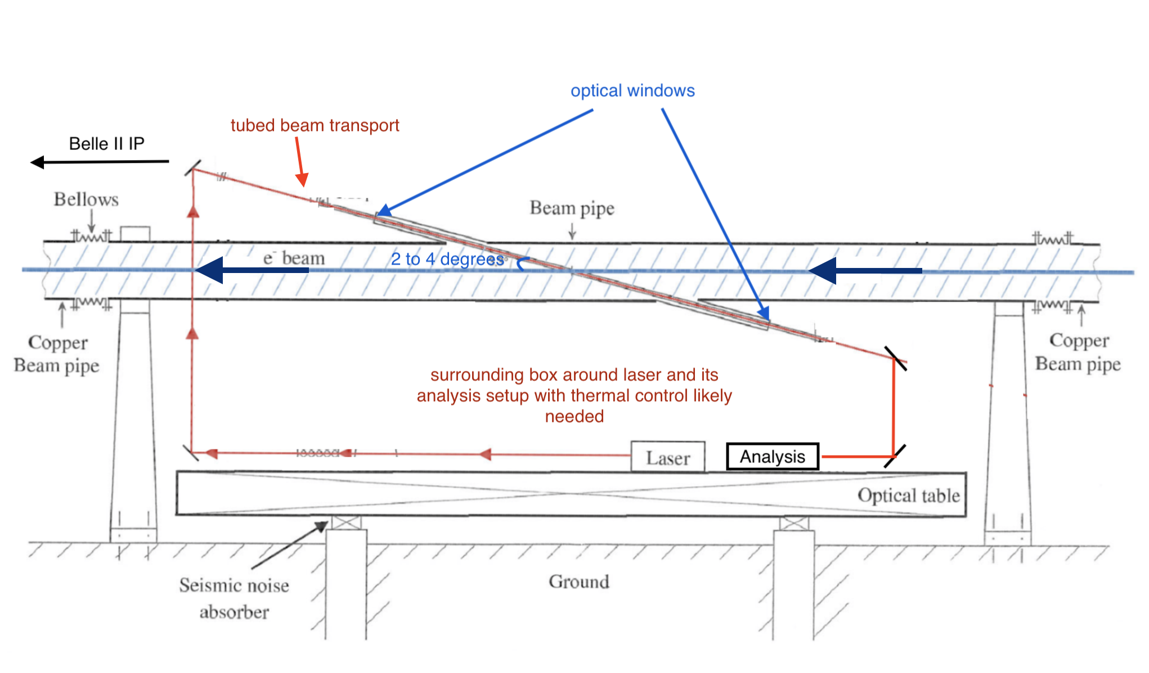
Beam pipe for interaction chamber
Fused silica ?
10mm diameter ?
Assumed vertical crossing.
2m
Influence of beam impedance → see Demin’s presentation

Slide 6
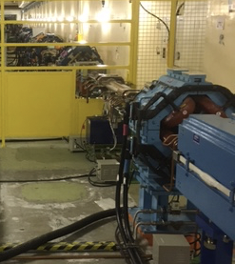
Gamma-beam detector
Magnet modifications are required to let gamma beam go through…
Pumping port on opposite side of SR 1m length every 4mm
Need to have a ~25mm diameter window to let the gamma beam go through on one side (assumed compton IP 12m upstream)
→ Size can be reduced by reducing distance to compton IP
→ Material and thickness to be discussed

Slide 7
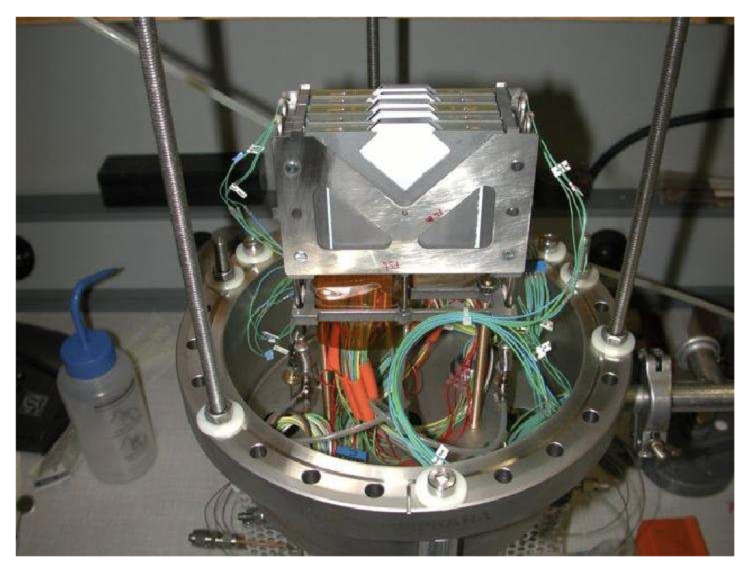
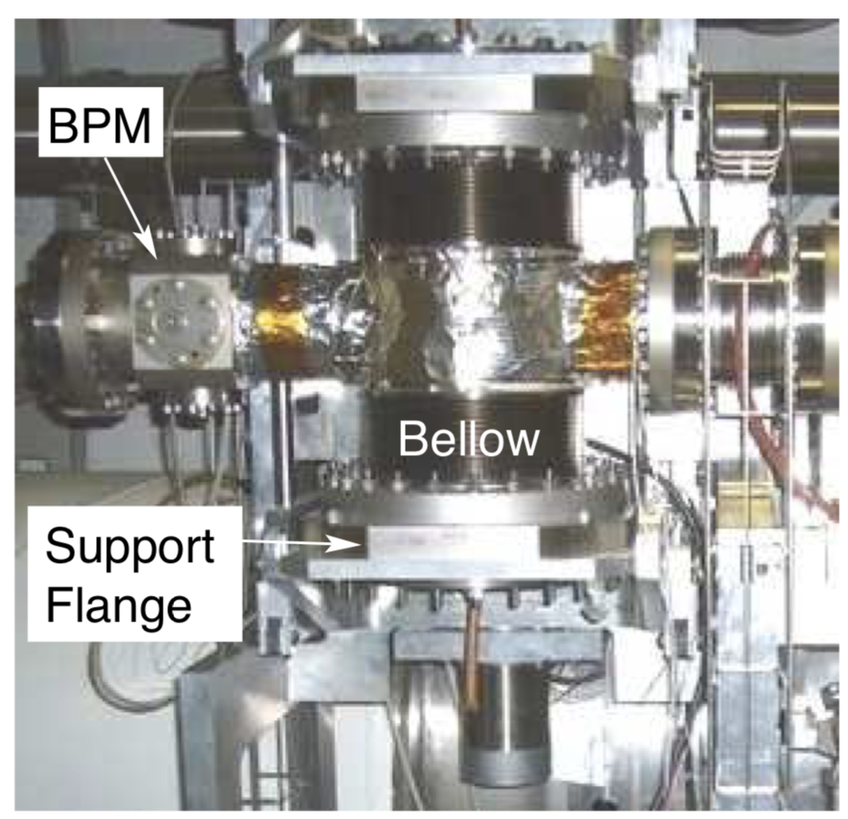
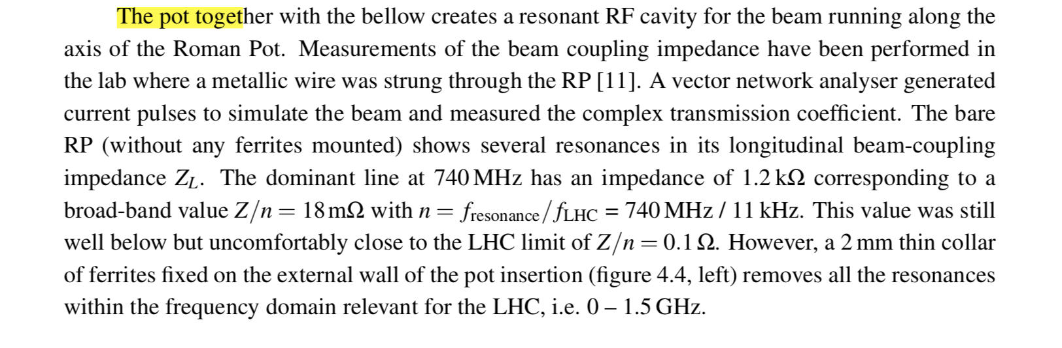
Electron detector location
https://jinst.sissa.it/LHC/TOTEM/ch04.pdf
Need to have a first sketch of the chamber to assess impact on beam impedance

Slide 8
Conclusion
Rough design of laser interaction point need validation in terms of beam impedance (see Demin’s presentation)
Sketch of electron detector chamber required to iterate on design to reduce potential effect on beam impedance
These informations have been updated in the WhiteReport polarimeter document
https://www.overleaf.com/9326578811gbpzcdnprnyv

