Slide 1

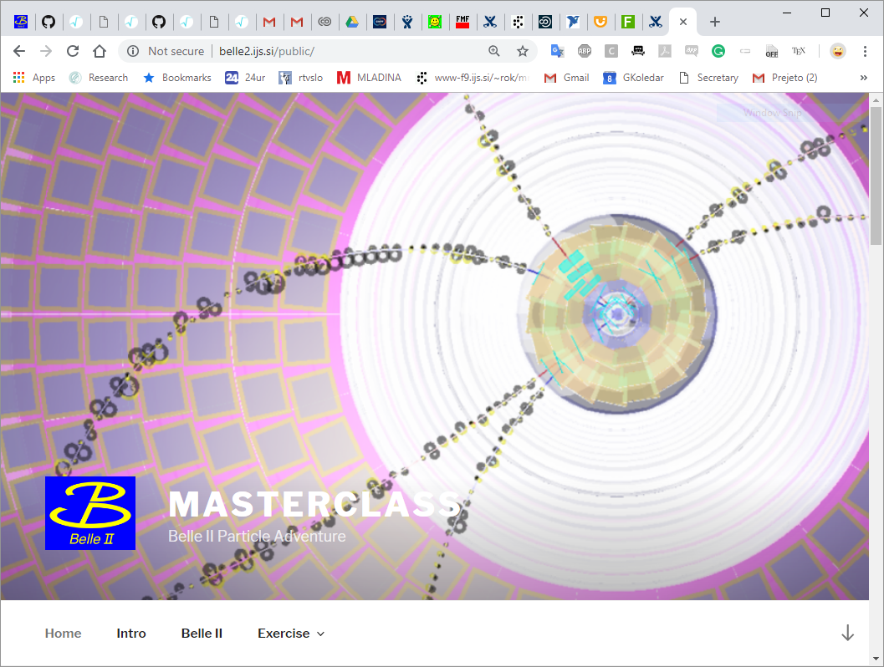
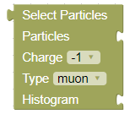
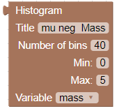
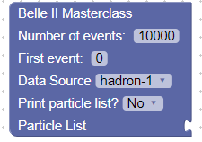
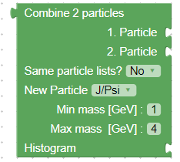

Belle II Masterclass Q&A
Rok Pestotnik, Jožef Stefan Institute, Ljubljana
  IMC Program support - JENIFFER2 project (H2020 MSCA RISE)

Slide 2


BELLE II IMC in 2022
Planned events:
Video conference Times:
Europe : Mar. 7, Mar. 16, Mar. 23
  zoom https://cern.zoom.us/j/62687960708?pwd=dWhPNEtkTy8vVlR5QzZVYVpwb2Zkdz09
Japan: March 2022 – KEK + Nara

Slide 3
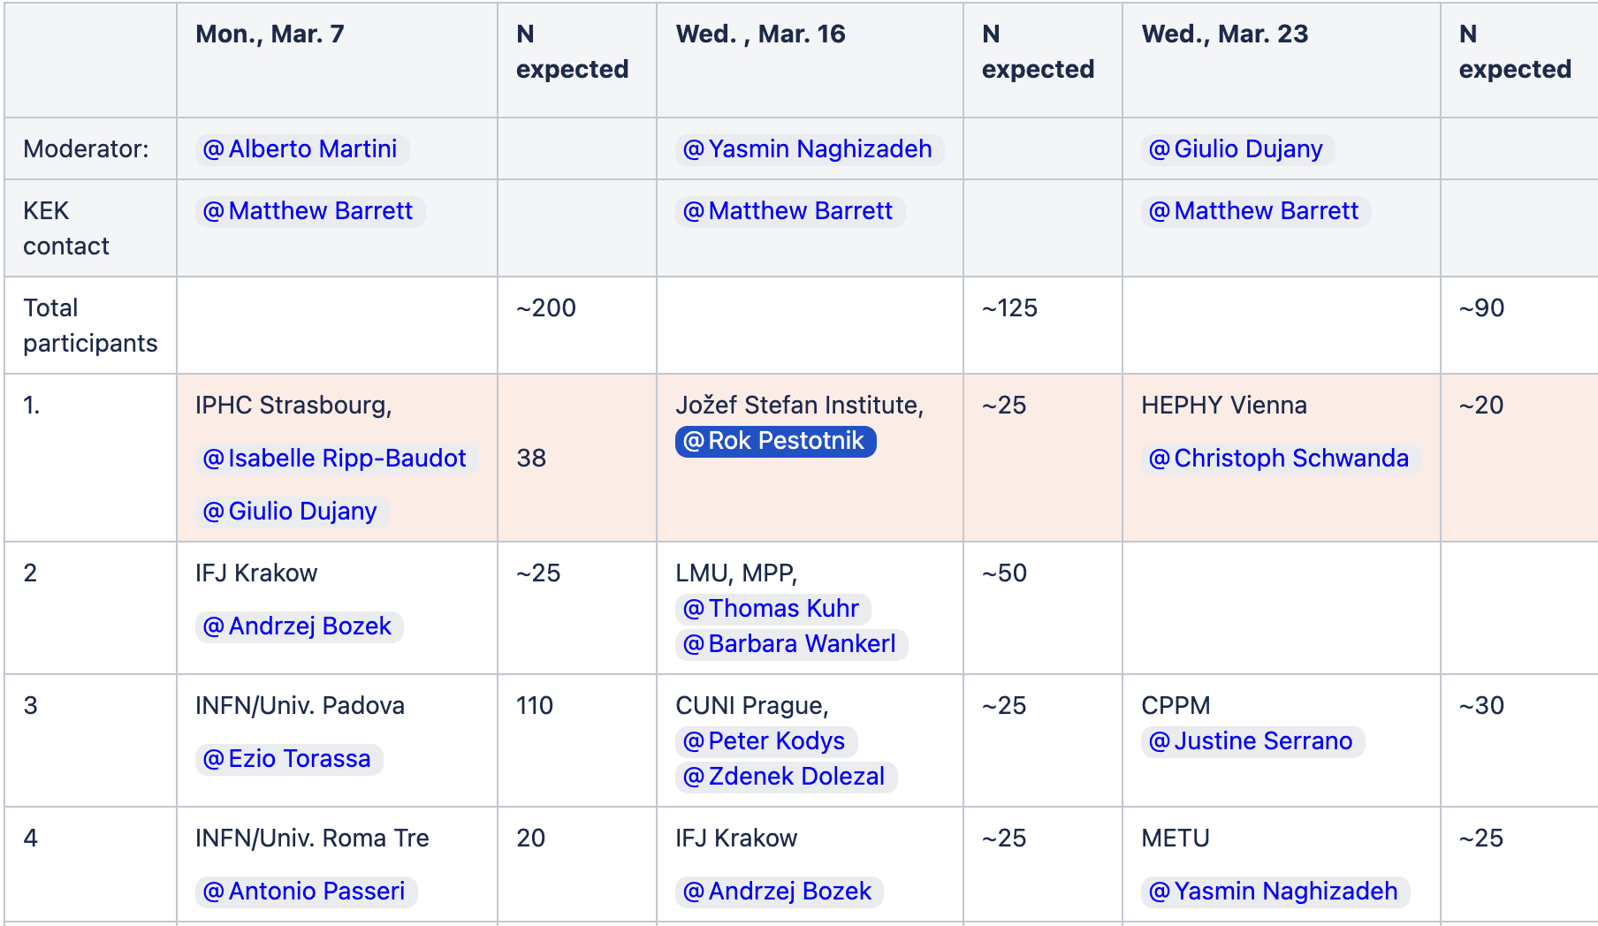
Planned Participation:
https://confluence.desy.de/display/BI/IMC+2022
Online and on-site participation

Slide 4
SUGGESTED event program
Tailor to your needs – common video conference at the end
8:45 | Registration
9:00 - 9:15 | Introduction
9:15 - 10:00 | Physics of elementary particles
10:00 - 10:45 | Experimental methods in high energy physics
10:45 - 11:15 | Belle II Virtual reality
11:15 - 11:45 | Introduction Data Analysis
11:45 - 12:45 | Lunch – meet the HEP researchers
12:45 - 15:00 | Belle Data Analysis + preparation of the presentations
15:00 - 16:00 | Joint Video conference

Slide 5
Photographs aND recordings
General Data Protection Regulation (EU) 2016/679
Give Masterclass participant control over their personal data
Collect permission to take photographs or to record videos and to post them for PR and collaboration use in advance
Post photos of the event in the internal confluence for later Outreach use (social media , etc.)

Slide 6
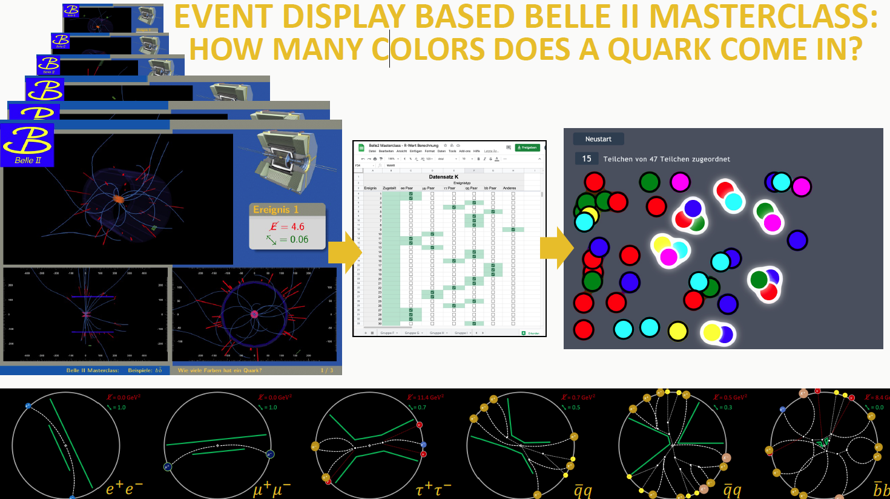
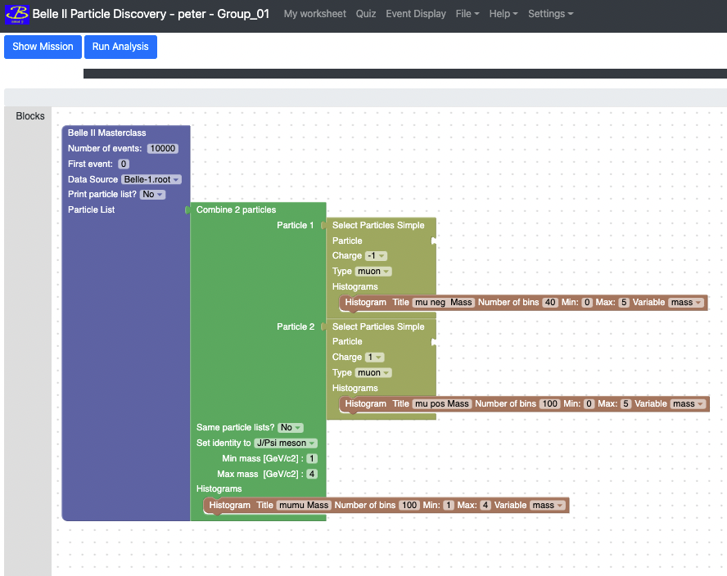
Hands-on exercises
Bonn University
Two measurements available:
  Test before use !
New – basic level: Measure quark colors
  similar to LHC experiments
  https://belle2.ijs.si/public/home/quark-colors/
  Limited sets of events
Standard level: Belle II Lab - Discovery of new particles based on the invariant mass distribution
  analysis of 5 mio. events from Belle and Belle II
  https://belle2.ijs.si/public/home/reconstruct-b-mesons/
Jožef Stefan Institute

Slide 7
Support materials for instructors & TUTORS
Belle II IMC 2022 page:
https://confluence.desy.de/display/BI/IMC+2022
Belle II Masterclass web page : http://masterclass.belle2.org
Organisation section of International Masterclasses web:
https://physicsmasterclasses.org/index.php?cat=local_organisation&page=organisation
IMC Media templates page: http://cern.ch/go/mj8H
Tutorial videos from 2021:
20210212_BelleIIMasterClass-Conference-and-quiz.mp4
20210212_BelleIIMasterClass-Introduction.mp4
BelleIIMasterClass-Demonstration.mp4

Slide 8
JOINT Video conference
Conference moderators & KEK contacts
2min | Opening statement
4x5min | Sites selects one of the results from exercises We hope to have both exercises presented Nominate 2 students for max. 5 min presentation
15 min | Particle quiz
5-10 min | Connection to Belle II control room and talk with the shift crew
10 min | Wrap Up talk
Quiz:
  Questions: asked by moderator (u:tutor, p:gdpr)
  https://belle2.ijs.si/masterclass/admin/quiz.php
  Answers: collected by Voting system https://belle2.ijs.si/masterclass/quiz.php
15 questions -2 categories:
  Science (10x) + Life in Japan (5x)
  Make sure you explain the content in the morning sessions

Slide 9
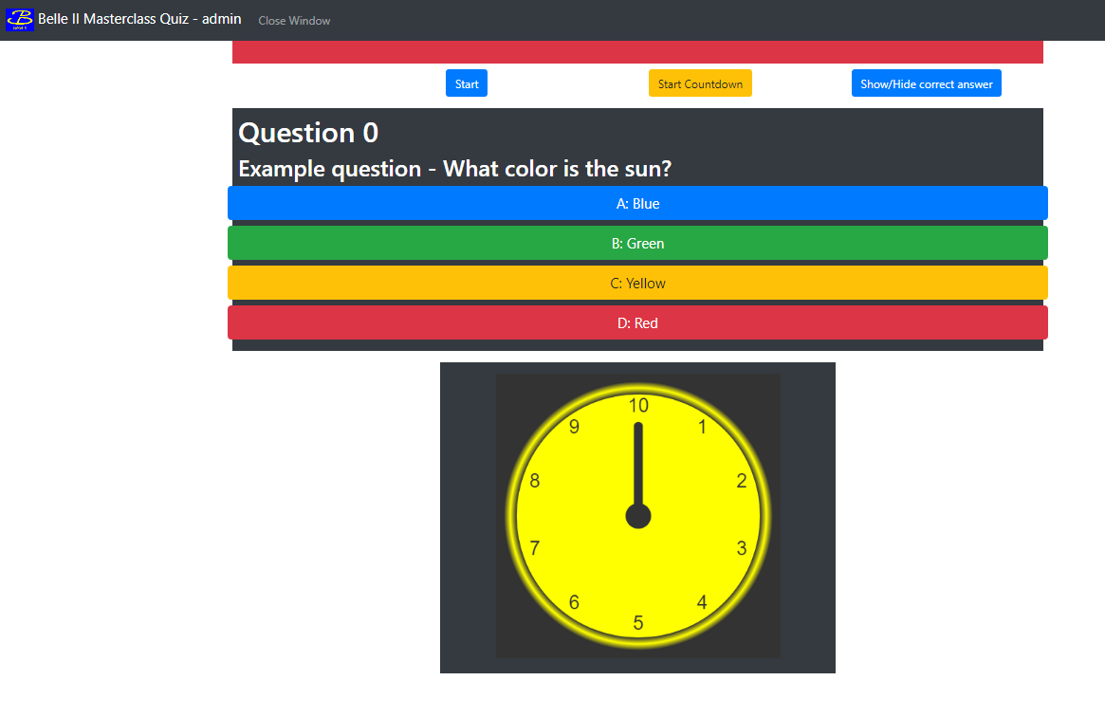
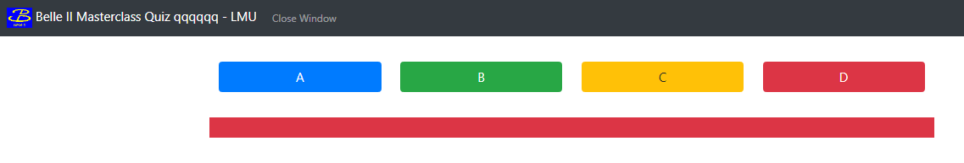
QUIZ
  Questions: asked by moderator - tutor can see them , but cannot enable the voting (u:tutor, p:gdpr)
  https://belle2.ijs.si/masterclass/admin/quiz.php
  Student Voting system https://belle2.ijs.si/masterclass/quiz.php
Moderator asks the question
Moderator starts the countdown timer and enables the voting system
Participants vote: after vote submission, they cannot vote for 15 seconds
Moderator checks the answer statistics
Moderator shows the correct answer

Slide 10
Questions

