Slide 1
New Physics Belle II Through CP Violation
David Atwood
Iowa State University

Slide 2
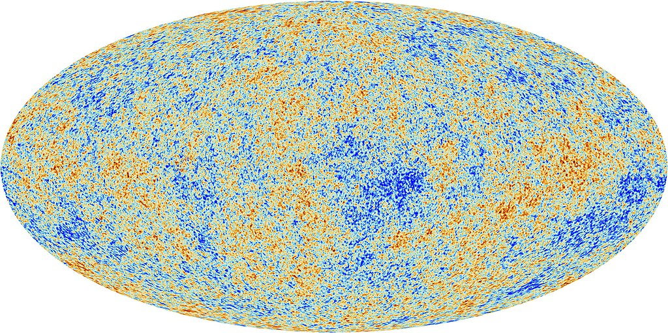

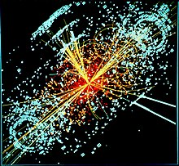
Why New Physics?
The Standard Model cannot be the complete story of fundamental physics because:
  Dark Matter
  Strong cosmological evidence for DM
  We don’t know what it is
  Baryon Asymmetry of the universe
  We see mater out there
  But almost no antimatter
  Hierarchy Problem
Higgs mass is unstable if there is no new physics by ~10TeV

Slide 3
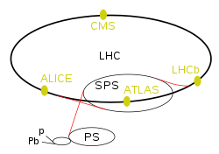
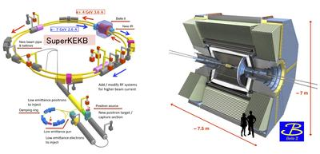
Frontiers
How do you get to the bottom of the fundamental laws of physics
  The obvious approach: go to higher energy and try to produce BSM particles directly:
  Energy Frontier
  (LHC)
  The subtle approach: Look for subtle effects of NP at low energy:
  The Intensity Frontier
  (BELLE II; LHCb)
Also Neutrino physics

Slide 4
Intensity Frontier.
B factories are uniquely able to look for NP because:
  The weak decay of b-quarks is suppressed because V_{cb} is <1
  Suppressed decays, perhaps involving NP is therefore more evident
  We do, however, need to produce a lot of B mesons to take advantage of this.
  Electron Positron B factories (i.e. Belle) are uniquely clean in that many final states may be reconstructed without overwhelming background allowing more channels to potentially look at.

Slide 5
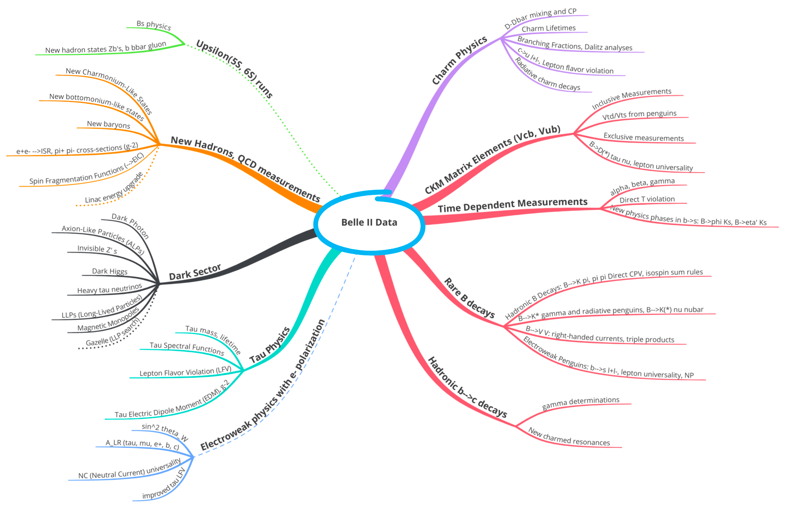
Mapping out Physics and signals
The Belle Physics book (PTEP 2019, 123C01 (2019)) contains a comprehensive list of possible new physics signals to be addressed at BELLE II which is nicely illustrated with the “Mind Map”.
In this talk I would like to stack things up a little differently and then focus on a few of the connections which may be productive (and are interesting to me)… I do suggest everyone read all 600 pages of the physics book

Slide 6

Threading from NP to Experimental Observables
Fundamental NP Model
SUSY
Extended Higgs sector
Vector like fermions
LR Symmetric models
Technicolor
Large Extra Dimensions
Extended Gauge groups
…and many more
Salient Feature
Z’
W’
Charged Scalars
Neutral Scalars
leptoquarks
Extra Fermions
Axions
These objects can be
- Produced explicitly
Appear in tree diagrams
Appear in loop diagrams (Wilson coefs.)
Type of observable
Missing Energy (low mass dark particle)
CP violation
–direct
–time dependent
Tauonic decays
$B→τν$
$B→X_{c}τν$
Precision CKM
b$→$sγ & b$→$s $l^{+}$ $l^{−}$
Rare hadronic B decays
b$→$ γ [γ γ]
Tau physics
Charm physics

Slide 7
CP Violation
Why is CP violation Interesting?
It is small in the SM (but not zero so there is something to see)
  So in B physics we are looking for a small effect in a meson with unusually suppressed decay rates.
  “Small in SM” gives an NP opportunity to shine through
It is almost certain that large CP violation exists at high energy and most likely at the TeV scale
The goal of CP studies at B factories are twofold:
  Refine our knowledge of the CKM matrix so that we know what the SM prediction is (or better yet find a inconsistency)
  Look for deviations from the SM.

Slide 8
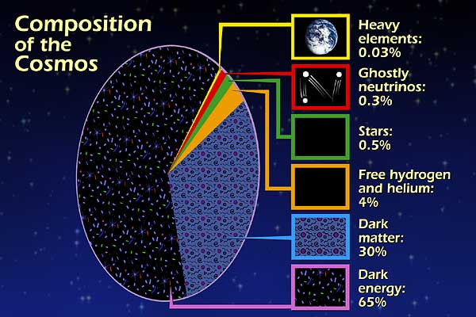
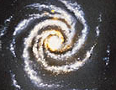
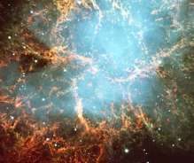
Energy budget of Universe
Dark
Energy:
~70%
Dark
Matter:
~25%
Antimatter: 0%
~25%
~70%

Slide 9
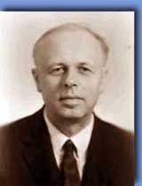
How do we know large CP violation is a feature of BSM Physics?
As a general feature, most NP models allow large CP violation baryogensis actually requires it.
Soon after the discovery of CP violation in the Laboratory in 1964, Andrei Sakharov proved in 1967 that some form of CP violation was essential for baryogenesis
Sakharov Theorem
If CPT is true and the universe is created with 0 baryon number, in order to have baryogenesis in the early universe, the following 3 conditions must be satisfied:
  Baryon Number is violated
    clearly needed to have excess baryons.
  CP is violated
    Need to tell the baryon violation which way to go otherwise baryon number will be erased
  The system must depart from thermal equilibrium

Slide 10
Baryogenesis Near EW Transition
Sakharov #1 Baryon Number is violated
  OK in SM High temperature Electroweak processes should violate baryon number
  In fact any previous baryon asymmetry may be erased absent the other two conditions (unless B-L is violated).
Sakharov #2 CP is violated
  CP violation is present in the SM
  However this CP violation is too weak to do the job
Sakharov #3 The system must depart from thermal equilibrium
  Phase transition is expected
  However strong first order phase transition needed in realistic models does not arise in bare SM
To get baryogenesis in the Electroweak era, new physics at the electroweak scale (we can hope to see it in our lifetime) is required.
In addition, new physics must violate CP substantially.

Slide 11
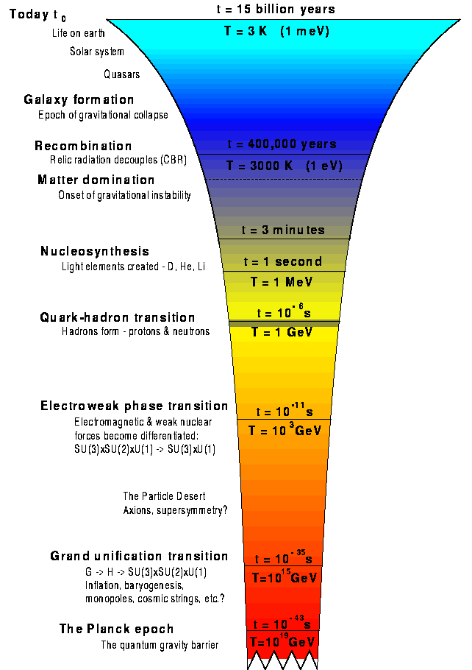
Astronomy
The farthest we can see EM radiation
with WMAP
Low Energy Nuclear Physics
QGP: High Energy Nuclear physics
W Z Fermions
massive
EW phase transition
W Z Fermions
massless
Leptogenesis via
Majorana Neutrino mass
converts to baryons via SM
⇒violation of B-L
GUT baryogen.

Slide 12
Baryogenesis near the bubble wall
Because CP is violated in the wall of the bubble
it can reflect right handed fermions and antifermions
more strongly.
t_{L}
Baryon number violation is CP
conserving so (for instance) it destroys t_{L}
at the same rate as t_{R}. Combined with the
helicity buildup you get net baryon
production
t_{L}
t_{R}
t_{R}
Broken Low
Temperature
Phase
What Happens at the Wall?
If there is CP violation in the Higgs sector then the phase will evolve through the bubble wall.
High Temperature
phase:
Baryon # Violation
occurs out here
Cohen Kaplan Nelson (94)

Slide 13
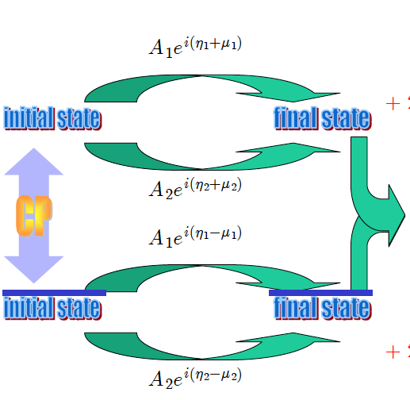
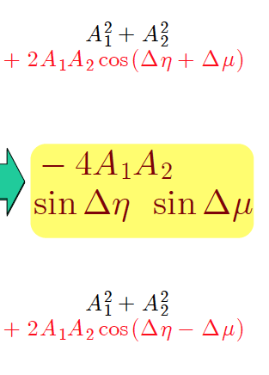


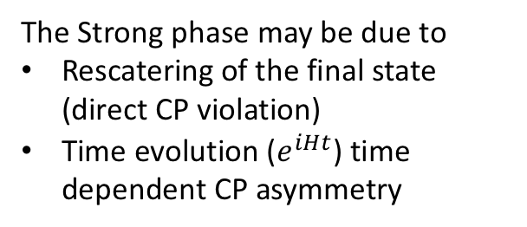
CP Violating Observables
The Strong phase may be due to
Rescatering of the final state (direct CP violation)
Time evolution ($e^{iHt}$) time dependent CP asymmetry

Slide 14
Source of Strong Phase
To produce a CP violating signal, we need Δη, the strong phase.
  Time Evolution
  Rescattering
f
B
B
a
B⁺
phase
f
b

Slide 15


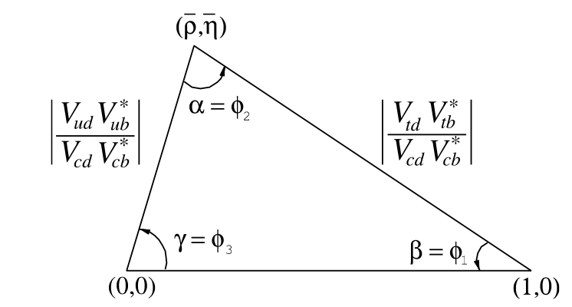

Gold Plated
CP violation in Oscillation to get CKM Phases
The CKM Matrix in the Wolfenstein Parameterization is
To lowest order $V_{ub}∝e^{−iφ_{3}}$ and $V_{td}∝e^{−iφ_{1}}$
Only the 1-3 elements have a phase
V_{CKM}=
=
U triangle: take first col and
third col conjugate multiply
them together they will sum
to 0 if CKM matrix is unitary

Slide 16
Status of CKM Matrix
CKM Fitter Plots form Moriond 2021

Slide 17
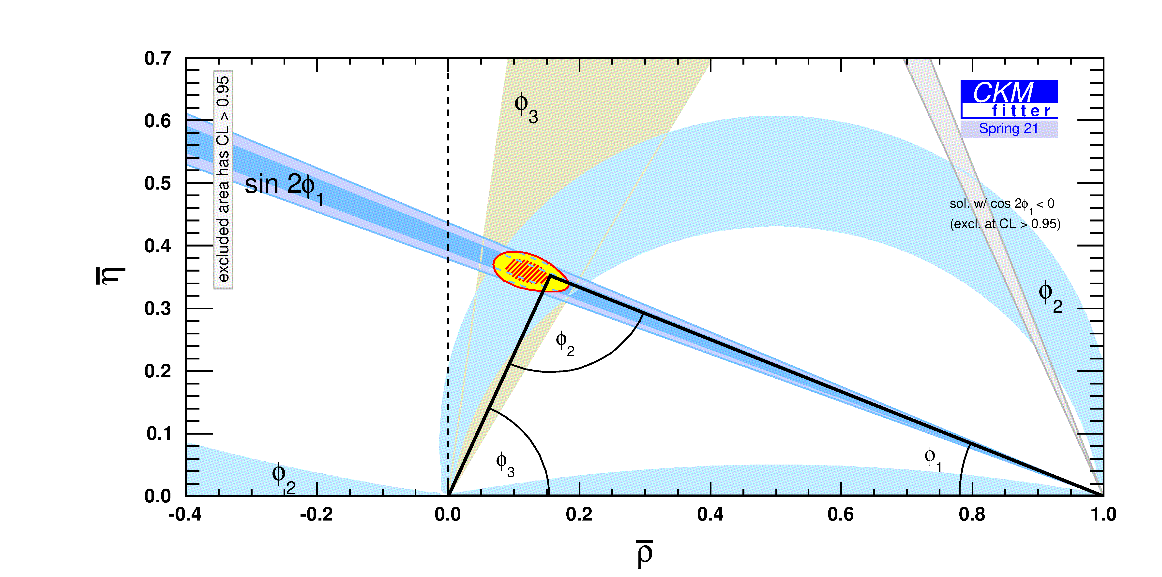
In Fact, just from CP studies

Slide 18
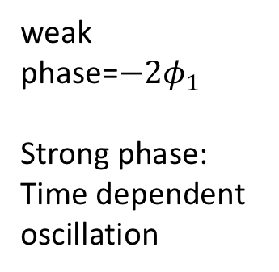

Applied to the gold plated $B→ψK_{s}$
Path 1
Path 2
weak phase=$−2φ_{1}$
Strong phase: Time dependent oscillation
No weak phase
No strong phase

Slide 19
The experiment you do
At B factories running at the 4S, the B meson pair is produced with little relative motion but moving in the lab due to asymmetric beams
The time dependence of the decay can thus be observed by looking at the relative position of the decay vertices
Of course many other similar modes are sensitive to the same CKM angle
Some other modes such as are sensitive to the same angle in the SM but proceed through gluonic penguins and therefore could be sensitive to NP which might be revealed by BELLE II.
Tag Decay

Slide 20
Gluonic Penguin
Phase the same as the
Previous case
But inside the penguin there
could be exotic particles bringing
in some NP CP phases

Slide 21
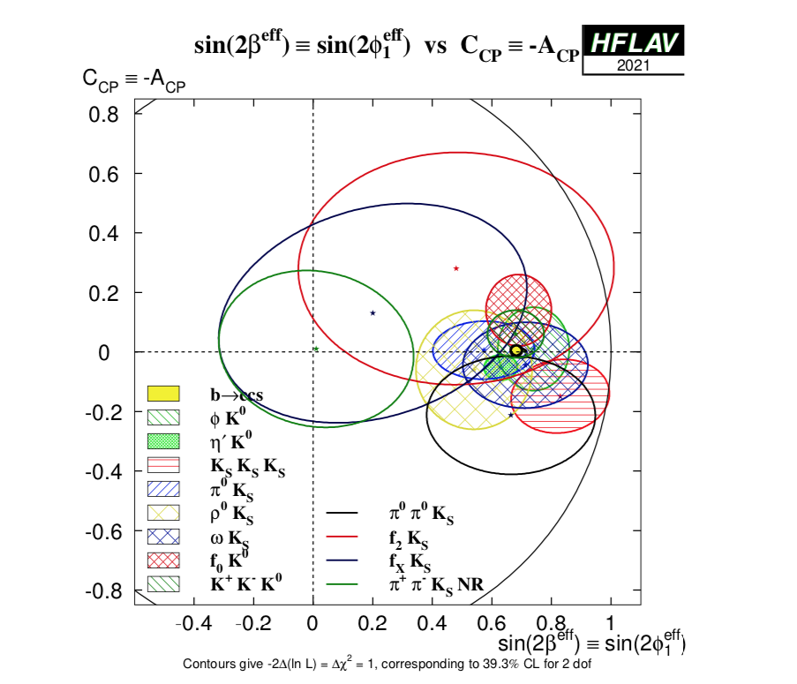

Gluonic $b→s$ Penguins Results so far
From HFLAG arXiv:2206.07501

Slide 22
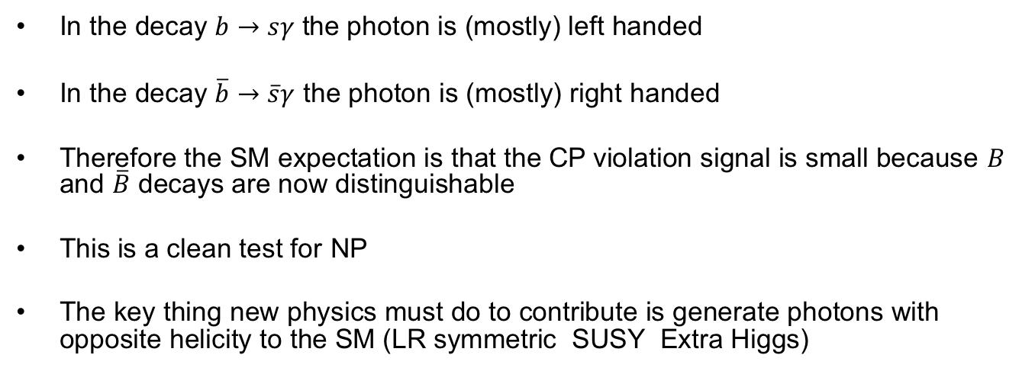
How about Photonic Penguins?
In the decay $b→sγ$ the photon is (mostly) left handed
In the decay $\overline{b}→\overline{s}γ$ the photon is (mostly) right handed
Therefore the SM expectation is that the CP violation signal is small because $B$ and $\overline{B}$ decays are now distinguishable
This is a clean test for NP
The key thing new physics must do to contribute is generate photons with opposite helicity to the SM (LR symmetric SUSY Extra Higgs)
deviation ∝ m_{s}/m_{b} and λ
DA, Gershon, Hazumi, Soni PRD 71, 076003 (2005)

Slide 23
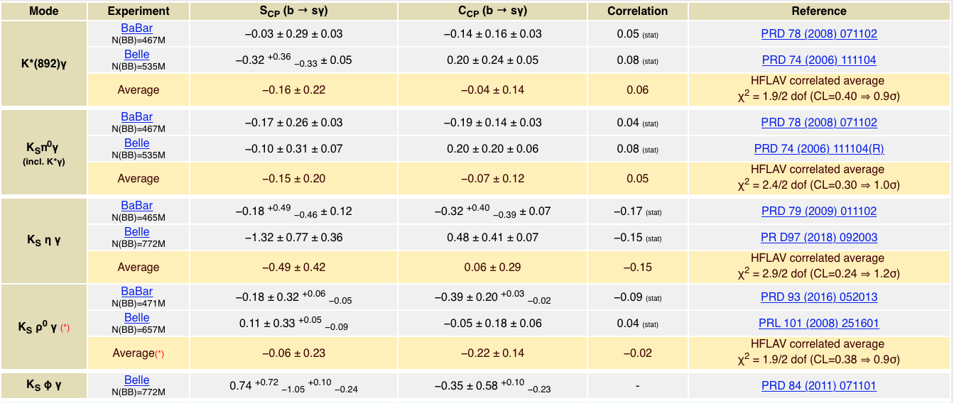
Such NP has not been discovered yet…
No signal is seen in this and related modes so far
From HFLAG arXiv:2206.07501

Slide 24
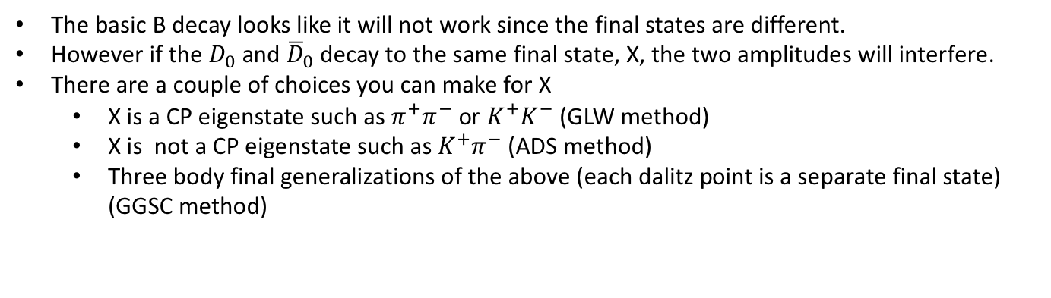
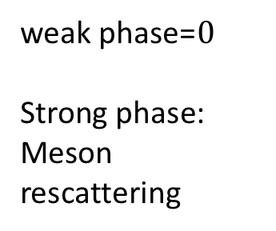
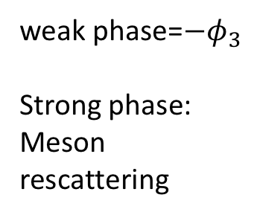

Time independent CP Violation to determine $φ_{3}$
-
K
u
o
X
o
-
s
D
D
s
K
c
c
u
u
weak phase=$0$
Strong phase:
Meson rescattering
u
W
-$φ_{3}$
W
weak phase=$−φ_{3}$
Strong phase:
Meson rescattering
u
b
u
b
-
-
B
B
The basic B decay looks like it will not work since the final states are different.
However if the $D_{0}$ and ${\overline{D}}_{0}$decay to the same final state, X, the two amplitudes will interfere.
There are a couple of choices you can make for X
  X is a CP eigenstate such as $π^{+}π^{−}$ or $K^{+}K^{−}$ (GLW method)
  X is not a CP eigenstate such as $K^{+}π^{−}$ (ADS method)
  Three body final generalizations of the above (each dalitz point is a separate final state) (GGSC method)
Gronau, Wyler Phys.Lett.B 265 (1991); Gronau London Phys.Lett.B 253 (1991); DA, Dunietz Soni PRL 78 3257 (97); Giri et al PRD68, 054018 (2003); Grossman et. al PRD67, 071301 (2003).

Slide 25
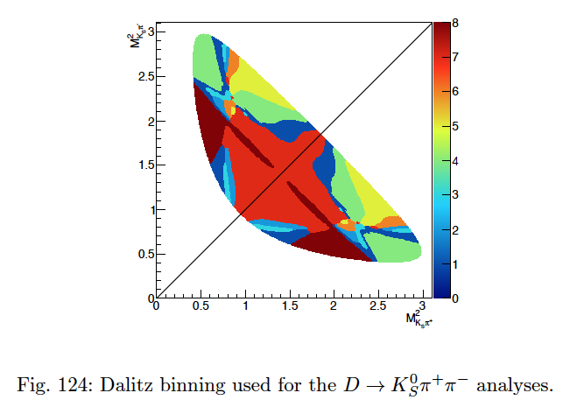
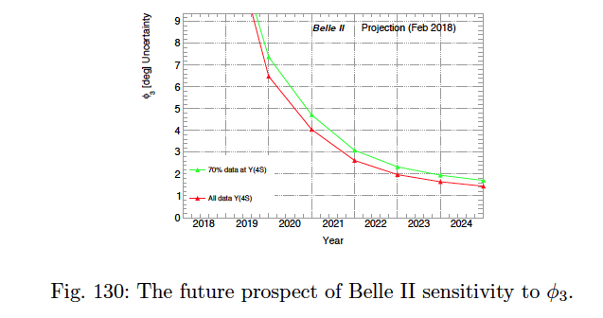

Prospect for $φ_{3}$
Belle Physics book
Belle Physics book
Gold plated mode for Belle II is thought to be $D→K_{s}π^{+}π^{−}$ with Dalitz binning

Slide 26
Conclusions
There must be physics beyond the SM; energy or intensity frontiers are where to look for it.
There are a multitude of signals to look for at B factories
CP violation is promising because we know there must be CP violation beyond the SM
CP violating observables can either be time dependent or time independent depending on the source of the strong phase.
Particular signals either check CKM unitarity directly or are sensitive to non-SM CP violation. BELLE II should allow meaningful probing of many such modes.

