Slide 1
Measuring Quark Polarization Dependent Di-Hadron Fragmentation Functions at Belle II
KATHERINE PARHAM
Graduate Research
Fellowship Program

Slide 2
FRAGMENTATION FUNCTIONS
INTRODUCTION
1
We want to know how quark properties lead to larger scale effects like hadron distribution and polarization.

Slide 3
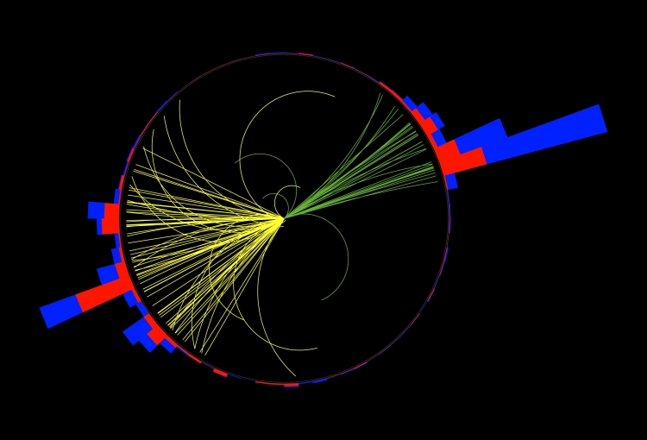
FRAGMENTATION FUNCTIONS
INTRODUCTION
1
We want to know how quark properties lead to larger scale effects like hadron distribution and polarization.
Jet: a collimated bunch of colorless,
bound hadronic states

Slide 4
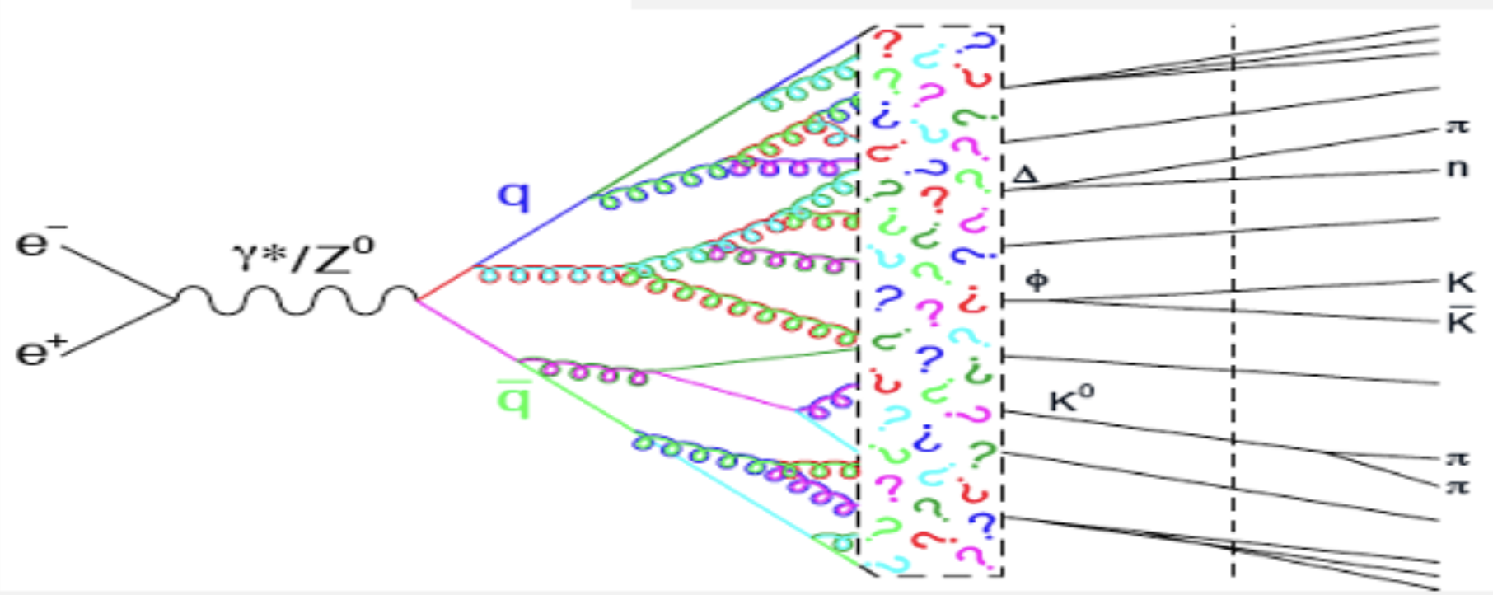
FRAGMENTATION FUNCTIONS
INTRODUCTION
2
Hadronization: the process by which a parton produces a jet

Slide 5
FRAGMENTATION FUNCTIONS
INTRODUCTION
2
Hadronization: the process by which a parton produces a jet
Fragmentation functions (FF): describe how color carrying quarks fragment into color neutral hadrons

Slide 6
FRAGMENTATION FUNCTIONS
INTRODUCTION
3
Parton Distribution Functions (PDF): probability densities for finding a quark or gluon with a particular momentum in a color neutral hadron

Slide 7
FRAGMENTATION FUNCTIONS
INTRODUCTION
5
Fragmentation functions and parton distribution functions are universal functions and fundamental QCD objects.
They are non-perturbative, so they cannot be calculated in QCD and (in most cases) must be determined experimentally.
Electron-positron experiments offer the cleanest environments in which to measure fragmentation functions.

Slide 8
FRAGMENTATION FUNCTIONS
FACTORIZATION
6
Scattering amplitudes can be factorized into a perturbatively calculable part, $\hat{σ}$, and a non-perturbatively calculable part:
Single-inclusive annihilation:
$$σ^{e^{+}e^{−}→hX}= \hat{σ} ⨂ FF$$
Semi-inclusive deep inelastic scattering:
$$σ^{ℓN→ℓhX}= \hat{σ} ⨂ PDF ⨂ FF$$
Single-inclusive proton-proton scattering:
$$σ^{pp→hX}= \hat{σ} ⨂ PDF ⨂ PDF ⨂ FF$$
Notes:
This is only the leading contribution!!

Slide 9
FRAGMENTATION FUNCTIONS
FACTORIZATION
6
Scattering amplitudes can be factorized into a perturbatively calculable part, $\hat{σ}$, and a non-perturbatively calculable part:
Single-inclusive annihilation:
$$σ^{e^{+}e^{−}→hX}= \hat{σ} ⨂ FF$$
Semi-inclusive deep inelastic scattering:
$$σ^{ℓN→ℓhX}= \hat{σ} ⨂ PDF ⨂ FF$$
Single-inclusive proton-proton scattering:
$$σ^{pp→hX}= \hat{σ} ⨂ PDF ⨂ PDF ⨂ FF$$

Slide 10
FRAGMENTATION FUNCTIONS
FACTORIZATION
6
Scattering amplitudes can be factorized into a perturbatively calculable part, $\hat{σ}$, and a non-perturbatively calculable part:
Single-inclusive annihilation:
$$σ^{e^{+}e^{−}→hX}= \hat{σ} ⨂ FF$$
Semi-inclusive deep inelastic scattering:
$$σ^{ℓN→ℓhX}= \hat{σ} ⨂ PDF ⨂ FF$$
Single-inclusive proton-proton scattering:
$$σ^{pp→hX}= \hat{σ} ⨂ PDF ⨂ PDF ⨂ FF$$

Slide 11
FRAGMENTATION FUNCTIONS
QUARK POLARIZATION DEPENDENT DI-HADRON FF
7
The ${\text{H}}_{1}^{∢}$ FF is dependent on the polarization of the parent quark and produces a pair of spin-0 hadrons.
${\text{H}}_{1}^{∢}$ observable:
Conservation of angular momentum leads to left and right asymmetry
The spin correlation between a quark-antiquark pair leads
to a correlation between the azimuthal
angle of the di-hadron pairs it produces
The amplitude of the resulting
asymmetry in the azimuthal angle is
directly proportional to ${\text{H}}_{1}^{∢}\overline{{\text{H}}_{1}^{∢}}$
𝛑+
𝛑-

Slide 12
${\text{H}}_{1}^{∢}$ EXTRACTION
AZIMUTHAL ANGLE MEASUREMENT
8
EVENT CUTS
e⁻
Number of hits in the CDC > 20
Particles originate from the e⁺ e⁻ collision point
dr < 2cm
|dz| < 4 cm
Visible energy is between 7 GeV and 12 GeV
$$\hat{z}$$
e⁺
Notes:
dr = transverse distance with respect to the interaction point
dz = z coordinate point of closest approach with respect to the interaction point

Slide 13
${\text{H}}_{1}^{∢}$ EXTRACTION
AZIMUTHAL ANGLE MEASUREMENT
9
THRUST
$$\overline{\text{q}}$$
e⁻
$$T= \max_{|\hat{n}|=1}\left[\frac{\sum_{i}{|{\vec{p}}_{i}∙\hat{n}|}}{\sum_{i}{|{\vec{p}}_{i}|}}\right]$$
In a perfectly di-jet event, $T$ = 1.0
In a perfectly spherical event $T$ = 0.5
The thrust axis, $\hat{n}$, is a good approximation of the q$\overline{\text{q}}$ axis when thrust is close to 1.0
e⁺
q
Thrust Axis
Notes:
Thrust is an event shape variable

Slide 14
${\text{H}}_{1}^{∢}$ EXTRACTION
AZIMUTHAL ANGLE MEASUREMENT
10
THRUST CUTS
e⁻
Thrust > 0.8
|$\hat{z}$ of the thrust axis| > 0.75
e⁺
Thrust Axis

Slide 15
${\text{H}}_{1}^{∢}$ EXTRACTION
AZIMUTHAL ANGLE MEASUREMENT
11
PION CUTS
Transverse momentum > 0.1 GeV/c
Full Belle II barrel acceptance
cosine between pion momenta and the beam axis > -0.79
cosine between pion momenta and the beam axis < 0.74
|cosine between pion momenta and thrust axis| > 0.8
Carries at least 10% of the total event energy
pionID > 0.7
e⁻
$${\vec{p}}_{π^{+}}$$
e⁺
$${\vec{p}}_{π^{−}}$$
$${\vec{p}}_{π^{+}}+ {\vec{p}}_{π^{−}}$$
Thrust Axis

Slide 16
${\text{H}}_{1}^{∢}$ EXTRACTION
AZIMUTHAL ANGLE MEASUREMENT
12
e⁻
$${\vec{p}}_{π^{+}}$$
e⁺
$${\vec{p}}_{π^{−}}$$
$${\vec{p}}_{π^{+}}+ {\vec{p}}_{π^{−}}$$
Thrust Axis

Slide 17
${\text{H}}_{1}^{∢}$ EXTRACTION
AZIMUTHAL ANGLE MEASUREMENT
13
ANGLE CALCULATION
$$φ_{2} − π$$
e⁻
$$φ_{1, 2}=sgn\left[\hat{n}∙\left\{\left(\hat{z} ×\hat{ n}\right) × \left(\hat{n} × P_{h1, 2}\right)\right\}\right]$$
$× arccos\left(\frac{\hat{z} × \hat{n}}{|\hat{z} × \hat{n}|}∙\frac{\hat{n} × P_{h1, 2}}{|\hat{n} × P_{h1, 2}|}\right)$
$${\vec{p}}_{π^{+}}$$
e⁺
$${\vec{p}}_{π^{−}}$$
$${\vec{p}}_{π^{+}}+ {\vec{p}}_{π^{−}}$$
$$π − φ_{1}$$
Thrust Axis

Slide 18
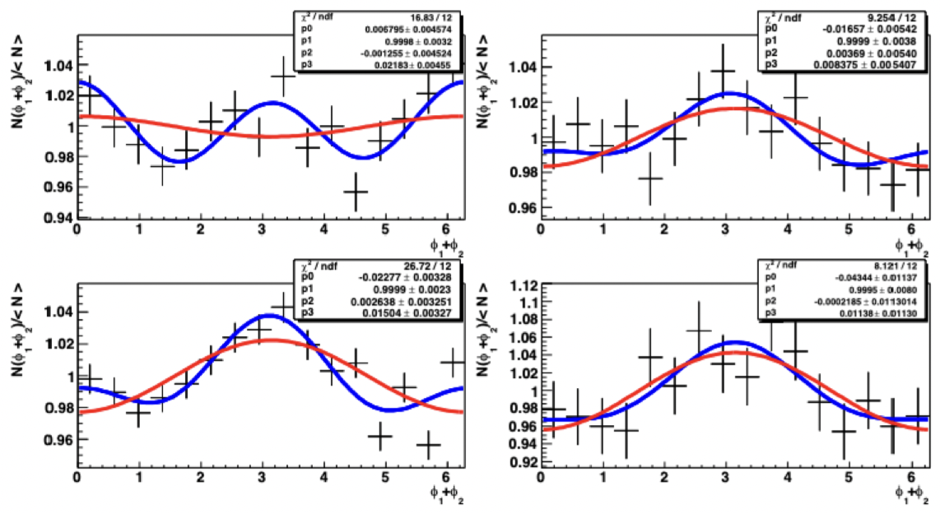
${\text{H}}_{1}^{∢}$ EXTRACTION
BELLE RESULTS
14
Extracting the asymmetry (p₀) from the azimuthal angle:
Azimuthal Angle:$φ_{1}+ φ_{2}$
Histogram Fits:
$$p_{0}\cos\left(φ_{1}+ φ_{2}\right)+1$$
$$p_{0}\cos\left(φ_{1}+ φ_{2}\right)+p_{1}+p_{2}\sin\left(φ_{1}+ φ_{2}\right)+p_{3} cos⁡(2\left(φ_{1}+ φ_{2}\right))$$
Phys. Rev. Lett. 107, 072004 (2011).

Slide 19
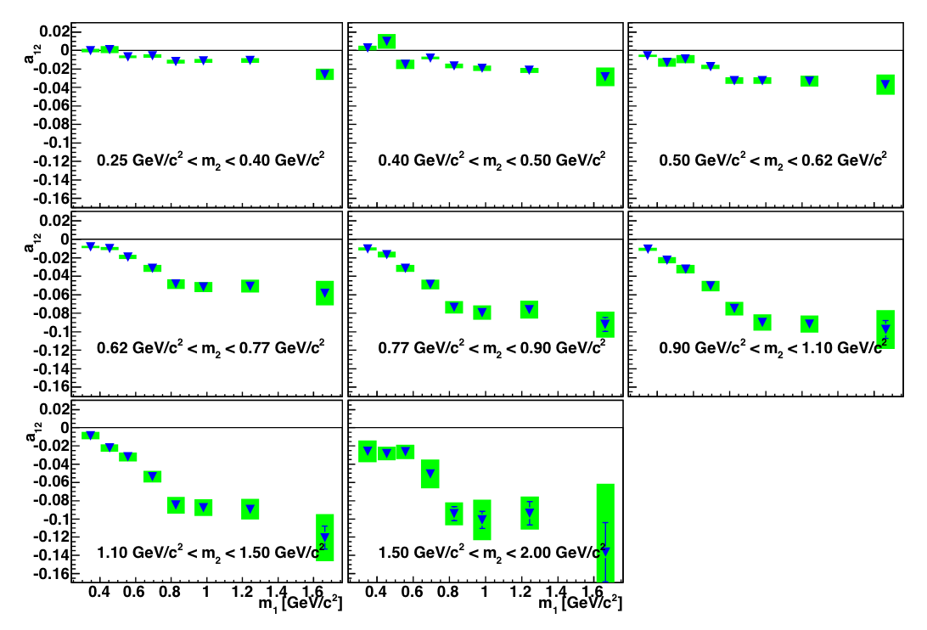
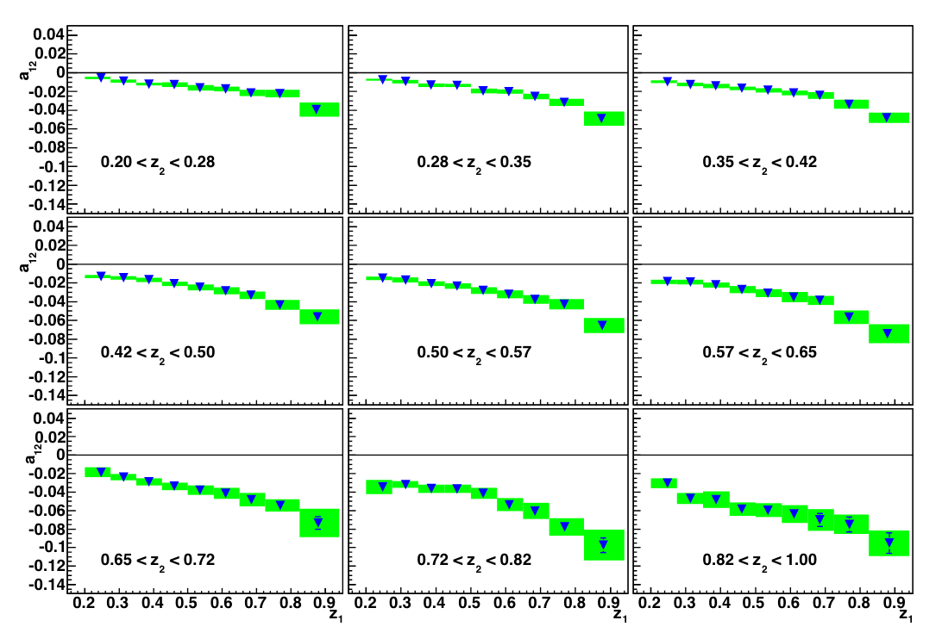
${\text{H}}_{1}^{∢}$ EXTRACTION
BELLE RESULTS
15
Asymmetry by Invariant Mass Bins:
Asymmetry by Pion Fractional Energy Bins:
Phys. Rev. Lett. 107, 072004 (2011).

Slide 20
${\text{H}}_{1}^{∢}$ EXTRACTION
USING JET ALGORITHMS
16
JET AXES
e⁻
Jets are well defined observables and produce better results than the naïve q$\overline{\text{q}}$ axis.
Resulting FFs in e⁺e⁻ are directly connected to FFs in SIDIS
Jet analysis of FFs has been done at Belle before (arXiv: 1505.08020)
e⁺
Jet Axes
Notes:
de-correlated axes leads to one fewer systematic error source

Slide 21
FUTURE RESEARCH
KAON INCLUSIVE MEASUREMENTS
17
The same measurement of ${\text{H}}_{1}^{∢}$ can be made with K⁺ K⁻, K⁺ π⁻, or π⁺ K⁻ pairs
Kaon inclusive measurements are sensitive to the strange quark
Resulting ${\text{H}}_{1}^{∢}$ measurements could be used to describe the distribution of strange quarks within the nucleon
u
u
u
d
d
s
Energy
s
Energy
u
d
u
d
d
u
u
u

Slide 22
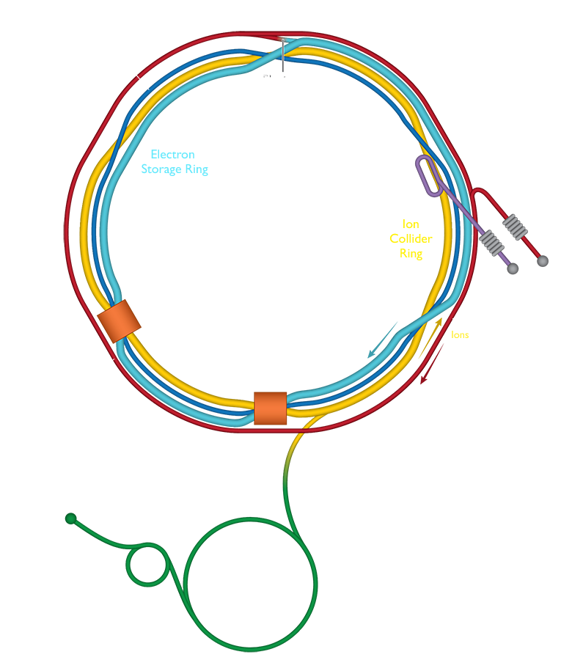
CONTRIBUTION TO THE FIELD
NUCLEON STRUCTURE
18
The EIC will be built using the components and space
left by the Relativistic Heavy Ion Collider (RHIC) at
Brookhaven National Lab
It will be the first polarized electron-proton collider
It will be uniquely suited to measure the
contributions of quarks and gluons to the proton spin
Because the EIC is a deep inelastic scattering
experiment, light quark fragmentation functions are
critical to unlocking its full science potential

Slide 23
SUMMARY
19
Fragmentation functions:
Fundamental QCD objects
Describe the hadronization process
Necessary to study nucleon structure
Electron positron annihilation provides the cleanest environment to study FFs
New measurement of ${\text{H}}_{1}^{∢}$
Sensitive to the strange quark
With respect to the jet axis
New measurements are critical to upcoming experiments at JLab and the EIC

Slide 24
This material is based upon work supported by the National Science Foundation Graduate Research Fellowship Program under Grant No. 2139754. Any opinions, findings, and conclusions or recommendations expressed in this material are those of the author and do not necessarily reflect the views of the National Science Foundation.

Slide 26
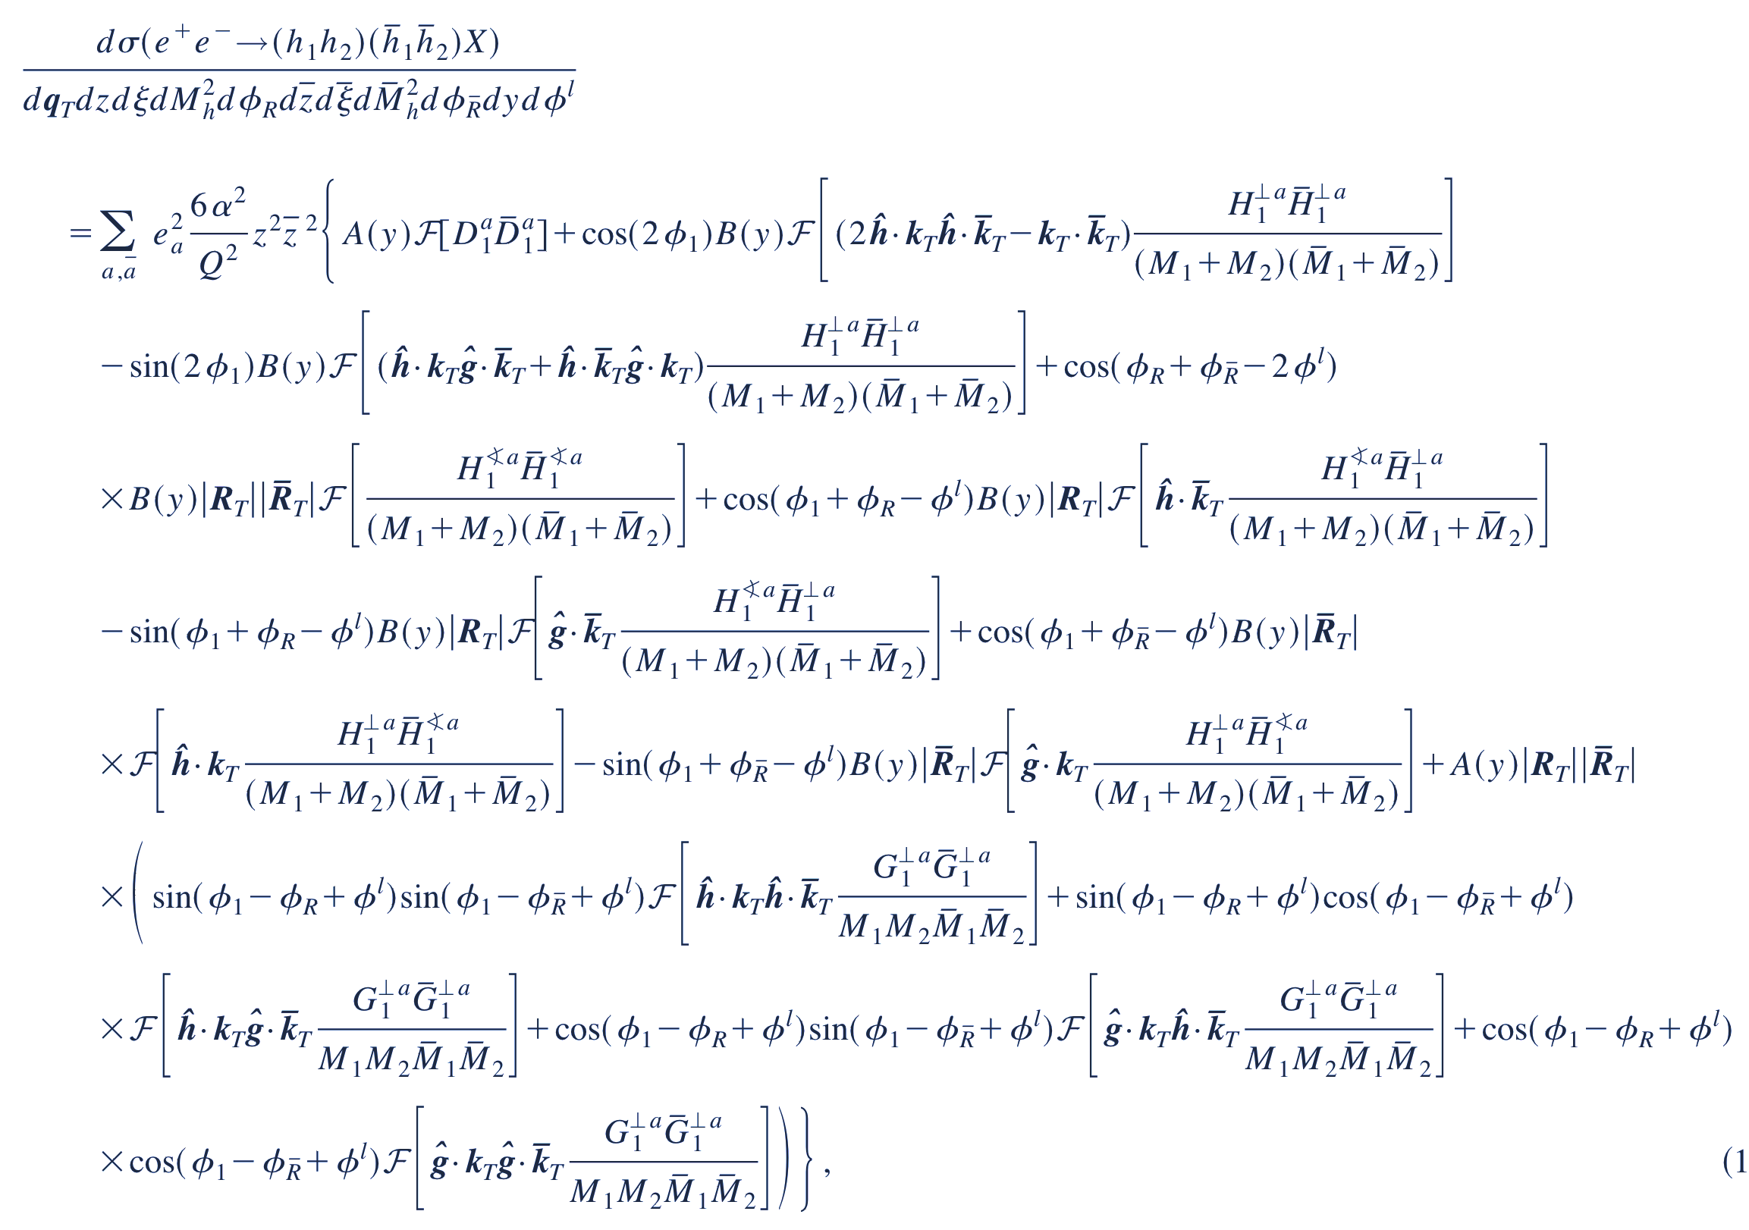
BACKUP SLIDES
FULLY DIFFERENTIAL CROSS SECTION
44
$R_{T}$: The transverse part of the relative momentum between the hadrons
$M_{1,2}$: Mass of hadron 1,2
$φ_{R}−φ^{l}$: The azimuthal angle with respect to the lepton frame
A kinematic factor dependent only on $θ$ in the center of mass frame:
$$B\left(y\right)= \frac{\sin^{2}θ}{4}$$
$ℱ$: The convolution
D. Boer, R. Jakob, and M. Radici, Phys. Rev. D 67, 094003 (2003).

Slide 27
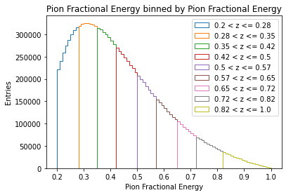
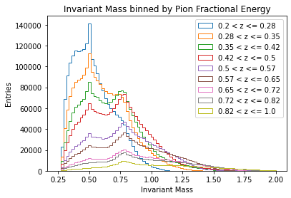
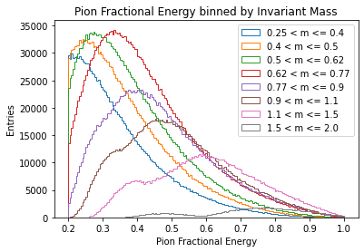
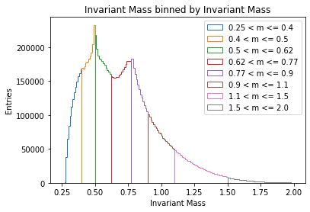
BACKUP SLIDES
WTA UUBAR MC BINNING
43
z
m
z
m

