Slide 1
Demystifying Real-Time System Development
Richard Peschke

Slide 2
Real-Time Systems, FPGAs, ASICs and HDLs
Real-Time Systems
Fixed (predictable) time for each operations
FPGA (Field-programmable gate array)
Integrated circuit which can be programmed after deployment (hence field-programmable)
Consists of logic gates that can be connected using firmware
Its logic can be designed with a Hardware design language
ASIC (Application-specific integrated circuit)
Integrated circuit chip customized for a particular use, rather than intended for general-purpose use.
HDL (Hardware description language)
HDLs are programming languages specialized to describe hardware systems
Most commonly the term HDL refers to VHDL and Verilog.
These languages are specially designed for describing hardware systems
But technically any language can be used as an HDL if there is a compiler that supports the generation Firmware (High Level synthesis)
And all languages (that can be simulated ) can be used to write software.
What makes a language a Hardware description language is the compiler
Notes:
Any real time system could do.
Give a sense of scale.
Number of operation on CPU are much larger.
Example add 1 to 100 numbers. This is one operation on FPGA.
Paralyzing simple tasks.
Predictable latency
HDL

Slide 3
Examples for real-time systems in Belle 2: Readout System | Trigger System
Real Time Systems
CPU Cluster
Notes:
Motivation for the trigger.
DAQ can't handle all data => focus on events of interest

Slide 4
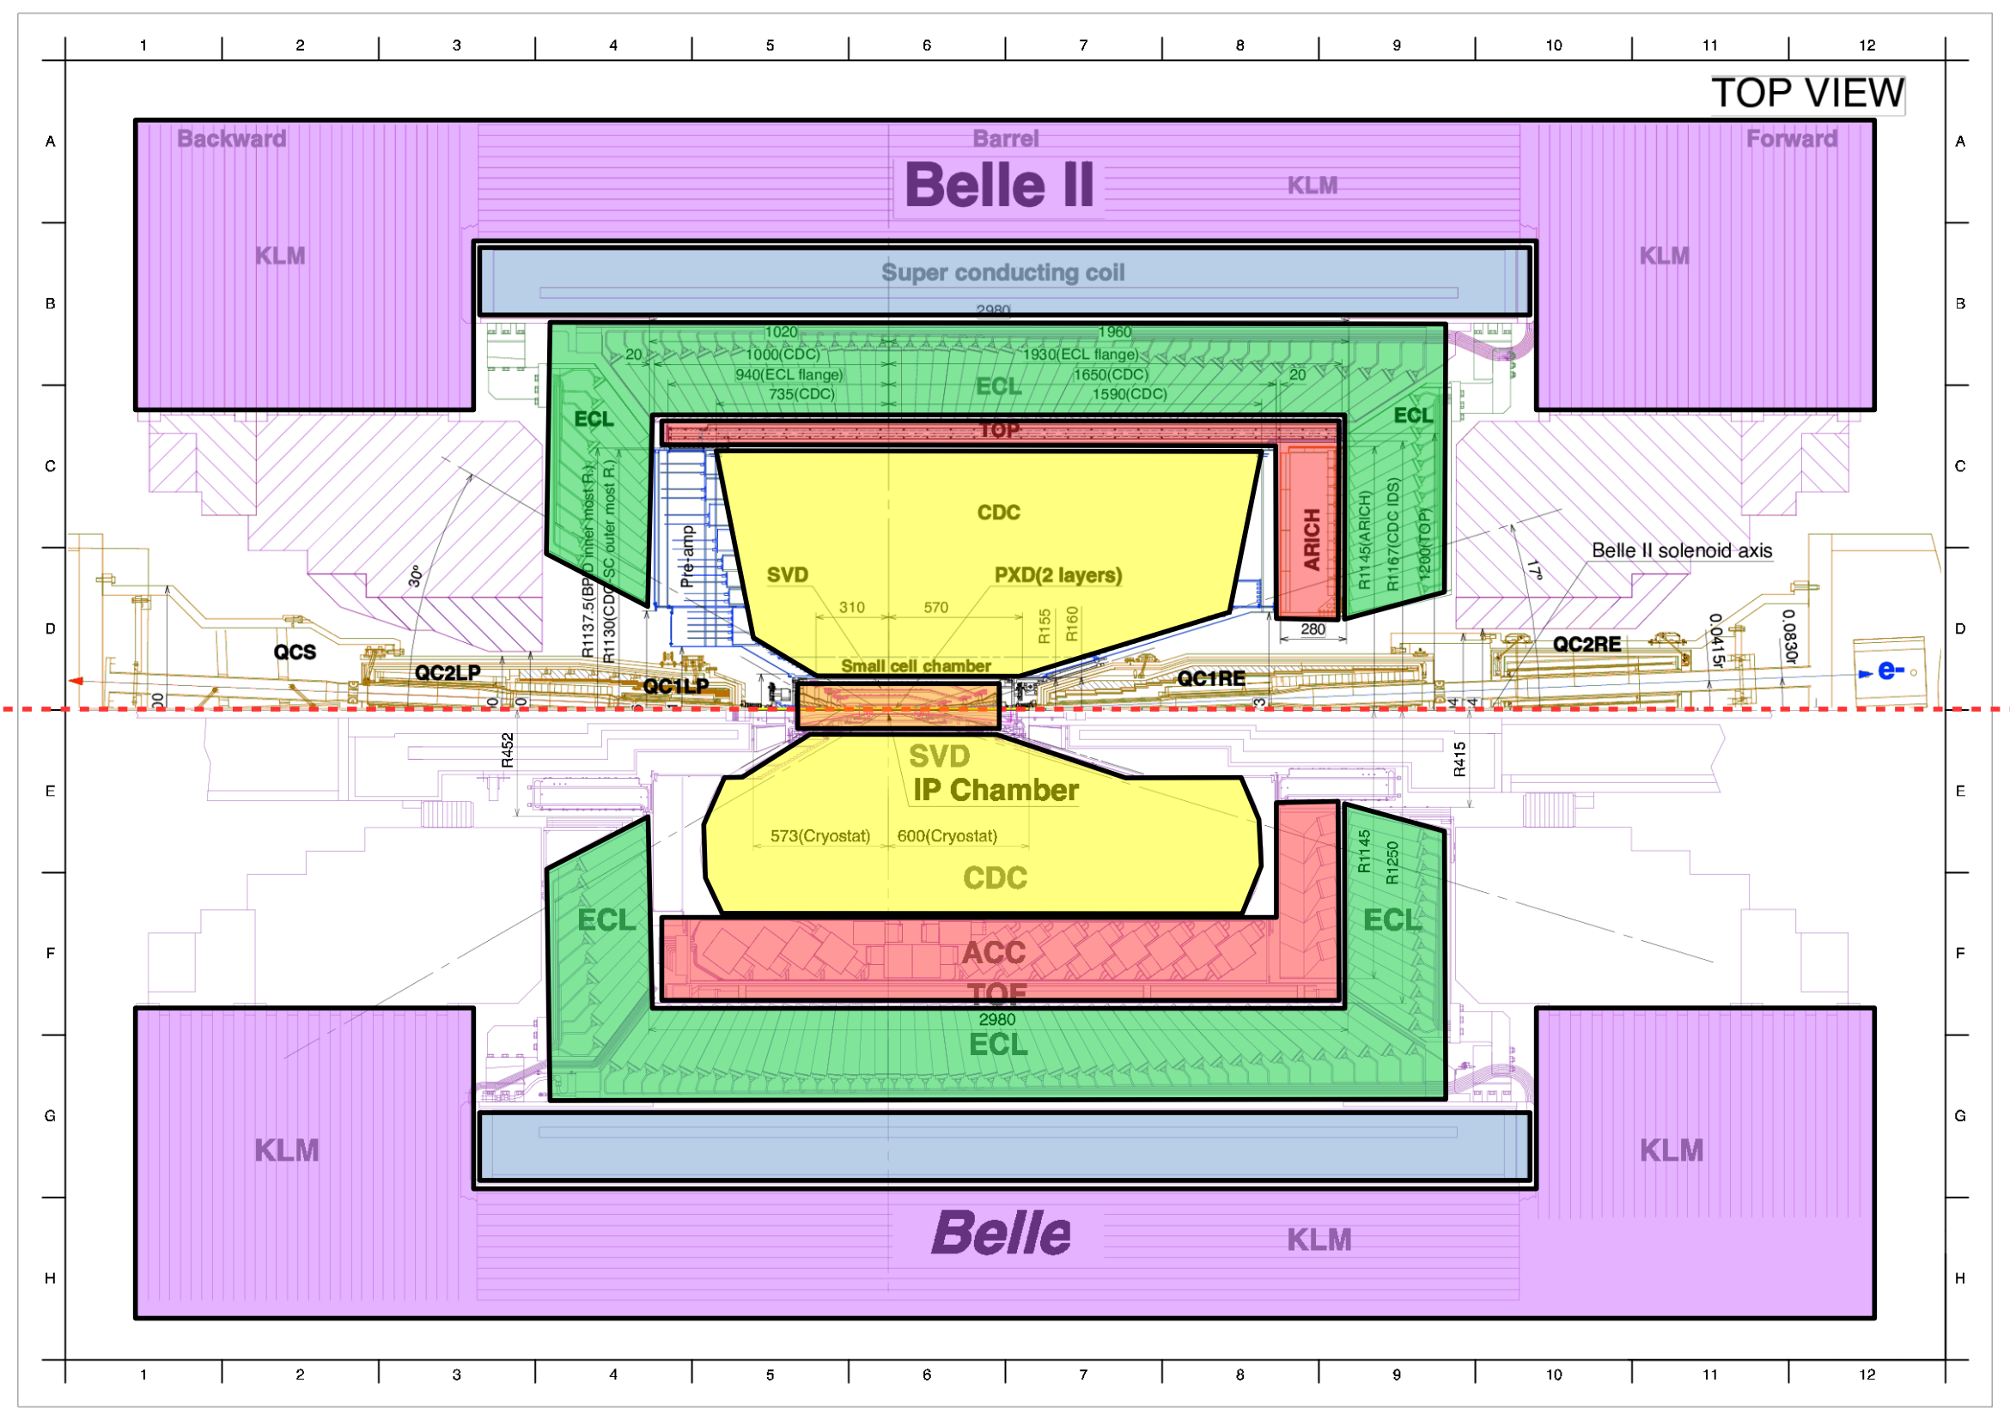
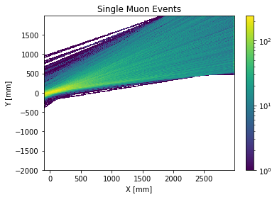
KLM Trigger Upgrade: Straight Line fit
Trigger rate Goals:
Single Muon ≤0.5 kHz
Di Muon ≤0.25 kHz
Signal Event
Trigger rate:
Cosmic Muons ~ 5 kHz
Cosmic Muons

Slide 5
Hardware Design Languages
Notes:
What are using VHDL
Where do we use FPGAs

Slide 6
Two Abstraction Levels of Firmware Design
Model/Entity/Block Level of Abstraction
Process/Logic Level of Abstraction
clk
Data_in
Filter
process(clk) is
variable axRX : axiStream_32_s := axiStream_32_s_null;
variable axTX : axiStream_32_m:= axiStream_32_m_null;
variable buff : STD_LOGIC_VECTOR(31 downto 0) := (others => '0');
begin
if rising_edge(clk) then
pull(axRX , rx_m2s);
pull(axTX , tx_s2m);
if isReceivingData(axRX) and ready_to_send(axTX) then
read_data(axRX,buff);
if buff > min_Value and buff < max_value then
send_data(axTX, buff);
end if;
end if;
push(axTX , tx_m2s);
push(axRX , rx_s2m);
end if;
end process;
Data_in_valid
Data_in_ready
Fifo_data
Fifo_data_valid
FIFO
Ethernet Output
Filter
Transformation
Fifo_data_ready
Filter_data
Filter_data_valid
Filter_data_ready
tf_data
Tf_data_valid
Tf_data_ready
Notes:
Be more explicit

Slide 7
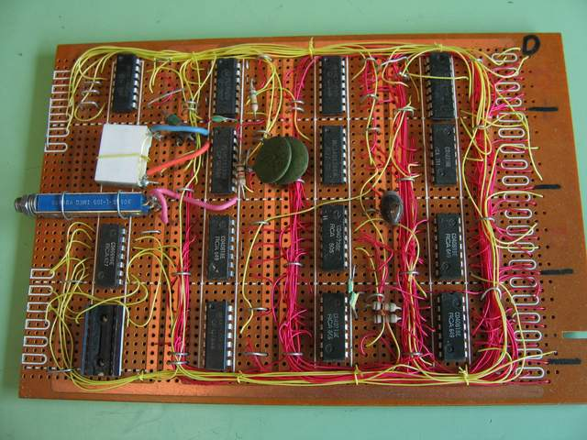
It is just like Strip Board Prototyping
https://www.nutsvolts.com/magazine/article/june2013_Dratwa
https://electronics.stackexchange.com/questions/176233/best-solution-for-compact-wiring-on-stripboard

Slide 8
Model/Entity/Block Level of Abstraction
Model/Entity/Block Declaration
Model/Entity/Block Instantiation
entity Filter is
generic (
min_Value : integer;
max_value : integer
); port (
clk : in std_logic;
rx_m2s : in axiStream_32_m2s;
rx_s2m : out axiStream_32_s2m;
tx_m2s : out axiStream_32_m2s;
tx_s2m : in axiStream_32_s2m
);
end entity;
u_filter1 : entity work.Filter generic map(
min_Value => 10 , max_value => 100000
) port map (
clk =>clk,
rx_m2s => rx_m2s,
rx_s2m => rx_s2m,
tx_m2s => u_filter1_tx_m2s,
tx_s2m => u_filter1_tx_s2m
);
u_filter2 : entity work.Filter generic map(
min_Value => 100 , max_value => 500
) port map (
clk =>clk,
rx_m2s => u_filter1_tx_m2s,
rx_s2m => u_filter1_tx_s2m,
tx_m2s => tx_m2s,
tx_s2m => tx_s2m
);
Wire Connection
Wire Connection
Wire Connection
Notes:
talk about what it is doing. Go back to the slide with the process block

Slide 9
Process/Logic Level of Abstraction
Sensitivity list
Process Block is executed when signal from the sensitivity list changes
Rising_edge statement ensures that the process is only executed on a rising edge
Sequential logic can be understood like any other program that gets executed top to bottom
Firmware separates between blocking and non blocking assignments
Blocking assignments means the value of the “variable” changes immediately and is changed on the next read of the variable
Non-Blocking assignment means that the value of the “signal” will only change after the execution of the process block is finished. The value will be changed on the next clock cycle
process(clk) is
variable axRX : axiStream_s := axiStream_s_null;
variable axTX : axiStream_m:= axiStream_m_null;
variable buff : STD_LOGIC_VECTOR(31 downto 0) := (others => '0');
begin
if rising_edge(clk) then
pull(axRX , rx_m2s);
pull(axTX , tx_s2m);
if isReceivingData(axRX) and ready_to_send(axTX) then
read_data(axRX,buff);
if buff > min_Value and buff < max_value then
send_data(axTX, buff);
end if;
end if;
push(axTX , tx_m2s);
push(axRX , rx_s2m);
end if;
end process;
Process header/
Variable definitions
Process Body/
Sequential logic
Procedure
Function

Slide 10
Example: How to use the AXI4-Lite Interface

Slide 11
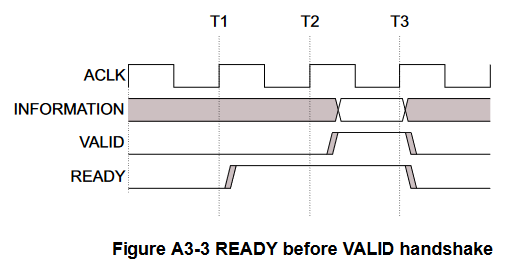
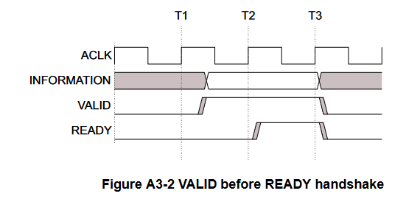
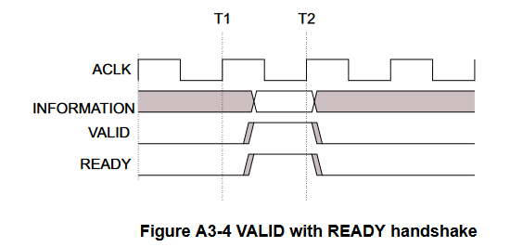
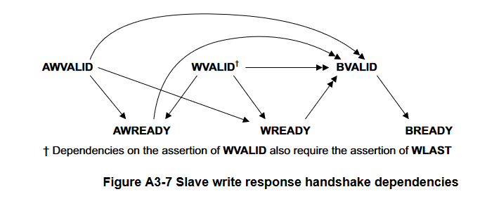
Example: How to use the AXI4-Lite Interface
Notes:
Talk about timing
Maybe talk about the moment of value taking. Show where it can glitch

Slide 12
Example: How to use the AXI4-Lite Interface without Pseudo Classes Xilinx VHDL Template for AXI-Lite Interface
library ieee;
use ieee.std_logic_1164.all;
use ieee.numeric_std.all;
entity axi_lite_standard_example_v1_0_S00_AXI is
generic (
-- Users to add parameters here
-- User parameters ends
-- Do not modify the parameters beyond this line
-- Width of S_AXI data bus
C_S_AXI_DATA_WIDTH : integer := 32;
-- Width of S_AXI address bus
C_S_AXI_ADDR_WIDTH : integer := 4
);
port (
-- Users to add ports here
-- User ports ends
-- Do not modify the ports beyond this line
-- Global Clock Signal
S_AXI_ACLK : in std_logic;
-- Global Reset Signal. This Signal is Active LOW
S_AXI_ARESETN : in std_logic;
-- Write address (issued by master, acceped by Slave)
S_AXI_AWADDR : in std_logic_vector(C_S_AXI_ADDR_WIDTH-1 downto 0);
-- Write channel Protection type. This signal indicates the
-- privilege and security level of the transaction, and whether
-- the transaction is a data access or an instruction access.
S_AXI_AWPROT : in std_logic_vector(2 downto 0);
-- Write address valid. This signal indicates that the master signaling
-- valid write address and control information.
S_AXI_AWVALID : in std_logic;
-- Write address ready. This signal indicates that the slave is ready
-- to accept an address and associated control signals.
S_AXI_AWREADY : out std_logic;
-- Write data (issued by master, acceped by Slave)
S_AXI_WDATA : in std_logic_vector(C_S_AXI_DATA_WIDTH-1 downto 0);
-- Write strobes. This signal indicates which byte lanes hold
-- valid data. There is one write strobe bit for each eight
-- bits of the write data bus.
S_AXI_WSTRB : in std_logic_vector((C_S_AXI_DATA_WIDTH/8)-1 downto 0);
-- Write valid. This signal indicates that valid write
-- data and strobes are available.
S_AXI_WVALID : in std_logic;
-- Write ready. This signal indicates that the slave
-- can accept the write data.
S_AXI_WREADY : out std_logic;
-- Write response. This signal indicates the status
-- of the write transaction.
S_AXI_BRESP : out std_logic_vector(1 downto 0);
-- Write response valid. This signal indicates that the channel
-- is signaling a valid write response.
S_AXI_BVALID : out std_logic;
-- Response ready. This signal indicates that the master
-- can accept a write response.
S_AXI_BREADY : in std_logic;
-- Read address (issued by master, acceped by Slave)
S_AXI_ARADDR : in std_logic_vector(C_S_AXI_ADDR_WIDTH-1 downto 0);
-- Protection type. This signal indicates the privilege
-- and security level of the transaction, and whether the
-- transaction is a data access or an instruction access.
S_AXI_ARPROT : in std_logic_vector(2 downto 0);
-- Read address valid. This signal indicates that the channel
-- is signaling valid read address and control information.
S_AXI_ARVALID : in std_logic;
-- Read address ready. This signal indicates that the slave is
-- ready to accept an address and associated control signals.
S_AXI_ARREADY : out std_logic;
-- Read data (issued by slave)
S_AXI_RDATA : out std_logic_vector(C_S_AXI_DATA_WIDTH-1 downto 0);
-- Read response. This signal indicates the status of the
-- read transfer.
S_AXI_RRESP : out std_logic_vector(1 downto 0);
-- Read valid. This signal indicates that the channel is
-- signaling the required read data.
S_AXI_RVALID : out std_logic;
-- Read ready. This signal indicates that the master can
-- accept the read data and response information.
S_AXI_RREADY : in std_logic
);
end axi_lite_standard_example_v1_0_S00_AXI;
architecture arch_imp of axi_lite_standard_example_v1_0_S00_AXI is
-- AXI4LITE signals
signal axi_awaddr : std_logic_vector(C_S_AXI_ADDR_WIDTH-1 downto 0);
signal axi_awready : std_logic;
signal axi_wready : std_logic;
signal axi_bresp : std_logic_vector(1 downto 0);
signal axi_bvalid : std_logic;
signal axi_araddr : std_logic_vector(C_S_AXI_ADDR_WIDTH-1 downto 0);
signal axi_arready : std_logic;
signal axi_rdata : std_logic_vector(C_S_AXI_DATA_WIDTH-1 downto 0);
signal axi_rresp : std_logic_vector(1 downto 0);
signal axi_rvalid : std_logic;
-- Example-specific design signals
-- local parameter for addressing 32 bit / 64 bit C_S_AXI_DATA_WIDTH
-- ADDR_LSB is used for addressing 32/64 bit registers/memories
-- ADDR_LSB = 2 for 32 bits (n downto 2)
-- ADDR_LSB = 3 for 64 bits (n downto 3)
constant ADDR_LSB : integer := (C_S_AXI_DATA_WIDTH/32)+ 1;
constant OPT_MEM_ADDR_BITS : integer := 1;
------------------------------------------------
------------------------------------------------
---- Signals for user logic register space example
--------------------------------------------------
---- Number of Slave Registers 4
signal slv_reg0 :std_logic_vector(C_S_AXI_DATA_WIDTH-1 downto 0);
signal slv_reg1 :std_logic_vector(C_S_AXI_DATA_WIDTH-1 downto 0);
signal slv_reg2 :std_logic_vector(C_S_AXI_DATA_WIDTH-1 downto 0);
signal slv_reg3 :std_logic_vector(C_S_AXI_DATA_WIDTH-1 downto 0);
signal slv_reg_rden : std_logic;
signal slv_reg_wren : std_logic;
signal reg_data_out :std_logic_vector(C_S_AXI_DATA_WIDTH-1 downto 0);
signal byte_index : integer;
signal aw_en : std_logic;
begin
-- I/O Connections assignments
S_AXI_AWREADY <= axi_awready;
S_AXI_WREADY <= axi_wready;
S_AXI_BRESP <= axi_bresp;
S_AXI_BVALID <= axi_bvalid;
S_AXI_ARREADY <= axi_arready;
S_AXI_RDATA <= axi_rdata;
S_AXI_RRESP <= axi_rresp;
S_AXI_RVALID <= axi_rvalid;
-- Implement axi_awready generation
-- axi_awready is asserted for one S_AXI_ACLK clock cycle when both
-- S_AXI_AWVALID and S_AXI_WVALID are asserted. axi_awready is
-- de-asserted when reset is low.
process (S_AXI_ACLK)
begin
if rising_edge(S_AXI_ACLK) then
if S_AXI_ARESETN = '0' then
axi_awready <= '0';
aw_en <= '1';
else
if (axi_awready = '0' and S_AXI_AWVALID = '1' and S_AXI_WVALID = '1' and aw_en = '1') then
-- slave is ready to accept write address when
-- there is a valid write address and write data
-- on the write address and data bus. This design
-- expects no outstanding transactions.
axi_awready <= '1';
aw_en <= '0';
elsif (S_AXI_BREADY = '1' and axi_bvalid = '1') then
aw_en <= '1';
axi_awready <= '0';
else
axi_awready <= '0';
end if;
end if;
end if;
end process;
-- Implement axi_awaddr latching
-- This process is used to latch the address when both
-- S_AXI_AWVALID and S_AXI_WVALID are valid.
process (S_AXI_ACLK)
begin
if rising_edge(S_AXI_ACLK) then
if S_AXI_ARESETN = '0' then
axi_awaddr <= (others => '0');
else
if (axi_awready = '0' and S_AXI_AWVALID = '1' and S_AXI_WVALID = '1' and aw_en = '1') then
-- Write Address latching
axi_awaddr <= S_AXI_AWADDR;
end if;
end if;
end if;
end process;
-- Implement axi_wready generation
-- axi_wready is asserted for one S_AXI_ACLK clock cycle when both
-- S_AXI_AWVALID and S_AXI_WVALID are asserted. axi_wready is
-- de-asserted when reset is low.
process (S_AXI_ACLK)
begin
if rising_edge(S_AXI_ACLK) then
if S_AXI_ARESETN = '0' then
axi_wready <= '0';
else
if (axi_wready = '0' and S_AXI_WVALID = '1' and S_AXI_AWVALID = '1' and aw_en = '1') then
-- slave is ready to accept write data when
-- there is a valid write address and write data
-- on the write address and data bus. This design
-- expects no outstanding transactions.
axi_wready <= '1';
else
axi_wready <= '0';
end if;
end if;
end if;
end process;
-- Implement memory mapped register select and write logic generation
-- The write data is accepted and written to memory mapped registers when
-- axi_awready, S_AXI_WVALID, axi_wready and S_AXI_WVALID are asserted. Write strobes are used to
-- select byte enables of slave registers while writing.
-- These registers are cleared when reset (active low) is applied.
-- Slave register write enable is asserted when valid address and data are available
-- and the slave is ready to accept the write address and write data.
slv_reg_wren <= axi_wready and S_AXI_WVALID and axi_awready and S_AXI_AWVALID ;
process (S_AXI_ACLK)
variable loc_addr :std_logic_vector(OPT_MEM_ADDR_BITS downto 0);
begin
if rising_edge(S_AXI_ACLK) then
if S_AXI_ARESETN = '0' then
slv_reg0 <= (others => '0');
slv_reg1 <= (others => '0');
slv_reg2 <= (others => '0');
slv_reg3 <= (others => '0');
else
loc_addr := axi_awaddr(ADDR_LSB + OPT_MEM_ADDR_BITS downto ADDR_LSB);
if (slv_reg_wren = '1') then
case loc_addr is
when b"00" =>
for byte_index in 0 to (C_S_AXI_DATA_WIDTH/8-1) loop
if ( S_AXI_WSTRB(byte_index) = '1' ) then
-- Respective byte enables are asserted as per write strobes
-- slave registor 0
slv_reg0(byte_index*8+7 downto byte_index*8) <= S_AXI_WDATA(byte_index*8+7 downto byte_index*8);
end if;
end loop;
when b"01" =>
for byte_index in 0 to (C_S_AXI_DATA_WIDTH/8-1) loop
if ( S_AXI_WSTRB(byte_index) = '1' ) then
-- Respective byte enables are asserted as per write strobes
-- slave registor 1
slv_reg1(byte_index*8+7 downto byte_index*8) <= S_AXI_WDATA(byte_index*8+7 downto byte_index*8);
end if;
end loop;
when b"10" =>
for byte_index in 0 to (C_S_AXI_DATA_WIDTH/8-1) loop
if ( S_AXI_WSTRB(byte_index) = '1' ) then
-- Respective byte enables are asserted as per write strobes
-- slave registor 2
slv_reg2(byte_index*8+7 downto byte_index*8) <= S_AXI_WDATA(byte_index*8+7 downto byte_index*8);
end if;
end loop;
when b"11" =>
for byte_index in 0 to (C_S_AXI_DATA_WIDTH/8-1) loop
if ( S_AXI_WSTRB(byte_index) = '1' ) then
-- Respective byte enables are asserted as per write strobes
-- slave registor 3
slv_reg3(byte_index*8+7 downto byte_index*8) <= S_AXI_WDATA(byte_index*8+7 downto byte_index*8);
end if;
end loop;
when others =>
slv_reg0 <= slv_reg0;
slv_reg1 <= slv_reg1;
slv_reg2 <= slv_reg2;
slv_reg3 <= slv_reg3;
end case;
end if;
end if;
end if;
end process;
-- Implement write response logic generation
-- The write response and response valid signals are asserted by the slave
-- when axi_wready, S_AXI_WVALID, axi_wready and S_AXI_WVALID are asserted.
-- This marks the acceptance of address and indicates the status of
-- write transaction.
process (S_AXI_ACLK)
begin
if rising_edge(S_AXI_ACLK) then
if S_AXI_ARESETN = '0' then
axi_bvalid <= '0';
axi_bresp <= "00"; --need to work more on the responses
else
if (axi_awready = '1' and S_AXI_AWVALID = '1' and axi_wready = '1' and S_AXI_WVALID = '1' and axi_bvalid = '0' ) then
axi_bvalid <= '1';
axi_bresp <= "00";
elsif (S_AXI_BREADY = '1' and axi_bvalid = '1') then --check if bready is asserted while bvalid is high)
axi_bvalid <= '0'; -- (there is a possibility that bready is always asserted high)
end if;
end if;
end if;
end process;
-- Implement axi_arready generation
-- axi_arready is asserted for one S_AXI_ACLK clock cycle when
-- S_AXI_ARVALID is asserted. axi_awready is
-- de-asserted when reset (active low) is asserted.
-- The read address is also latched when S_AXI_ARVALID is
-- asserted. axi_araddr is reset to zero on reset assertion.
process (S_AXI_ACLK)
begin
if rising_edge(S_AXI_ACLK) then
if S_AXI_ARESETN = '0' then
axi_arready <= '0';
axi_araddr <= (others => '1');
else
if (axi_arready = '0' and S_AXI_ARVALID = '1') then
-- indicates that the slave has acceped the valid read address
axi_arready <= '1';
-- Read Address latching
axi_araddr <= S_AXI_ARADDR;
else
axi_arready <= '0';
end if;
end if;
end if;
end process;
-- Implement axi_arvalid generation
-- axi_rvalid is asserted for one S_AXI_ACLK clock cycle when both
-- S_AXI_ARVALID and axi_arready are asserted. The slave registers
-- data are available on the axi_rdata bus at this instance. The
-- assertion of axi_rvalid marks the validity of read data on the
-- bus and axi_rresp indicates the status of read transaction.axi_rvalid
-- is deasserted on reset (active low). axi_rresp and axi_rdata are
-- cleared to zero on reset (active low).
process (S_AXI_ACLK)
begin
if rising_edge(S_AXI_ACLK) then
if S_AXI_ARESETN = '0' then
axi_rvalid <= '0';
axi_rresp <= "00";
else
if (axi_arready = '1' and S_AXI_ARVALID = '1' and axi_rvalid = '0') then
-- Valid read data is available at the read data bus
axi_rvalid <= '1';
axi_rresp <= "00"; -- 'OKAY' response
elsif (axi_rvalid = '1' and S_AXI_RREADY = '1') then
-- Read data is accepted by the master
axi_rvalid <= '0';
end if;
end if;
end if;
end process;
-- Implement memory mapped register select and read logic generation
-- Slave register read enable is asserted when valid address is available
-- and the slave is ready to accept the read address.
slv_reg_rden <= axi_arready and S_AXI_ARVALID and (not axi_rvalid) ;
process (slv_reg0, slv_reg1, slv_reg2, slv_reg3, axi_araddr, S_AXI_ARESETN, slv_reg_rden)
variable loc_addr :std_logic_vector(OPT_MEM_ADDR_BITS downto 0);
begin
-- Address decoding for reading registers
loc_addr := axi_araddr(ADDR_LSB + OPT_MEM_ADDR_BITS downto ADDR_LSB);
case loc_addr is
when b"00" =>
reg_data_out <= slv_reg0;
when b"01" =>
reg_data_out <= slv_reg1;
when b"10" =>
reg_data_out <= slv_reg2;
when b"11" =>
reg_data_out <= slv_reg3;
when others =>
reg_data_out <= (others => '0');
end case;
end process;
-- Output register or memory read data
process( S_AXI_ACLK ) is
begin
if (rising_edge (S_AXI_ACLK)) then
if ( S_AXI_ARESETN = '0' ) then
axi_rdata <= (others => '0');
else
if (slv_reg_rden = '1') then
-- When there is a valid read address (S_AXI_ARVALID) with
-- acceptance of read address by the slave (axi_arready),
-- output the read dada
-- Read address mux
axi_rdata <= reg_data_out; -- register read data
end if;
end if;
end if;
end process;
-- Add user logic here
-- User logic ends
end arch_imp;

Slide 13
VHDL an (almost) Object-Oriented Language in disguise
Object-Oriented Design
Encapsulation
Abstraction
Information Hiding
Class
Polymorphism
Inheritance
Object-Oriented Design:
is fundamental for (virtually) all High-Level Programming Languages
Is very successful when modeling complex system
Encapsulation
An Object has one task, and it contains all components it needs to fulfill this task
Objects are modified through function ➔Preserving invariance ➔Avoiding Undefined behavior
Information Hiding
Objects are defined by there public interface not by their internal structure
An object's internal structure is not important for the user of the object

Slide 14
Designing Objects in VHDL
Class
(Pseudo) Class Definition:
type axiStream_m is record
last : std_logic;
valid : std_logic;
data : std_logic_vector(31 downto 0);
ready : std_logic;
end record;
data
Connects to the in/out ports of the entity
Absorbs interface specific code that needs to run on every clock cycle
Functionality
procedure pull ( self : inout axiStream_m; signal tx : in axiStream_s2m);
procedure push ( self : inout axiStream_m; signal tx : out axiStream_m2s);
procedure send_data ( self : inout axiStream_m; dataIn : in std_logic_vector);
function ready_to_send ( self : axiStream_m) return boolean;
Call syntax
C++: Obj.send_data( MyData) ;
VHDL: send_data(obj, MyData);
Procedures can modify inputs but do not return something
Functions cannot modify inputs but do return something
Overload resolution will pick the right function

Slide 15
Example: How to use the AXI4-Lite Interface with Pseudo Classes
architecture rtl of axi4lite_s_example is
signal i_slv_reg0_o : std_logic_vector(31 downto 0);
begin
slv_reg0_o <= i_slv_reg0_o;
process(clk) is
variable rx: AXI4LITE_s := AXI4LITE_s_null;
variable rx_data : std_logic_vector(31 downto 0);
variable rx_addr : std_logic_vector(31 downto 0);
begin
if rising_edge(clk) then
pull(rx , rx_m2s);
if is_requesting_data(rx) then
get_read_address(rx, rx_addr);
if rx_addr = x"00000000" then
set_read_data(rx, i_slv_reg1_o);
end if;
end if;
if is_receiving_data(rx) then
get_write_data(rx, rx_addr, rx_data);
if rx_addr = x"00000000" then
i_slv_reg0_o <= rx_data;
end if;
end if;
push(rx, rx_s2m);
end if;
end process;
end architecture;
library ieee;
use ieee.std_logic_1164.all;
use ieee.numeric_std.all;
use work.AXI4LITE_pac.all;
entity axi4lite_s_example is
port (
clk : in std_logic;
rx_m2s : in AXI4LITE_m2s;
rx_s2m : out AXI4LITE_s2m;
slv_reg0_o : out std_logic_vector(31 downto 0)
);
end entity;

Slide 16
Summay
Real-Time Systems are a key component of the readout of any detector system
We are using real-time systems to preform “simple” tasks fast and reliable
Real-Time Systems give the user clock cycle precise timing
Firmware is programming
Abstraction & encapsulation are key to clean and correct code
Firmware development has different constrains than other languages
Firmware development takes a lot longer than other languages

