Slide 1
2022 Belle II Summer Workshop Closeout
{
44 in-person attendees!
Graduate Students | 24
Postdocs | 7
Faculty | 13
Remote | 51
95 attendees in total
Pedagogical talks | 11
Hands-on sessions | 3
Tutorials | 1
Boot camps | 2
PD/GS talks | 15

Slide 2
A few final details
All sessions have been recorded and posted (except for today which will be done tonight)
The recordings (especially the pedagogical talks) are a valuable resource and we would all benefit by re-watching them at least a few more times
To help improve future B2SWs, we will be sending out a survey in the next few days – please respond!
Some of you have already passed on some useful suggestions (most of which I’ve written down) but please also include those suggestions (and others) in your survey response
We will add a photo page to indico – if you have photos of the workshop or ISU/Ames, please send them to me

Slide 3
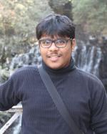
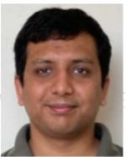
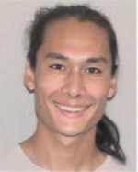
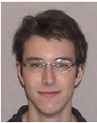
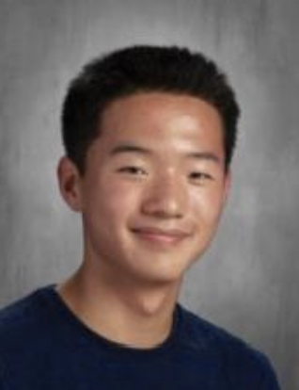
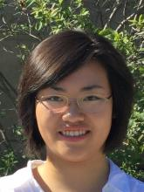
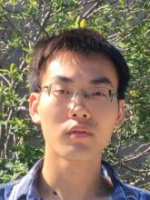
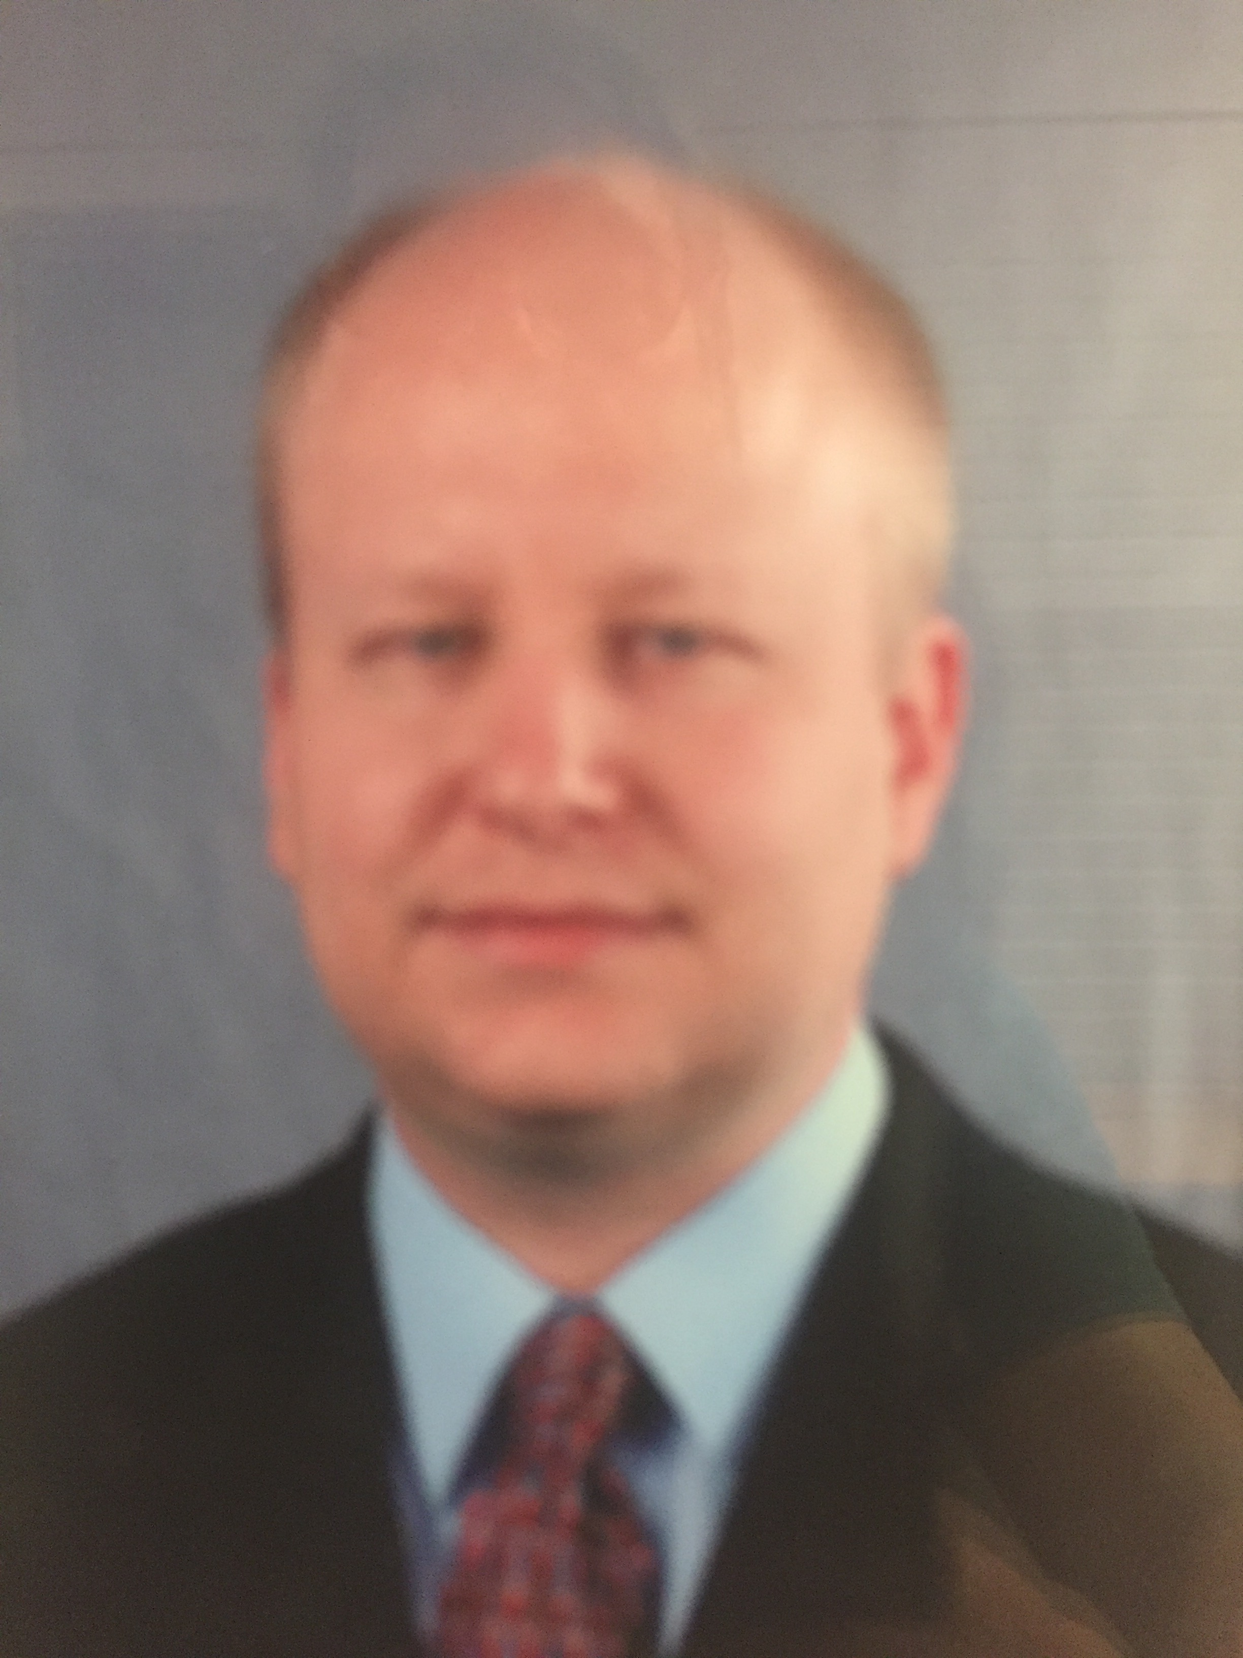
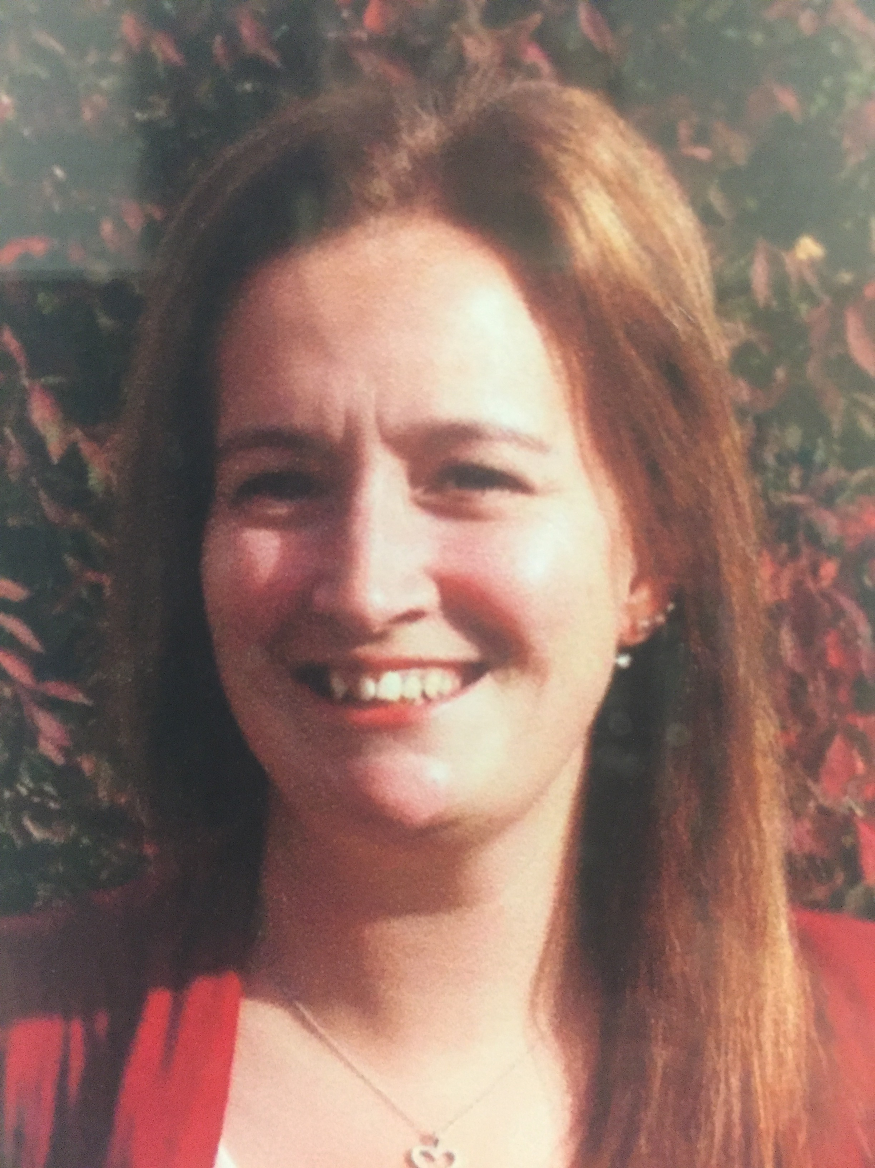
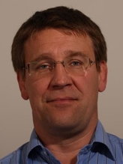
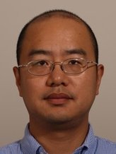
So many people to thank!
Many thanks to our Organizing Committee: Leo, Jake, Janaka, Michelle, Shahab, Soeren, & Chunhui
Many thanks to the ISU team:
Sayan
Avinash
Noah
Wes
Adrian
Michelle
Shuaiyan
Extra Special thanks!
Many thanks to our IT support:
Brad
Theresa
A big thanks to my partners in crime
And a huge thanks to all the speakers!!!!
Soeren
Chunhui

Slide 4
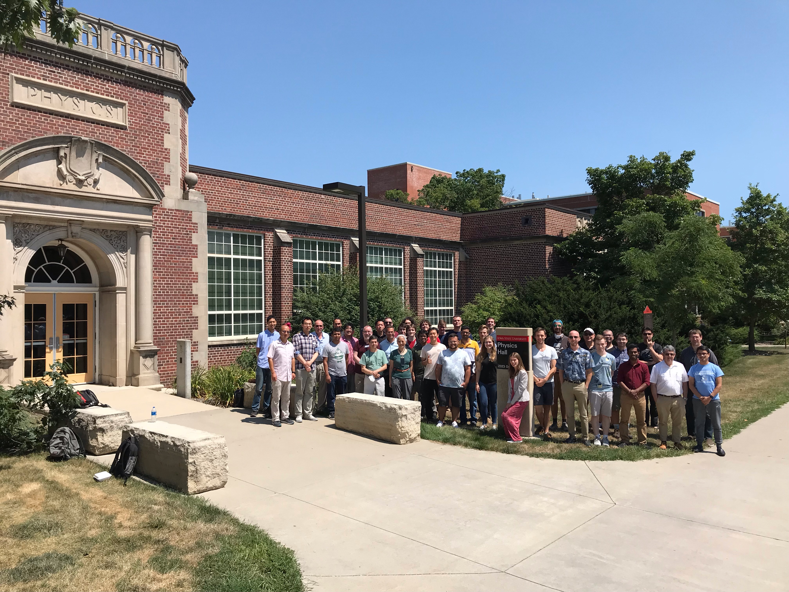
And a tremendous thanks to all of you!
We very much enjoyed this workshop and look forward to seeing all of you next year or perhaps sooner at KEK
Safe Travels!

