Slide 1
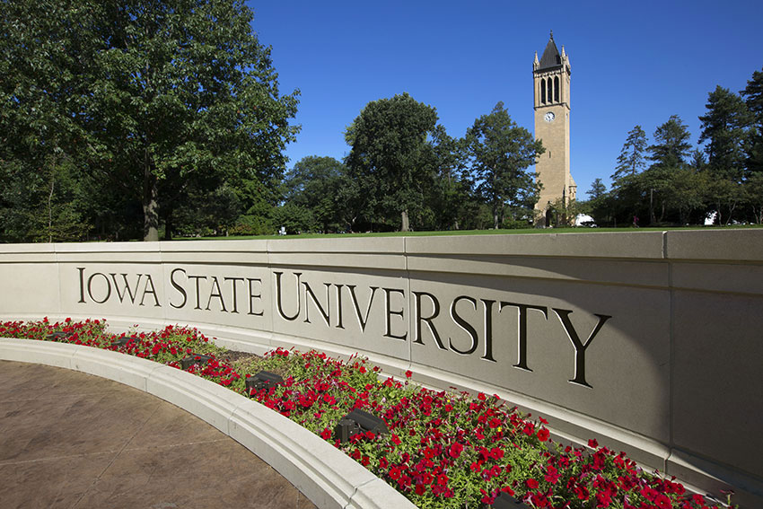
Welcome to the 2022 Belle II Summer Workshop
and Welcome to Ames & ISU!
Hopefully your travels went smoothly
If you need help with anything, please contact me, Soeren, or Chunhui:
Jim: cochran61@gmail.com, (515) 441-1258
Soeren: prell@iastate.edu, (515) 708-6124
Chunhui: cchen23@iastate.edu, (515) 233-1582

Slide 2
Important information (for those in-person)
Wifi: for most of you, eduroam should work – if it doesn’t please use “IASTATE-guest”
Parking tags: we still have some (and can get more), please let me know if you need some
Bus tickets: I can get more - please let me know if you need any
Important information (for those connecting remotely)
The zoom component of the workshop does not include the one-on-one sessions
The zoom component thus covers the period 1pm – 6pm US CT each day (a bit later start on Wednesday)
that’s 3am – 8am at KEK
and 11:30pm – 4:30am in India
The zoom sessions will be recorded

Slide 3
Overall outline of the worshop:
Session on Detectors & Performance – Monday & Tuesday
Session on Belle II Physics – Tuesday & Wednesday
Hands-on session on basf2 – Monday afternoon
Hands-on session gbasf2 – Tuesday afternoon
Tutorial on Statistics & Systematics
Session on Diversity, Equity, & Inclusion – Wednesday afternoon
Theory talk (D. Atwood) – Thursday afternoon
SuperKEKB talk – Thursday afternoon
Career Development bootcamps for postdocs & students
~ 13 postdoc/student talks & student flash talks (last day)
Plenty of one-on-one time (mornings) with experts available

Slide 4
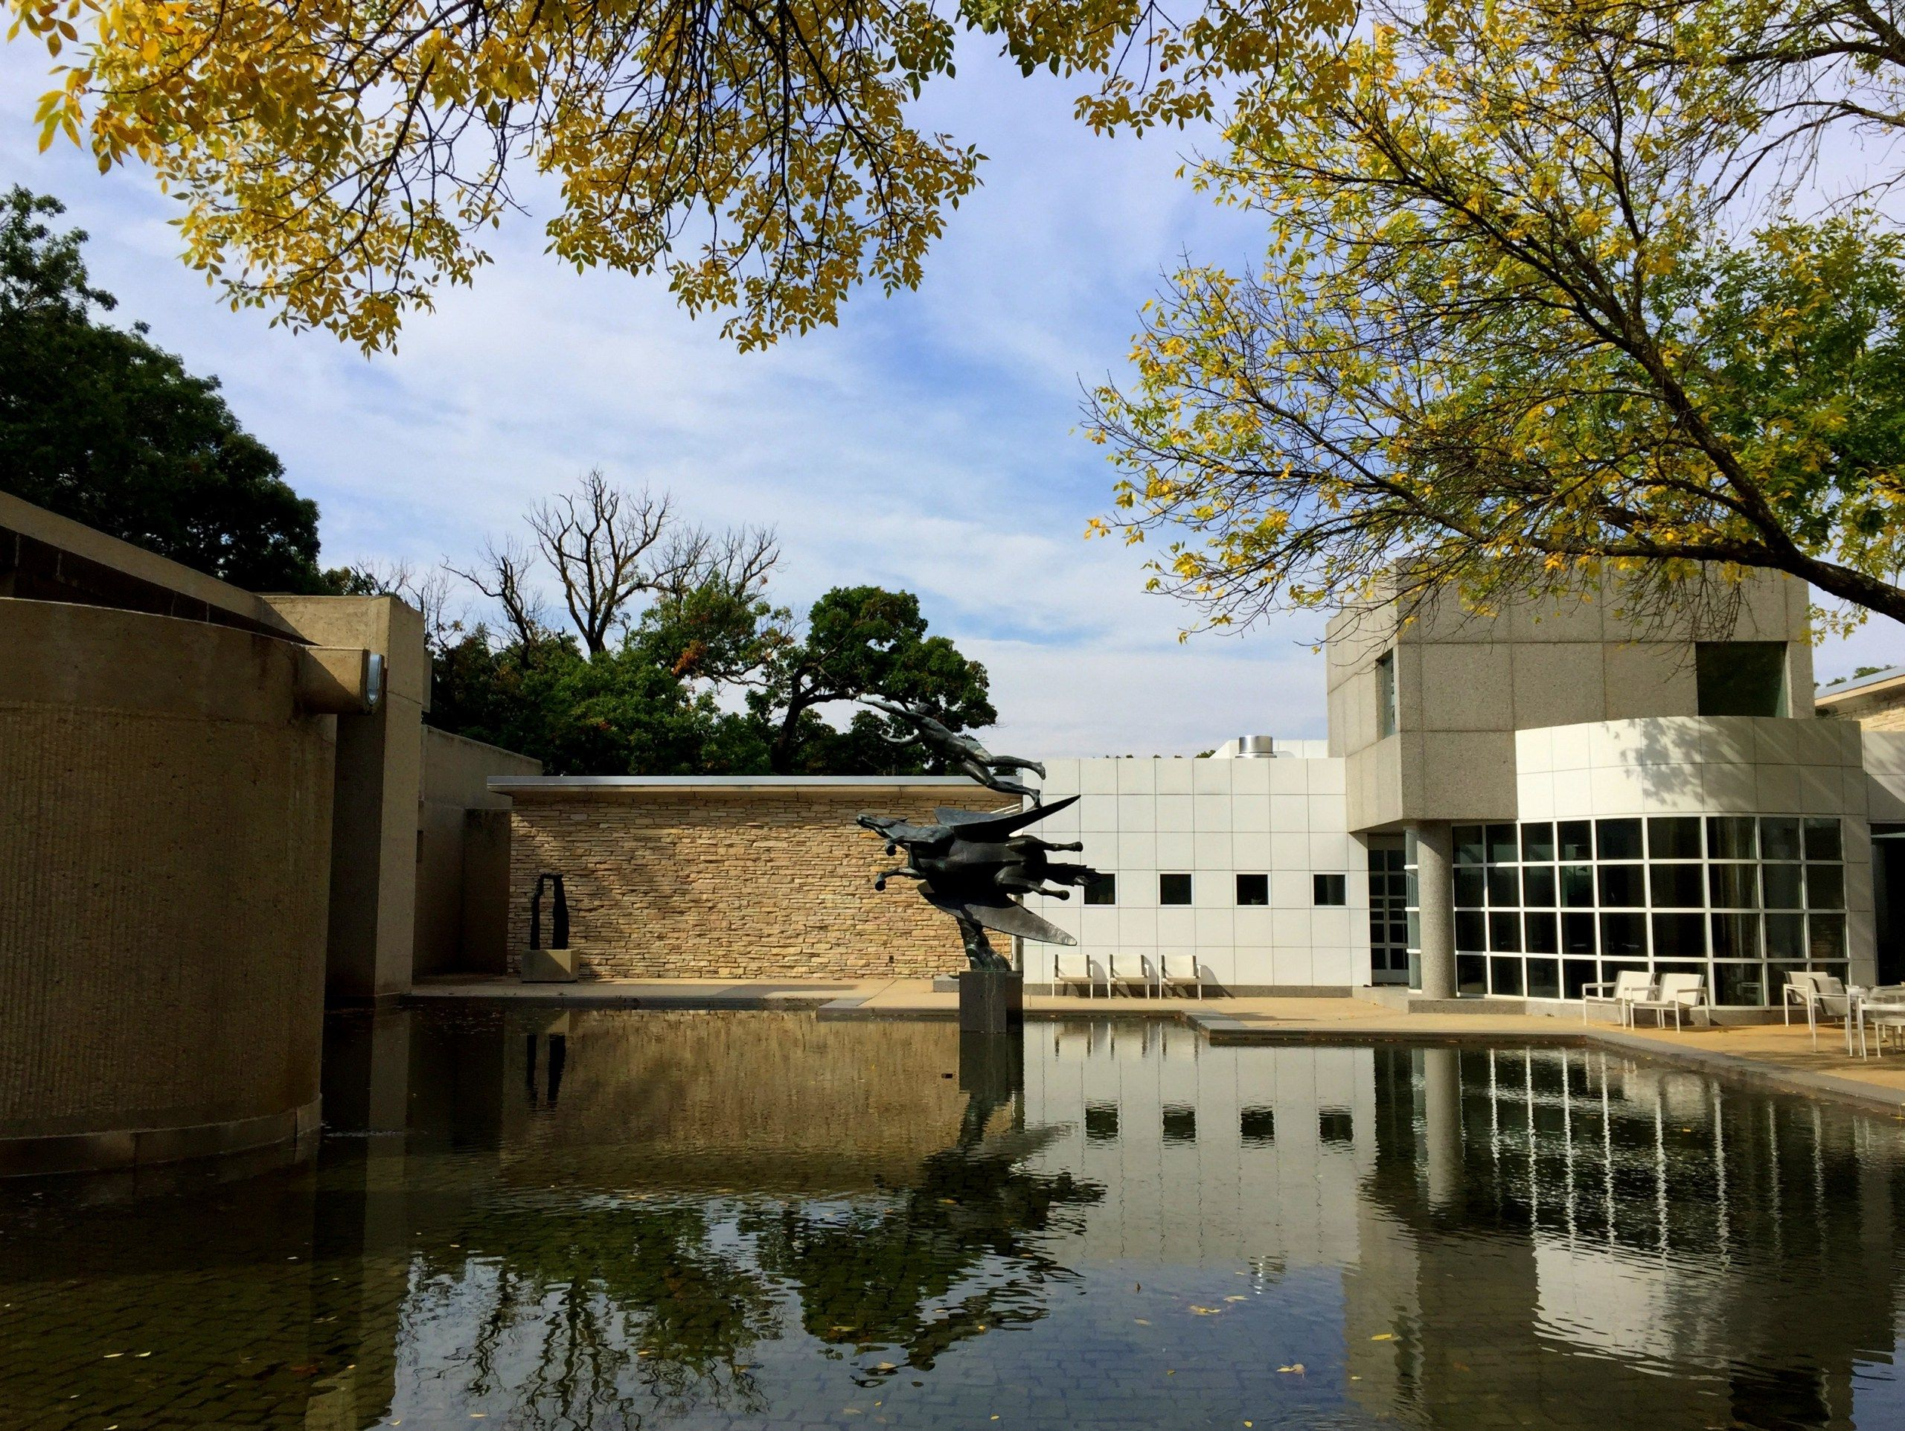
Wednesday morning excursion & lunch at the Des Moines Art Center
We will leave from Ames at 9am (3 mini-vans)
More details tomorrow …
We will have an early lunch (10am) and the tours
We should return by 1pm but if we are running late the afternoon schedule could be shifted

Slide 5
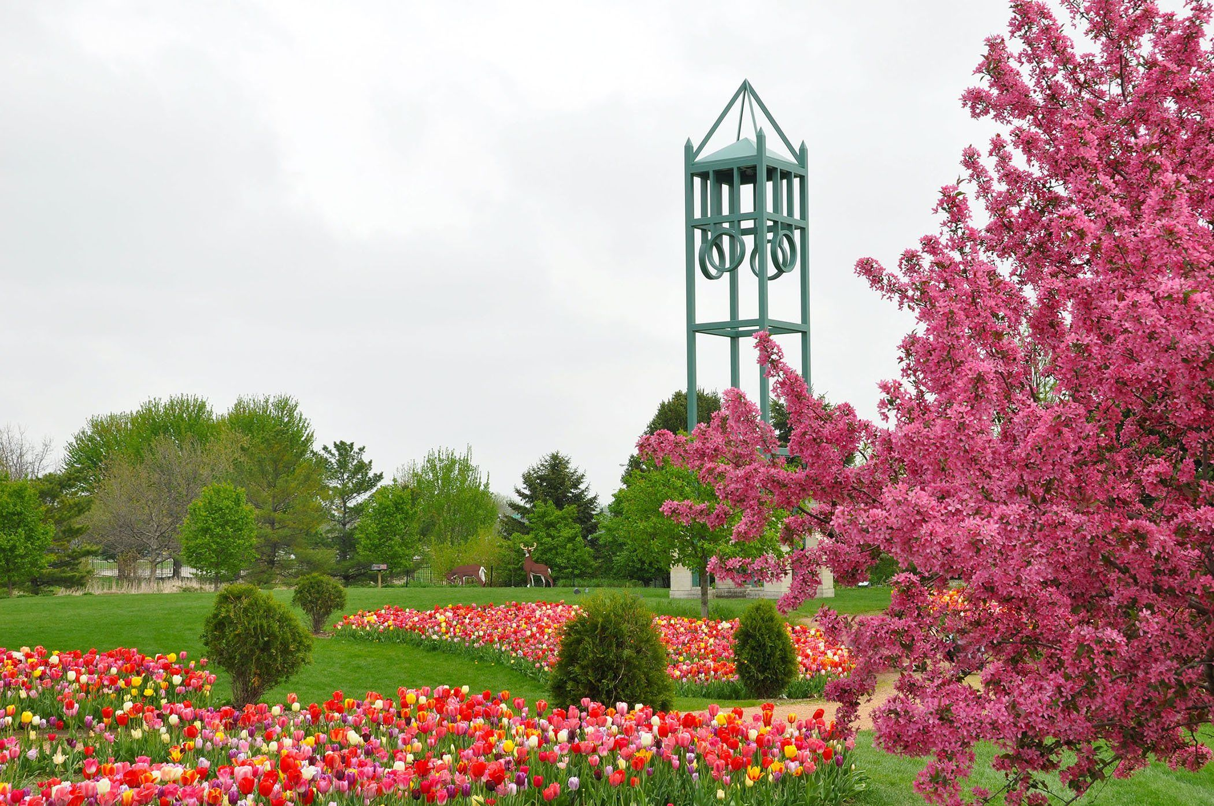
Workshop Dinner at Reiman Gardens (Thursday)
It’s about a 30 minute walk from Physics Hall
If it’s hot, maybe best to carpool
We are in Hunziker House – no charge to enter RG
hors d'oeuvres start at 6pm
Cash bar (they take cards) opens at 6pm
and closes at 8pm (last call at 7:45pm)
Dinner (buffet) starts at 6:45pm
We should leave by ~9pm

