Slide 1


Recent Belle II results on decay-time-dependent CP violation
M.-C. Chang,
On behalf of Belle II Collaboration,
Fu Jen Catholic University(FJCU)

Slide 2
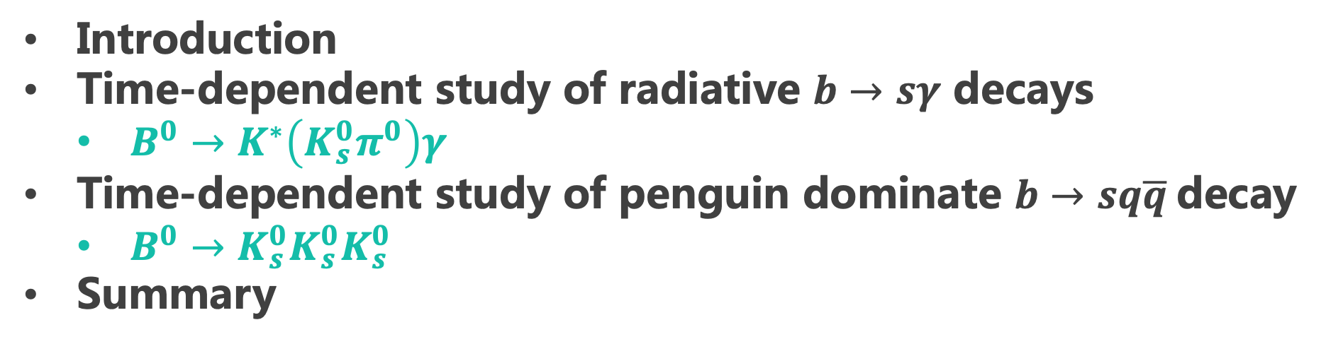
Outline
Introduction
Time-dependent study of radiative $b→sγ$ decays
  $B^{0}→K^{∗}\left(K_{s}^{0}π^{0}\right)γ$
Time-dependent study of penguin dominate $b→sq\overline{q}$decay
  $B^{0}→K_{s}^{0}K_{s}^{0}K_{s}^{0}$
Summary

Slide 3
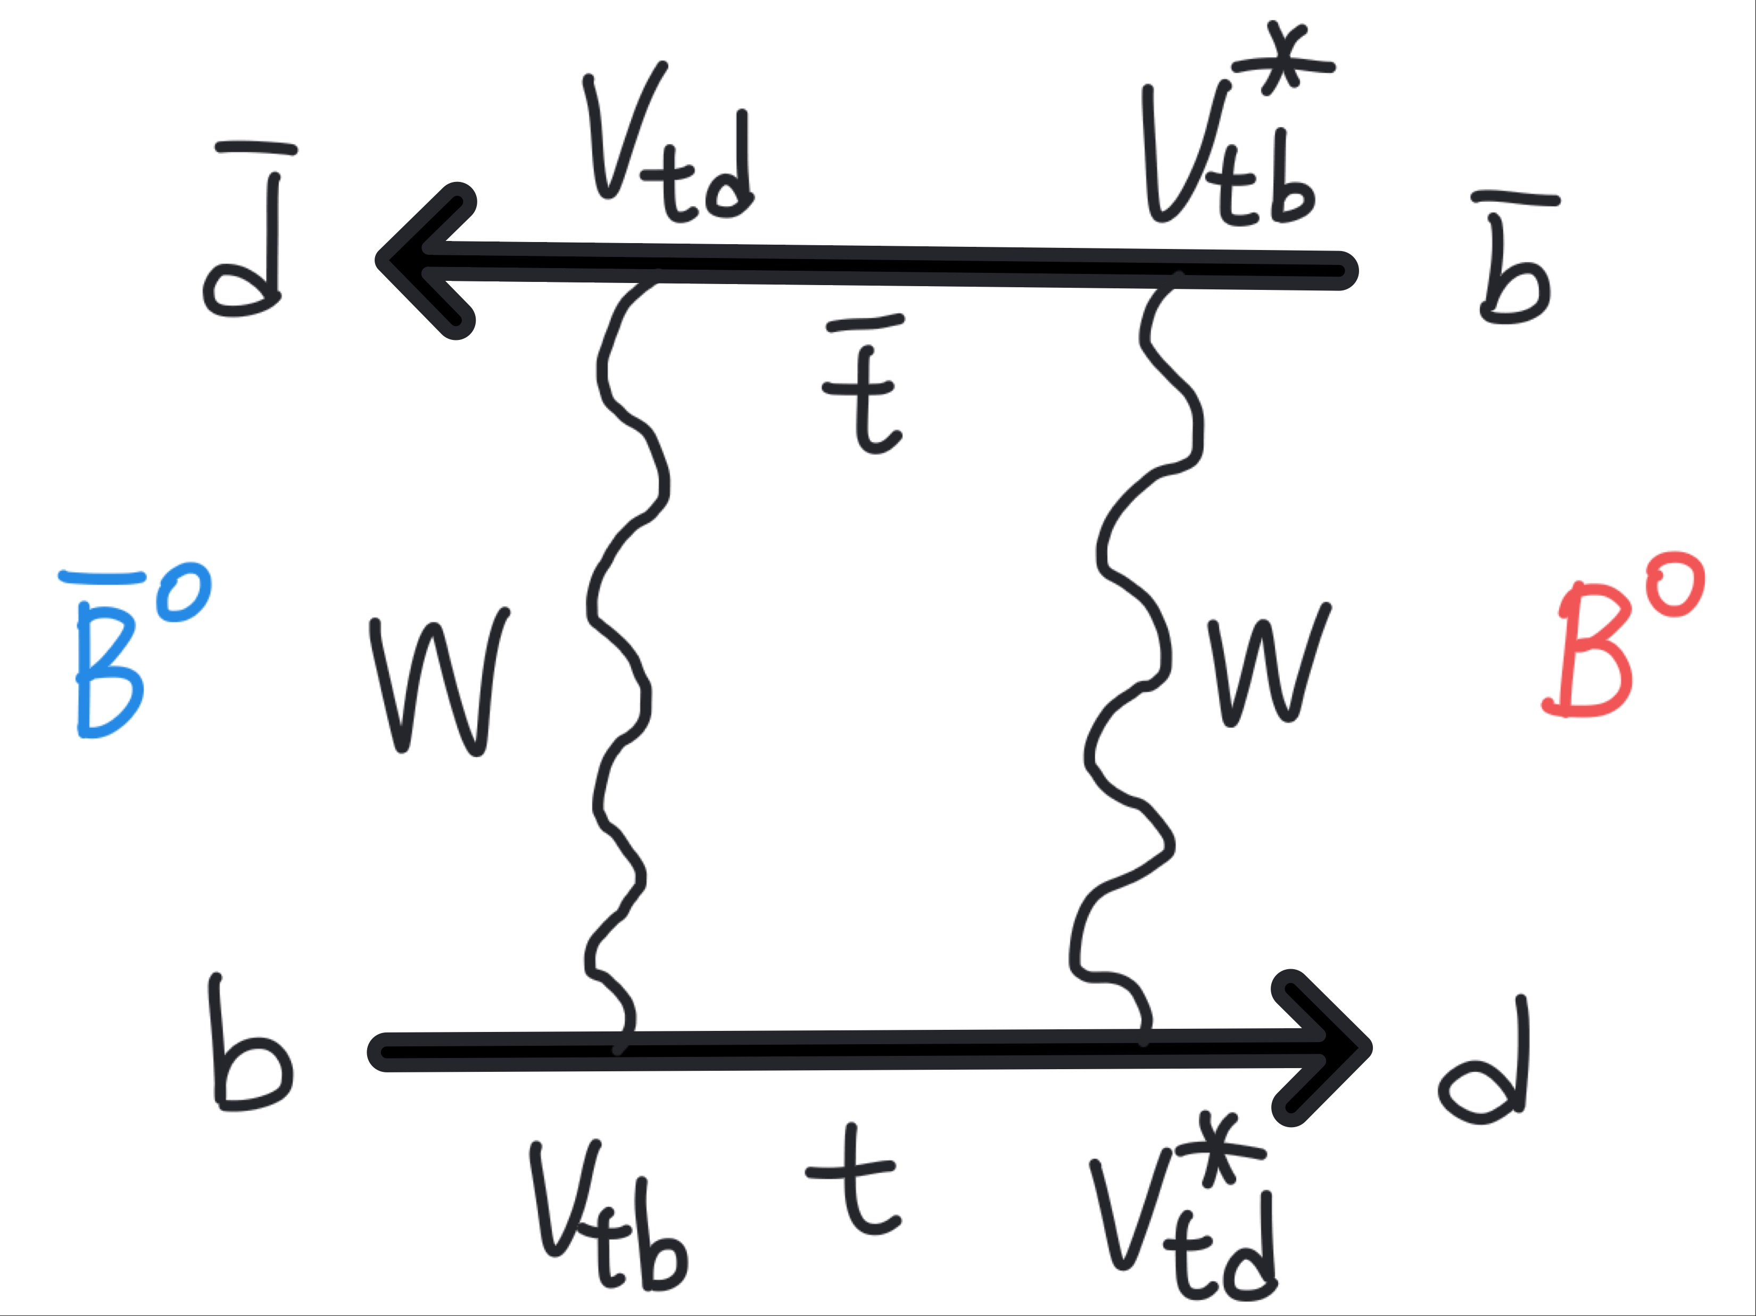

Introduction
$B^{0}−{\overline{B}}^{0}$ mixing
  B meson flavor changes via a box diagram and flavor oscillates with time evolution
In Belle II, B meson pairs are produced from $Υ(4S)$ decay and mixing occurs simultaneously in two B mesons due to quantum entanglement.
Fig1. box diagram

Slide 4
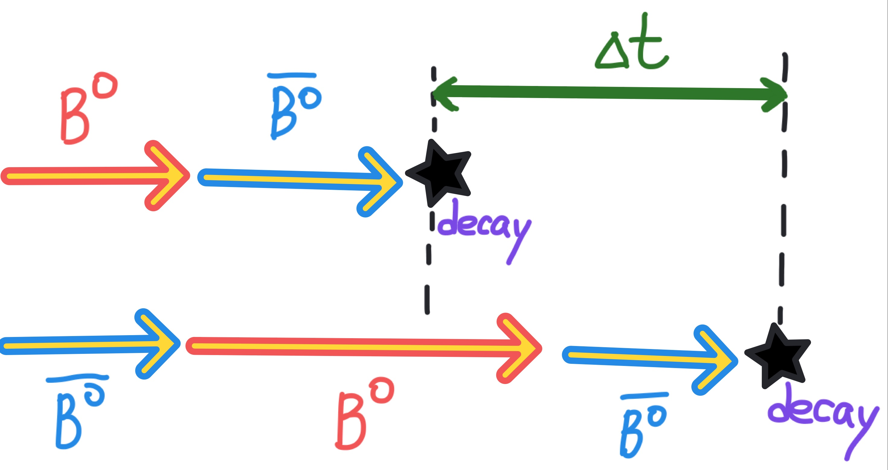

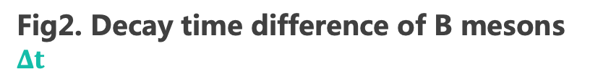
Introduction
Time-dependent analyses are performed by measuring a decay time difference of B mesons $Δt$.
Number of Mixed ($B^{0}−B^{0}$ or ${\overline{B}}^{0}−{\overline{B}}^{0}$) and Un-mixed ($B^{0}−{\overline{B}}^{0}$) events:
  $N_{M}∝e^{−\frac{\left|Δt\right|}{τ_{B^{0}}}\left[1−\cos\left(ΔmΔt\right)\right]}$
  $N_{U}∝e^{−\frac{\left|Δt\right|}{τ_{B^{0}}}\left[1+cos(ΔmΔt)\right]}$
Fig2. Decay time difference of B mesons $Δt$

Slide 5
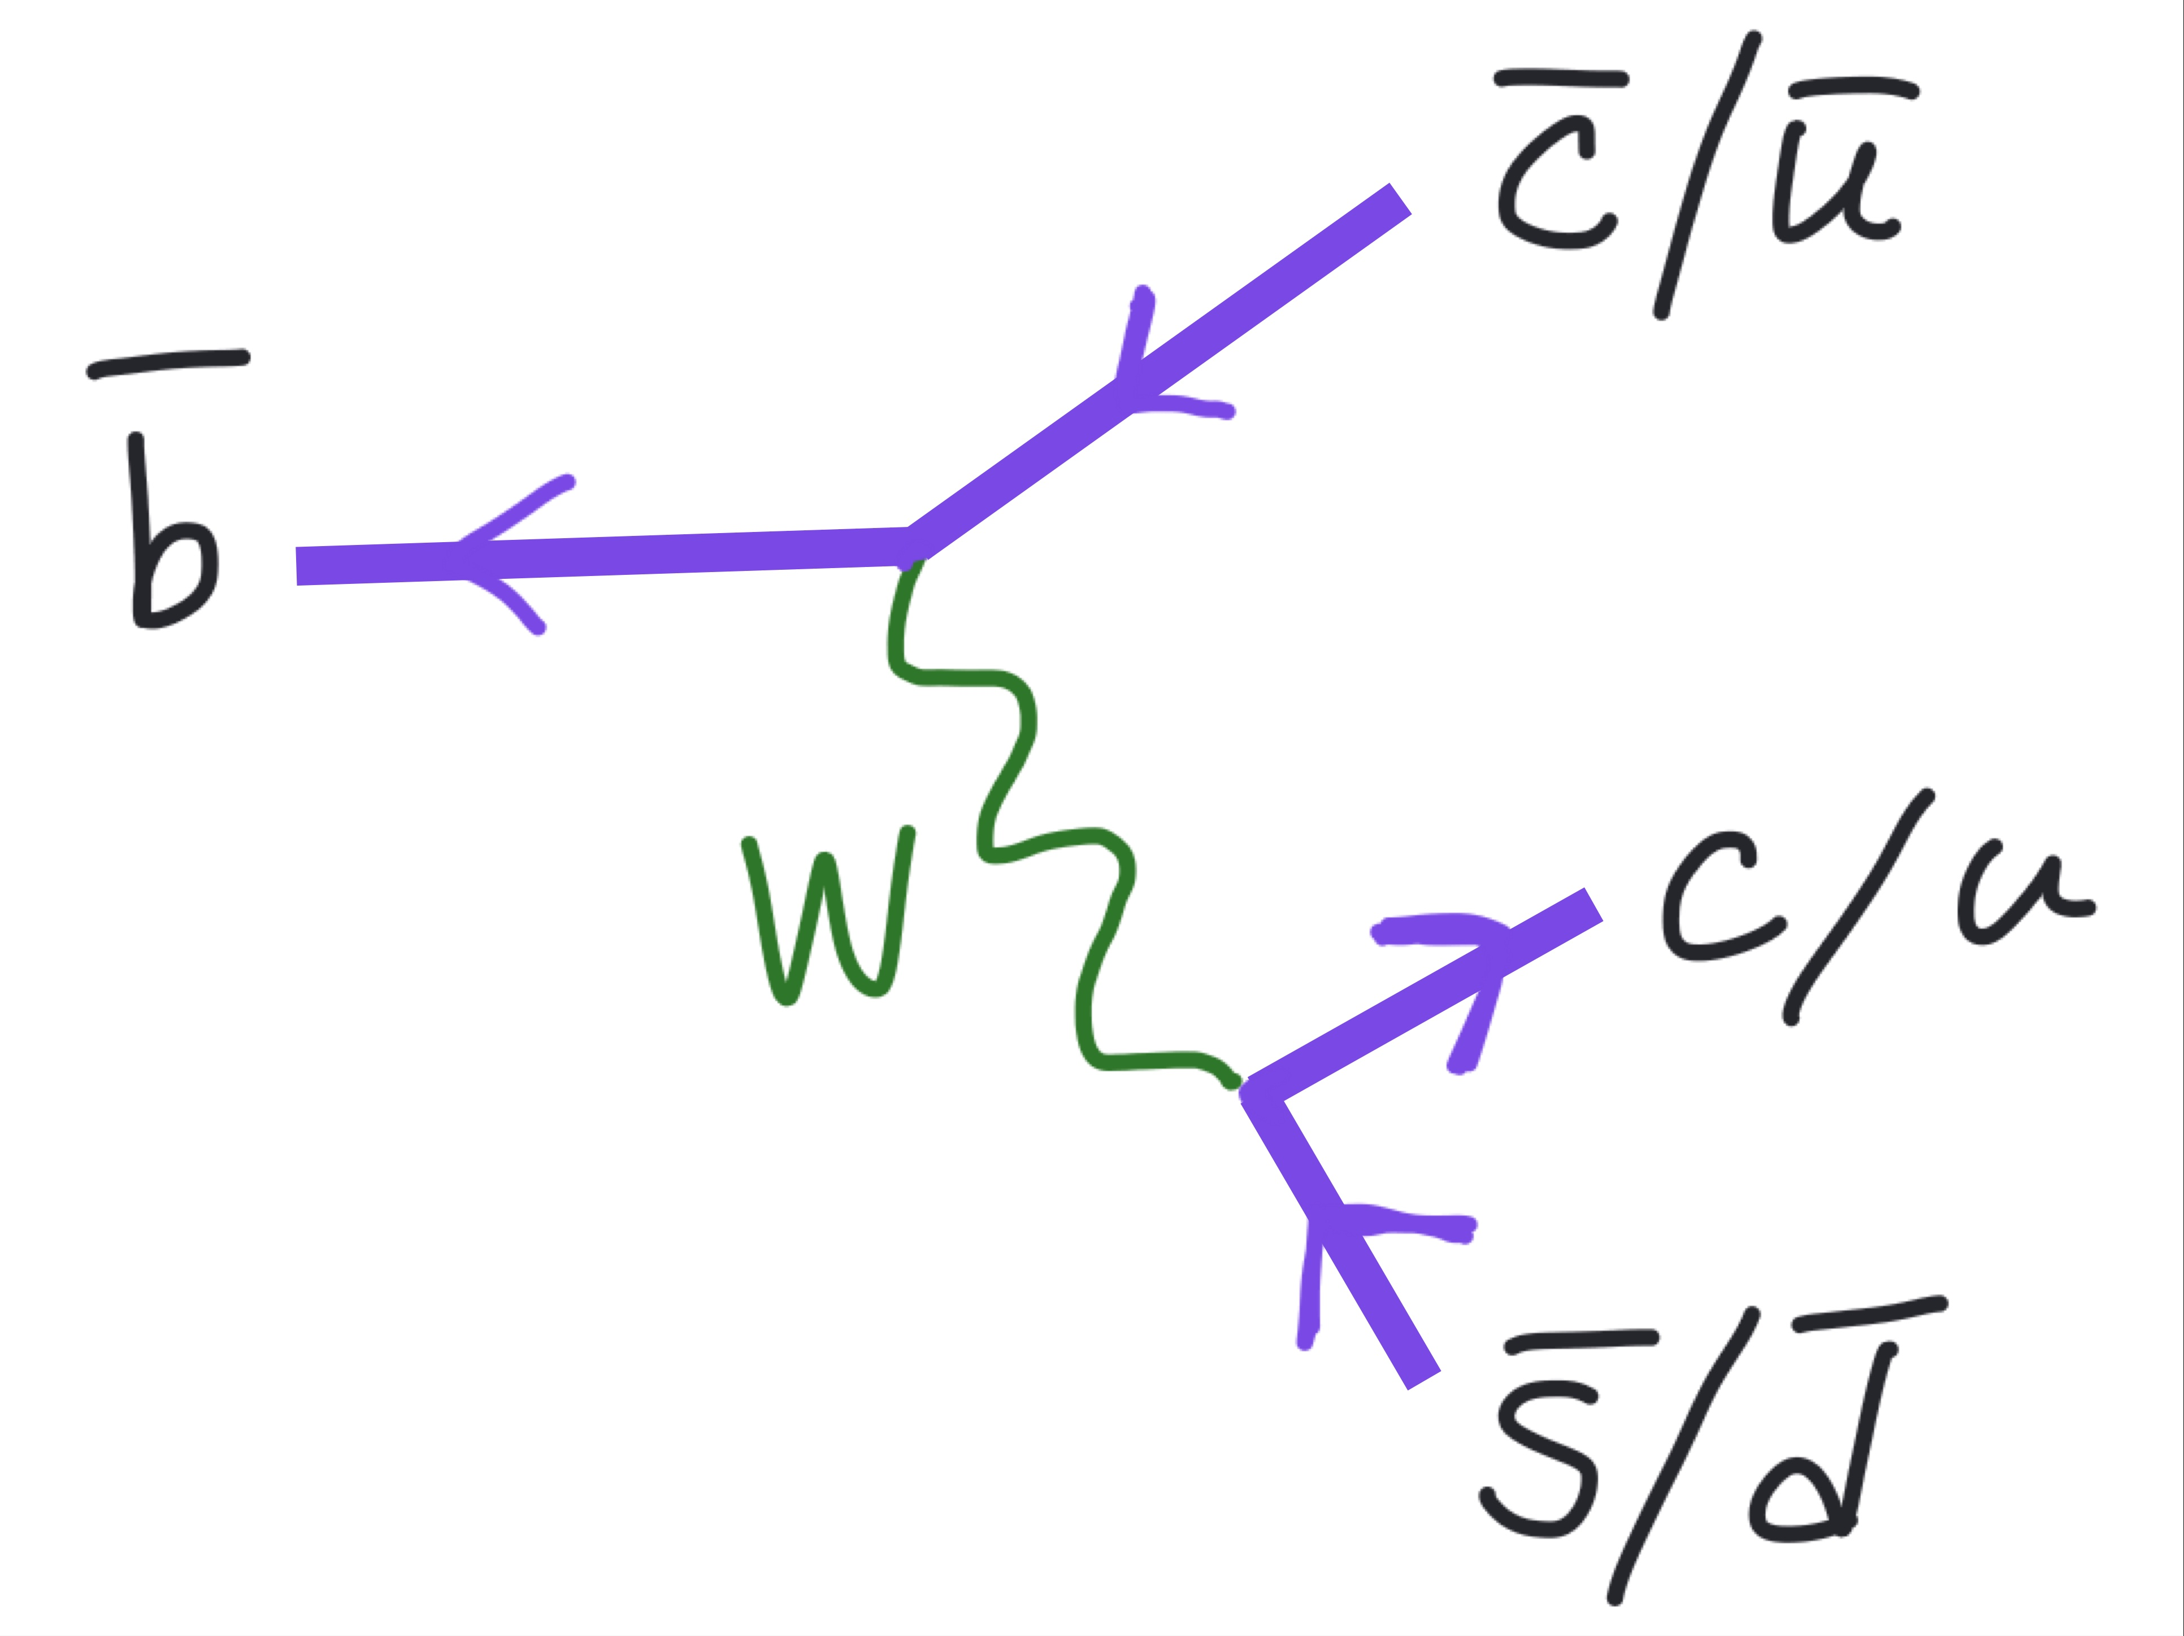
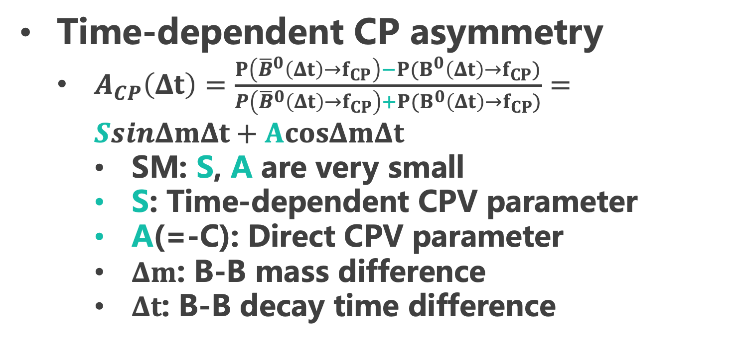
Time-dependent CP violation (TDCPV)
Time-dependent CP asymmetry
  $A_{CP}\left(Δt\right)=\frac{P\left({\overline{B}}^{0}\left(Δt\right)→f_{CP}\right)−P(B^{0}\left(Δt\right)→f_{CP})}{P\left({\overline{B}}^{0}\left(Δt\right)→f_{CP}\right)+P(B^{0}\left(Δt\right)→f_{CP})}=SsinΔmΔt+AcosΔmΔt$
    SM: S, A are very small
    S: Time-dependent CPV parameter
    A(=-C): Direct CPV parameter
    $Δm$: B-B mass difference
    $Δt$: B-B decay time difference
Fig3. Tree with box diagram.

Slide 6
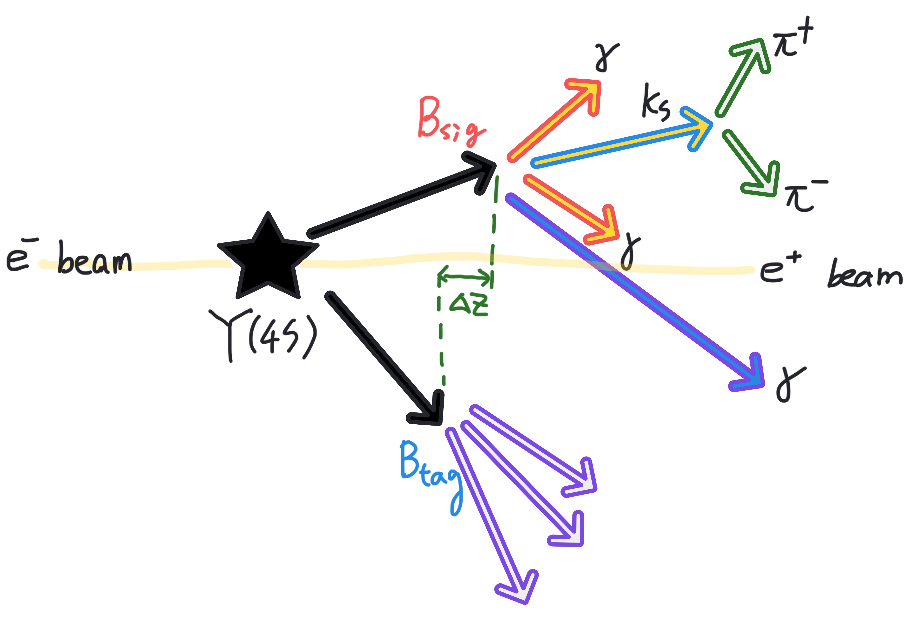
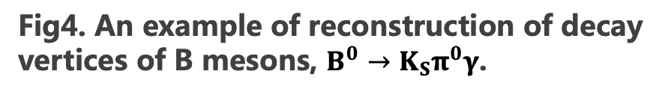

$$\text{Vertexing}$$
B mesons are produced through asymmetric energy collision of $e^{+}e^{−}$ beams, displacement of decay vertices is measured
$Δz\sim βγΔt$ relies on vertexing of both B mesons ($B_{sig}$ and $B_{tag}$ ), it converts to $Δt$ as known as boost effect
7 GeV
4 GeV
Fig4. An example of reconstruction of decay vertices of B mesons, $B^{0}→K_{S}π^{0}γ$.

Slide 7
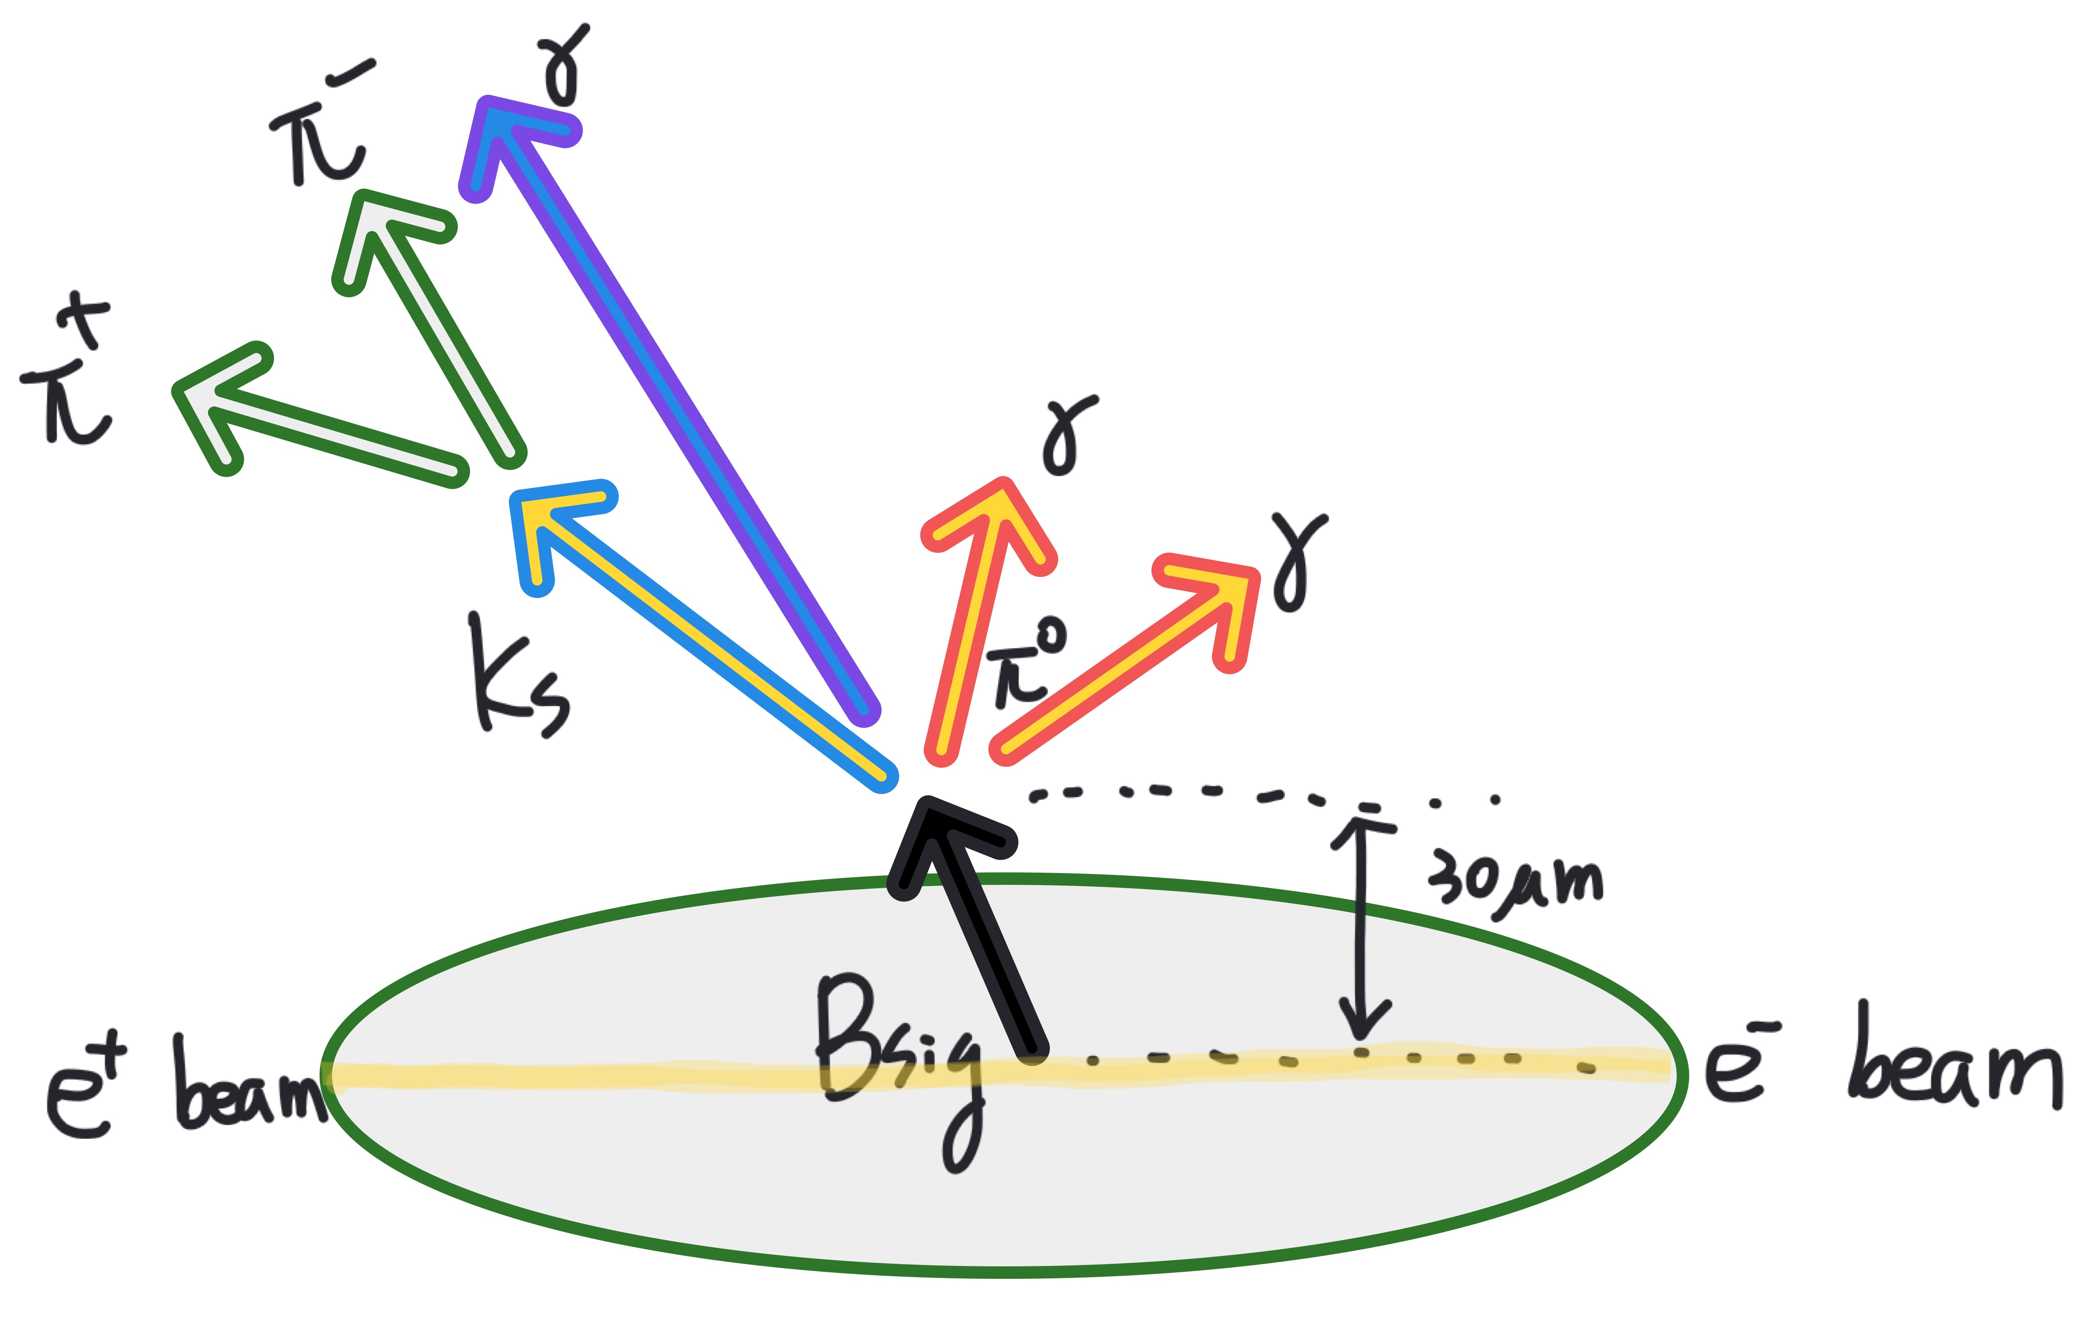

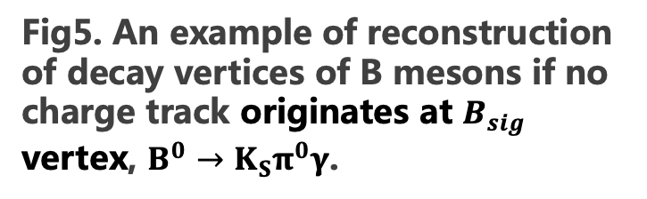
$$\text{Vertexing}$$
Beam spot constraining technique if no charge track originates at $B_{sig}$ vertex
Extrapolate $K_{s}$ flight to the beam spot
Fit $Υ\left(4S\right)→B^{0}{\overline{B}}^{0}$ with kinematical constraint
Validate using $B^{0}→J/ψK_{s}$ control sample
The vertex precision is related to vertex detector resolution
Fig5. An example of reconstruction of decay vertices of B mesons if no charge track originates at $B_{sig}$ vertex, $B^{0}→K_{S}π^{0}γ$.

Slide 8
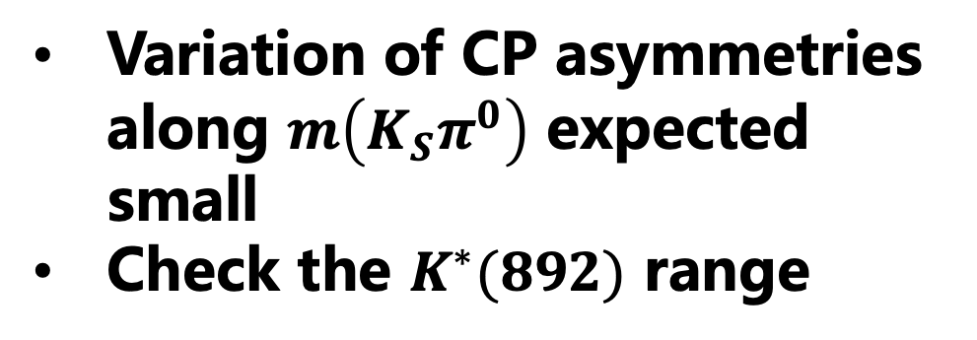
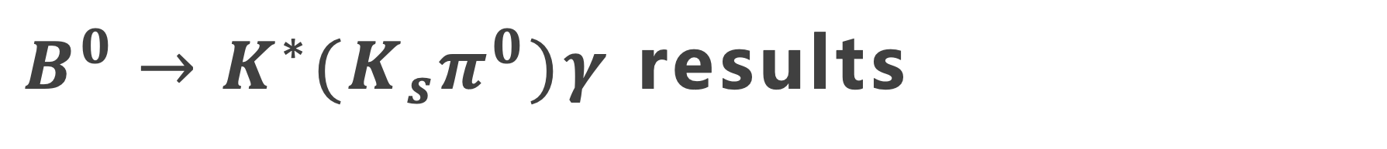

$B^{0}→{K^{∗}(K}_{s}π^{0})γ$ results
Variation of CP asymmetries along $m\left(K_{S}π^{0}\right)$ expected small
Check the $K^{∗}(892)$ range
didn’t find released results in Belle II web page. Who should I talk to?
Fig6. $B^{0}→K_{S}π^{0}γ$.

Slide 9
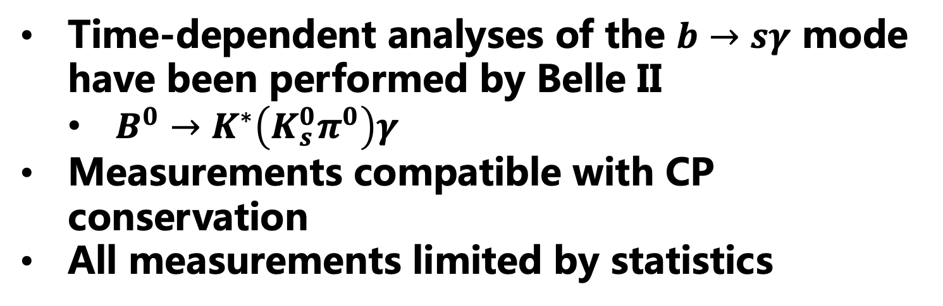

Summary of the $b→sγ$ mode
Time-dependent analyses of the $b→sγ$ mode have been performed by Belle II
  $B^{0}→K^{∗}\left(K_{s}^{0}π^{0}\right)γ$
Measurements compatible with CP conservation
All measurements limited by statistics

Slide 10
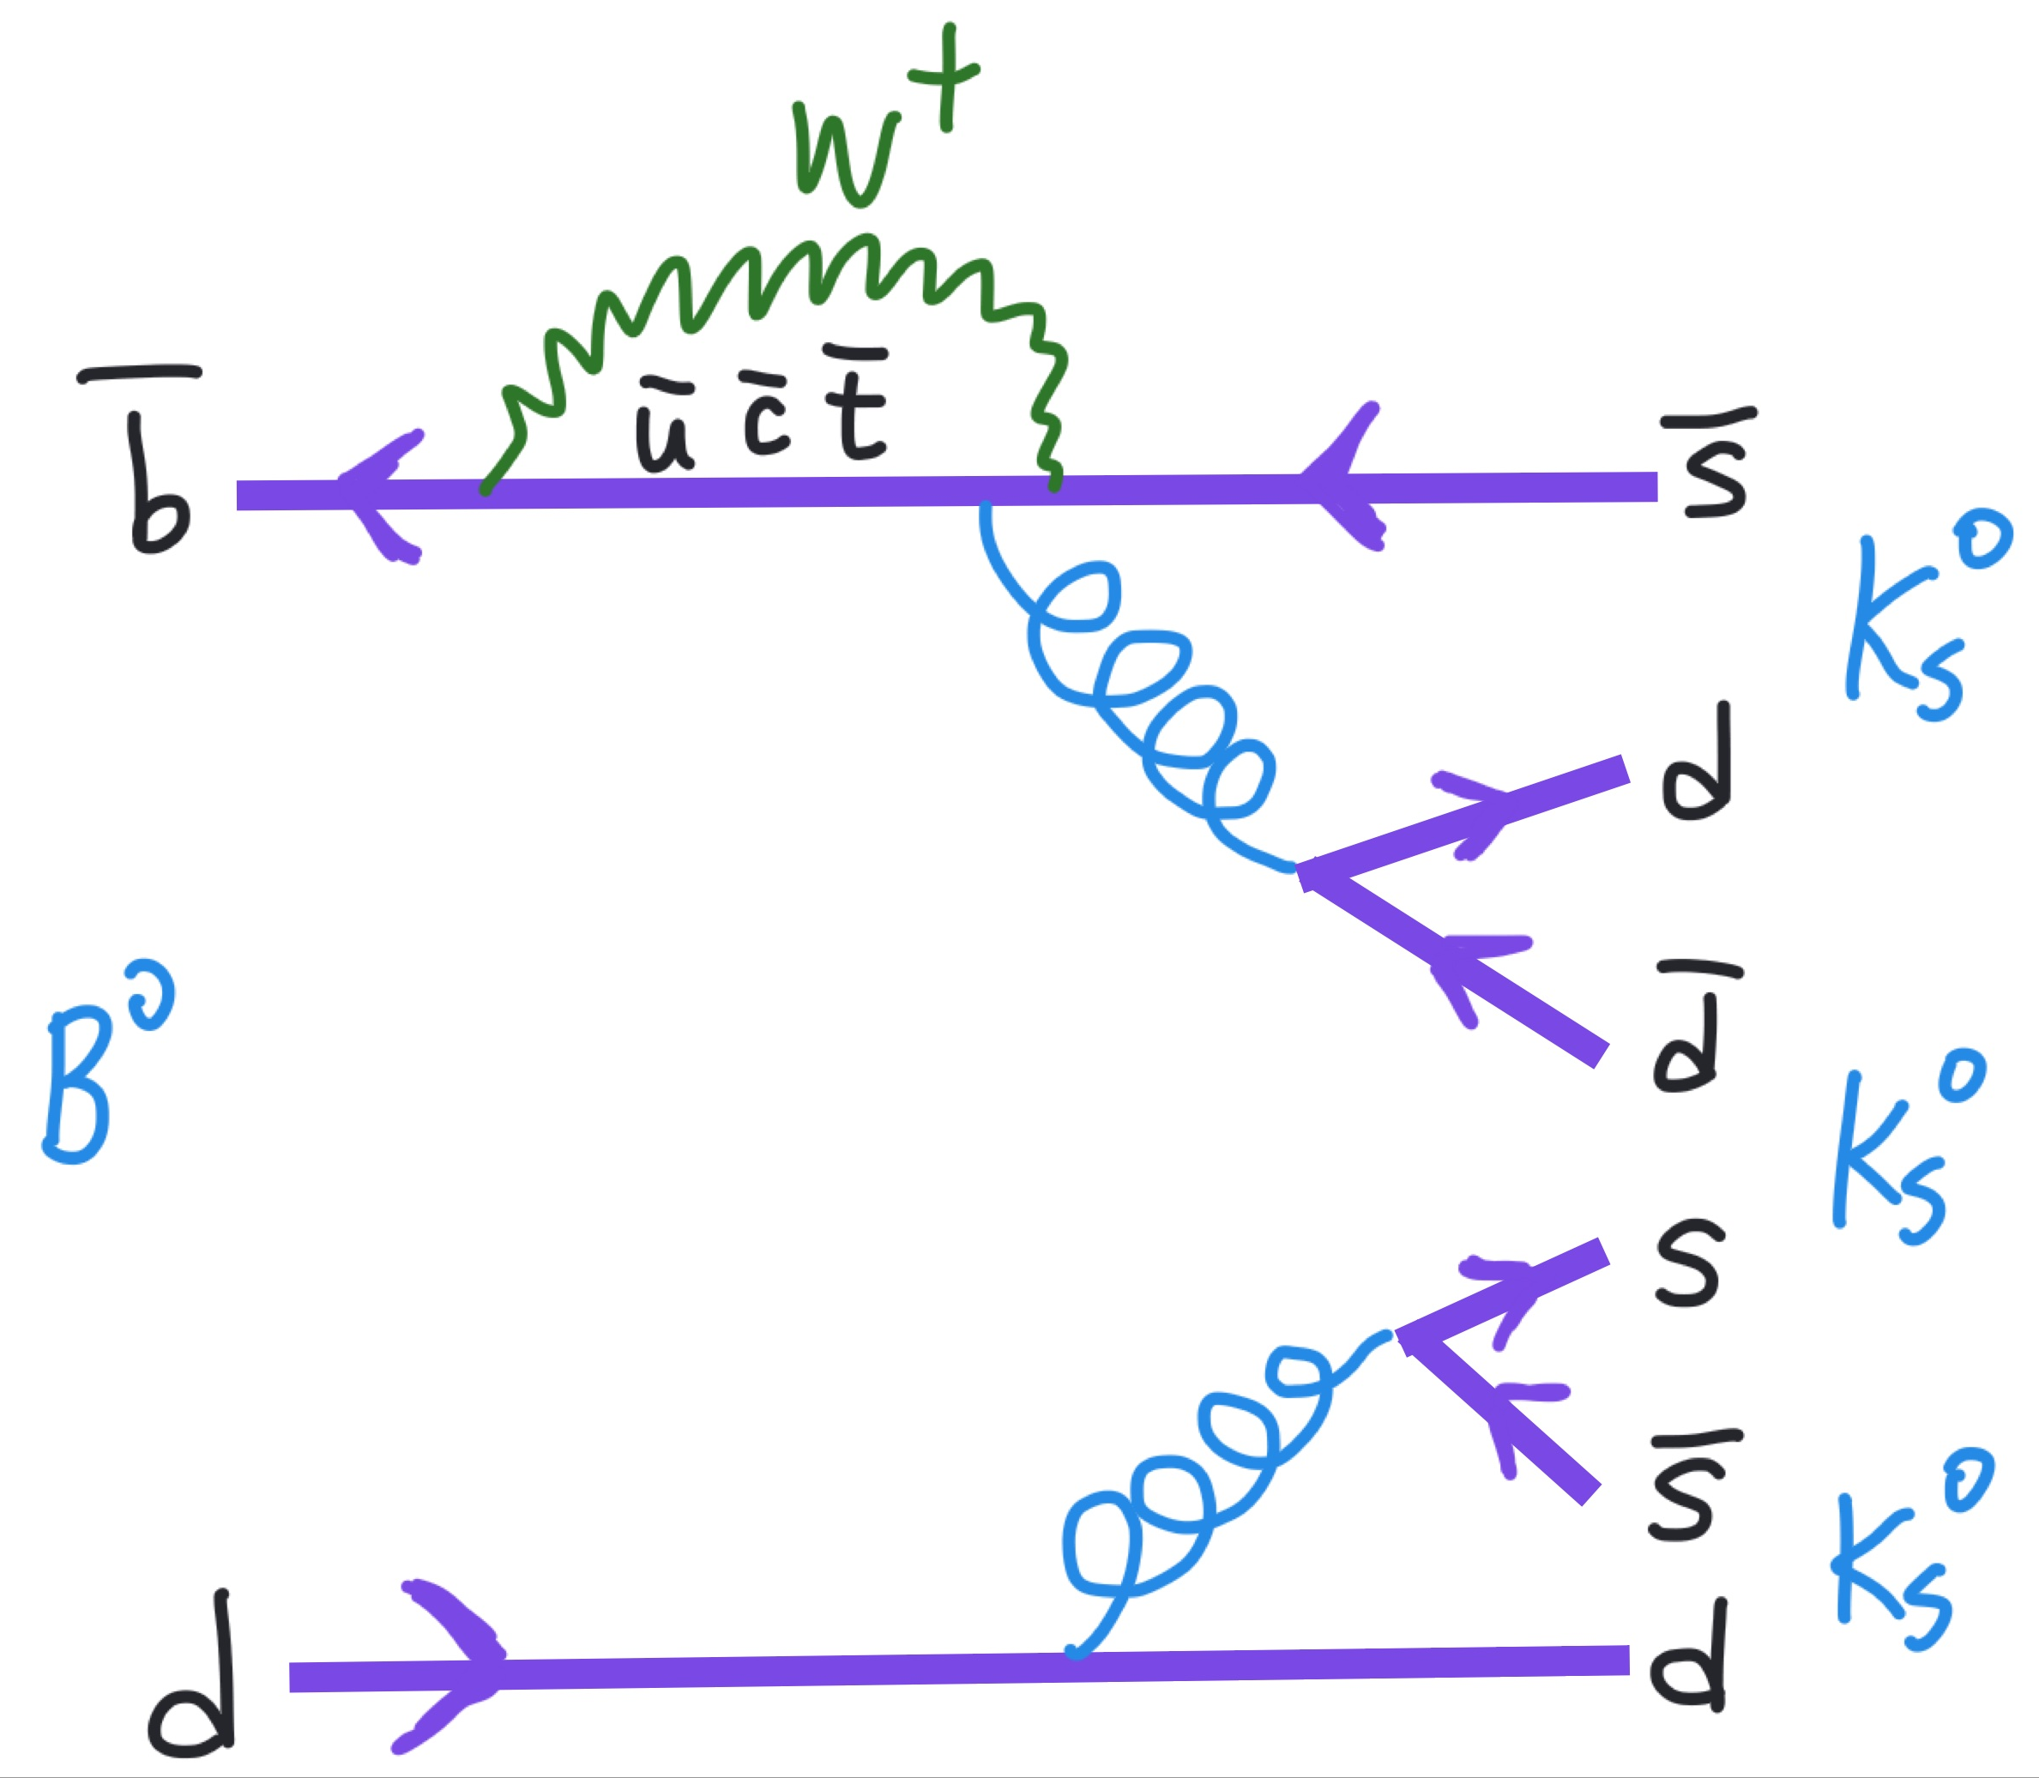
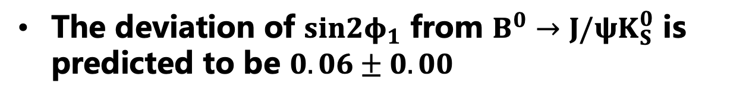

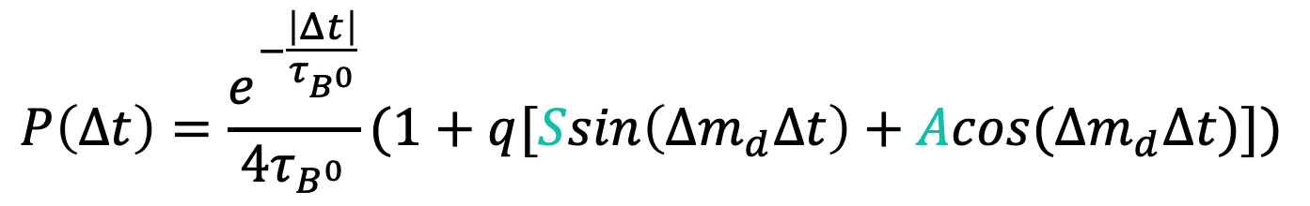
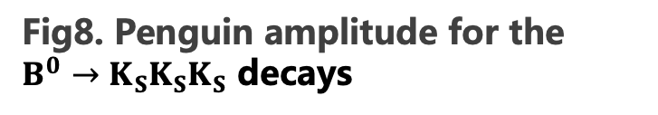
Penguin dominate: $B^{0}→K_{s}K_{s}K_{s}$
$$P\left(Δt\right)=\frac{e^{−\frac{\left|Δt\right|}{τ_{B^{0}}}}}{4τ_{B^{0}}}(1+q[Ssin\left(Δm_{d}Δt\right)+Acos(Δm_{d}Δt)])$$
The deviation of $sin2φ_{1}$ from $B^{0}→J/ψK_{S}^{0}$ is predicted to be $0.06±0.00$
Fig8. Penguin amplitude for the $B^{0}→K_{S}K_{S}K_{S}$ decays

Slide 11

Penguin dominate: $B^{0}→K_{s}K_{s}K_{s}$
Belle experiment using 772 M $B\overline{B}$ pairs
  $S=−0.71±0.23 \left(stat\right)±0.05 \left(syst\right)$
  $A=0.12±0.16 \left(stat\right)±0.05 (syst)$
BaBar experiment using 468 M $B\overline{B}$ pairs
  $S=−0.94{±_{0.21}^{0.24}}_{}\left(stat\right)±0.06 \left(syst\right)$
  $A=0.17±0.18 \left(stat\right)±0.04 \left(syst\right)$
  Belle II data in this analysis using 200 M $B\overline{B}$ pairs
  $S=−1.86±0.83 \left(stat\right)±0.09 \left(syst\right)$
  $A=−0.22±0.29 \left(stat\right)±0.04 (syst)$
Fig8. Penguin amplitude for the $B^{0}→K_{S}K_{S}K_{S}$ decays

Slide 12
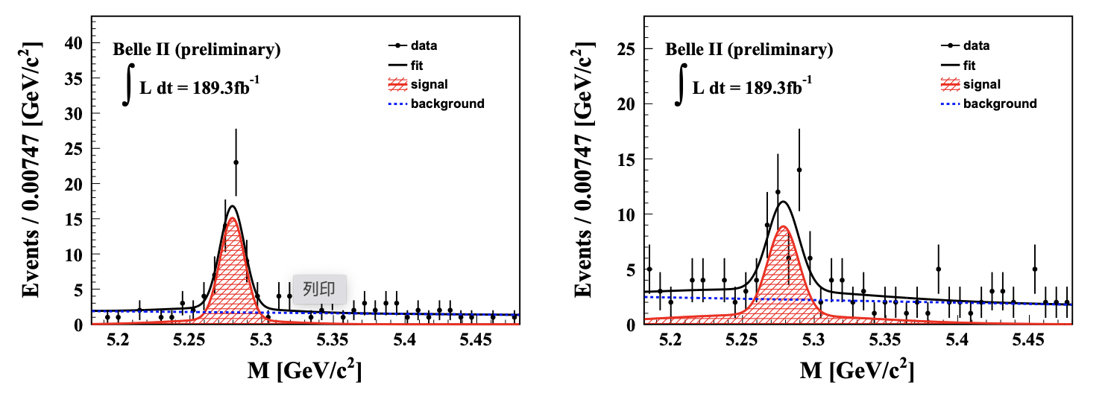

The M_{bc} distributions: $B^{0}→K_{s}K_{s}K_{s}$

Slide 13
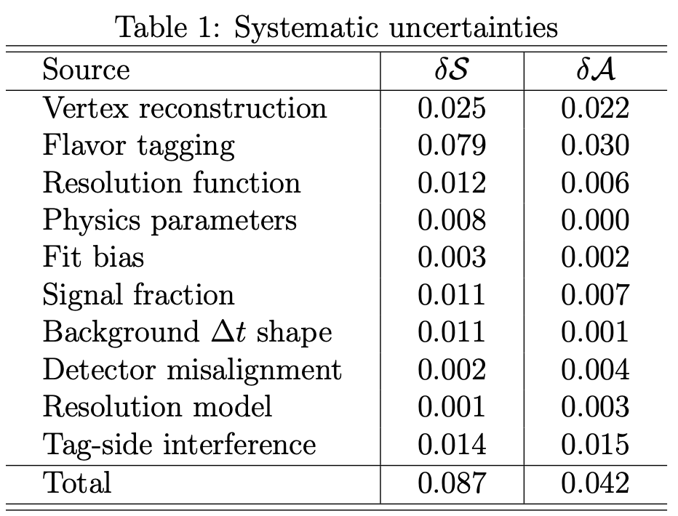
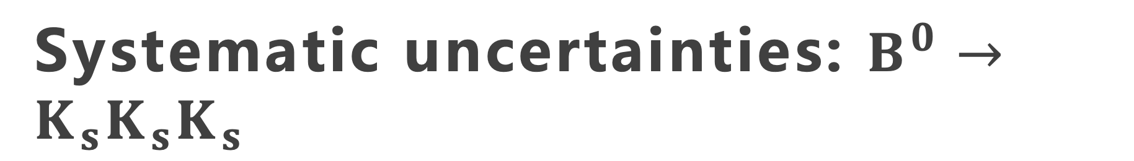
Systematic uncertainties: $B^{0}→K_{s}K_{s}K_{s}$
Dominate systematic uncertainties is Flavor tagging

Slide 14
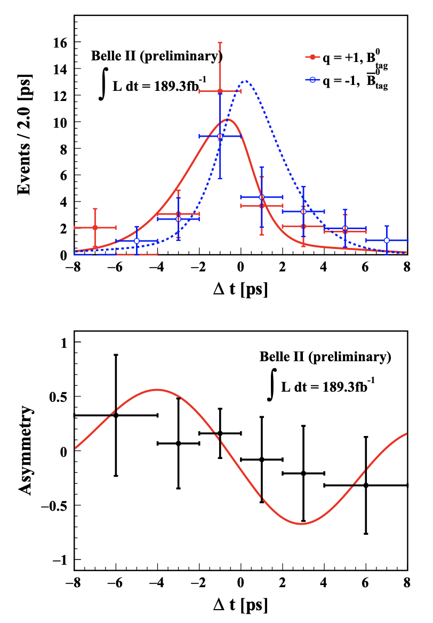
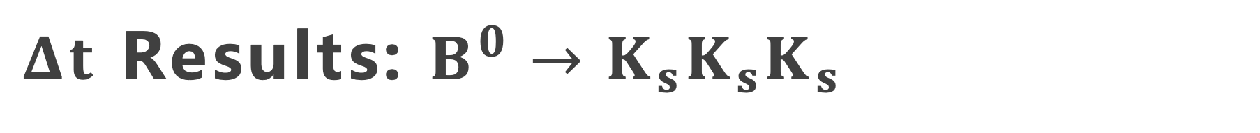
$Δt$ Results: $B^{0}→K_{s}K_{s}K_{s}$
measurements limited by statistics

Slide 15
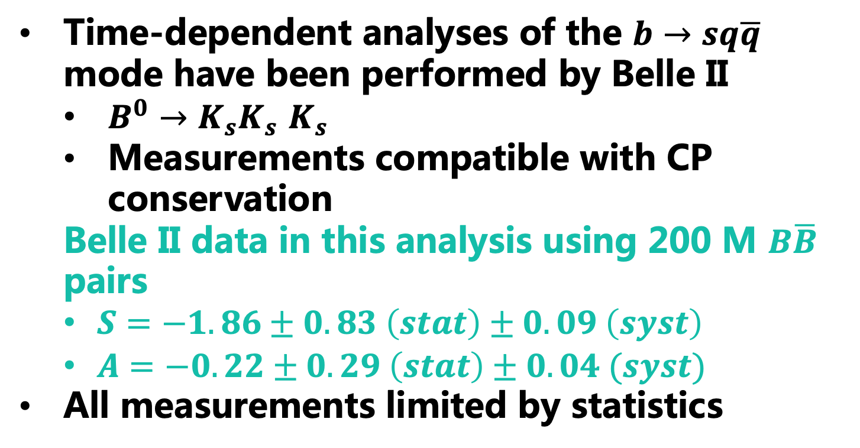

Summary of the $b→sq\overline{q}$ mode
Time-dependent analyses of the $b→sq\overline{q}$ mode have been performed by Belle II
  $B^{0}→K_{s}K_{s}$ $K_{s}$
  Measurements compatible with CP conservation
  Belle II data in this analysis using 200 M $B\overline{B}$ pairs
  $S=−1.86±0.83 \left(stat\right)±0.09 \left(syst\right)$
  $A=−0.22±0.29 \left(stat\right)±0.04 (syst)$
All measurements limited by statistics

Slide 16
backup

Slide 17

Introduction
Time-dependent analyses are performed by measuring a decay time difference of B mesons $Δt$.
Fig2. Decay time difference of B mesons $Δt$

Slide 18

Time-dependent CP violation (TDCPV)
Induced by quantum interference with decay to the CP-eigenstates
Time-dependent CP asymmetry
  $A_{CP}\left(Δt\right)=\frac{P\left({\overline{B}}^{0}\left(Δt\right)→f_{CP}\right)−P(B^{0}\left(Δt\right)→f_{CP})}{P\left({\overline{B}}^{0}\left(Δt\right)→f_{CP}\right)+P(B^{0}\left(Δt\right)→f_{CP})}=SsinΔmΔt+AcosΔmΔt$
    SM: S, A are very small
    S: Time-dependent CPV parameter
    A(=-C): Direct CPV parameter
    $Δm$: B-B mass difference
    $Δt$: B-B decay time difference
Fig3. Tree with box diagram.

Slide 19
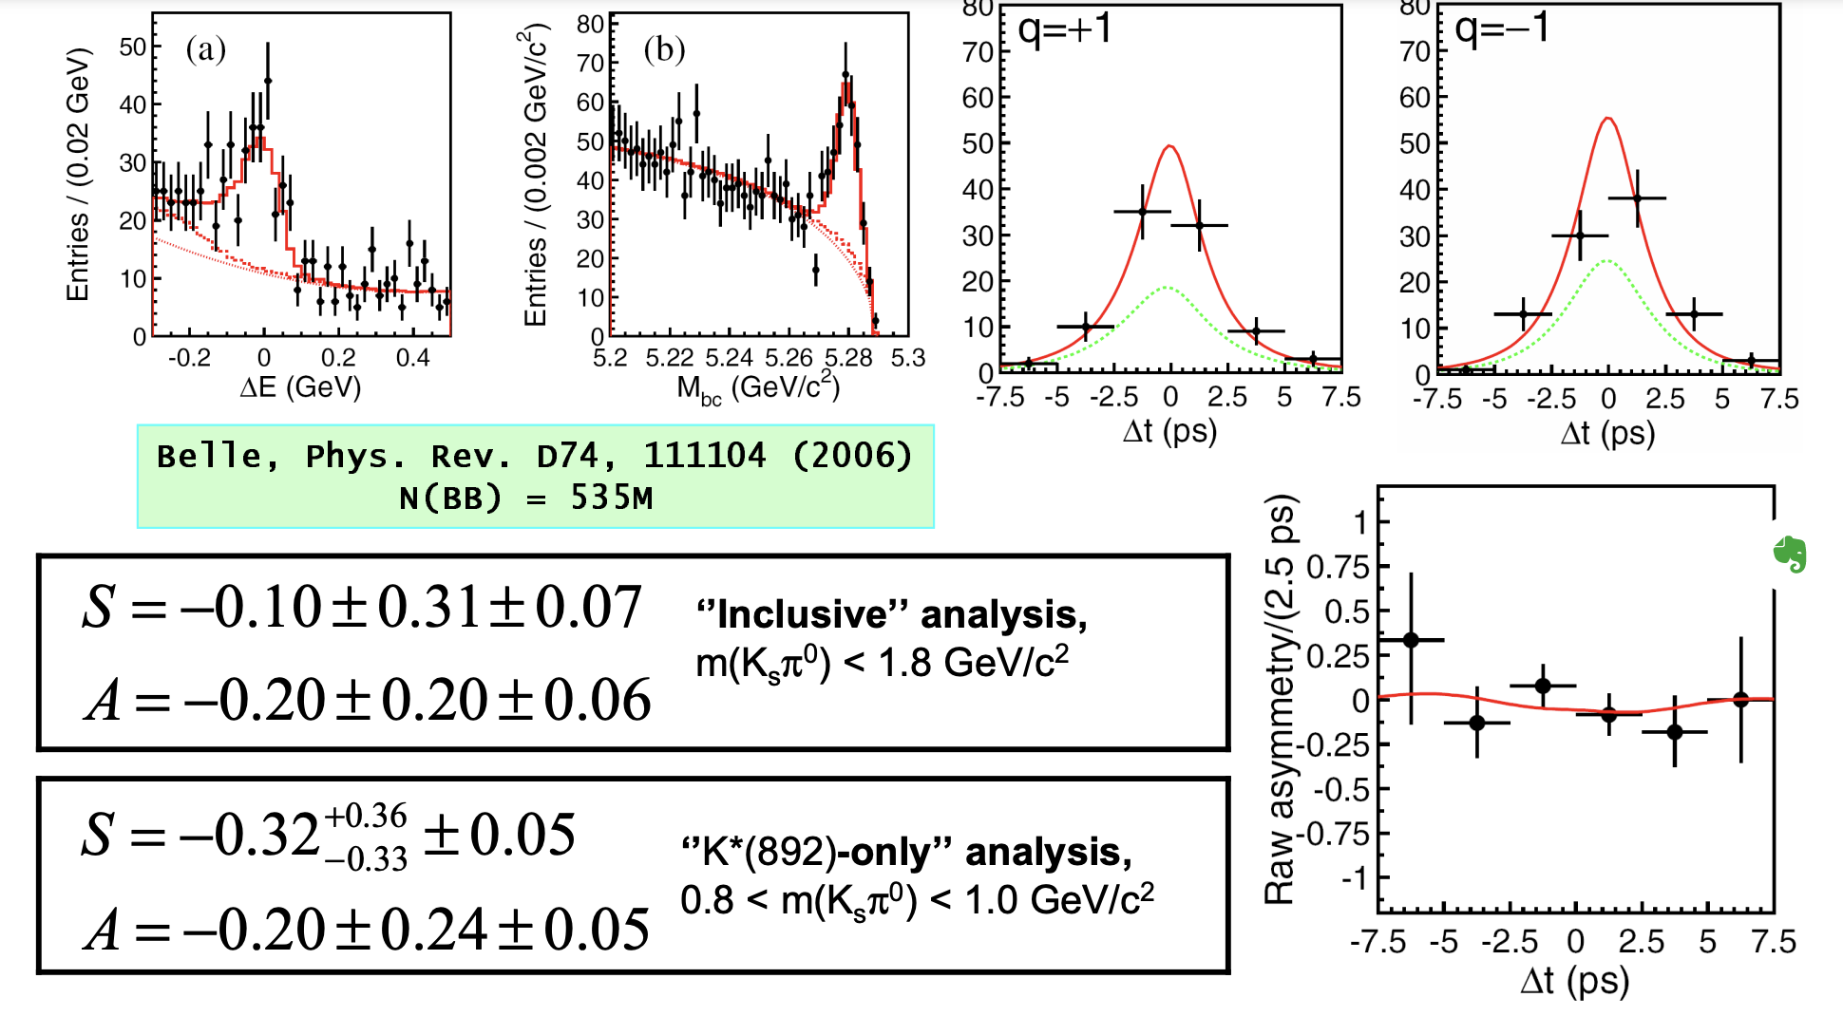
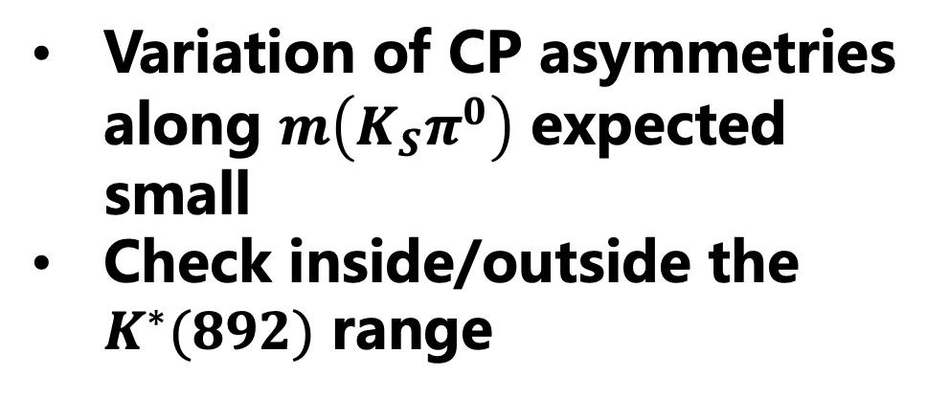
$B^{0}→{K^{∗}(K}_{s}π^{0})γ$ results
Variation of CP asymmetries along $m\left(K_{S}π^{0}\right)$ expected small
Check inside/outside the $K^{∗}(892)$ range
can’t find the new results in Belle II web page. Who should I talk to?
BELLE2-CONF-PH-2021-014

Slide 20
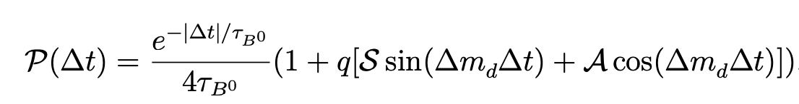
Penguin dominate: $B^{0}→K_{s}K_{s}K_{s}$
$$P\left(Δt\right)=\frac{e^{−\frac{\left|Δt\right|}{τ_{B^{0}}}}}{4τ_{B^{0}}}(1+q[Ssin\left(Δm_{d}Δt\right)+Acos(Δm_{d}Δt)])$$
Fig8. Penguin amplitude for the $B^{0}→K_{S}K_{S}K_{S}$ decays

Slide 21
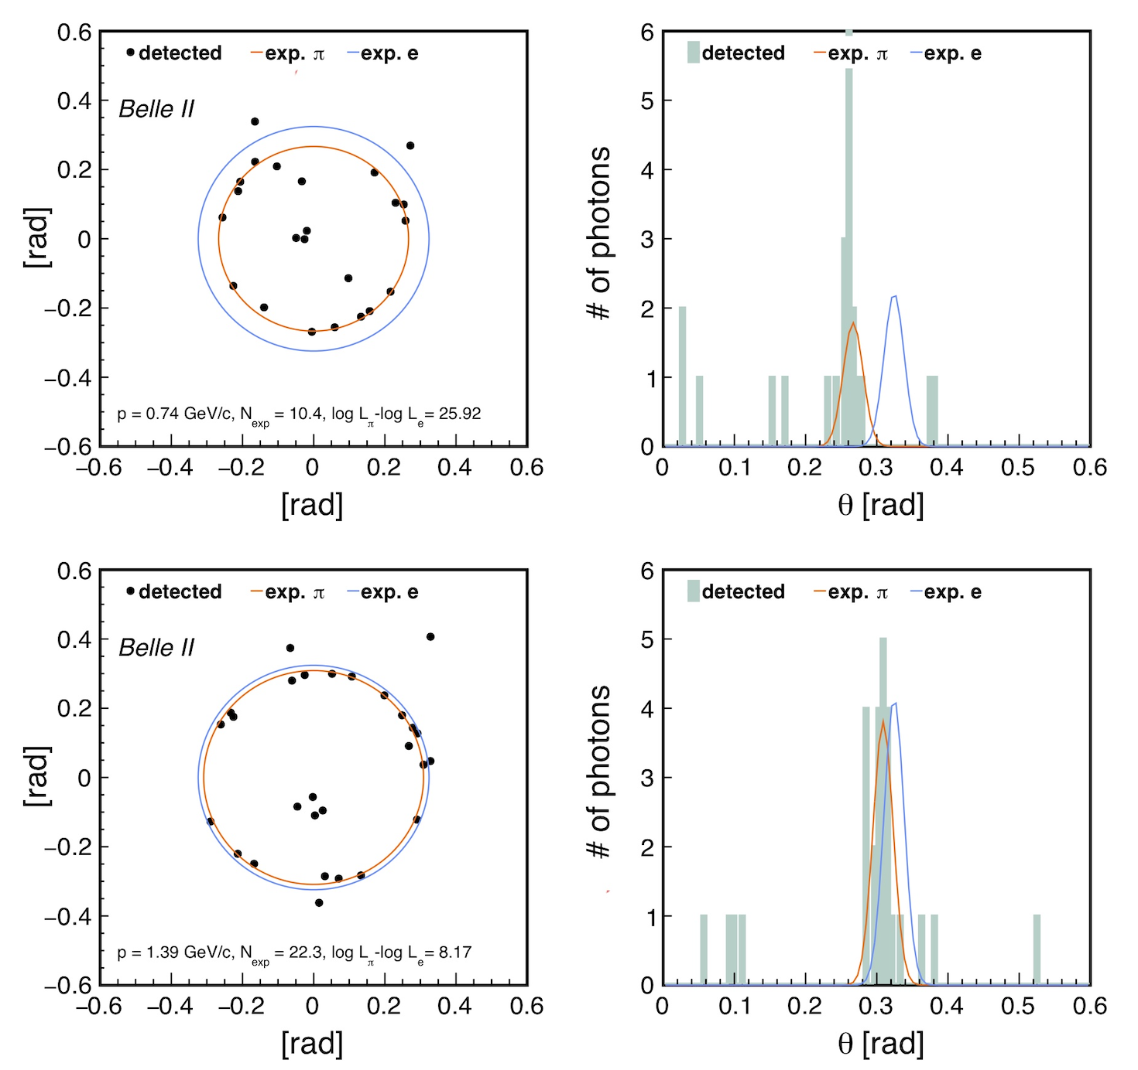

Performance highlights from Belle II
The observed Cherenkov rings for pion tracks in data from $K_{s}^{0}→π^{+}π^{−}$ decays with track momentum of p = 0.74 GeV/c (top) and p = 1.39 GeV/c (below). The red and blue rings show the expected rings for the pion and electron hypotheses respectively.
#2022 Belle II ICHEP note

Slide 22
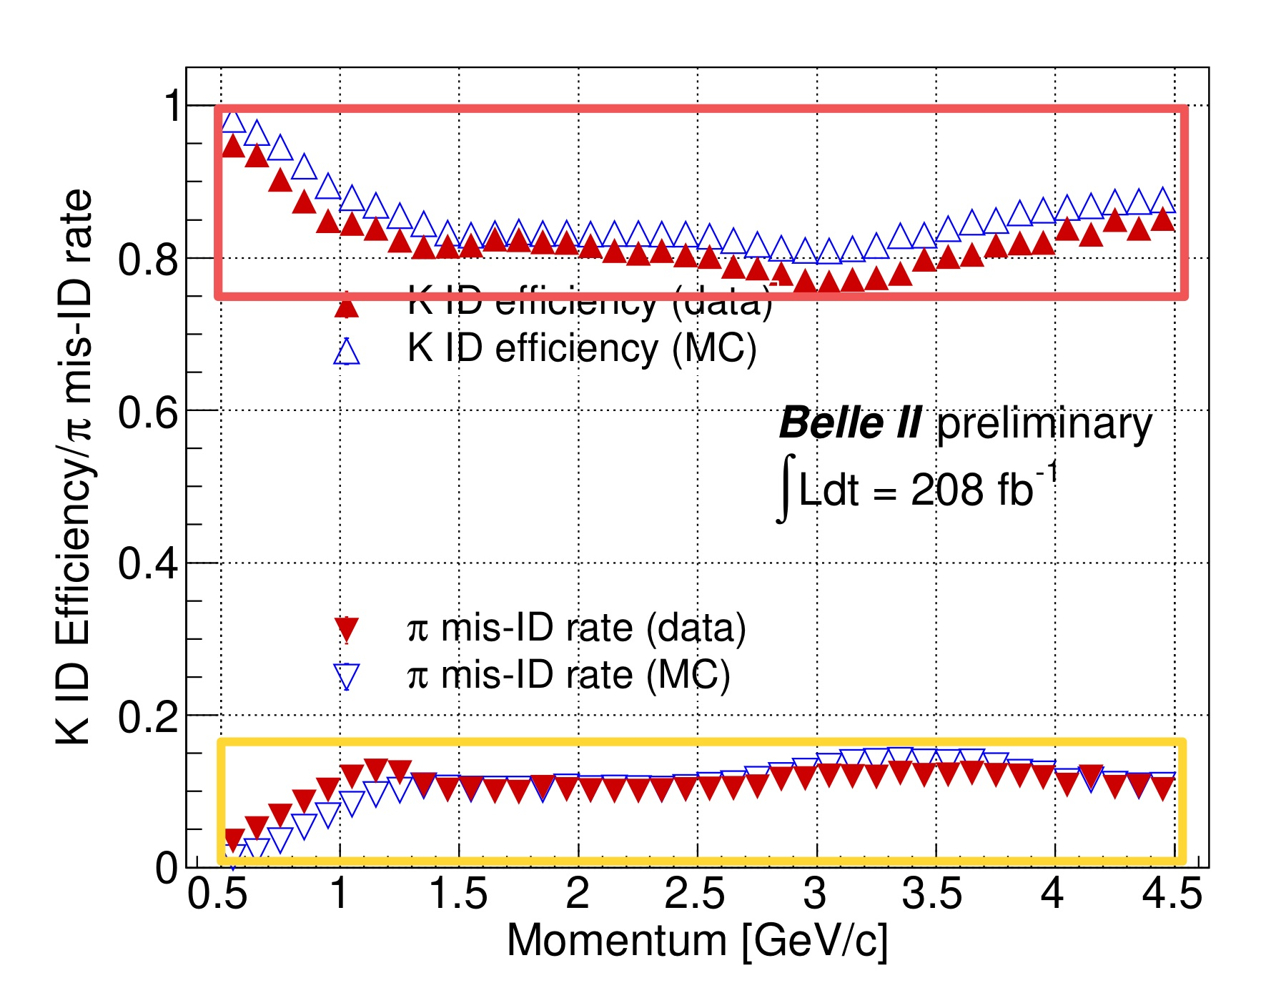

Performance highlights from Belle II
Binary ($R_{Kπ}>0.5$) $K/π$ separation performance as a function of the laboratory frame momentum measured with the $D^{∗+}→D^{0}π_{s}^{+}, D^{0}→K^{−}π^{+}$ sample. Upward pointing triangles: K identification efficiency for the dependent MC (empty blue triangles) and data (filled red). Downward pointing triangles: $π$ mis-identification probability for MC (empty blue) and data (filled red).
#2022 Belle II ICHEP note

Slide 23
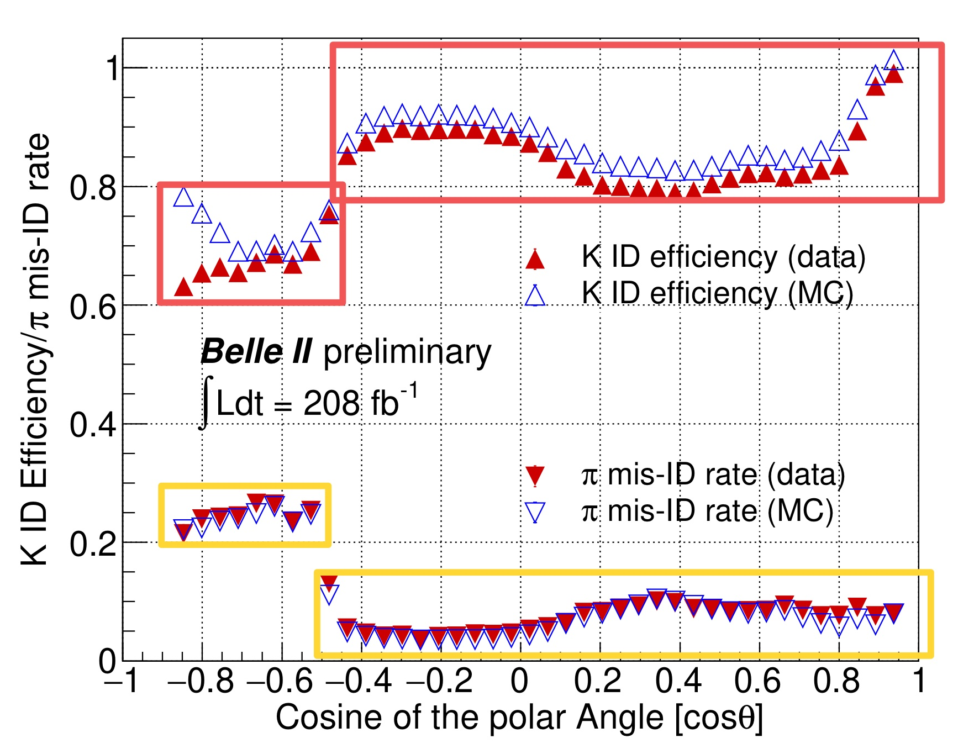
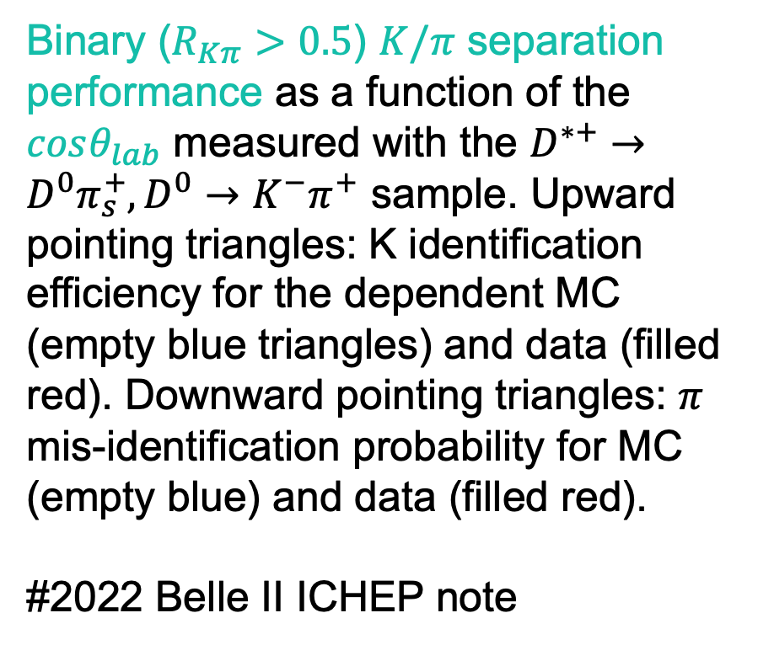
Performance highlights from Belle II
Binary ($R_{Kπ}>0.5$) $K/π$ separation performance as a function of the $cosθ_{lab}$ measured with the $D^{∗+}→D^{0}π_{s}^{+}, D^{0}→K^{−}π^{+}$ sample. Upward pointing triangles: K identification efficiency for the dependent MC (empty blue triangles) and data (filled red). Downward pointing triangles: $π$ mis-identification probability for MC (empty blue) and data (filled red).
#2022 Belle II ICHEP note

Slide 24
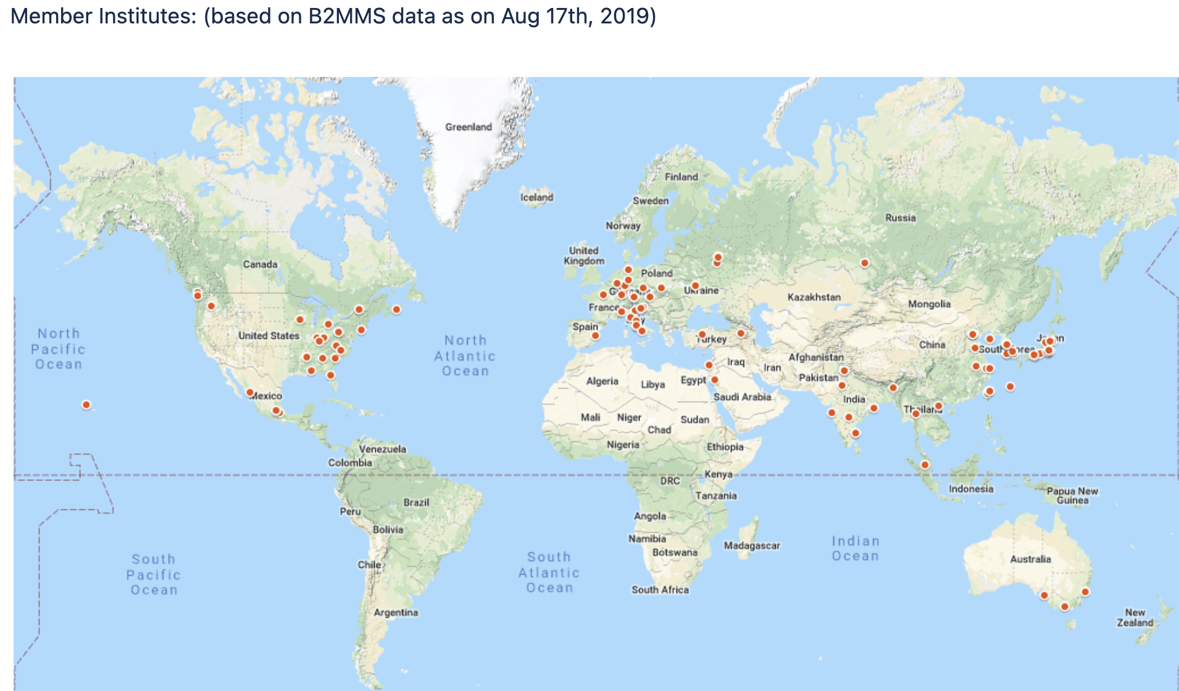
Belle II, international collaboration
KEK, Japan
#2022 Belle II public webpage

Slide 25
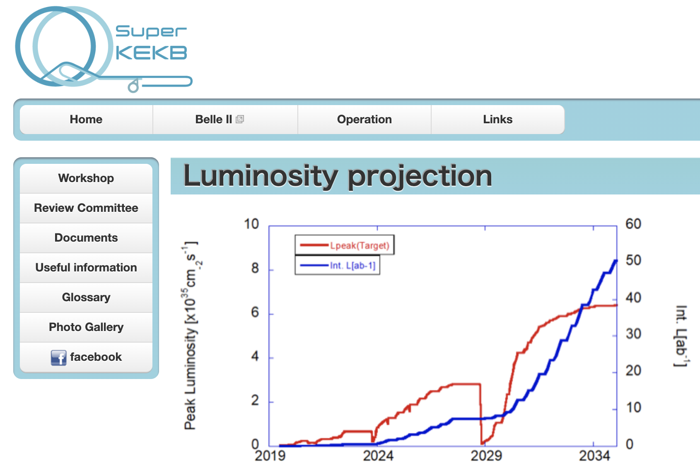
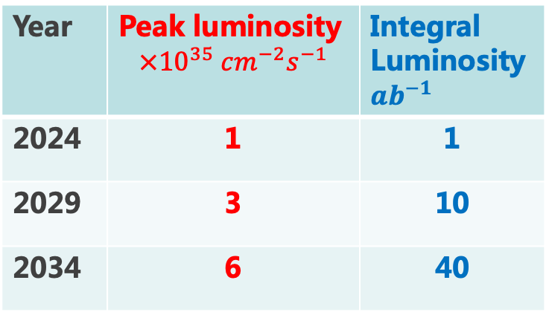
Accelerator: SuperKEKB
Goal
Year | Peak luminosity $$×{10}^{35} cm^{−2}s^{−1}$$ | Integral Luminosity $ab^{−1}$
2024 | 1 | 1
2029 | 3 | 10
2034 | 6 | 40
#2022 Belle II public webpage

Slide 26
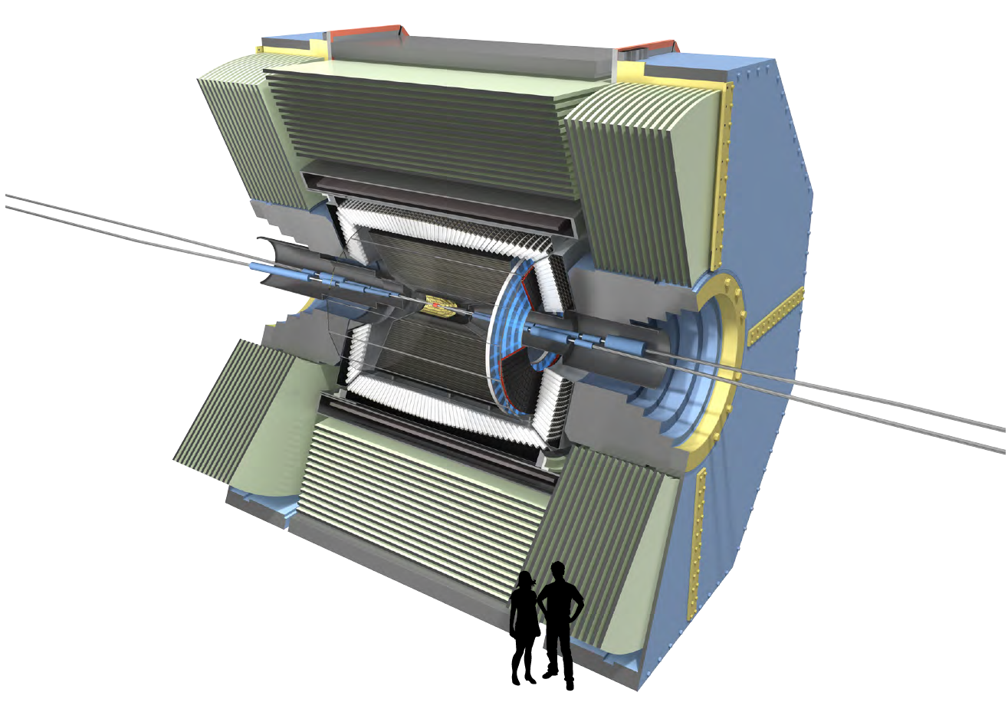
Detector: Belle-II
KL and muon detector
Resistive Plate Counter (barrel outer layers)
Scintillator + WLSF + MPPC
(end-caps , inner 2 barrel layers)
EM Calorimeter
CsI(Tl), waveform sampling electronics
Belle II Detector [735 collaborators, 101 institutes, 23 nations]
Particle Identification
Time-of-Propagation counter (barrel)
Prox. focusing Aerogel RICH (forward)
electrons (7 GeV)
Vertex Detector
2 layers Si Pixels (DEPFET) +
4 layers Si double sided strip DSSD
positrons (4 GeV)
Central Drift Chamber
Smaller cell size, long lever arm
#2022 Belle II public webpage
Belle II TDR, arXiv:1011.0352

