Slide 1
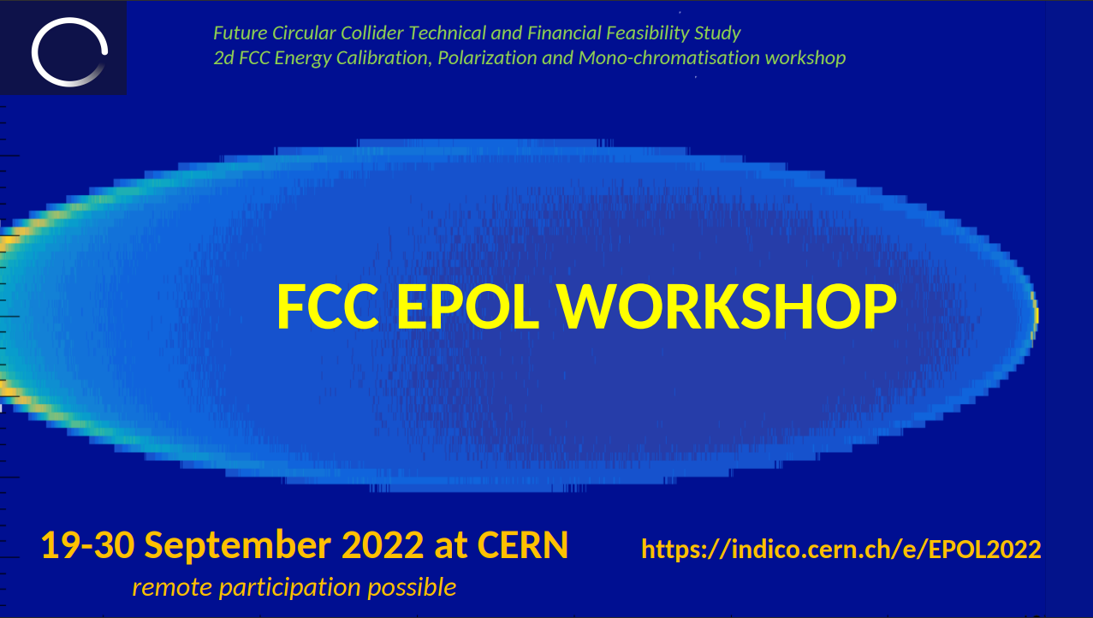
A quick summary of EPOL2 workshop
Aurélien MARTENS

Slide 2
Introduction
The key subjects of this workshop are summarized as follows: 1) Polarization simulations and spin-tune to beam energy relationship, wigglers and kickers 2) Simulation of the relationship between average beam energy and centre-of-mass energies 3) Polarimeter design, performance and integration 4) Measurements in particle physics experiments 5) Monochromatization
Was a very nice opportunity to meet with people involved in polarimetry for future FCCee, EIC, ILC, current JLAB and VEPP and former SLD and HERA
Overall an interesting week with several presentations form SuperKEKB upgrade team → I will not cover those
It made it clear (I think) that beyond its physics potential, SuperKEKB upgrade appears as a nice test bed both for EIC and FCCee
I recommend that you have a look, some talks may be of interest to you/some of you

Slide 3
A lot of information about beam polarization in rings
https://indico.cern.ch/event/1181966/contributions/5041445/attachments/2513986/4321673/22_09_19EPOL_Hoffstaetter.pdf

Slide 4
Spin transport from source to ring
https://indico.cern.ch/event/1181966/contributions/5041430/attachments/2511783/4317563/EIC_Polarized_Beams_VP.pdf

Slide 5
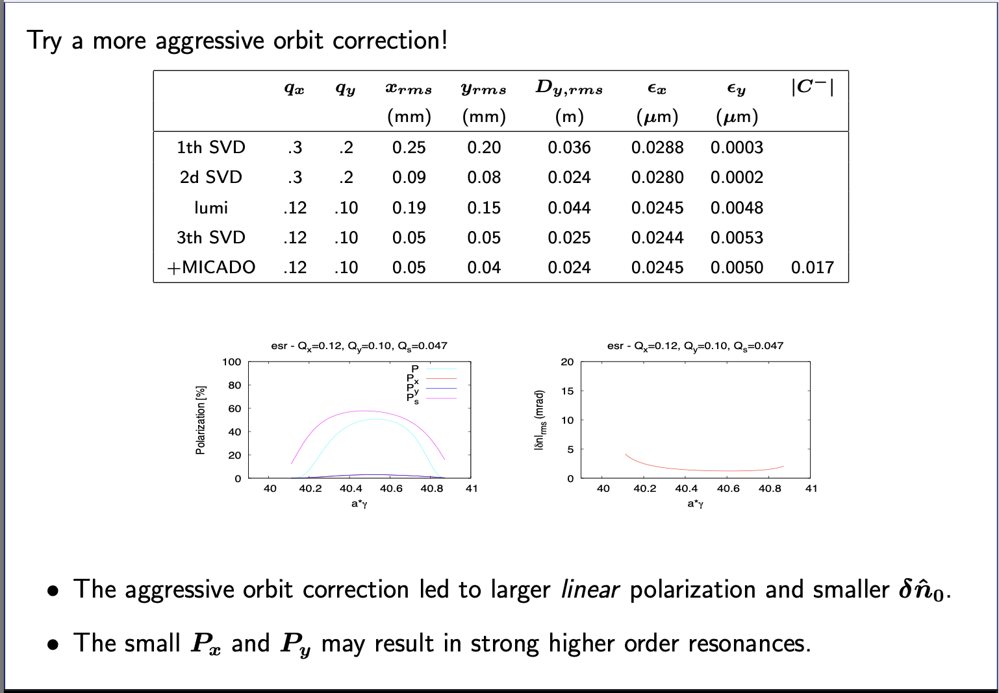
Ring spin dynamics - misalignments
https://indico.cern.ch/event/1181966/contributions/5051857/attachments/2512404/4318827/epol2022_esr_polarization.pdf

Slide 6
Polarimetry: some similarities with EIC
https://indico.cern.ch/event/1181966/contributions/5046168/attachments/2512081/4318158/220919_ComptonEIC_FCCpolWkShop_CGal.pdf

Slide 7
Beam polarization measurement at VEPP
https://indico.cern.ch/event/1181966/contributions/5046176/attachments/2512076/4319317/EPOL_report_Zakharov.pdf

Slide 8
EIC detectors

Slide 9
Conclusion
Do not hesitate to have a look to workshop content.
Some similarities with EIC (JLAB) polarimeters
Already exploited for electron detection, not quite for photon detection.

