Slide 1
Some thougts about transverse polarimetry for the SuperKEKB upgrade
Aurélien MARTENS

Slide 2
Introduction
The possibility of the phased approach of the upgrade has been mentioned
The first step would be do produce, transport and store polarized electron beams
A Compton polarimeter able to measure the transverse beam polarization would be nice (to actually show and quantify the polarization transport)
I try to look at this possibility today

Slide 3

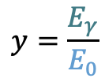
Compton cross-section
$$x=\frac{2E_{0}ω_{0}}{m^{2}}\left(1+\cos{θ_{0}}\right)$$
$$y=\frac{E_{γ}}{E_{0}}$$
The Compton cross-section averaged over scattered particles spins:
Differential cross-section
Transverse laser polarisation: nuisance parameter to minimize and keep under control
Transverse electron beam polarisation: intervenes as an asymmetry in the transverse plane
$$\frac{dσ}{dydφ_{obs}}\left(x,y\right)=\frac{dσ_{0}}{dy}\left(x,y\right)+\frac{dσ_{⊥}}{dy}\left(x,y\right)\cos\left(2\left(φ_{obs}−φ_{las}\right)\right)𝒫_{lin}^{las}+\frac{dσ_{∥}}{dy}\left(x,y\right)𝒫_{C}^{las}(P_{T}f_{T}\left(x,y\right)\cos\left(φ_{obs}−φ_{elec}\right)+P_{L}f_{L}(x,y))$$
Electron beam polarization independent
Electron beam polarization dependent
⚠️ Transverse e-beam polarimetry implies measuring geometrical asymmetries in the detection plane

Slide 4
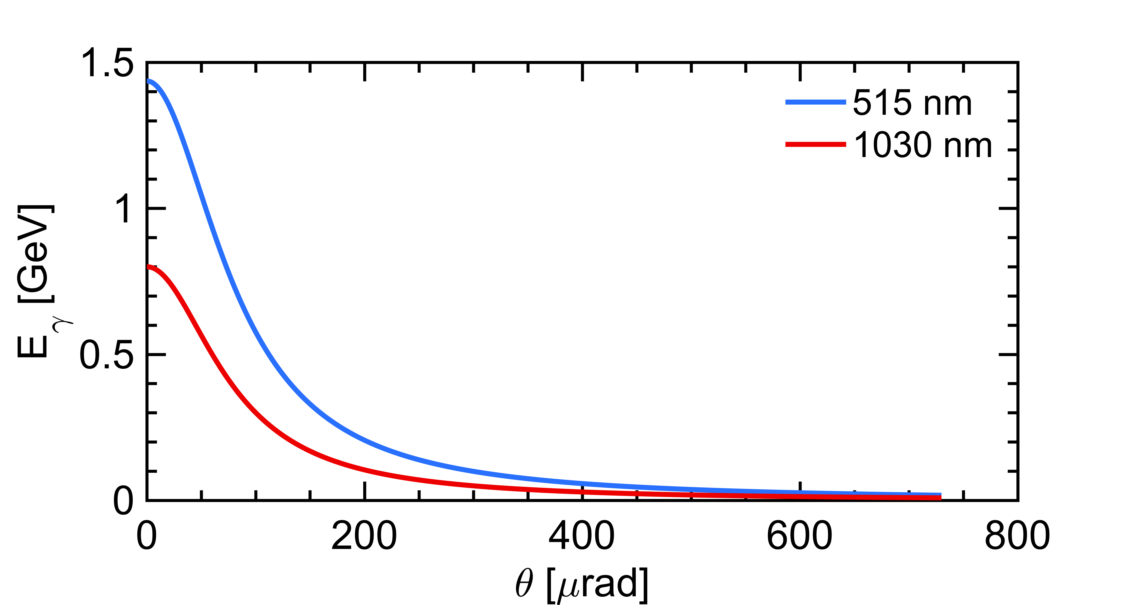


A first look at the unpolarized term
laser (E_{λ})
Initial electron energy (7 GeV)
Initial photon energy (1.2eV at 1030nm)
Crossing angle of beams
Emitted photon energy
$$θ_{0}$$
θ
e⁻ beam $Ee$
energy vs emission angle correlation
Landau-Lifshitz QED book paragaphs 86 and 87
Typical opening:
1/gamma~70urad
Conical emission:
98% of photons within 730𝜇rad
Typical spatial resolving power:
7mm for a detector at 100m
⚠️ Photons (electrons too) are scatterred in the forward direction, in a narrow cone around the electron beam axis

Slide 5
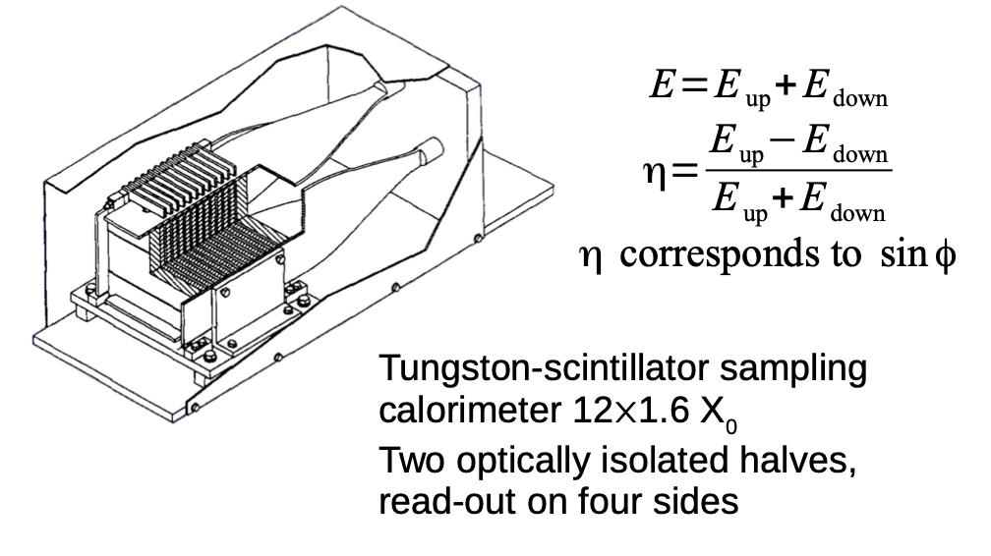
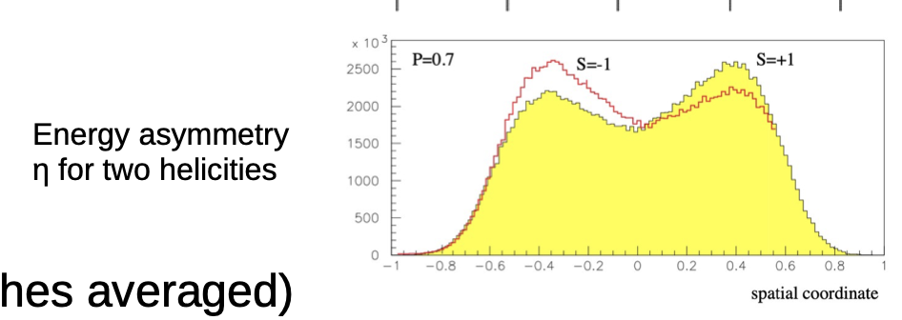
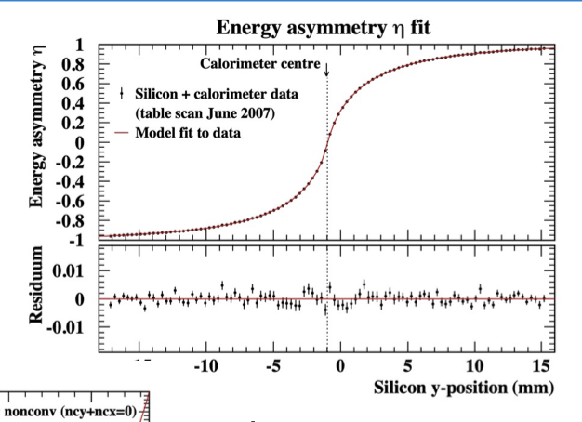
Some history
Material taken from: https://indico.cern.ch/event/1181966/contributions/5046178/attachments/2512013/4318517/220905_tpol.pdf
Exactly the operation that was done at HERA TPOL a long time ago.
Notoriously a difficult task but ‘do-able’
→ Requires detailed simulations
Can be eased by implementing a nicely vertically segmented electron detector.

Slide 6
SuperKEKB implementation
Thanks to D. Zhou and M. Masuzawa for the help, pics…
We typically need a long line of sight for the photon beam ~50-100m
There are not so many places for that in SuperKEKB ring…
One option could be somewhere around FUJI
Positron injection → radiation levels in laser system…
Laser-e beam IP ?
FUJI
Detector somewhere here ?
~100m
It sounds that the environment will be harsh for the laser (at least…)

Slide 7
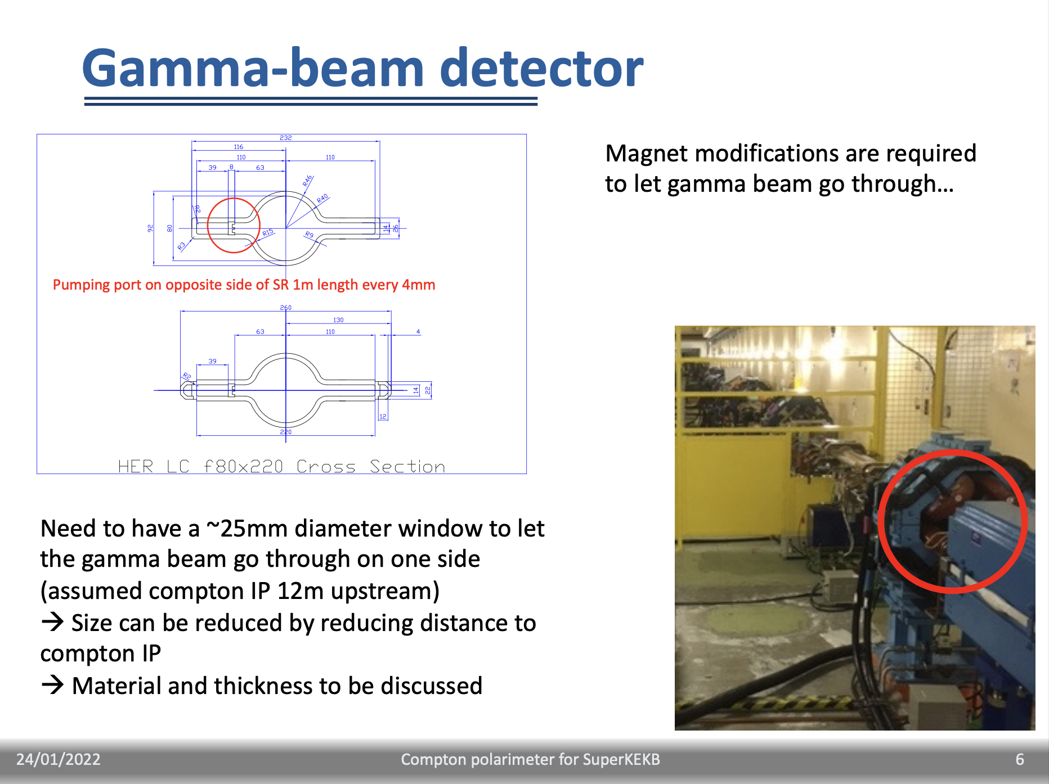
Magnet…
BX1E magnet is 5.9m length, the outcome is similar to that around BLA2LE
Magnet modification is required to let the photon beam out.

Slide 8
Electron detector
Not so much space. Need to discuss its possible integration

Slide 9
Alternative: BLA2LE/BLX2LE.2
Line of sight ~20-30m provided that fence can be moved and something placed in between the two arcs
→ Requires some very detailed simulation to prove the concept works
But same location of laser as final polarimeter, photon detector needs to be moved ‘as far as possible’
→Requires a detailed look, on site.
Still need to change magnet… (for the photon detector)
Probably need move/change 1rst quad
Photon detection
Electron detection
Laser/e-beam interaction point
BLA2LE

Slide 10
Conclusion
Insertion of transverse Compton polarimeter is not a straightforward step in the upgrade
  maybe a new polarimeter in a new location
  or recycle location proposed earlier for L-polarimeter
Magnet modification to let gamma beam out
  In any case required
  Not a cheap operation, lattice change → needs to be studied
Integration for electron detector
  Might be possible → need some evaluations
Photon detector requires detailed simulations

