Slide 1
Some questions on polarimetry to address in view of a CDR
Aurélien MARTENS

Slide 2
Introduction
Discuss longitudinal polarimeter, presentation made last week on the possibilities on the T-pol
Try to show current open points (in my opinion), please feel free to suggest more

Slide 3
Laser and related integration
Vacuum chamber: some concept exist and has been validated for impedance
Need some 3D model of the chamber
need SuperKEKB experts involved
Laser: schematics can be reviewed and improved further
preliminary drawing of laser table (underneath beam) + periscope is needed
Laser synchro to RF
need a contact
Guess of laser hardware cost ~250kE including laser table but excluding beam pipe
Need also involvement of SuperKEKB team for utilities (mainly cables)

Slide 4
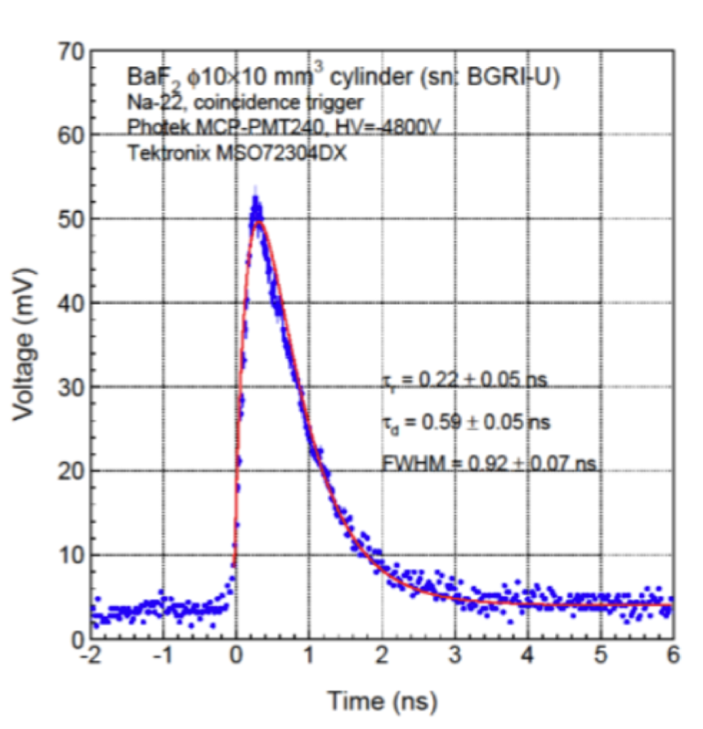
Photon detector
Concept of detector based on BaF2 exists but requires experimental validation
backup solution consist in integrating over several bunches and use PbWO2 instead
still conceptual electronics design must be drawn
Main integration issue:
requires to modify a magnet, a redesign with change of open side needed
expensive
no impact on lattice itself
Beam pipe for photon window need to be drawn

Slide 5
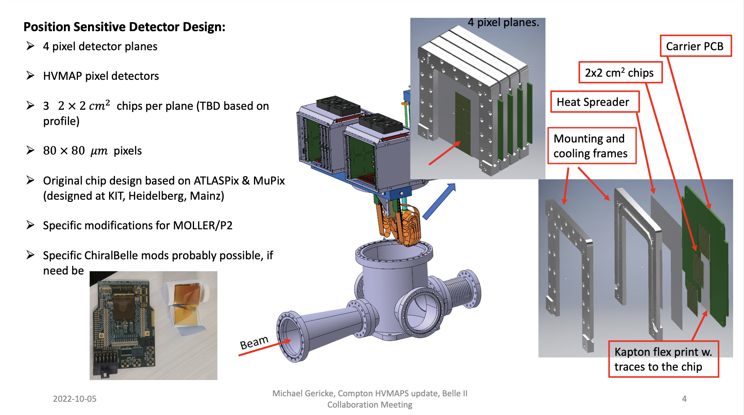
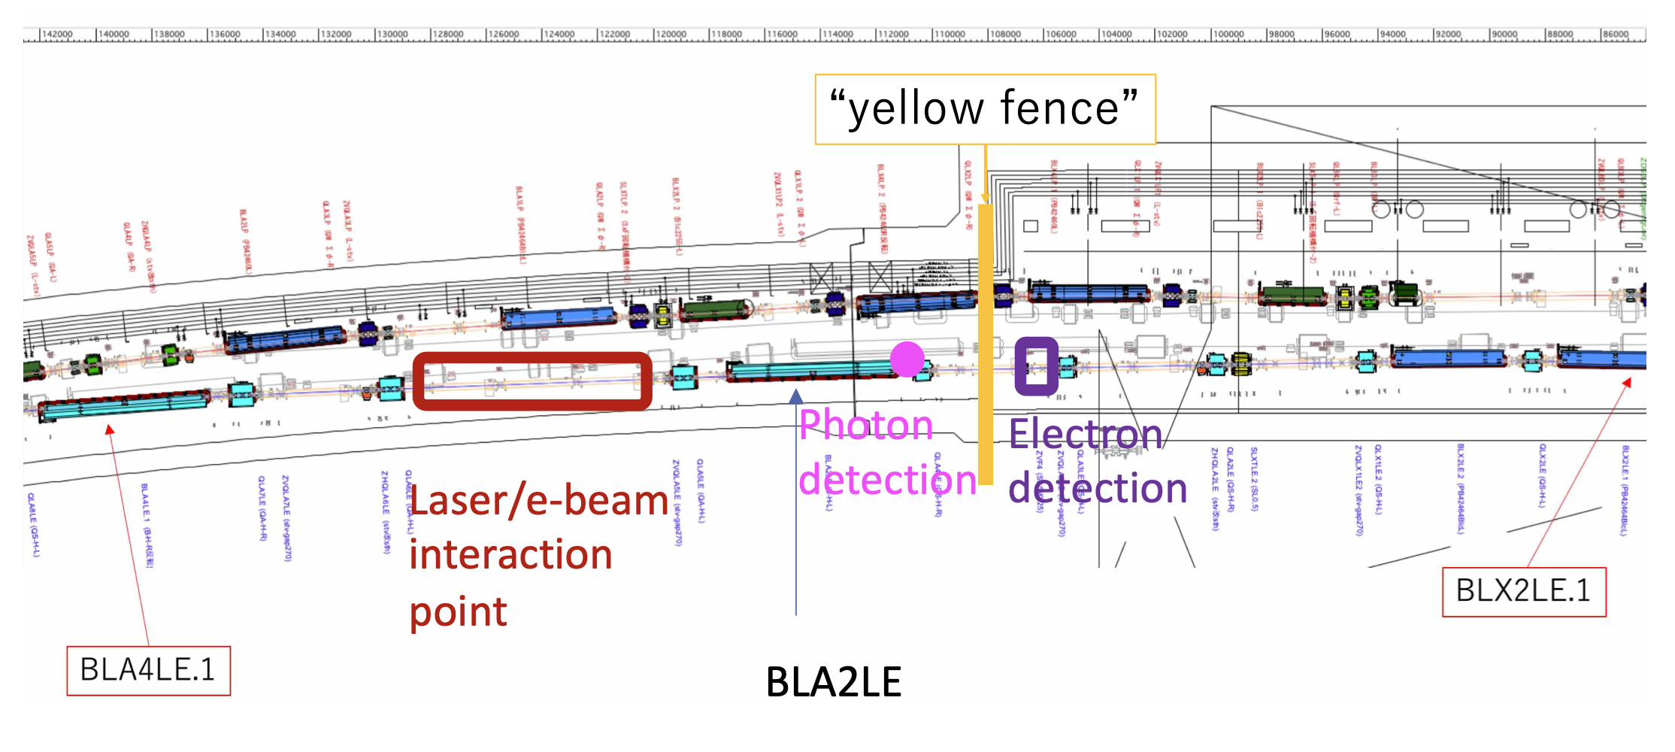
Electron detector
Currently prototyping phase
Open points:
number of planes, pixel sizes, number of chips/plane
Study of impact of Quad in beam line on electrons trajectory extrapolation
Integration:
model needed for impedance check
Required modifications to beam pipe ? (ensure electrons do not hit material)

Slide 6
Polarimeter performance
Some detailed simulations for photon detector
Need to be reviewed with up-to-date location and beam parameters in a consistent picture with lattice modified by Yuhao
Not so much for electron detector (AFAIK)
Maybe useful now to help design electron detector and assess performance
Transverse polarimetry need to be studied to some extent also with same polarimeter location

