Slide 1
The European Research Council
Working as a physicist
in the European public administration
Christian Oswald
Christian.Oswald@ec.europa.eu
25 May 2023
Belle II Academy 2023
© Art & Build Architect / Montois Partners / credits: S. Brison

Slide 2
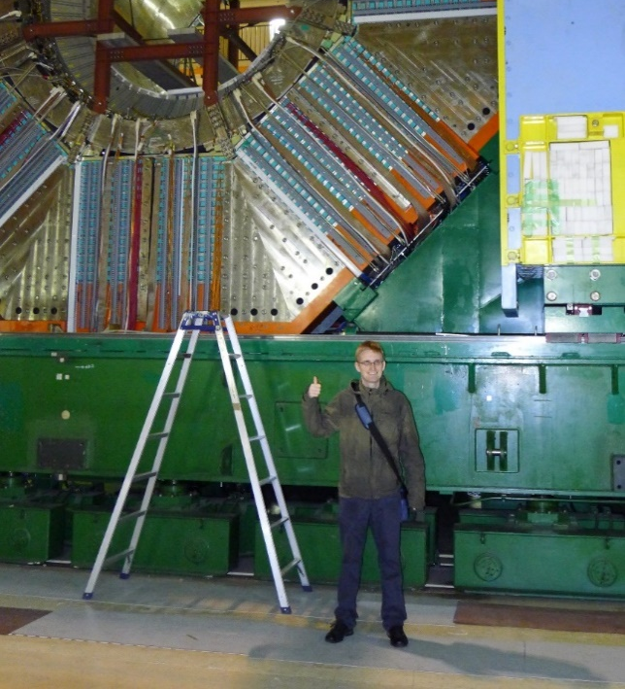
My CV
5 years
1 year
Master and PhD at Belle
Team of the Agency Director
at the European Research Council
3 years
Scientific Officer
at the European Research Council
IT Project Manager
in the German public service
3 years

Slide 3
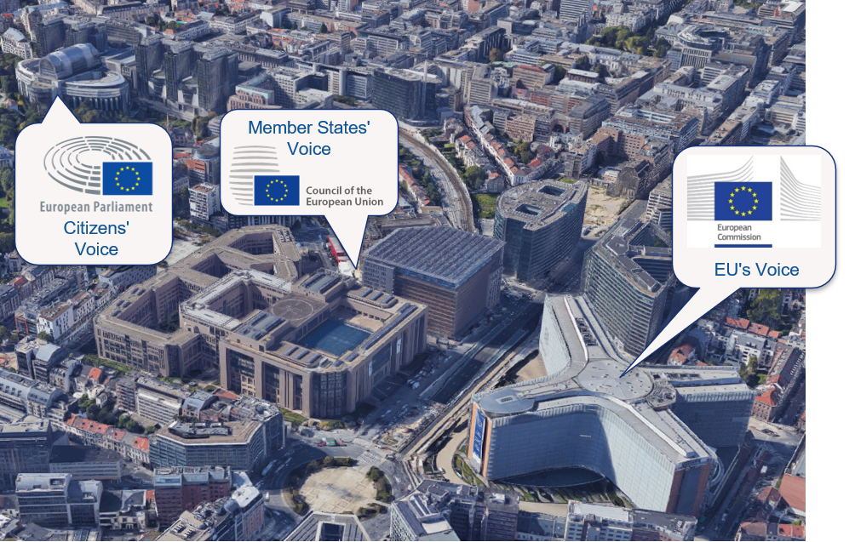
EU institutions
Source: Google Maps

Slide 4
Roles of the European Commission
RIGHT OF INITIATIVE
POLICY & BUDGET IMPLEMENTATION
GUARDIAN OF THE TREATIES
INTERNATIONAL DIMENSION

Slide 5
Long-term budget 2021-2027 & Next Generation EU
 | MFF**: | Next Generation EU Post-COVID recovery instrument | TOTAL
I. Single Market, Innovation and Digital | €149.5 | €11.5 | €161.0
II. Cohesion, Resilience and Values | €426.7 | €776.5 | €1203.2
III. Natural Resources and Environment | €401.0 | €18.9 | €419.9
IV. Migration and Border Management | €25.7 | - | €25.7
V. Security and Defence | €14.9 | - | €14.9
VI. Neighbourhood and the World | €110.6 | - | €110.6
VII. European Public Administration | €82.5 | - | €82.5
Total | €1 210.9 | €806.9 | €2.018
(current prices, EUR billion)
** MFF: EU long-term budget, also known as MFF (Multiannual Financial Framework)
Source: The EU’s 2021-2027 long-term budget & NextGenerationEU: Facts and Figures

Slide 6
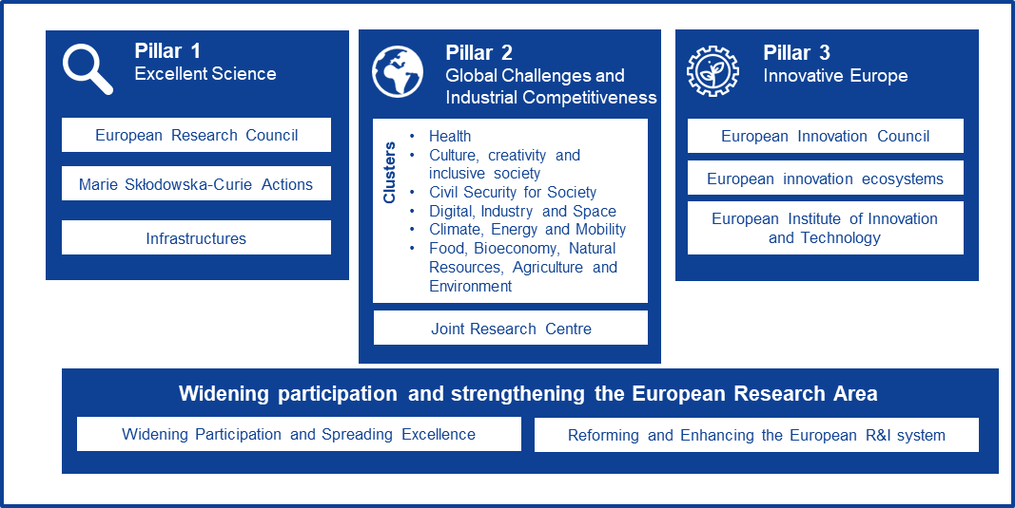
Horizon Europe
EUR 16 billion
ERC budget in Horizon Europe
17%
of the entire Horizon Europe budget

Slide 7
ERC Grant Schemes
Starting Grants
starters (2-7 years after PhD) up to € 1.5 Mio
for 5 years
Consolidator Grants
Consolidators (7-12 years after PhD) up to € 2 Mio
for 5 years
Advanced Grants
track-record of significant research achievements in the last 10 years up to € 2.5 Mio
for 5 years
Synergy Grants
2 – 4 Principal Investigators up to € 10.0 Mio for 6 years 1 PI can be based outside EU/AC

Slide 8
Scientists working in Belle II funded by the ERC
InterLeptons
Gianluca Inguglia
A search for new interactions
at Belle II using leptons
NEPAL
Justine Serrano
NEw Physics searches
with tAu Leptons
NECTAR
Peter Krizan
Flavour Anomalies with
advanced particle Identification
MEthods

Slide 9
ERC in Figures
12,000
200,000
Over
top researchers funded since
the ERC creation in 2007
Over
articles from ERC projects published
in scientific journals
900
80,000
Over research institutions hosting ERC grantees – universities, public or private research centres in the EU or Associated Countries
Over
researchers and other professionals
employed in ERC research teams
2,200
88
Over
patents and other IPR applications generated by ERC funding
nationalities of
grant holders
400
Over
start-ups identified as founded
or co-founded by ERC grantees
12 Nobel Prizes, 6 Fields Medals, 11 Wolf Prizes
and other prizes awarded to ERC grantees

Slide 10
Staff categories
Contract agents
(CAST)
Temporary agents
Interim staff
Freelance
Seconded National Experts
Trainees

Slide 11
CAST selection procedure
Open registration period
Preselection by recruiting services
Testing by EPSO (MCQs):
Reasoning tests (Verbal, numerical, abstract) in Language 1
Competency test (knowledge in the field) in Language 2
Interview by recruiting service
if successful, results valid for 10 yrs
if successful, results valid for 5 yrs
Recruiting

Slide 12
Evaluation: Panel Structure
(2021-2023)
Physical Sciences & Engineering
PE1 Mathematics
PE2 Fundamental Constituents of Matter
PE3 Condensed Matter Physics
PE4 Physical and Analytical Chemical Sciences
PE5 Synthetic Chemistry and Materials
PE6 Computer Science and Informatics
PE7 Systems and Communication Engineering
PE8 Products and Processes Engineering
PE9 Universe Sciences
PE10 Earth System Science
PE11 Materials Engineering
Life Sciences
LS1 Molecules of Life: Biological Mechanisms, Structures and Functions
LS2 Integrative Biology: From Genes and Genomes to Systems
LS3 Cellular, Developmental and Regenerative Biology
LS4 Physiology in Health, Disease and Ageing
LS5 Neuroscience and Disorders of the Nervous System
LS6 Immunity, Infection and Immunotherapy
LS7 Prevention, Diagnosis and Treatment of Human Diseases
LS8 Environmental Biology, Ecology and Evolution
LS9 Biotechnology and Biosystems Engineering
Social Sciences and Humanities
SH1 Individuals, Markets and Organisations
SH2 Institutions, Governance and Legal Systems
SH3 The Social World and Its Diversity
SH4 The Human Mind and Its Complexity
SH5 Cultures and Cultural Production
SH6 The Study of the Human Past
SH7 Human Mobility, Environment, and Space
│ 12

Slide 13
ERC in Figures
12,000
200,000
Over
top researchers funded since
the ERC creation in 2007
Over
articles from ERC projects published
in scientific journals
900
80,000
Over research institutions hosting ERC grantees – universities, public or private research centres in the EU or Associated Countries
Over
researchers and other professionals
employed in ERC research teams
2,200
88
Over
patents and other IPR applications generated by ERC funding
nationalities of
grant holders
400
Over
start-ups identified as founded
or co-founded by ERC grantees
12 Nobel Prizes, 6 Fields Medals, 11 Wolf Prizes
and other prizes awarded to ERC grantees

