Slide 1



Update about
Compton polarimeter at SuperKEKB
Farah MAWAS
Aurélien MARTENS

Slide 2
Introduction
A summary and update of IJCLab activities has been presented yesterday at Hiroshima Workshop by Farah and Aurelien.
https://indico.belle2.org/event/7500/timetable/#20230209.detailed
We give here some summary:
polarimeter integration
sensitivity studies for photon detector
Some comments about transverse polarimetry and Touschek lifetime

Slide 3
BLA2LE/BLX2LE.2
Photon detection
Electron detection
Laser/e-beam interaction point
BLA2LE

Slide 4
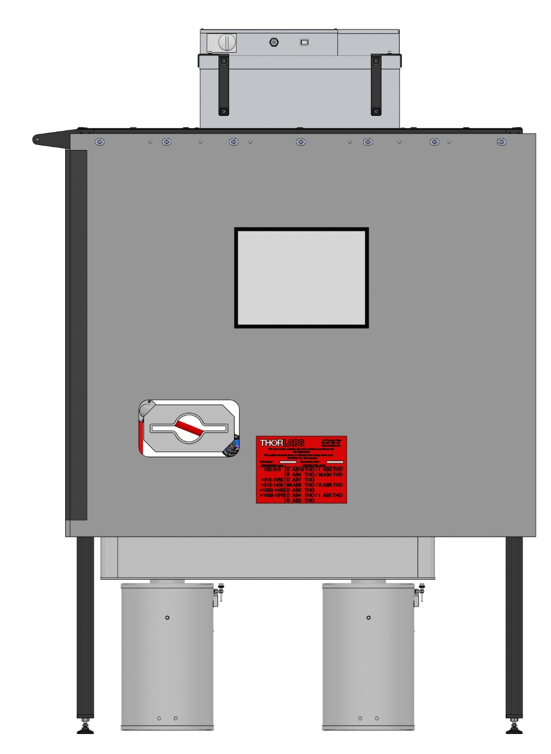
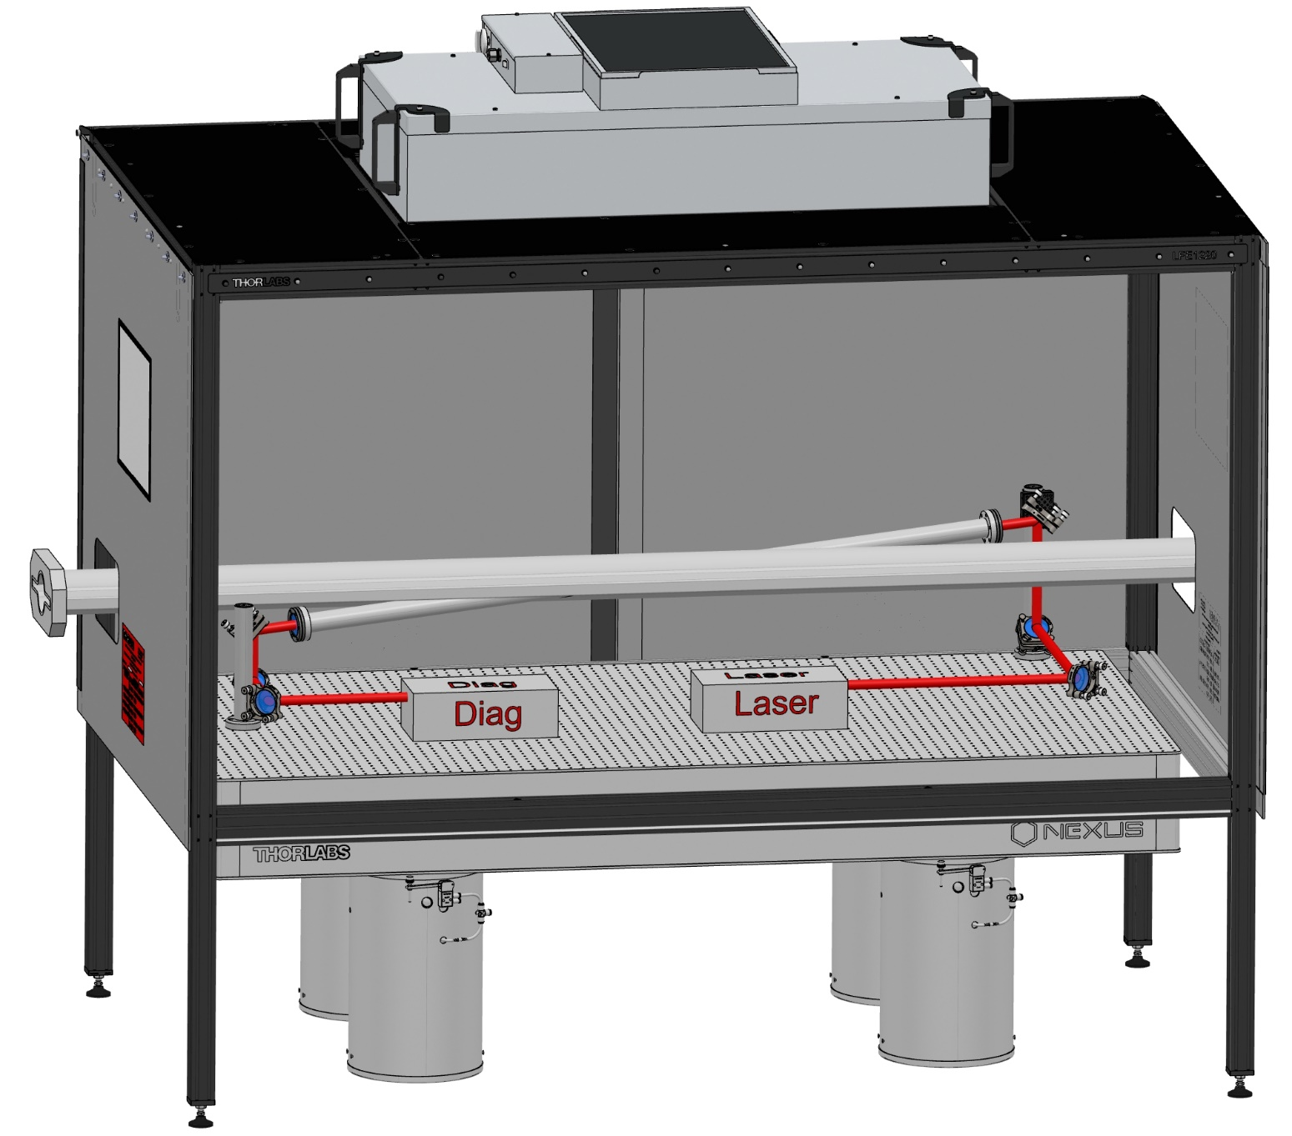
Mechanical system integration
910 mm
450 mm
Cross Angle Horizontal : 10 deg
Cross Angle Vertical : 4 deg
May need some lead shielding around electronics to be located below the table

Slide 5
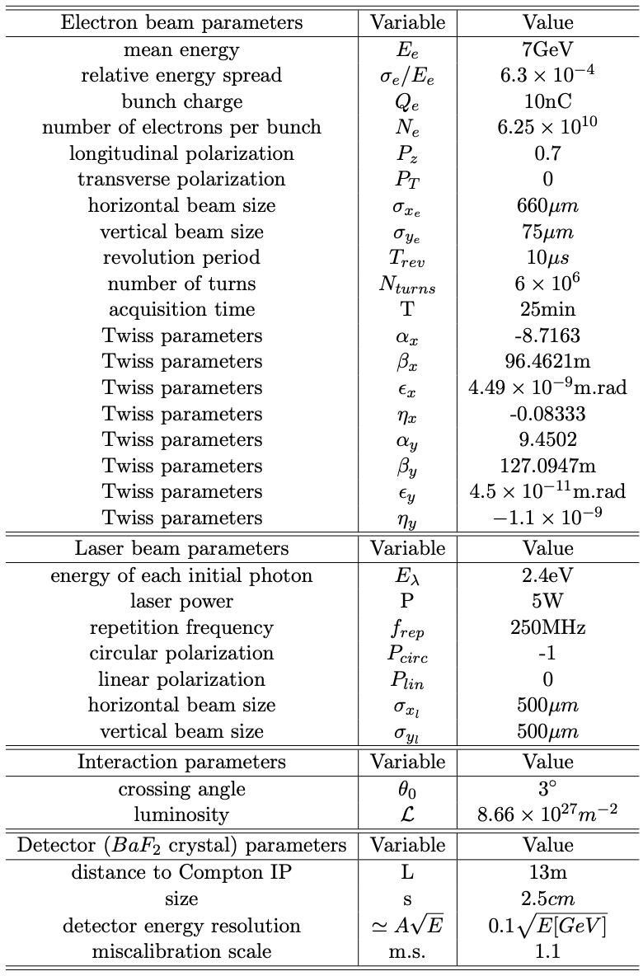
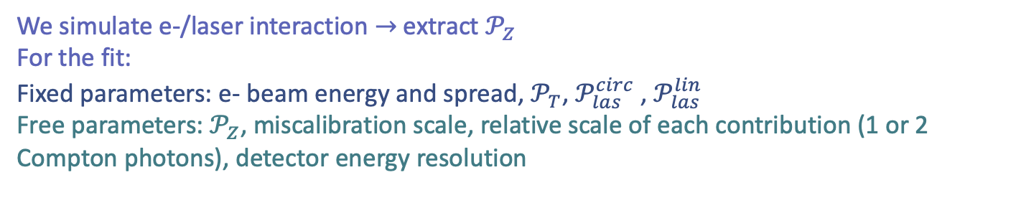
Toy-MC sensitivity studies
We simulate e-/laser interaction $→$extract $𝒫_{Z}$
For the fit:
Fixed parameters: e- beam energy and spread, $𝒫_{T}$, $𝒫_{las}^{circ}$ , $𝒫_{las}^{lin}$
Free parameters: $𝒫_{Z}$, miscalibration scale, relative scale of each contribution (1 or 2 Compton photons), detector energy resolution
We focus on photon detection here

Slide 6
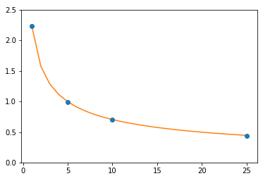

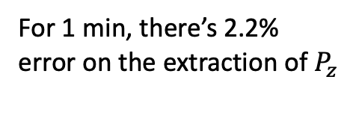
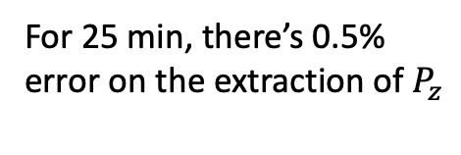
Statistical sensitivity
$σ_{P_{z}}$(%)
For 1 min, there’s 2.2% error on the extraction of $P_{z}$
For 25 min, there’s 0.5% error on the extraction of $P_{z}$
Acquistion time (min)

Slide 7
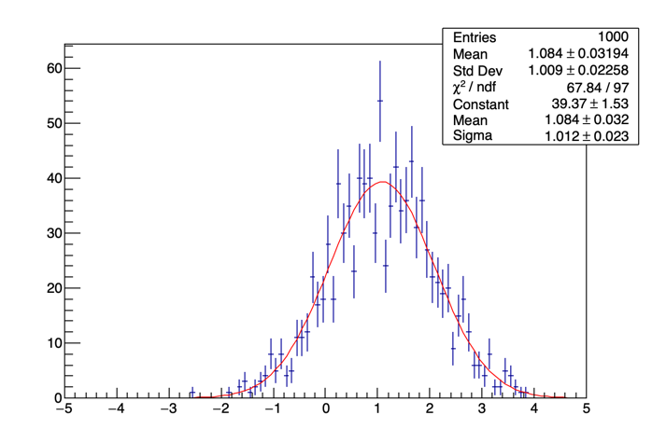
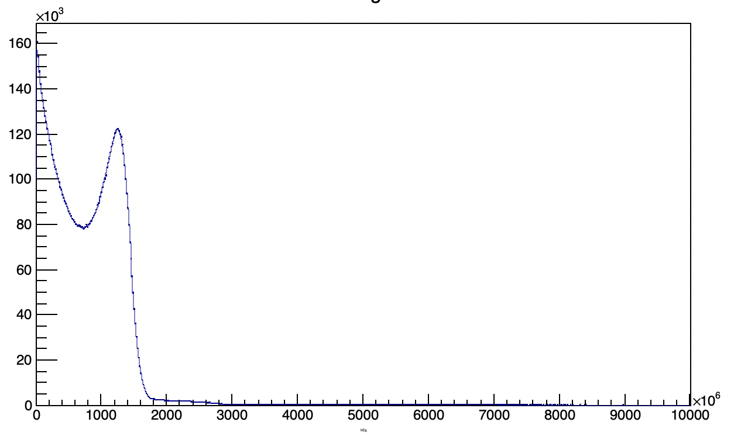
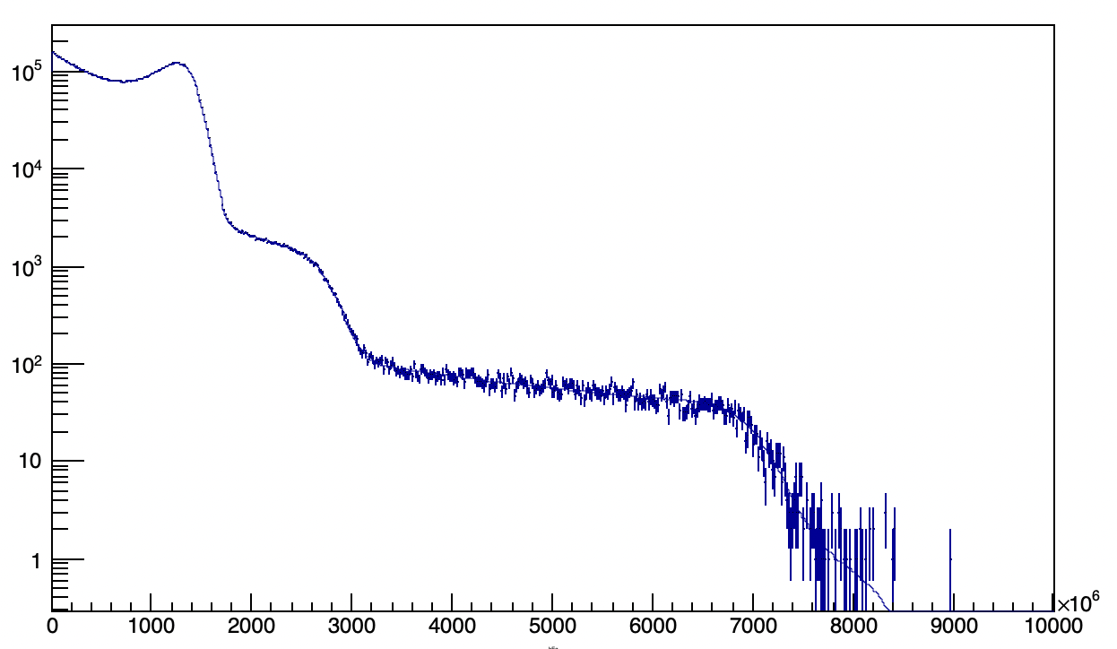
Signal+background Toy-MC
!!
Background fitting being worked on.
Significant bias of the fit with background included
~0.45% systematic uncertainty assigned
Actual background need to be measured to improve significance of simulation

Slide 8
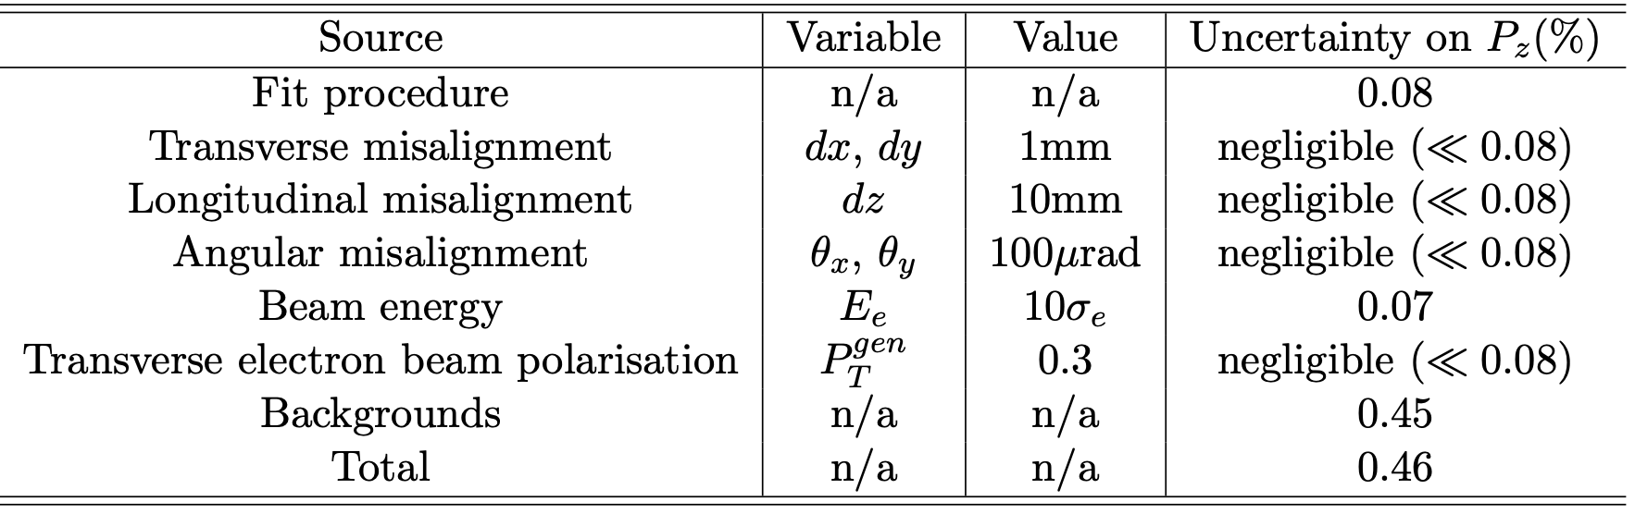
Table of systematics
Need to add a systematic uncertainty associated to mis-knowledge of laser polarization
~0.3% at most, target 0.1%
Systematic uncertainty related to transport of polarisation from Compton IP to Belle 2 ?

Slide 9
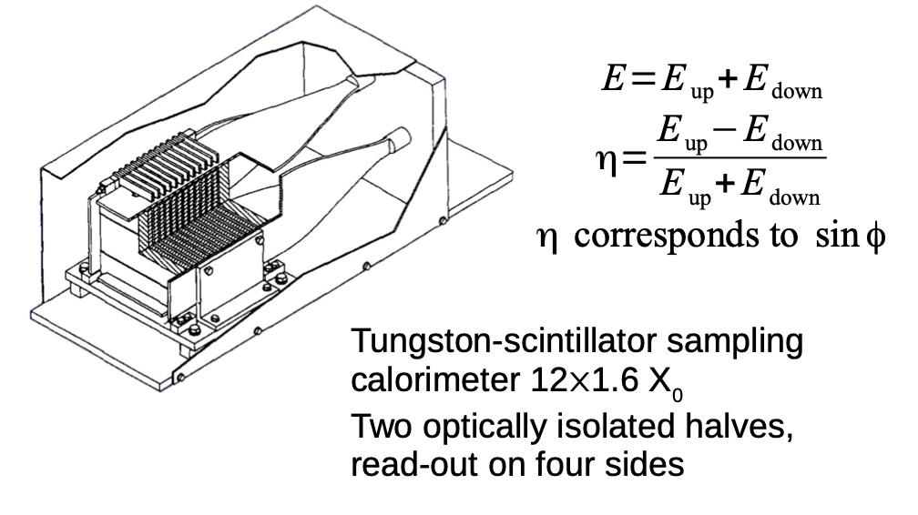
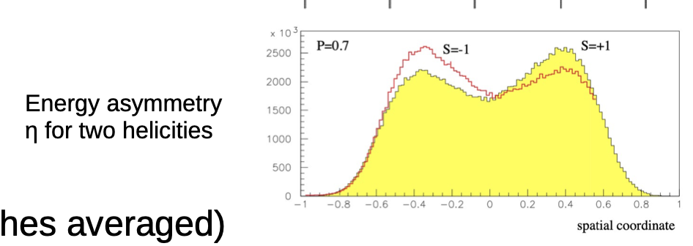
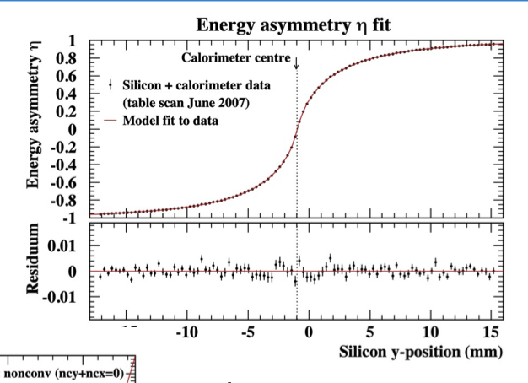
Transverse polarimetry at HERA
https://indico.cern.ch/event/1181966/contributions/5046178/attachments/2512013/4318517/220905_tpol.pdf
Exactly the operation that was done at HERA TPOL a long time ago.
Notoriously a difficult task but ‘do-able’
Requires detailed simulations
Requires some transverse sampling (not easy for photons)
Eased by implementing a nicely vertically segmented electron detector.

Slide 10
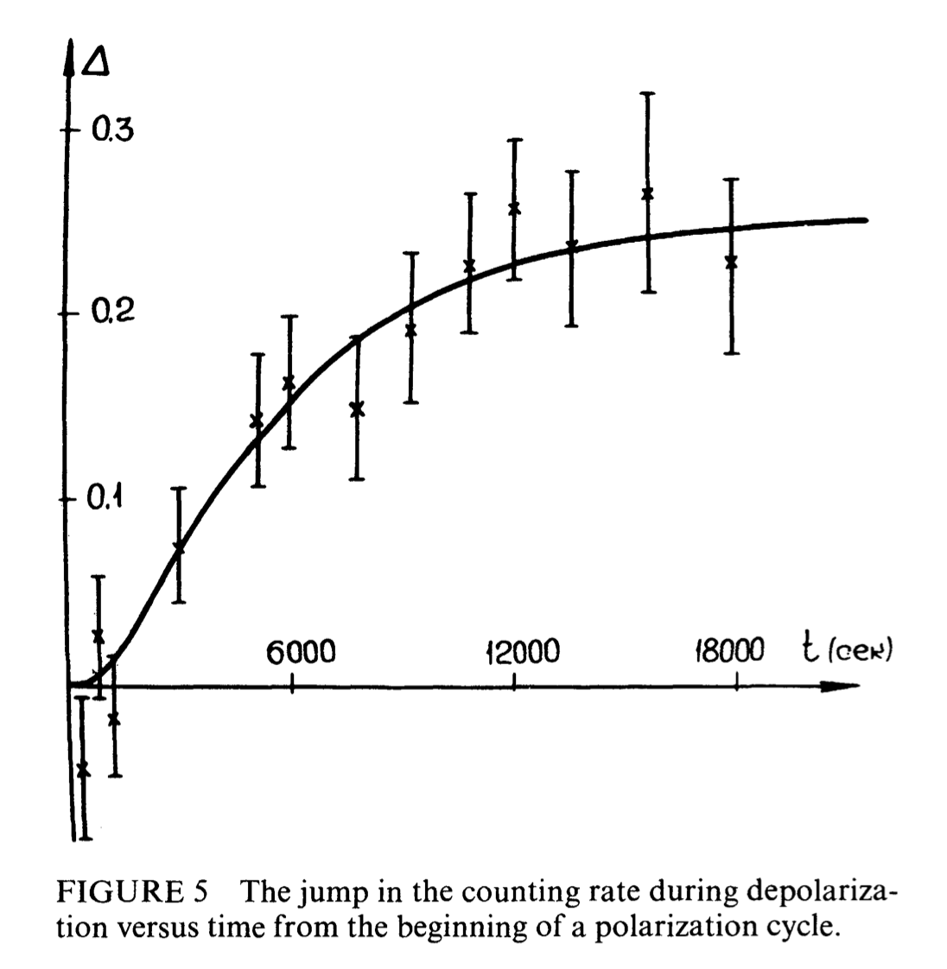
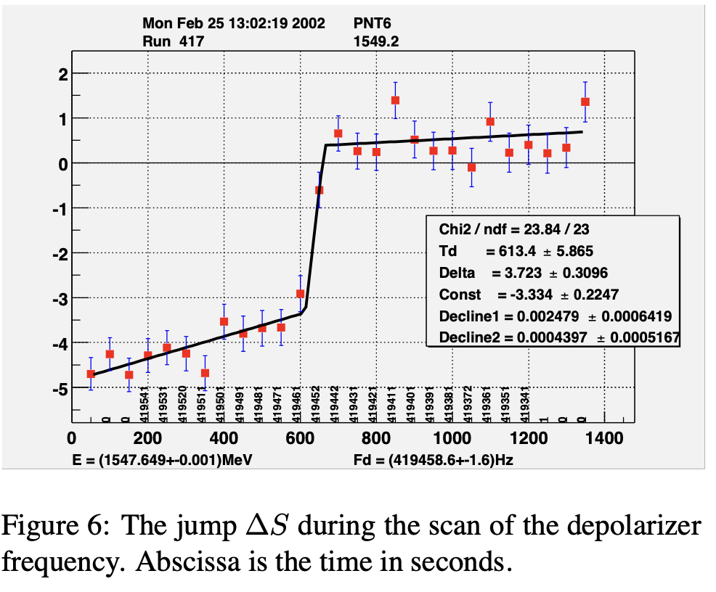
Touschek lifetime can be used also
Touschek described the lifetime of electrons in AdA (’accumulation ring’) in 1963 (Bernardini et al., Phys. Rev. Lett 10 (1963) 407)
Baier & Khoze, pointed out that Touschek lifetime is sensitive to polarization (At. Energ. 25 (1968) 440)
It was then use in the VEPP-2M ring to measure depolarization (and thus beam energy): Derbenev Part. Acc. 8 (1978) 115
  Measuring the couting rate of scattered electrons
Ex: Allowed first precision mass measurement of J/Psi (3096.93+-0.09 MeV) then superseded in 1993 (E760)
Continously improved at VEPP-4M (KEDR at VEPP-4M: 3096.900 ± 0.002 ± 0.006 MeV): Phys. Lett 96B (1980) 214; Blinov et al., proc. of EPAC (2002) 1954

Slide 11
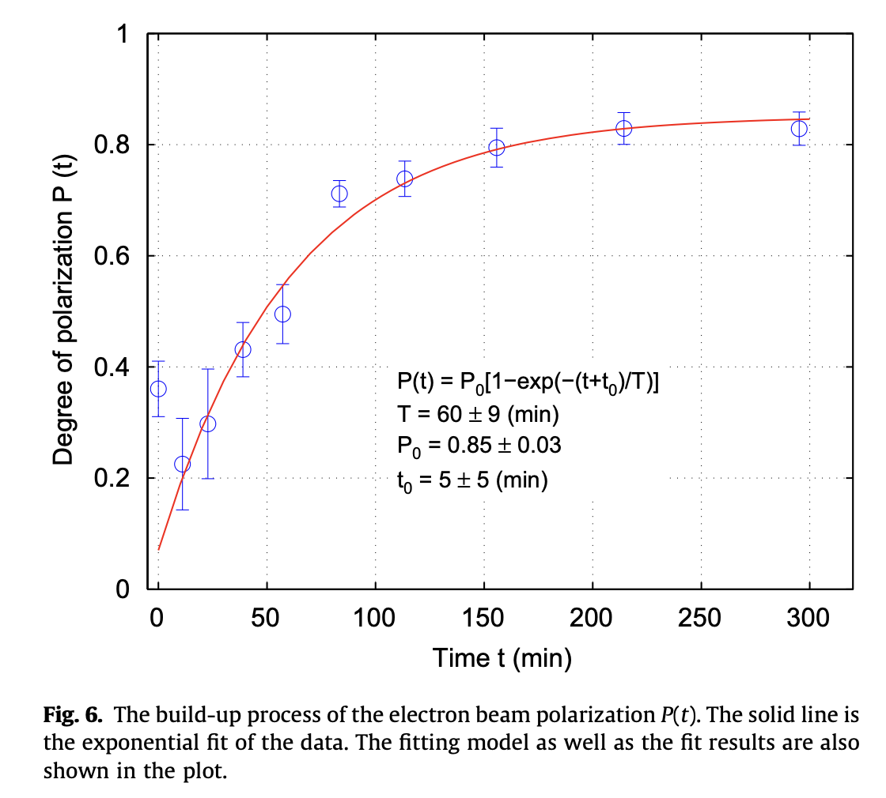
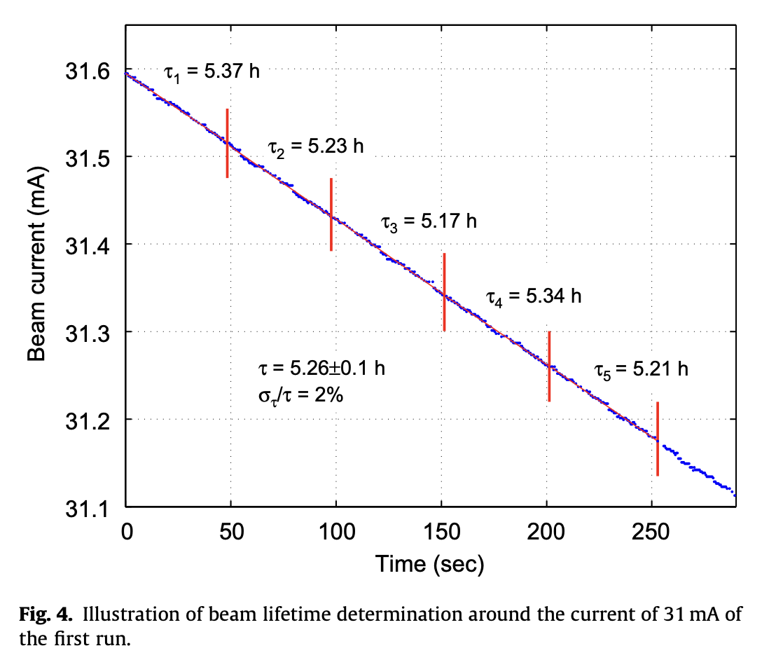
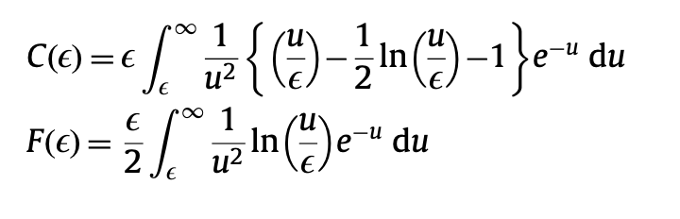
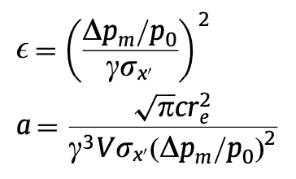
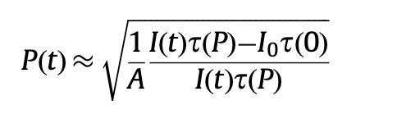
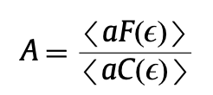
a slightly more modern use
Used at :
  HIgS (DUKE): NIMA 614 (2010) 339
  SOLEIL, NIMA 697 (2013) 1
  Diamond Light Source, PRAB22 (2019) 122801
  Based on expressions given in NIMA 554 (2005) 85
  Also proposed for FCCee: arXiv1909.12245

Slide 12
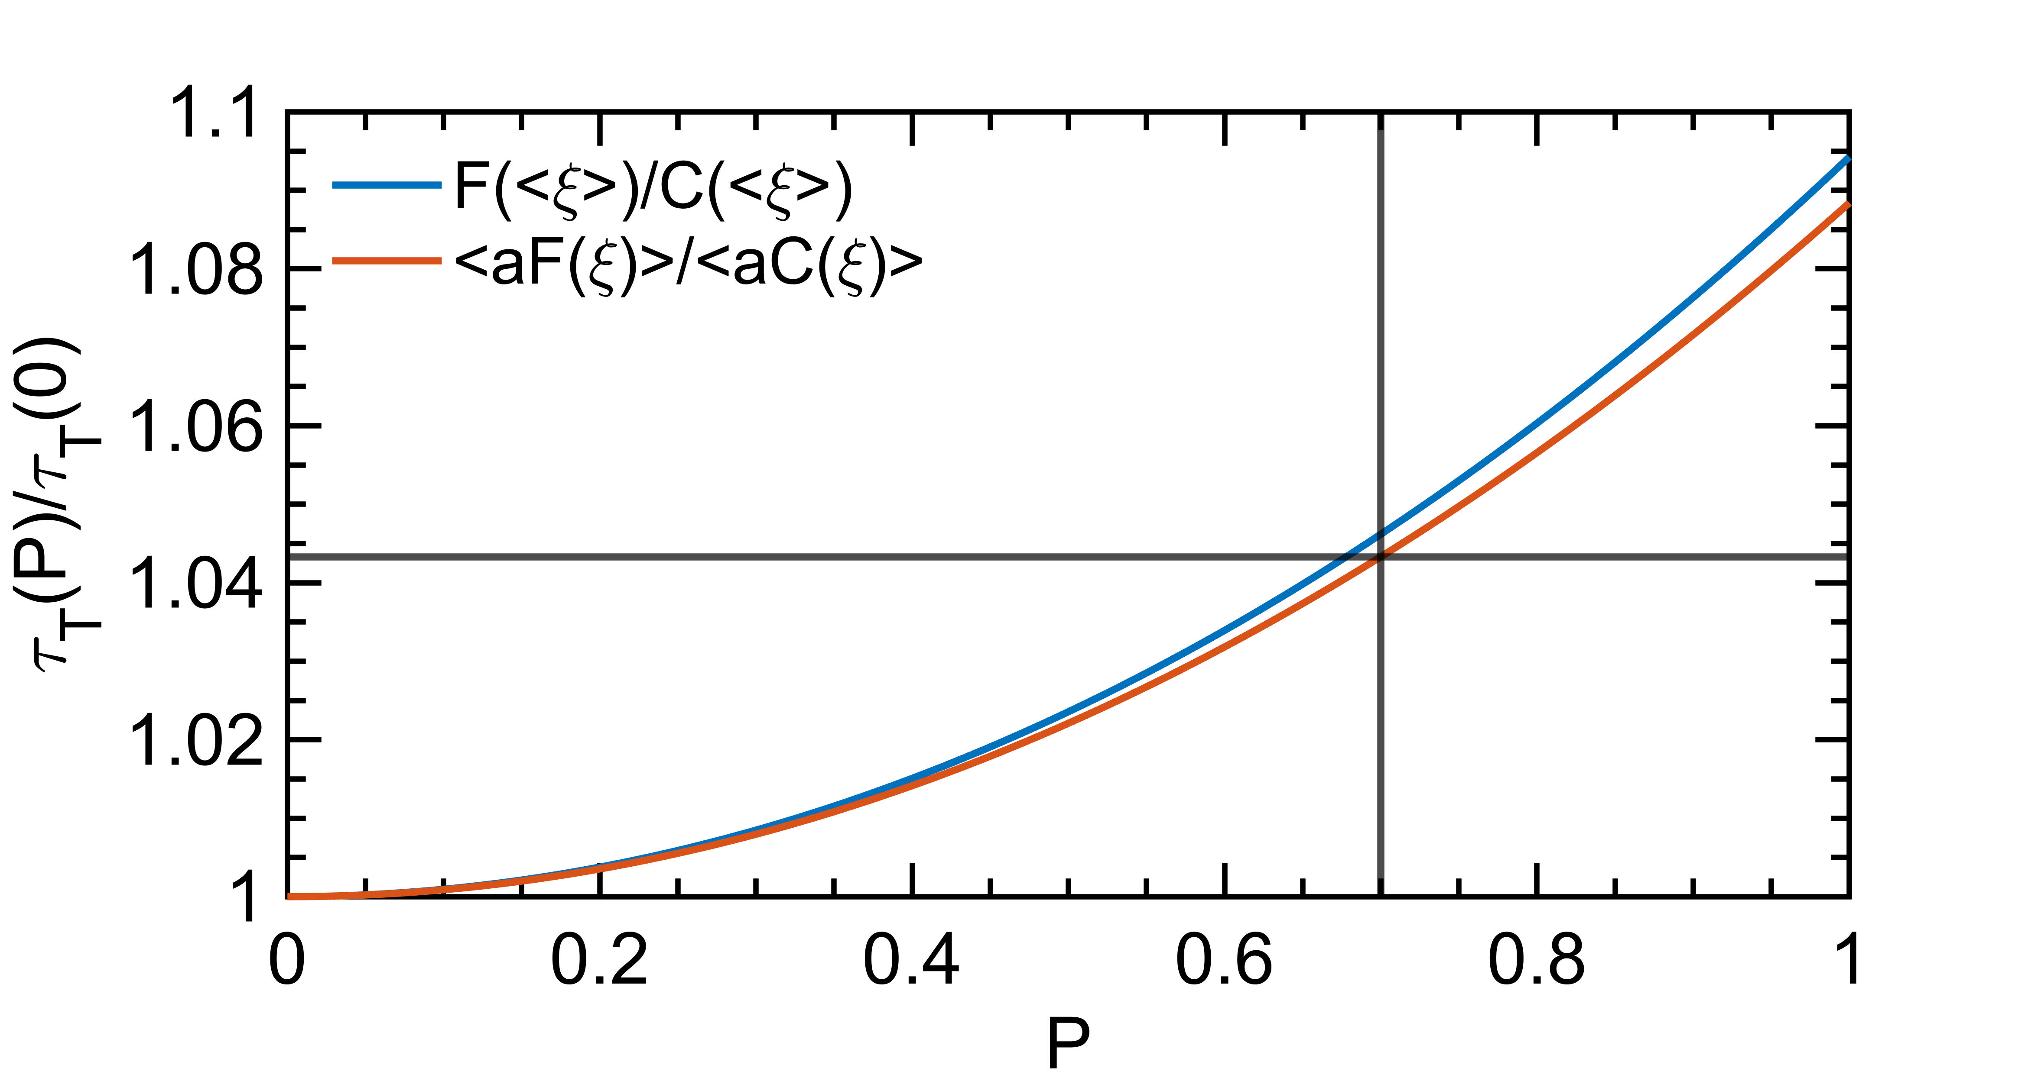
For SuperKEKB
It is ~4% effect assuming (overall) momentum acceptance of 0.6%, and using her_2021-06-09_231636.388_MeasOpt
This is likely observable in SuperKEKB
May need to inject both polarized and unpolarized beams in the ring and measure bunch/bunch intensity with time to minimize systematics (feasbile according to Demin)
Maybe F/C factor could be calibrated by comparing measurements with various momentum acceptances ? (linked to RF voltage ?)

Slide 13
Conclusion
Laser interaction chamber integration has progressed well
Sensitivity studies for photon detector nearly completed for a CDR document
Transverse polarimetry could be done with Touschek lifetime or with HVMAPS of Manitoba, more difficult for photon detector
Real-time laser polarimetry being worked on (some progresses already)
Next steps:
  Photon detector integration concept (need tunnel visit next week).
  Improve optics design
  CDR document
  Prototype BaF2 detector (needs funding : just got answer from French national agency that not selected for 2023)

