Slide 1
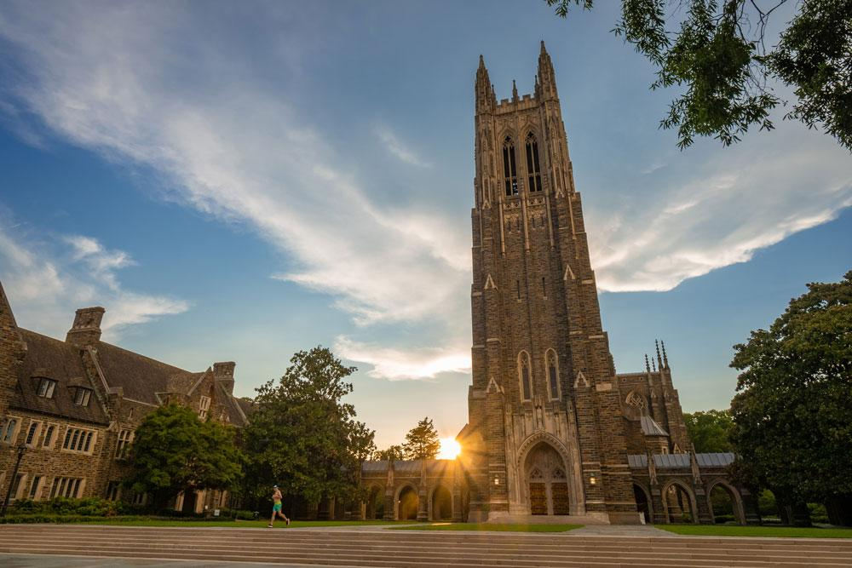


Flavor Anomalies: A Brief Review
Jim Cochran
Iowa State University
B2SW 2023
July 24-28, 2023
Duke University

Slide 2
Disclaimers
As I investigated, I found that tests of lepton-flavor violation are a much broader effort than I appreciated
If one searches for “LFU violation” in iNSPIRE >1500 contributions appear
Therefore
Given the time constraints, I will focus
on the recent anomalies and related measurements
on results and not the details of each analysis

Slide 3
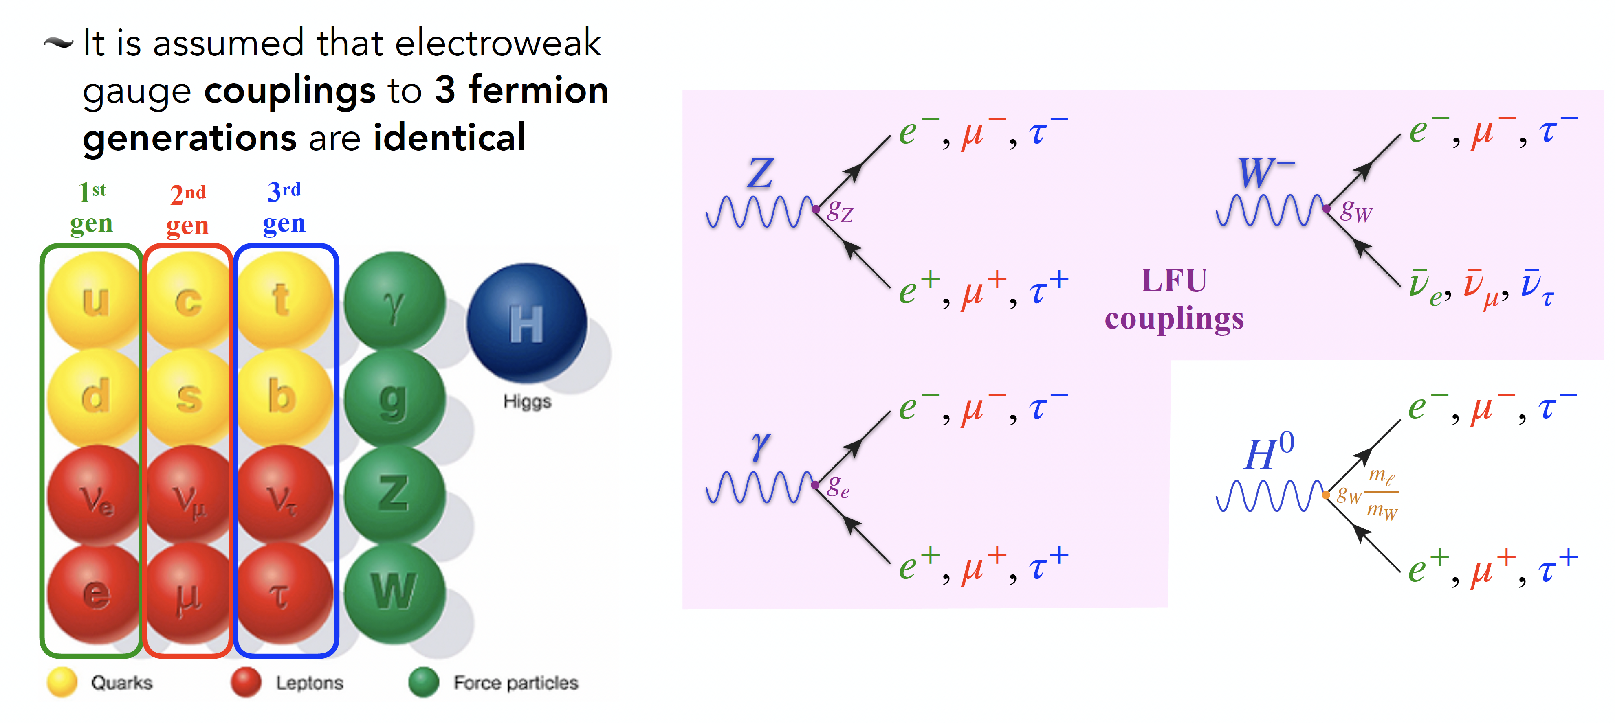
Lepton Flavor Universality (LFU)
So, any observed difference is due to the mass differences of the given leptons

Slide 4
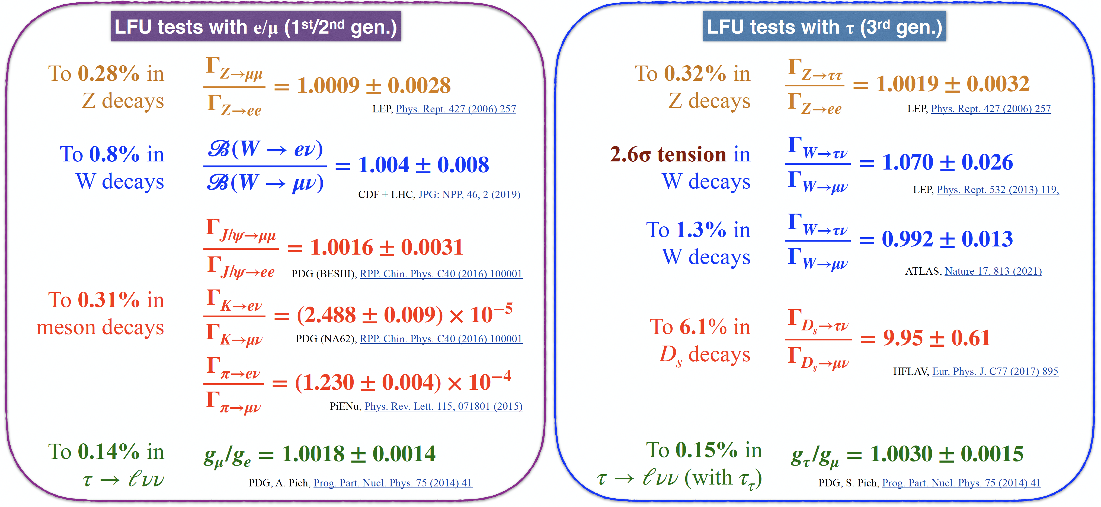
LFU has been tested and found to be conserved

Slide 5
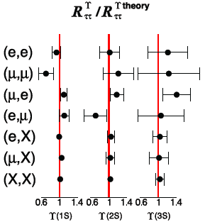
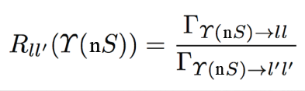
Likewise for Charmonia
CLEO
PRL 98 (2007) 98.052002]

Slide 6
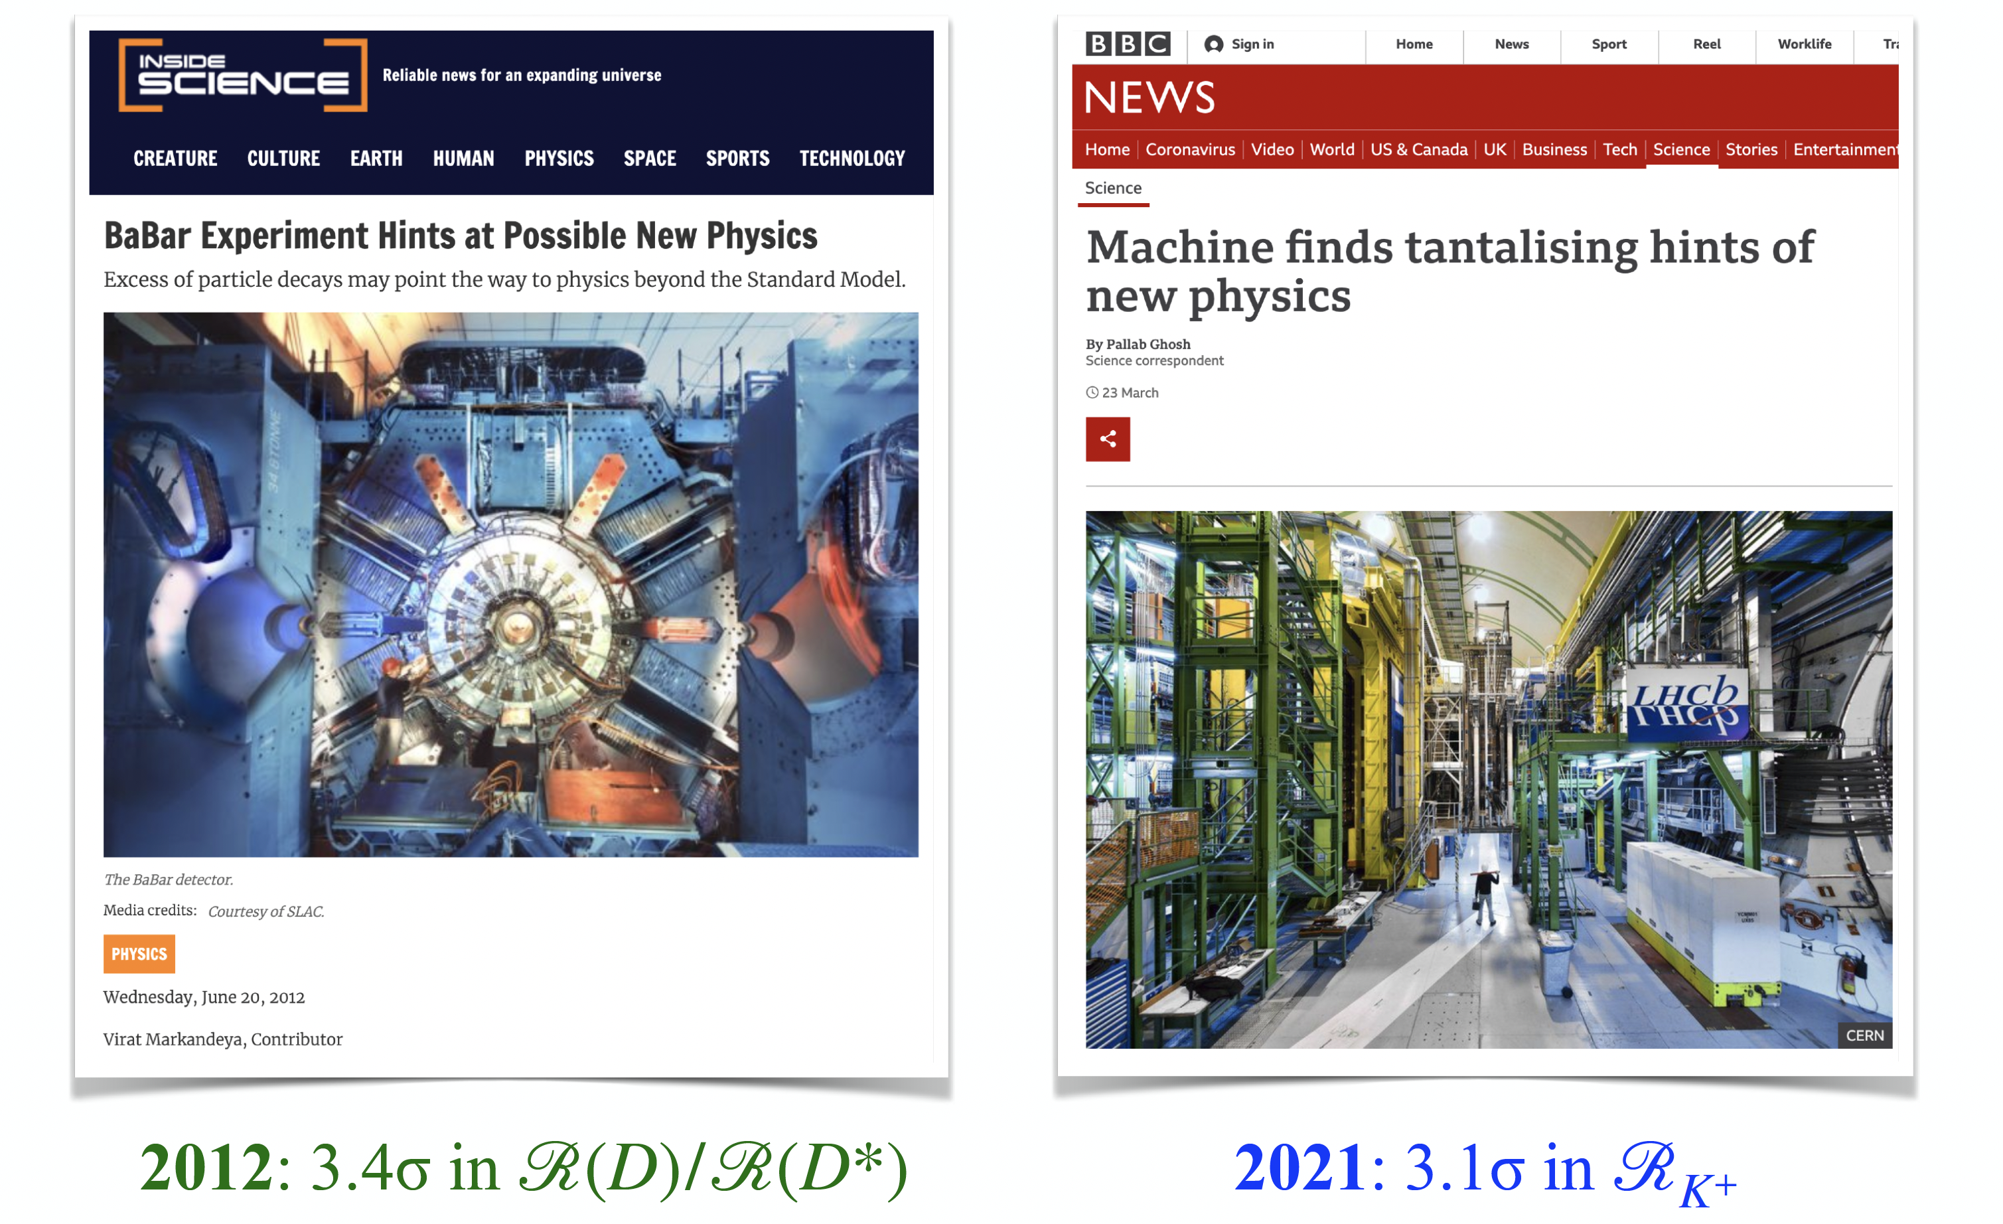
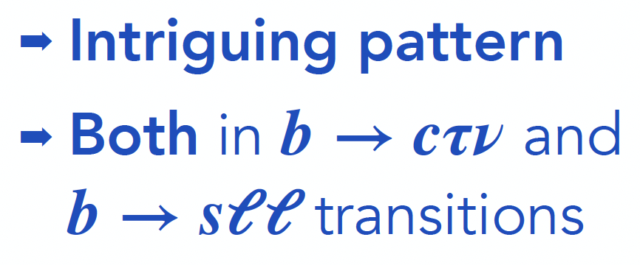
but in B decays, maybe not ?
Since ~2012,
hints of LFU viol

Slide 7
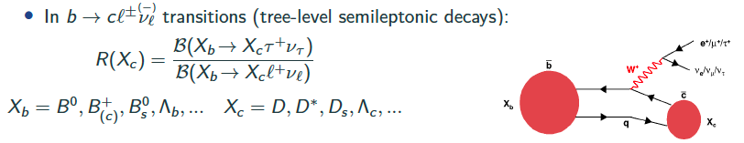
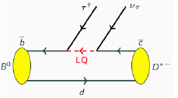
Possible LFU violation in b → cτν transitions
Powerful tests with ratios (many uncertainties cancel)
Ratios sensitive to possible enhanced coupling to the 3rd generation (e:g: Leptoquarks) predicted by some models involving physics beyond SM
[PRD 85, 094025 (2012), PLB 755, 270 (2016),...]

Slide 8
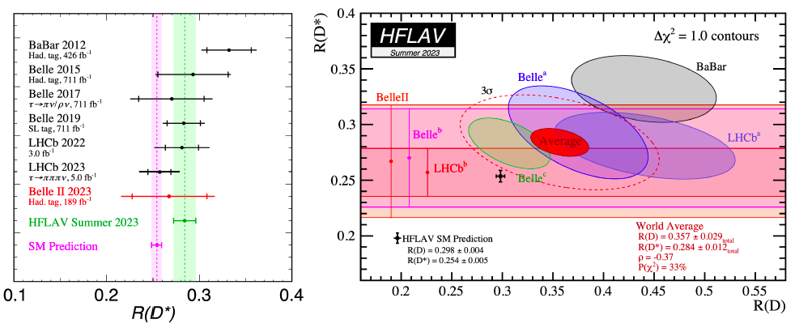
Example: R(D), R(D*)
New Belle II result is consistent with both the SM prediction and the HFLAV average
The new HFLAV average increases the tension with the SM from 3.2σ to 3.3σ

Slide 9
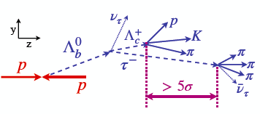
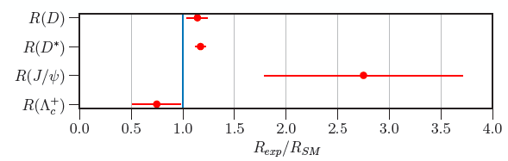
First measurement of b → cτν in baryons (LHCb)
Phys. Rev. Lett. 128, 191803 (2022)

Slide 10

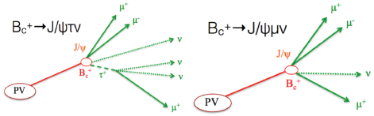
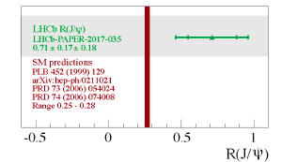
R(J/Ψ)
Similar technique to R(D*)
Precision of ~35% using 3fb⁻¹
PRL 120 (2018) 121801

Slide 11
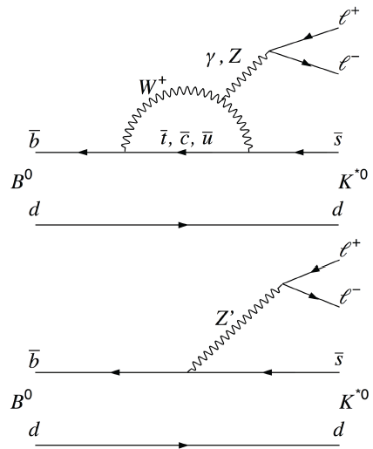
Possible LFU violation in b → sll transitions
b → sττ has not yet been observed: compare e & μ
Hadronic uncertainties largely cancel
X_{s}=K, K*, K⁺, …
New Particles can
Enhance/suppress decay rates
Introduce new sources of CP violation
Modify the angular distribution of the final state particles
Sensitive to Z’ boson and Leptoquarks
Expected to be unity in SM

Slide 12
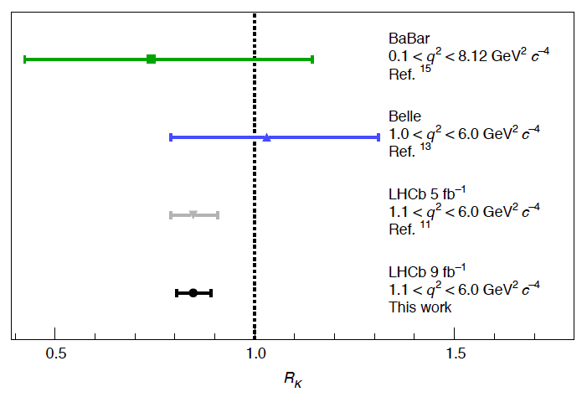
Up through 2021
2015
2021
2019
March 2022
Nature Physics volume 18, pages 277–282 (2022)

Slide 13
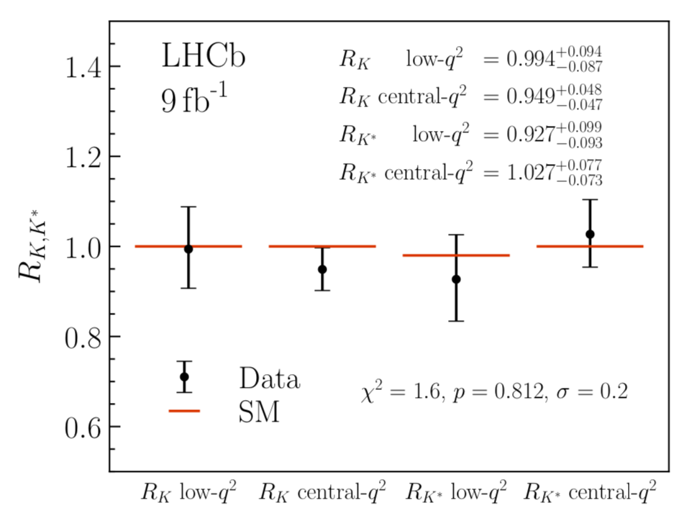
LHCb: December 2022
First simultaneous fit/measurement of R(K) & R(K*)
R(K⁽*⁾) bites the dust
arXiv:2212.09152 and arXiv:2212.09153

Slide 14
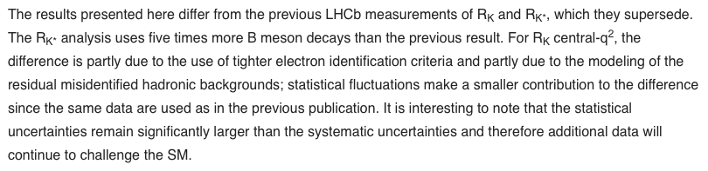
So what changed ?
It is worth noting that electron reconstruction is challenging for LHCb
LHCb public page on this result

Slide 15

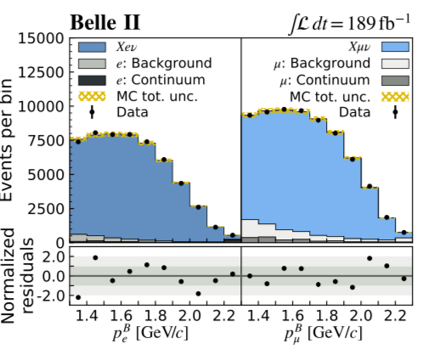
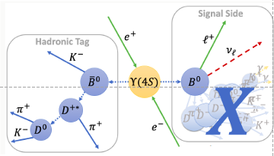
Coming back to b → clν transitions
New test of of e/μ universality
Most precise test in b → clν to date
arxiv.org/pdf/2301.08266.pdf
and a precursor to an inclusive in b → cτν/ in b → clν measurement

Slide 16

Looking forward
In my investigations, I discovered the following conference
attended by all the people you would expect …
I thought I had hit the jackpot! Sadly, none of the slides were available.
While waiting for the bus from our hotel yesterday, I mentioned to Tom (of course of of the participants) my sadness at the lack of slides
He kindly sent me his slides and some newer ones with updated content
It always pays to ask …

Slide 17
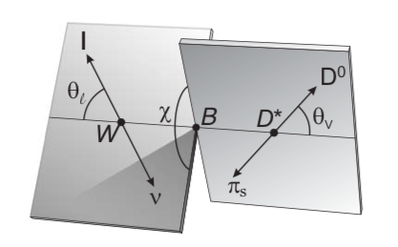
Additional observables to test LFU
It is possible that these anomalies are the result of poorly understood uncertainties in the theoretical predictions (primarily what are known as non-local contributions to the decays) – more sophisticated observables can test this hypothesis (and test LFU)
In such decays there are many angular observables, not all of which are sensitive to new physics – examples P₅’, P₂, A_{FB}, F_{L}, S₅, S₃ …
These observables are rather complex functions of the angles we measure in the lab (see backup)
arxiv.org/pdf/1207.2753.pdf
arxiv.org/pdf/2203.07189.pdf

Slide 18
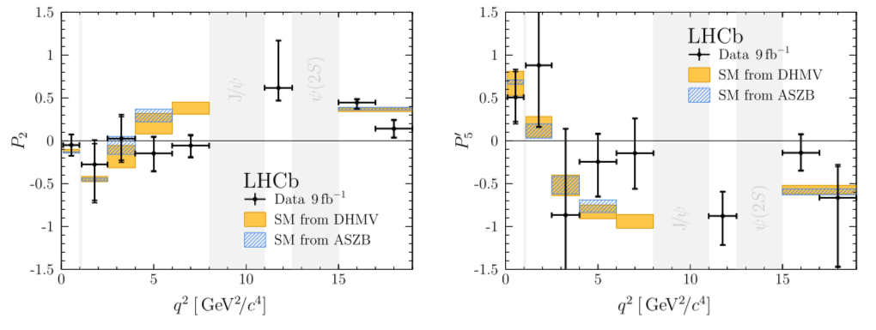
Examples: P₂ & P₅’
There is a version of the P₅’ plot including results from Belle, ATLAS, & CMS but I could not find the reference
PhysRevLett.126.161802

Slide 19
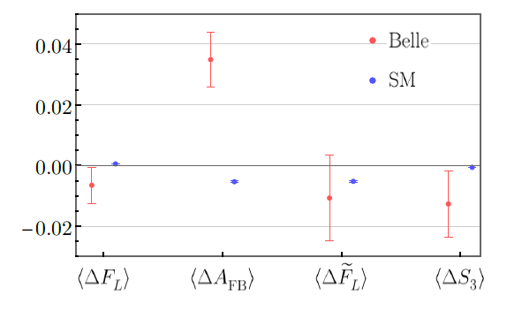
More Examples: ΔA_{FB}, ΔF_{L}, ΔS₃, …
Hadronic form factor uncertainties cancel out in $Δ$ variables

Slide 20
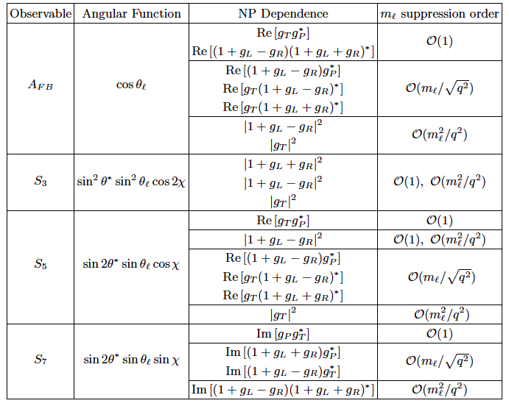
Dependence of observables on NP
Effect is small but potentially measurable
arxiv.org/pdf/2203.07189.pdf

Slide 21
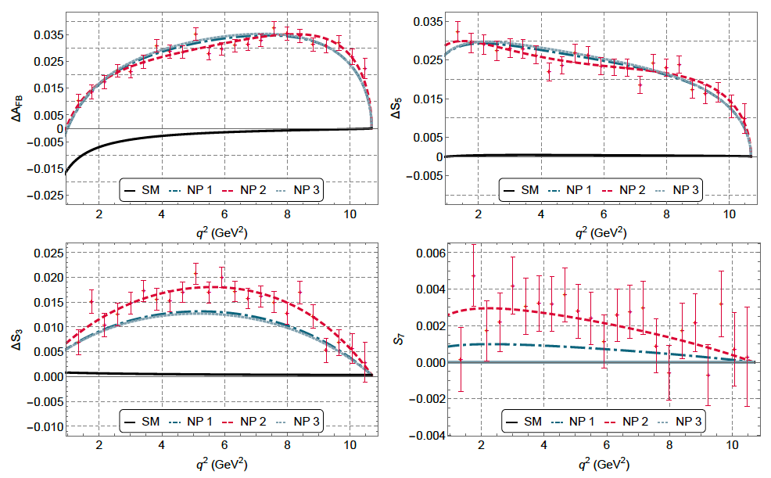
Data points are EvtGen for NP2

Slide 22
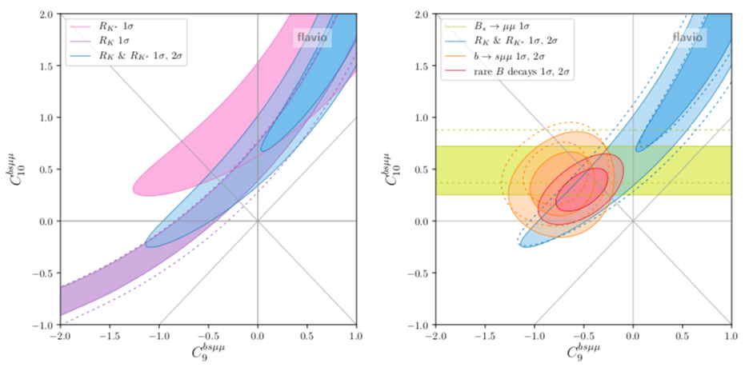
Fits of Wilson coefficients
LFU ratios only
Combination of LFU ratios, combination of b → sμμ observables, B(B_{s} → μμ), and the global fit
arxiv.org/pdf/2103.13370.pdf

Slide 23
Summary
This has been and interesting and fun exploration!
More data and more effort (esp the use of angular observables) will add to this story

Slide 24
Backup

Slide 25
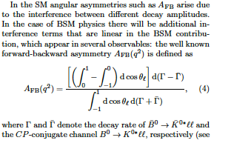
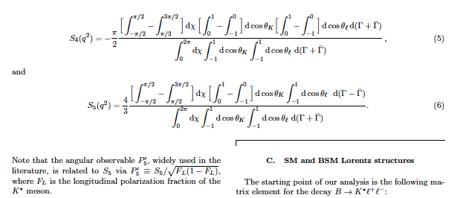
Definitions of asymmetries in B→K* l+ l-

