Slide 1



Compton polarimeter at SuperKEKB
Aurélien MARTENS
Farah MAWAS
Yann PEINAUD

Slide 2
Introduction
A summary and update of IJCLab activities has been presented in Februray’23 at Hiroshima Workshop by Farah and Aurelien.
https://indico.belle2.org/event/7500/timetable/#20230209.detailed
Since then little progress mostly related to the integration of the system in the ring

Slide 3
BLA2LE/BLX2LE.2
1. For spin rotators at current B2E location ← I consider this as baseline for polarimeter studies.
→ a nice place before BLA2LE where polarization is longitudinal and enough free space
→ polarimeter data is representative of polarization at Belle II IP (up to magnet mislalignments)
2. For spin rotators at about 80m from Belle II IP
→ no solution found to measure longitudinal polarization
→ use same location but measure transverse polarization
Photon detection
Electron detection
Laser/e-beam interaction point
BLA2LE

Slide 4
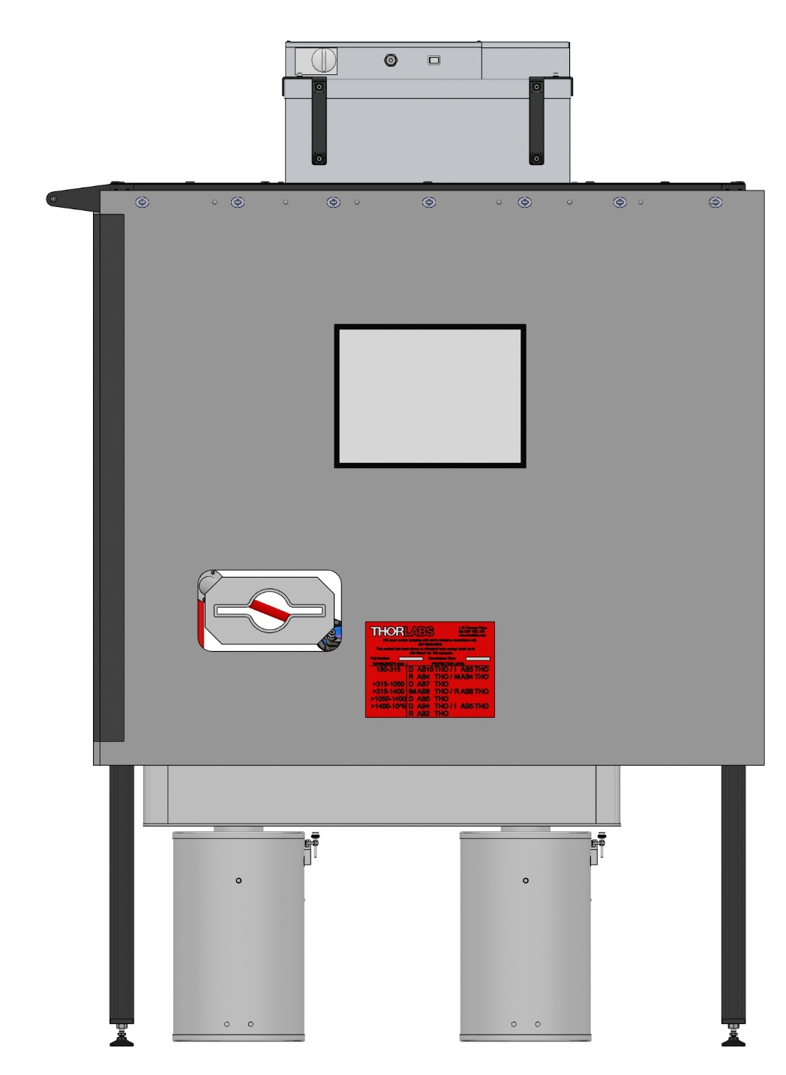
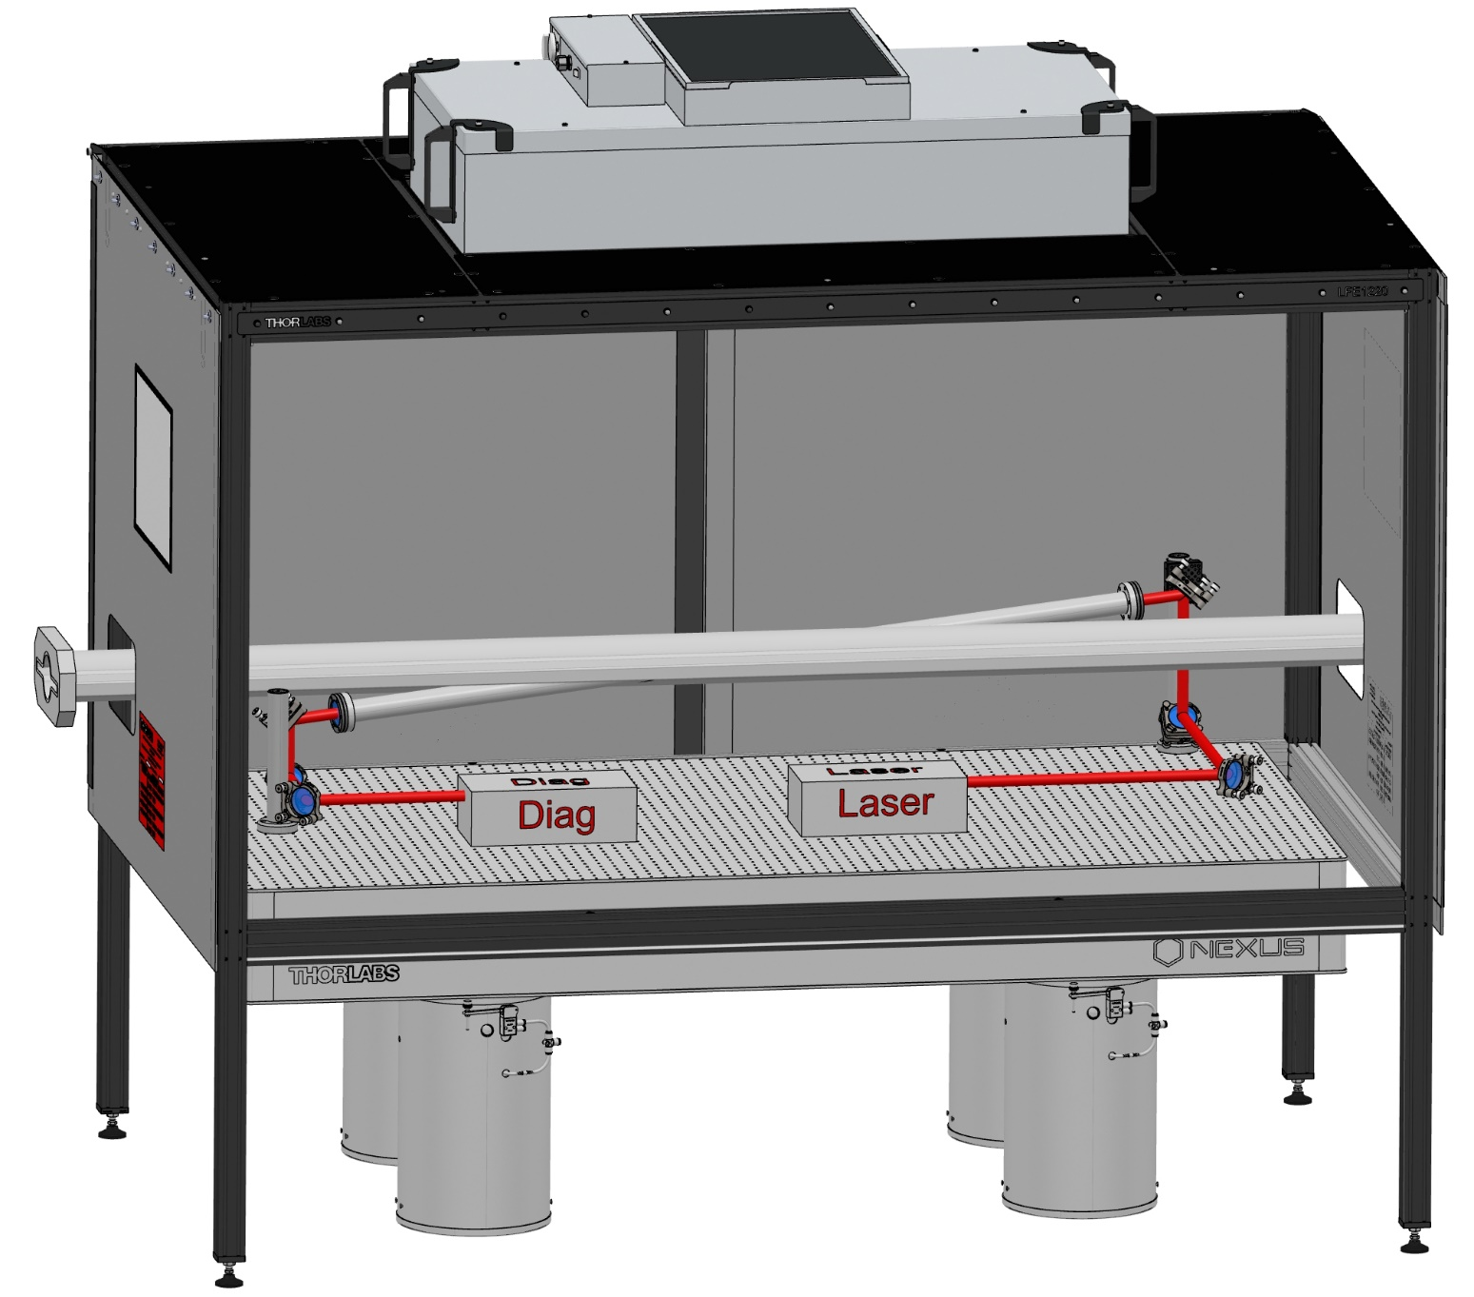
Mechanical system integration
910 mm
450 mm
Cross Angle Horizontal : 8 deg
Cross Angle Vertical : 4 deg
+ some neutron + lead shielding around electronics to be located below the table
+ some lead shielding around the table to protect a bit the laser

Slide 5
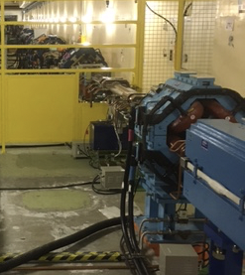
Photon detector integration
Requires modifications of BLA2LE
→ open side of the iron not on the ‘right’ side (to let scattered photons out)
→ NEG pumping not on the ‘right’ side either
Requires modification of a pipe to let photon beam out and begin diagnosed.
→ first proposal of pipe modification being prepared (iteration with SKB experts has to be done)
Pumping port on opposite side of SR 1m length every 4mm

Slide 6
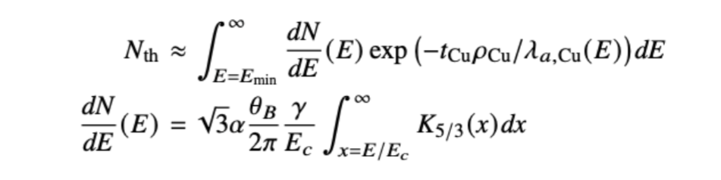
SR background and exit window
Critical energy of synchrotron radiation amounts to 4keV for BLA2LE
Using a crude model:
From NIST data
Synchrotron radiation spectrum
Using a tCu=4mm thickness Copper window → 1 MeV impinges the detector (~30 SR photons)

Slide 7
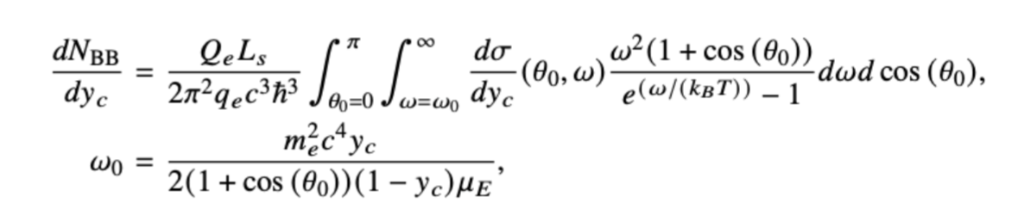
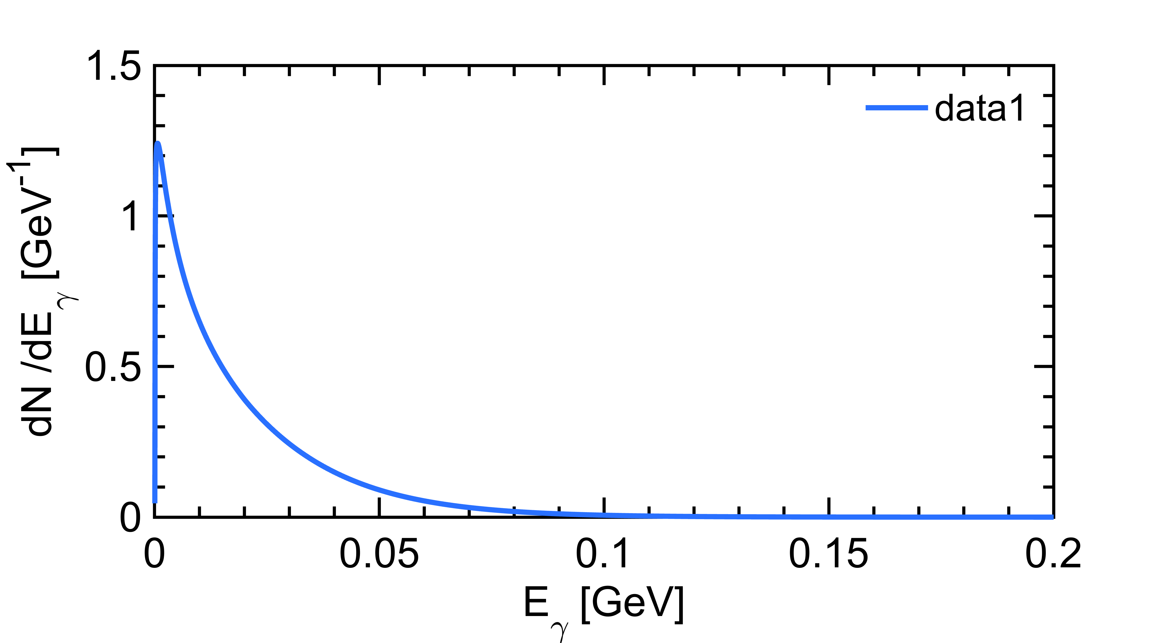
Compton on thermal photons
yc=E/Ee
+ as for SR use the absorption length data from NIST
Using a tCu=4mm thickness Copper window → 0.02 photons/crossing

Slide 8
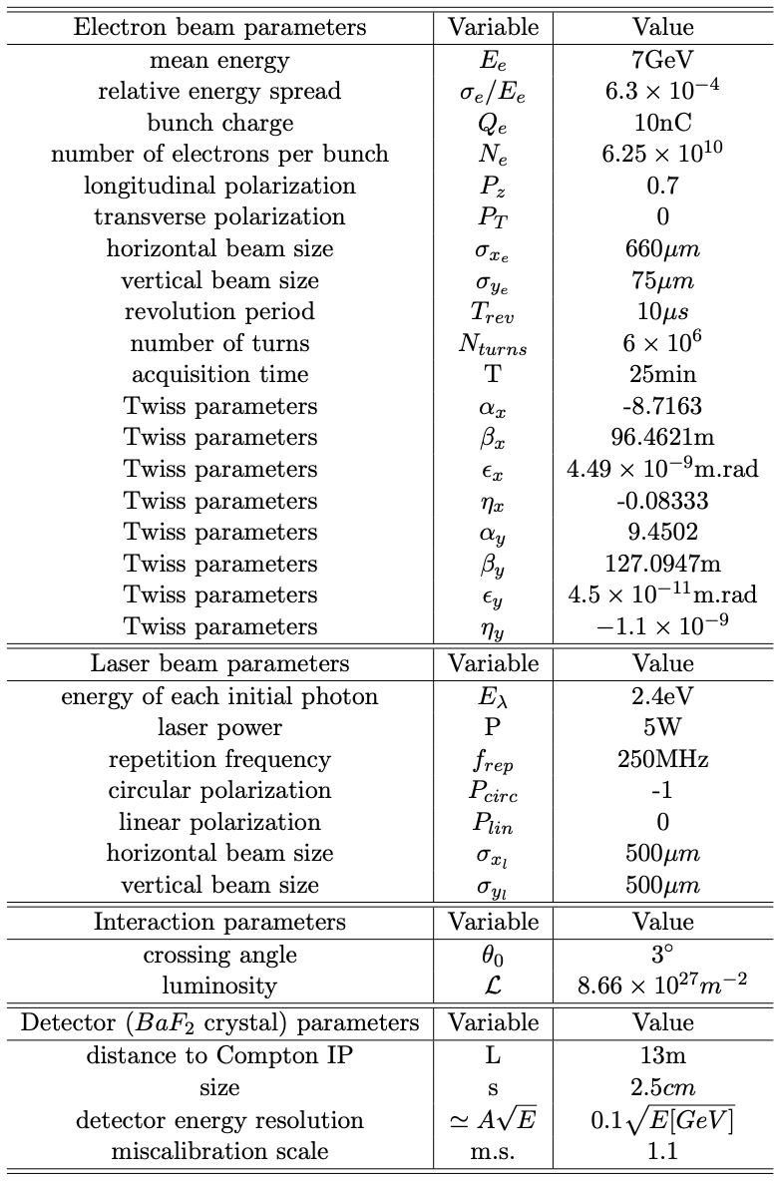
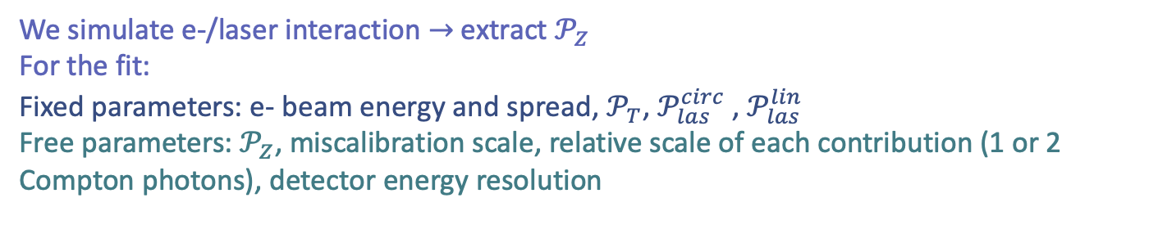
Toy-MC sensitivity studies
We simulate e-/laser interaction $→$extract $𝒫_{Z}$
For the fit:
Fixed parameters: e- beam energy and spread, $𝒫_{T}$, $𝒫_{las}^{circ}$ , $𝒫_{las}^{lin}$
Free parameters: $𝒫_{Z}$, miscalibration scale, relative scale of each contribution (1 or 2 Compton photons), detector energy resolution
We focus on photon detection here

Slide 9
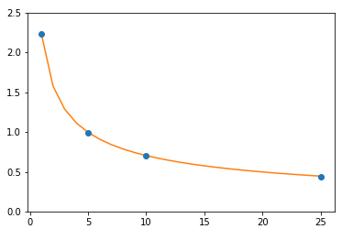

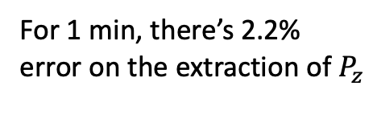
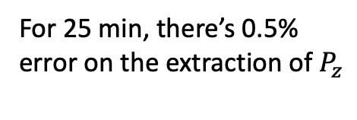
Statistical sensitivity
$σ_{P_{z}}$(%)
For 1 min, there’s 2.2% error on the extraction of $P_{z}$
For 25 min, there’s 0.5% error on the extraction of $P_{z}$
Acquistion time (min)

Slide 10
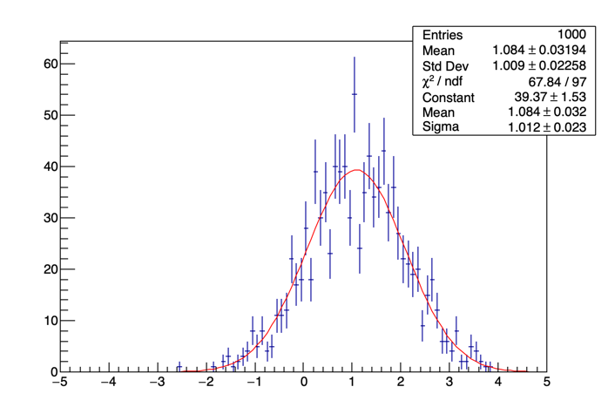
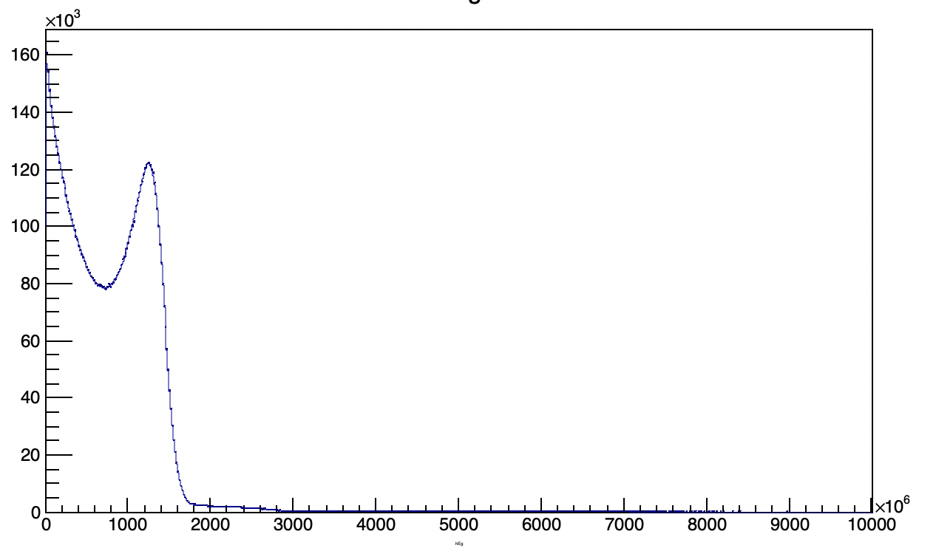
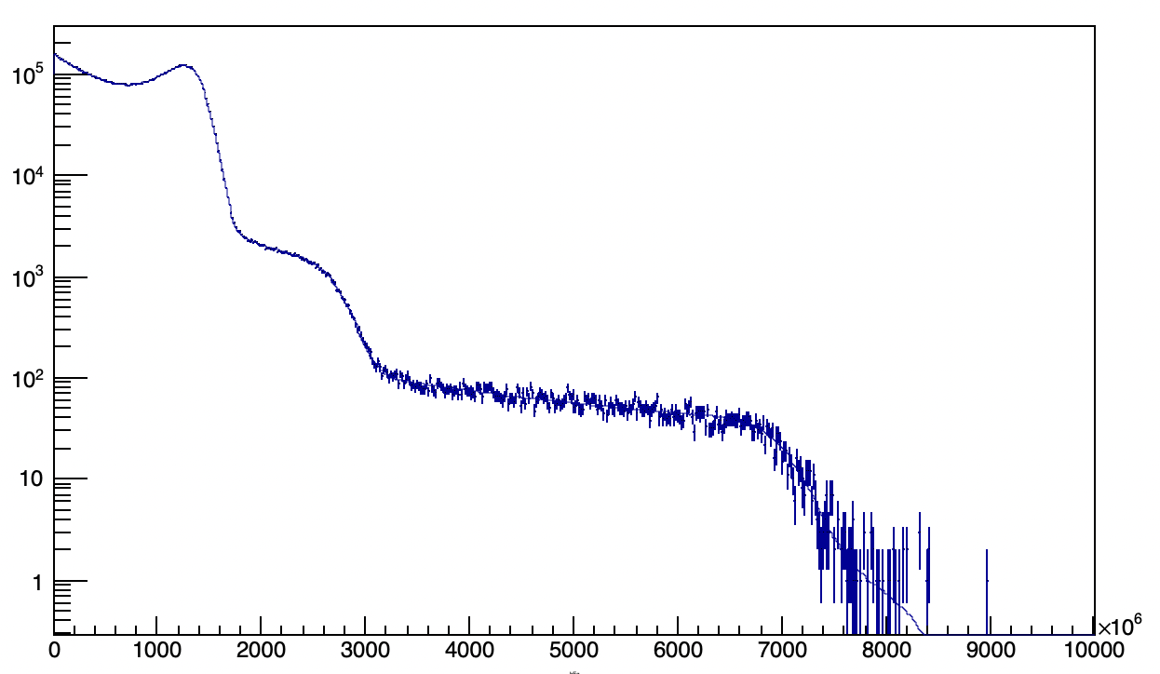
Signal+Beam gas background (toy MC)
!!
Background fitting being worked on.
Significant bias of the fit with background included
~0.45% systematic uncertainty assigned
Actual background need to be measured to improve significance of simulation

Slide 11
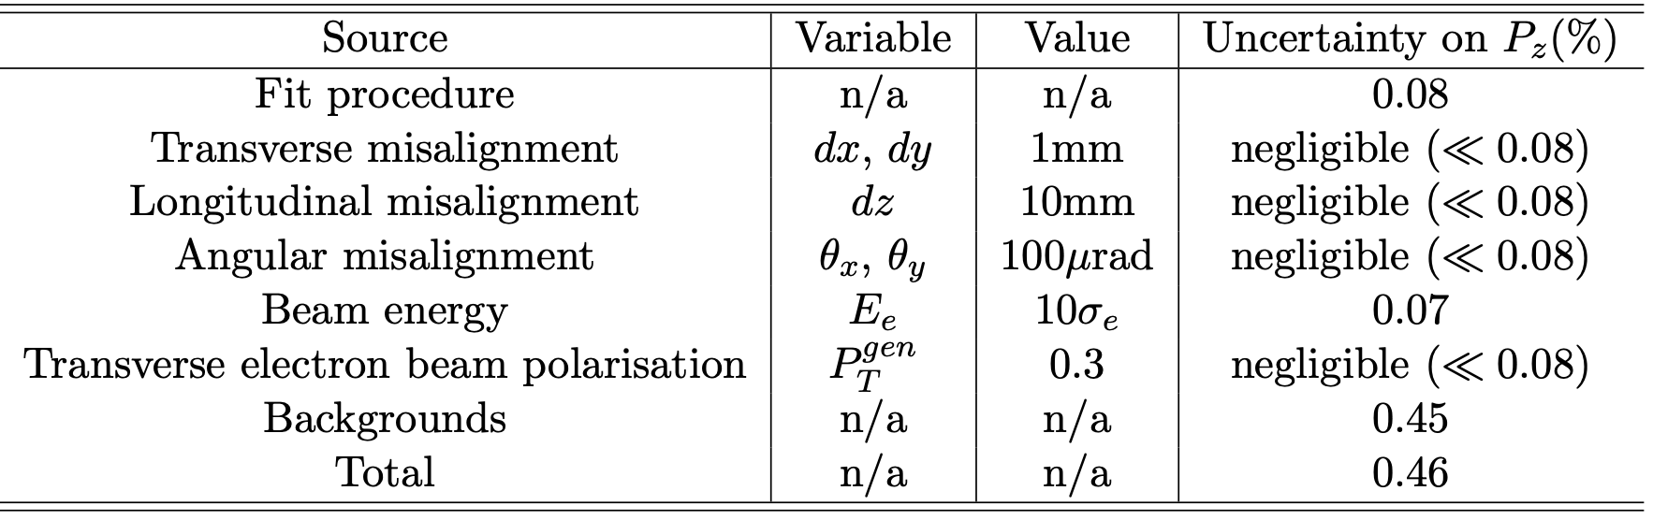
Table of systematics
Knowledge of laser polarisation <0.3
Spin transport to Belle 2 IP (magnet misalignments) TBD

Slide 12
Conclusion/CDR writing status
Laser system and integration is done (for a CDR document)
Integration of photon detector being prepared (IJCLab mechanical office) under progress
Integration of electron detector → to be updated from White paper
Sensitivity study (MC description + fit + results) nearly all described (maybe too many details) to be continued
Description of Touschek lifetime polarimetry (for staged approach) TBD
Quick description transverse Compton polarimetry and related challenges TBD
Please comment, comment/criticize

Slide 13
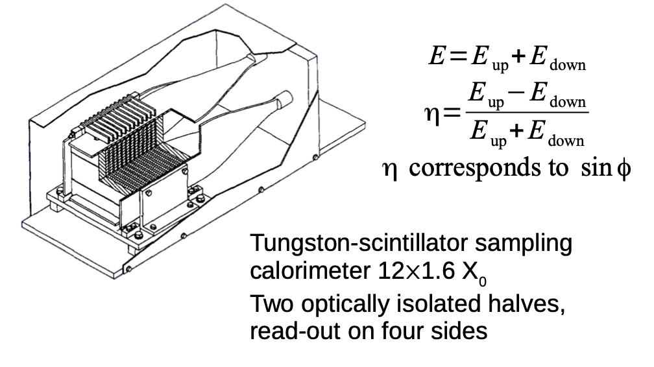
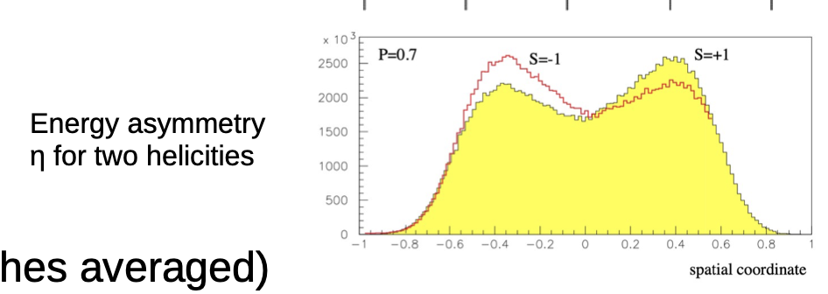
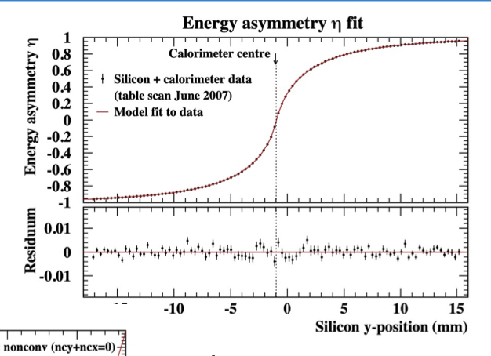
Transverse polarimetry at HERA
https://indico.cern.ch/event/1181966/contributions/5046178/attachments/2512013/4318517/220905_tpol.pdf
Exactly the operation that was done at HERA TPOL a long time ago.
Notoriously a difficult task but ‘do-able’
Requires detailed simulations
Requires some transverse sampling (not easy for photons)
Eased by implementing a nicely vertically segmented electron detector.

Slide 14
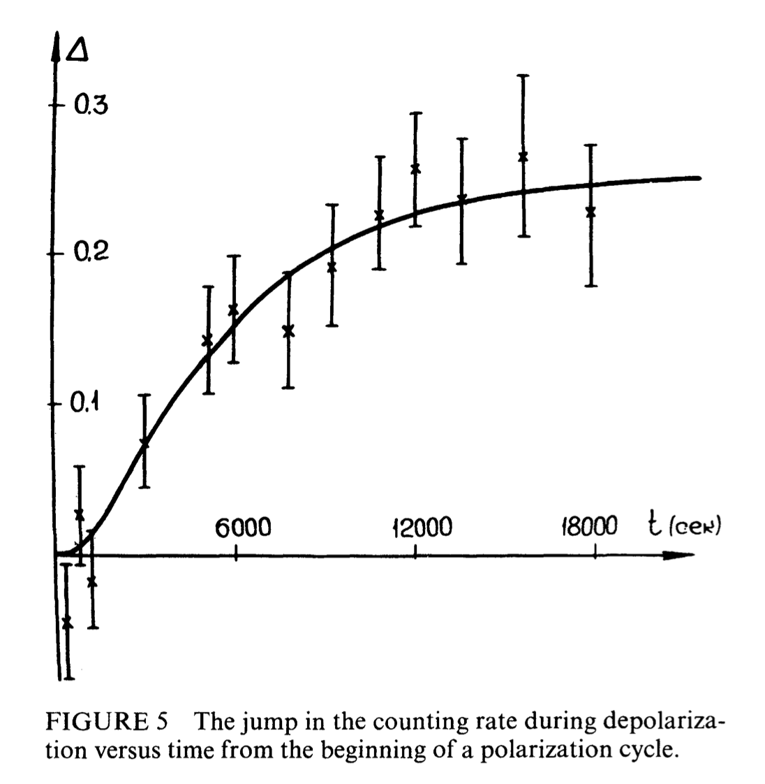
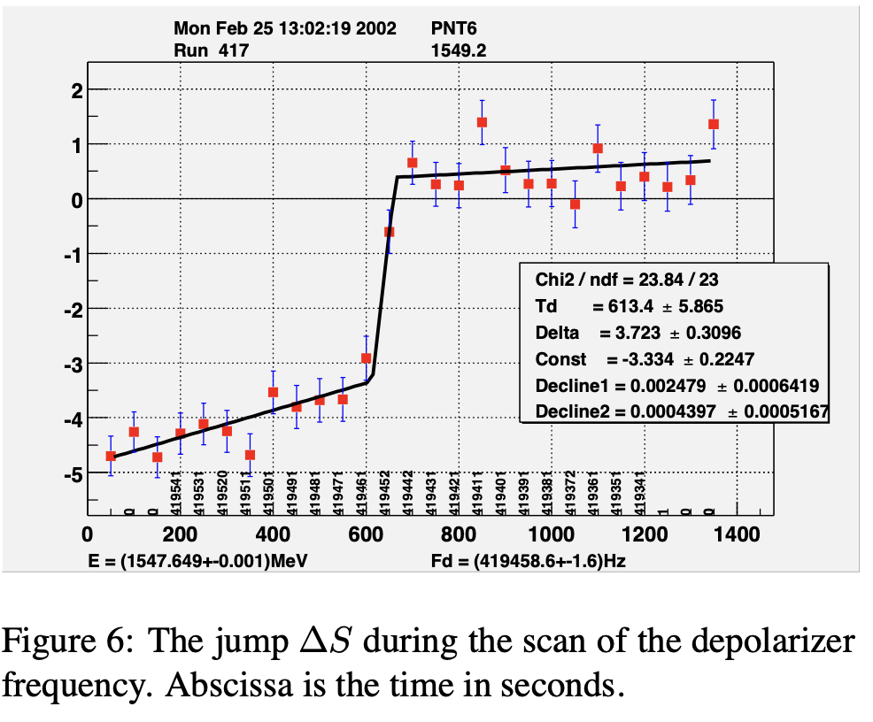
Touschek lifetime can be used also
Touschek described the lifetime of electrons in AdA (’accumulation ring’) in 1963 (Bernardini et al., Phys. Rev. Lett 10 (1963) 407)
Baier & Khoze, pointed out that Touschek lifetime is sensitive to polarization (At. Energ. 25 (1968) 440)
It was then use in the VEPP-2M ring to measure depolarization (and thus beam energy): Derbenev Part. Acc. 8 (1978) 115
  Measuring the couting rate of scattered electrons
Ex: Allowed first precision mass measurement of J/Psi (3096.93+-0.09 MeV) then superseded in 1993 (E760)
Continously improved at VEPP-4M (KEDR at VEPP-4M: 3096.900 ± 0.002 ± 0.006 MeV): Phys. Lett 96B (1980) 214; Blinov et al., proc. of EPAC (2002) 1954

Slide 15
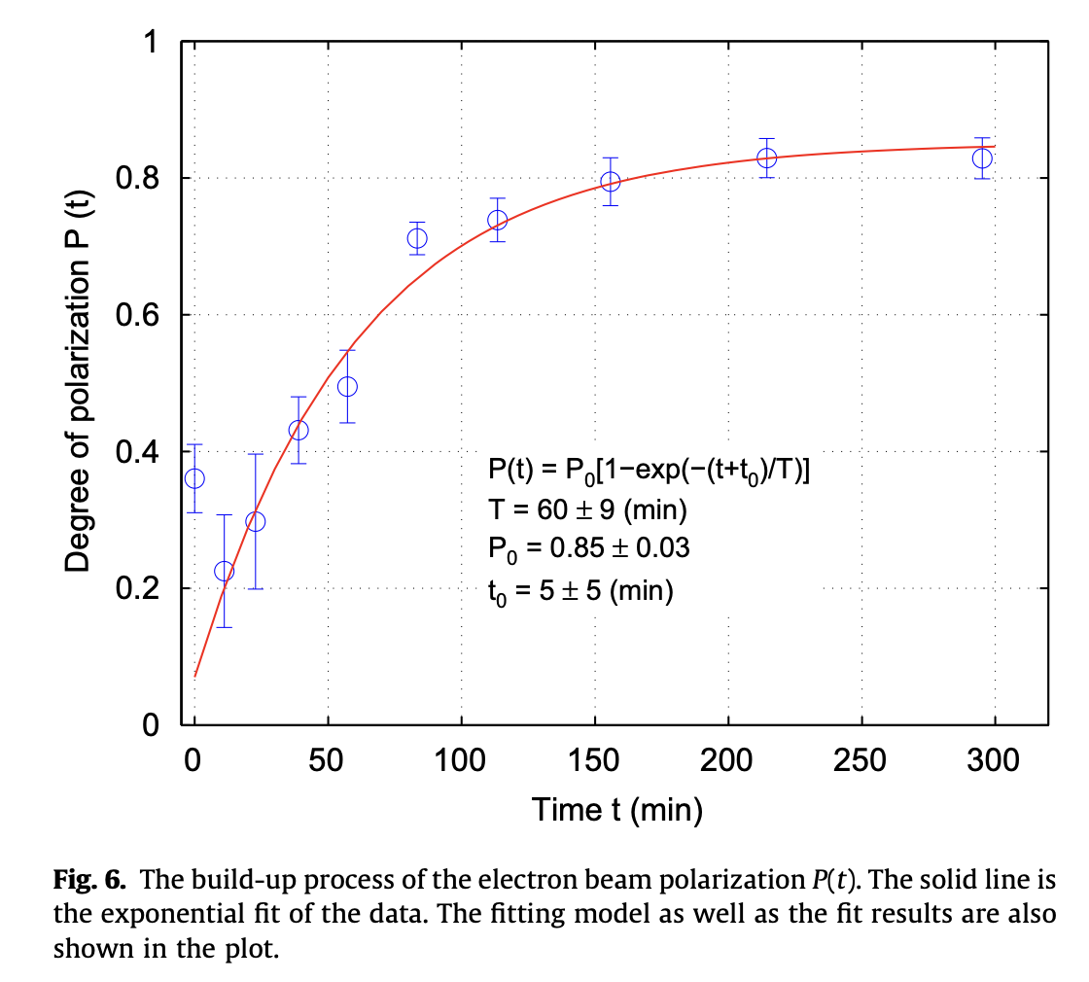
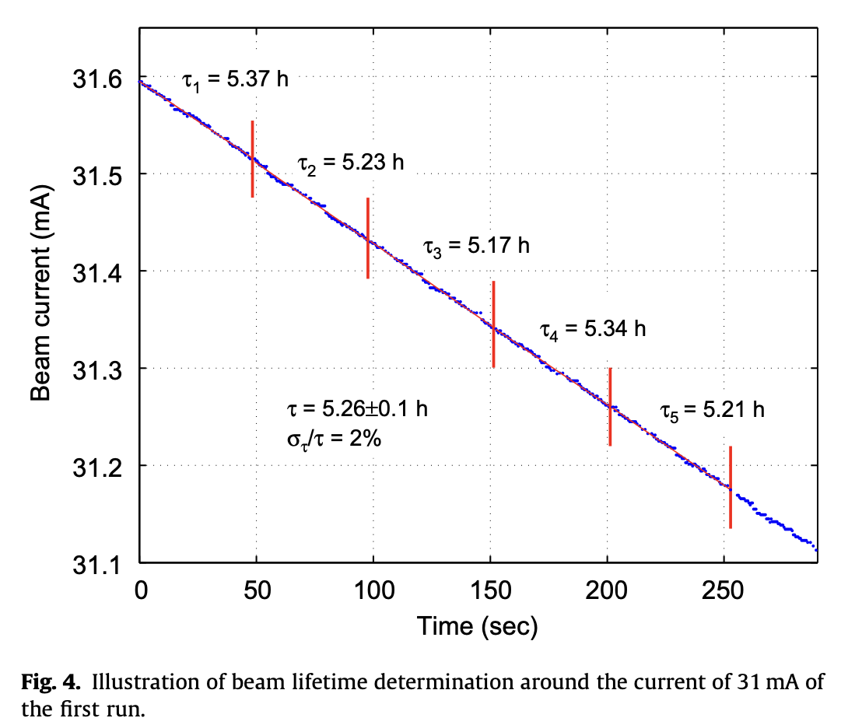
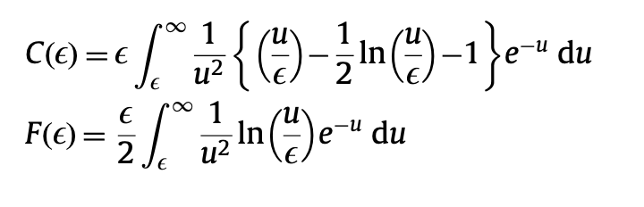
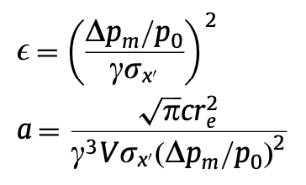
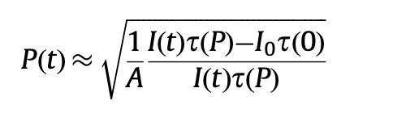
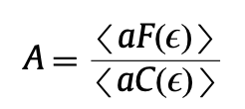
a slightly more modern use
Used at :
  HIgS (DUKE): NIMA 614 (2010) 339
  SOLEIL, NIMA 697 (2013) 1
  Diamond Light Source, PRAB22 (2019) 122801
  Based on expressions given in NIMA 554 (2005) 85
  Also proposed for FCCee: arXiv1909.12245

Slide 16
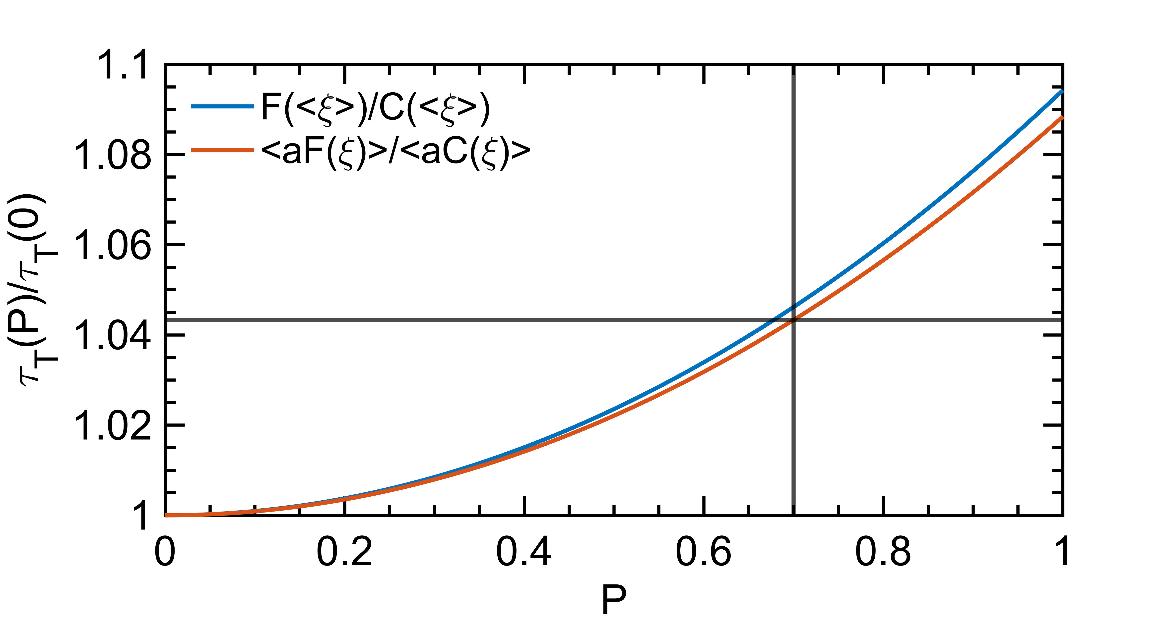
For SuperKEKB
It is ~4% effect assuming (overall) momentum acceptance of 0.6%, and using her_2021-06-09_231636.388_MeasOpt
This is likely observable in SuperKEKB
May need to inject both polarized and unpolarized beams in the ring and measure bunch/bunch intensity with time to minimize systematics (feasbile according to Demin)
Maybe F/C factor could be calibrated by comparing measurements with various momentum acceptances ? (linked to RF voltage ?)

