Slide 1
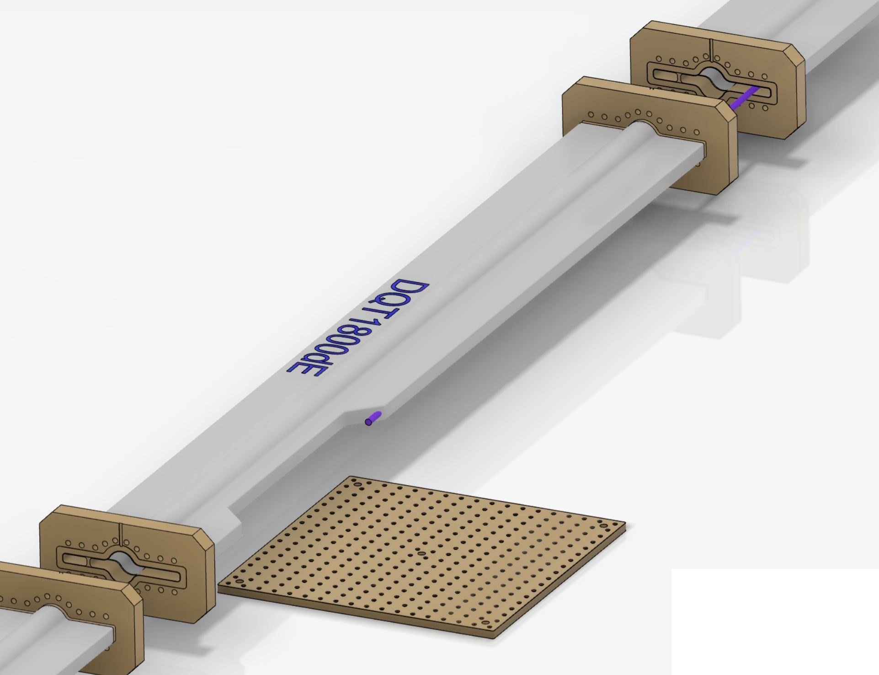
Photon detector integration
‘minor’ modifications of BLA2LE region
→ actually no modification of magnet needed (contrary to initial suspicion)
→ NEG pumping not on the ‘right’ side either
Requires modification of a pipe to let photon beam out
→ proposed pipe modification (validated by T. Ishibashi and D. Zhou)
Pumping port side need to be changed.
Xray out : 210 µrad
≈ Ø6 mm at 14,5 meters
BreadBoard 450x450 mm²

